Slide 1
UIDAI HACKATHON
Team Reference ID : 1BkEKZ4zbN
Team Member Details
Sl No | Name | E Mail ID
1 | SHREEJIT SAHA | parachuteregiment09@gmail.com
2 | ARIT DUTTA | aritdutta74@gmail.com
3 | DEBASHISH RAJBONGSHI | bishalrajbongshi9@gmail.com
4 | KAIF AHMAD | azaansaikh9@yahoo.com

Slide 2
About the Problem Statement
Theme: Authentication Reimagined
Problem Statement:
Verifier Application
Secure QR code is available in E-Aadhaar and Aadhaar print letter. In future this will be available in offline e-KYC service also.
Secure QR code is divided into four parts:
Text Data
Photo of the Resident
E-mail Id and Mobile Number
Signature

Slide 3
Approach
Data Format:
Sequence of embedded data in Secure QR Code:
• 0, 1, 2, 3:
0 - No mobile or email.
1- Only Email
2 - Only mobile.
3 - Both email and mobile

Slide 4
• Reference Id – last 4 digits of Aadhaar code and date timestamp in “DDMMYYYYHHMMSSsss” (including milliseconds)
• Name
• Date of Birth
• Gender
• Address : care of
• Address : district
• Address : landmark
• Address : house
• Address : location
• Address : pin code
• Address : post office

Slide 5
• Address : State
• Address : Street
• Address : Sub district
• Address : VTC (Village, Town, City)
• Photo of the resident (highly compressed including face only
in JPG2000 format)
• Email as hash (hashing logic same as offline xml)
[fixed size - 32 bytes]
• Mobile as hash (hashing logic same as offline xml)
[fixed size - 32 bytes]
• Signature hash [fixed size - 256 bytes]

Slide 6




Architectural Diagram
Scan this code for the website
XML file encoded with QR code
Request direction through browser
8
4
Authenticating server[https://resident.uidai.gov.in/offlineaadhaar]
3
Fetching demographic details from www.uidai.gov.in
https://uidai.nseitexams.com
Uploading the XML file for decoding details of Aadhaar user
9
https://uidai.nseitexams.com
2
7
6
5
https://resident.uidai.gov.in/offlineaadhaar
Access to the website
1
10
Local User
Target User details
www.uidai.gov.in

Slide 7
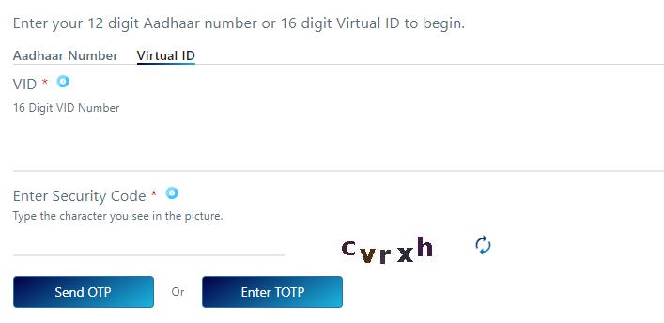

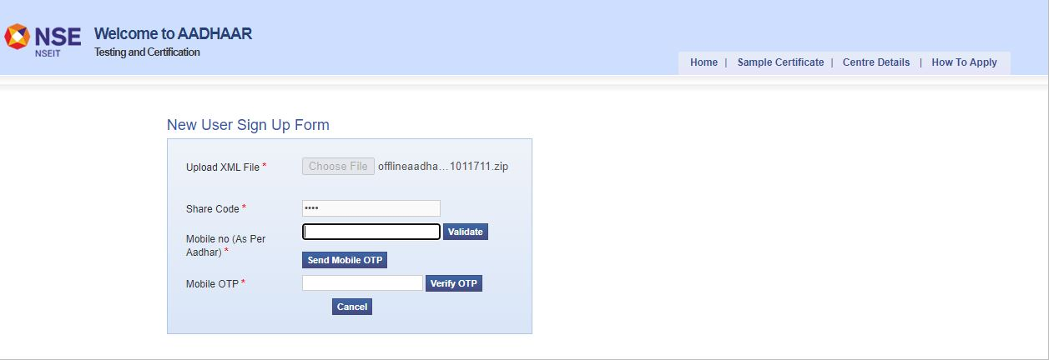
1
2

Slide 8

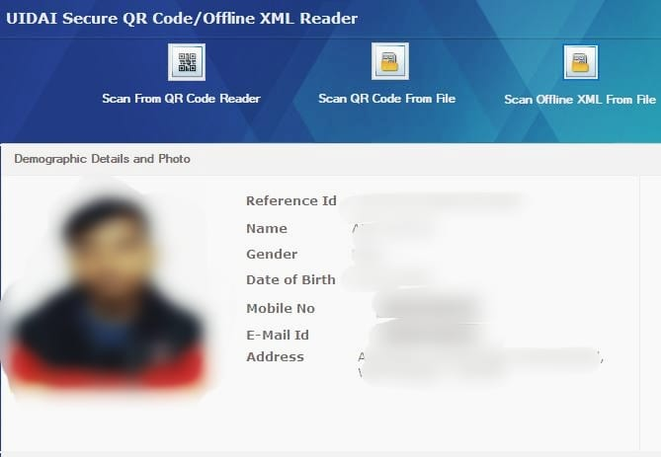
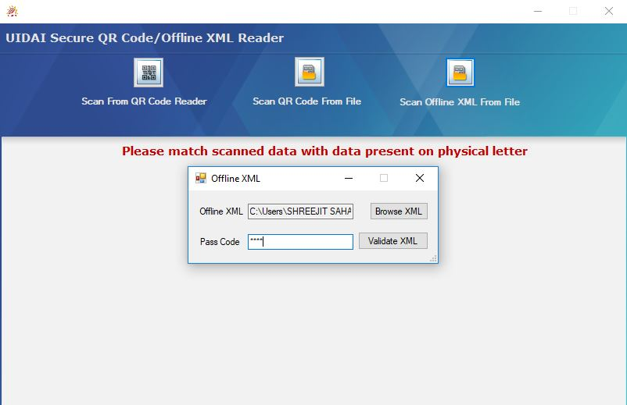
1
2

Slide 9
API Usage
Aadhaar authentication service is exposed as stateless service over HTTPS. Usage of open data format in XML and widely used protocol such as HTTPS allow easy adoption and deployment of Aadhaar authentication. To support strong end to end security and avoid tampering and man-in-the-middle attacks, it is essential that the encryption of data happens at the time of verification through the capture device (Laptop).

Slide 10
Security Considerations
QR codes in E- Adhaars and E- Adhaar letters contain demographic details of an user and QR code is end-to-end ecrypted. It can be a secured platform to authenticate an user through API’s.

