Slide 1
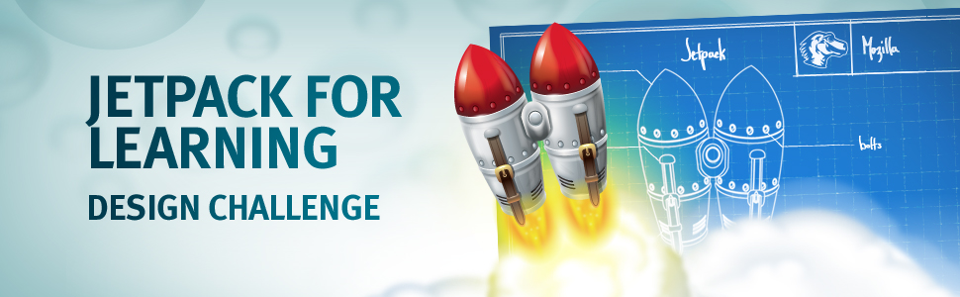



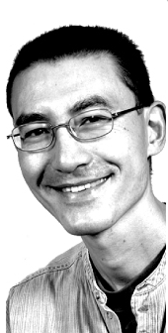
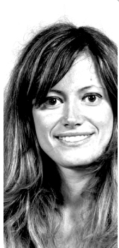
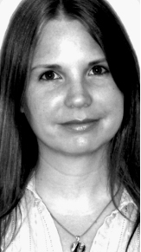
http://www.olnet.org
Jetpack For Learning: Design Challenge
http://cohere.open.ac.uk
Making Learners’ thinking visible
Michelle Bachler
Simon Buckingham Shum
Anna De Liddo

Slide 2
http://www.olnet.org
Jetpack For Learning: Design Challenge
http://cohere.open.ac.uk
Making Learners’ thinking visible
Michelle Bachler
Simon Buckingham Shum
Anna De Liddo

