Slide 1

Install Typescript – Chapter 1
TypeScript
Installation one-time setup
Creating first APP with Axios

Slide 2
Install Typescript – Chapter 1
Chapter 1
TypeScript
Environment Setup
Window 1. Install Node: Download Node from https://nodejs.org/en 2. Check if “npm” is installed correctly: “npm - -version” on CMD
3. Install Typescript and ts-node “npm install -g typescript ts-node”
macOS If getting EACCESS error, add “sudo” in front of the command “sudo npm install -g typescript ts-node”

Slide 3

Install VSCode – Chapter 2
Chapter 1
TypeScript
VSCode
Download & installation code editor
https://code.visualstudio.com/download

Slide 4
First App – Chapter 3
Chapter 2
TypeScript
First APP
Let’s take a look at the fake API we'll use to fetch data
Create a new project directory
Create a package.json file – npm init -y
Install Axios to make a request – npm install axios
Let’s write code!

Slide 5
Execute typescript – chapter 4
Chapter 2
TypeScript
Fake API with TypeScript with Axios and displaying unexpected behavior

Slide 6
Catching Errors – chapter 5
Chapter 2
TypeScript
Write the first code and Catch Basic Errors
From my first APP

Slide 7
Catching Errors – chapter 5
Chapter 2
TypeScript
Syntax and Design pattern

Slide 8
Types – chapter 6
Chapter 3
TypeScript
Types
A way to define what kind of value we are going to set in a variable

Slide 9
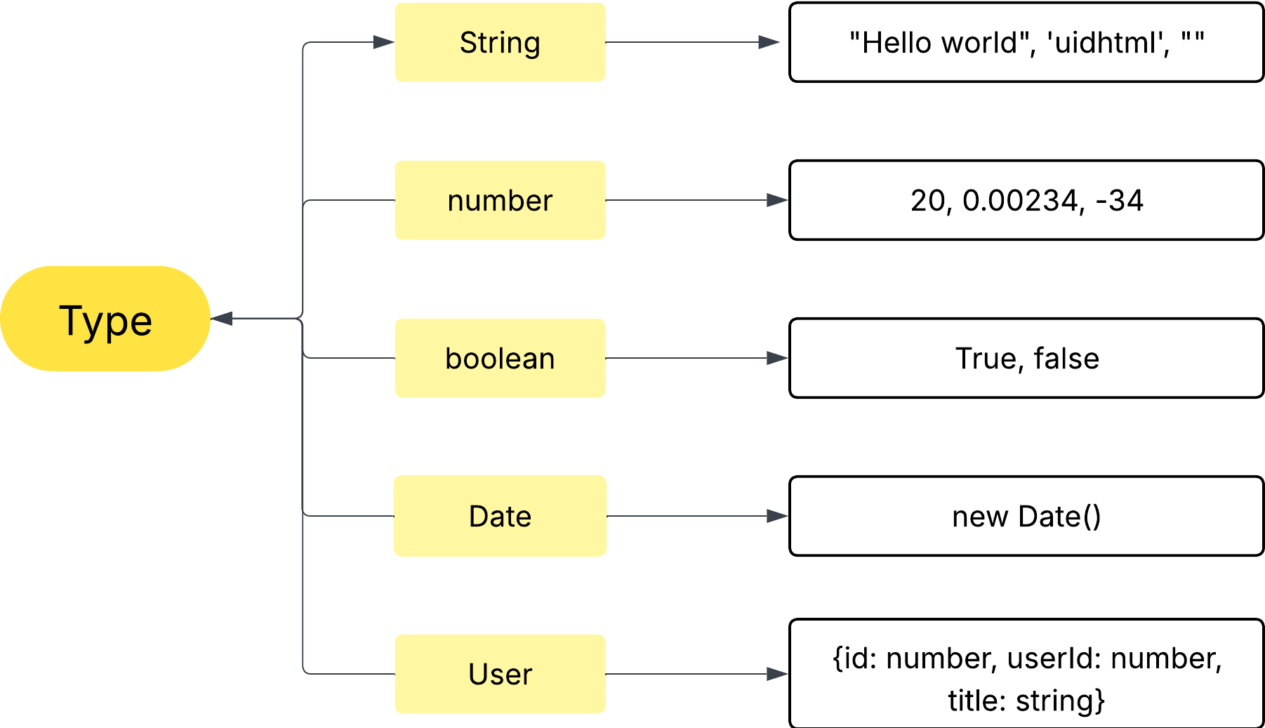
Types – chapter 6
Chapter 3
TypeScript

Slide 10
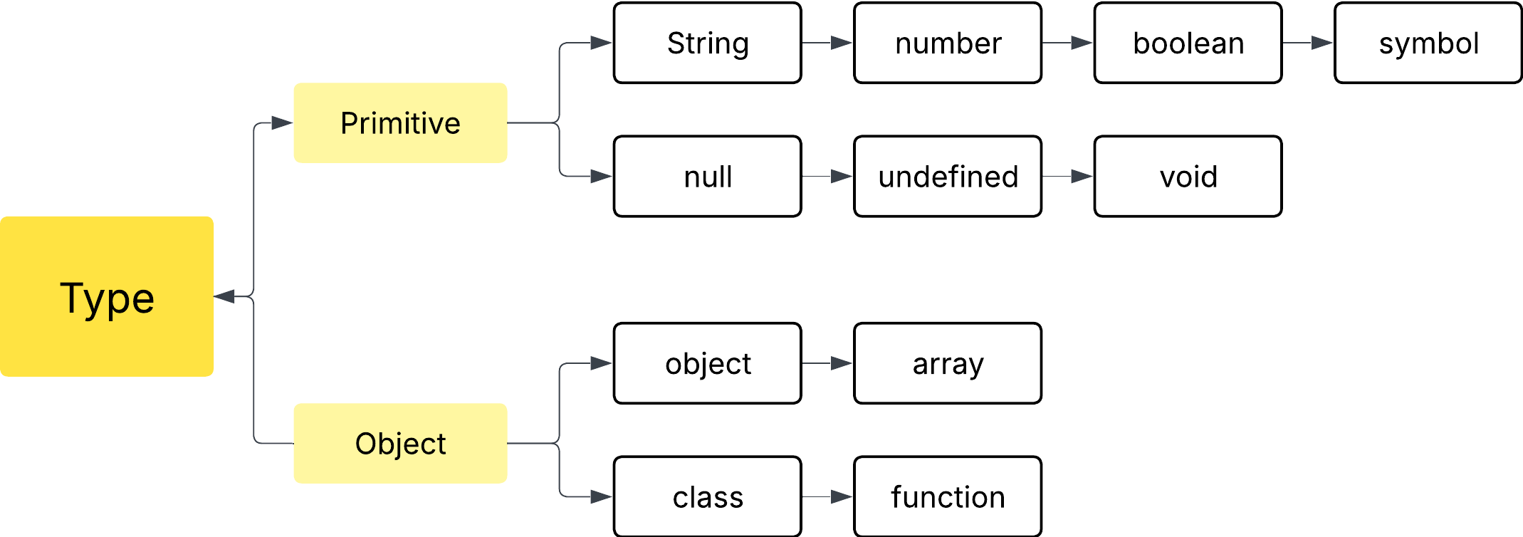
Types – chapter 6
Chapter 3
TypeScript

Slide 11
Types – chapter 6
Chapter 3
TypeScript
Examples

Slide 12
Types – chapter 6
Chapter 3
TypeScript
Types Why should we use types? 1. Compiler shows errors during code writing
2. The developer can understand what type of data is flowing through our code.
Where do we use types?
Ans- Everywhere

Slide 13
Types – chapter 6
Chapter 4
TypeScript
Types Annotations with Variables let myVar: number = 10

