Slide 1
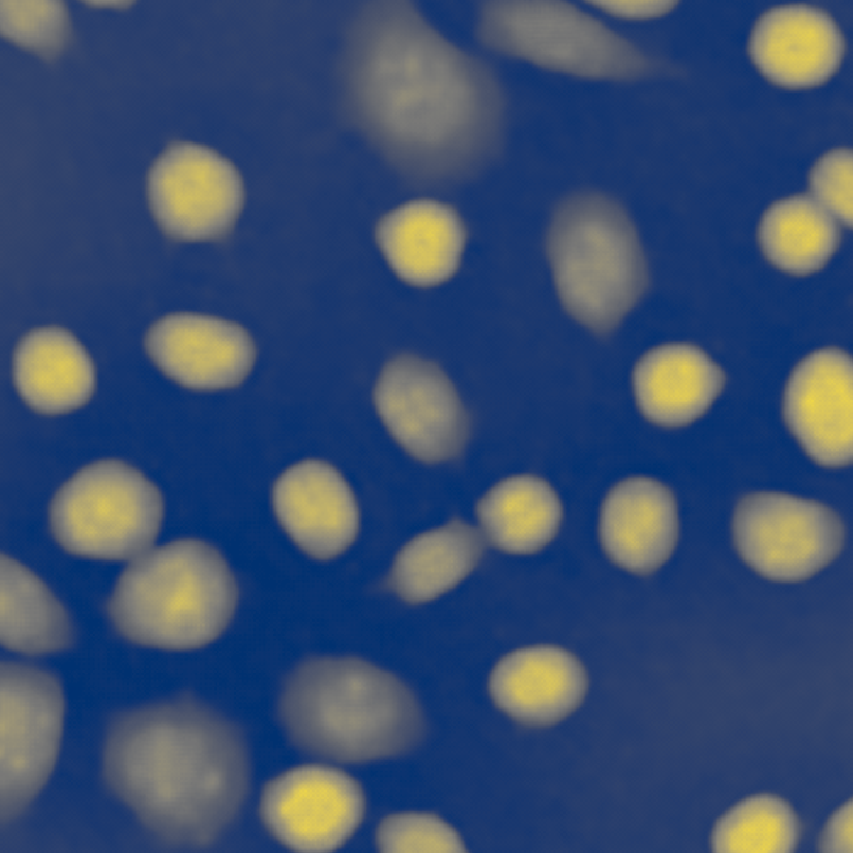
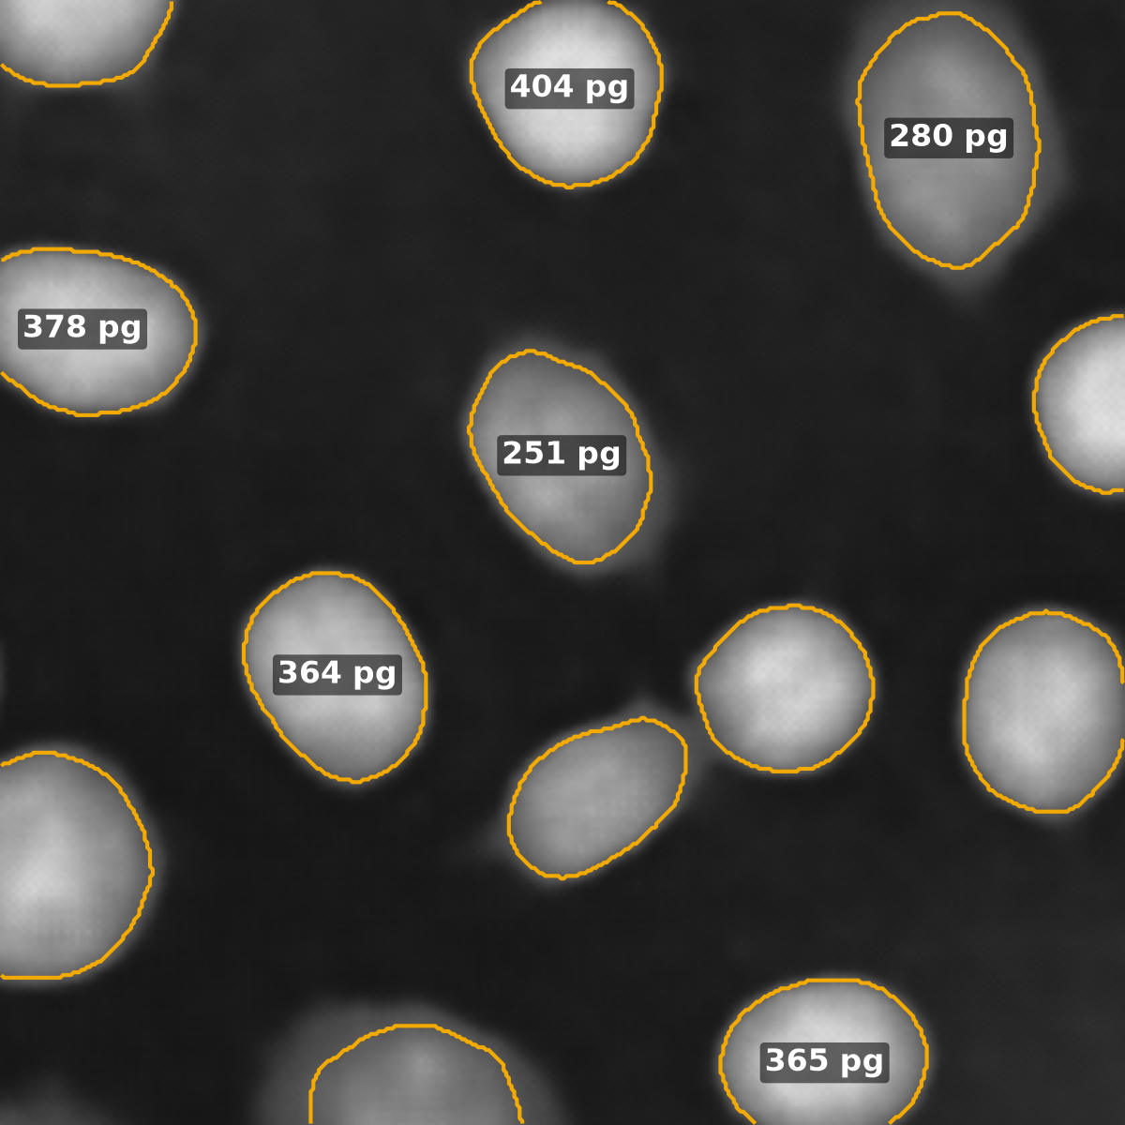
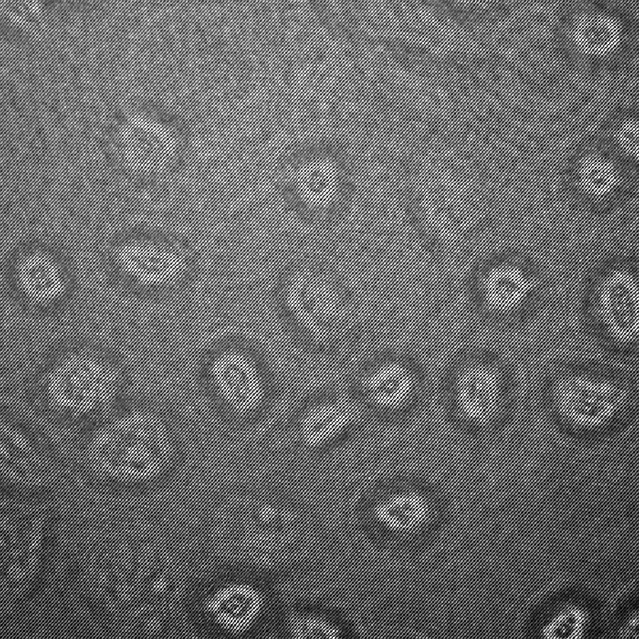
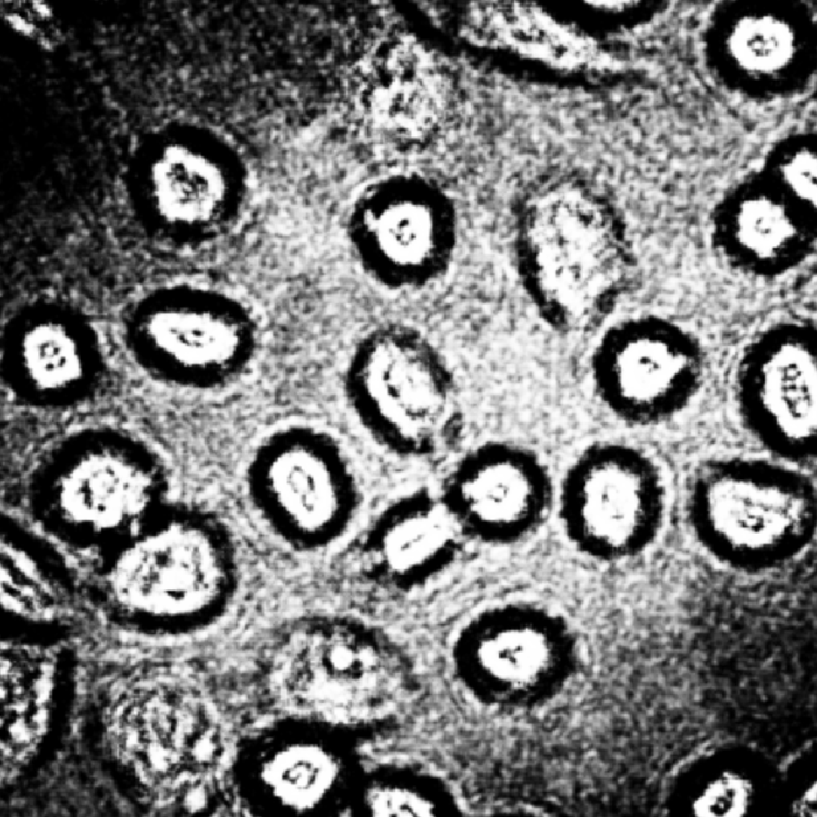

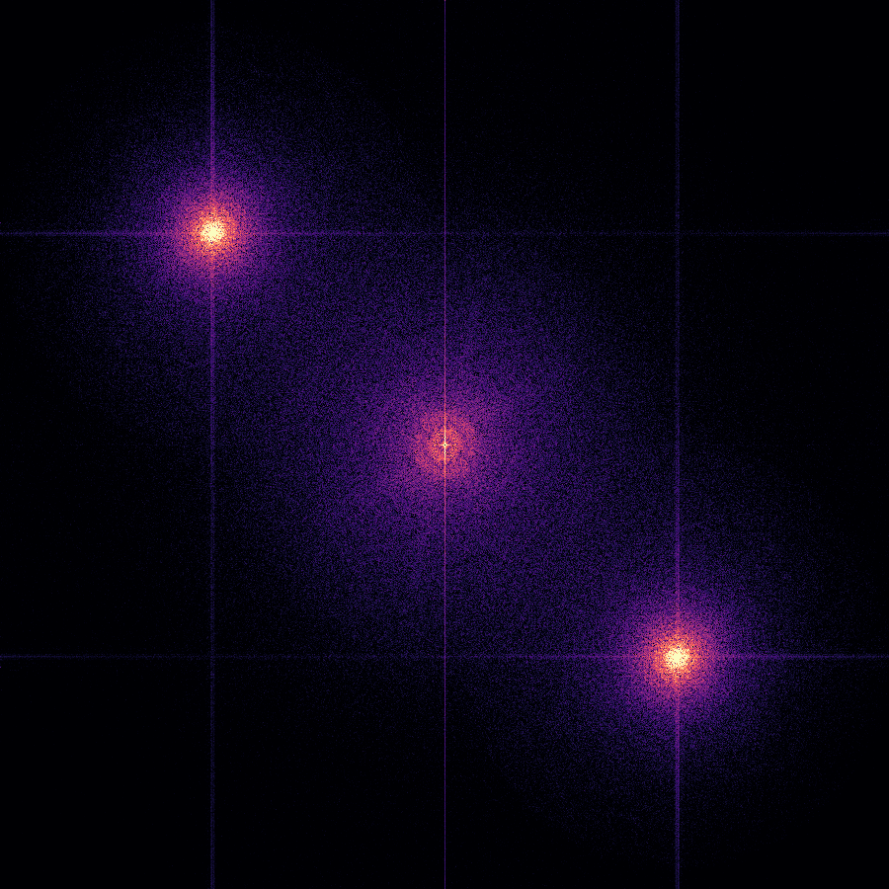

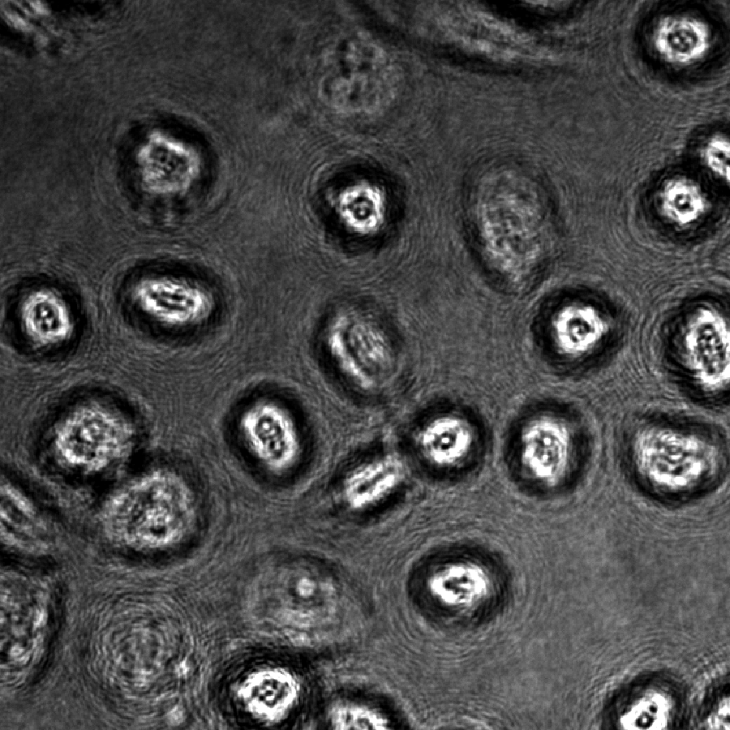
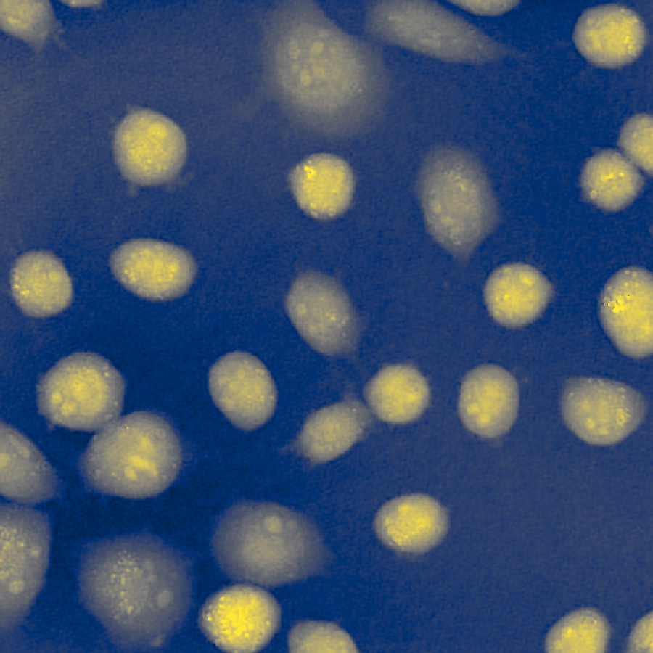

a Raw hologram input
b End-to-end network
c Predicted fields
d Per-cell measurement
Off-axis hologram (one channel, 8-bit), cropped 1024² → 900² onto the phase grid (origin moved by (−6, −2) px)
One shared encoder, two decoders; no classical reconstruction in the inference path
rad
Cell k, predicted phase φ over its domain Ωₖ:
Aₖ = Nₖ dx dy
Cₖ = min(1, 4π Nₖ / Pₖ²)
Sₖ = Σ φ dx dy
mₖ = λ / (2πα) · Sₖ
4
phase head (rad)
2
0
amplitude head*
Phase decoder
256/128/64/32
Quantitative phase (rad)
λ = 0.666 µm
α = 0.2 mL/g
dx = dy = 0.285 µm
max
* +Amplitude / +Fwd only; agreement is with a reconstruction-derived amplitude, not a measured one
Dry mass pg per cell (primary quantity)
2-class head
Projected area µm² per cell
min
Shared encoder
MobileNetV2 (ImageNet init.), 1 input channel; features at strides 2–32
Transmitted amplitude*
Segmentation decoder
256/128/64/32
Circularity shape descriptor, 0–1
2-class map →
watershed
instances;
colour =
identity only
U-Net skip connections from every encoder stage; outputs at stride 2, bilinearly upsampled to 900²
Integrated phase Sₖ rad·µm² per cell (30–6000 µm² cells)
fringe detail
|FFT|: DC + sidebands
In-line (Gabor) hologram
same field; same architecture trained separately (In-Line Neural Configuration)
9.60 M parameters · 45.85 GMAC
Compact: 256-ch projection, 3.36 M
Counts: detection recall and precision reported alongside, because per-cell errors are computed only for detected and matched cells
* amplitude head only in +Amplitude and +Fwd configurations
Cell segmentation (instances)
e Supervision and training objective
f Evaluation on the measurand
Every configuration: ℒphase = L1 + 0.5·|∇| + 0.2·(1−SSIM) ℒseg = Dice + CE
vs reference
per-cell MAPE over matched cells (IoU ≥ 0.5), with recall, coverage-adjusted MAPE and per-field Bland–Altman
vs Classical Pipeline
angular-spectrum reconstruction + the same segmentation labelling and measurement chain; off-axis and in-line
Model-free error floor
known boundary shifts propagated to area and mass; chain checked on analytic fields
Added one term at a time (ablations):
measurement-aware
+IPP (per-cell)
+IPP (image)
+Area
+BGA
reference phase
Otsu labels
output / forward model
+Amplitude
+Fwd (fixed / free z)
hologram forward model on Â·exp(iφ)
labels are derived from the reference phase (no manual annotation)

