Slide 1


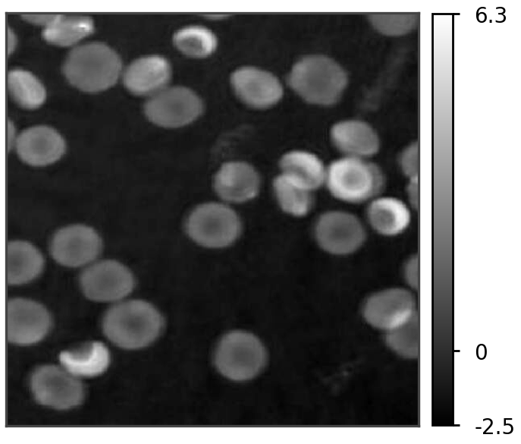
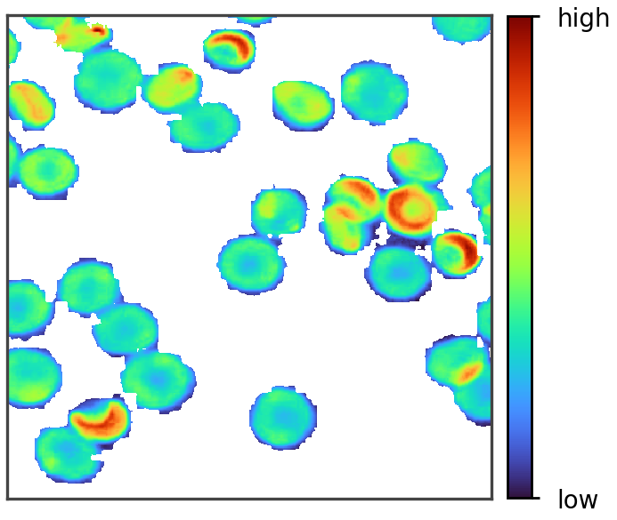





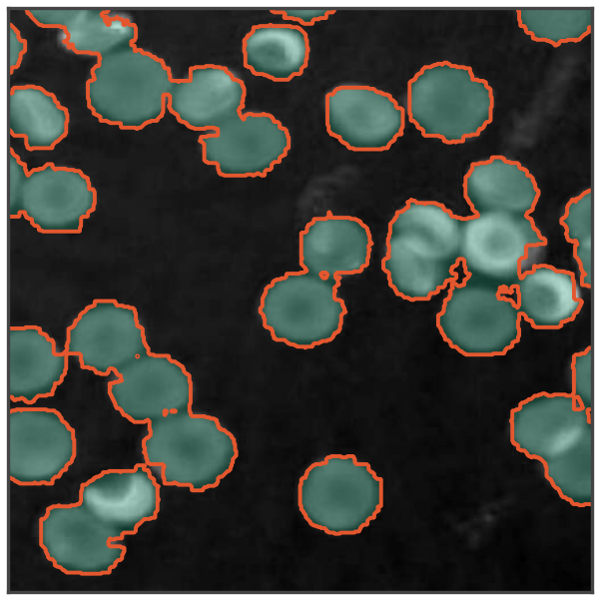
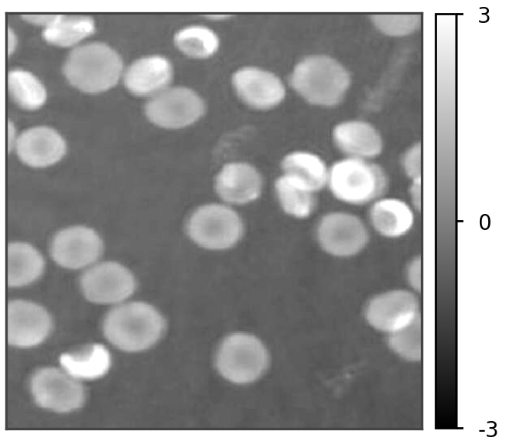


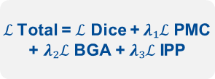

Figure 1
Raw unnormalised phase $φ$ (radians) bypasses normalisation and supervises the loss
1. QPI preprocessing
2. Frozen encoder + LoRA
3. Trainable decoder
4. Physics-aware loss
5. Quantitative readout
Reconstructed phase $φ$
Frozen lightweight encoder
Fully trainable
Physics-Aware Phase
Consistency Loss
Phase-integrated
optical volume
EdgeSAM (RepViT)
MobileSAM (TinyViT)
MobileNet-UNet (MobileNetV2)
1-Channel stem
(Single channel, radians)
Normalisation
6.3
$ℒ$ Dice
high
Parameters
Class-weighted overlap
Decoder
Geometric localisation
Head
0
Pretrained weights held fixed
$λ₁ ℒ$PMC
-2.5
Frozen
Ttrainable
Phase-mask contrast
Cell phase > background
$λ₁$ = 0.10
low
LoRA adapters in encoder attention
and convolutional bottleneck layers
5-Class prediction M
standardise
$λ₂ ℒ$BGA
$A = NΩ · Δx²$
Boundary-gradient alignment
Projected area
Frozen W
Adapted W′
Contour on $∇φ$ridge
$λ₂$= 0.05
Normalised input $Φ$
$C = 4πA / P²$
(Matched to RGB
Pretraining statistics)
$λ₃ ℒ$IPP
Circularity
+
B
A
=
Integrated-phase preservation
3
r × k
Conserves optical mass
$λ₃$= 0.10
$Vφ = Σ φᵢ · Δx²$
d × r
Phase-integrated
optical quantity
0
0
1
2
3
4
$ℒ$Total = $ℒ$ Dice +$λ₁ℒ$PMC
+ $λ₂ℒ$BGA + $λ₃ℒ$IPP
W′ = W + ($α / r$) BA, r = 8
Background
Discocyte
Echinocyte
Spherocyte
Stomatocyte
$m = (λ / 2πα) · Vφ$
-3
Trainable (8.90% of parameters)
Dry mass
Gradients update LoRA adapters, Stem, Normalisation and head only

Slide 2
Figure 1 Objects

Slide 3
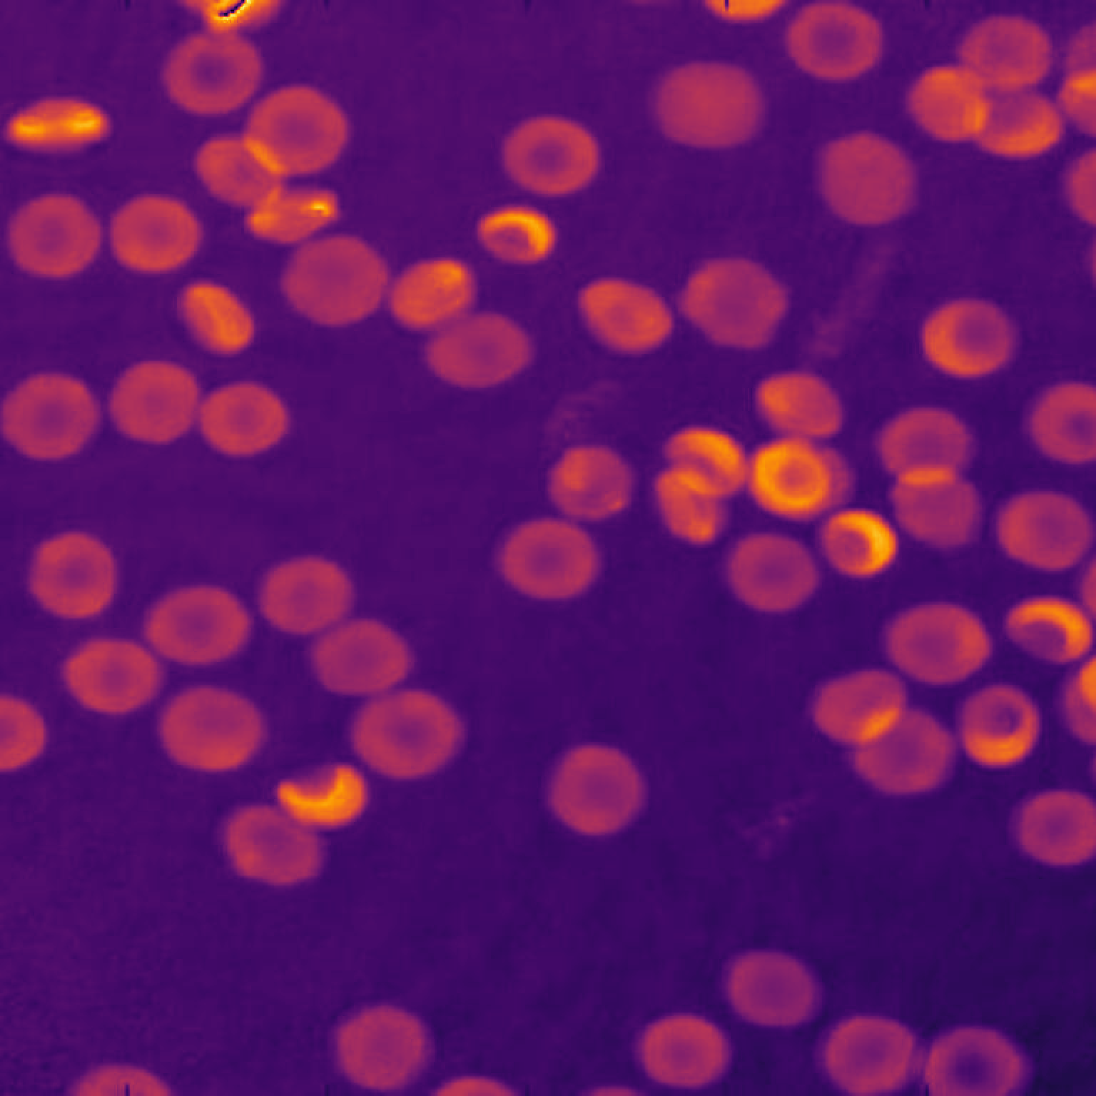
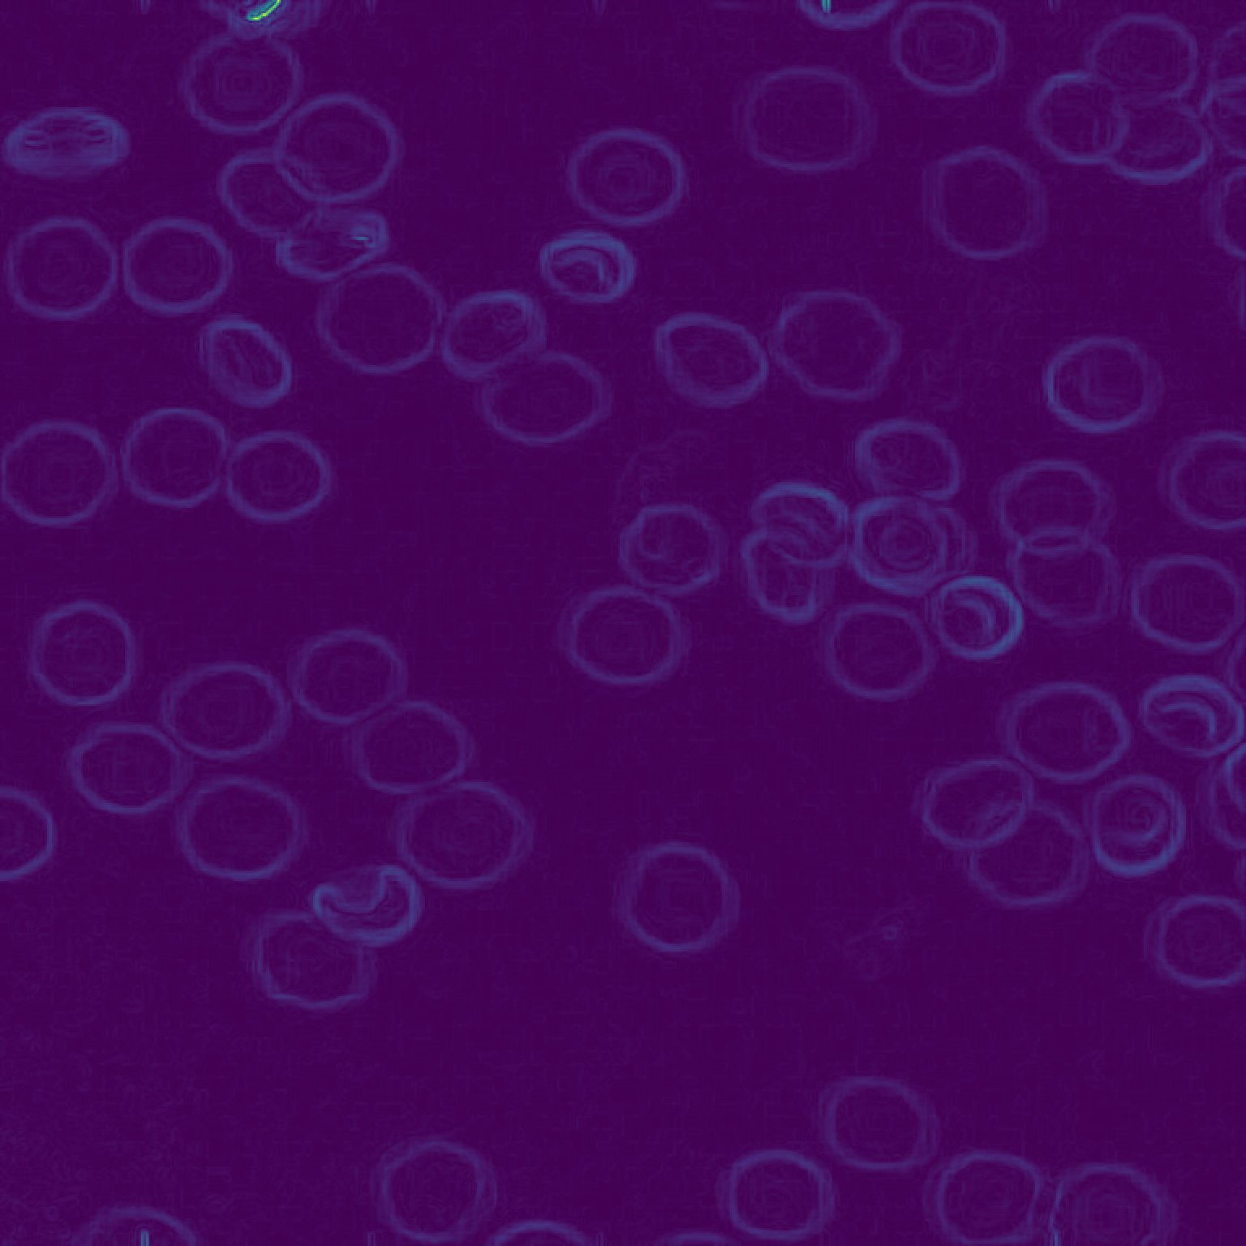
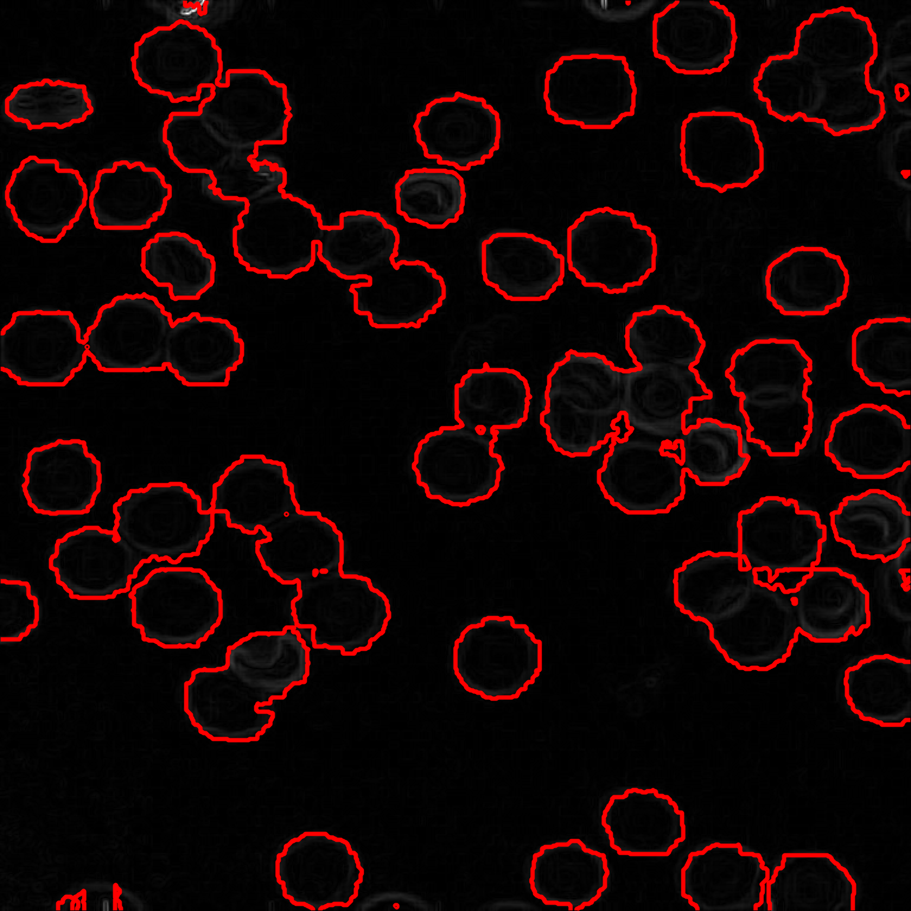
Figure S-4
Raw Quantitative Phase Map (rad)
Phase Gradient Magnitude
Predicted Contour Alignment
20 μm
20 μm
20 μm
Panel image 1536 × 1536 px, upsampled 2× from the 768 × 768 px source array.
Pixel pitch 0.1441 μm/px, so one panel spans 768 × 0.1441 = 110.67 μm.
Panel placed on this slide at 8.5178 × 8.5178 cm.
Scale bar 20 μm = 20 / 110.67 = 18.07 % of panel width = 8.5178 × 0.1807 = 1.5393 cm.

Slide 4
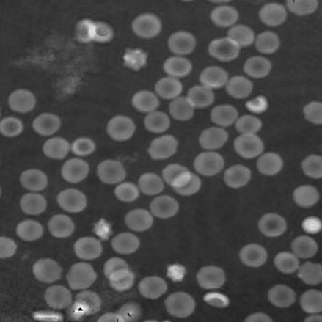

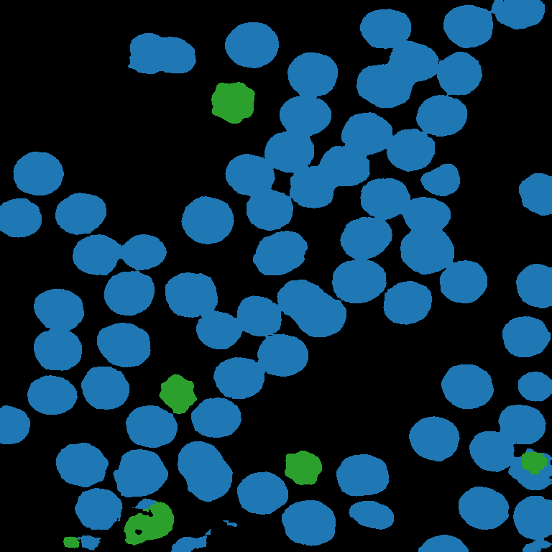


Figure 6
20 μm
20 μm
20 μm
20 μm
20 μm
20 μm
20 μm
20 μm
20 μm
20 μm
20 μm
20 μm
20 μm
20 μm
20 μm
20 μm
20 μm
20 μm
Panel image 1536 × 1536 px, upsampled 2× from the 768 × 768 px source array.
Pixel pitch 0.1441 μm/px, so one panel spans 768 × 0.1441 = 110.67 μm.
Panel placed on this slide at 5.0726 × 5.0726 cm.
Scale bar 20 μm = 20 / 110.67 = 18.07 % of panel width = 5.0726 × 0.1807 = 0.9167 cm.
20 μm
20 μm

Slide 5
Figure 11
Storage Lesion Timeline: RBC Morphology Degradation Over Storage
Day 0
Day 8
Day 19
Day 27
Day 47
20 μm
20 μm
20 μm
20 μm
20 μm
20 μm
20 μm
20 μm
20 μm
20 μm
Panels are grey placeholders: the dataset needed to render them is not in the project.
Panel image 1536 × 1536 px, upsampled 2× from the 768 × 768 px source array.
Pixel pitch 0.1441 μm/px, so one panel spans 768 × 0.1441 = 110.67 μm.
Panel placed on this slide at 5.0726 × 5.0726 cm.
Scale bar 20 μm = 20 / 110.67 = 18.07 % of panel width = 5.0726 × 0.1807 = 0.9167 cm.

