Slide 1


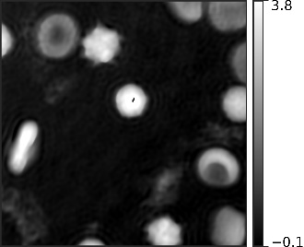
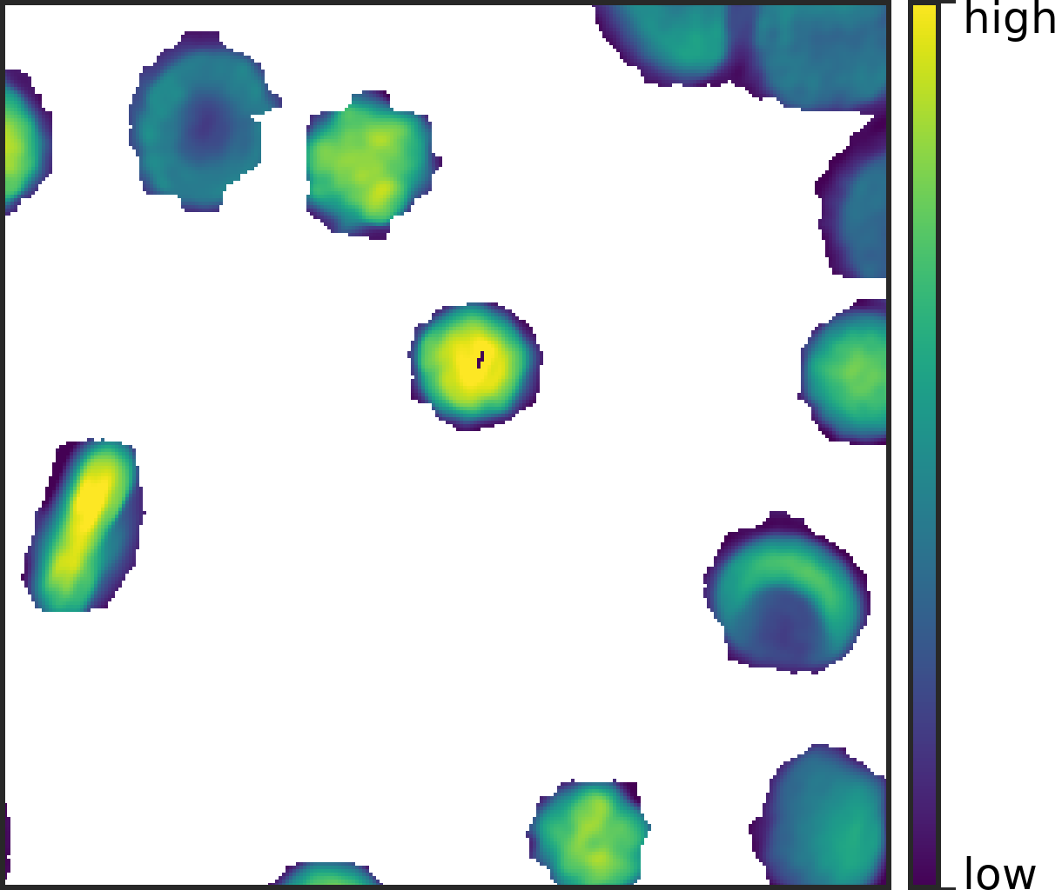





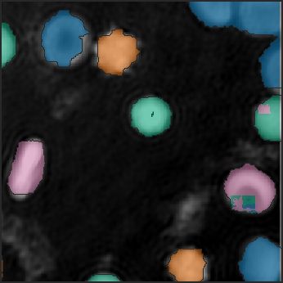
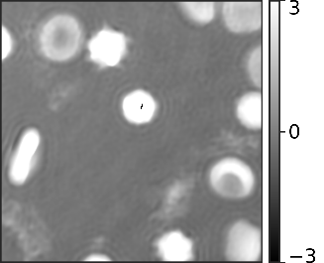


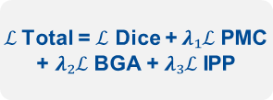


Figure 1
Background-referenced phase 𝝓 (radians) enters the loss directly
1. QPI preprocessing
2. Frozen encoder + LoRA
3. Trainable decoder
4. Physics-aware loss
5. Quantitative readout
Reconstructed phase $φ$
Frozen lightweight encoder
Fully trainable
Physics-Aware Phase
Consistency Loss
Integrated phase
and dry mass
EdgeSAM (RepViT)
MobileSAM (TinyViT)
MobileNet-UNet (MobileNetV2)
1-Channel stem
(Single channel, radians)
Normalisation
Parameters
$ℒ$ Dice
Class-weighted overlap
Decoder
Geometric localisation
Head
Pretrained weights held fixed
$λ₁ ℒ$PMC
Frozen
Trainable
Phase-mask contrast
Cell phase > background
$λ₁$ = 0.10
LoRA adapters in encoder attention,
linear and convolution layers
5-Class prediction M
standardise
$λ₂ ℒ$BGA
$A=N_{Ω}⋅Δx_{eff}^{2}$
Boundary-gradient alignment
Projected area
Frozen W
Adapted W′
Contour on $∇φ$ridge
$λ₂$= 0.05
Standardised input 𝚽
$C = 4πA / P²$
(z-score per image:
zero mean, unit variance)
$λ₃ ℒ$IPP
Circularity
+
B
A
=
Integrated-phase preservation
r × k
Conserves optical mass
$λ₃$= 0.10
𝑺 = 𝚺(𝝓_{i} − 𝝓_{bg}) · 𝚫𝒙²
d × r
Phase-integrated optical quantity
0
1
2
3
4
$ℒ$Total = $ℒ$ Dice +$λ₁ℒ$PMC
+ $λ₂ℒ$BGA + $λ₃ℒ$IPP
W′ = W + (𝜶 / 𝒓) BA
Background
Discocyte
Spherocyte
Echinocyte
Stomatocyte
𝒎 = (𝝀 / 𝟐𝝅𝜶) · 𝑺
Trainable (EdgeSAM, r = 32: 21.2%)
Dry mass
Gradients update LoRA adapters, stem, normalisation and decoder

Slide 2
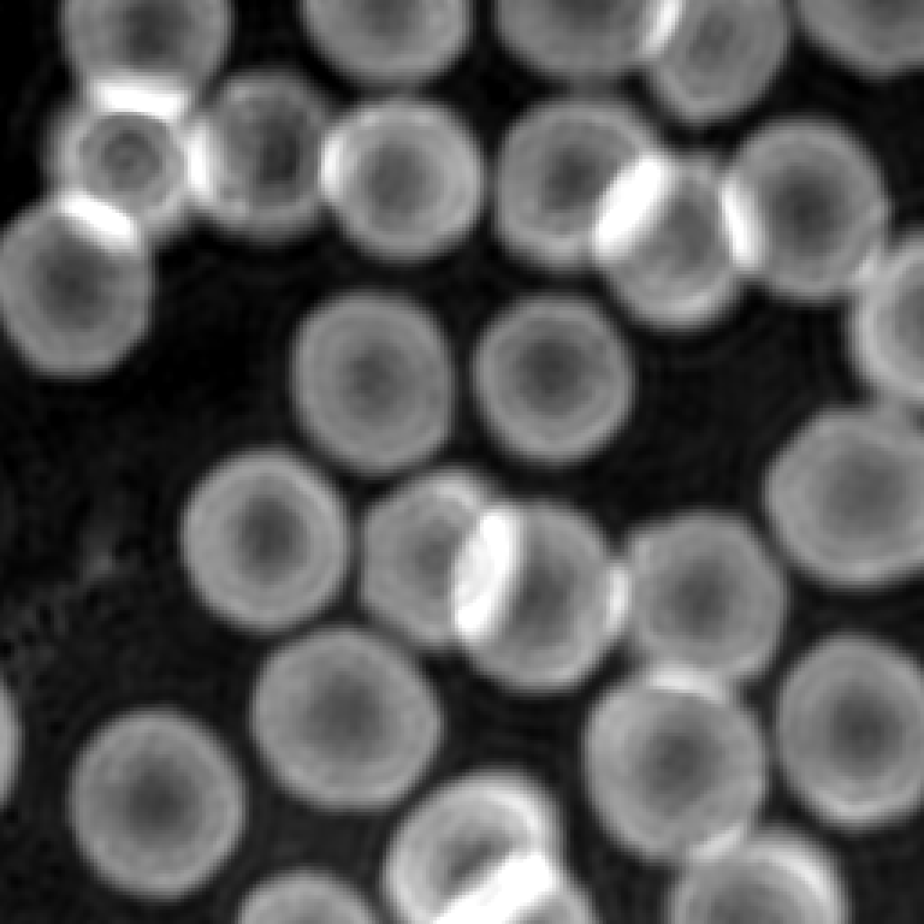
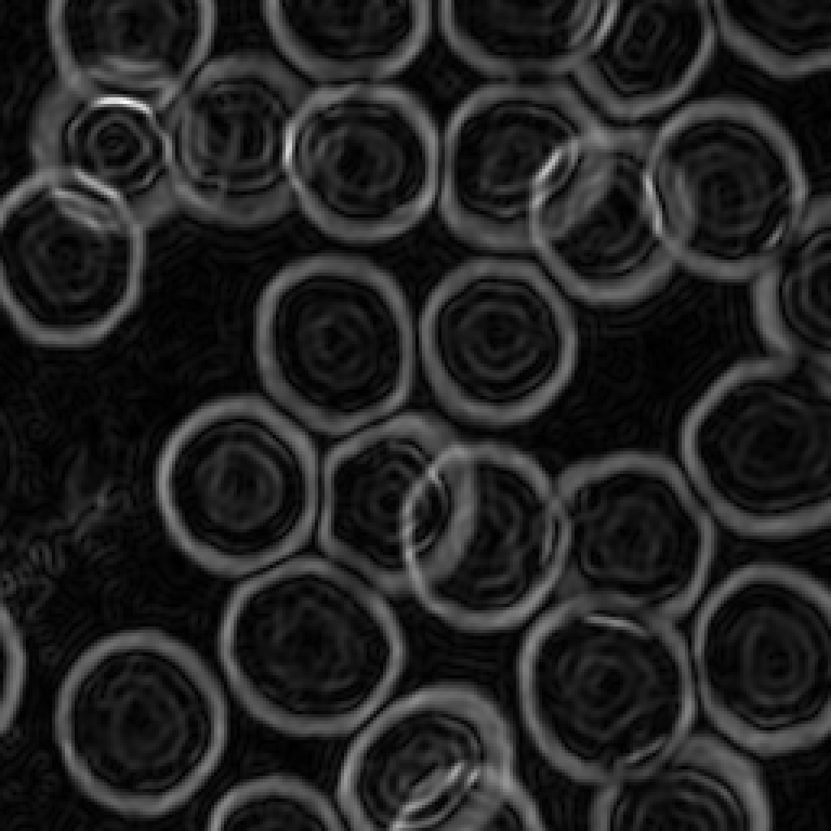
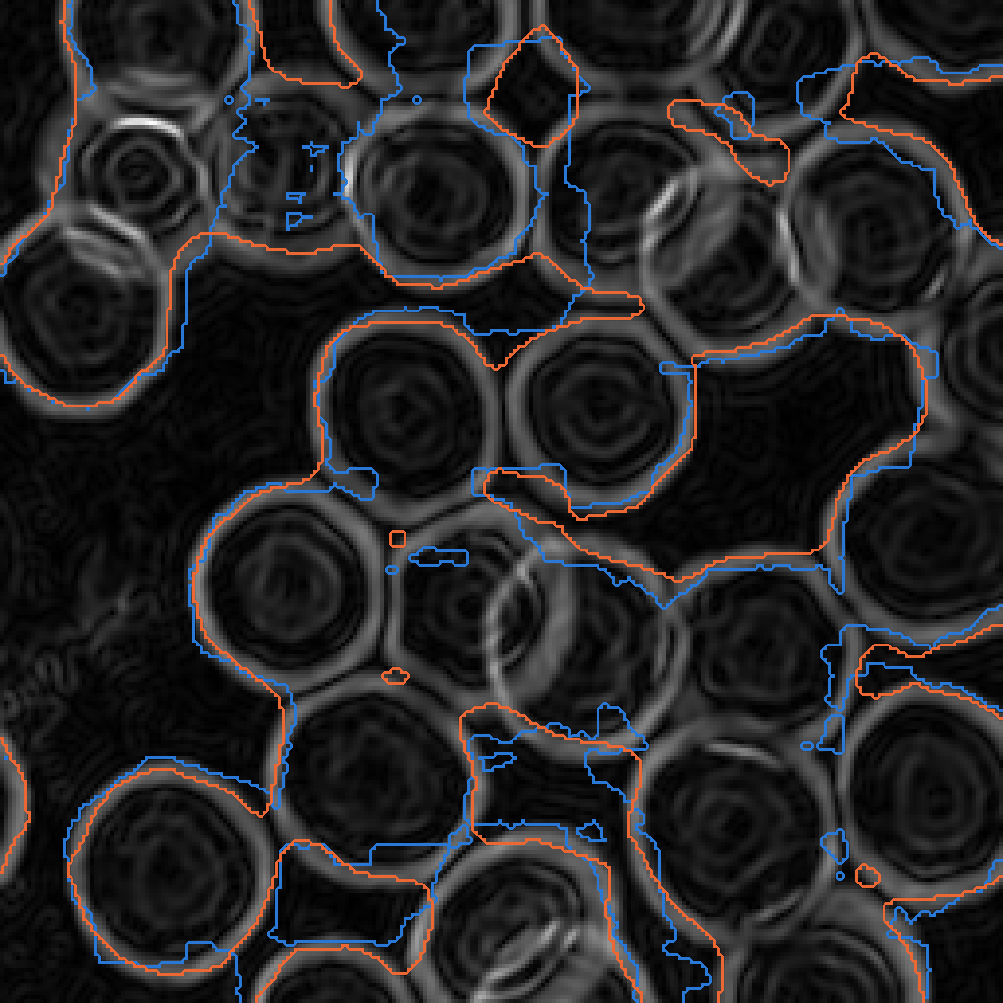
Figure S-4
Phase (rad)
Phase-gradient magnitude
Predicted contours
EdgeSAM (r=32)
MobileSAM (r=8)
20 μm
20 μm
20 μm
Panel image 1024 × 1024 px, upsampled 4× from the 256 × 256 px window (objects.json, FigS4).
Pixel pitch 0.1441 μm/px, so one panel spans 256 × 0.1441 = 36.89 μm.
Panel placed on this slide at 8.5178 × 8.5178 cm.
Scale bar 20 μm = 20 / 36.89 = 54.2 % of panel width = 4.6180 cm.

Slide 3
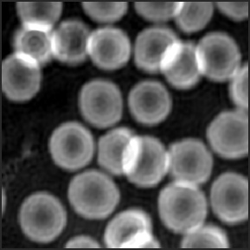
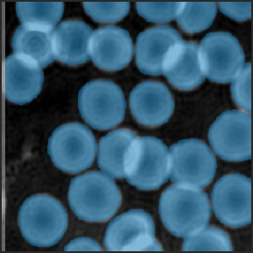
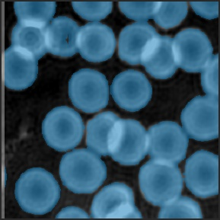
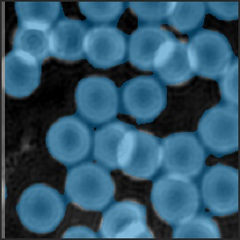
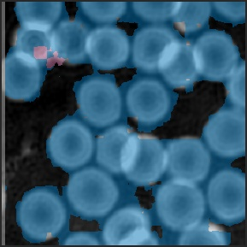
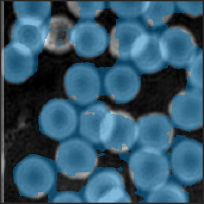
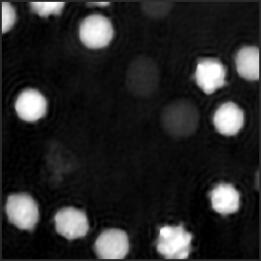
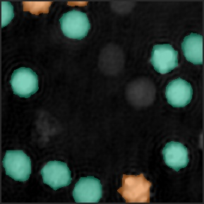
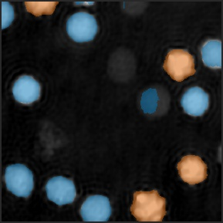
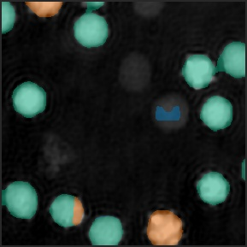
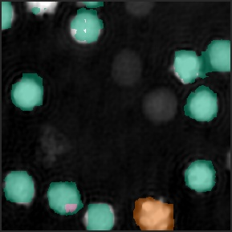
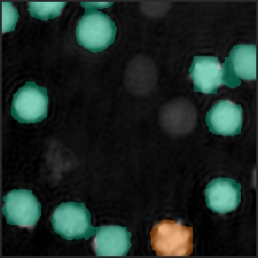
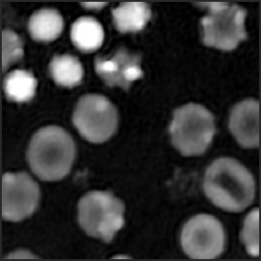
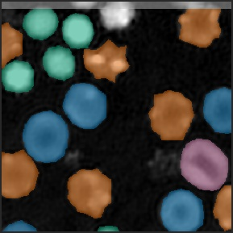
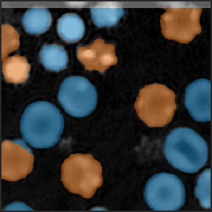
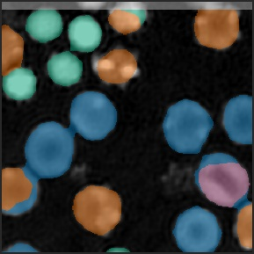
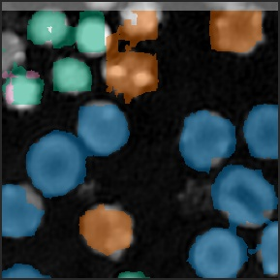
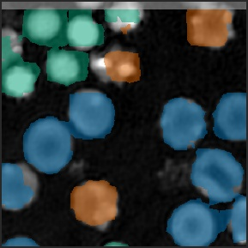
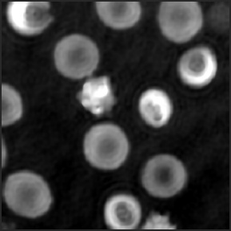
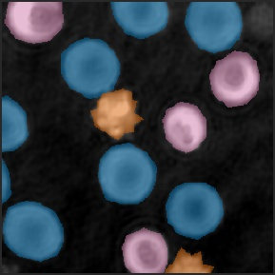
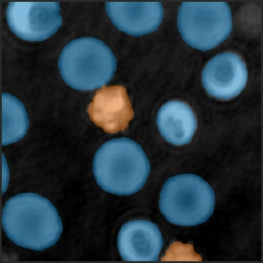
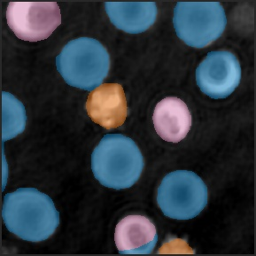
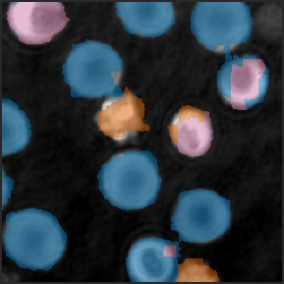
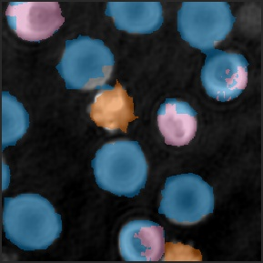
Figure 6
Phase
Annotation
MobileNet-UNet (r = 8)
MobileSAM (r = 8)
EdgeSAM (r = 8)
EdgeSAM (r = 32)
Each panel: 256 × 256 px window (36.89 µm), object 1024 × 1024 px (4× upsampled).
Scale bar 20 µm = 54.2% of the panel width. Row days follow objects.json (Fig6);
all predictions from training seed 42.
Discocyte (1)
day 15
20 µm
20 µm
20 µm
20 µm
20 µm
20 µm
Spherocyte (2)
day 47
20 µm
20 µm
20 µm
20 µm
20 µm
20 µm
Echinocyte (3)
day 30
20 µm
20 µm
20 µm
20 µm
20 µm
20 µm
Stomatocyte (4)
day 19
20 µm
20 µm
20 µm
20 µm
20 µm
20 µm
Discocyte (1)
Spherocyte (2)
Echinocyte (3)
Stomatocyte (4)
outside annotated field

Slide 4
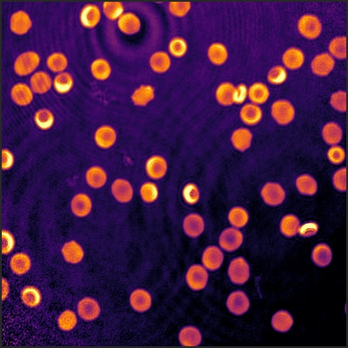
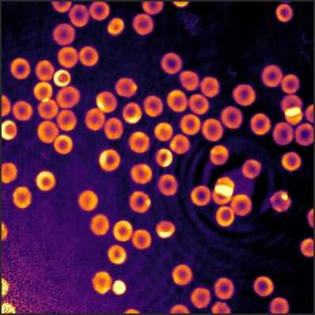
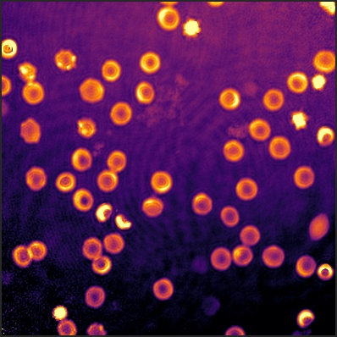
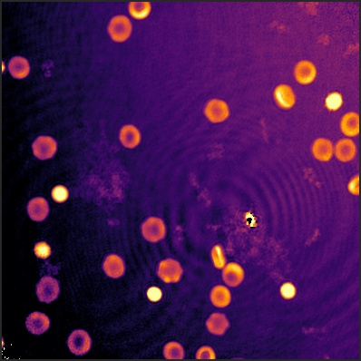
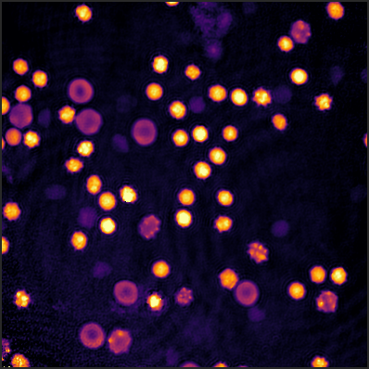
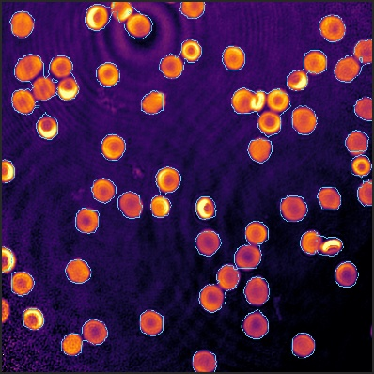
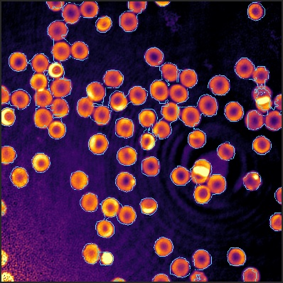

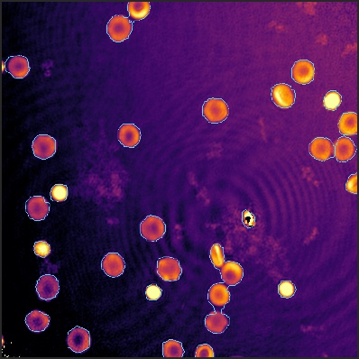
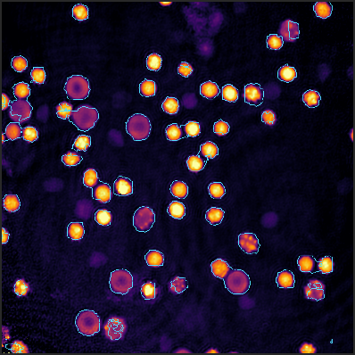
Figure S-5
Day 0
Day 8
Day 19
Day 27
Day 47
Phase
20 μm
20 μm
20 μm
20 μm
20 μm
EdgeSAM ( r = 32)
contours
20 μm
20 μm
20 μm
20 μm
20 μm
Panel objects: artifacts/figures/objects/FigS5/ (make_figure_objects.py).
Panel image 1536 × 1536 px, upsampled 2× from the 768 × 768 px source array.
Pixel pitch 0.1441 μm/px, so one panel spans 768 × 0.1441 = 110.67 μm.
Scale bar 20 μm = 18.07% of the panel width.

Slide 5
Background-referenced phase 𝝓 (radians) enters the loss directly
1. QPI preprocessing
2. Frozen encoder + LoRA
3. Trainable decoder
4. Physics-aware loss
5. Quantitative readout
Reconstructed phase $φ$
Frozen lightweight encoder
Fully trainable
Physics-Aware Phase
Consistency Loss
Integrated phase
and dry mass
EdgeSAM (RepViT)
MobileSAM (TinyViT)
MobileNet-UNet (MobileNetV2)
1-Channel stem
(Single channel, radians)
Normalisation
Parameters
$ℒ$ Dice
Class-weighted overlap
Decoder
Geometric localisation
Head
Pretrained weights held fixed
$λ₁ ℒ$PMC
Frozen
Trainable
Phase-mask contrast
Cell phase > background
$λ₁$ = 0.10
LoRA adapters in encoder attention,
linear and convolution layers
5-Class prediction M
standardise
$λ₂ ℒ$BGA
$A=N_{Ω}⋅Δx_{eff}^{2}$
Boundary-gradient alignment
Projected area
Frozen W
Adapted W′
Contour on $∇φ$ridge
$λ₂$= 0.05
Standardised input 𝚽
$C = 4πA / P²$
(z-score per image:
zero mean, unit variance)
$λ₃ ℒ$IPP
Circularity
+
B
A
=
Integrated-phase preservation
r × k
Conserves optical mass
$λ₃$= 0.10
𝑺 = 𝚺(𝝓_{i} − 𝝓_{bg}) · 𝚫𝒙²
d × r
Phase-integrated optical quantity
0
1
2
3
4
$ℒ$Total = $ℒ$ Dice +$λ₁ℒ$PMC
+ $λ₂ℒ$BGA + $λ₃ℒ$IPP
W′ = W + (𝜶 / 𝒓) BA
Background
Discocyte
Spherocyte
Echinocyte
Stomatocyte
𝒎 = (𝝀 / 𝟐𝝅𝜶) · 𝑺
Trainable (EdgeSAM, r = 32: 21.2%)
Dry mass
Gradients update LoRA adapters, stem, normalisation and decoder

Slide 6
Phase (rad)
Phase-gradient magnitude
Predicted contours
EdgeSAM (r = 32)
MobileSAM (r = 8)
20 μm
20 μm
20 μm

Slide 7
Phase
Annotation
MobileNet-UNet (r = 8)
MobileSAM (r = 8)
EdgeSAM (r = 8)
EdgeSAM (r = 32)
Discocyte (1)
day 15
20 µm
20 µm
20 µm
20 µm
20 µm
20 µm
Spherocyte (2)
day 47
20 µm
20 µm
20 µm
20 µm
20 µm
20 µm
Echinocyte (3)
day 30
20 µm
20 µm
20 µm
20 µm
20 µm
20 µm
Stomatocyte (4)
day 19
20 µm
20 µm
20 µm
20 µm
20 µm
20 µm
Discocyte (1)
Spherocyte (2)
Echinocyte (3)
Stomatocyte (4)
outside annotated field

Slide 8

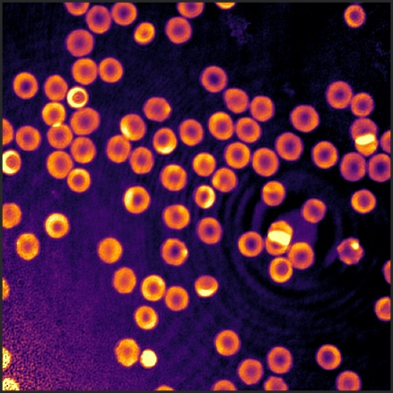


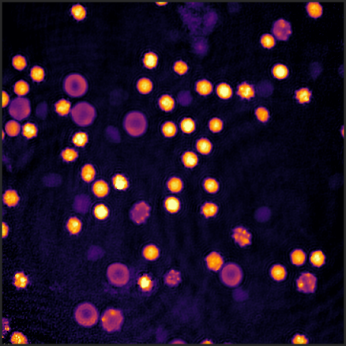

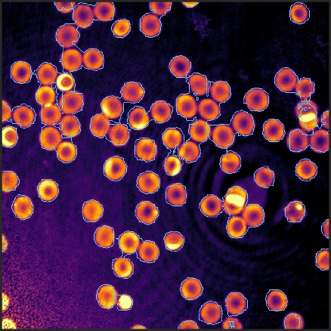
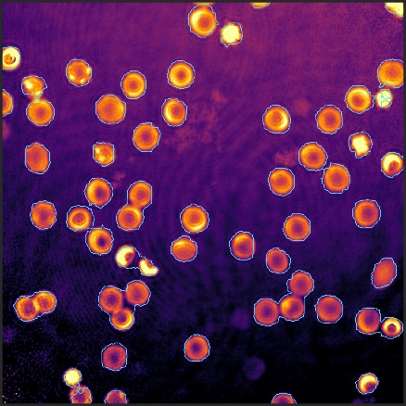


Day 0
Day 8
Day 19
Day 27
Day 47
Phase
20 μm
20 μm
20 μm
20 μm
20 μm
EdgeSAM ( r = 32)
contours
20 μm
20 μm
20 μm
20 μm
20 μm

