Slide 1
Irregular Curves : Joints and Knots, Connectivity
A regular curve is a set of highlighted pixels on a raster display (or dots on a printed page) that define the perimeter (or part of the perimeter) of a conic section.
An irregular curve is a set of pixels that define a curve that does not fit the perimeter of a conic section. The ending point is excluded from a curve just as it is excluded from a line.

Slide 2
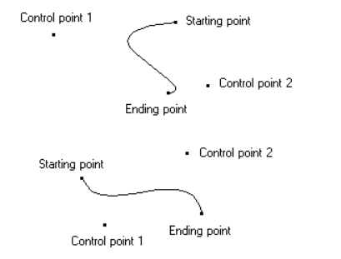
Irregular Curves : Joints and Knots, Connectivity

Slide 3
Irregular Curves : Joints and Knots, Connectivity
A Non-Uniform Rational B-Spline curve is defined by three things:
• Control points
• The curve's order.
• A knot vector

Slide 4
Rules for Knots
First, the number of control points defining the curve must always be equal to or greater than the order of the curve.
E.g., a quadratic (order = 3) must have at least three points, a cubic at least four, etc.

Slide 5
Rules for Knots
Second, the number of knots in the knot vector is always equal to the number of control points plus the order of the curve. E.g., a cubic (order=4) with four control points has eight items in the knot vector.

Slide 6
Rules for Knots
Third, the order of a curve must be at least two.
Fourth, the values in the knot vector must always be in ascending order.
E.g., [0 0 0 1 2 3 3 3] is a valid knot vector, but [0 0 0 2 1 3 3 3] is not.

Slide 7
Rules for Knots
The valid parameter range for a curve starts at umin=uorder-1 and goes up to (but does not include!) umax =um, where m is the number of control points. Values less than the minimum parameter, or equal or above the maximum parameter aren’t defined. (In other words, u must be umin ≤ u < umax).

Slide 8
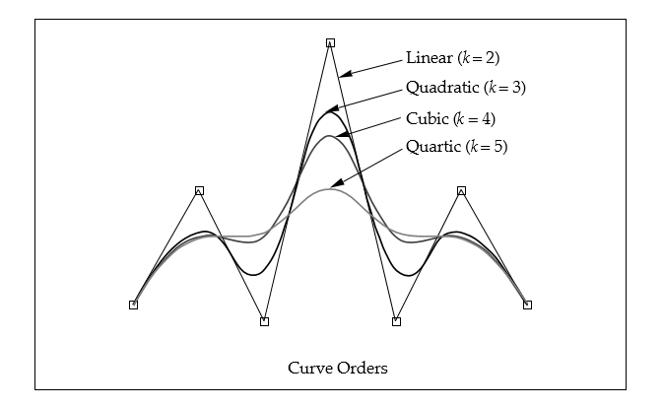
Curve Orders

Slide 9
Basic knot vectors
Pinned Uniform
Piecewise Bezier

Slide 10
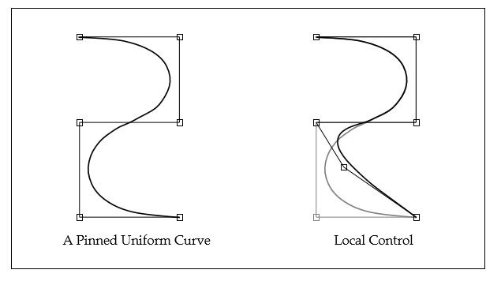
Basic knot vectors

Slide 11
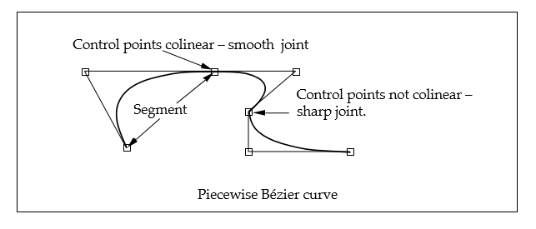
Basic knot vectors

Slide 12
Knots and breaks – continuity.
• C0 – Change in position - in this case, the curve actually has a break in it.
[paths w/multiple pieces, etc]
• C1 – Change in tangent - a kink in the curve (e.g., the corner of a rectangle).
• C2 – Change in acceleration - e.g., a change in the speed of a camera as it moves along a path.

Slide 13
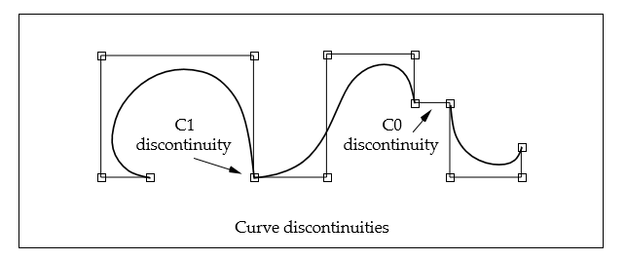
Kinks and breaks – continuity.

Slide 14
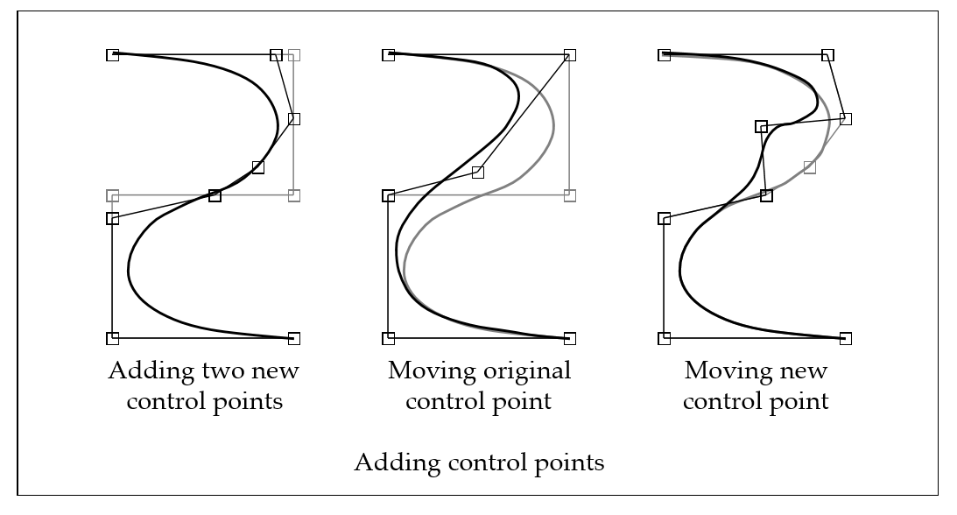
Adding Control points
Knot insertion:
It is possible to add control points to a curve without changing it’s shape.
This process is called refinement or knot insertion.

Slide 15
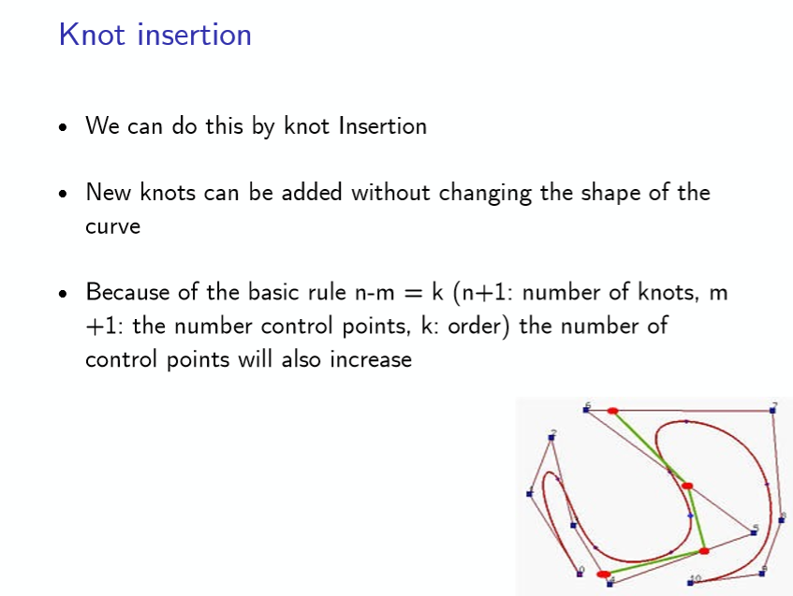

Slide 16
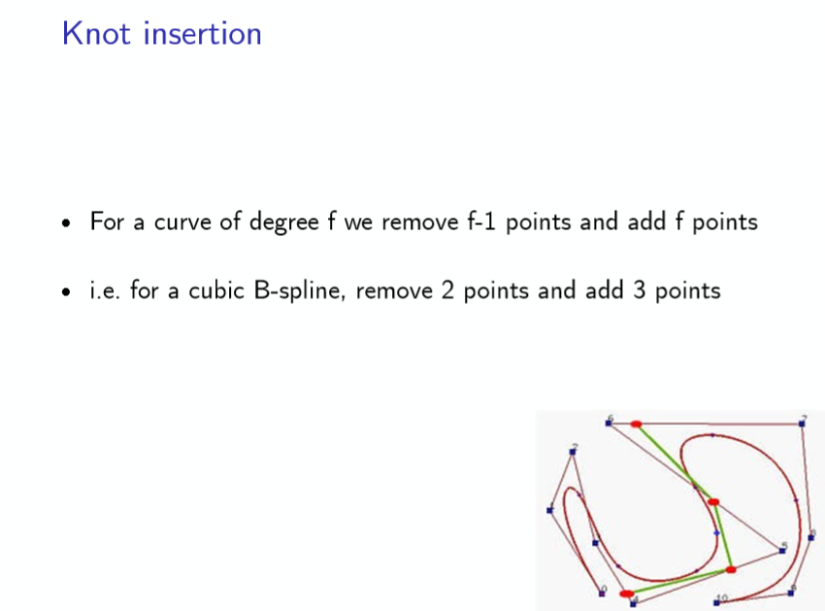

Slide 17
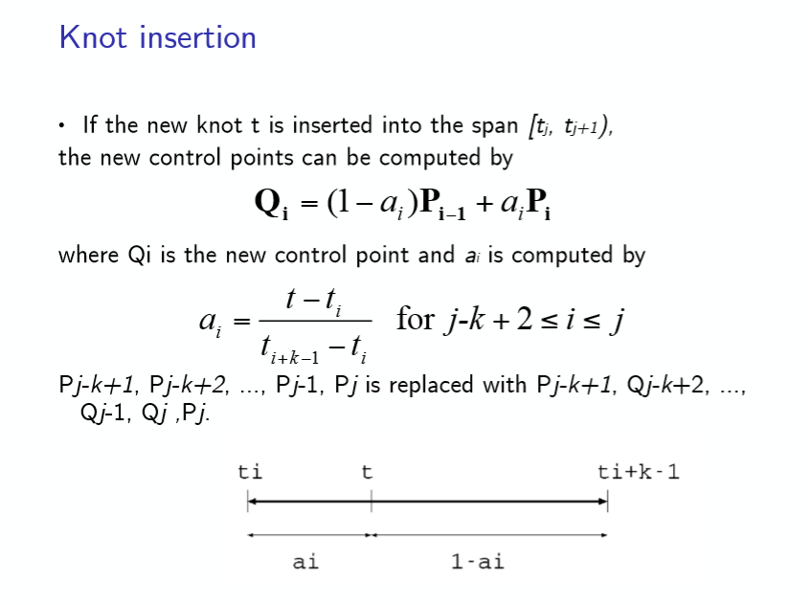

Slide 18
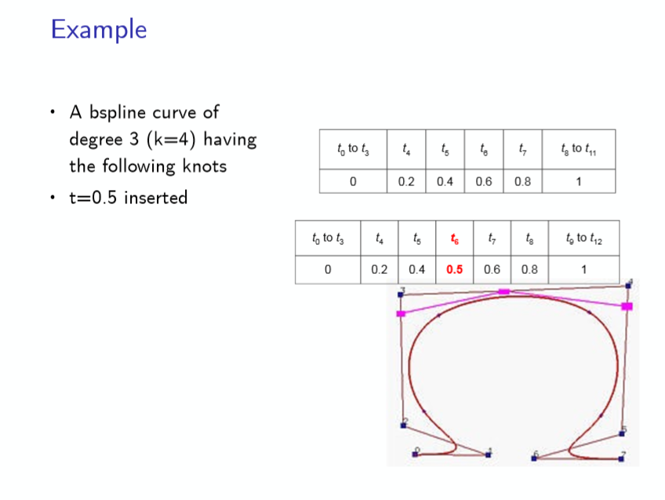

Slide 19
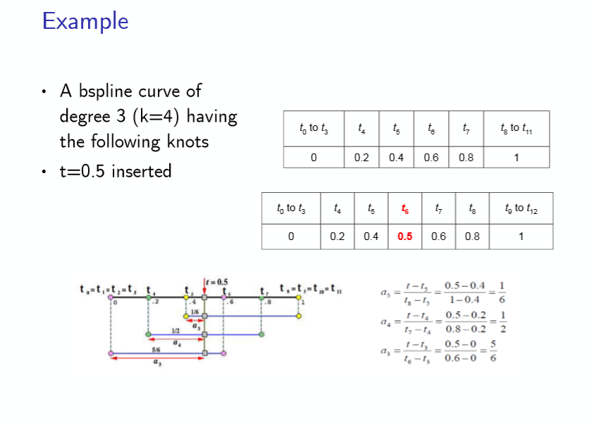

Slide 20
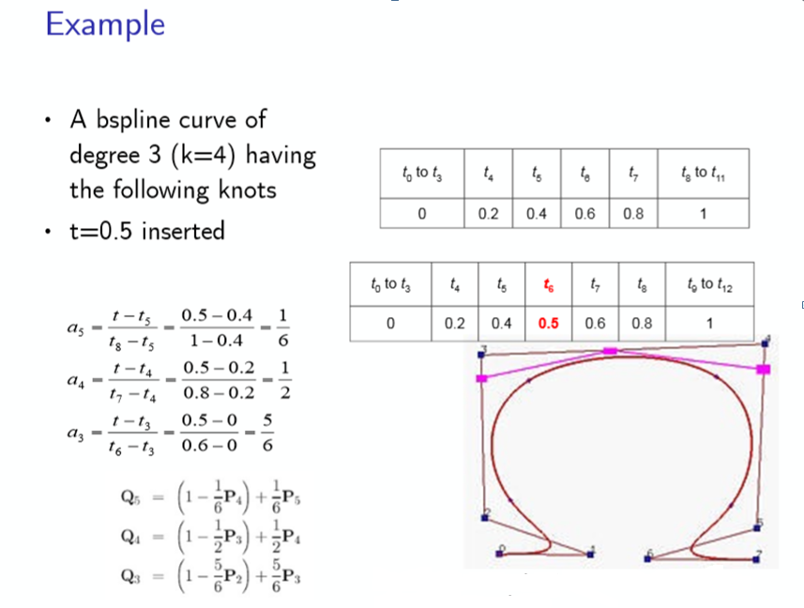

Slide 21
Joining Curves
Add the last value in the first curve’s knot vector to all the knots in the second curve.
Remove the first control point and the k first knots from the second curve (k = order). Remove the last knot from the first curve. Concatenate the second curve’s control points and knot vector.
To smooth the join, space apart the knots where the two knot vectors were joined. This removes the discontinuity. As they’re moved further apart, the join becomes less sharp.

Slide 22
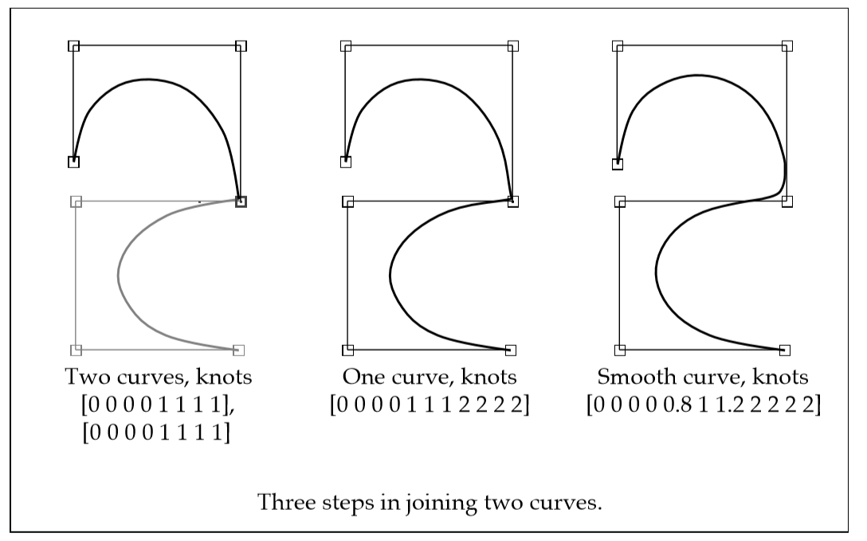
Joining Curves

Slide 23
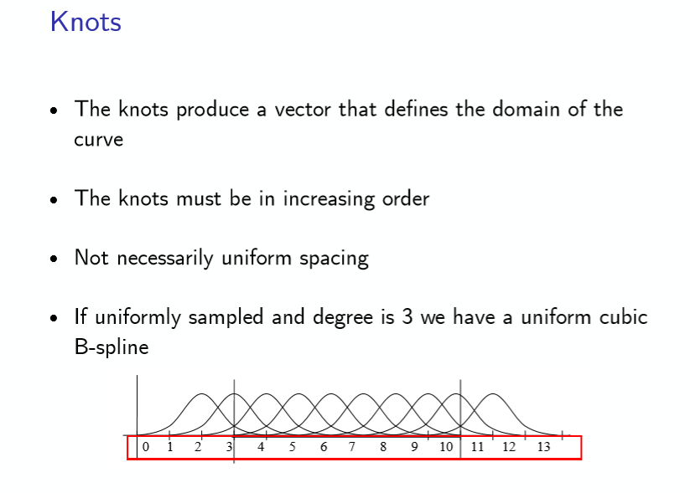

Slide 24
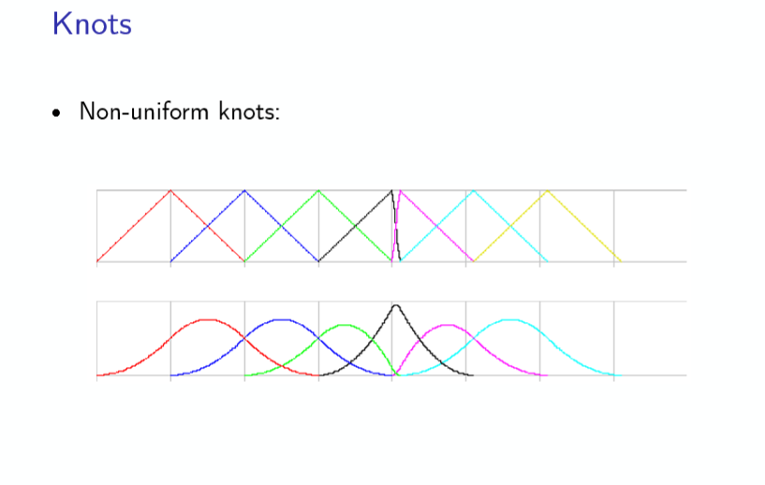

Slide 25
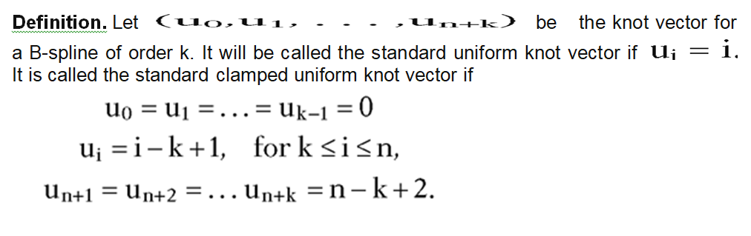

Slide 26
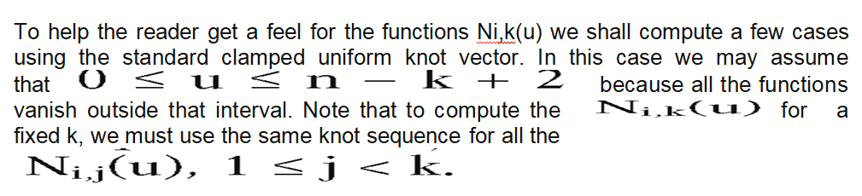

Slide 27
Example 1:
n=3 and k=1
shows the graphs of N_{i,1}(u)
Example 2:
n=3 and k=2
shows the graphs of N_{i,1}(u)

Slide 28
