Slide 1
Foreign Key Concept
Prajakta Ugale

Slide 3
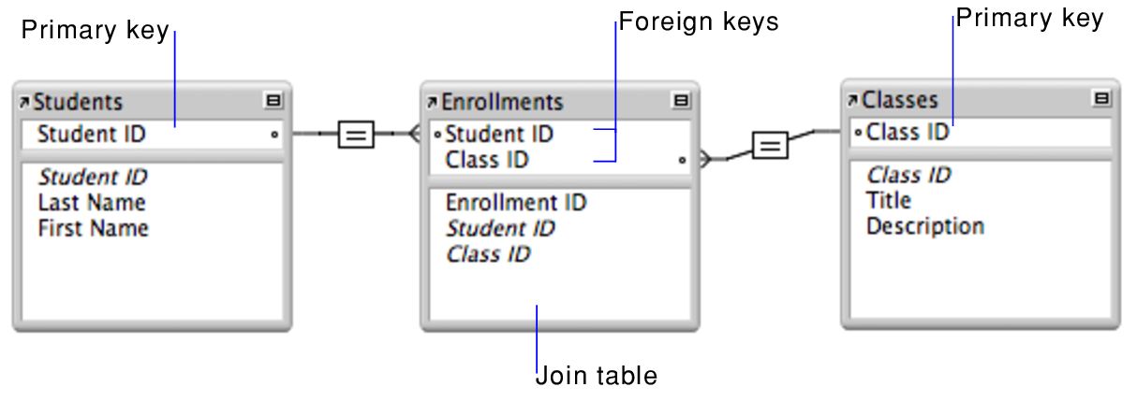
Ref:https://macxima.medium.com/primary-key-vs-foreign-key-in-sql-d89260b74e1c

