Slide 1
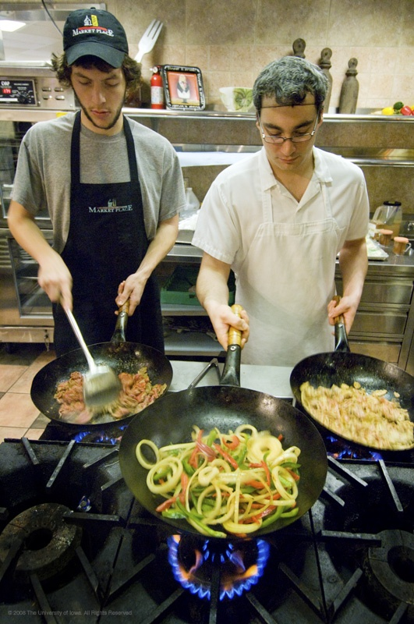
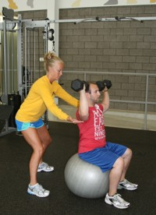
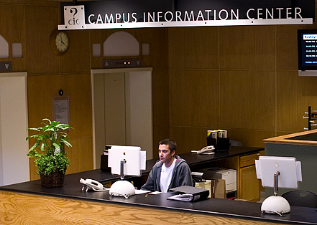
Connecting Work and Academics:
How Students and Employers Benefit

Slide 2
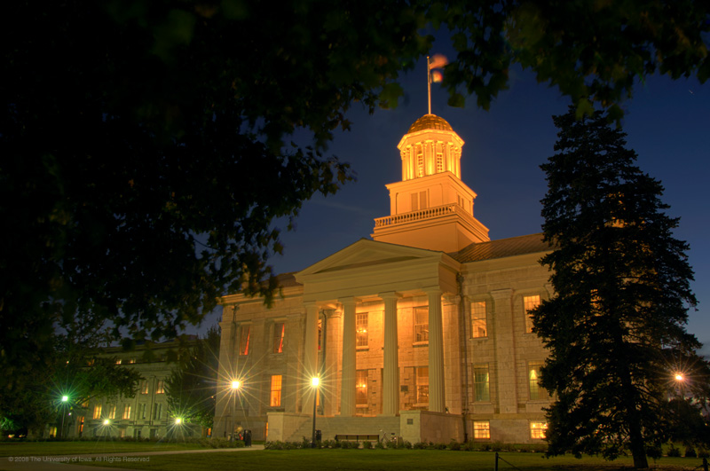
The University of Iowa Mission
“To educate students for success and personal fulfillment in a diverse world.” [excerpt]

Slide 3
Meet & Greet
In groups of 2-3 share your name, department, student supervision and what you are hoping to gain from the workshop today.

Slide 4
Our Agenda Today
Overview student success and student employment
Enhancing student success through employment
The key role of supervisors
Strategies for supporting your students

Slide 5
Assumptions
Student employment is positive for the student and the employer
Student employees can be challenging
It is easier for supervisors in some areas to spend time developing student employees than in other areas
Small efforts can still make a big difference in helping our students develop important skills for lifelong success

Slide 6


Defining Student Success
(UI SST, 2007)
University of Iowa students succeed when they achieve personal and institutional educational goals.
Successful students develop skills and knowledge, become more mature in their thinking, assume greater responsibility for their own lives and learning, develop understanding of diversity and multiculturalism, and become effective leaders.

Slide 7
Defining Student Success at Iowa
Student success at . . . Iowa is a shared enterprise.
Students succeed by active engagement in educationally-purposeful activities. Faculty, staff, and students create . . . learning opportunities [and] policies, programs, and practices that foster student engagement.

Slide 8
Defining Student Success at Iowa
Student success can only be achieved if students stay at Iowa (Retention).

Slide 9
Where do Students…
-develop skills and knowledge?
-become more mature in their thinking?
-assume greater responsibility?
-develop understanding of diversity?
-become more effective leaders?

Slide 10
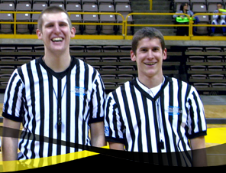
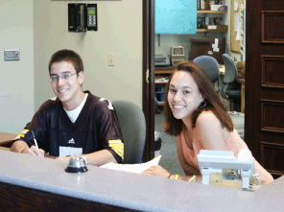
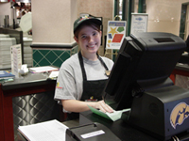
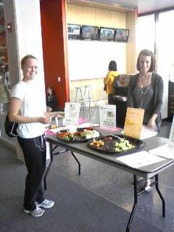
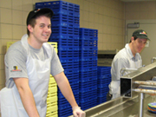
Classrooms, Student Activities, and…

Slide 11

Why Should we Focus on the Learning in Employment?
Kuh: Students are most successful in “seamless environments” where they can make connections between classroom and out of classroom experiences.

Slide 12
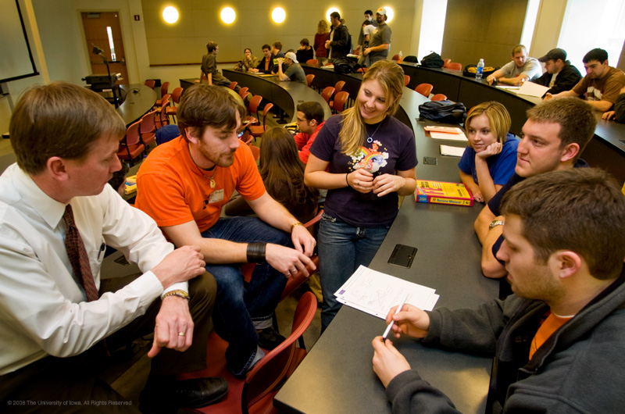
What is High-Impact?
High impact activities are those that allow students to apply learning to real-life, to make connections, reflect and integrate learning.
Campus jobs can be
high-impact for our
students.

Slide 13
High-Impact Activities:
Student Employment
Most students work at some point
Employment can be related positively to engagement with the institution not a ‘distraction’ from academic pursuits
Work can be high-impact with some additional structure from us (supervisors)

Slide 14
Student Employment and Transferable Skills
Take a moment to complete item 1 on your worksheet.
Discuss with a partner.
What should students know and be able to do after working in your office? (Tasks, skills, competencies)

Slide 15
Student Voices
“My job provided me with a sense of belonging. It gave me a place where I was needed, a place where I was accepted, and a place I was expected to be.”
“It has taught me the responsibility of time management and to apply the knowledge I get from the classes to my work. It has also improved my communication as well as personal skills.”

Slide 16
Student Voices
“It makes me feel more of a part of the university.”
“My job with the University has helped me learn the importance of effective communication and time management.”
“I have met wonderful people in my office and established connections that will last beyond my time as a college student.”

Slide 17
Our Goal
How can we make student employment a high-impact activity?

Slide 18
IOWA GROW™: Guided Reflection on Work
  Supervisors from Student Health Service/Health Iowa, University Housing, and the Iowa Memorial Union were recruited to participate in IOWA GROW™
Supervisors received one hour of training on:
  Outcomes of student employment
  Results from the previous year’s Division of Student Services Student Employment Survey
  Background on the role supervisors can play in helping students make connections between work and academics
  Expectations for IOWA GROW™
Notes:
Types of jobs:
Iowa Memorial Union
Campus Information Center: Information Specialist; Special Project Assistant
Guest and Event Services: Student Custodians
University Bookstore: Student Clerical Worker
IMU Business Office: Cashier Assistant
Student Health Service
Health Iowa: Health Promotion Assistant
University Housing
IT Support Staff
Tutors
Residence Hall Desk Staff
Hillcrest and Burge Marketplace
University Libraries

Slide 19
IOWA GROW™: Guided Reflection on Work
Supervisors were asked to have two structured conversations with each of their student employees during the spring semester.
They were asked to record the student’s answers to 5 questions.
Supervisors submitted completed questionnaires to the IOWA GROW™ Project Team.
Notes:
Questions:
How is this job fitting in with your academics?
What are you learning here at work that is helping you in school?
What are you learning in class that you can apply here at work?
Can you give me a couple examples of things you are learning here at work that you will be using in your chosen profession?
Fifth question – Can you think of a couple of things you will be doing in your chosen profession that we could use here at work?

Slide 20

IOWA GROW™: Guided Reflection on Work
Did taking time to talk with students about their learning help them see what they were learning more clearly?
How are our student jobs contributing to the key aspects of student success we mentioned earlier?
Notes:
Making learning on the job “visible” to the student. Have you ever driven the same route to and from work and then one day you suddenly notice something (a sign, a shed, a new house) that seemingly popped up over night. By having these conversations we are hoping that we are not only helping students learn to talk about their work, but also helping them see things they may not have seen before.

Slide 21
Students Were More Likely to Report…
Their supervisor helped them make connections between work and life as a student
They could see connections between work and coursework
Their job contributed positively to:
  written communication skills
  oral communication skills
  conflict resolution skills
  time management
Notes:
Making learning on the job “visible” to the student. Have you ever driven the same route to and from work and then one day you suddenly notice something (a sign, a shed, a new house) that seemingly popped up over night. By having these conversations we are hoping that we are not only helping students learn to talk about their work, but also helping them see things they may not have seen before.

Slide 22
Students Were More Likely to…
Mention positive outcomes of employment other than money
Noted they felt as though they were making a positive contribution to The University of Iowa
Be able to state at least one thing they’ve learned on the job
Notes:
No one in the pilot mentioned money as the key way that their job contributed. Very few non-pilot participants mentioned feeling they were making a contribution at their work site.
“What are you learning here at work that is helping you in school?”
Relationship skills
Responsibility and time management
Understanding others’ learning styles/needs
Problem solving skills
Communication skills
“What are you learning in class that you can apply here at work?”
Advanced knowledge (content learned in class that can be applied on the job)
Teaching methods
Relationship skills
Problem solving skills
Responsibility and time management
Study skills
“Can you give me a couple examples of things that you are learning here at work that you will be using in your future profession?”
Relationship skills
Communication skills
Teaching methods
Responsibility and time management
Problem solving skills

Slide 23
What About YOU?
When students make connections to the workplace, they are more invested.
Invested employees:
  do better work
  feel more committed and responsible to you

Slide 24
Thinking About Your Goals…
When you think about the students you supervise, discuss this question…
“By May, I hope the students I supervise are able to….” (do more, do better, know more, know better)
Thinking about the student employment conversations, discuss this prompt…
“For me, what might work would be to….”

Slide 25
Positive Outcomes of Employment
Please describe one specific way your work as a student employee has positively influenced your experience at the UI.
Themes (most to least frequently mentioned)
IOWA GROW Participants | Non-IOWA GROW Participants
Forming relationships | Forming relationships
Feeling satisfied with job contribution | Gaining time management skills
Gaining knowledge of self | Earning money
Gaining work-related knowledge and skills | Gaining work-related knowledge and skills
Notes:
No one in the pilot mentioned money as the key way that their job contributed. Very few non-pilot participants mentioned feeling they were making a contribution at their work site.

Slide 26
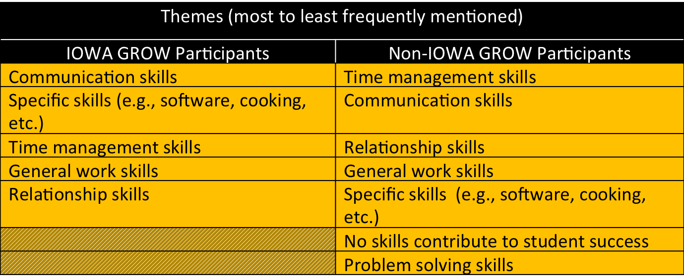
Specific Skills that Contribute to Student Success
Please describe one specific skill you have learned as a student employee that contributes to your success as UI student.
Notes:
No one in the pilot said “nothing”. Multiple students in the non-pilot said so

Slide 27
1:1 Meetings:
Supervisors and Supervisees
“What are you learning here at work that is helping you in school?”
Themes (most to least frequently mentioned)
Relationship skills
Responsibility and time management
Understanding others’ learning styles/needs
Problem solving skills
Communication skills

Slide 28
Structured Discussions:
Supervisors and Supervisees
“What are you learning in class that you can apply here at work?”
Themes (most to least frequently mentioned)
Advanced knowledge (content learned in class that can be applied on the job)
Teaching methods
Relationship skills
Problem solving skills
Responsibility and time management
Study skills

Slide 29
Structured Discussions:
Supervisors and Supervisees
“Can you give me a couple examples of things that you are learning here at work that you will be using in your future profession?”
Themes (most to least frequently mentioned)
Relationship skills
Communication skills
Teaching methods
Responsibility and time management
Problem solving skills
Notes:
Helping students see transferrable skills

Slide 30
Connecting Work to Academics – the BIG picture
UI Institutional Learning Goals | Key Outcomes from IOWA GROW
Build a broad knowledge base inside and outside the classroom | Specific content knowledge such as software, project management, teaching methods, etc.
Intellectual and practical skills (communication – oral/written, teamwork, problem solving, critical and creative thinking, information literacy) | Communication Teamwork Critical thinking/problem solving Conflict resolution
Develop intellectual, personal, and social responsibility (responsibility, intercultural knowledge) | Time management Multicultural competence Relationship skills Study skills
Learn to apply knowledge in new settings (integrate ideas across experiences within and beyond the classroom) | The very nature of IOWA GROW is connecting across contexts

Slide 31
Enhancing Student Learning Through Employment
Things to consider….
  Establish general outcomes for student employment
    What should students know and be able to do after working in your office? (Tasks, skills, competencies)
  Incorporate language of student learning into job announcements and position descriptions
  Create and use interview questions that encourage students to make connections between world of work and academics
*Suggestions may not all be applicable to every setting/job type
Notes:
Perozzi – Enhancing Student Learning Through College Employment

Slide 32
Enhancing Student Learning Through Employment
Things to consider:
  Add discussions of learning outcomes to Orientation/Training checklists
  Provide questions for supervisors that they can use to help students make work/academic connections
  Provide overview for supervisors of pilot survey data and get their suggestions for helping students make connections
  Share information by department

Slide 33
Sharing Our Successes
George Kuh article in Chronicle of Higher Education
Organizational Effectiveness series for Supervising Students

Slide 34
Questions? Comments?
Sarah Hansen
Director, Assessment and Strategic Initiatives
sarah-hansen@uiowa.edu
335-1168
Michelle Cohenour
Director of Retention for Early Intervention
michelle-cohenour@uiowa.edu
335-1497

