Slide 1
Firebase Book Report
By: Ben DeSollar

Slide 2
Introduction to Firebase
Platform developed by Google for mobile and web applications
From only real-time database -> Comprehensive App Dev Platform
Easy to use, and tons of features
Notes:
Notes:Briefly introduce Firebase as a platform developed by Google for creating mobile and web applications.
Highlight its start as a real-time database but has since evolved into a comprehensive app development platform.
Mention the ease of integration and the benefits of using Firebase, such as speeding up the development process, improving app quality, and growing the user base.

Slide 3
Core Features of Firebase
Firestore (real-time database)
Authentication
Hosting
Cloud Functions
Analytics
Storage
Notes:
List and explain the core features: Firestore (real-time database), Authentication, Hosting, Cloud Functions, Analytics, and Storage.
Authentication
Firebase Authentication provides a complete identity solution, supporting email and password login, as well as social login providers like Google, Facebook, Twitter, and more. It also supports phone number login and can be easily integrated into your app.
Hosting
Firebase Hosting offers fast and secure web hosting for static files like HTML, CSS, JavaScript, and more. It's backed by a global content delivery network (CDN), and provides features such as one-click rollbacks and custom domain support, with automatic SSL certificate provisioning.
Cloud Functions
Cloud Functions are Firebase's scalable solution for running backend code in response to events triggered by Firebase features and HTTPS requests. Written in JavaScript or TypeScript, these functions are executed in a managed, serverless environment.
Analytics
Firebase Analytics is a free app measurement solution that provides insights on app usage and user engagement. Integrated across Firebase's services, it helps you understand how people use your app, giving you the data needed to improve your app's performance and grow your user base.
Storage
Firebase Storage provides secure file uploads and downloads for your Firebase apps, regardless of network quality. Backed by Google Cloud Storage, it's built for app developers who need to store and serve user-generated content, such as photos or videos.

Slide 4

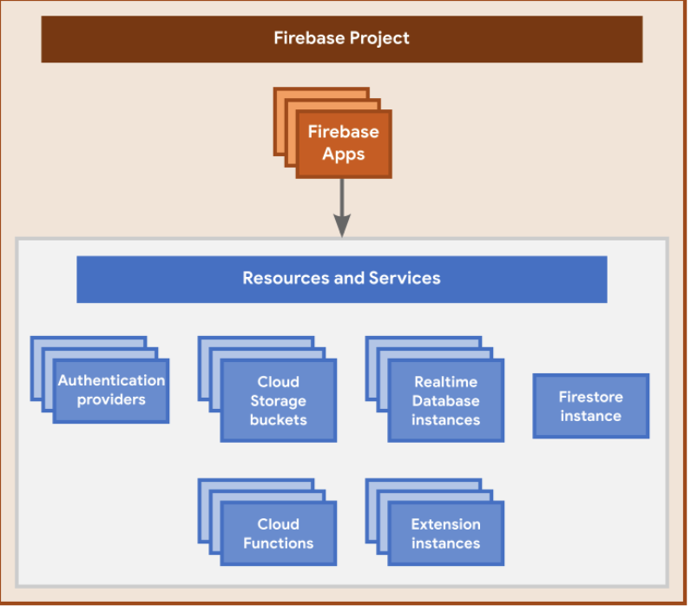
Hierarchy of Firebase projects
A Firebase project is like a container
A Firebase project can have one or more Firebase Apps registered to it
(for example, both the iOS and Android versions of an app, or both the free and paid versions of an app).
All Firebase Apps registered to the same Firebase project share and have access to all the same resources and services
All the Firebase Apps registered to the same Firebase project share the same backends
Firebase Hosting, Authentication, Realtime Database, Cloud Firestore, Cloud Storage, and Cloud Functions

Slide 5
Relationship between Firebase projects and Google Cloud
Firebase Project = Google Cloud Project
Interaction w/ project via Firebase console, Google Cloud console, and Google APIs console.
Can use products and APIs from both Firebase and Google Cloud in a project.
Unique identifiers for a project (like project number and project ID) are shared across Firebase and Google Cloud.
Deleting a project deletes it everywhere
Notes:
- Unique identifiers for a project (like project number and project ID) are shared across Firebase and Google Cloud.
- Deleting a project deletes it across Firebase and Google Cloud.

Slide 6


Setting up a Firebase project and registering apps

Slide 7
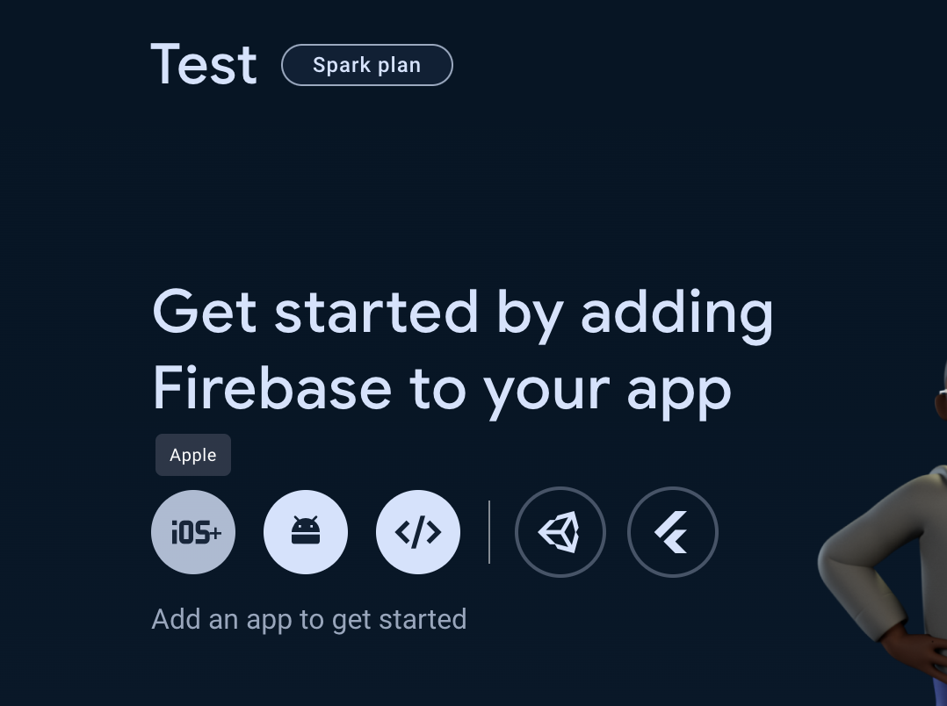
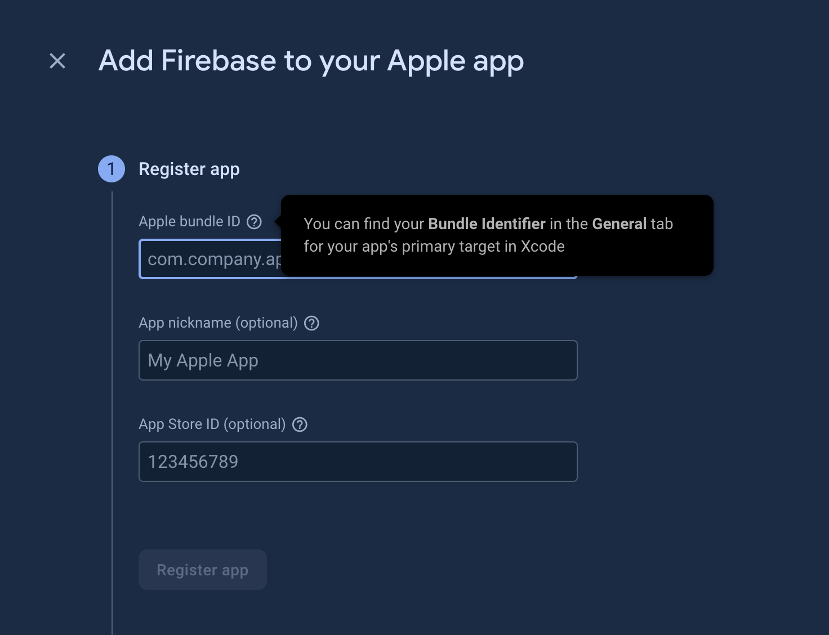
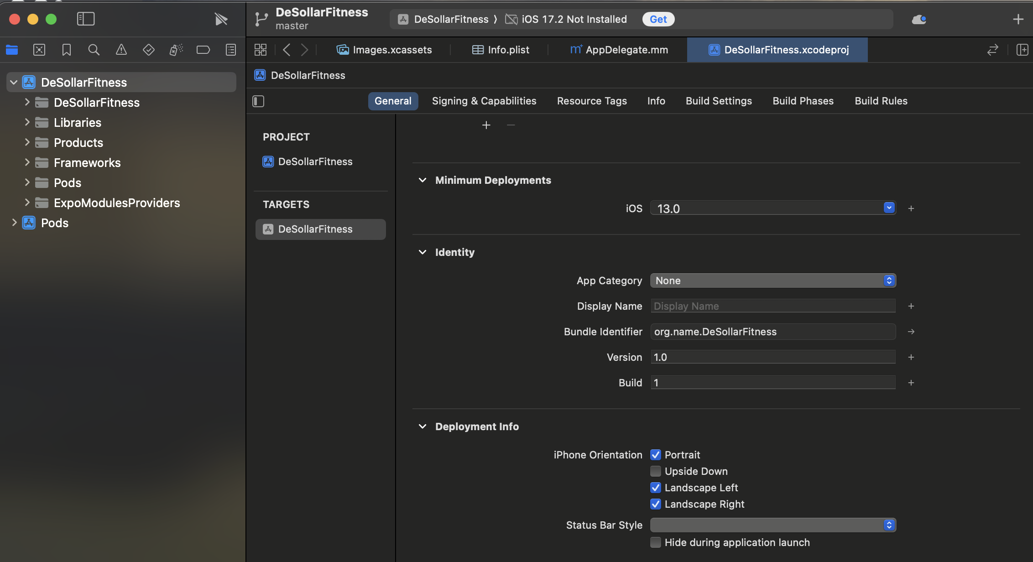

Slide 8
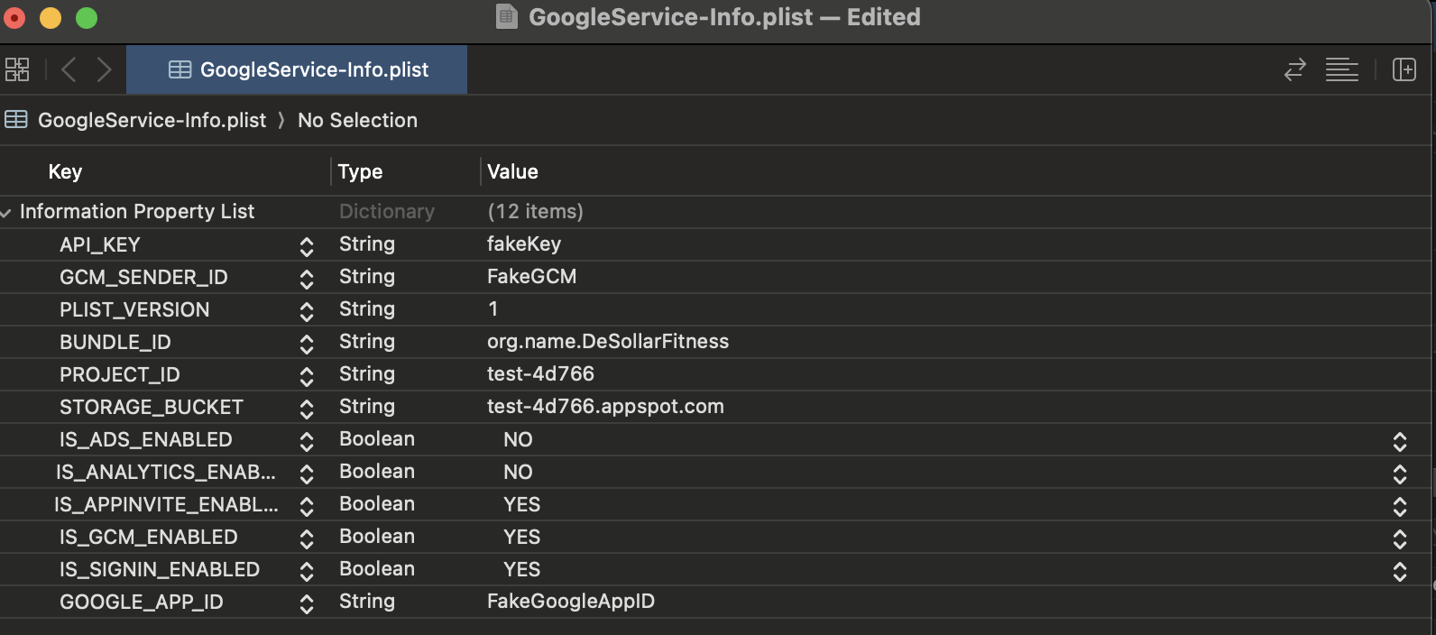
Installing Firebase in Expo App
Install Firebase in Expo app
npx expo install firebase
Initialize the SDK in your project
For config file use values from the GoogleService-Info.plist
Configure Metro
npx expo customize metro.config.js
Setup any services you want from there (Auth, Database, etc)

Slide 9
Conclusion
Pros
Rapid Development and Easy Integration
Scalability
Rich Set of Features and Integrations
Cons
Vendor Lock-in
Pricing Concerns
Limited Database Query Capabilities
Notes:
Rapid Development and Easy Integration:
Pro: Firebase offers a wide range of tools and services that can significantly speed up the development process. The ease of integration of its features, such as authentication, real-time databases, and analytics, allows for quick setup and deployment, reducing development time and effort.
Notes: Highlight how Firebase's comprehensive suite of tools can be seamlessly integrated into various platforms (iOS, Android, Web) with minimal configuration, facilitating rapid prototyping and release cycles.
Scalability:
Pro: Firebase's infrastructure is designed to scale automatically, handling the complexities of scaling your app as it grows. This means developers can focus more on creating features and less on managing infrastructure.
Notes: Discuss Firebase's ability to scale from a handful of users to millions without requiring significant changes to the app infrastructure, ensuring that your app can grow with your user base.
Rich Set of Features and Integrations:
Pro: Beyond core functionalities like hosting and real-time databases, Firebase offers advanced features such as machine learning capabilities, performance monitoring, and crash reporting. Additionally, its integration with other Google Cloud services and third-party tools enhances app functionality and analysis.
Notes: Emphasize the benefits of having a wide range of tools at your disposal for enhancing app quality, user engagement, and analytics, all within a single platform.
Cons of Using Firebase:
Vendor Lock-in:
Con: Using Firebase can lead to vendor lock-in, making it challenging to migrate to another platform in the future. As your app becomes more dependent on Firebase's services, switching costs and technical adjustments can increase.
Notes: Acknowledge the concerns about vendor lock-in and the importance of evaluating the long-term implications of tightly coupling your app's architecture with Firebase.
Pricing Concerns:
Con: While Firebase offers a free tier, costs can escalate quickly as your app scales and utilizes more resources or advanced features. The pricing model can be unpredictable for apps with variable usage patterns.
Notes: Discuss the need for careful monitoring of Firebase services usage to manage costs effectively and consider providing examples or strategies for optimizing resource use to stay within budget.
Limited Database Query Capabilities:
Con: Firebase's databases (Firestore and Realtime Database) offer ease of use and real-time capabilities but have limitations in terms of complex querying and data modeling compared to traditional relational databases.
Consider an application with a Firestore database that stores user data and their posts. Suppose you want to perform a complex query like fetching all users who are older than 30 and have made more than 100 posts in the last year. In a traditional SQL database, this could be achieved with a single SQL join query across tables, utilizing where clauses for age and post count within a specific timeframe.
Firestore allows querying documents within a single collection efficiently but doesn't support SQL-like joins in a single query. To achieve the above in Firestore, you'd likely need to:
Query one collection (e.g., users) to find users over 30,
Query another collection (e.g., posts) to count posts per user within the last year,
Merge these results in your application code to filter out users who meet both criteria.
This process can be more cumbersome and less efficient, especially with large datasets.

Slide 10
Resources
https://firebase.google.com/docshttps://firebase.google.com/docs
https://docs.expo.dev/guides/using-firebase/

