Slide 1

Infinite Focus Demo
By: Ben DeSollar, Adnane Ezouhri, and Joslin Some

Slide 2
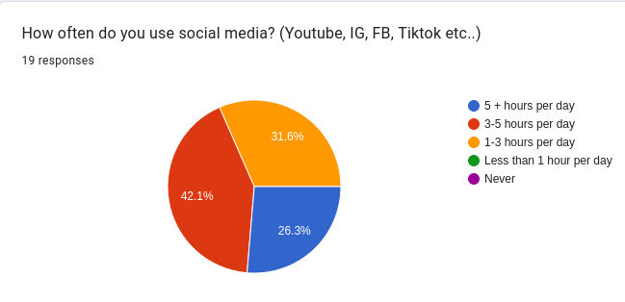
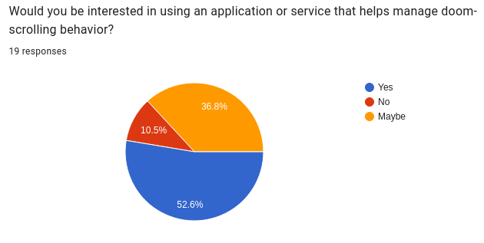
Product Motivation
Younger generation is more and more addicted to screens
Short attention spans, due to excessive stimulation

Slide 3
The What, How, and Why of Infinite Focus
Doom Scrolling
Application
Chrome Extension, Mobile/Web App
Increase Productivity

Slide 4
Tech Stack
Mobile: React native vs Flutter/Swift
Web UI: React vs Angular/HTML,CSS
Backend: Node JS vs Python
Database: Mongo DB vs SQL

Slide 5




MERN
Mongo DB
Express JS
React
Node

Slide 6
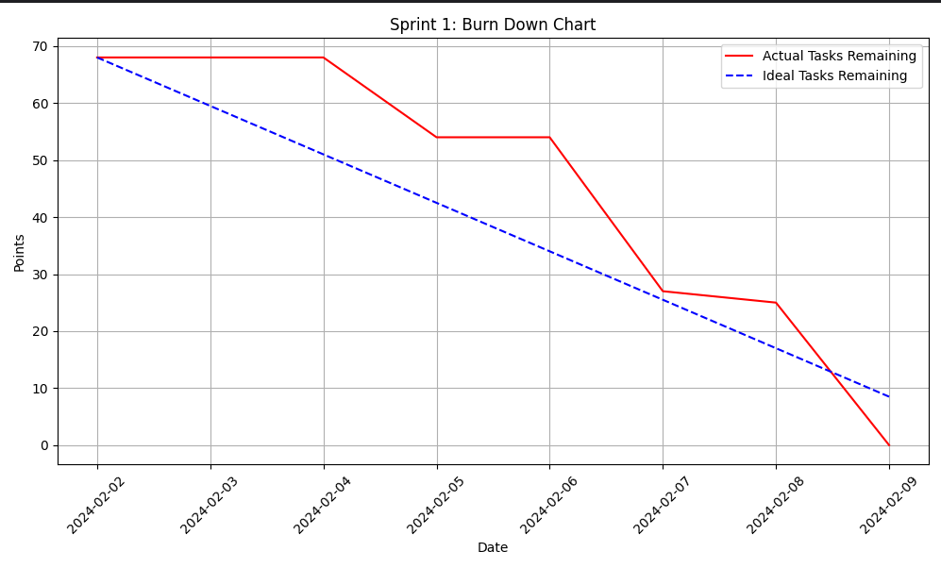
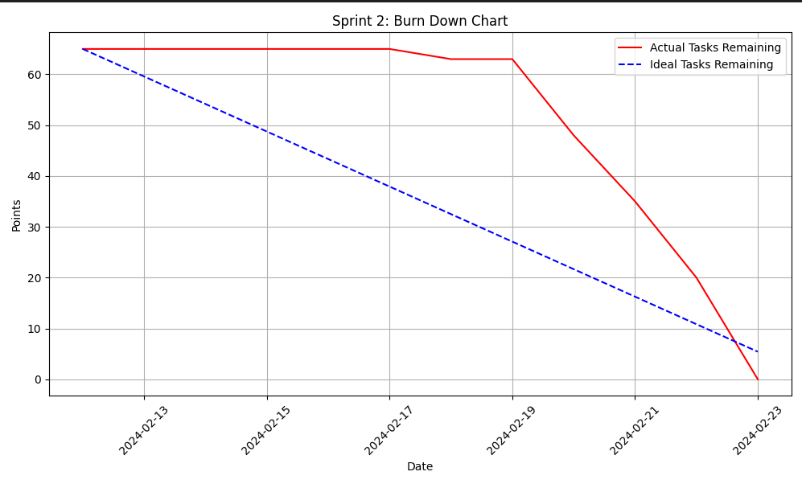
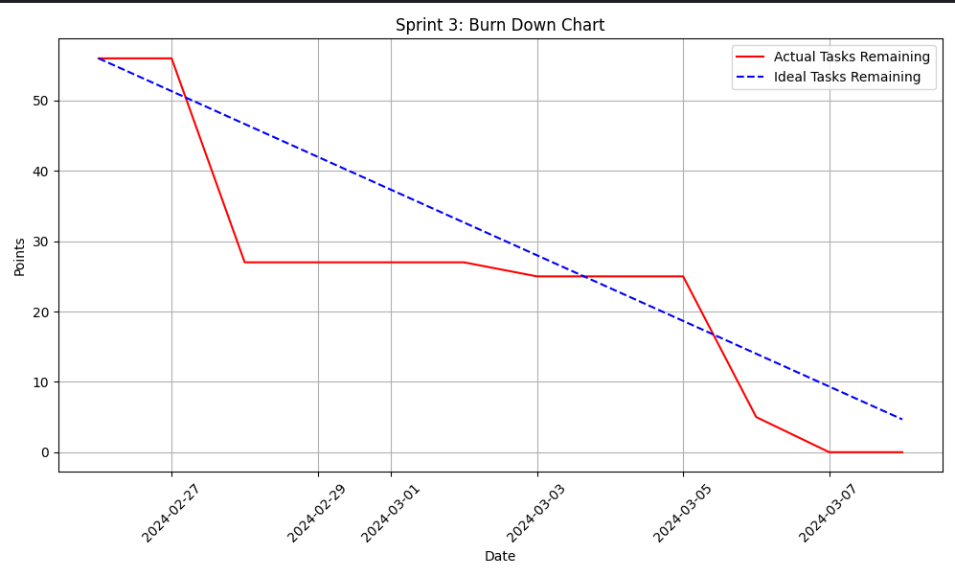
Moving Towards Better Efficiency and Progress

Slide 7
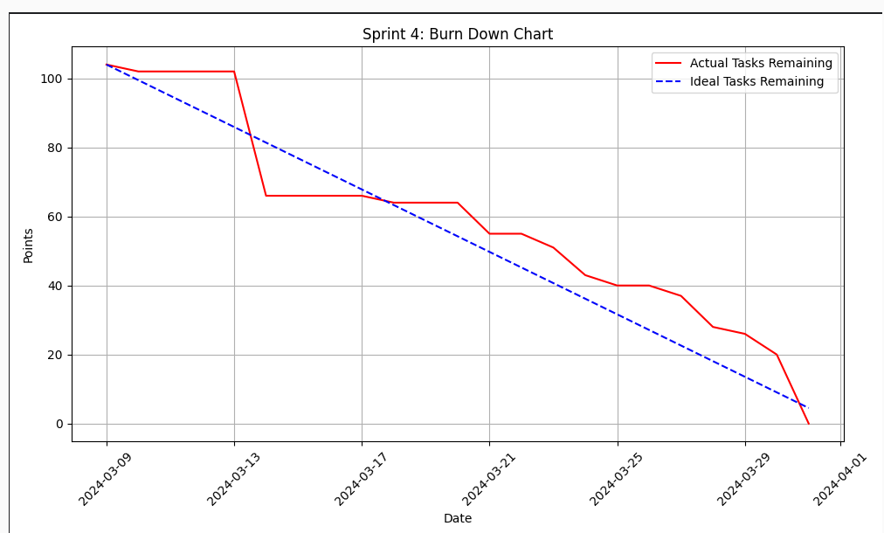
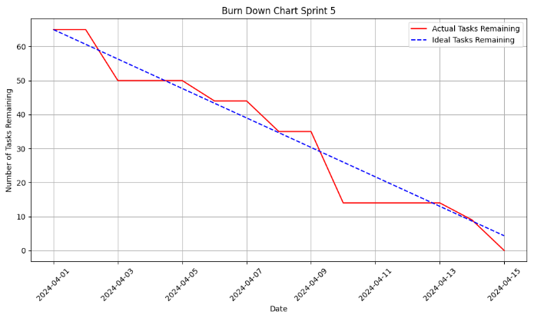
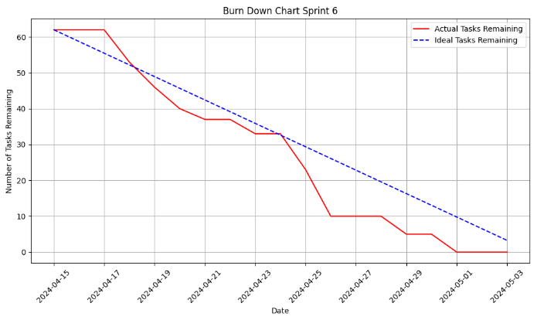

Slide 8
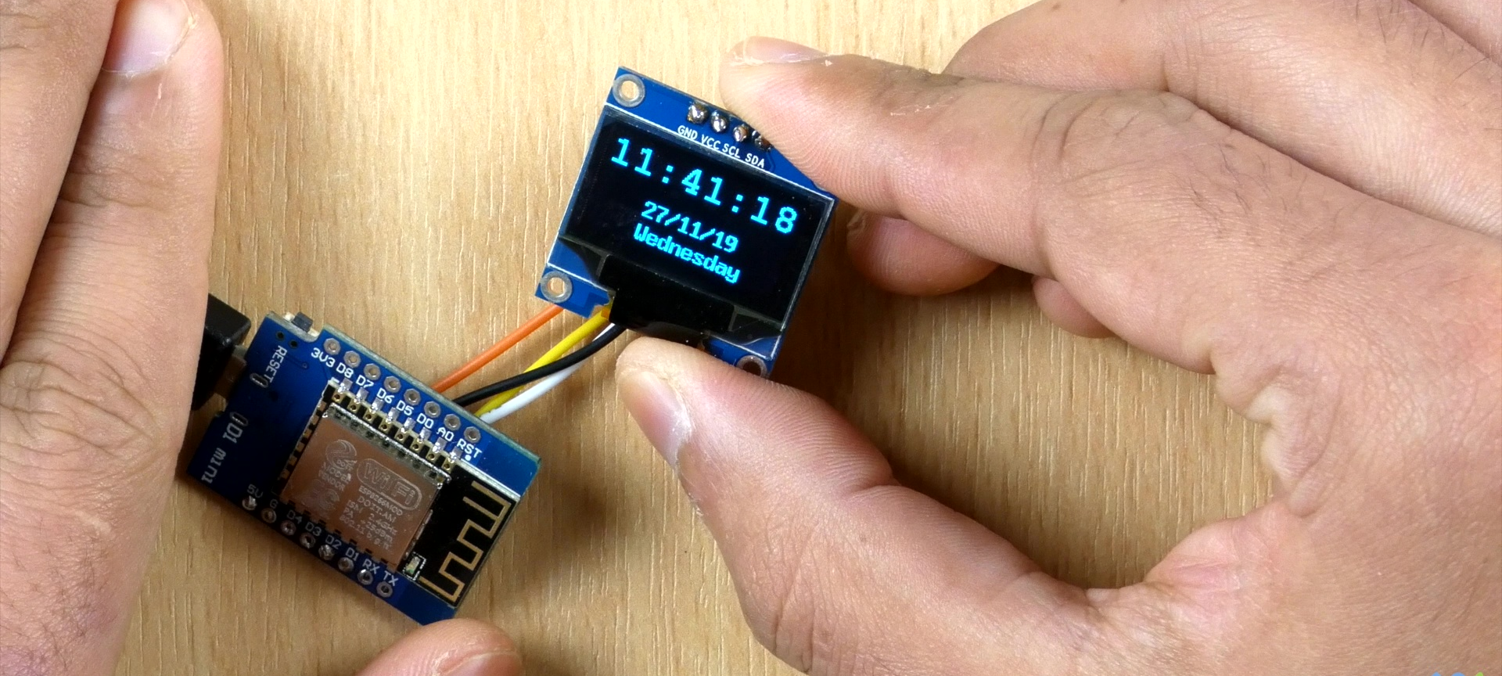
Product Demonstration
This Photo by Unknown Author is licensed under CC BY-SA
Notes:
Put an actual video here of the product

Slide 9
Live Demo

Slide 10
Slow and Steady Wins the Race
GitHub Projects
Detailed Issues (Features/Bugs)
CI/CD
Detailed Commits

Slide 11
Slow and Steady Wins the Race
GitHub Projects
Detailed Issues (Features/Bugs)
CI/CD
Detailed Commits

Slide 12
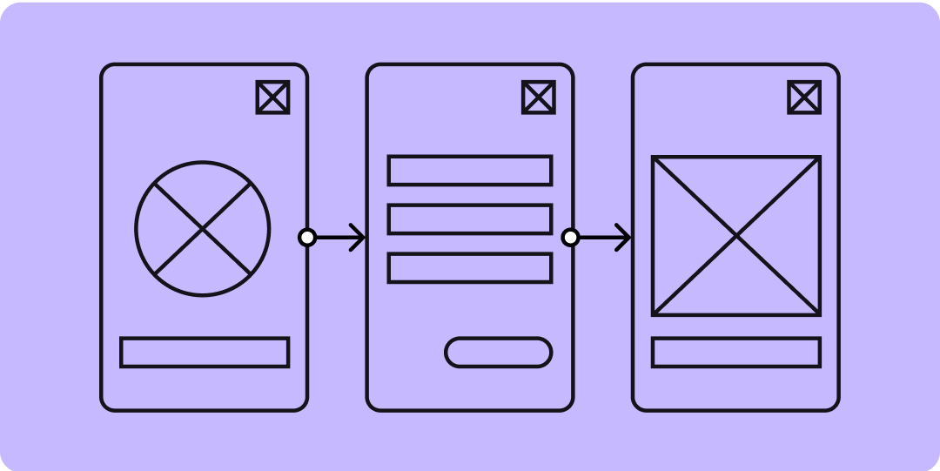


Areas for improvement
Notes:
Will talk about how our productivity could always be better, reference to burndown charts that may not have been the best from a sprint to another, while we did find a consistency, would have been better to find it earlier.
Do Lo-fi diagram as we found out that we would talk about the same thing but with a different visualization that sometime slows use down later down the pipeline
Finally gather more user feedback as to how the app looks to them. While css and html are something we can easily improve, continuously gather feedback and making css improvement every other sprint rather than a huge turn over towards the end.

Slide 13
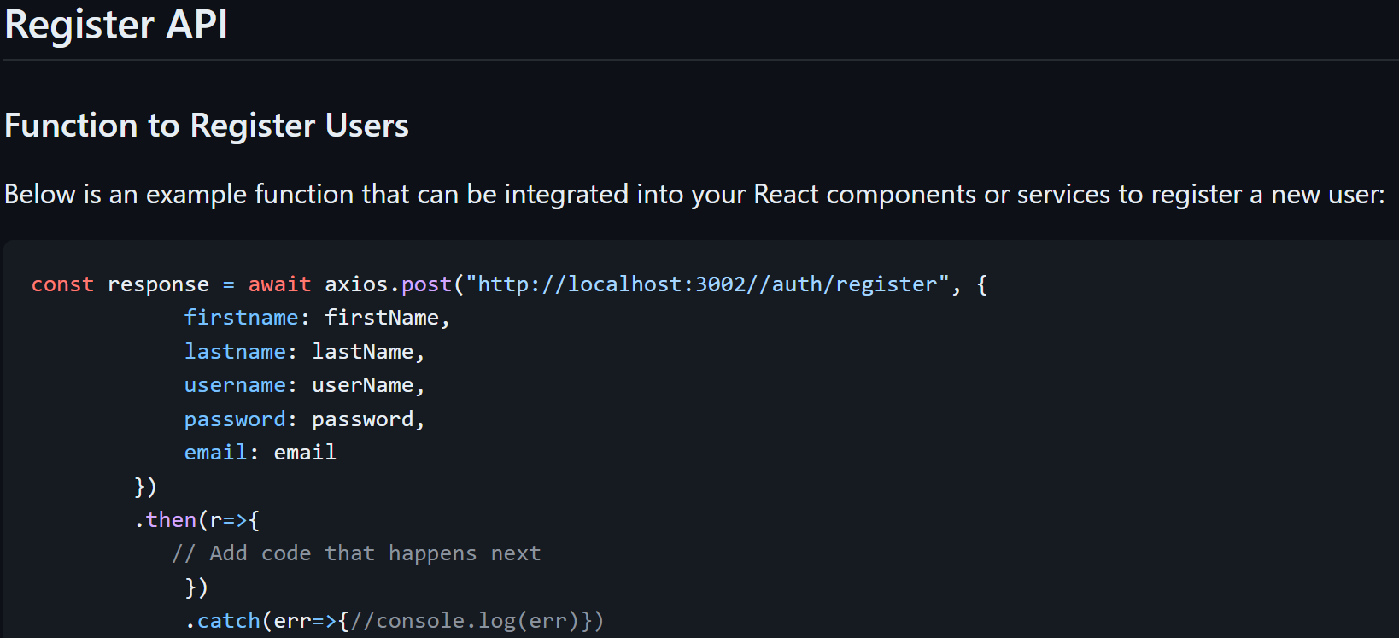
Strengths: Successful Teamwork
Team Composition
Adnane: Lead Web Developer
Ben: Lead Mobile Developer
Joslin: Lead Extension Backend Developer and Project Manager
Team Collaboration
Utilized frequent meetings to ensure alignment
Designated "project captains" for coordination
Communication
Emphasized active communication among team members
Encouraged open critique to improve performance
Project Integration
Required effective communication to ensure compatibility between different projects
Ensured seamless integration of web, mobile, and backend components
Documentation
Maintained good developer documentation on a wiki platform
Facilitated understanding and collaboration across the team

Slide 14
It’s Not a Bug It’s a Feature
Fail Quick & Fail Often
Testing is King
Disagreements are OK
Working Feature > Cool Feature
Your Ideas Are Not Always the Best

Slide 15
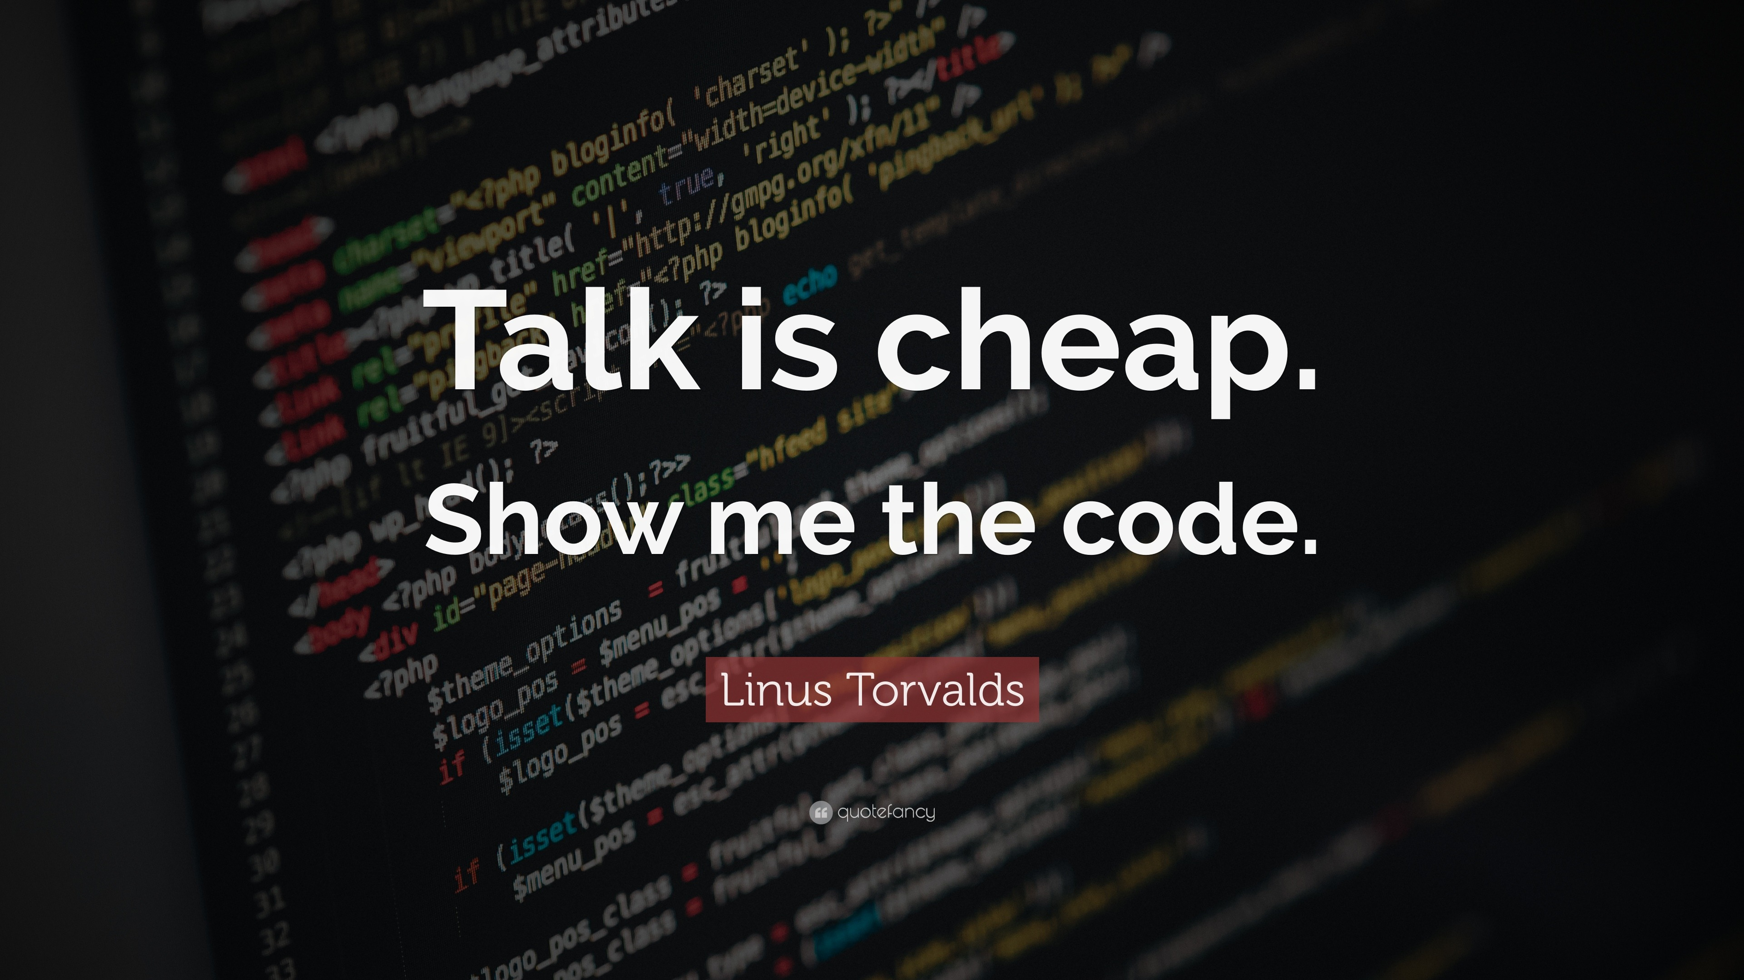
Notes:
Linus Torvald is the creator and lead developer of the Linux kernel. He also created the distributed version control system Git.
- Be careful of throw-away statements (MONGO DB) = Dont say more versatile
-

