Slide 1
002_Image_Pro
Zach, Audrey, Michal, Ivan

Slide 2
Overview and Accomplishments
Maintained and extended an existing application to fit our needs
Enhanced our Docker skills
Learned two completely new deployment strategies
AWS (EKS)
Kubernetes/Minikube
Able to identify areas of improvement and turn into actions
Whole team willing to be flexible, learn new processes, and help out where needed

Slide 3
Skill Showcase
Zach
- Analyzing, documenting, and training of backend and database operations
- Flexible and assist development on a wide range of areas (Docker, AWS, Kube)
Audrey
- Organization and documentation of meetings
- Go-to member for frontend, database redesign, dev experience with Docker, Kube, AWS
Ivan
- Medical Imaging Domain and Docker expert
- Project Manager / Customer liaison
Michal
- Deep Learning expert
- Kubernetes Lead

Slide 4
Communication
SCRUM Meetings
3 times per week
Working Meetings
Scheduled as necessary with agendas
IPM Meetings
Retrospectives

Slide 5
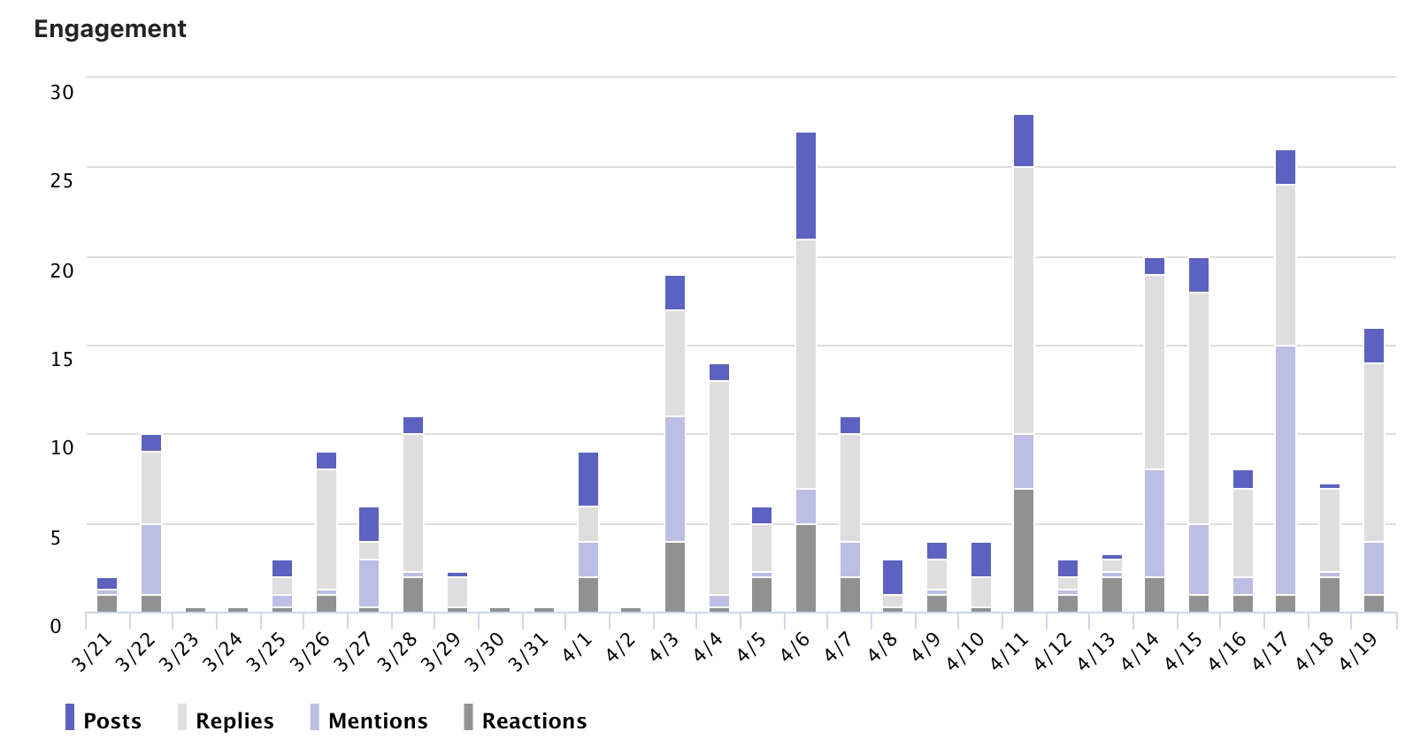
Extensive Usage of Teams in Sprints 4 and 5

Slide 6
Retrospection
Things that worked...
Extended sprint
Pair programming
Things that could be improved...
Documentation of what we tried vs didn't try development would go a lot faster
User manual
Smaller issue creation
Plans for improvement...
New wiki pages for our manual
Communicate in teams

Slide 7
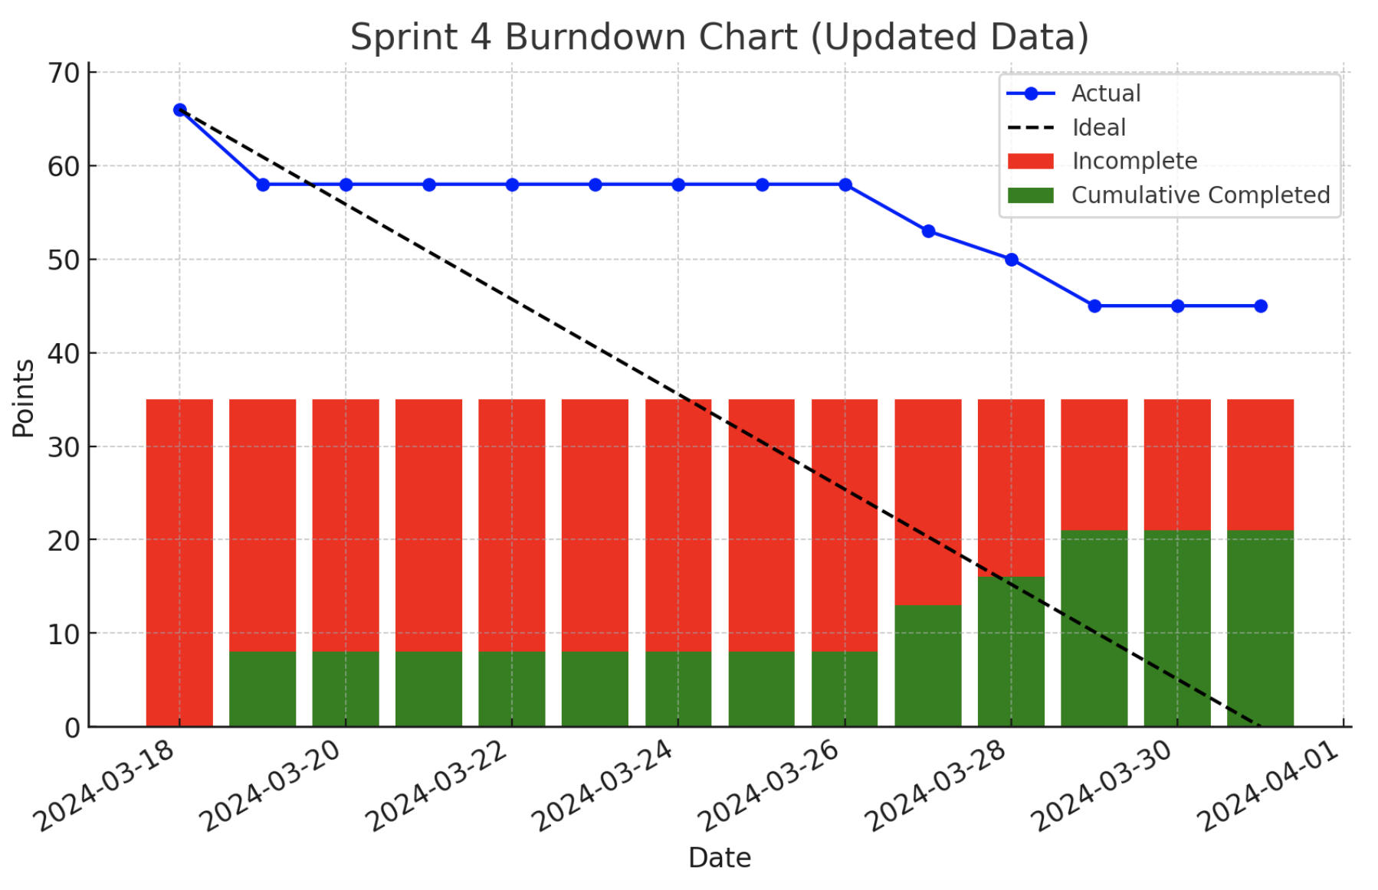
Burndowns – Sprint 4

Slide 8
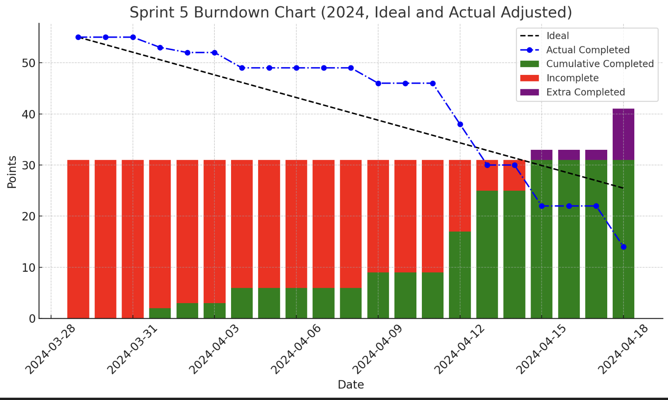
Burndowns – Sprint 5

Slide 9
Standards
Naming conventions
Branches and PRs – prefixed with issue number
Commits – TYPE: message
Templates for issues
User, Bug, Feature, Chore, Documentation
Tools and versions listed
easier debugging if we all use the same
Inline documentation
Docstrings
Notes:
We use github to document our coding standards to be followed by the development team. We have specified naming conventions for issues, branches, PRs, commits that make it easy to read and review these different items. We use templates for issues and PRs to expedite creation and homogenize items for easier review. We list development tools and versions to ensure that there are no differences between development devices. Inline documentation is mandatory as robust comments make understanding and modifying code much easier. We spend more time reading code than writing!

Slide 10
Planning
User stories that capture key functionality are created in advance
More detailed Feature Request issues are created that describe technical components to be added
Issues are labeled and estimated appropriately
During sprint planning meeting, issues are assigned to developer and milestone if needed and moved to Github Projects to be tracked
Diagrams are created and tracked on wiki prior to development
Consistent team meetings to ensure we are on track and reallocate development resources

Slide 11
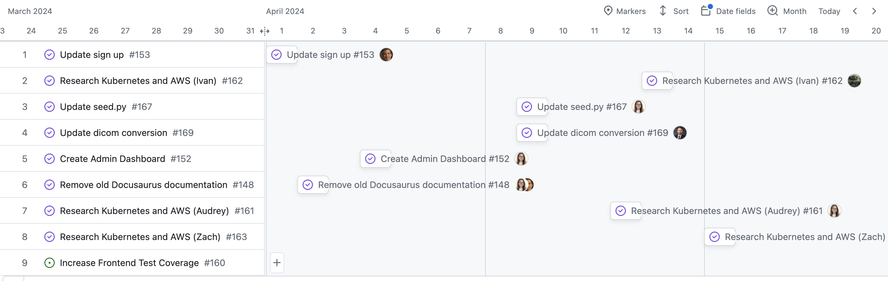
Tracking
Github Projects used to track progress of each sprint

Slide 12
Testing
TDD and unit testing/coverage through jest and pytest
Integration testing through jest, pytest, and cypress
Acceptance testing and manual testing done by product owners, documented on wiki
Github Actions workflows run all tests on each branch and PR
For sprint 6 we are planning on getting our frontend coverage above 80%

Slide 13
Source Code Management
Main branch protection rules
Linear History
PR before merge
Status Checks
No force pushes
Pre-commit hook
Detects errors and allows for fixing before committing
Proactive instead of reactive

Slide 14
Questions and Comments?

