Slide 1
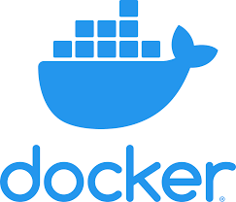
Docker
Zach Morris

Slide 2
'It Doesn't Work on My Machine'
Different Configurations
Missing Tools
Hardware Dependencies

Slide 3
Solution: Docker
Allows packaging of apps into isolated environments - images
Containers can be run on any device that can run Docker
Contain all dependencies for running app: code, runtime, system tools, settings …
Lightweight, isolated, portable, scalable

Slide 4
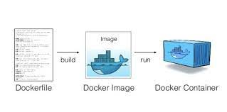
Docker Anatomy

Slide 5
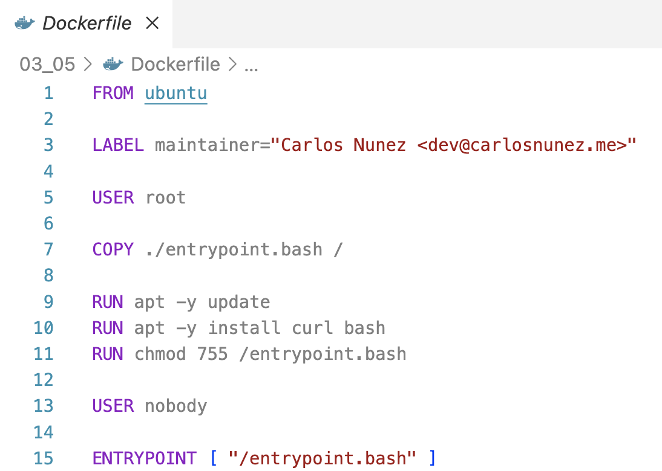
Docker Anatomy: Dockerfile

Slide 6
Creating an Image

Slide 7
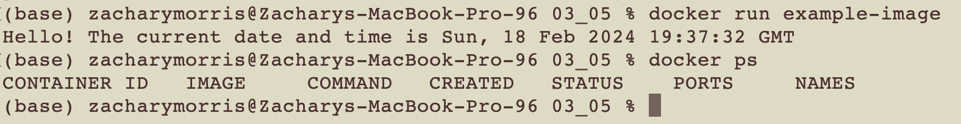
Running a Container

Slide 8
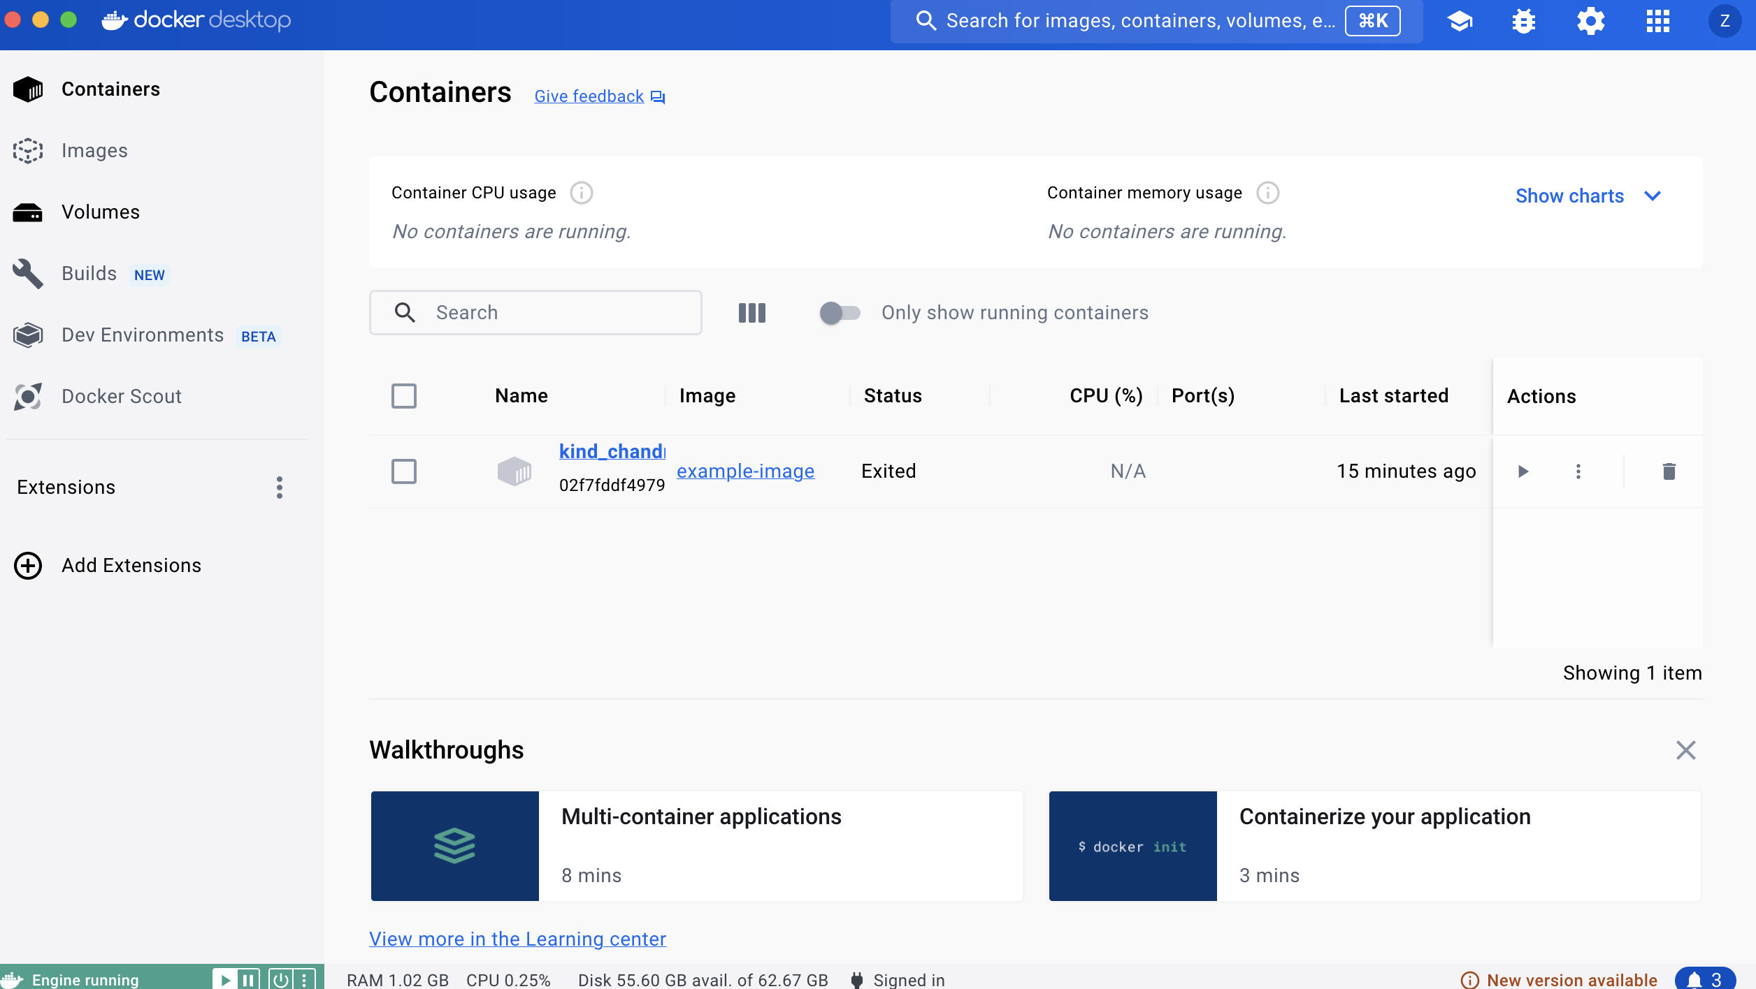

Docker Desktop and DockerHub

Slide 9


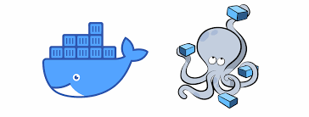
Advanced Tools

Slide 10
The End!
Questions?
Comments?
Critiques?
Roasts?
Resource will be posted in Teams!

