Slide 1
002_Image_Pro
Zach, Audrey, Michal, Ivan

Slide 2
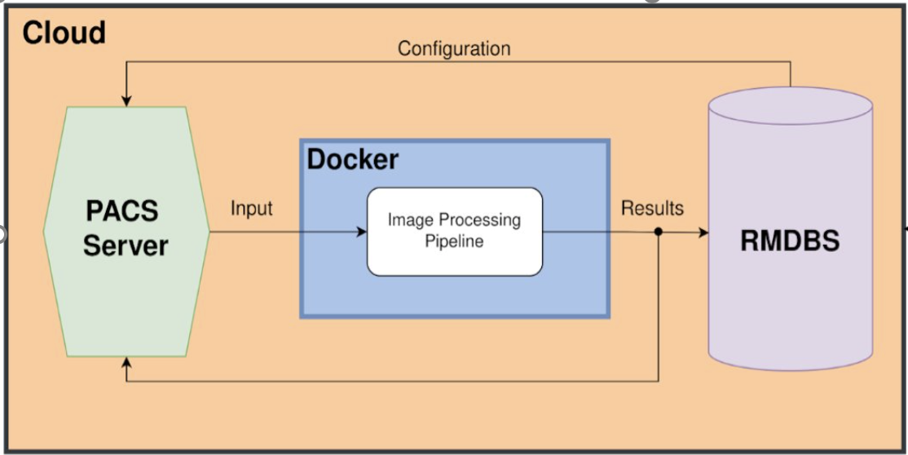
System Overview
Job monitoring App
Frontend
Backend
Hospital 1
Enterprise system
Hospital 2

Slide 3
Demo
mvp

Slide 4
Standards
Naming conventions
Branches and PRs – prefixed with issue number
Commits – TYPE: message
i.e. ADD: unit test for function
Templates for issues
User, Bug, Feature, Chore, Documentation
Tools and versions listed
easier debugging if we all use the same
Inline documentation
Docstrings
Notes:
We use github to document our coding standards to be followed by the development team. We have specified naming conventions for issues, branches, PRs, commits that make it easy to read and review these different items. We use templates for issues and PRs to expedite creation and homogenize items for easier review. We list development tools and versions to ensure that there are no differences between development devices. Inline documentation is mandatory as robust comments make understanding and modifying code much easier. We spend more time reading code than writing!

Slide 5
Communication
SCRUM Meetings
3 times per week
Working Meetings
Scheduled as necessary with agendas
Usually debugging, community programming sessions, and knowledge sharing

Slide 6
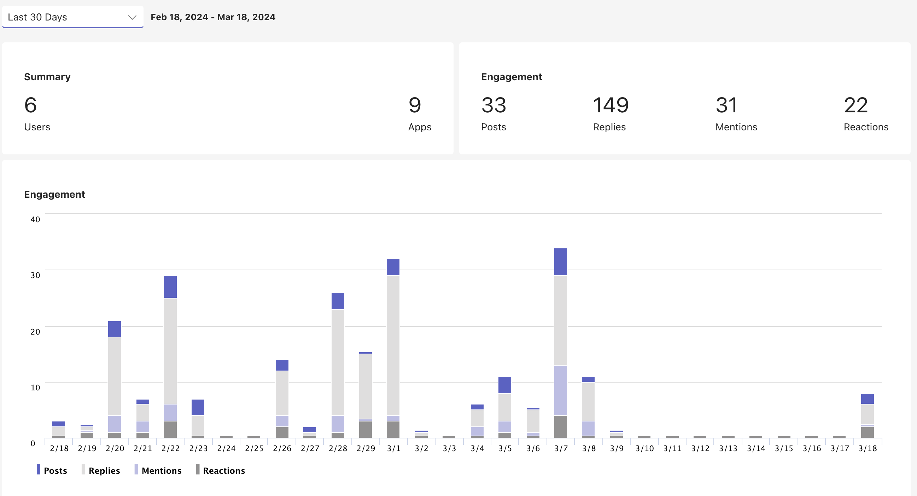
Extensive Usage of Teams
This doesn't show the calls which occur ~2-3 times per week

Slide 7
Planning
User stories that capture key functionality are created in advance
More detailed Feature Request issues are created that describe technical components to be added
Issues are labeled and estimated appropriately
During sprint planning meeting, issues are assigned to developer and milestone if needed and moved to Github Projects to be tracked
Diagrams are created and tracked on wiki prior to development

Slide 8
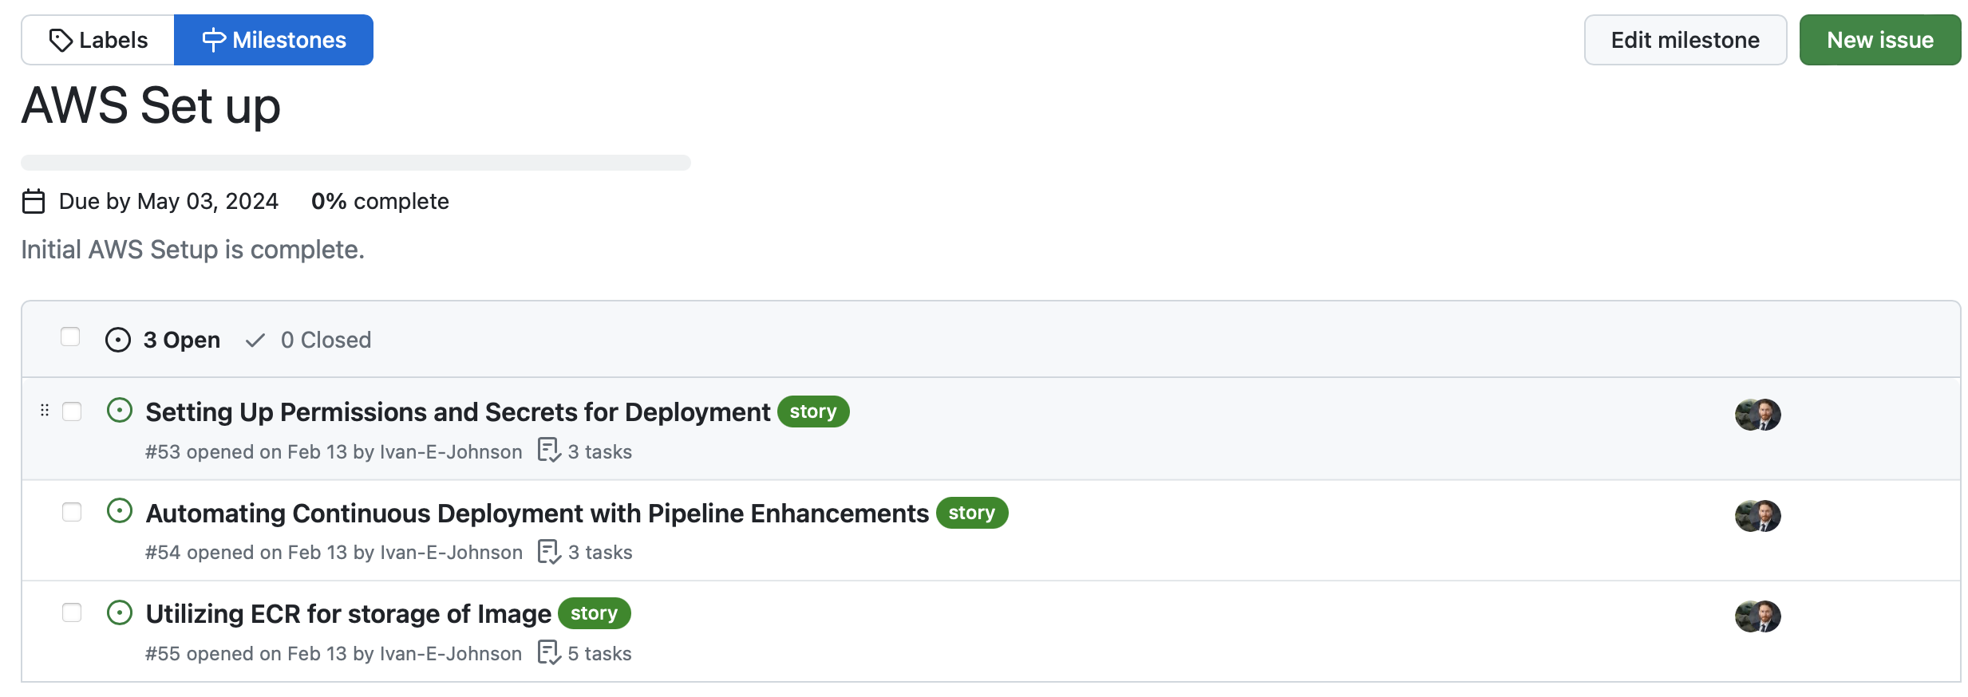
Tracking
Main objectives are created for each sprint as milestones, each containing issues to complete that milestone
Issues from the backlog are added to the appropriate milestone and moved into the github project for tracking
Notes:
How do we decide how many points to add to each sprint?

Slide 9
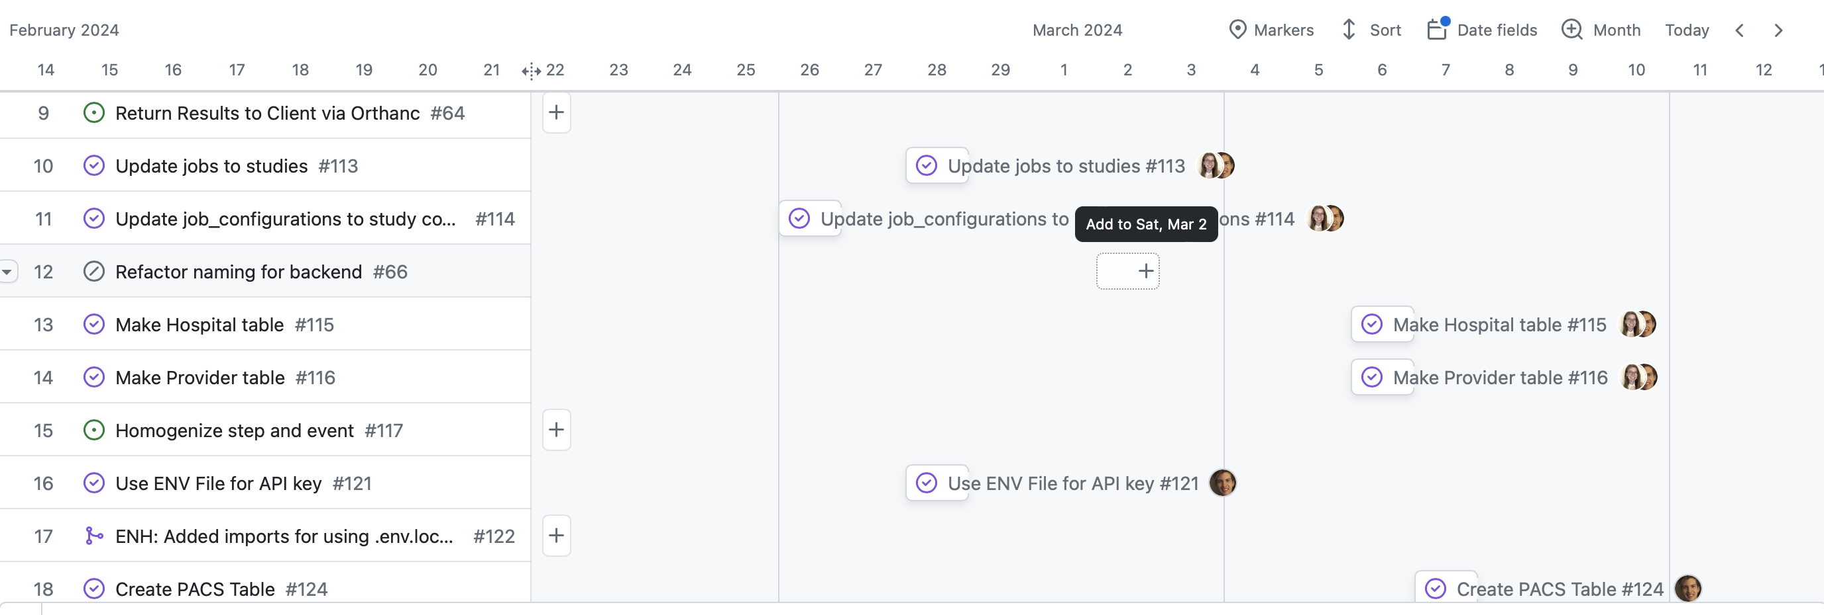
Tracking
Github Projects used to track progress of each sprint
Dates are tracked for progress and estimating

Slide 10
Testing
TDD and unit testing/coverage through jest and pytest
Integration testing through jest, pytest, and cypress
Acceptance testing and manual testing done by product owners, documented on wiki
Github Actions workflows run all tests on each branch and PR

Slide 11
Dockerized Full-Stack Testing Strategy
Manual End-to-End Testing and Linting
Environment Setup: Use Docker Compose to mimic production.
Track all Manual test in our wiki
Hedolint - linter for Dockerfiles
Multistage Building
Add testing stage to the build process
Can only proceed with build if the testing stage passes
Pumba
Can artificially introduce adverse network conditions (packet loss, latency, etc)
Test robustness of Docker containers
Docker Bench
Automated tool for checking Docker containers against security benchmarks

Slide 12
Source Code Management
Main branch protection rules
Linear History
PR before merge
Status Checks
No force pushes
Pre-commit hook
Detects errors and allows for fixing before committing
Proactive instead of reactive

Slide 13
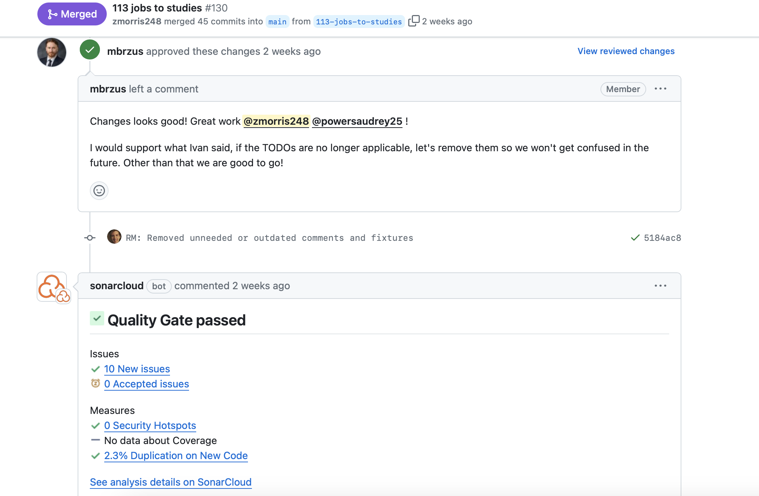
Code Reviews and Pull Requests
Github Actions workflows and SonarCloud must pass for each PR
PRs are reviewed and tested by each developer
At least one approval by a different developer is needed to merge
PR comments used to clarify new code and communicate issues or bugs found

Slide 14
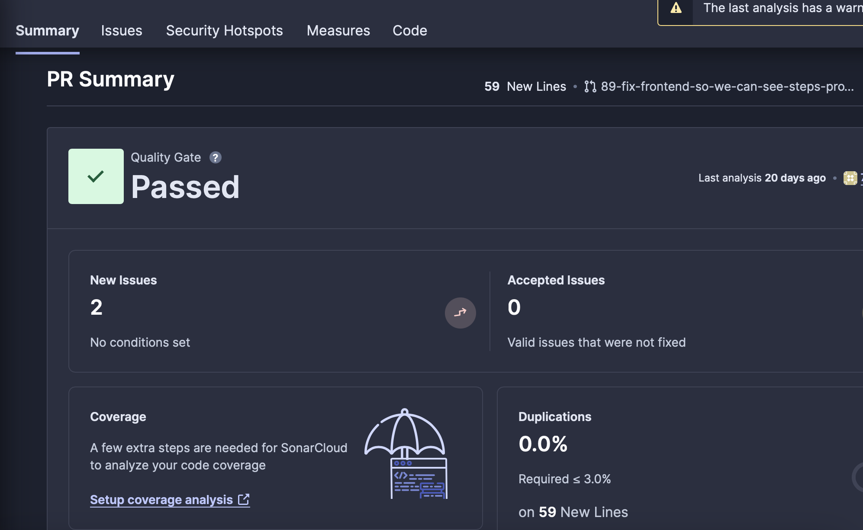
SonarCloud
Static analysis tool that is executed along with Github Actions workflows on each branch and PR
Provides insight into duplicated code, security risks, code smells
Allows for early bug detection and improved code quality

Slide 15
Retrospection
Things that worked...
More documentation allowed for better understanding of old code
Effective community programming sessions
Things that could be improved...
Better timeboxing of issues
Less generic templates
Plans for improvement...
Agendas for working meetings
More research on AWS

Slide 16
Notable Improvements
Schema changes required better processes
Incremental
Small commits
Planning phase
More designs and visuals
Documentation
More inline documentation
Better descriptions on wiki

Slide 17
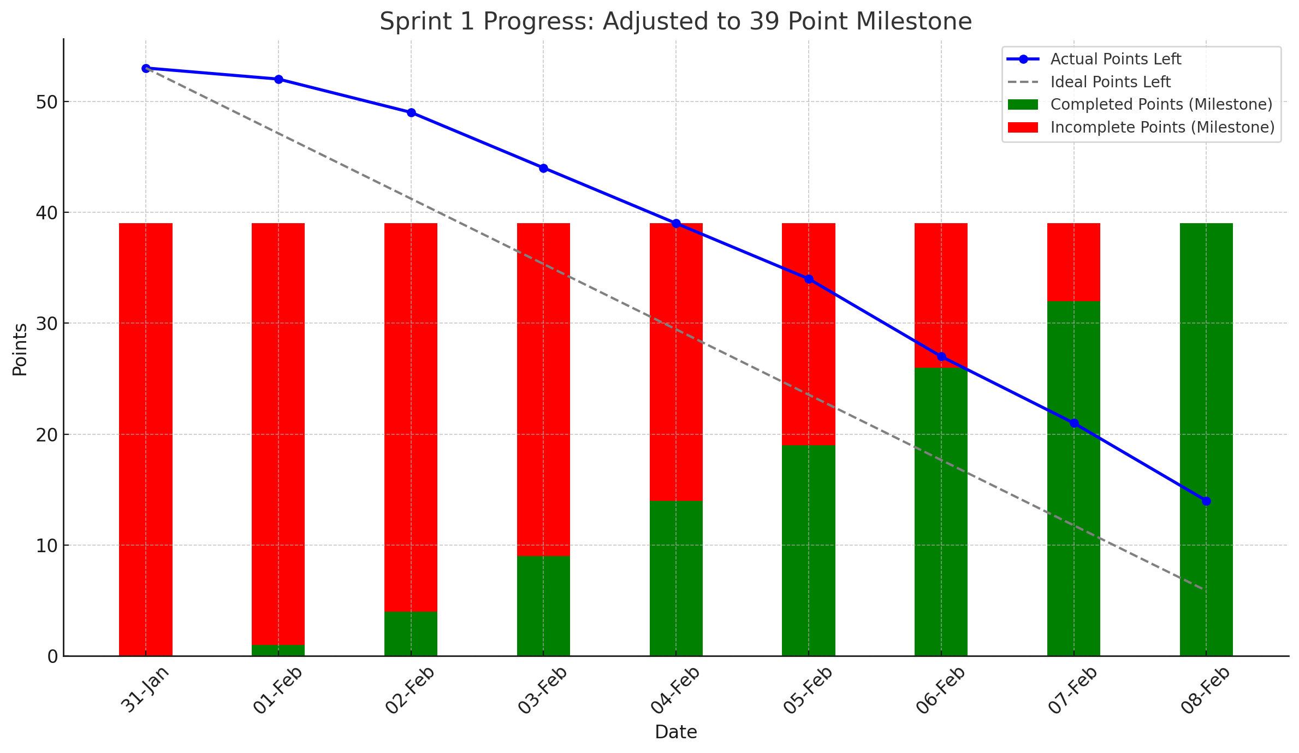
Burndowns – Sprint 1

Slide 18
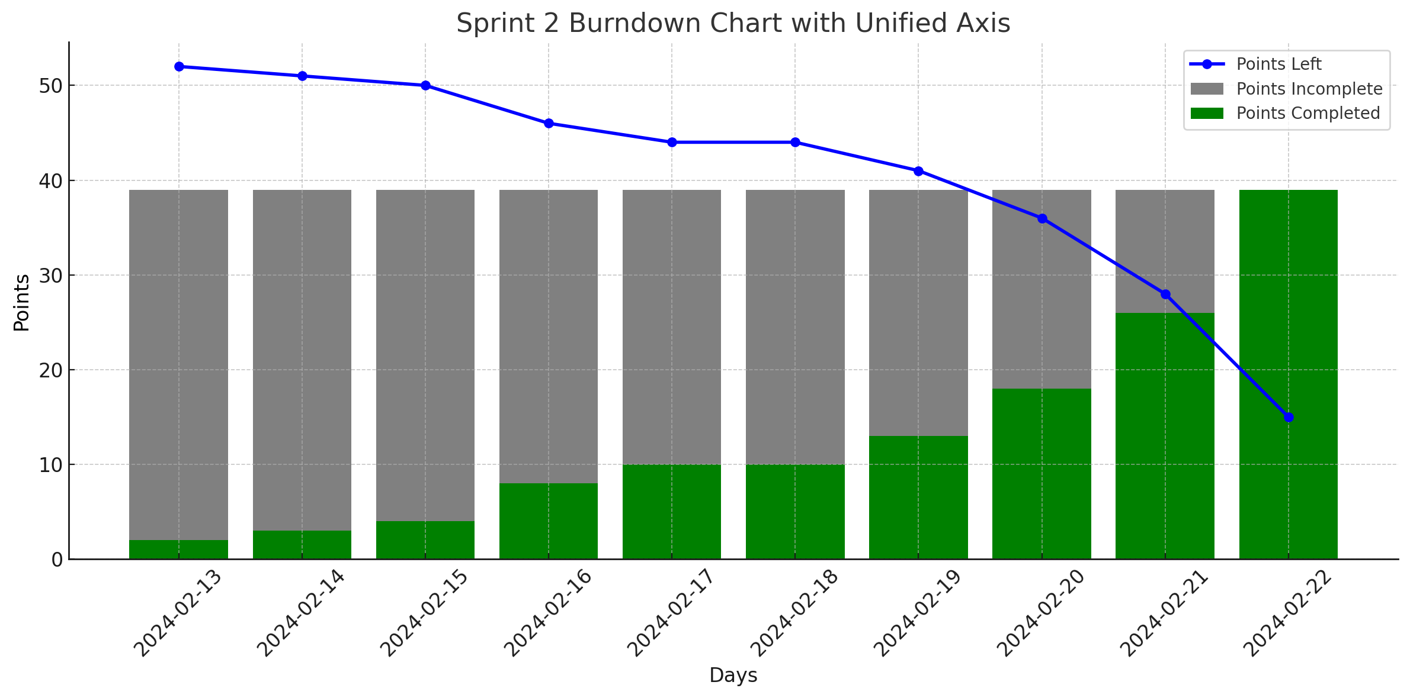
Burndowns – Sprint 2

Slide 19
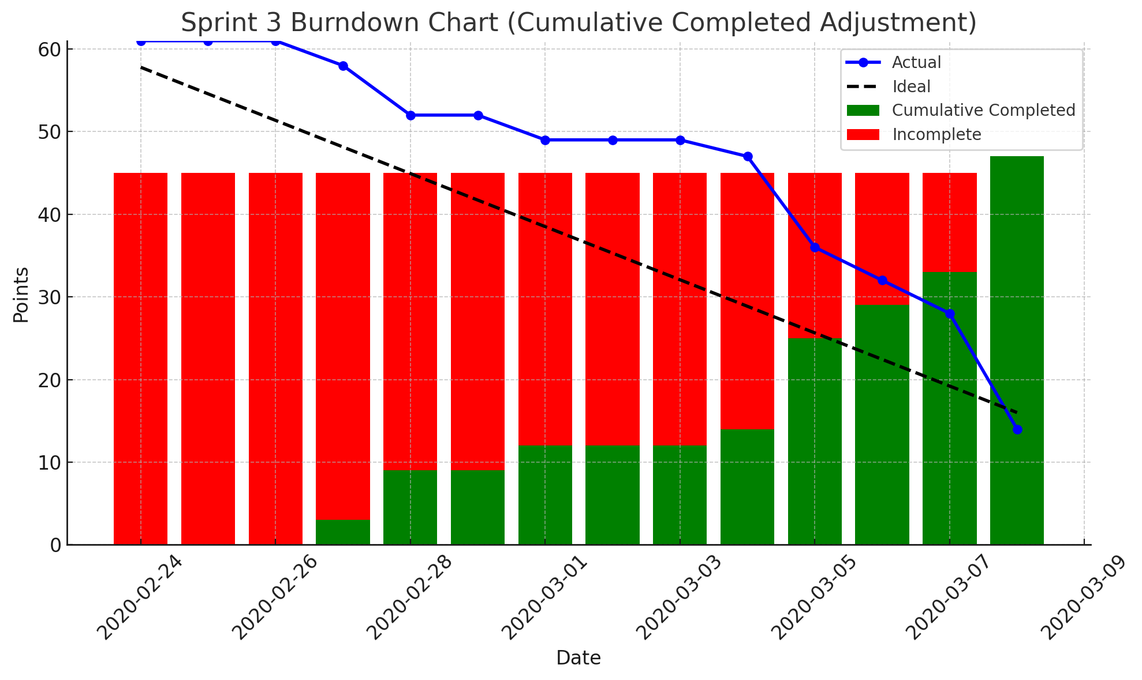
Burndowns – Sprint 3

Slide 20
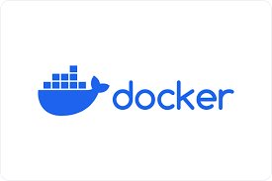
Future work: Phase 1
Orchestrated Docker Compose Network
All run same environment as production
Self-contained, secure environment and networking
Helps facilitate manual testing
Holistic environment
Increases security and protects company Intellectual Property

Slide 21

Future work: Phase 2
Deploy to ECS (AWS elastic container service)
Intermediary stage between what we have and Amazon ECK
Simpler to use than the ECK, allows us to get our Dockers deployed to production environment
Costs are associated with resources used

Slide 22

Future work: Phase 3
Deploy to ECK (AWS kubernetes)
Fully automated scalability through kubernetes system:
Providers product instances spin up according to incoming studies.
Efficiency in resource utilization
Stable performance through automatic adjustment to incoming load
Constant container health monitoring

Slide 23
Future work: Phase 4
Extended System Functionality and Features
Introduce:
Automated billing for providers and hospitals
Permission dependent schemas and frontend views
Detailed steps and analytics for provider users

Slide 24
Questions and Comments?

