Slide 1
Clean Code
A Handbook of Agile Software Craftsmanship

Slide 2
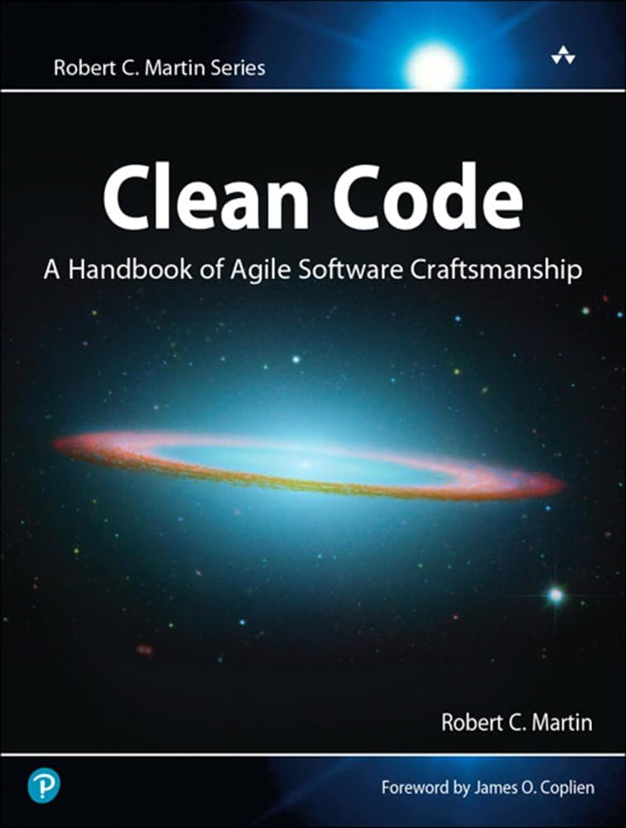
What is Clean Code?
Written by “Uncle” Bob with help from many renowned engineers.
Software Engineer since 1970’s
Help from inventor of C++ and one of the inventors of eXtreme Programming
Divided into three parts:
The principles, patterns, and practices of writing clean code.
Several case studies of increasing complexity.
A list of heuristics and “smells” gathered while creating the case studies.

Slide 3
What is Clean Code?
“Clean code always looks like it was written by someone who cares. There is nothing obvious that you can do to make it better. All of those things were thought about by the code’s author, and if you try to imagine improvements, you’re led back to where you are, sitting in appreciation of the code someone left for you—code left by someone who cares deeply about the craft.”
Michael Feathers, author of Working Effectively with Legacy Code

Slide 4
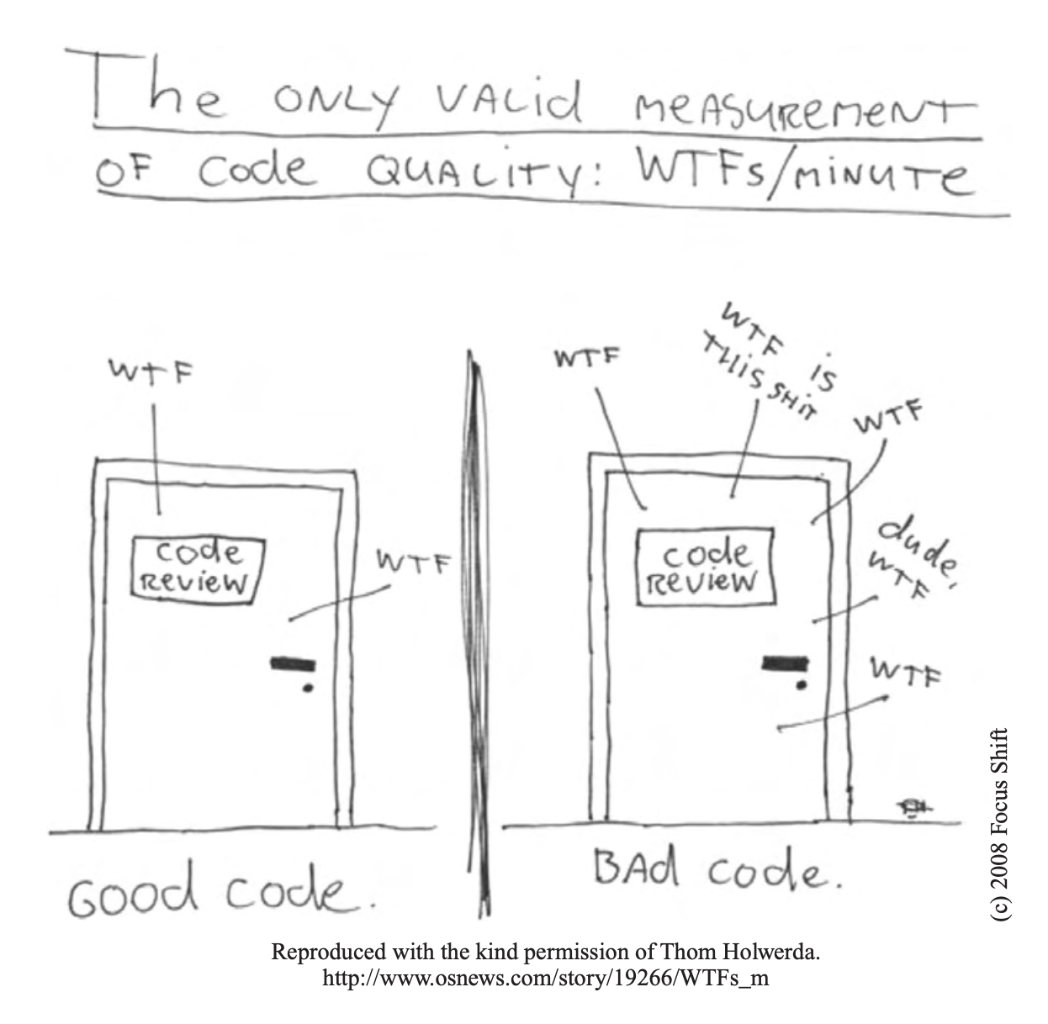
Why is clean code important?
Because we spend much more time reading code than actually writing.
Because the total cost of owning a mess can be expensive in time and money.
Because messy code will only slow you down in the long-run.

Slide 5
My favorite principles
(That are relevant to this class.)

Slide 6
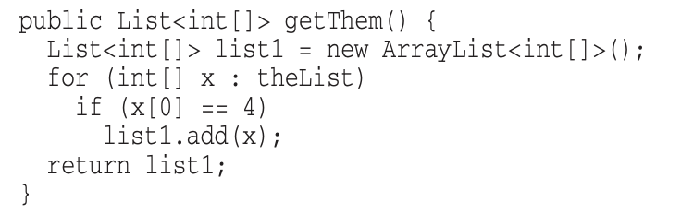
Meaningful names
Names should reveal intention and avoid disinformation

Slide 7
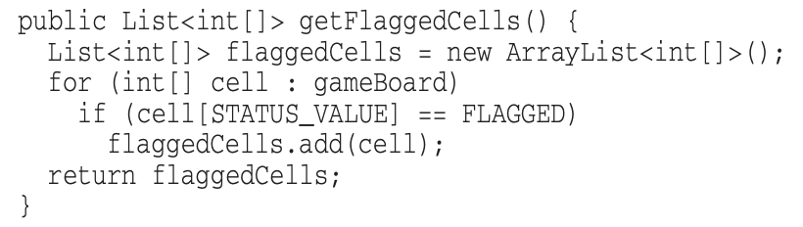
Meaningful names
Names should reveal intention and avoid disinformation

Slide 8
Meaningful names
Avoid the need for mental mapping
“There can be no worse reason for using the name c than because a and b were already taken.”

Slide 9
Meaningful names
Avoid the need for mental mapping
“There can be no worse reason for using the name c than because a and b were already taken.”

Slide 10
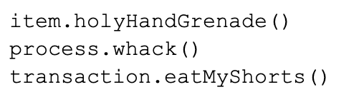
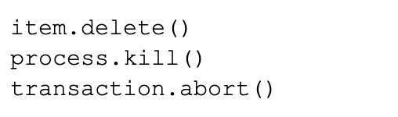
Meaningful names
Cute Clear
Don’t be cute

Slide 11
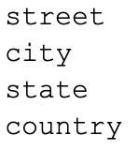
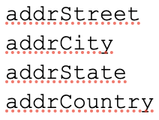
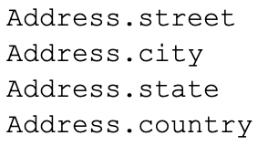
Meaningful names
Make sure variables have meaningful context
More context

Slide 12
The rules of functions
Functions should be small!
Functions should be smaller than that!
Functions should do only one thing and do it well.
A good check for this is whether you can divide your function into sections.

Slide 13
The rules of functions
4. “The ideal number of arguments for a function is zero, then one, followed closely by two. Three should be avoided. More than three requires very special justification—and then shouldn’t be used anyway.”
5. Avoid flag arguments!
6. No side effects!
7. Don’t care about the rules too much until your code works!

Slide 14
Good emergent design
Create good design as you work.
Opposite of deterministic or big plan up front design.
Good emergent design comes about from good, clean practices.

Slide 15
Good emergent design
Some keys to well designed systems:
Runs all tests.
Contains no duplication.
Expresses the intent of the programmer
Minimizes the number of classes and methods

Slide 16
Takeaways
Extremely dense book.
It’s like a book on painting. You’ll learn about painting, but it won’t immediately make you a good painter.
Case studies take a while to digest, but are interesting and will help you practice.
Java-focused, but no need to know Java.

Slide 17
Sources
The Clean Code book (duh)

