Slide 1


Slide 2
Download UL ShouldStop.exe from Git
Add UL Should Stop .nupkg from UiPath Marketplace
Demo

Slide 3
Download UL ShouldStop.exe from Git
Download UL SholdStop.exe from git using below url
https://github.com/uipathsudheer/ULShouldStop/blob/master/UL%20ShouldStop.exe

Slide 4
2. Add UL Should Stop .nupkg from UiPath Marketplace
Download .nupkg from Market Place using this url
https://connect.uipath.com/marketplace/components/cg2020-ul-assistant
Add Package to UiPath Studio

Slide 5
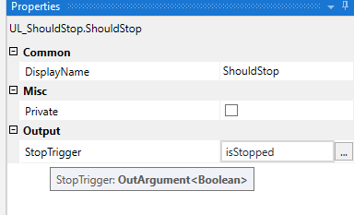

3. Demo

Slide 6
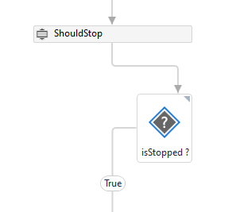
3. Demo
The Output of SholdStop activity is Boolean
You can use it in decision flow

Slide 7
Thanks
Sudheer Nimmagadda
Email: UiPath.Learner@gmail.com
https://www.youtube.com/uipathlearner

