Slide 1


ACCELERATING THROUGH

Slide 2
Quick Start
The Angular CLI is a command line interface tool that can create a project, add files, and perform a variety of ongoing development tasks such as testing, bundling, and deployment.

Slide 3
Step 1. Set up the Development Environment
You need to set up your development environment before you can do anything.
Install Node.js® and npm if they are not already on your machine.
Verify that you are running at least node 6.9.x and npm 3.x.x by running node -v and npm -v in a terminal/console window. Older versions produce errors, but newer versions are fine.
Then install the Angular CLI globally.
npm install -g @angular/cli

Slide 4
Step 2. Create a new project
Open a terminal window.
Generate a new project and skeleton application by running the following commands:
ng new my-app
Patience please. It takes time to set up a new project, most of it spent installing npm packages.

Slide 5
Step 3: Serve the application
Go to the project directory and launch the server.
cd my-app
ng serve --open
The ng serve command launches the server, watches your files, and rebuilds the app as you make changes to those files.
Using the --open (or just -o) option will automatically open your browser on http://localhost:4200/.

Slide 6

What Is Angular?
Angular is a framework for dynamic web applications.
Provides a way to organize your HTML, JavaScript, and CSS to keep your front-end code clean.
Released in 2011.
Mainly maintained by Google with the help of the open source community.

Slide 7
What Will This Course Cover?
Level 1
Our First Component
Level 2
Structural Directives, Pipes & Methods
Level 3
Data Binding
Level 4
Services & HTTP

Slide 8



What Do You Need to Know to Take This Course?
Basic JavaScript
You don’t need any prior experience with Angular 1
Basic HTML & CSS
Front-end Foundations & Front-end Formations
(optional)
JavaScript: ES2015
ES2015: The Shape of JavaScript to Come

Slide 9
What Is the Difference Between Angular 1 & 2?
Speed — Angular 2 is faster.
Components — Instead of controllers and scope, we use components, which feel simpler.
Simpler Directives — Creating custom directives is much simpler.
Intuitive Data Binding — When we need to link data to an HTML element or listen for a button clicking on the page, we have an intuitive syntax.
Services are now just a class.
Many more small improvements.

Slide 10
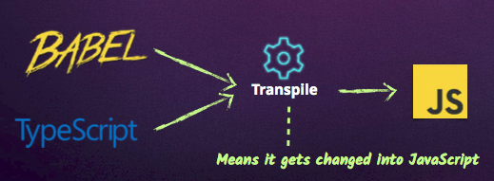
What Language to Use With Angular 2?
JavaScript
But all browsers don’t support the newest version of JavaScript.
There are ways to access these features:

Slide 11
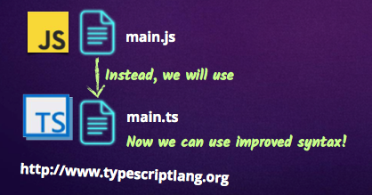
TypeScript: Our Language of Choice
TypeScript is Microsoft’s extension of JavaScript that allows the use of all ES2015 features and
adds powerful type checking and object-oriented features.
The Angular 2 source is programmed with TypeScript.

Slide 12
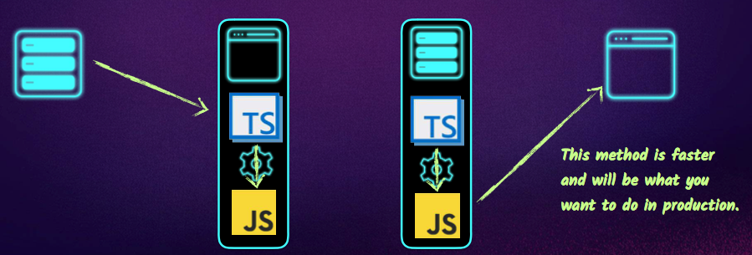
Transpiling Locations
Our browsers don’t know how to read TypeScript out of the box, so we have two options
when it comes to changing our TypeScript code into JavaScript.
Transpile to JavaScript in the browser
Transpile to JavaScript before shipping to browser

Slide 13
Writing Our First TypeScript File
Angular 2 library
Import
ES2015 feature used to import functions, objects, or primitives.
Component
Function we will use to create our first Component.
Components are the basic building blocks of Angular 2
applications. A component controls a portion of the screen.

Slide 14
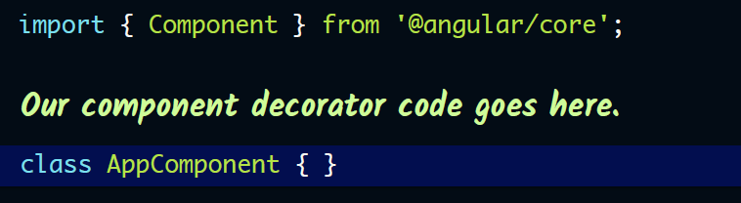
Component Is a Decorator Function
A decorator adds more behavior to our class from outside the class.
It must be declared immediately before the class.
The decorator turns our plain old JavaScript class into a component.

Slide 15
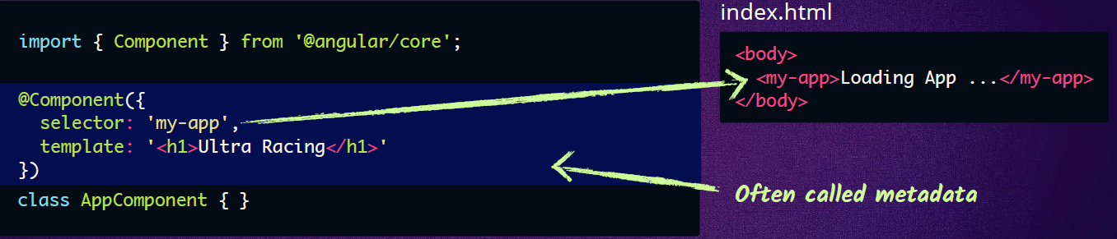
Decorating Our First Component
@Component
Used to apply our component decorator to our class.
Decorators are a TypeScript feature.
Selector
The CSS selector for the HTML element where we want the component
to load.
Template
The content we want to load inside our selector.

Slide 16
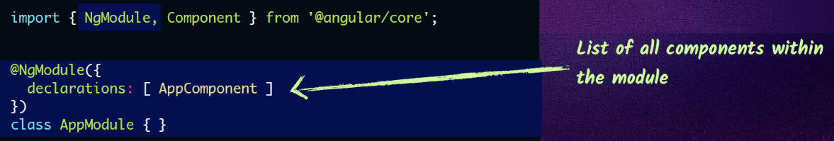
Declaring the Root Angular Module
Modules are how we organize our application in Angular. Every Angular application must
have a “root module,” which we’ll need to launch it.

Slide 17
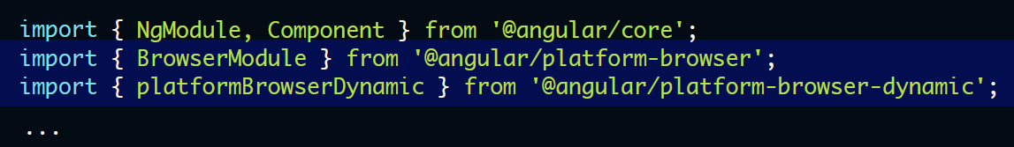
Dependencies to Render the Application
Selector
Module needed for running Angular websites.
platformBrowserDynamic
Angular library that platformBrowserDynamic will render the website.
This will allow us to bootstrap, or launch, the app.

Slide 18
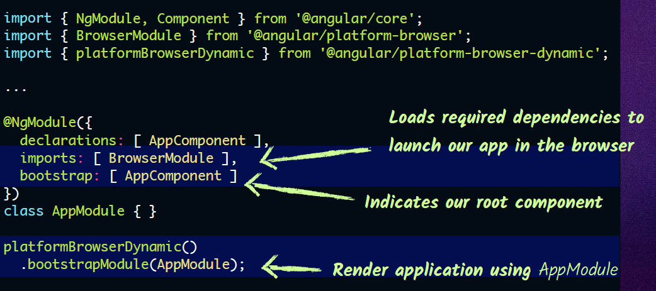
Bootstrapping Our Component
Using our new dependencies.

Slide 19
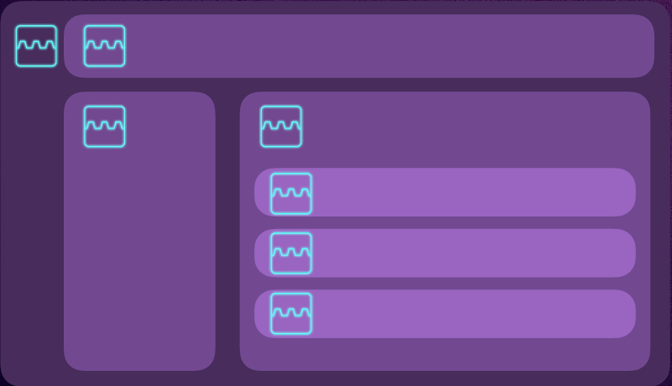
Our App Is Full of Components
Components are the building blocks of Angular 2 applications.
And they easily nest one inside the other.
Each component may have its own:
class file
html file
css file

Slide 20
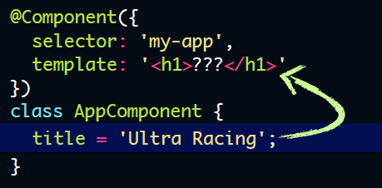
Sending Data Around
How do we send a property from our component class into our HTML?
Inside a TypeScript class, we don’t use the var or let
keywords to declare class properties.
Though we do in regular methods.

Slide 21
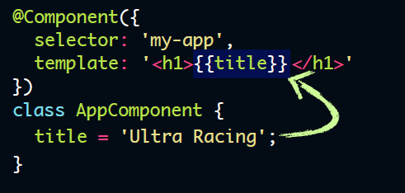
Using Interpolation to Print Properties
Curly braces allow us to load in component properties — this is called interpolation.

Slide 22
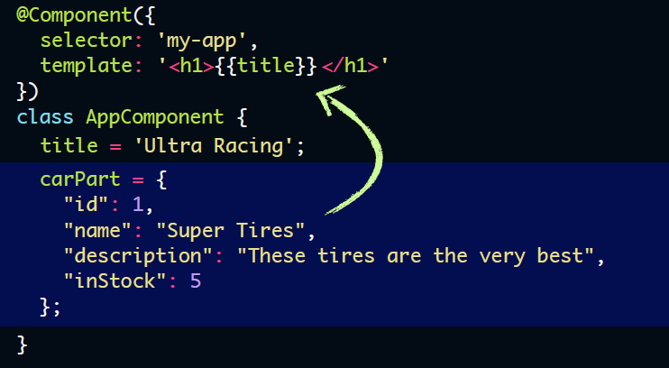
Loading an Object
What if we have an object we want to print out onto the screen?

Slide 23
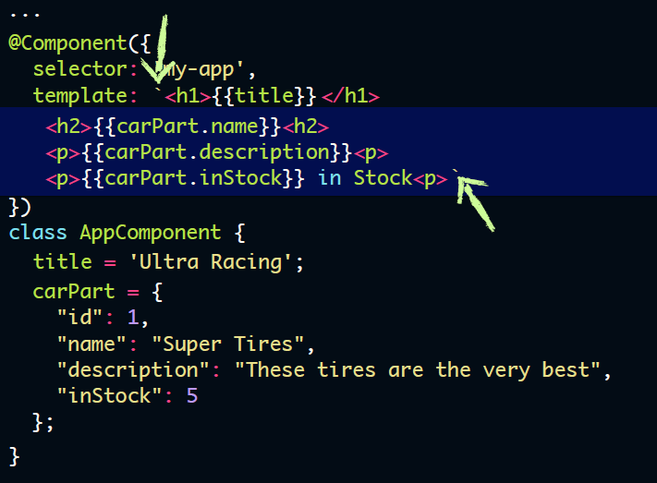
Template with Back Ticks
Our template now uses back ticks
instead of single quotes.
Single Quote
Back Tick
Using the back ticks allows us to
have template strings, which allows
us to be multiline.
This is another ES2015 feature.

Slide 24
What’d We Learn?
• Angular is a framework for dynamic web applications.
• We are coding Angular using TypeScript, a language that transpiles into JavaScript.
• NgModules group Angular code into blocks of functionality.
• Components are the basic building blocks of any Angular application.
• We use a custom HTML tag (aka, selector) to show where we want our component to load
inside our HTML.
• Decorators are what turn our plain TypeScript classes into Components.

