Slide 1


ACCELERATING THROUGH

Slide 2
Quick Start
The Angular CLI is a command line interface tool that can create a project, add files, and perform a variety of ongoing development tasks such as testing, bundling, and deployment.

Slide 3
Step 1. Set up the Development Environment
You need to set up your development environment before you can do anything.
Install Node.js® and npm if they are not already on your machine.
Verify that you are running at least node 6.9.x and npm 3.x.x by running node -v and npm -v in a terminal/console window. Older versions produce errors, but newer versions are fine.
Then install the Angular CLI globally.
npm install -g @angular/cli

Slide 4
Step 2. Create a new project
Open a terminal window.
Generate a new project and skeleton application by running the following commands:
ng new my-app
Patience please. It takes time to set up a new project, most of it spent installing npm packages.

Slide 5
Step 3: Serve the application
Go to the project directory and launch the server.
cd my-app
ng serve --open
The ng serve command launches the server, watches your files, and rebuilds the app as you make changes to those files.
Using the --open (or just -o) option will automatically open your browser on http://localhost:4200/.

Slide 6

What Is Angular?
Angular is a framework for dynamic web applications.
Provides a way to organize your HTML, JavaScript, and CSS to keep your front-end code clean.
Released in 2011.
Mainly maintained by Google with the help of the open source community.

Slide 7
What Will This Course Cover?
Level 1
Our First Component
Level 2
Structural Directives, Pipes & Methods
Level 3
Data Binding
Level 4
Services & HTTP

Slide 8



What Do You Need to Know to Take This Course?
Basic JavaScript
You don’t need any prior experience with Angular 1
Basic HTML & CSS
Front-end Foundations & Front-end Formations
(optional)
JavaScript: ES2015
ES2015: The Shape of JavaScript to Come

Slide 9
What Is the Difference Between Angular 1 & 2?
Speed — Angular 2 is faster.
Components — Instead of controllers and scope, we use components, which feel simpler.
Simpler Directives — Creating custom directives is much simpler.
Intuitive Data Binding — When we need to link data to an HTML element or listen for a button clicking on the page, we have an intuitive syntax.
Services are now just a class.
Many more small improvements.

Slide 10
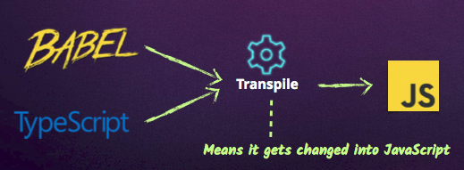
What Language to Use With Angular 2?
JavaScript
But all browsers don’t support the newest version of JavaScript.
There are ways to access these features:

Slide 11
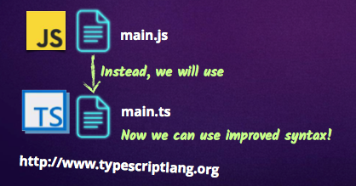
TypeScript: Our Language of Choice
TypeScript is Microsoft’s extension of JavaScript that allows the use of all ES2015 features and
adds powerful type checking and object-oriented features.
The Angular 2 source is programmed with TypeScript.

Slide 12
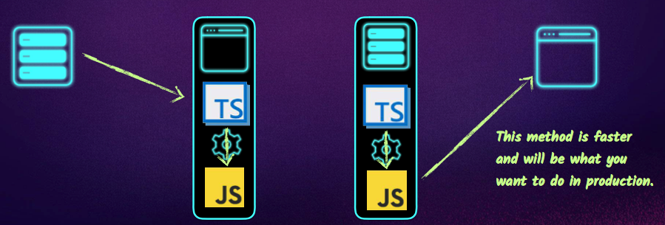
Transpiling Locations
Our browsers don’t know how to read TypeScript out of the box, so we have two options
when it comes to changing our TypeScript code into JavaScript.
Transpile to JavaScript in the browser
Transpile to JavaScript before shipping to browser

Slide 13
Writing Our First TypeScript File

