Slide 1
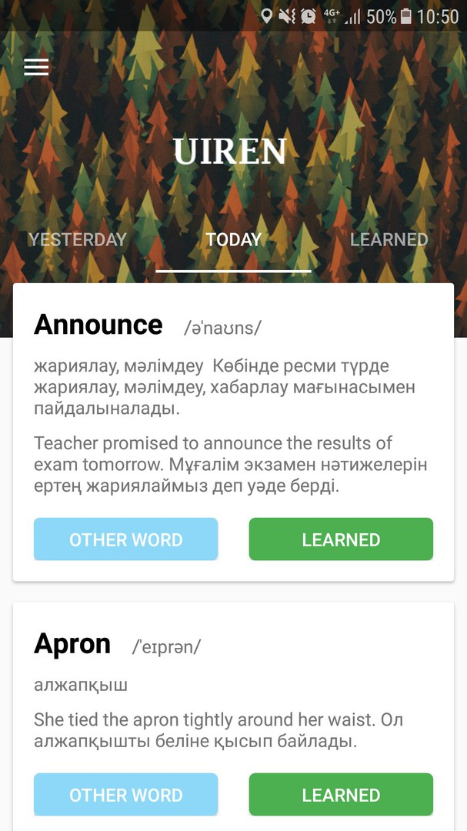
Unlock your learning superpowers with Uiren
Uiren

Slide 2

Hello!
Nice to meet you
- Uatbayeva Aibanu – front-end developer and back – end developer.

Slide 3

Help Easy Minimalism Simple
Idea

Slide 4

Go from zero to language hero
(Customers)

Slide 5
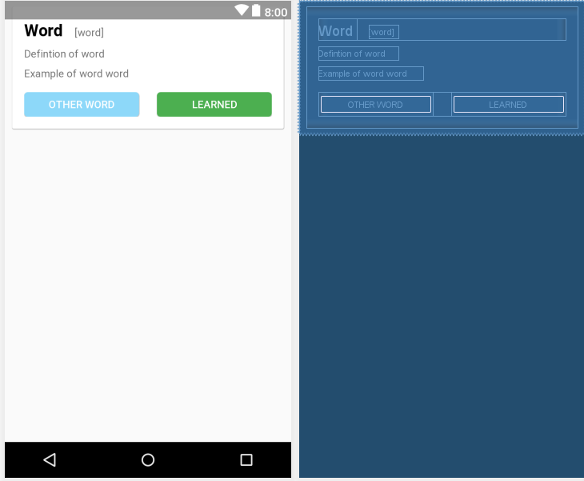
Every word is one card view.
First Linear Layout – textviews(word, definition, example,pronoune) and second linear layout(buttons)

Slide 6
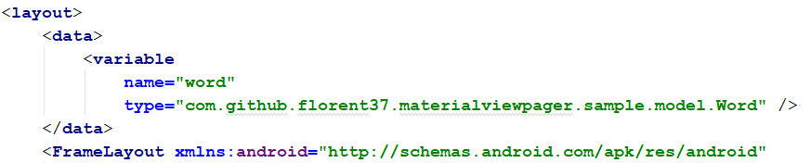
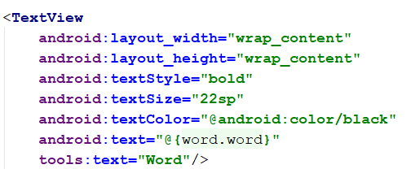
In XML file exists data variable - “Word”. Every word will be send as data to xml file

Slide 7
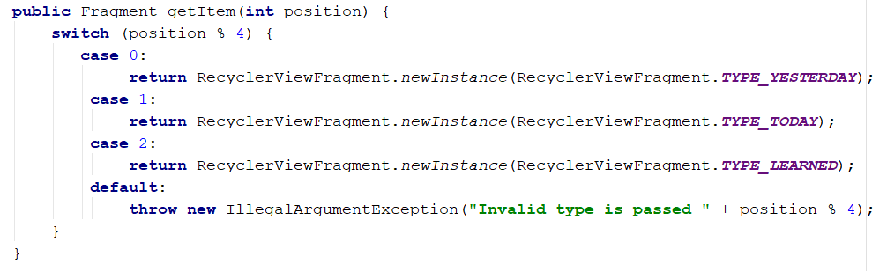
Three fragments:
Yesterday
Today
Learned

Slide 8
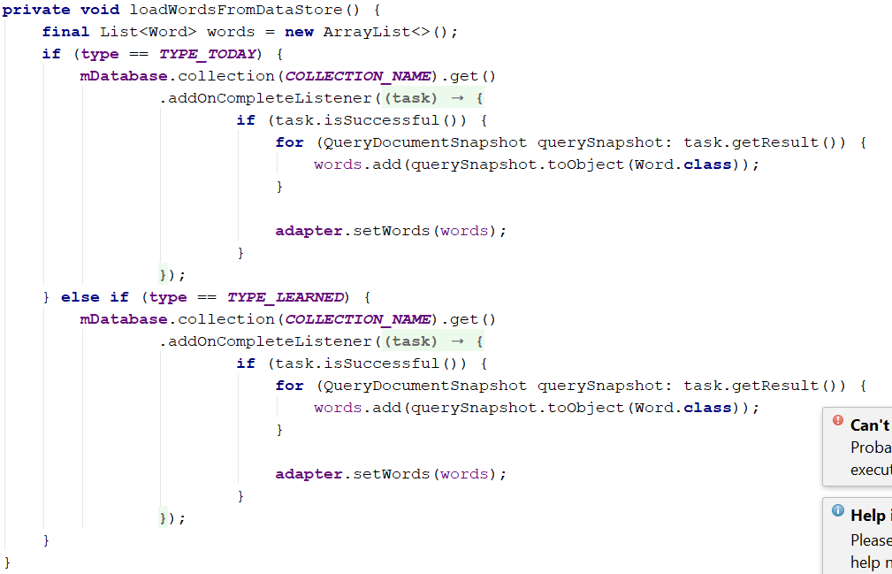

Slide 9
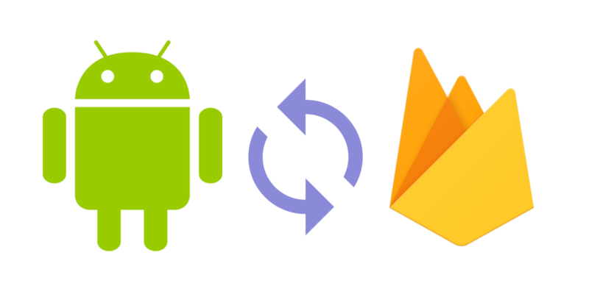
Database - Firebase

Slide 10
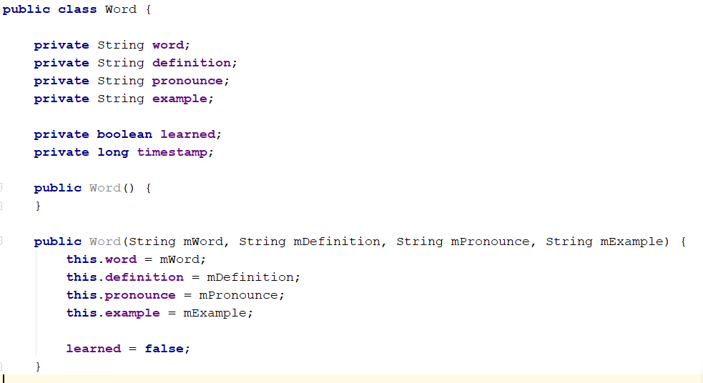
Class that creates object “word”. This class Has 6 entities.

Slide 11




Competitors

Slide 12
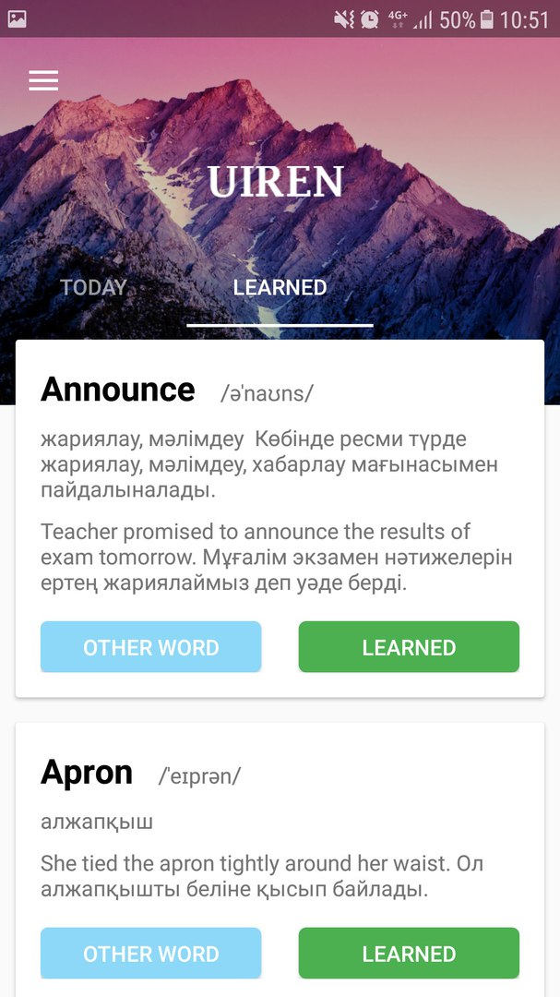
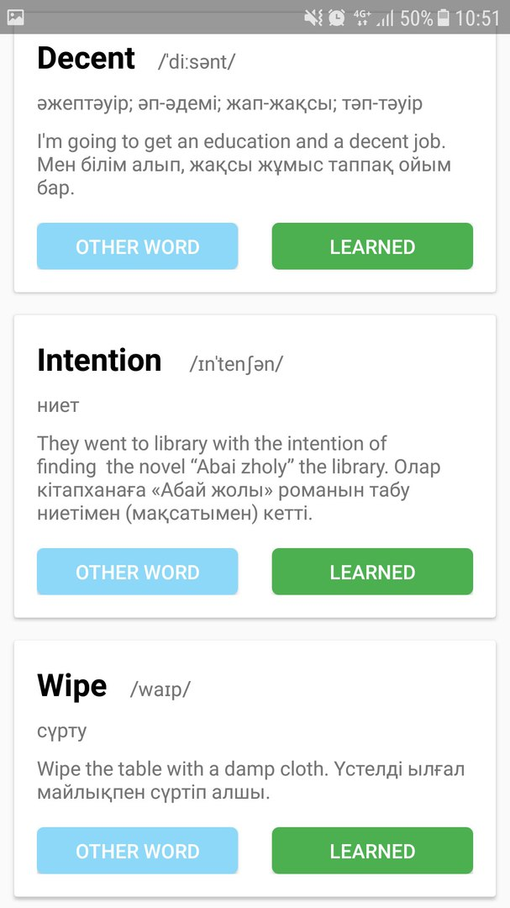
Prototype

Slide 13
Conclusion
At the end, analyzing the sphere of language learning, I came to the conclusion that at the moment there are no similar programs like "UIREN". I call everyone to my team who interested in learning language.
Go from zero to language Hero

Slide 14

Thank you very much for your time

