Slide 1


sessio.app
Strava for Study Sessions
Sessio
Presented by :
2026

Slide 2
Sessio
Invisible Effort
Hours vanish into studying with nothing to show for it — no record of what got done, no progress over time, and motivation fades fast.
The Problem
Students lose 3+ hours a day to distraction. Their effort is invisible, their study spots are guesswork, and the grind is lonely — three problems with no unified fix.
Campus Guessing Game
Is Grainger too crowded? Which spot actually helps me focus? Students have zero data to guide the decision.
The Lonely Grind
Deep work happens in isolation. Without accountability or community, showing up every single day is nearly impossible.
sessio.app
2026

Slide 3


Sessio
Why Tools Fall Short
01
Pomodoro Timers
03
Study Groups
Track time in blocks — but no campus context, no social layer, and no history of what you actually accomplished.
Real accountability — but no measurement, no analytics, and painful to coordinate across everyone's schedule.
02
Calendar Apps
04
Time-Lapse Apps
Schedule focus blocks — but never track the actual work, and offer no community or outcome data.
Record your screen — but drain your battery, raise privacy concerns, and give you nothing social to share.
sessio.app
2026

Slide 4
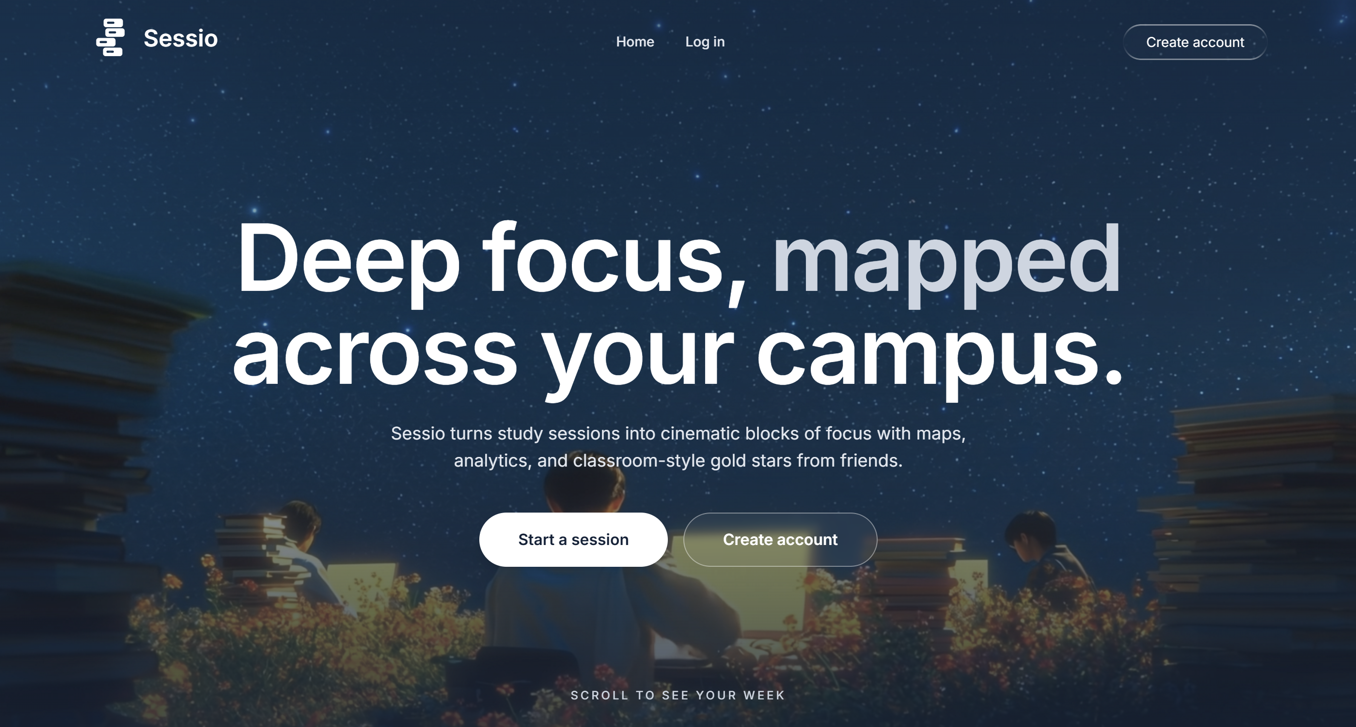
Sessio
Intentional Sessions
Set a goal, run a distraction-free timer, and log what you accomplished. Build a verifiable history of real deep work.
Meet Sessio
Campus Intelligence
A live heat map of UIUC spots with real building hours and per-spot analytics, so you learn exactly where you focus best.
Social Accountability
Form study squads, share sessions in a live feed, give gold stars, and climb friend leaderboards. Momentum, together.
sessio.app
2026

Slide 5
Sessio
How It Works
01
Open the App
03
Deep Focus
8:00 AM — Sarah sees her 12-day streak, 8h 45m this week, and a suggested spot: Grainger L2 at an 85% goal completion rate.
8:06–9:06 AM — the progress ring fills, notifications stay silenced, and Sarah holds an hour of uninterrupted flow.
02
Start a Session
04
Log the Win
8:05 AM — CS 225 MP3, a 60-minute target at Grainger Library, distraction-free mode on, shared with her CS Grind Squad.
9:06 AM — goal complete, an AI summary posts to the feed, her streak hits 13 days, and friends drop three gold stars.
sessio.app
2026

Slide 6


Sessio
Analytics Dashboard
A weekly focus chart, KPI cards with week-over-week deltas, a streak tracker, and goal-completion trends. Watch progress compound.
Key Features
Three features turn intention into habit: a Strava-style analytics dashboard, a live campus heat map, and a social feed that keeps you accountable.
Campus Heat Map
100+ real UIUC buildings color-coded by recent activity, with per-spot goal rates and a smart pick for your best spot.
Social Feed & Squads
A live feed of friends' sessions, gold-star encouragement, and weekly leaderboards scoped to the people you actually know.
sessio.app
2026

Slide 7
Sessio
Built to Scale
01
Row-Level Security
03
Real-Time, No Polling
Every Postgres table is guarded by RLS — users only ever see sessions they own or are explicitly allowed to view.
Supabase Realtime over true WebSockets — gold stars and leaderboards update instantly across every connected client.
02
AI With Fallback
04
Real Campus Data
OpenAI writes session summaries from goals and notes, and falls back to a local template if the API is down.
Vendored IlliniSpots data: 100+ UIUC buildings with coordinates and hours, seeded with one import command.
sessio.app
2026

Slide 8

Sessio
From UIUC Outward
01
Phase 1 · Now
03
Phase 3 · 12–24 mo
UIUC launch across 40,000+ students, starting with Research Park and CS courses. Target: 1,000 active this semester.
Roll out to the top 50 universities with user-created spots and a campus partner API. Target: 100,000+ users.
02
Phase 2 · 6–12 mo
04
Phase 4 · 24 mo+
Expand to Big Ten schools — Michigan, Purdue, Wisconsin — with localized spot data. Target: 10,000 users.
Beyond students — remote workers, researchers, and distributed teams. Deep work as a service.
sessio.app
2026

Slide 9
Sessio
Future Plans
Beta with 50 students, smoother onboarding, and social media marketing.
The Roadmap
We're shipping in waves, each unlocking the next growth lever — from a focused beta to native apps and a multi-campus launch.
3 Months Later
Squad challenges, a built-in Pomodoro mode, Spotify focus music, calendar sync, and badges for major milestones.
Next 6 Months
Native iOS and Android apps, AI that predicts your best study times, Canvas and Moodle integration, and 3–5 new campuses.
sessio.app
2026

Slide 10
Sessio
How We Compare
01
vs. Forest
03
vs. Focus@Will
Great for time-blocking — but no campus map, no analytics dashboard, and no social feed to keep you accountable.
Focus music only — no session tracking, no goals, no community, and no sense of place on campus.
02
vs. Study Together
04
vs. RescueTime
Video co-working — but no goal logging, no spot analytics, and no progress history to build on.
Passive productivity tracking — but no goals, no campus intelligence, and no social accountability.
sessio.app
2026

Slide 11
Sessio
sessio.app
Built by students
Try Sessio
2026

