Slide 1
SOK-3021 Økonomisk analyse av tidsserier
UiT The Arctic University of Norway
HHT

Slide 2
Course Description:
This course provides a basic introduction to time series analysis, with a focus on economic and financial data.
Students will learn how to analyze, model, and forecast data that evolves over time.
The course covers both univariate and multivariate time series models.
Emphasis is placed on practical applications using R for statistical computing and data visualization.

Slide 3
Course Curriculum:
In this course, we will cover the four chapters from the Principles of Econometrics 5th Edition (POE5), Wiley - 2018.
The four chapters include:
i) Chapters 9: Regression with Time-Series Data: Stationary
Variables
ii) Chapter 12: Regression with Time-Series Data: Nonstationary
Variables
iii) Chapter 13:Vector Error Correction and Vector
Autoregressive Models
iv) Chapter 14: Time-Varying Volatility and ARCH/GARCH
Models

Slide 4
Assessments: Assignment and Exam
Assignment:
  This course includes one mandatory assignment (which must be presented orally).
  Completion of both the assignment & its presentation is required to be eligible for the final exam.
  Students are required to find their own time series data and apply the full time series modeling procedure.
  Submission deadline: At the end of the course

Slide 5
Assessments: Assignment and Exam
School Exam:
  Written school exam (Date: 27/04 at Kl 09:00)
  Exam Type: Closed part + Open part
  Closed Exam (60%):
- True/False
- Multiple Choice
- Fill in the blank's questions
  Open Part (40%):
- Designed to test your empirical ability

Slide 6
Introduction to Time Series Analysis

Slide 7
Types of Data
In economics, we often work with three types of data.
1. Cross-sectional data
2. Time series data
3. Pooled/Panel data

Slide 8
Cross-sectional Data:
Cross-sectional data are data on one or more variables collected from multiple units at the same point in time.
Examples:
  Income, educational level, age, and gender of 1,000 households in Norway in 2025
  Health indicators (e.g., BMI, smoking status) of individuals surveyed once
  Test scores of students from different schools in the same academic year , etc.

Slide 9
Time Series Data:
A time series is a set of observations on the values that a variable takes at different times.
It is collected at a regular time intervals, such as annually, quarterly, monthly, weekly, daily, etc.
Examples:
GDP of Norway, 1960-2025
Monthly inflation rate & unemployment rate in Norway, 2000 - 2025, etc.

Slide 10
Pooled/Panel Data
Pooled data is a combination of both cross-sectional & time series data.
It is data collected from multiple units observed over time.
Panel/longitudinal data is a special type of pooled data in which the same cross-sectional unit (say , a family or firm) is surveyed over time.
Examples:
Household panels tracking consumption and demographics over time
Country-level macroeconomic indicators (e.g., GDP, inflation) observed over several decades, etc.

Slide 11
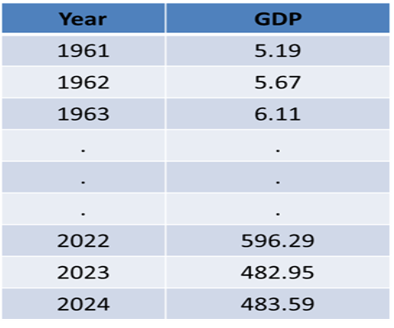

Time Series Analysis
Time series data observe the same variable over multiple time periods.
Such observations may be denoted by $y_{1},y_{2},y_{3},...,y_{t},...,y_{T}$ since data are usually collected at discrete points in time

Slide 12
Features of Time Series Data
Time-series data have a natural ordering according to time
Time-series observations on a given economic unit, observed over a number of time periods, are likely to be correlated
That is, what happens today may depend on what happened yesterday
In time series data, there is the mutual dependence between the observations, generally called SERIAL CORRELATION OR AUTOCORRELATION observation at time t

Slide 13
Time Series Analysis
In time series analysis, we analyze the past behavior of a variable in order to predict its future behavior.
Businesses are often very interested in forecasting time series variables since social and economic conditions are constantly changing over time.
Time Series Analysis, using statistical methods, allows to enhance comprehension and predictions on any quantitative variable of interest (sales, demand of products, financial performance indicators, logistics, etc.)

Slide 14
Area of Applications of Time Series?
The fields of application of Time series Analysis are numerous: Demand Planning is one of the most common application, however, from industry to industry there are other possible uses. For instance:
(a) Economics: GDP, monthly unemployment rates, inflation
rates, stock market prices, sales, prices, etc.
(b) Epidemiology: the number of influenza cases observed over
sometime period, the number of COVID-19 cases and deaths, etc.
(c) Social sciences: population series, such as birthrates, school
enrollments, etc.
(d) Transport: Number of traffic accidents per day, month, or year,
number of passengers traveling through airports each month or year, etc
(e). Global warming, CO2 concentration in the atmosphere in 2050,
etc….

Slide 15
Forecasting
Once someone said:
“Forecasting is the art of saying what will happen in the
future and then explaining why it didn’t“
The reality is that forecasting is a really tough task, and you can do really bad,
History is full of examples of «bad forecasts», just like IBM Chairman’s famous quote in 1943: “there is a world market for maybe five computers in the future.”
But we can definitely reduce uncertainty and improve the accuracy of our forecasts

Slide 16
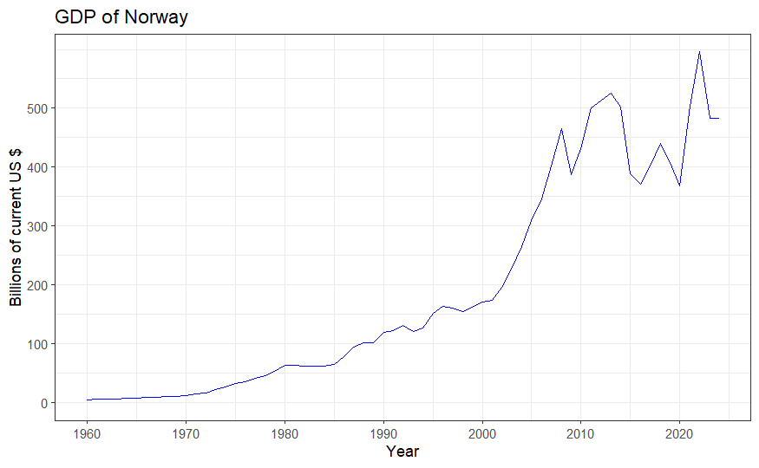
Graphical Analysis: Time Series plot
A time series plot is a sequence plot with the time series variable y_{t} the vertical axis and time t on the horizontal axis.
What do you notice about the movement of GDP over time?
Can you see periods of faster or slower growth?

Slide 17
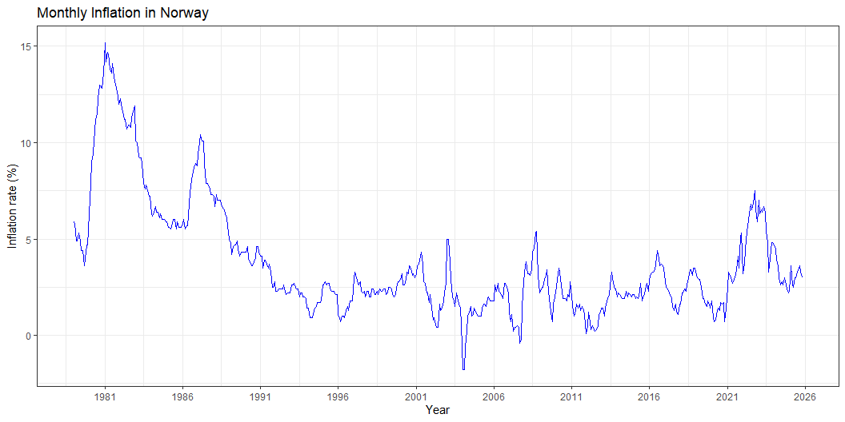
Graphical Analysis: Time Series plot
Does inflation change smoothly or abruptly?

Slide 18
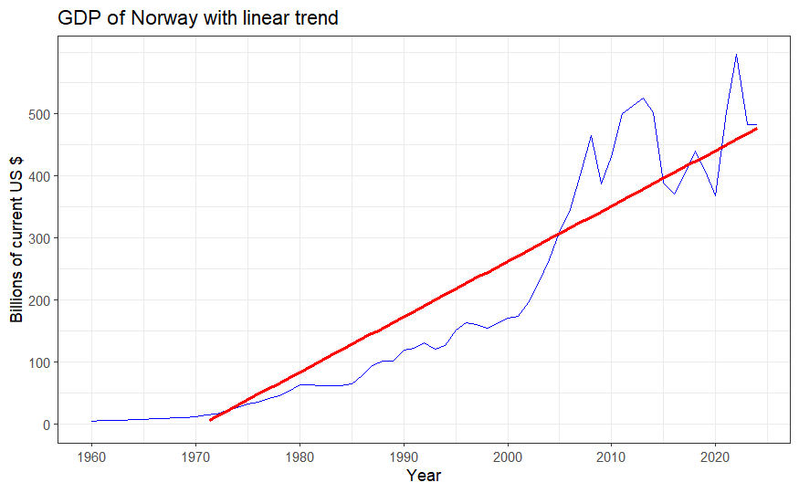
Components of a Time Series
A time series is made up of one or more components of the following :
1). Trend
The general direction in which the series is running during a long period
A TREND exists when there is a long-term increase or decrease in the data.
It does not have to be necessarily linear (could be exponential or others functional form).

Slide 19
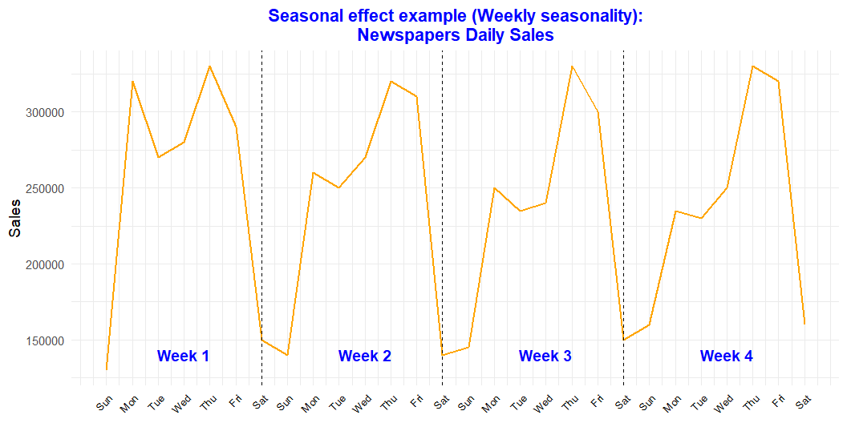
Components of a Time Series
2). Seasonal effects
Short-term fluctuations that occur regularly – often associated with months or quarters
A SEASONAL PATTERN exists when a series is influenced by seasonal factors (e.g., the quarter of the year, the month, day of the week).
Seasonality is always of a fixed and known period.

Slide 20
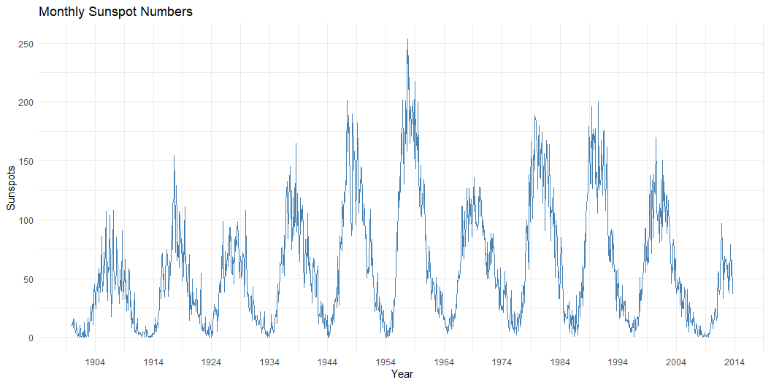
Components of a Time Series
3). CYCLE
Long-term fluctuations that occur regularly in the series
A CYCLE is an oscillatory component (i.e. Upward or Downward swings) which is repeated after a certain number of years, so:
May vary in length and usually lasts several years (from 2 up to 20/30) Difficult to detect, because it is often confused with the trend component

Slide 21
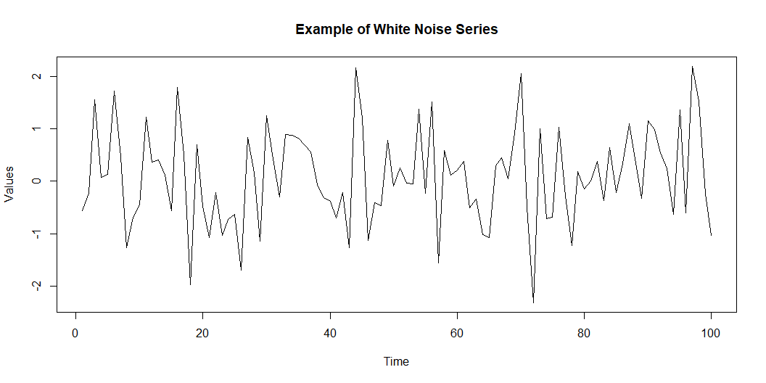
Components of a Time Series
4). RESIDUAL
Whatever remains after the other components have been taken into account
The residual/error component is everything that is not considered in previous components
Typically, it is assumed to be the sum of a set of random factors (e.g. a white noise series) not relevant for describing the dynamics of the series

Slide 22
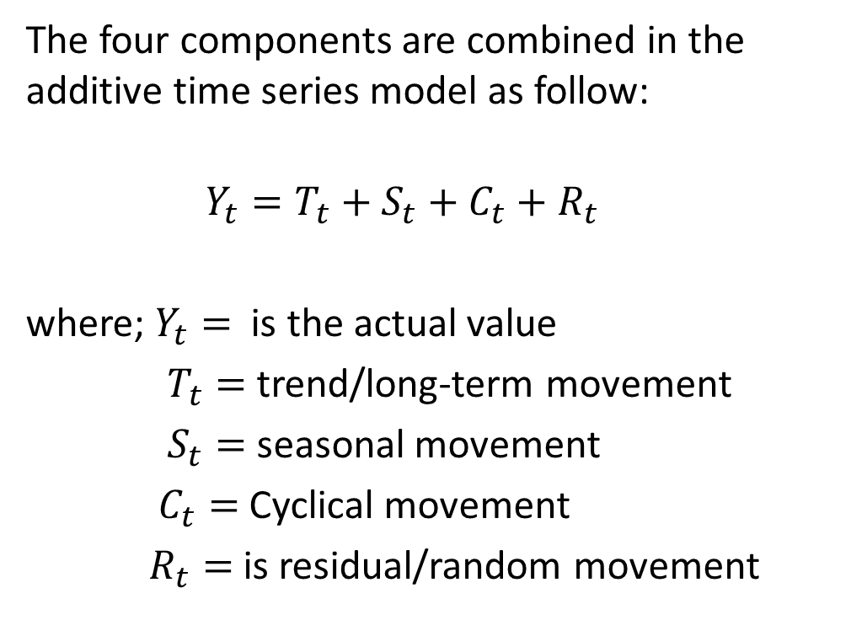
Components of a Time Series
The four components are combined in the additive time series model as follow:
$$Y_{t}=T_{t}+S_{t}+C_{t}+R_{t}$$
where; $Y_{t}=$ is the actual value
$T_{t}=$ trend/long-term movement
$S_{t}=$ seasonal movement
$C_{t}=$ Cyclical movement
$R_{t}=$ is residual/random movement

Slide 23
Task & Dataset:
From the R package fpp2 in R, load the quarterly beer production data in Australia.
plot the time series plot of the data
find the trend, seasonality, and noise of the quarterly beer production

Slide 24
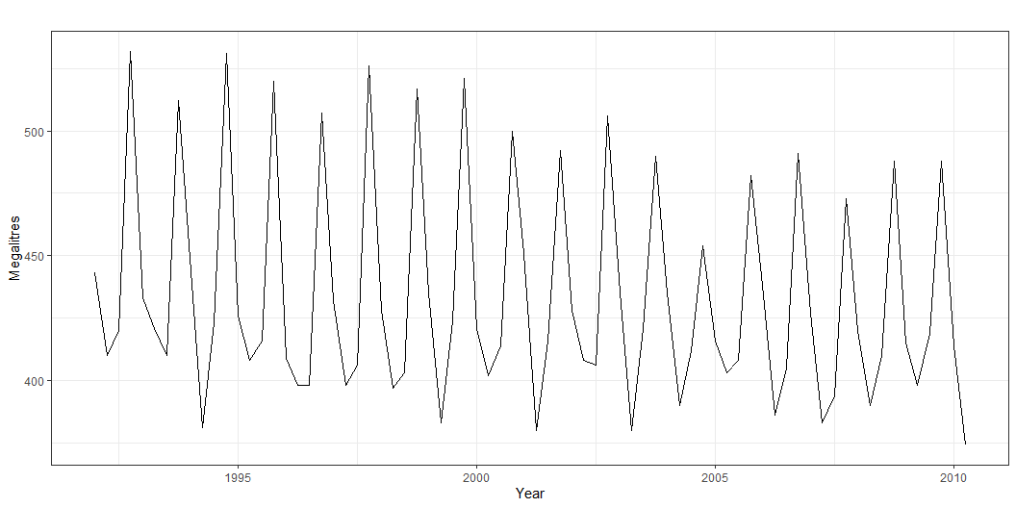
Fig. The quarterly beer production data in Australia

Slide 25
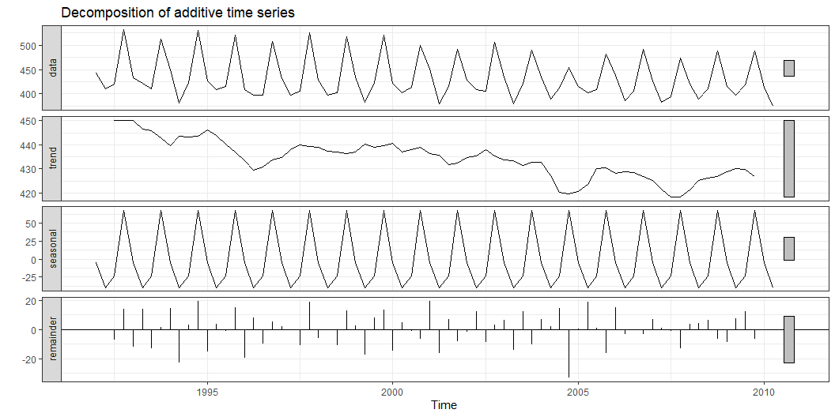
The time series decomposition of the quarterly beer production in Australia:

Slide 26
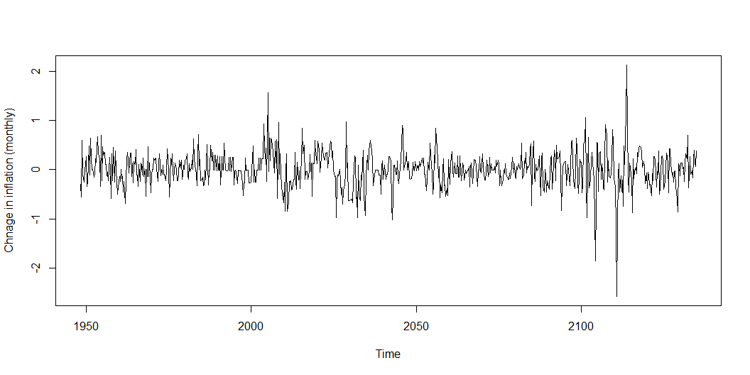
Some Time series Terms
Stationary Data - a time series variable exhibiting no significant upward or downward trend over time.
A Stationary time series data has constant means, variance and autocovariance overtime.

Slide 27
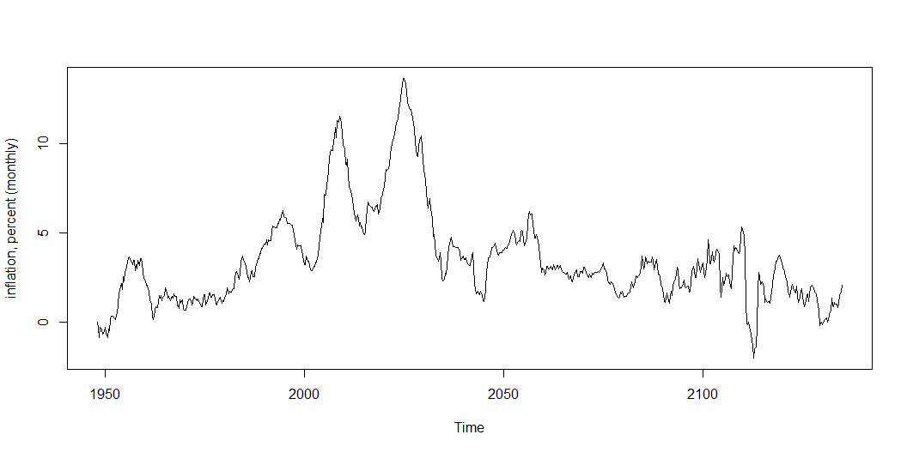
Some Time series Terms
Nonstationary Data - a time series variable exhibiting a significant upward or downward trend over time.
Non-stationary time series data has means and variances that change over time

Slide 28
Approaching Time Series Analysis
There are many, many different time series techniques/models.
It is usually impossible to know which technique will be best for a particular data set.
It is customary to try out several different techniques and select the one that seems to work best.
To be an effective time series modeler, you need to keep several time series techniques in your “tool box.”

Slide 29
Task & Dataset
.
Download annual CO₂ emissions data from Our
World in Data:
(https://ourworldindata.org/co2-emissions).
Construct time-series plots of annual CO₂ emissions for the world and for Norway from 1960 t0 2024.
Describe the main pattern of the plot.

Slide 30
Task & Dataset
.
Download annual CO₂ emissions data from Our
World in Data:
(https://ourworldindata.org/co2-emissions).
Construct time-series plots of annual CO₂ emissions for the world and for Norway from 1960 t0 2024.
Describe the main pattern of the plot.

