Slide 1

WIRELESS NETWORKS SECURITY
Shambhu Upadhyaya
Computer Science & Eng.
University at Buffalo
Buffalo, New York 14260
1/29/2019
Wireless Networks Security
Shambhu J Upadhyaya
<number>

Slide 2
Acknowledgments
DoD Capacity Building Grant
NSF Capacity Building Grant
Cisco Equipment Grant
Anusha Iyer, Pavan Rudravaram, Himabindu Challapalli, Parag Jain, Mohit Virendra, Chris Crawford, Ameya Sanzgiri
1/29/2019
Wireless Networks Security
Shambhu J Upadhyaya
<number>

Slide 3
Motivation
Military
  Success of Desert Storm in Gulf War attributed to Wireless communication
  Military superiority may not win war anymore
  Mass destruction possible with Cyber weapons
  Data sharing is critical in coalition partners
  Wireless is key for communication in the intelligence community
Public/Private
  Today, a large no. of Internet connections happen from mobile devices
  Wireless is ubiquitous, it has stayed here
Info. must flow in and out of government to private sectors
1/29/2019
Wireless Networks Security
Shambhu J Upadhyaya
<number>

Slide 4
Wireless – Another Perspective
Why and when of Wireless
  No way to run the cable
  Convenience of less hardware – e.g., Conferences
  Temporary setups
  Costs of cabling too expensive
  Scalability and Flexibility - Easy to grow
  Reduced cost of ownership - initial costs the same as the wired networks
  Mobility
1/29/2019
Wireless Networks Security
Shambhu J Upadhyaya
<number>
Notes:
1.

Slide 5
Mobility and Security
Increased mobility has become way of life
Wireless is at the first and last miles
Presents itself to security problems
Proper security must be practiced
A new security culture needs to emerge across the entire Internet user community
Hacker ethic “destructiveness is inquisitiveness” – must be resisted
Instead, proper online security habits must be practiced
1/29/2019
Wireless Networks Security
Shambhu J Upadhyaya
<number>

Slide 6
Good Security Thinking
(Edney & Arbaugh ’04)
Don’t talk to anyone you don’t know
Accept nothing without a guarantee
Treat everyone as enemy until proven otherwise
Don’t trust your friends for long
Use well-tried solutions
Watch the ground you are standing on for cracks
Good habits
  Changing passwords, disconnecting when not in use, run antivirus daily, change default password, use appropriate security and encryption services
1/29/2019
Wireless Networks Security
Shambhu J Upadhyaya
<number>

Slide 7
Wireless Security
– the Course
An approach of best business practice due to the nature of the topic
Components of the course
  Threat model
  Security protocol
  Keys and passwords
  Key entropy
  Authentication
  Authorization
  Encryption
1/29/2019
Wireless Networks Security
Shambhu J Upadhyaya
<number>
Notes:
Key entropy – key effectiveness

Slide 8
Why is Wireless Different
First know the distinction between communication and computing (cellular networks vs. data networks)
Wireless – info. travels through free-space on certain spectrum allocations
PDAs, Cell phones, pagers inherently less secure
  Limited bandwidth, memory, processing capabilities
  Anyone with some technology can intercept it
  Enemy need not come to you, victims go to attackers simply by roaming
  Poor authenticating services – poor identity guarantees on user and devices
  You can deny your act (non-repudiation)
  Reestablishing connections without re-authenticating is dangerous
Man in the middle attacks are easier
1/29/2019
Wireless Networks Security
Shambhu J Upadhyaya
<number>

Slide 9
Security and Privacy
Wireless infrastructure
  Less physical assets to protect
  But there is no locked door on the airways
Infrastructure protection
  In Government hands
  Being public asset, government feels responsible
  National security
Military is often the originator of digital security measures
Regulations are likely to thwart privacy
FBI’s Carnivore program – automated snooping tool, unpopular
  Similar to wiretapping, but sniff email, designed in 1999
  Violated free speech and civil rights?
  Program abandoned completely in Jan. 2005
NSA’s Prism Program
  Clandestine mass electronic surveillance data mining program (2007)
  Existence was leaked by Edward Snowden in June 2013
1/29/2019
Wireless Networks Security
Shambhu J Upadhyaya
<number>

Slide 10
Course Outline
Mixture of basic and advanced topics
Projects, Homeworks and Research Reading
Form groups of 2
Two midterms (3/28, 5/7) and several quizzes
Several projects using network simulation tools and laptops
1/29/2019
Wireless Networks Security
Shambhu J Upadhyaya
<number>

Slide 11
Sample Projects
Packet Analysis & Spoofing
  WildPacket’s AiroPeek, Ethereal, etc.
RF Jamming & Data Flooding
  Get an idea on AP vulnerabilities
Information Theft
  Implement a covert channel through a wireless communication path, how easy or difficult?
Layered Wireless Security
  Lightweight Extensible Authentication Protocol (LEAP) system of Cisco
Wireless Bridging Security
  Fragile communication path from a wireless to wired device
1/29/2019
Wireless Networks Security
Shambhu J Upadhyaya
<number>

Slide 12
Wireless Networks
Cellular Networks (CDMA, OFDMA, GSM)
  1G, 2G, 3G, 4G, 5G
  Main function is to send voice (make calls), but data over voice applications (GPRS, EDGE, HSDPA) have been developed to enable web surfing from cell phones
Data Networks (802.11, 802.15, 802.16, 802.20 - Mobile Broadband Wireless Access (MBWA) )
  Main function is to send data, but voice over data applications have also been developed (e.g., VOIP)
Emphasis of the course is on Data Networks
  802.11: WLANs, MANETs, Sensor Networks
  802.11 is a STANDARD with different implementations
  802.11 only tells about how to access the channel, how to back-off to prevent collisions, how to send a packet over the air
1/29/2019
Wireless Networks Security
Shambhu J Upadhyaya
<number>
Notes:
Categories of Wireless Networks
- WLAN.
- WPAN.
- WWAN.
WLAN, representing Wireless Local Area Networks, includes 802.11, Hyperlan, and several others.
WPAN, represents Wireless Personal Area Network technologies such as Bluetooth and Infrared.
WWAN, representing Wireless Wide Area Networks, includes wide coverage area technologies such as 2G cellular, Cellular Digital Packet Data (CDPD), Global System for Mobile Communications (GSM) and Mobitex.
All the above wireless networks use wavelengths ranging from Radio Frequency up to and above IR band.(9 kHz to 1000’s of GHz).
GPRS – Global Packet Radio Service for mobile data
GPRS (128 kb/s), EDGE – Enhanced Data rates for GSM Evolution (236 kb/s)
HSDPA -- High-Speed Downlink Packet Access (14.4Mb/s)

Slide 13
Cellular Networks
1G or first generation
  analog networks
    Low voice quality
    very less security
    low capacity
2G or second generation
  analog and digital networks
  Advanced Mobile Phone Service (AMPS)
  Time Division Multiple Access (TDMA)
  Global System for Mobile Communications (GSM)
  Code Division Multiple Access (CDMA)
    digital encoding
    high bit rate voice
    better security
    limited data communication
1/29/2019
Wireless Networks Security
Shambhu J Upadhyaya
<number>
Notes:
AMPS is analog in 800-900 MHZ frequency band.
The digital version is D-AMPS, which uses FDMA
2G GSM uses TDMA, CDMA is Qualcomm chip, proprietary.
Both CDMA and 2G GSM will be phased out in USA by 2019.
‘G’- stands for generation.
1G or first generation analog networks usually circuit switched networks.
characteristics –Low voice quality, very less security, low capacity.
2G or second generation a term for analog and digital current networks operating on 800 MHz or 1900 MHz spectrums. These include Advanced Mobile Phone Service (AMPS), Time Division Multiple Access (TDMA), Global System for Mobile Communications (GSM), and Code Division Multiple Access (CDMA).
characteristics-digital encoding, high bit rate voice, better security, limited data communication.
3G or third generation also known as Universal Mobile Telecommunications System (UMTS). 3rd Generation standards boost additional services, more extensive roaming capabilities, and transfer rates 26x faster than those allowed by current CDMA networks. 3G networks should be implemented in the United States over the next three to five years.
Characteristics - higher data rates, more security.

Slide 14
Cellular Networks (Contd.)
3G or third generation
  Includes GSM, EDGE, UMTS, and CDMA2000
  Universal Mobile Telecommunications System (UMTS)
    higher data rates
    more security
    Transfer rates 26x faster than CDMA networks
  3G networks - implemented in the United States in the last 10-12 years
    AT&T iPhone
4G
  Aims to provide ultra-broadband (gigabit-speed) Internet access to mobile as well as stationary users
  100 Mbit/s to 1 Gbit/s
1/29/2019
Wireless Networks Security
Shambhu J Upadhyaya
<number>
Notes:
GSM – Global Systems for Mobile Communications
EDGE - Enhanced Data rates for GSM Evolution
GSM, EDGE – use WCDMA (wideband CDMA)
UMTS – uses Frequency division duplex (FDD)
CMDA2000 – Qualcomm started the company to sell CDMA products. It is the 3G version of CDMA.
4G uses OFDMA
LTE is true 4G and uses OFDMA (for downlink), FDD (uplink) and TDD (China Mobile)
5G uses OFDM and will be available in April 2019. Higher data rate, also called millimeter wave technology.

Slide 15
Cellular Networks (Contd.)
Wireless Wide Area Networks
Connects to the office network wirelessly from home or while traveling
Use Radio waves
Request for information is sent to WAP gateway
Coverage area - several miles
Transfer speeds: from 5 kbps - 20 kbps
Operated by public carriers
Use open standards such as AMPS, GSM, TDMA, and CDMA
1/29/2019
Wireless Networks Security
Shambhu J Upadhyaya
<number>
Notes:
WWANs- Wireless Wide Area Networks.
Provides the facility to connect to the office network wirelessly even while at home or while traveling to and from the office.
Means of transmitting data - radio waves.
WWAN allows to connect to internet even while traveling.The request for Web content is sent through the wireless network to a WAP gateway, where it is processed and the required information is retrieved and returned.
Coverage area in wireless WANs is around several miles.
Transfer speeds: from 5 kbps - 20 kbps.
Unlike WLANs, which are unlicensed and typically administered privately by the customer, WWANs are generally operated by public carriers, and use open standards such as AMPS, GSM, TDMA, and CDMA

Slide 16
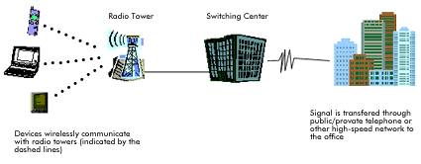
WWAN-Wireless Wide Area Networks
1/29/2019
Wireless Networks Security
Shambhu J Upadhyaya
<number>

Slide 17
WAP
WAP - Internet and advanced telephony services
WAP bridges mobile world, Internet and corporate intranets
WAP defines WAE (wireless application environment)
  Micro browser
  Scripting facilities
  e-mail
  World Wide Web (WWW)–to-mobile-handset messaging
  Mobile-to-telefax access, etc.
1/29/2019
Wireless Networks Security
Shambhu J Upadhyaya
<number>
Notes:
Wireless application protocol (WAP) is an application environment and set of communication protocols for wireless devices designed to enable manufacturer-, vendor-, and technology-independent access to the Internet and advanced telephony services.
WAP bridges the gap between the mobile world and the Internet as well as corporate intranets and offers the ability to deliver an unlimited range of mobile value-added services to subscribers—independent of their network, bearer, and terminal.
WAP also defines a wireless application environment (WAE) aimed at developing advanced differentiating services and applications including a microbrowser, scripting facilities, e-mail, World Wide Web (WWW)–to-mobile-handset messaging, mobile-to-telefax access etc.
As of 2013, WAP has pretty much disappeared.

Slide 18
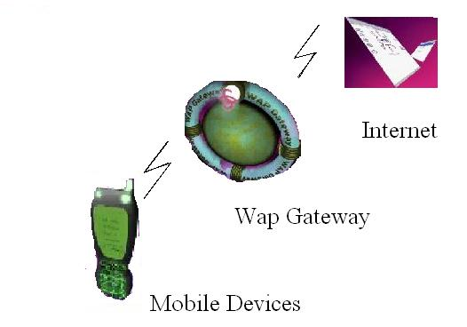
WAP
1/29/2019
Wireless Networks Security
Shambhu J Upadhyaya
<number>
Notes:
iPhone and such applications are making WAP almost obsolete.

Slide 19
Data Networks (WLANS)
WLANs
Coverage areas-fixed
Range: 100 - 500 ft - indoors; 1000 ft - outdoors
Transfer speeds: up to 54 mbps
Electromagnetic waves-Spread spectrum technology
As Ethernet is for wired LANs - 802.11 is for wireless LANs
802.11 works in unlicensed spectrum of 2.4 GHz
1/29/2019
Wireless Networks Security
Shambhu J Upadhyaya
<number>
Notes:
WLANs-Wireless Local Area Networks.
WLANs provide continuous coverage for devices in the network. As devices may roam freely within the coverage areas, these coverage areas remain fixed.
Range: 100 - 500 feet indoors and up to 1000 feet outdoors.
Transfer speeds: up to 10 mbps. (New products based on the 802.11a chip set accelerate possible transfer rates up to 54 mbps)
WLANs use electromagnetic waves (typically radio or infrared), to enable communication between devices in a limited area. Spread spectrum technology, based on radio transmission is most commonly used to deploy WLANs today
As the ethernet is considered as the standard in wired LANs 802.11 is considered as the standard in wireless LANs

Slide 20
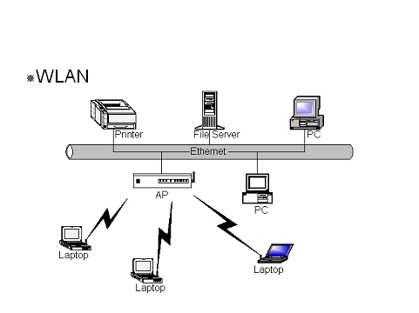
WLAN-Configuration
1/29/2019
Wireless Networks Security
Shambhu J Upadhyaya
<number>

Slide 21
Wi-Fi-802.11
Uses unlicensed spectrum - 2.4 GHz
Simple, flexible, cost effective
Covers MAC layer and physical layer
Uses FHSS for transmission
802.11b uses DFSS for transmission
Speeds
  2, 9, 11, 54 Mbps
  Speed depends on
    Modulation technique
    Distance of the node to the Access Point
    FEC level (Forward Error Correction)
1/29/2019
Wireless Networks Security
Shambhu J Upadhyaya
<number>
Notes:
802.11 works in unlicensed spectrum of 2.4 GHz
802.11 WLAN technology is simple, flexible, cost effective
802.11 cannot provide QoS support for increasing number of multimedia applications
802.11 WLAN standard covers the MAC layer and physical layer of OSI
802.11 typically uses Frequency-Hopping Spread Spectrum for transmission.
802.11b uses Direct-Frequency Spread Spectrum for transmission.
Speeds
Typically the speeds are 2, 9, 11, 54 Mbps
Speed depends on
Modulation technique
Distance of the node to the Access Point
Other factors like-FEC level (Forward Error Correction)-using extra data to recover Available only in 802.11.

Slide 22
802.11 (Contd.)
MAC (Media Access)
  Same in 802.11, 802.11b, 802.11a
  Based on CSMA/CA (Carrier Sense Multiple Access / Collision Avoidance)
    Basic idea
      RTS (request to send)
      CTS (clear to send) channel reservation mechanism
HIPERLAN – Alternative to 802.11, did not survive due to complexity of implementation
MMAC –HiSWAN – costlier multimedia alternative
Disadvantage:
  Cannot provide QoS support for increasing number of multimedia applications
1/29/2019
Wireless Networks Security
Shambhu J Upadhyaya
<number>
Notes:
MAC – Media Access Control is the same in 802.11, 802.11b, 802.11a and is based on CSMA/CA(Carrier Sense Multiple Access / Collision Avoidance) to avoid collisions and packet loss.
Basic idea
RTS(request to send)
CTS(clear to send) channel reservation mechanism.
HIPERLAN was one more alternative to 802.11 but couldn’t survive because of complexity of implementation and the huge processing power required
MMAC –HiSWAN is another wireless technology that supports high speed multimedia applications but works at higher frequency and is costlier
Multimedia Mobile Access Communication (MMAC) over 5GHz
HiSWAN – high speed wireless LAN

Slide 23
History of 802.11x
1990 - IEEE Started 802.11 standard
1997 - Drafted 802.11
1999 – Drafted 802.11a and 802.11b
2003 - 802.11g Draft Approved
2006 - 802.11n (draft, ratified in 2009)
(2003 - 802.15 Draft Approved)
  Personal Area Networks
  Bluetooth, ZigBee (low-powered digital radios), etc.
1/29/2019
Wireless Networks Security
Shambhu J Upadhyaya
<number>
Notes:
In 1997, the IEEE drafted the standard the 802.11 standard for wireless LAN
802.11, world’s wireless standard was working in 2.4GHz offering 1-2Mbps
Two extensions to 802.11 were designed
-- 802.11a in 5GHz range
-- 802.11b in 2.4GHz range
MAC layers of 802.11a and 802.11b are relatively identical
802.11a uses OFDM (Orthogonal Frequency Division Multiplexing)
802.11b uses DSSS, FHSS, IR in physical layer
802.11b products are widespread in use and 802.11a is not compatible with 802.11b products and are costlier
802.11g which works in 2.4GHz range offers mode bandwidth and compatible with 802.11b and this has become standard in 2003

Slide 24
Wireless Network Types
Fixed networks
  Point-to-point network
Nomadic networks
  Point-to-multipoint network
  Computing devices are somewhat mobile
  802.11b, 802.11g, 802.11a support this
  Becoming quite commonplace – coffee shop
Mobile networks
  Must support high velocity mobility
  802.16e, 802.20 and CDMA2000 standards
1/29/2019
Wireless Networks Security
Shambhu J Upadhyaya
<number>

Slide 25
802.11 Variations
Variation | Operating Frequency | Bandwidth | Disadvantages
802.11 | 2.4GHz | 2 Mbps | Less Bandwidth
802.11b | 2.4 GHz | 11 Mbps | Lack of QoS and multimedia support
802.11g | 2.4 GHz | 20 Mbps | Same as 802.11b
802.11a | 5 GHz | 54 Mbps | More Expensive and less range
802.11h | 5 GHz | 54 Mbps | Same as 802.11a
802.11n | 2.4 GHz or 5 GHz | 300 Mbps | Expensive
802.11e | QoS Support to 802.11 LAN
802.11f | access point communications among multiple vendors
802.11i | Enhance security and authentication mechanism for 802.11 mac
1/29/2019
Wireless Networks Security
Shambhu J Upadhyaya
<number>

Slide 26
Other Types of Data Networks (WLANs)
HiperLAN-
  High Performance Local Area Network
  Similar to 802.11
  Two types
    HiperLAN 1 -20 mbps
    HiperLAN 2 -54mbps
  5Ghz bandwidth
  One of the prime features of HiperLAN is its support for Wireless ATM
  WATM - extension of ATM capabilities
HomeRF-
  Wireless home networking
  50 meters
  Data rates upto 1.6 Mbps
  Uses SWAP (shared wireless access protocol)
  Uses 2.4Ghz band
1/29/2019
Wireless Networks Security
Shambhu J Upadhyaya
<number>
Notes:
Wireless ATM – facilitates transmission of voice, data, images etc. No standards exist.
HomeRF-
-- HomeRF is used for wireless home networking for devices like,
intelligent home appliances, laptops, smart pads etc.
-- It has a range of upto 50 meters which is adequate for short scale
networks.
-- It supports data rates upto 1.6 Mbps which is low by todays WLAN
norms.

Slide 27
Bluetooth
Cable replacement technology
Interconnect portable devices
2.45 Gigahertz (GHz)
Transfer speeds: up to 1 mbps
Ad hoc network provides spontaneous connectivity
Range: 20-350 feet
Supports up to three simultaneous voice channels
Employs frequency-hopping schemes
Power reduction to reduce interference
IEEE 802.15 (standardized within the 802.15 Personal Area Network Working group)
1/29/2019
Wireless Networks Security
Shambhu J Upadhyaya
<number>
Notes:
Cable replacement RF technology for short range communication.
It is used to interconnect portable devices, such as, cellular phones, laptops, palmtops, etc., without the need to carry interconnecting cables.
The Bluetooth standard specifies wireless operation in the 2.45 Gigahertz (GHz) radio band and supports data rates up to 720kbps.
It supports up to three simultaneous voice channels and employs frequency-hopping schemes and power reduction to reduce interference with other devices operating in the same frequency band.
The IEEE 802.15 organization has derived a wireless personal area networking technology based on Bluetooth specifications
Uses Link Manager Protocol (LMP) to configure, authenticate and handle the connections between Bluetooth devices.

Slide 28
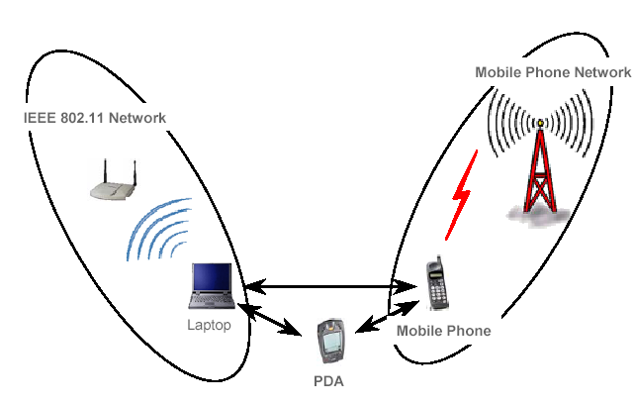
Bluetooth
1/29/2019
Wireless Networks Security
Shambhu J Upadhyaya
<number>

Slide 29
Bluetooth (Cont..)
Uses Link Manager Protocol (LMP)
  To configure
  Authenticate
  Handle connections
Piconets-
  Up to 8 devices
  Master and slaves
Scatternet – up to 10 piconets
Present status of the technology
  common with phones and handheld devices
  Laptops and smartphones are nowadays Bluetooth enabled
1/29/2019
Wireless Networks Security
Shambhu J Upadhyaya
<number>
Notes:
Bluetooth is a short-range, ad hoc network that provides spontaneous connectivity. In WPANs, as devices move, the network moves
Range: 20-350 feet (depending on whether the interaction is client-to-client or client-to-access point, and if the network is outdoors or in a building).
Transfer speeds: up to 1 mbps.
Piconets- ad hoc networks of several (up to eight) devices.One of the 8 devices is the master and the others are slaves. Master sets the frequency hopping behavior of the piconet.
Several (upto 10) piconets can be connected together to form Scatternet.
Present status of the technology: first Bluetooth devices in beta-launch.

Slide 30

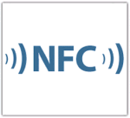
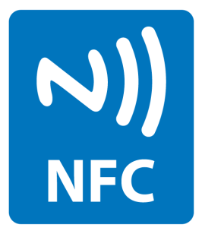
Near Field Communication (NFC)
This is an extension of RFID technology, allowing for two-way communication
Standard for smartphones to communicate with each other using radio (standardized in 2004)
Uses
  NFC is predominantly meant more for secure transactions – Contactless payments, airline check-ins, etc.
  Social networking – sharing photos, videos, files, etc., securely
  In-vehicle networks
Range is a few centimeters
Logo:
1/29/2019
Wireless Networks Security
Shambhu J Upadhyaya
<number>

Slide 31
Wireless Networks
Deployment Strategies
Two modes of operation of 802.11 devices
a) Infrastructure mode
b) Ad hoc mode
Infrastructure mode
  AP bridging wireless media to wired media
  AP handles station authentication and association to the wireless network
Ad hoc mode
  An ad hoc network between two or more wireless devices without Access point (AP)
1/29/2019
Wireless Networks Security
Shambhu J Upadhyaya
<number>

Slide 32
Infrastructure Mode
802.11 networking framework
Devices communicate through an Access Point (AP)
AP connected to wired network and a set of wireless stations - Basic Service Set (BSS)
Extended Service Set (ESS) is a set of two or more BSSes
Operate in infrastructure mode when required access to the wired LAN
Corporate sector implementation
1/29/2019
Wireless Networks Security
Shambhu J Upadhyaya
<number>
Notes:
An 802.11 networking framework in which devices communicate with each other by first going through an Access Point (AP).
In infrastructure mode, wireless devices can communicate with each other or can communicate with a wired network.
When one AP is connected to wired network and a set of wireless stations it is referred to as a Basic Service Set (BSS).
An Extended Service Set (ESS) is a set of two or more BSSs that form a single sub-network.
Most corporate wireless LANs operate in infrastructure mode because they require access to the wired LAN in order to use services such as file servers or printers.

Slide 33
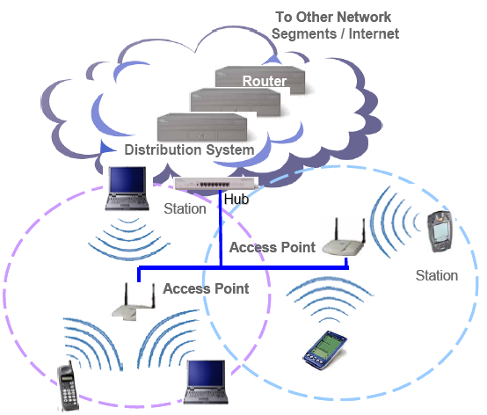
Infrastructure Mode Architecture
1/29/2019
Wireless Networks Security
Shambhu J Upadhyaya
<number>

Slide 34
Ad-hoc Networks
802.11 networking framework
Devices or stations communicate directly with each other
Networks with no fixed infrastructure
Mobile nodes: communicate within radio-range directly
Node mobility-frequent change in network topology
Rapidly deployed networks
Relatively low cost
The lack of infrastructure
  Introduces vulnerability to DoS
  Mobility induces link breakage and channel errors
Growing commercial and military deployments - rapid need for scalability
1/29/2019
Wireless Networks Security
Shambhu J Upadhyaya
<number>
Notes:
An 802.11 networking framework in which devices or stations communicate directly with each other, without the use of an access point (AP).
Networks with no fixed infrastructure
Mobile nodes : communicate within radio-range directly
Node mobility implies frequent change in network topology.
Rapidly deployed networks
Relatively low cost
The lack of infrastructure
Introduces vulnerability to DoS attacks in ad hoc networks.
Mobility induces link breakage and channel errors.
Growing commercial and military deployments of these networks poses the challenge of rapid need for scalability.

Slide 35
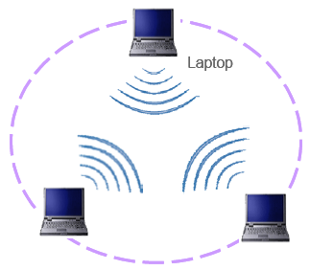
Ad-hoc Mode Architecture
1/29/2019
Wireless Networks Security
Shambhu J Upadhyaya
<number>

Slide 36
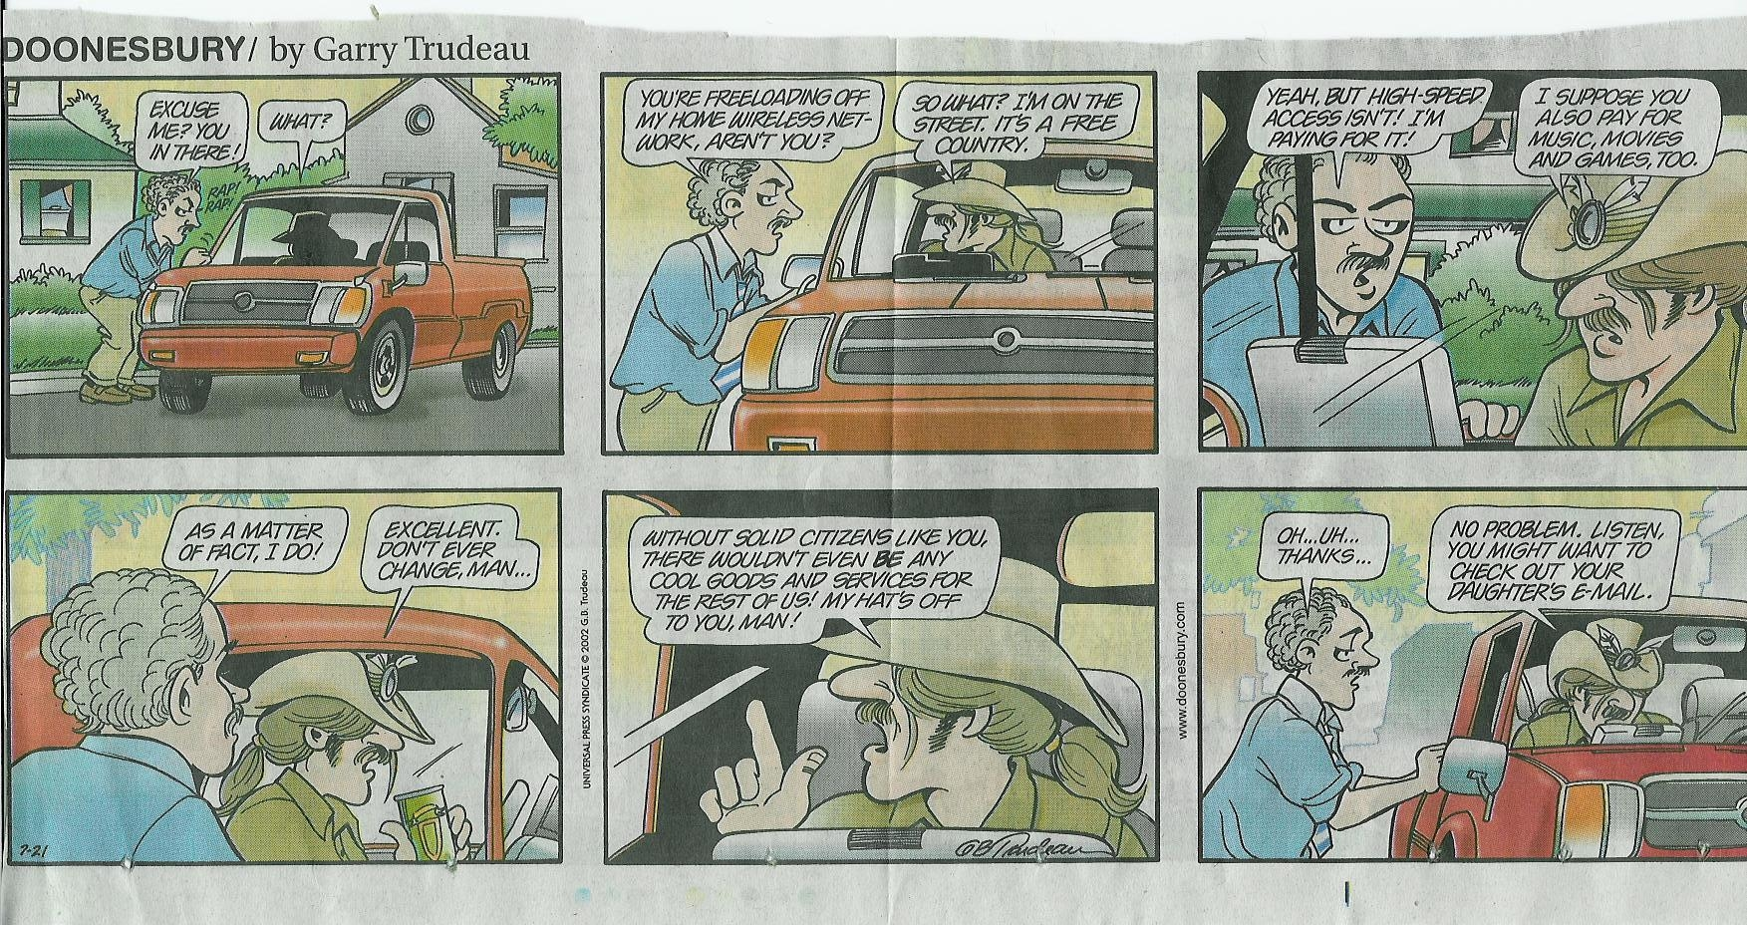
1/29/2019
Wireless Networks Security
Shambhu J Upadhyaya
<number>

Slide 37
Devices Associated with Wireless Networking
Access point
NIC compatible devices –
- Laptops
- PDAs
- Scratchpads
Smart phones-Cellular phones
Mouse
Keyboards
Text messaging devices
Speakers/Headphones
1/29/2019
Wireless Networks Security
Shambhu J Upadhyaya
<number>

Slide 38
Wireless Network Concerns
Radio Signal Interference
  Sources-Atmospheric noise, Nearby wireless devices
  Effects-Delay, Blocking, Bit errors, Limit the coverage area
  Counter measures-Limit operating power, Spread spectrum techniques, Frequency management
Power Management
  Battery weight, operation time
System Interoperability
  Protocols and Electrical characteristics
Network Security and threats
  Main concerns
Connection Problems
Installation Issues - Infrastructure, initial installations
1/29/2019
Wireless Networks Security
Shambhu J Upadhyaya
<number>
Notes:
Radio Signal Interference
Sources-Atmospheric noise, Nearby wireless devices.
Effects-Delay, Blocking, Bit errors, Limit the coverage area.
Counter measures- Limit operating power, Spread spectrum techniques, Frequency management
Power Management- Does not depend on wires.
Concerns: Battery weight and operation time.
System Interoperability- Depends on protocols and Electrical characteristics.
Network Security and threats are the main concerns of the wireless networks which will be discussed in detail.
Connection Problems- Connection loss mainly due to server/client applications.
Installation Issues-Infrastructure, initial installations,

Slide 39
Limitations of
Wireless Networks
Wireless Devices
Slow processing power
Less memory
Power constraints
Smaller displays
Weak authentication
Wireless Networks
Less bandwidth
Higher latency
Lower stability
Lower availability
Slow connections
1/29/2019
Wireless Networks Security
Shambhu J Upadhyaya
<number>

Slide 40
Security Issues in 802.11
WEP (Wired Equivalent Privacy)
128-bit key in 802.11a
Security Problems - 802.11 family faces the same problems
  Sniffing and War driving
  WEP (Wired Equivalent Privacy)
  Authentication
  MAC Address
Default installation
  Allows any wireless node (NIC) to access the network
  Walk around and gain access to the network
1/29/2019
Wireless Networks Security
Shambhu J Upadhyaya
<number>

