Slide 1
Introduction to Security Principles
Shambhu Upadhyaya
Wireless Network Security
CSE 566 (Lectures 3,4)
Shambhu Upadhyaya
<number>

Slide 2
Outline
Basic Encryption Methodology
Message Authentication and Integrity
Program Security
Network Security
Intrusion Detection
Firewalls
Shambhu Upadhyaya
<number>

Slide 3
Popular Encryption Methods
Stream Ciphers
  One Time Pad
  RC4
Block Ciphers
  DES/AES
  RSA
  RC5
Shambhu Upadhyaya
<number>

Slide 4
Stream Ciphers
Processes the message bit by bit (as a stream)
Typically has a (pseudo) random stream key
Combined (XORed) with plaintext bit by bit
Randomness of stream key completely destroys any statistically properties in the message
  C_{i} = M_{i} XOR StreamKey_{i}
Concept is very simple!
Stream key should not be reused
  If reused the patterns can be used to re-identify the message
Shambhu Upadhyaya
<number>

Slide 5
Stream Cipher Properties
Some design considerations are:
  Long period with no repetitions
  Statistically random
  Depends on large enough key
  Large linear complexity
  Correlation immunity
  Confusion
  Diffusion
  Use of highly non-linear boolean functions
Shambhu Upadhyaya
<number>
Notes:
Criteria from Rueppel
One likes to have linear complexity of the algorithms
Non-linear boolean functions will provide resilience to correlation attacks, linear attacks, etc.
Can realize non-linear boolean functions by mixing various LFSR functions

Slide 6
RC4
A proprietary cipher owned by RSA DSI
Another Ron Rivest design, simple but effective
Variable key size, byte-oriented stream cipher
Widely used (web SSL/TLS, wireless WEP)
Key forms random permutation of all 8-bit values
Uses that permutation to scramble input info. processed a byte at a time
Shambhu Upadhyaya
<number>
Notes:
Probably the most widely used stream cipher
RSA DSI – RSA Data Security, Inc.

Slide 7
RC4 Key Schedule
Starts with an array S of numbers: 0..255
Use key to well and truly shuffle
S forms internal state of the cipher
Given a key k of length l bytes
  for i = 0 to 255 do
    S[i] = i
  j = 0
  for i = 0 to 255 do
    j = (j + S[i] + k[i mod l]) (mod 256)
    swap (S[i], S[j])
Shambhu Upadhyaya
<number>
Notes:
The RC4 key schedule initializes the state S to the numbers 0..255, and then walks thru each entry in turn, using its current value plus the next byte of key to pick another entry in the array, and swaps their values over. After doing this 256 times, the result is a well and truly shuffled array. The total number of possible states is 256! - a truly enormous number, much larger even than the 2048-bit (256*8) max key allowed can select.
The period of the cipher is greater than 10^100.

Slide 8
RC4 Encryption
Encryption continues shuffling array values
Sum of shuffled pair selects "stream key" value
XOR with next byte of message to en/decrypt
  i = j = 0
  for each message byte M_{i}
    i = (i + 1) (mod 256)
    j = (j + S[i]) (mod 256)
    swap(S[i], S[j])
    t = (S[i] + S[j]) (mod 256)
    C_{i} = M_{i} XOR S[t]
Shambhu Upadhyaya
<number>
Notes:
To form the stream key for en/decryption (which are identical), RC4 continues to shuffle the permutation array S by continuing to swap each element in turn with some other entry, and using the sum of these two entry values to select another value to use as the stream key.

Slide 9
RC4 Security
Since RC4 is a stream cipher, must never reuse a key
Used in SSL and WEP
Claimed secure against known attacks
  Falls short of the standards of a secure cipher in several ways, and thus is not recommended for use in new applications
Fluhrer, Mantin and Shamir Attack can be used to break the cipher
Shambhu Upadhyaya
<number>
Notes:
RC4 is widely used, in SSL for secure web transactions amongst other uses. Currently its regarded as quite secure, if used correctly.

Slide 10
Block Cipher Characteristics
Features seen in modern block ciphers are:
  Variable key length/block size/no. of rounds
  Mixed operators, data/key dependent rotation
  Key dependent S-boxes
  More complex key scheduling
  Operation of full data in each round
  Varying non-linear functions
Shambhu Upadhyaya
<number>

Slide 11
DES Algorithm
Confusion and Diffusion
64 bit block cipher, plaintext is encrypted in blocks of 64 bits
Substitution and Permutation (Transposition)
56 bit key + 8 bit parity = 64 bit key
Repetitive nature – shift and xor
Outline
  Split data in half
  Scramble each half independently
  Combine key with one half
  Swap the two halves
  Repeat the process 16 times
Shambhu Upadhyaya
<number>

Slide 12
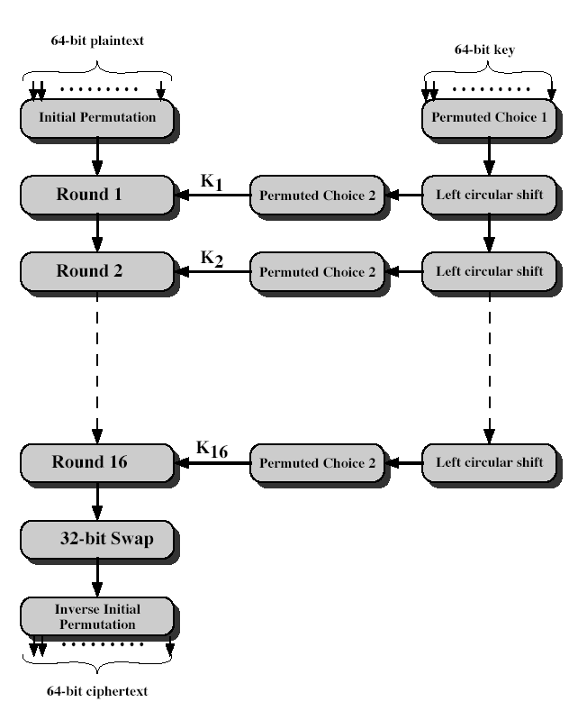
DES Encryption
Shambhu Upadhyaya
<number>
Notes:
The basic process in enciphering a 64-bit data block using the DES, shown on the left side, consists of:
- an initial permutation (IP)
- 16 rounds of a complex key dependent round function involving substitution and permutation functions
- a final permutation, being the inverse of IP
The right side shows the handling of the 56-bit key and consists of:
- an initial permutation of the key (PC1) which selects 56-bits in two 28-bit halves
- 16 stages to generate the subkeys using a left circular shift and a permutation

Slide 13
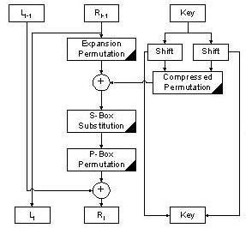
One Round of DES
L_{i} = R _{i-1}
R_{i} = L_{i-1} xor F(R_{i-1}, K_{i} )
Shambhu Upadhyaya
<number>

Slide 14
AES (Advanced Encryption Standard) Requirements
Private key symmetric block cipher
128-bit data, 128/192/256-bit keys
Stronger & faster than Triple-DES
Active life of 20-30 years (+ archival use)
Provide full specification & design details
Both C & Java implementations
NIST have released all submissions & unclassified analyses
Shambhu Upadhyaya
<number>

Slide 15
Rijndael
Processes data as 4 groups of 4 bytes (state)
Has 9/11/13 rounds in which state undergoes:
  byte substitution (1 S-box used on every byte)
  shift rows (permute bytes between groups/columns)
  mix columns (subs using matrix multiply of groups)
  add round key (XOR state with key material)
Initial XOR key material & incomplete last round
All operations can be combined into XOR and table lookups - hence very fast & efficient
Shambhu Upadhyaya
<number>
Notes:
Data is written into the state matrix by columns; this matrix is manipulated at stage of the en/decryption process, and is then finally copied to the output.
The key is expanded into 44/52/60 lots of 32-bit words (see later), with 4 used in each round.
The data computation then consists of an “add round key” step, then 9/11/13 rounds with all 4 steps, and a final 10th/12th/14th step of byte subs + mix cols + add round key. All steps are easily reversed.
Note only the “add round key” step makes use of the key and obscures the result, hence MUST be used at start and end of each round, since otherwise could undo effect of other steps. But the other steps provide confusion/diffusion/non-linearity. ie can look at cipher as a series of XOR with key then scramble/permute block repeated. This is efficient and highly secure it is believed.

Slide 16
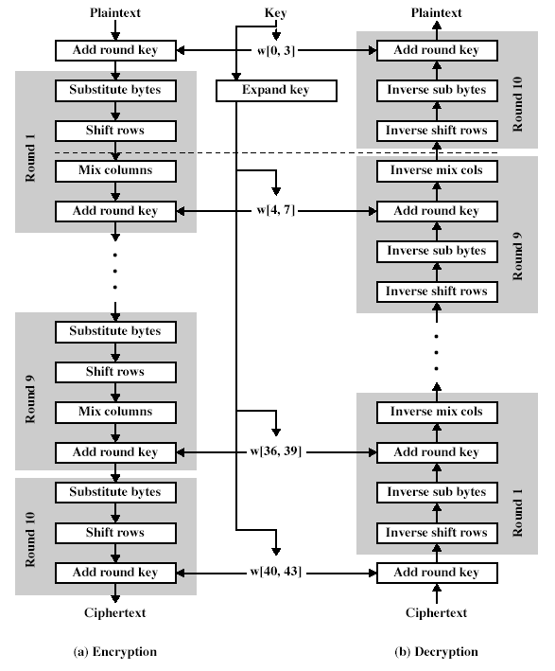
Rijndael
Shambhu Upadhyaya
<number>

Slide 17
Public Key Infrastructure
Based on mathematical functions
Asymmetric (two separate keys)
Enhances confidentiality, key distribution and authentication
Ingredients are
  Plaintext
  Encryption algorithm
  Public and private keys
  Ciphertext
  Decryption algorithm
Shambhu Upadhyaya
<number>

Slide 18
RSA
RSA encryption and decryption are commutative, hence it may be used directly as a digital signature scheme
Given an RSA scheme {(e,R), (d,p,q)}
To sign a message, compute:
  S = M^{d}(mod R)
To verify a signature, compute:
  M = S^{e}(mod R) = M^{e.d}(mod R) = M(mod R)
Thus know the message was signed by the owner of the public-key
Shambhu Upadhyaya
<number>

Slide 19
RSA
Would seem obvious that a message may be encrypted, then signed using RSA without increasing its size
But have blocking problem, since it is encrypted using the receivers modulus, but signed using the senders modulus (which may be smaller)
Several approaches possible to overcome this
More commonly use a hash function to create a separate message digest which is then signed
Shambhu Upadhyaya
<number>

Slide 20
RC5
A proprietary cipher owned by RSADSI
Designed by Ronald Rivest (of RSA fame)
Used in various RSADSI products
Can vary key size / data size / no. of rounds
Very clean and simple design
Easy implementation on various CPUs
Yet still regarded as secure
Shambhu Upadhyaya
<number>
Notes:
Successor to RC5 is RC6 which was a candidate for AES.
RC5 is known to be very secure. It is based on Feistel cipher.

Slide 21
RC5 Ciphers
RC5 is a family of ciphers RC5-w/r/b
  w = word size in bits (16/32/64)
  data=2w
  r = number of rounds (0..255)
  b = number of bytes in key (0..255)
Nominal version is RC5-32/12/16
  i.e., 32-bit words, so encrypts 64-bit data blocks
  using 12 rounds
  with 16 bytes (128-bit) secret key
Shambhu Upadhyaya
<number>

Slide 22
RC5 Key Expansion
RC5 uses 2r+2 subkey words (w-bits)
Subkeys are stored in array S[i], i=0..t-1
Then the key schedule consists of
  Initializing S to a fixed pseudorandom value, based on constants e and phi
  The byte key is copied (little-endian) into a c-word array L
  A mixing operation then combines L and S to form the final S array
Shambhu Upadhyaya
<number>

Slide 23
RC5 Encryption
Split input into two halves A & B
  L₀ = A + S[0];
  R₀ = B + S[1];
  for i = 1 to r do
    L_{i} = ((L_{i-1} XOR R_{i-1}) <<< R_{i-1}) + S[2 x i];
    R_{i} = ((R_{i-1} XOR L_{i}) <<< L_{i}) + S[2 x i + 1];
Each round is like 2 DES rounds
Note rotation is main source of non-linearity
Need reasonable number of rounds (e.g., 12-16)
Shambhu Upadhyaya
<number>

Slide 24
RC5 Modes
RFC2040 defines 4 modes used by RC5
  RC5 Block Cipher, is ECB mode
  RC5-CBC, is CBC mode
  RC5-CBC-PAD, is CBC with padding by bytes with value being the number of padding bytes
  RC5-CTS, a variant of CBC which is the same size as the original message, uses ciphertext stealing to keep size same as original
Shambhu Upadhyaya
<number>

Slide 25
Message Authentication
Message authentication is concerned with
  Protecting the integrity of a message
  Validating identity of originator
  Non-repudiation of origin (dispute resolution)
Can be provided by three methods
  Message encryption
  Message authentication code (MAC)
  Hash function
Shambhu Upadhyaya
<number>
Notes:
Up till now, have been concerned with protecting message content (ie secrecy) by encrypting the message. Will now consider how to protect message integrity (ie protection from modification), as well as confirming the identity of the sender. Generically this is the problem of message authentication, and in eCommerce applications is arguably more important than secrecy.

Slide 26
Message Encryption
Message encryption by itself also provides a measure of authentication
If symmetric encryption is used then
  Receiver knows sender must have created it
  Since only sender and receiver know the key used
  Content cannot be altered
  If message has suitable structure, redundancy or a checksum to detect any changes
Shambhu Upadhyaya
<number>

Slide 27
Message Encryption
If public-key encryption is used
  Encryption provides no confidence of sender at all
  Since anyone potentially knows public-key
  However if
    Senders sign message using their private-key
    Then encrypts with recipients public key
    Have both secrecy and authentication
  But at the cost of two public-key uses on message
Shambhu Upadhyaya
<number>

Slide 28
Message Authentication Code (MAC)
Generated by an algorithm that creates a small fixed-sized block
  Depending on both message and some key
  Like encryption, though need not be reversible
Appended to message as a signature
Receiver performs same computation on message and checks if it matches the MAC
Provides assurance that message is unaltered and comes from sender
Shambhu Upadhyaya
<number>

Slide 29
Digital Signatures
Have looked at message authentication
  But does not address issues of lack of trust
Digital signatures provide the ability to
  Verify author, date & time of signature
  Authenticate message contents
  Be verified by third parties to resolve disputes
Hence include authentication function with additional capabilities
Shambhu Upadhyaya
<number>

Slide 30
Digital Signature Properties
Must depend on the message signed
Must use information unique to sender
  To prevent both forgery and denial
Must be relatively easy to produce
Must be relatively easy to recognize & verify
Be computationally infeasible to forge
  With new message for existing digital signature
  With fraudulent digital signature for given message
To be practical, save digital signature in storage
Shambhu Upadhyaya
<number>

Slide 31
Direct Digital Signatures
Involve only sender & receiver
Assumes receiver has sender’s public-key
Digital signature made by sender signing entire message or hash with private-key
Can encrypt using receivers public-key
Important that sign first then encrypt message & signature
Security depends on sender’s private-key
Shambhu Upadhyaya
<number>
Notes:
Direct Digital Signatures involve the direct application of public-key algorithms. But are dependent on security of the sender’s private-key. Have problems if lost/stolen and signatures forged. Need time-stamps and timely key revocation.
Sign first and then encrypt. This way, when there is a dispute, the third party can simply view the message and its signature. If signed on an encrypted message, then the third party should have decryption key as well.

Slide 32
Arbitrated Digital Signatures
Involves use of arbiter A
  Validates any signed message
  Then dated and sent to recipient
Requires suitable level of trust in arbiter
Can be implemented with either private or public-key algorithms
Arbiter may or may not see the message
Shambhu Upadhyaya
<number>
Notes:
See Stallings Table 13-1 for various alternatives.

Slide 33
Digital Signature Standard (DSS)
U.S. Govt approved signature scheme FIPS 186
Uses the SHA hash algorithm
Designed by NIST & NSA in early 90's
DSS is the standard, DSA is the algorithm
A variant on ElGamal and Schnorr schemes
Creates a 320 bit signature, but with 512-1024 bit security
Security depends on difficulty of computing discrete logarithms
Shambhu Upadhyaya
<number>
Notes:
DSA is the US Govt approved signature scheme - designed to provide strong signatures without allowing easy use for encryption. The signature scheme has advantages, being both smaller (320 vs 1024bit) and faster (much of the computation is done modulo a 160 bit number) than RSA.

Slide 34
DSA Key Generation
Have shared global public key values (p,q,g):
  A large prime p such that 2^{L-1} < p < 2^{L}
    Where L= 512 to 1024 bits and is a multiple of 64
  Choose q, a 160 bit prime factor of p-1
  Choose g = h^{(p-1)/q}
    Where h<p-1, h^{(p-1)/q} (mod p) > 1
Users choose private & compute public key:
  Choose x<q
  Compute y = g^{x} (mod p)
Shambhu Upadhyaya
<number>

Slide 35
DSA Signature Creation
To sign a message M the sender:
  Generates a random signature key k, k<q
  k must be random, be destroyed after use, and never be reused
Then computes signature pair:
  r = (g^{k}(mod p))(mod q)
  s = (k⁻¹.SHA(M)+ x.r)(mod q)
Sends signature (r,s) with message M
Shambhu Upadhyaya
<number>
Notes:
Signature creation is similar to ElGamal with the use of a per message temporary signature key k, but doing calculations first mod p, then mod q to reduce the size of the result. Note that the use of the hash function SHA is explicit.
Note that only computing r involves calculation mod p and does not depend on message, hence can be done in advance.

Slide 36
DSA Signature Verification
Having received M & signature (r,s)
To verify a signature, recipient computes:
  w = s⁻¹(mod q)
  u1= (SHA(M).w)(mod q)
  u2= (r.w)(mod q)
  v = (g^{u1}.y^{u2}(mod p)) (mod q)
If v=r then signature is verified
Shambhu Upadhyaya
<number>
Notes:
Verification also consists of comparing two computations. Note that the difficulty of computing discrete logs is why it is infeasible for an opponent to recover k from r.
Note that nearly all the calculations are mod q, and hence are much faster save for the last step.

Slide 37
Program/Application Security
Intrusion by misusing programs in clever ways to obtain unauthorized higher levels of privilege
To prevent this a baseline behavior is established by observing the system call sequences
This can be done by executing the program in isolation and generating huge amount of data to train the system
Any malicious activity is captured through deviations from this baseline behavior
Avoids attacks such as obtaining root privileges illegally, running malicious code, insider threats, etc.
Shambhu Upadhyaya
<number>

Slide 38
Program/Application Security
Advantages
  Provides “true” end-to-end security
  Flexibility
  Protection against insider attacks
  Secure audit trails
  Mandate Use
Disadvantages
  Application dependence
  Maintenance difficulties
  Process speed degradation
Shambhu Upadhyaya
<number>

Slide 39
Network Security
The aim of network security is to protect networks from unauthorized modification, destruction, or disclosure, and provision of assurance that the network performs its critical functions correctly without harmful side-effects
Detection based on packet patterns
One of the methods for detecting intrusions is by using honeypots
Avoids unauthorized access to network resources, Denial Of Service attacks, etc.
Shambhu Upadhyaya
<number>

Slide 40
Network Security
Advantages
  Application independent
  Reduced cost
  Protection against external attack
  Ease of upgrade and modification
Shambhu Upadhyaya
<number>

Slide 41
Intruders
Significant issue for networked systems is hostile or unwanted access
Either via network or local
Can identify classes of intruders:
  Masquerader
  Misfeasor
  Clandestine user
Varying levels of competence
Shambhu Upadhyaya
<number>
Notes:
Masquerader – impersonation
Misfeasor – wrong use of legal operation
Clandestine – secretive operation (covert operation)

Slide 42
Intruders
Clearly a growing publicized problem
  From “Wily Hacker” in 1986/87
  Clearly escalating CERT stats
May seem benign, but still cost resources
May use compromised system to launch other attacks
Shambhu Upadhyaya
<number>

Slide 43
Intrusion Techniques
Aim to increase privileges on system
Basic attack methodology
  Target acquisition and information gathering
  Initial access
  Privilege escalation
  Covering tracks
Key goal often is to acquire passwords
So then exercise access rights of owner
Shambhu Upadhyaya
<number>

Slide 44
Password Guessing
One of the most common attacks
Attacker knows a login (from email/web page etc.)
Then attempts to guess password for it
  Try default passwords shipped with systems
  Try all short passwords
  Then try by searching dictionaries of common words
  Intelligent searches try passwords associated with the user (variations on names, birthday, phone, common words/interests)
  Before exhaustively searching all possible passwords
Check by login attempt or against stolen password file
Success depends on password chosen by user
Surveys show many users choose poorly
Shambhu Upadhyaya
<number>
Notes:
Password guessing is a common attack. If an attacker has obtained a poorly protected password file, then can mount attack off-line, so target is unaware of its progress. Some O/S take less care than others with their password files. If have to actually attempt to login to check guesses, then system should detect an abnormal number of failed logins, and hence trigger appropriate countermeasures by admins/security. Likelihood of success depends very much on how well the passwords are chosen. Unfortunately, users often don’t choose well.

Slide 45
Password Capture
Another attack involves password capture
  Watching over shoulder as password is entered
  Using a Trojan horse program to collect
  Monitoring an insecure network login (e.g., telnet, FTP, web, email)
  Extracting recorded info after successful login (web history/cache, last number dialled, etc.)
Using valid login/password can impersonate user
Users need to be educated to use suitable precautions/countermeasures
Shambhu Upadhyaya
<number>
Notes:
Have a range of ways of "capturing" a login/password pair, from the low-tech looking over the shoulder, to sophisticated network monitoring tools, or extracting recorded info after a successful login - say from web history or cache, or last number dialed memory on phones etc. Need to educate users to be aware of whose around, to check they really are interacting with the computer system (trusted path), to use secure network connections (HTTPS, SSH, SSL), to flush browser/phone histories after use etc

Slide 46
Intrusion Detection
Inevitably will have security failures
So need also to detect intrusions so you can
  Block if detected quickly
  Act as deterrent
  Collect info. to improve security
Assume intruder will behave differently to a legitimate user
  But will have imperfect distinction between
Shambhu Upadhyaya
<number>

Slide 47
Approaches to Intrusion Detection
Anomaly Detection Systems
  Statistical Approaches
  User Intent Identification
  Predictive pattern generation
  Neural Networks
Misuse Detection Systems
  Expert Systems
  Signature Analysis
  Colored Petri Nets
Shambhu Upadhyaya
<number>

Slide 48
What is a Firewall?
A choke point of control and monitoring
Interconnects networks with differing trust
Imposes restrictions on network services
  Only authorized traffic is allowed
Auditing and controlling access
  Can implement alarms for abnormal behavior
Is itself immune to penetration
Provides perimeter defense
Shambhu Upadhyaya
<number>

Slide 49
Firewall Limitations
Cannot protect from attacks bypassing it
  E.g., sneaker net, utility modems, trusted organizations, trusted services (e.g., SSL/SSH)
Cannot protect against internal threats
  E.g., disgruntled employee
Cannot protect against transfer of all virus infected programs or files
  Because of huge range of O/S & file types
Shambhu Upadhyaya
<number>
Notes:
Ssh tunneling via port forwarding. Google with keywords: “ssh tunneling firewall”

Slide 50
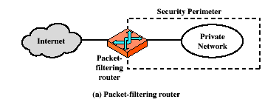
Firewalls – Packet Filters
Shambhu Upadhyaya
<number>

Slide 51
Firewalls – Packet Filters
Simplest of components
Foundation of any firewall system
Examine each IP packet (not content) and permit or deny according to rules
Hence restrict access to services (ports)
Possible default policies
  That not expressly permitted is prohibited
  That not expressly prohibited is permitted
Shambhu Upadhyaya
<number>

Slide 52
Attacks on Packet Filters
IP address spoofing
  Attack by spoofing trusted source addresses
  Remedy: Configure filters to ignore external incoming packets with internal source IP addresses
Source routing attacks
  Source routing involves specifying the exact route of the packet in the network
  Attacker sets a route other than default so as to attack a particular resource
  Remedy: Block source routed packets until necessary
Shambhu Upadhyaya
<number>

Slide 53
Attacks on Packet Filters
Tiny fragment attacks
  Split packet over several tiny packets (intentionally or due to underlying media requirements)
  Generally packet filters reject the first packet and let others pass with assumption that without the first packet the whole message cannot be reassembled
  To prevent an attack configure firewalls to keep a cache of recently seen first fragments and the filtering decision that was reached, and look up non-first fragments in this cache in order to apply the same decision
Shambhu Upadhyaya
<number>
Notes:
The gist of the slide is as follows -
Typical packet filters will drop the first packet if it matches with a bad signature but let the remaining fragments of the message through (in order to minimize checking overhead). However, a clever attacker can make tiny fragments such that the first packet will be pushed through (because the signature will not hit a match on the first tiny fragment......you need the full packet to hit a match). So, if you have a packet filter that rejects only the first packet (and lets the remaining packets through when there is a hit), then, by letting the first tiny fragment through, the attacker is able to smuggle in the entire bad message.
Countermeasure: 1) The packet filter must specify minimum size for a fragment so that such sneaky tiny fragments shouldn't be allowed in.
2) Bring in some more intelligence into the packet filter (this is the solution hinted in the slide). For example, keep a history of first fragments (regular or small) and the decision that was taken before (accept or reject). Then apply the reject decision for all non-first fragments so that no re-assembly is possible even if the first packet gets sneaked in.
The slide is a bit unclear. You can tell the class that one can address certain attacks on firewalls by making them a bit more intelligent (keep history and generating new rules.)

