Slide 1
Challenges, Threats and Hacking Methodologies and 802.11 Basics
Shambhu Upadhyaya
Wireless Network Security
CSE 566 (Lectures 5, 6)
Shambhu Upadhyaya
<number>

Slide 2
Outline of the Lecture
Overview of Challenges
802.11 Architecture
Shambhu Upadhyaya
<number>

Slide 3
Overview of Challenges
Shambhu Upadhyaya
Wireless Network Security
CSE 566 (Lecture 5)
Shambhu Upadhyaya
<number>

Slide 4
WLAN Security Goals
There are four goals one should aim for when installing a wireless network
  Access control - Only authorized users should be allowed to use the wireless network
  Data integrity - The network traffic should be secure against tampering
  Confidentiality - The user should be protected against a third party listening to the conversation
  Availability of service - The service should be secured against Denial of Service (DoS) attacks
Shambhu Upadhyaya
<number>

Slide 5
Basic WLAN Security Mechanisms
Service Set Identifier (SSID)
MAC Address filtering
Open System Authentication
Shared Key Authentication
Wired Equivalent Privacy (WEP) protocol
802.11 products are shipped by the vendors with all security mechanisms disabled !!
Shambhu Upadhyaya
<number>

Slide 6
SSID-Service Set Identifiers
Limits access by identifying the service area covered by the access points
AP periodically broadcasts SSID in beacon frames
End station listens to these broadcasts and choose an AP to associate with based upon its SSID
Use of SSID is a weak form of security as beacon management frames on 802.11 WLAN are always sent in the clear
A hacker can use analysis tools (e.g., AirMagnet, Netstumbler, AiroPeek) to identify SSIDs
Some vendors use default SSIDs which are pretty well known (e.g., CISCO uses tsunami)
Shambhu Upadhyaya
<number>
Notes:
Null authentication – you respond with an empty string for the SSID
Some APs accept it.

Slide 7
MAC Address Filtering
The system administrator can specify a list of MAC addresses that can communicate through an access point
Advantage
  Provides stronger security than SSID
Disadvantages
  Increases Administrative overhead
  Reduces scalability
  Determined hackers can still break it
Shambhu Upadhyaya
<number>

Slide 8

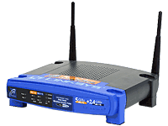
Open System Authentication
The default authentication protocol for 802.11
Authenticates anyone who requests authentication (null authentication)
End Node
Access Point
Authentication Request
Authentication Response
Shambhu Upadhyaya
<number>
Notes:
Use the authentication diagram from NIST notes.

Slide 9
Shared Key Authentication
This assumes that each station has received a secret shared key through a secure channel independent from the 802.11 network
Stations authenticate through shared knowledge of the secret key
Use of shared key authentication requires implementation of the ‘Wired Equivalent Privacy’ algorithm
Authentication Request
Authentication Challenge
Authentication Response
Authentication Result
End Station
Access Point
Shambhu Upadhyaya
<number>

Slide 10
Wired Equivalence Privacy (WEP)
Designed to provide confidentiality to a wireless network similar to that of standard LANs
WEP is essentially the RC4 symmetric key cryptographic algorithm (same key for encrypting and decrypting)
Transmitting station concatenates 40 bit key with a 24 bit Initialization Vector (IV) to produce pseudorandom key stream
Plaintext is XORed with the pseudorandom key stream to produce ciphertext
Shambhu Upadhyaya
<number>

Slide 11
Wired Equivalence Privacy (WEP)
Ciphertext is concatenated with IV and transmitted over the Wireless Medium
Receiving station reads the IV, concatenates it with the secret key to produce local copy of the pseudorandom key stream
Received ciphertext is XORed with the key stream generated to get back the plaintext
Shambhu Upadhyaya
<number>

Slide 12
Wired Equivalence Privacy (WEP)
WEP has been broken! Walker (Oct 2000), Borisov et al. (Jan 2001), Fluhrer-Mantin -Shamir (Aug 2001)
Unsafe at any key size: Testing reveals WEP encapsulation remains insecure whether its key length is 1 bit or 1,000 or any other size
Shambhu Upadhyaya
<number>
Notes:
More about this at: http://grouper.ieee.org/groups/802/11/Documents/DocumentHolder/0-362.zip – this link may not be active!

Slide 13
Threats to Wireless Networks
Threats in wireless networks can be configured into the following categories
  Errors and omissions
  Fraud and theft committed by authorized or unauthorized users of the system
  Employee sabotage
  Loss of physical and infrastructure support
  Malicious hackers
  Industrial espionage
  Malicious code
  Threats to personal privacy
Shambhu Upadhyaya
<number>

Slide 14
Vulnerabilities in Wireless Networks
Vulnerabilities in wireless networks include
  Existing vulnerabilities of wired networks apply to wireless networks as well
  Sensitive information that is not encrypted (or is encrypted with poor cryptographic techniques) and that is transmitted between two wireless devices may be intercepted and disclosed
  Denial of service (DoS) attacks may be directed at wireless connections or devices
  Sensitive data may be corrupted during improper synchronization
Shambhu Upadhyaya
<number>

Slide 15
Vulnerabilities, Contd..
  Malicious entities may be able to violate the privacy of legitimate users and be able to track their actual movements
  Handheld devices are easily stolen and can reveal sensitive information
  Interlopers, from inside or out, may be able to gain connectivity to network management controls and thereby disable or disrupt operations
Shambhu Upadhyaya
<number>

Slide 16
Wi-Fi Evil Twins
Evil twins are the latest menace to threaten the security of Internet users
Anyone with suitable equipment can locate a hotspot and take its place, substituting their own "evil twin”
There are no good solutions against it
Strong authentication and encryption could be good defenses
Shambhu Upadhyaya
<number>

Slide 17
Risks in Wireless Networks
Risks in wireless technology are considerable
Most of current communication protocols provide inadequate security
Many organizations still poorly manage their networks
  Deploying equipments with “factory default” settings
  Failing to control access points
  Not implementing security capabilities provided
  Not developing a suitable security architecture (e.g., Firewalls between wireless and wired systems, not using strong cryptography, etc.)
Shambhu Upadhyaya
<number>

Slide 18
WLAN - Security Problems
Attacks in WLANs can be classified as
Passive Attacks
  An attack in which an unauthorized party simply gains access
  to an asset and does not modify its content
  Eavesdropping
  Traffic Analysis
Active Attacks
An attack whereby an unauthorized party makes modifications to a message, data stream, or file
  Masquerading
  Replay
  Message Modification
  Denial of Service (DoS)
Shambhu Upadhyaya
<number>

Slide 19
Passive Attacks – Eavesdropping
Eavesdropping
  Used to gather information on the network under attack
  The intruder configures his wireless terminal to appear to have the same MAC address as an authorized access point or wireless terminal (Spoofing)
  When spoofing an access point, the intruder’s terminal appears as the authorized access point, with the intent to associate with an authorized wireless terminal and access the data on that device
  The anonymous attacker can passively intercept radio signals and decode the data being transmitted
Shambhu Upadhyaya
<number>

Slide 20
Passive Attacks – Eavesdropping
  Goals of attacker are to know about
    Users of the networks
    Accessible resources
    Capabilities of the equipment on the network
    Least and most used resources
    Coverage area of the network
  Attacker can then use this information to launch an attack on the network later
Shambhu Upadhyaya
<number>

Slide 21
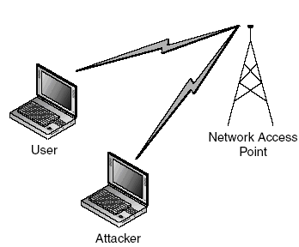
Passive Attacks – Eavesdropping
Eavesdropping
Shambhu Upadhyaya
<number>

Slide 22
Passive Attacks – Eavesdropping
With little or no modification, devices can be configured to capture all traffic on a particular network channel or frequency
Tests have shown that an attacker can be nearly 20 miles away from a target and still receive a signal, thereby eavesdropping on wireless network communications
Many commonly used network protocols transmit sensitive data such as username and password information in cleartext which can be captured by an attacker
These attacks are nearly impossible to detect and even harder to prevent
Shambhu Upadhyaya
<number>

Slide 23
Passive Attacks – War Driving
War Driving
  Very prevalent problem these days
  The process of searching for open wireless LANs by driving around a particular area
  The name comes from the term “war dialing” which is an old attack method that involves repeatedly dialing different numbers to search for modems and other network entry points
  War-driving software are freely available from sites like www.netstumbler.com
  War Driving conviction is first under the recent Can-Spam act (Controlling the Assault of Non-Solicited Pornography and Marketing Act of 2003)
Shambhu Upadhyaya
<number>
Notes:
News article for war driving conviction
http://news.com.com/%27Wardriving%27+conviction+is+first+under+Can-Spam/2100-7351_3-5390722.html?tag=st.rn
Some use GPS or antennas
Netstumbler, Kismet etc. are some of the software that are available
A Southern California man pleaded guilty to spamming people through unprotected hot spots, the first-ever conviction under the Can-Spam Act, and a case that again raises concerns about the risks of open-access Wi-Fi service.
Nicholas Tombros admitted driving around Venice, Calif., last year, searching for unprotected hot spots--an activity called "wardriving"--and exploiting them to distribute unsolicited e-mail that advertised pornographic Web sites.

Slide 24
Active Attacks - Jamming
Interference and Jamming
  Jamming is the deliberate introduction of interference to the signal by generating another signal at greater power and close to the transmitted frequency of the first signal
  Interference can be best described as the effect of unwanted signals or noise on a wanted signal
  Co-channel interference is caused by unwanted signals sharing the same frequency as the wanted signal
  Adjacent Channel Interference is caused by signals on neighbouring channels
Shambhu Upadhyaya
<number>

Slide 25
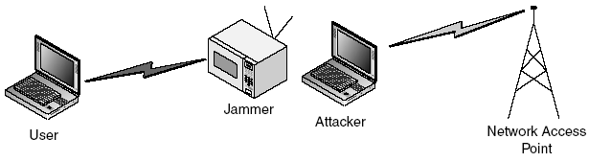
Active Attacks - Jamming
Client Jamming
  Provides an opportunity for a rogue client to take over or impersonate the jammed client
  Could be used to carry out DoS against a client station so that it loses network connectivity
  Could be used to interrupt connectivity of the client with the real base station to then reattach with a rogue station
Shambhu Upadhyaya
<number>

Slide 26
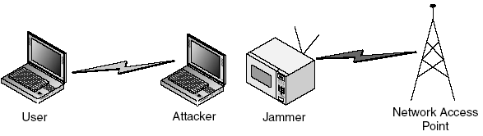
Active Attacks - Jamming
Base Station Jamming
  Jamming a base station provides an opportunity for a rogue base station to stand in for the legitimate base station
Shambhu Upadhyaya
<number>

Slide 27
Active Attacks - DoS
Jamming can be used to carry out Denial of Service (DoS) attacks against the network
DoS attacks can be carried out in the following ways
  Brute force attack
    Send a huge flood of packets that uses up all of the network's resources and forces it to shut down
    Use a very strong radio signal that totally dominates the airwaves and renders access points and radio cards useless
Shambhu Upadhyaya
<number>

Slide 28
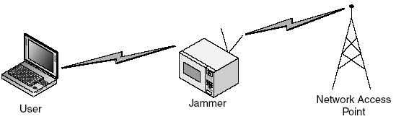
DoS Attack (Radio Signal Based)
As the entire area is flooded with interference, no stations can communicate with each other
This type of attack can require a significant amount of power if applied to a broad area
DoS attacks on wireless networks may be difficult to prevent and stop
Most wireless networking technologies use unlicensed frequencies and are subject to interference from a variety of different electronic devices
Shambhu Upadhyaya
<number>

Slide 29
DoS (Packet Based)
  The attacker uses other computers on the network to send useless packets to the server
  To initiate an attack, the intruder discovers an access point on the wireless network and then sends it a continuous stream of meaningless information
  This adds significant overhead on the network and takes away useable bandwidth from legitimate users
  Difficult to trace the attack source as it is hidden behind other users
Shambhu Upadhyaya
<number>

Slide 30
DDoS Using Botnets
Botnets (collection of software modules called robots) can be used to stage DDoS (distributed DoS) attacks
Basically, botnets are used to control and manage the zombies that are used to conduct distributed DoS attacks on a large scale
Botnets generally run hidden like the spyware and exercise control through IRCs (Internet Relay Chat)
There are instances where DNS attacks were carried out using botnets
Shambhu Upadhyaya
<number>
Notes:
In 2013, Syrian army staged a DNS attack on New York Times, Twitter and Huffington Post and took them offline.
DNS – translates the IP addresses to domain names.

Slide 31
DoS (Another type)
  Wi-Fi Protected Access (WPA) is vulnerable to a type of DoS attack
  WPA uses mathematical algorithms to authenticate users to the network
  If a non-authenticated user sends more than two packets of unauthorized data within one second, WPA assumes it is under attack and shuts down
  This opens up a loophole for the hackers where all they have to do is to send data-frames periodically, causing constant shutdowns
  The hackers are difficult to find because they don't need to use much transmit power or utilization of the network
Shambhu Upadhyaya
<number>

Slide 32
Active Attacks – Replay Attacks
The intruder monitors and captures transmitted packets between wireless terminals and access point
This is achieved via a passive monitoring utilities called ‘sniffers’ such as AirSnort, which are readily available on the Internet as freeware
Then these messages are replayed later so that they appear to be coming from authentic users
Shambhu Upadhyaya
<number>

Slide 33
Injection & Modification of Data
Injection attacks occur when an attacker adds data to an existing connection to maliciously send data or commands
An attacker can manipulate control messages and data streams by inserting packets or commands to a base station and vice versa
Inserting control messages on a valid control channel can result in the disassociation or disconnection of users from the network
An attacker can also flood the network access point with connect messages, tricking the network access point into exceeding a maximum limit, thereby denying authorized users access to the network
Shambhu Upadhyaya
<number>

Slide 34
Man in the Middle Attack
Man in the middle attack
  An attack that requires sophisticated software and can cause significant disruption or data loss
  The hacker inserts themselves between an access point and a wireless terminal to capture packets in transmission
  The wireless terminal sees the hacker as an authorized access point, while the access point sees the hacker as an authorized wireless terminal
  Both authorized devices fail to detect the intruder and continue transmitting information
  The intruder captures legitimate information and is also able to inject false data into the network, or initiate a DoS attack
  Can be active or passive attack
Shambhu Upadhyaya
<number>

Slide 35
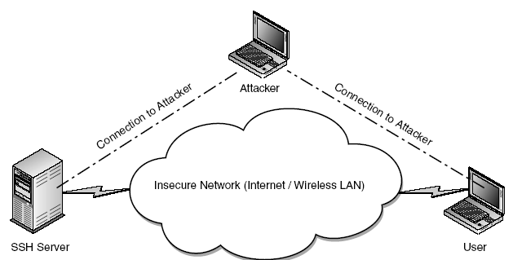
Man in the Middle Attack
Man in The Middle Attack
Shambhu Upadhyaya
<number>

Slide 36
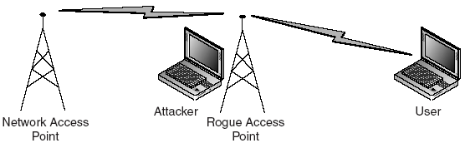
Rogue Access Points
Largest percentage of WLAN security attacks
Intercepts the traffic between access point and authorized user
Can collect the sensitive information like authentication credentials from the user
Shambhu Upadhyaya
<number>

Slide 37
Infrastructure Equipment Attacks
  Incorrectly configured infrastructure equipments targeted in such attacks
  Network devices such as routers, switches, backup servers, and log servers are prime targets
  Classified mainly as follows
    Switch attacks
      Flooding the MAC or ARP table in the switch to cause it to fail open
      Manipulating the protocol that the switches use to communicate - such as spanning tree
Shambhu Upadhyaya
<number>

Slide 38
Infrastructure Equipment Attacks
    MAC attacks
      ARP spoofing and other physical layer attacks that can be used to fool network devices into sending the data to unintended recipients
    Routing attacks
      Participating in the routing protocol, such as Open Shortest Path First (OSPF) or Enhanced Interior Gateway Routing Protocol (EIGRP), to change the flow of traffic for DoS or sniffing
Shambhu Upadhyaya
<number>
Notes:
ARP does the IP address translation to MAC addresses.

Slide 39
References
William A. Arbaugh, Narendar Shankar, Y.C. Justin Wan, “Your 802.11 Wireless Network has No Clothes, University of Maryland, 2001
NIST Notes on Wireless Networks Security,
Wireless Security, Merritt Maxim and David Pollino Copyright © 2002 by The McGraw-Hill Companies
Shambhu Upadhyaya
<number>

Slide 40
802.11 Architecture
Shambhu Upadhyaya
Wireless Network Security
CSE 566 (Lecture 6)
Shambhu Upadhyaya
<number>

Slide 41
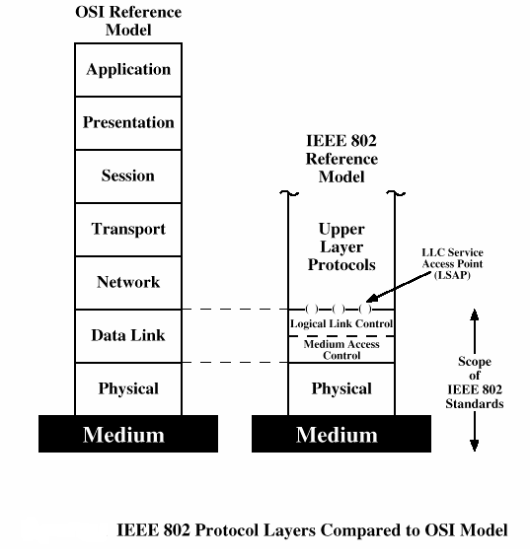
IEEE 802 Protocol Layers
Shambhu Upadhyaya
<number>

Slide 42
802.11 Sub-Layers
Higher layers
802.11c
802.11F
802.11d
802.11e
802.11h
802.11i
MAC
PHY
802.11a
802.11b
802.11g
Shambhu Upadhyaya
<number>

Slide 43

802.11 Layers Description
802.11 protocol covers the MAC and Physical Layer
Current standard defines Single MAC
Three Physical layers are supported
  Frequency Hopping Spread Spectrum in the 2.4 GHz Band
  Direct Sequence Spread Spectrum in the 2.4 GHz Band
  InfraRed
Shambhu Upadhyaya
<number>
Notes:
A dual media access control interface of the processor handles both the network requests of the processor and all co-processors, such as proactive management processors.

Slide 44
Protocol Architecture
Functions of physical layer
  Encoding/decoding of signals
  Preamble generation/removal (for synchronization)
  Bit transmission/reception
  Includes specification of the transmission medium
Functions of Medium Access Control (MAC) layer
  On transmission, assemble data into a frame with address and error detection fields
  On reception, disassemble frame and perform address recognition and error detection
  Govern access to the LAN transmission medium
Shambhu Upadhyaya
<number>

Slide 45
Protocol Architecture
Functions of logical link control (LLC) Layer
  Provide an interface to higher layers and perform flow and error control
The logic required to manage access to a shared-access medium not found in traditional layer 2 data link control
For the same LLC, several MAC options may be provided
Shambhu Upadhyaya
<number>
Notes:
MAC options are – CSMA/CA, CDMA, Slotted ALOHA, etc.

Slide 46
802.11 Physical Layer
MAC Protcol Data
Unit (MPDU)
Receiver
MAC Protcol Data
Unit (MPDU)
MAC
Sender
PHY
PLCP
header
MAC Protcol Data
Unit (MPDU)
PLCP
header
MAC Protcol Data
Unit (MPDU)
Physical Media
Dependent (PMD) layer
PMD layer
Frequency Hopping Spread Spectrum (FHSS) PHY
1, 2 Mbps
Direct Sequence Spread Spectrum (DSSS) PHY
1,2 Mbps
Infrared (IR) PHY
1,2 Mbps
Orthogonal Frequency Division Multiplexing (OFDM) PHY
6,9,12,18,24,36,48,54 Mbps
802.11a
Higher rate (DSSS) PHY
20+ Mbps
802.11g
High rate (DSSS) PHY
11, 5.5 Mbps
802.11b
2.4 GHz
5.7 GHz
Shambhu Upadhyaya
<number>
Notes:
Physical Layer Convergence Procedure Sublayer (PLCP)
IR frequencies – may vary on a wide range (GHz to THz)

Slide 47
802.11 MAC Layer
MAC Layer defines two different access methods
  The Distributed Coordination Function
  The Point Coordination Function
Shambhu Upadhyaya
<number>

Slide 48
Distributed Coordination Function
This uses the CSMA/CA (Carrier Sense Multiple Access/Collision Avoidance) mechanism for access resolution
Based on the popular CSMA protocols (eg., CSMA/CD used in Ethernet)
CSMA Protocol works as follows
  A station desiring to transmit senses the medium
  If the medium is busy then the station defers its transmission to a later time
  If the medium is sensed free then the station is allowed to transmit
Protocol extremely effective when medium is not heavily loaded
Shambhu Upadhyaya
<number>
Notes:
CSMA/CA is different from CSMA/CD. CSMA/CD deals with network transmissions after a collision is detected.
CSMA/CA listens to the network to avoid collision. This means that it contributes to the network traffic. It has to broadcast a signal to network to listen for collision scenario.

Slide 49
Distributed Coordination Function
If stations simultaneously sense the medium as being free and transmit at the same time, it causes a collision
Collision detected by MAC layer which causes retransmission
(In Ethernet the collisions are sensed by the sending stations which then cause an exponential backoff)
Similar strategy cannot be applied to Wireless networks because
  This would require full duplex radios capable of transmitting and receiving at the same time which would be very expensive
  In wireless domain all stations do not hear all other stations which is a requirement for this protocol
Shambhu Upadhyaya
<number>

Slide 50
CSMA/CA
Thus 802.11 uses a Collision Avoidance scheme with positive acknowledgements
  A station wanting to transmit senses the medium. If the medium is busy then it defers
  If the medium is free for a specified time (Distributed Inter Frame Space (DIFS)), then the station is allowed to transmit
  The receiving station checks the CRC of the received packet and sends an acknowledgment packet (ACK)
  Receipt of the acknowledgment indicates to the transmitter that no collision occurred
  If the sender does not receive the acknowledgment then it retransmits the fragment until it receives acknowledgment or is thrown away after a given number of retransmissions
Shambhu Upadhyaya
<number>

Slide 51
CSMA/CA
To reduce the probability of collisions between transmissions from stations which cannot hear each other, Wi-Fi uses a Virtual Carrier Sense mechanism
  If a station wants to transmit it sends a RTS (Request to Send) signal
  This includes the source, destination, duration of the following transmission
  If the medium is free the destination responds with a CTS (Clear to Send) signal
  All stations receiving either the RTS and/or the CTS, set their Virtual Carrier Sense indicator (called NAV, (Network Allocation Vector)), for the given duration
  The stations use the NAV along with physical carrier sense to sense and transmit
Shambhu Upadhyaya
<number>

Slide 52
Point Coordinated Function
Beyond the basic Distributed Coordination Function, there is an optional Point Coordination Function
May be used to implement time-bounded services, like voice or video transmission
This Point Coordination Function makes use of the higher priority that the Access Point may gain by the use of a smaller Inter Frame Space (PIFS)
By using this higher priority access, the Access Point issues polling requests to the stations for data transmission, hence controlling medium access
In order to still enable regular stations to access the medium, there is a provision that the Access Point must leave enough time for Distributed Access in between the PCF
Shambhu Upadhyaya
<number>

Slide 53
802.11 MAC Contd…
Fragmentation and Reassembly
  Typical Ethernet packets are long (hundreds of bytes)
  Smaller packets preferable for wireless networks
    Due to the higher Bit Error Rate of a radio link, probability of packet getting corrupted increases with packet size
    In case of packet corruption (either due to collision or noise), the smaller the packet, the less overhead it causes to retransmit it
    Due to Frequency Hopping system, the medium is interrupted periodically for hopping, so smaller packets cause less overhead
Shambhu Upadhyaya
<number>
Notes:
Smaller granularity is better.

Slide 54
Fragmentation & Reassembly
To have smaller packet size for 802.11 a fragmentation/reassembly mechanism is placed at the MAC Layer
It uses a simple Send – Wait algorithm
  In this a large frame is fragmented and individual fragments are transmitted
  Once a fragment is transmitted the algorithm waits till one of the following happens:
    Receives an ACK for the said fragment, or
    Decides that the fragment was retransmitted too many times and drops the whole frame
Shambhu Upadhyaya
<number>

Slide 55
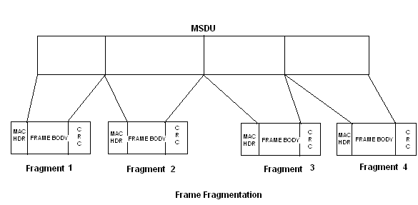
Fragmentation & Reassembly
MSDU – MAC Service Data Unit
CRC – Cyclic Redundancy Check
Shambhu Upadhyaya
<number>
Notes:
MSDU MAC Layer Service Data unit
MPDU MAC Layer Protocol Data Unit
MSDU – 2304 Octets
The maximum size of
a MSDU is 2304 octets and of a MPDU 2312 octets, i.e. without fragmentation. However for the direct
sequence spread spectrum (DSSS) physical layer with a data rate of 2 MBit/s the recommended maximum
MPDU size is 800 octets, which corresponds to a packet duration smaller than 3.5 milliseconds. The MAC
and PHY overhead per packet is 58 octets. On the reverse link the size of an ACK frame is 38 octets or 152
microseconds

Slide 56
802.11 MAC Contd..
MAC Defines 4 types of Inter Frame Space (IFS)
  SIFS - Short Inter Frame Space
  PIFS - Point Coordination IFS
  DIFS - Distributed IFS
  EIFS - Extended IFS
Shambhu Upadhyaya
<number>

Slide 57
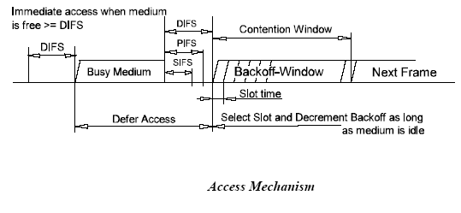
Exponential Back-off Algorithm
Exponential Back-off Algorithm- Resolves Contention and is executed in the following cases
  When the station senses the medium before the first transmission of a packet, and the medium is busy
  After each retransmission, and
  After a successful transmission
Shambhu Upadhyaya
<number>

Slide 58
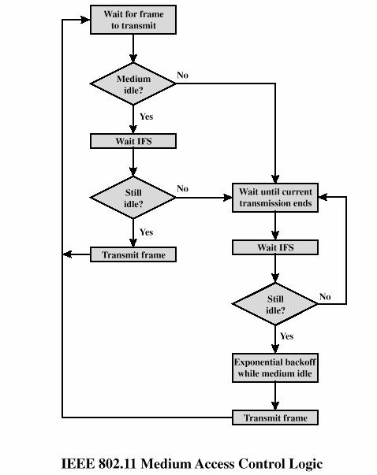
802.11 MAC Logic
Shambhu Upadhyaya
<number>

Slide 59
MAC Frames
MAC frames can be classified into following 3 types
  Data Frames
    Used for transmission of actual data on the medium
  Control Frames
    Used for controlling access to the medium (RTS, CTS,
    ACK)
  Management Frames
    Transmitted in manner similar to data frames and
    used to exchange management information but
    are not transferred to upper layers
Shambhu Upadhyaya
<number>

Slide 60
MAC Frames
Control Frames
  RTS (Request To Send)
  CTS (Clear To Send)
  ACK (Acknowledge)
Management Frames
  Beacon (notify)
  Probe (notify)
  Authenticate (request and response)
  Associate (request and response)
  Reassociate (request and response)
  Disassociate (notify)
  Deauthenticate (notify)
Shambhu Upadhyaya
<number>

Slide 61
MAC Frames
Frame Format
This contains the following fields
Preamble
PLCP (Physical Layer Convergence Protocol) Header
MAC Header
User Data
CRC (Cyclic Redundancy Check)
Shambhu Upadhyaya
<number>

Slide 62
MAC Frames
Preamble
  This is used to identify the frame format as 802.11
  Contains special bit sequences used by clients for synchronization purpose
PLCP Header
  Contains the information used by the Physical Layer to decode the frames like data rate, packet length etc.
MAC Header
  Different for Data, Control and Management frames
  Most important part of MAC header is the addressing information
  The addresses are 6 bytes long and are unique for each device
Shambhu Upadhyaya
<number>

Slide 63
MAC Frames Contd..
  Destination address can be of the following types:
    Unicast Address
    Multicast Address
    Broadcast Address
  Frame can have two to four addresses
    Transmitter Address (TA)
    Receiver Address (RA)
    Source Address (SA)
    Destination Address (DA)
User Data
  This is the actual data to be transmitted
CRC
  Used for error detection and correction
Shambhu Upadhyaya
<number>

Slide 64
Beacon Frames
Sent by Access Points to advertise themselves
Can be used to
  Locate access point with right SSID and suitable parameters
  After association, lets devices know that the base station is still active
  Helps coordinate operations such as power save mode
Shambhu Upadhyaya
<number>

Slide 65
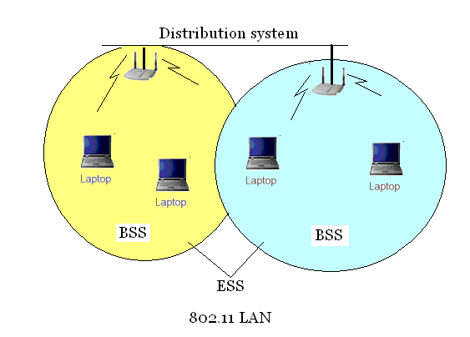
802.11 LAN Example
Shambhu Upadhyaya
<number>

Slide 66
802.11 Architecture
Architecture Components
  802.11 LAN is based on a cellular architecture
  Basic Service Set (BSS)
  Background Network- Distribution system (DS)
  Extended Service Set (ESS)
  Portal: Device which connects between an 802.11 and another 802 LAN
802.11 Supports
  Infrastructure Mode
  Ad hoc mode
Shambhu Upadhyaya
<number>

Slide 67
802.11 Architecture
Infrastructure mode
  An 802.11 networking framework in which devices communicate with each other by first going through an Access Point (AP)
AD-hoc Mode
  An 802.11 networking framework in which devices or stations communicate directly with each other, without the use of an access point (AP)
Shambhu Upadhyaya
<number>

Slide 68
IEEE 802.11 Terminology
Basic Service Set (BSS)
  A set of stations controlled by a single “Coordination Function” (= the logical function that determines when a station can transmit or receive)
  Similar to a “cell” in pre IEEE terminology
  A BSS can have an Access-Point (both in standalone networks and in building-wide configurations), or can run without an Access-Point (in standalone networks only)
  Diameter of the cell is approx. twice the coverage-distance between two wireless stations
BSS
Shambhu Upadhyaya
<number>

Slide 69
IEEE 802.11 Terminology
IBSS- Independent Basic Service Set
  A Basic Service Set (BSS) which forms a self-contained network in which no access to a Distribution System is available
  A BSS without an Access-Point
  One of the stations in the IBSS can be configured to “initiate” the network and assume the Coordination Function
  Diameter of the cell determined by coverage distance between two wireless stations
IBSS
Shambhu Upadhyaya
<number>

Slide 70
IEEE 802.11 Terminology
Extended Service Set (ESS)
  A set of one or more Basic Service Sets interconnected by a Distribution System (DS)
  Traffic always flows via Access-Point
  Diameter of the cell is double the coverage distance between two wireless stations
Distribution System (DS)
  A system to interconnect a set of Basic Service Sets
    Integrated: A single Access-Point in a standalone network
    Wired: Using cable to interconnect the Access-Points
    Wireless: Using wireless to interconnect the Access-Points
Shambhu Upadhyaya
<number>

Slide 71

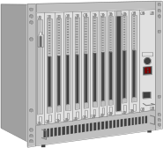


Infrastructure Mode
fixed
terminal
mobile terminal
infrastructure
network
access point
application
application
TCP
TCP
IP
IP
LLC
LLC
LLC
802.11 MAC
802.11 MAC
802.3 MAC
802.3 MAC
802.11 PHY
802.11 PHY
802.3 PHY
802.3 PHY
Shambhu Upadhyaya
<number>

Slide 72
Operation in Infrastructure Mode
For a Station to associate with an Access Point
for data transfer it goes through the following
steps
Station finds the Access Point it wants to associate with. This can be done by
  Passive Scanning
    Station just waits to receive a Beacon Frame which the
    Access Point periodically transmits
  Active Scanning
  Station tries to locate an Access Point by transmitting Probe Request Frames to the Access Point
Station decides to join one of the available Access Points based on signal strength
Shambhu Upadhyaya
<number>

Slide 73
Operation in Infrastructure Mode
After the station chooses the particular access point it wants to associate with, it goes through the Authentication process
  This is used to control the access to infrastructure
  Stations identify themselves to other stations (or Access-Points) prior to data traffic or association
  802.11 provides two types of authentication methods:
    Open System Authentication
      Uses null authentication algorithm
      Default
    Shared Key Authentication
      Uses WEP privacy algorithm
      Optional
Shambhu Upadhyaya
<number>

Slide 74
Operation in Infrastructure Mode
Depending on the result of the Authentication phase the Access Point replies with a Authentication Response (accept/reject) Message
On getting a positive Authentication Response message the station sends a Association Request to the Access Point
In reply to this message the Access Point replies with a Association Response message
This leads to a successful connection establishment between the station and the Access Point and now the channel is usable for data transfer
Shambhu Upadhyaya
<number>

Slide 75
Services in Infrastructure Mode
Association-Related Services
  Association
    Establishes initial association between Station and Access Point
  Re-Association
    Enables transfer of association from one Access Point to another, allowing station to move from one BSS to another
  Disassociation
    Association termination notice from station or Access Point
Shambhu Upadhyaya
<number>

Slide 76
Services in Infrastructure Mode
Access and Privacy Services
  Authentication
    Establishes identity of stations to each other
  De-Authentication
    Invoked when existing authentication is terminated
  Privacy
    Prevents message contents from being read by unintended recipient
Shambhu Upadhyaya
<number>

Slide 77
Services in Infrastructure Mode
Transition Services Based On Mobility
  No transition
    Stationary or moves only within BSS
  BSS transition
    Station moving from one BSS to another BSS in same ESS
  ESS transition
    Station moving from BSS in one ESS to BSS within another ESS
Shambhu Upadhyaya
<number>

Slide 78
References
Jon Edney and William Arbaugh, Real 802.11 Security, Addison-Wesley, 2004 (Chapter 5)
IEEE 802.11 Technical Tutorial,
http://sss-mag.com/pdf/802_11tut.pdf
Shambhu Upadhyaya
<number>

