Slide 1
802.11 Security – WEP
Shambhu Upadhyaya
Wireless Network Security
CSE 566 (Lecture 9)
Shambhu Upadhyaya
<number>

Slide 2
Requirements of 802.11 WLAN Security
Encryption and Data Privacy
Requires mechanism to provide data privacy and integrity
  The security mechanism should enforce the integrity of data under any circumstances
Authentication and Access Control
Authentication should be mutual
  A framework to facilitate the transmission of authentication messages between clients, access points and authentication servers
Shambhu Upadhyaya
<number>

Slide 3
WEP – Wired Equivalent Privacy
WEP
  Used to protect link-layer communications from eavesdropping and other attacks
  Determines what encryption and authentication method is used to secure wireless data
WEP has two types of Protection:
  Secret Key
  Encryption
Shambhu Upadhyaya
<number>

Slide 4
WEP Description
According to 802.11 WEP is:
  Reasonably strong: Changing the Key (K) and Initialization Vector (IV)
  Self synchronizing- critical for data link level encryption
  Efficient- Both hardware and software implementations
  It is Optional
Two levels of security:
  Open security – really means no security
  Shared security – known secret key
Authentication: Two parts to WEP
  Authentication
  Encryption
Shambhu Upadhyaya
<number>
Notes:
From chapter 6 of 802.11 security book

Slide 5

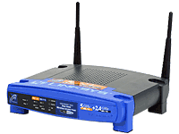
Authentication Sequence in 802.11
Open Authentication
Access Point
Authentication Request
Authentication Response
Shambhu Upadhyaya
<number>

Slide 6
Authentication Sequence in 802.11
Shared Key Authentication
Authentication Request
Authentication Challenge
Authentication Response
Authentication Result
End Station
Access Point
Shambhu Upadhyaya
<number>

Slide 7
WEP Limitations
Shared key authentication in WEP doesn’t provide mutual authentication
With 802.11 WEP, the AP and client stations on a particular WLAN must use the same encryption key
A major problem with the 802.11 standard is that the keys are cumbersome to change
There is no key management provision in the WEP protocol
So, there is no security if many users sharing the identical key continue to use for long periods of time
If one station is lost or stolen, it will threaten the security of all stations using this key
Shambhu Upadhyaya
<number>

Slide 8
WEP
WEP uses stream ciphers
Stream ciphers - Sequence of ordinary data to sequence of encrypted data
WEP uses RC4 Algorithm to encrypt data
Initialization Vector (IV) + Secret key → Combined RC4 Key
RC4
Algorithm
$
a
c
W
&
b
Shambhu Upadhyaya
<number>

Slide 9
RC4
Encryption algorithm used to encrypt the data sent over the airwaves
Scrambles each and every byte of data sent in a packet
RC4 consists of two parts:
  The Key Scheduling Algorithm (KSA)
  The Psuedo Random Generation Algorithm (PRGA)
Shambhu Upadhyaya
<number>
Notes:
Introduce to array swapping.

Slide 10
Key Scheduling Algorithm
First part of the encryption process
Algorithm
  1. Assume N = 256
  2. K[ ] = Secret Key array
  3. Initialization:
  4. For i = 0 to N – 1
  5. S[ i ] = i
  6. j = 0
  7. Scrambling:
  8. For i = 0 ... N – 1
  9. j = j + S[i] + K[i]
  10. Swap(S[i], S[j])
Shambhu Upadhyaya
<number>
Notes:
Explanation
1. N is an index value. It determines how strong the scrambling process is. WEP uses a value of 256.
2. K is the letter used to symbolize the secret key array. In the case of a five character, pre-shared key, this value would be the three-character IV + five character pre-shared key _ eight-character secret key. Each character is held in the corresponding K position. This value does not get scrambled.
3. This starts the initialization of the KSA. It basically is used to seed the empty State (S[]) array with values 0[nd]255.
4. This is the start of the loop process that increases the value of i each time the algorithm loops.
5. Once it is done, the S array will hold values 0[nd]255 in corresponding array position 0[nd]255.
6. j is used to hold a value during the scrambling process, but it must first be initialized to ensure that it always starts at 0.
7. This starts the scrambling process that creates the psuedo random S array from the previously seeded S array.
8. Another loop that ensures the scrambling process occurs 256 times.
9. This is the equation used to merge the properties of the secret key with the state array (S[]) to create a pseudo random number, which is assigned to j.
10. Finally, a swap function is performed to swap the value held in S[i] with the value held in S[j].

Slide 11
Pseudo Random Generation Algorithm
Pseudo Random Generation Algorithm outputs a streaming key based on the KSA’s pseudo random state array
Streaming key + plaintext data ---> stream of encrypted data
Algorithm
  1. Initialization:
  2. i = 0
  3. j = 0
  4. Generation Loop:
  5. i = i + 1
  6. j = j + S[i]
  7. Swap(S[i], S[j])
  8. Output z = S[S[i] + S[j]]
  9. Output XORed with data
Shambhu Upadhyaya
<number>
Notes:
Explanation
1. Again, before using the PRGA, the i and j values must be initialized.
2. i initialized to 0.
3. j initialized to 0.
4. This starts the stream-generation processes. It will continue until there is no more data, which in WEP’s case is the end of the packet of data[md]or about 1,500 bytes.
5. i is added to itself to keep a running value used in the swap process.
Note: This value will ALWAYS equal 1 the first time through the PRGA loop (i = i + 1 _ i = 0 + 1 = 1).
6. j is used to hold the pseudo random number in the S[] position, with the previous S[] added to it.
Note: This value will ALWAYS hold the value held in S[1] for the first iteration of the PRGA (j = j + S[i] _ j = 0 + S[1]).
7. Another swap function is performed that switches the values held in the i position and j position of the state array.
8. z is calculated based on an addition of the value held in the state array, as represented by the addition of the values held in S[i] added to S[j]. (This will be better understood after seeing the example later in the article.)
9. Finally, the z value is XORed with the plaintext to create a new and encrypted value. This can be represented by the equation encrypted data = z XOR plaintext.
Note: XOR only requires that you know ANY two of the values to deduce the third. In other words, if the plaintext is known and the encrypted data is captured by a sniffer, a hacker can deduce the z value outputted by the PRGA.

Slide 12
Cyclic Redundancy Checksum
Final part of the data-transmission process
Used to check the integrity of the transmitted data
CRC – comparing the CRC before packaging the data and after transmission
NEW CRC matches ORIGINAL CRC – Packet is complete else corrupted
Shambhu Upadhyaya
<number>

Slide 13
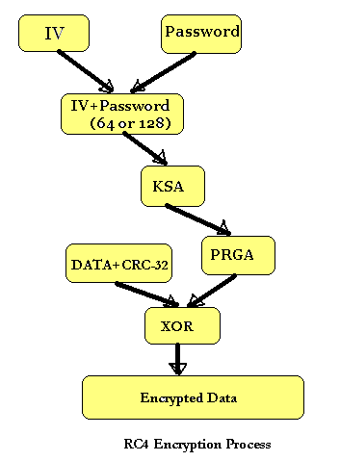
Encryption Algorithm
Shambhu Upadhyaya
<number>

Slide 14
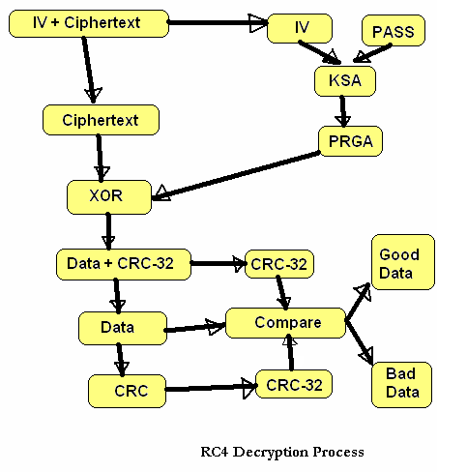
Decrypting algorithm
Shambhu Upadhyaya
<number>

Slide 15
Cracking WEP
Vulnerabilities in WEP
  IV is sent as plaintext with the encrypted packet. Hence by sniffing it is easy to find the first 3 characters of the secret key
  The KSA and PRGA leak information during the first few iterations of their algorithm
    The i will always be 1, and j will always equal S[1] for the first iteration of the PRGA
    KSA is easily duplicable for the first three iterations as the first 3 characters of the secret key are passed as plaintext
  XOR is a simple process that can be easily used to deduce any unknown value if the other two values are known
Shambhu Upadhyaya
<number>

Slide 16
Cracking WEP – FMS Attack
Fluhrer Mantin Shamir (FMS) Attack
  Identified certain IVs that leak information about the secret key
  Reduces the key space so brute force is practically possible
  This assumes that the attacker has knowledge of the first few bytes of plain text
  Because of RFC 1042 (SNAP headers), all IP and ARP packets always start with 0xAA
  Therefore, the first few bytes of plaintext are always known
  Requires collection of ~ 500,000-2,000,000 packets and < 1 minute cracking time
  Works with both 40-bit and 104-bit independent of how the key is generated
Shambhu Upadhyaya
<number>
Notes:
SNAP Header – Subnet Access Protocol

Slide 17
Cracking WEP – FMS Attack
This attack requires huge amount of data collection
In a high traffic network, this can be accomplished in a matter of hours
However, in a low traffic environment, this process can take days or weeks
To expedite this process some attackers artificially generate network traffic in order to capture cipher text to crack the key
Shambhu Upadhyaya
<number>

Slide 18
Cracking WEP – FMS Attack
One possible packet injection attack works like this:
  The attacker captures an encrypted text looking for a known protocol negotiation based on the size of the packet. E.g., an ARP request has a predictable size (28 bytes)
  Once captured, the attacker re-injects the encrypted packet (ARP request) over and over again
  The ARP response will generate new traffic, which the attacker can then capture
  If the attacker repeats this process over and over again, it is possible to generate enough traffic for a successful FMS attack in about an hour
Shambhu Upadhyaya
<number>

Slide 19
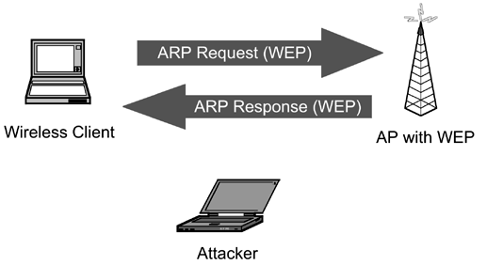
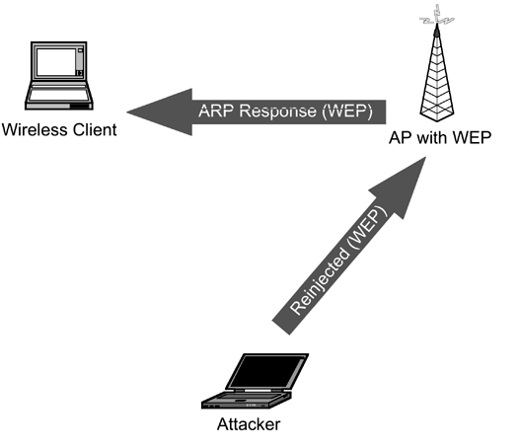
Cracking WEP – FMS Attack
The attacker captures a legitimate, encrypted packet and guesses that it is an ARP request based on a known size (28 bytes)
The attacker floods the network with the re-injected ARP request. This results in a flood of ARP responses, which the attacker captures as part of an FMS attack
Shambhu Upadhyaya
<number>

Slide 20
Methods to crack WEP
Vulnerabilities of WEP:
  WEP key recovery
  Unauthorized decryption and the violation of data integrity
  Poor key management
  No access point authentication
Tools used to crack WEP keys
  WEP crack (https://sourceforge.net/projects/wepcrack/)
  Air snort (https://airsnort.soft112.com/)
  Many more…..
Shambhu Upadhyaya
<number>

Slide 21
Improving WEP’s Security
Recommended Practice includes
  Per-link keys
    Unique key per STA
  IV Sequencing
    Check for monotonically increasing IVs
    Weak IV avoidance
  104-bit keys
    IV + Key = 128-bits
  Rapid Rekey
    Derive WEP keys from master key
    Change encryption key frequently
Shambhu Upadhyaya
<number>

Slide 22
Suggested Improvements to WEP
IV Sequence check protects from both intentional and unintentional IV reuse. Protection from IV reuse makes it harder to mount attacks
Longer Key requires adversary to acquire more packets for key recovery
Authenticated Key Refreshing provides a secure and synchronized mechanism for re-keying
Frequent rekeying makes it harder to recover (derived) encryption key. Even if key is cracked, it’s only the temporal encryption key
MAC-Layer Rekeying allows for faster refresh
Implementation is backward compatible. All improvements are additions on top of current WEP implementations
Shambhu Upadhyaya
<number>

Slide 23
References
Jon Edney and William Arbaugh, Real 802.11 Security, Addison-Wesley, 2004 (Chapter 6)
Shambhu Upadhyaya
<number>

