Slide 1
Ad Hoc Networks, Routing and Security
Shambhu Upadhyaya
Wireless Network Security
CSE 566 (Lectures 20)
Shambhu Upadhyaya
<number>

Slide 2
Introduction
Two basic groups of ad-hoc networks
  Networks of mobile computers
  Wireless sensor networks
Basic characteristic
Ability to establish network communication between hosts without any infrastructure
  The most significant advance compared to classical fixed systems
  Reveals a very large scale of new possibilities
Shambhu Upadhyaya
<number>

Slide 3
Ad-hoc Fundamentals
Ad hoc networks are autonomous networks operating either in isolation or as “stub networks” connecting to a fixed network
Do not necessarily rely on existing infrastructure
No “access point”
Each node serves as a router and forwards packets for other nodes in the network
Topology of the network continuously changes
Shambhu Upadhyaya
<number>
Notes:
Stub network is a LAN which has only one logical path to the non-local network. It is like an island connected to the mainland by one bridge or a set of bridges (logically, it is just a bridge).

Slide 4
Ad-Hoc Fundamentals
Characteristics
  Dynamic topology: Nodes are free to move arbitrarily within the network (or leave and join the network) causing random topology changes which can happen rapidly at unpredictable times. Packets are very likely routed over multiple hops
  Variable capacity links: Significantly lower link capacities compared to traditional hardwired links. High mobility -> low link capacity and vice versa
  Congestion: More like a rule than exception
  Energy-constrained mobile nodes: Nodes usually operate on batteries -> all operations must be optimized for energy conservation
  Weakened physical security: More prone to physical threats than hardwired networks
Shambhu Upadhyaya
<number>
Notes:
High mobility results in time-varying characteristics and link errors.

Slide 5
Motivation
Must support mobility
Avoids single point of failure typical of centralized systems
Often unable to rely on existing communications infrastructure
Desire for a rapidly deployable, self -organizing network
Multi-hop packet routing used to exchange messages between users who are not within LOS of each other
Shambhu Upadhyaya
<number>

Slide 6
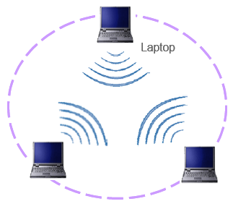
Why Ad-hoc networks?
Setting up of fixed access points and backbone infrastructure is not always viable
  Infrastructure may not be present in a disaster area or war zone
  Infrastructure may not be practical for short-range radios; Bluetooth (range ~ 10m)
Ad hoc networks
  Do not need backbone infrastructure support
  Are easy to deploy
  Self-configure
  Useful when infrastructure is absent, destroyed or impractical
Shambhu Upadhyaya
<number>

Slide 7
Challenges
Limitations of the Wireless Network
Packet loss due to transmission errors
Variable capacity links
Frequent disconnections/partitions
Limited communication bandwidth
Broadcast nature of the communications
Limitations imposed by Mobility
Dynamically changing topologies/routes
Lack of mobility awareness by system/applications
Limitations of the Mobile Computer
Short battery lifetime
Limited capacities
Shambhu Upadhyaya
<number>
Notes:
Variable capacity due to congestion is common.

Slide 8
Applications
Military
  Rapidly deployable battle-site networks
  Sensor fields
  Unmanned aerial vehicles
Disaster management
  Disaster relief teams that cannot rely on existing infrastructure
Neighborhood area networks (NANs)
  Shareable Internet access in high density urban settings
Impromptu communications among groups of people
  Meetings/conferences
  Wearable computing
Automobile communications
Shambhu Upadhyaya
<number>

Slide 9
Routing in Ad-Hoc Networks
Why traditional routing protocols cannot be used in mobile ad-hoc networks?
  MANETs are usually highly dynamic and heterogeneous mobile networks
  No pre-existing infrastructure
  No centralized administration
  Dynamic topologies
  Variable capacity links
  Energy-constrained nodes
  Limited physical security
Shambhu Upadhyaya
<number>

Slide 10
MANET Protocols
Proactive Protocols
  Table driven
  Continuously evaluate routes
  No latency in route discovery
  Large network capacity to keep info. current
  Most routing info. may never be used!
  Establish routes in advance
  Example: Optimized Link State Routing Protocol (OLSR)
Reactive Protocols
  On Demand
  Route discovery by some global search
  Bottleneck due to latency of route discovery
  May not be appropriate for real-time comm.
  Establish routes as needed
  Example: Dynamic Source Routing (DSR)
  Less routing overhead, but higher latency in establishing the path
Shambhu Upadhyaya
<number>

Slide 11
MANET Protocols
Hybrid
  Proactive within a restricted geographic area, reactive if a packet must traverse several of these areas
  Example: Zone Routing Protocol (ZRP)
Shambhu Upadhyaya
<number>

Slide 12
DSR (Dynamic Source Routing)
DSR is a simple and efficient on-demand source routing protocol designed for multi-hop wireless ad-hoc networks
DSR doesn’t require any existing network infrastructure
DSR allows network to be completely self-organizing and self configuring
Two major phases
  Route discovery
  Route maintenance
Route discovery: Used to discover new source routes across multiple network hops to arbitrary destinations in an ad-hoc network
Route maintenance: Responsible for detecting network topology changes and keeping up-to-date information of already discovered source routes
Shambhu Upadhyaya
<number>

Slide 13
Overview
Route discovery and route maintenance rely on source route caches that are maintained in each node participating in a DSR network
Each route cache can contain several routes to the same destination node
Upper levels of software can decide on which criteria source route is selected (throughput, reliability, no. of hops, etc.)
Designed to work up to 200 nodes
Use of source routing makes packet routing trivially loop free
Supports both unidirectional and bidirectional links
Entirely on-demand based operation -> protocol overhead
Scales to that needed to react to the topology changes (zero overhead if all nodes stationary and routes have been discovered already)
Shambhu Upadhyaya
<number>
Notes:
Protocol overhead if demands increase

Slide 14
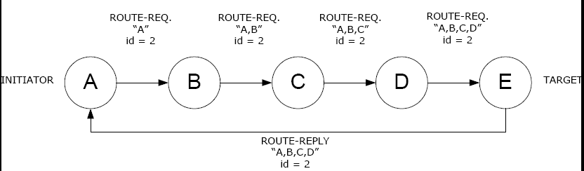
Route Discovery
If source route to the target node is not found in the cache, node A initiates route discovery
Route-Request packet contains
  Information about the initiator (A)
  The target of the Route-Request (E)
  Unique request identifier (2)
  List of node addresses through which the particular Route-Request packet has been forwarded
Shambhu Upadhyaya
<number>

Slide 15
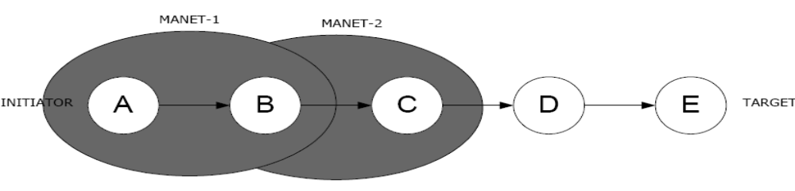
Route Discovery
It is highly possible that some nodes receive the same Route-Request packet more than once -> duplicate packets are discarded
When returning Route-Reply, node E must take into account that some links in source route might be unidirectional
If node E doesn’t have a route to node A, it must in turn send a Route-Request to the node A. In that case, Route-Reply packet is piggybacked in a Route-Request packet to avoid infinite recursion
Shambhu Upadhyaya
<number>

Slide 16
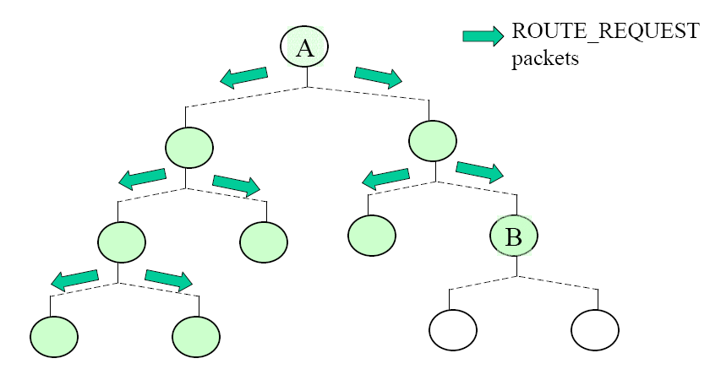
DSR Illustration
Shambhu Upadhyaya
<number>

Slide 17
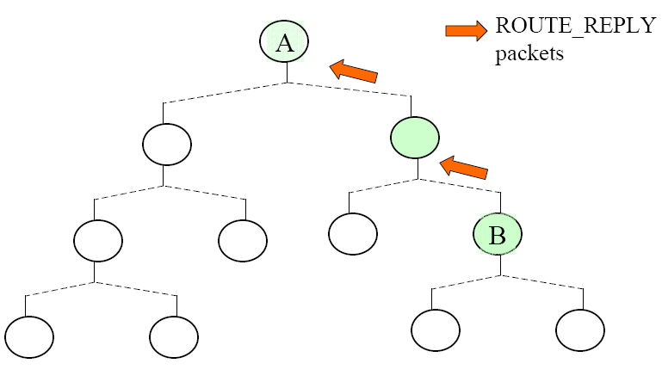
DSR Illustration
Shambhu Upadhyaya
<number>

Slide 18
DSR Illustration
Intermediate nodes may cache accumulated route record contained in the ROUTE_REQUEST packet headers in order to reduce routing overhead
  Security concerns with this type of snooping
Confirmation of the receipt of a packet can be done by passive acknowledgement
  Node overhears a downstream node forwarding the packet
DSR also contains provisions to avoid route reply storms
5
1
3
1,3,4
1,3
1
1,3,4,5
(1,3,4,6)
5
3
src
1,2
4
(1,3,4,6)
1
1
2
1,3,4
6
4
(1,3,4,6)
dst
6
2
Shambhu Upadhyaya
<number>

Slide 19

Route Maintenance
Each node is responsible for confirming that the next hop in a source route receives the packet
The packet is retransmitted up to some maximum number of times until the confirmation is received from the next hop
Confirmation options: link-level acks, passive acks or software level acks
If retransmission results in a failure, Route-Error packet is sent to the initiator. Route-Error packet contains information about which link has failed so the initiator can remove that source route from its cache
Shambhu Upadhyaya
<number>

Slide 20
Summary
Advantages
  Ability to work with asymmetric links
  No periodical routing advertisement
    Enables bandwidth and energy conservation
    Overhead does not exist when there are no changes in the network
  Can be easily improved to become able
  for providing multiple routes
    That way, it is not always necessary to initiate new route discovery when some link breaks
Shambhu Upadhyaya
<number>

Slide 21
Summary
Disadvantages
  Large bandwidth overhead
    Route request packets rapidly grow as they propagate through the network (in their route records they store information about every host over which they passed)
    That causes potential huge route reply packets
    Also larger message packets, because addressing demands the whole route to be specified
  Scalability problems – acceptable size of the network is limited
    Diameter of the network (the largest number of hops needed for communication between any two hosts in the network) directly refers to bandwidth overhead
Shambhu Upadhyaya
<number>

Slide 22
AODV protocol
Ad hoc On demand Distance Vector routing protocol
New route is discovered in a manner
that looks similar to route discovery by DSR
  Source host (src) broadcasts route request (RREQ) to all of its neighbors when it needs to discover route to some destination host (dst)
  Then, it waits for route reply (RREP)
But similarity is discontinued at this point
Shambhu Upadhyaya
<number>

Slide 23
AODV protocol
Sequence number
  Number that every host generates for itself
  It is incremented every time when something
  is changed in adjacency (e.g., when some link breaks)
  For every route, destination sequence number (DSN) is stored in the routing table
  Last DSN that src earlier knew for any route to dst, is sent in RREQ, together with current sequence number of src and other information needed
  RREQ (src, dst, srcSN, dstDSN, … )
Shambhu Upadhyaya
<number>

Slide 24
AODV protocol
RREQ does not contain the route record
  Does not collect information about hosts through which it propagates
  Remembers only the number of hops
Instead, the host through which RREQ propagates adds inverse route (towards src) to its routing table
  Stores, together with other relevant information, the address of the neighbor that sent RREQ to it
  If that host later receives relevant RREP, it will automatically know that reply should be transferred to the neighbor
  In that case, it also records the address of the neighbor that sent RREP, thus establishing route towards dst
Shambhu Upadhyaya
<number>

Slide 25
AODV protocol
Instead of recording the whole route, as with DSR applied, host here keeps only next hop (among other relevant information about some destination), i.e., address of its neighbor to which it transfers packets addressed to the destination
Shambhu Upadhyaya
<number>

Slide 26
Summary
Advantages
  Significantly smaller network bandwidth overhead
    Both control and message packets are smaller
    The reason is the requirement of only two addresses when routing (destination and next hop), instead of the whole route as with sequenced routing
    This is good for scalability, because the size of a packet does not depend on the network diameter
  Provides support for multicasting
Shambhu Upadhyaya
<number>

Slide 27
Summary
Disadvantages
  Works only with symmetric links
  Hosts must periodically advertise hello messages
    Increased bandwidth overhead
    Reduced possibility of energy conservation
    by remaining in the sleep mode
  Does not support multi path routing (offers only one route per destination)
    Every time when some link on the route breaks, new route must be discovered
    Increased probability of congestion
Shambhu Upadhyaya
<number>

Slide 28
Security Goals and Challenges
Availability
  Survive despite DoS attack
  Primary concern: Key management service
Confidentiality
Integrity
Authentication
Non-repudiation
Challenges
  Use of wireless links leads ad hoc networks susceptible to link attacks
  Relatively poor protection, as in battlefields
  So for high survivability, distributed architecture needed
  Dynamic network topology: ROUTING
  Scalable security mechanisms
Shambhu Upadhyaya
<number>

Slide 29
Security Problems with Existing Ad hoc Routing Protocols
Attacks against ad hoc routing protocols can be active or passive
A passive attack does not disrupt the operation of the protocol, but tries to discover valuable information by listening to traffic
An active attack injects arbitrary packets and tries to disrupt the operation of the protocol in order to limit availability, gain authentication, or attract packets destined to other nodes
Shambhu Upadhyaya
<number>

Slide 30
Specific Attacks
Location disclosure: reveals information regarding the location of nodes, or the structure of the network
Black hole: an attacker advertises a zero metric for all destinations causing all nodes around it to route packets towards it
Replay attack: an attacker sends old advertisements to a node causing it to update its routing table with stale routes
Wormhole: an attacker records packets at one location in the network, and tunnels them to another location
Shambhu Upadhyaya
<number>

Slide 31
Security Requirements for Ad hoc Routing Protocols
Certain discovery: if a route between two nodes exists it should always be found
Isolation: misbehaving nodes should be identified and isolated from routing
Location privacy: protect information about node location and network structure
Self-stabilization: the routing protocol should be able to recover from any problem without human intervention
Byzantine robustness: should be able to function properly even if some participating nodes are disrupting its operation
Lightweight computations
Shambhu Upadhyaya
<number>

Slide 32
Routing Security in MANETs
The External Attack Prevention Model (EAPM) secures the network from external attacks by implementing message authentication code to ensure integrity of route request packets
The Internal Attack Detection Model (IADM) is used to analyze local data traces gathered by the local data collection module and identify the misbehaving nodes in the network
Shambhu Upadhyaya
<number>
Notes:
Reference: Hongmei Deng, Wei Li and Dharma P. Agrawal, “Routing Security in Wireless Ad Hoc Networks” , IEEE Communications Magazine, vol. 40, no. 10, October 2002.

Slide 33
Possible Solutions
Black hole - disable the ability to reply in a message of an intermediate node
IPSec – but complex
TIARA (Techniques for intrusion resistant ad hoc routing protocols)
SAR (Security aware ad hoc routing)
ARAN (Authenticated routing for ad hoc networks)
Shambhu Upadhyaya
<number>

Slide 34
References
http://www.cscjournals.org/manuscript/Journals/IJCSS/Volume1/Issue1/IJCSS-6.pdf
Shambhu Upadhyaya
<number>

