Slide 1
Sensor Networks Security
Shambhu Upadhyaya
Wireless Network Security
CSE 566 (Lecture 23)
Shambhu Upadhyaya
<number>

Slide 2
Outline
Motivation
Challenges
Threat and trust model
Overview of security solutions
DoS attack case study for sensor networks
  Physical layer
  Link layer
  Transport layer
Protocol vulnerabilities
Shambhu Upadhyaya
<number>

Slide 3
Motivation
Sensor networks – promising approach
Monitoring wildlife, machinery performance monitoring, earthquake monitoring, military application, highway traffic, etc.
Perform in-network processing
  Data aggregation and forwarding summaries
Critical to protect it
  Traditional security techniques cannot be applied
  Deployed in accessible areas – subject to physical attacks
  Close to people – poses additional problems
Shambhu Upadhyaya
<number>
Notes:
Some examples –
Sensor networks over mobile phones
Wildlife passages - Europe
Forest fire monitoring – Australia
Volcano eruption monitoring in Ecuador
Land slide monitoring in Kerala, India
Animal Habitat monitoring at Cornell U.

Slide 4
Sensor Networks Vulnerabilities
Military Applications
Military can use sensor networks for a host of purposes like detecting the movement of troops, etc.
Disasters
It may be necessary to protect the location and status of casualties from unauthorized disclosure
Public Safety
False alarms about chemical, biological, or environmental threats could cause panic or disregard for warning systems. An attack on the system’s availability could precede a real attack on the protected resource
Home HealthCare
Because protecting privacy is paramount, only authorized users should be able to query or monitor the network
Shambhu Upadhyaya
<number>

Slide 5
Challenges
Challenges in sensor networks
  Resource constrained environments
  Large scale ad-hoc distribution
  High fault tolerance requirement
  Large range of operating environments
  Limited Bandwidth
Security challenges
  Key establishment
  Secrecy, authentication, privacy, robustness against DoS attacks
  Secure routing
  Node capture
Shambhu Upadhyaya
<number>

Slide 6
Threat and Trust Model
Outsider attacks
  Eavesdropping passive attacks
  Alter or spoof packets or inject interfering wireless signals to jam network
  Disable sensor nodes by injecting useless packets and drain battery
Insider attacks
  Node compromise (capture and reprogram)
  Possess the keys and participate in the secret communications
Base station as a point of trust
  Scalability becomes a problem
  Base station becomes a bottleneck
Shambhu Upadhyaya
<number>

Slide 7
Security Solutions
Secrecy and authentication
  Key establishment and management
  PKI is expensive and subject to DoS attacks (bogus messages to initiate signature verification)
  Multicast authentication using mTesla
Availability
  Jamming and packet injection (use spread spectrum, authentication, etc. to counter attack)
  Routing attacks (use multi-path routing)
Stealth attacks
  Attack the service integrity
  Make networks accept false data value (no good solutions available)
Shambhu Upadhyaya
<number>

Slide 8
The Denial of Service Threat
Denial of Service could be due to any of the following factors
  An adversary trying to bring down the network
  Hardware failures
  Software bugs
  Resource exhaustion
  Environmental conditions
  Any complicated interaction of the above factors
Shambhu Upadhyaya
<number>

Slide 9
Design Considerations
Operate in harsh environments
Distinguish among DoS attacks and normal failure of node
Considerations like protection of keys in case of physical attack
Layered network architecture although computationally expensive helps in a better security design
Shambhu Upadhyaya
<number>

Slide 10
Jamming Attacks (DoS)
Jamming is transmitting signals to the receiving antenna at the same frequency band or sub band as the communications transmitter transmits
Jamming, thus is used to hinder the reception at the other end
Nodes can distinguish jamming from failure as in jamming constant energy rather than lack of response impedes communication
Shambhu Upadhyaya
<number>

Slide 11
Jamming Attacks (Contd…)
Most common defense against jamming attacks is to use spread spectrum techniques
These techniques can be defeated by following the exact hopping sequence or by jamming a large bandwidth
Defense
  The nodes can combat jamming by switching to a lower duty cycle and hence preserving power
Shambhu Upadhyaya
<number>

Slide 12
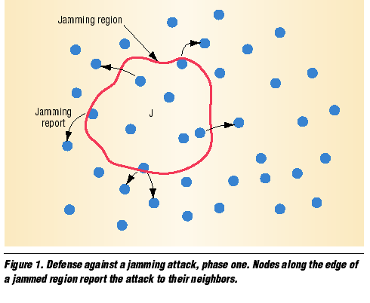
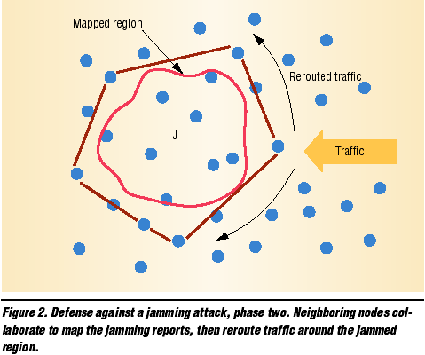
Jamming Attacks
Shambhu Upadhyaya
<number>

Slide 13
Tampering (DoS)
This attack involves physical access, interrogation and compromise of the nodes
Providing physical security to all the nodes in a large sensor network is impractical
Defense
  The nodes should react to tamper in a fail-complete manner
Shambhu Upadhyaya
<number>
Notes:
Example of the U.S. spy plane that landed in Chinese territory in April 2001. Sensitive equipments were destroyed before interrogation.

Slide 14
Link Layer (DoS)
Link Layer provides channel arbitration for neighbor to neighbor communication. It uses cooperative schemes like carrier sense that makes it vulnerable to DoS attacks
  Exhaustion
  This involves induction of continuous collisions and other messages to exhaust the resources of the other nodes
  Collision
  In this type of attacks adversaries induce a collision during the transmission of frame causing retransmission
Shambhu Upadhyaya
<number>

Slide 15
Collision Attack
This attack involves inducing a collision in just one octet of transmission
The collision causes a checksum error at the other end
Corrupted ACK control messages can cause expensive exponential back-off in some protocols
Shambhu Upadhyaya
<number>

Slide 16
Collision Attack
Error Correcting codes can be used to minimize the effect of such attacks but these have expensive overheads
Although networks can use collision detection to thwart such attacks, however, a degree of cooperation is required among the nodes for network operation
Shambhu Upadhyaya
<number>

Slide 17
Exhaustion Attack
This type of attack involves introducing collisions in frames towards the end of transmission
Thus the transmitting node continuously retransmits the packets and finally dies off
A self sacrificing node can use the interactive nature of MAC protocols to launch an interrogation attack
Defense
  One solution is to make MAC admission control rate limiting so that network ignores excessive requests
Shambhu Upadhyaya
<number>
Notes:
Interrogation attack – excessive RTS, CTS

Slide 18
Network Layer (DoS)
Routing protocols that exist in the network layer must be simple enough to scale to a large number of nodes yet robust enough to cope with failures
  Homing Attack
  In this type of attack the attacker tries to get down Nodes with special functions
  Neglect and Greed
  In this attack the adversary node confirms the reception of the transmission but then drops it rather than forwarding it
Shambhu Upadhyaya
<number>

Slide 19
Network Layer
  Misdirection
  This involves forwarding of packets along wrong paths so as to waste network bandwidth
  Black Holes
  This type of attacks are used in networks using distance vector routing where the adversary sends out incorrect route cost advertisements
Shambhu Upadhyaya
<number>

Slide 20
Neglect and Greed
This is one of the simplest form of attack where the malicious node acknowledges the reception of message from other node but then drops the packet
This leads to waste of precious network bandwidth and causes retransmission
If the node gives undue priority to its own messages then it is also called as Greedy
Shambhu Upadhyaya
<number>

Slide 21
Neglect and Greed
The Dynamic Source Routing (DSR) protocol is susceptible to this attack
As the network caches routes, nodes use the same route to the destination and if a node is not generous, it may degrade or block traffic
Defense
  Use of multiple routing paths
  Sending redundant messages
Shambhu Upadhyaya
<number>

Slide 22
Homing Attack
In a sensor network some nodes are assigned special responsibilities
Location based network protocols that rely on geographic forwarding expose the network to such attacks
In these attacks the attacker passively listens to the network and learns the location of such nodes
Then with the help of powerful mobile devices these nodes are attacked and brought down
Defense
  One approach is to encrypt the headers so as to hide the location of the important nodes
Shambhu Upadhyaya
<number>
Notes:
Location-based protocol

Slide 23
Misdirection
This is a more active form of attack where the messages are forwarded along wrong paths perhaps by fabricating malicious route advertisements
One variant of this attack is the Internet Smurf attacks
In sensor network an adversary can forge the address of a node and send route discovery messages to all the nodes
Defense
  This type of attack can be thwarted by using egress filtering
  Using authentication of sender can also help
Shambhu Upadhyaya
<number>
Notes:
Smurf attack: Send ICMP echo request “ping” to target machines from a spoofed address. The replies will overwhelm the network – DOS attack.
Egress filtering ensures that spoofed packets don’t leave your network.

Slide 24
Black Hole Attack
Networks using distance vector routing protocols are susceptible to this attack
It involves network nodes sending zero cost route advertisements to all its neighbors
As these cost advertisements propagate all network traffic is directed towards this node which leads to intense resource contention in the neighboring nodes
Hence this forms a sort of Black Hole in the network
Defense
  Allow only authorized nodes to exchange route info
  Monitoring of nodes and node watchdogs
  Test network connectivity by probing
  Use message redundancy
Shambhu Upadhyaya
<number>

Slide 25
Transport Layer (DoS)
This layer is responsible for maintaining end to end connections among the communicating entities. Sensor networks are vulnerable to the following attacks at this layer
  Flooding
  Attacks protocols maintaining state at either end of the connection by causing memory exhaustion
  De-synchronization
  This involves disrupting existing connections among the nodes by desynchronizing their transmissions
Shambhu Upadhyaya
<number>

Slide 26
Flooding Attack
This attack is similar to the TCP SYN attack where a node opens a large number of half open connections with another node to use up the resources
Limiting the total number of connections prevents complete resource exhaustion but it also may prevent legitimate users from accessing the node
Defense
  This type of attack can be prevented by the use of client puzzles
  The puzzles are computationally expensive and hence serve as a deterrent
Shambhu Upadhyaya
<number>
Notes:
Client puzzle is a cryptographic countermeasure against DoS attacks. Client has to computer a mathematical function before making the connection.

Slide 27
De-synchronization
This attack is used to disrupt existing connection by causing them to go out of synchronization
This involves repeatedly sending forged messages to both of the communicating parties with various flags like Seq, Control flags set so that the nodes go out of synchronization
If the attacker can maintain proper timing then it can prevent both the nodes from exchanging any useful information
Defense
  Use message authentication for control packets
Shambhu Upadhyaya
<number>

Slide 28
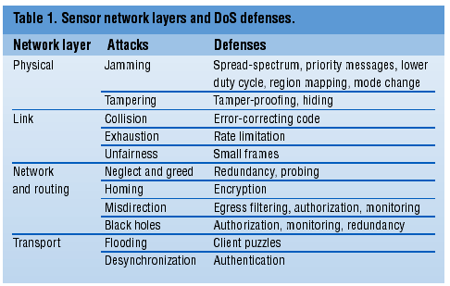
Attacks and Defenses
Shambhu Upadhyaya
<number>

Slide 29
Attacks on Improved MAC Protocols in Sensor Networks
Adaptive Rate Control Protocol
  Developed to improve MAC layer performance but lends itself vulnerable to DoS attacks
Real Time Location Based Protocols (RAP)
  Uses a novel velocity monotonic scheduling (VMS) policy but adversary can exploit this feature
Shambhu Upadhyaya
<number>
Notes:
Adaptive rate control and RAP are some protocol improvements (MAC protocols) for sensor networks
Adaptive rate control protocols
Improve the CSMA schemes, exponential backoff combined with random delay.
Ref: Alec Woo and David E. Culler. 2001. A transmission control scheme for media access in sensor networks. In Proceedings of the 7th annual international conference on Mobile computing and networking (MobiCom '01). ACM, New York, NY, USA, 221-235.

Slide 30
Adaptive Rate Control Protocol
Random delays for transmissions
Back off that shifts an application’s periodicity phase
Minimization of overhead in contention control mechanisms
Passive adaptation of originating and route through admission control rates
Anticipatory delay for avoiding multi-hop hidden-node problems
Shambhu Upadhyaya
<number>
Notes:
Hidden node problem occurs in star topology. Nodes can communicate with the hub. But the nodes themselves cannot hear each other.
Route through admission control:
In MANETs, one can practice admission control to better utilize the bandwith at the time of connection.

Slide 31
Adaptive Rate Control Protocol
All these features help in improving the efficiency of the protocol but still rely on co-operation among nodes
The protocol also gives preference to route-through traffic by reducing the back-off for such packets by 50%
This increases the probability of Flooding attacks
Shambhu Upadhyaya
<number>

Slide 32
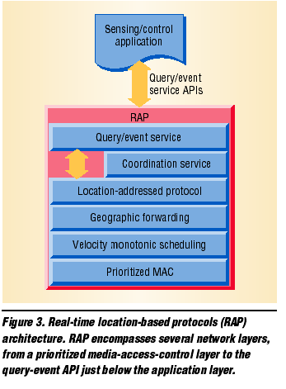
Real Time Location Based Protocol (RAP)
The VMS layer stamps packets with a desired velocity, calculated from the distance to travel and the end-to-end deadline
The originator can compute the velocity statically or the network can re-compute it dynamically at each intermediate node, based on the distance left and the time taken so far
Nodes schedule packet relay by giving higher priority to higher-velocity packets
Shambhu Upadhyaya
<number>

Slide 33
Real Time Location Based Protocol (RAP)
An attacker can exploit the vulnerabilities in the RAP protocol by generating a large number of High Velocity packets. This can be achieved by
  Making the deadlines short
  Making the distance extraordinarily large
This attack could succeed even if the network uses a location directory to detect out of network nodes
Shambhu Upadhyaya
<number>

Slide 34
Real Time Location Based Protocol (RAP)
The malicious node can also cause the packets being routed from it to miss their deadlines by intentionally lowering the velocity
Also the RAP Protocol uses a synchronized clock to compute the time frame for the packets. Hence this also forms a possible area of attack
Shambhu Upadhyaya
<number>

Slide 35
Conclusion
Secure routing is vital to acceptance and use of sensor networks
The current protocols lack the support and are inherently insecure
Authentication and cryptography presents the first line of defense but is not enough
Security in sensor networks is an open problem and requires much more work
Shambhu Upadhyaya
<number>

Slide 36
References
Wood, A.D., and Stankovic, J.A., “Denial of Service in`Sensor Networks”, IEEE Computer, Oct 2002, pp. 54-62
Shi E. and A. Perrig, “Designing Secure Sensor Networks”, IEEE Wireless Communications, Dec. 2004
A. Perrig, J. Stankovic and D. Wagner, “Security in Wireless Sensor Networks”, CACM, June 2004
Shambhu Upadhyaya
<number>

