Slide 1
INF-1400 Mandatory Assignment 1
Breakout-Clone
Isak S. Singh
Emil Rydningen
Raymon S. Hansen
24.1.2017

Slide 2
Introduction
Python + Pygame
Object Oriented Programming: Classes and Methods

Slide 3
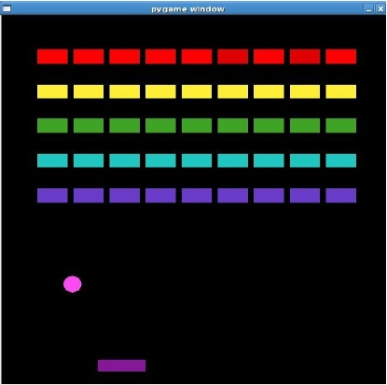
Breakout
Support the basic mechanic of the original game
Paddle
Bricks
Win the game when all bricks are removed
If the ball misses the paddle, the game is lost
Interface/Visuals: Completely free

Slide 4
Requirements
Object Oriented Programming: Classes and Methods
The paddle should be steered with either the mouse or arrow keys
The ball should bounce off the platform in different angles depending on where on the paddle it hit
Bricks should disappear when hit by the ball
The ball should bounce of the walls and the ceiling
The game is won when all bricks are gone, and lost if the ball hits the ground
Well structured and commented code

Slide 5
Extras
More levels
Health system (the ball has to hit the floor 3 times before losing the game)
Highscore-list
Sounds
Power-ups (Extra life, shooting, bigger platform, etc.)
Bricks can take multiple hits
Whatever you want

Slide 6
Report
Describe what you did
Discuss relevant and difficult problems regarding your solution
Class diagram (see book og slides)
Figures
Present the most important you have done, and the hardest part of it all

Slide 7
Alternate Assignment
Possibility to do something completely different
Design must be approved by the course staff before implementation
Still a requirement for object oriented programming
It will mean a higher workload if you choose to do so

Slide 8
Deliverables
inf1400-username-1/
|--src/
| |--all the source files here
| |--README
|
|--report.pdf
The report must be in .pdf format to be approved
.zip or tar.gz archive
Deadline: February 21th

Slide 9
Cheating
Copying code is not allowed
Copying someone elses design or a design found on the internet is not allowed
Looking at a solution while writing the assignment is not allowed
Incorrect use of references is not allowed
Getting help from a fellow student to solve a problem is allowed
Discussing design with a fellow student is allowed
Obtaining the solution (code, design or a description) is not allowed

Slide 10
Tips
Start early!
Uphold the deadline, no matter the status of your implementation
Ask us if you are having trouble
Questions?

Slide 11
Questions
We are available through email
  raymon.s.hansen@uit.no
  isak.s.singh@uit.no

