Slide 1
Introduction
inf-2201 Operating System Fundamentals
Spring 2017
Lars Ailo Bongo (larsab@cs.uit.no)

Slide 2

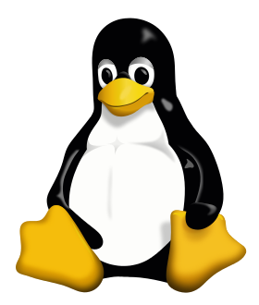

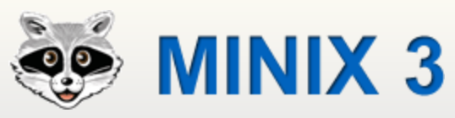

Slide 3
Application
Operating System
Hardware
OS’es for many different types of devices
Differing requirements (functionality, footprint, real-time)
Abstractions and many design issues are still shared

Slide 4












Slide 5
Multics
IBM OS/360
IBM VM/370
MS-DOS
Unix’es
Mach
L4
Exokernel
…
Barrelfish
Corey/ The Library OS
Tesselation
Vortex
…

Slide 6
New challenges
1000s of cores
TB’s of memory
100’000s of machines
GPU, accelerators
Power usage
Sensors
…

Slide 7
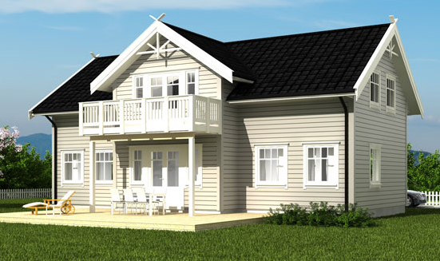

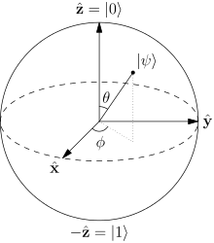
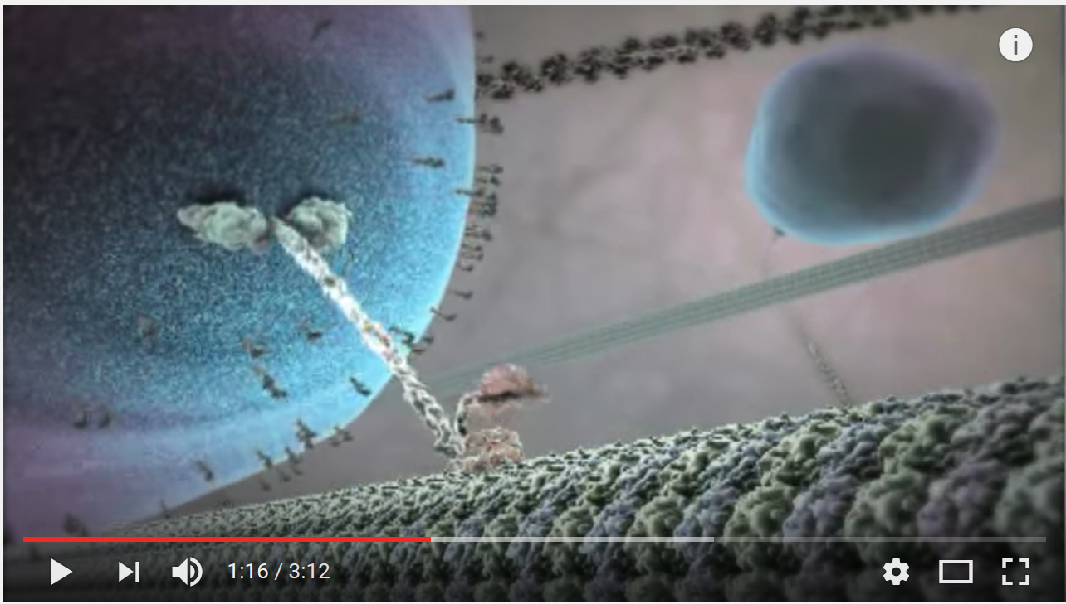
Future OS’es?

Slide 8
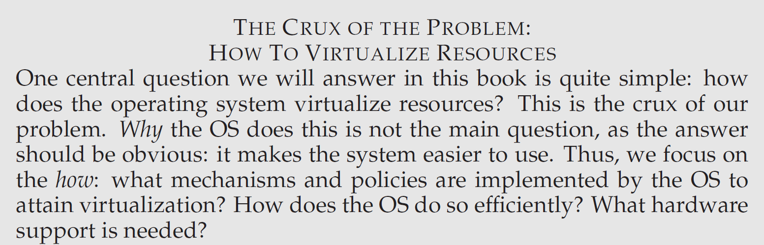
http://pages.cs.wisc.edu/~remzi/OSTEP/

Slide 9
Outline
How?
Why?
What?

Slide 10
Teaching staff
Associate Prof. Lars Ailo Bongo
Associate Prof. Tore Brox-Larsen
Teaching Assistant Marius Wiik
Teaching Assistant Nikolai Magnussen
Our external sensor

Slide 11
Resources
Web page: http://www.cs.uit.no/kursinfo/inf2201
Lecture plan, including readings and slides
Project plan
Mailing list: inf-2201-s17@list.uit.no
Important information
Slack team
Discussions
GitHub organization: https://github.com/uit-inf-2201-s17
Project pre-code
Wiseflow
Exams
We will not use Fronter

Slide 12
TODO list 1:
Make sure you are subscribed to the mailing list
https://list.uit.no/sympa/info/inf-2201-s17
Can use non-UiT email
Create GitHub account
Request membership to GitHub organization
Get invite to Slack team

Slide 13
Why Study Operating Systems
Understand how computers work under the hood
“You need to understand the system at all abstraction levels or you don’t” (Yale Patt, private communications)
“The devil is in the details” (Unknown)
Magic to provide infinite CPUs, memory, devices, and networked computing.
Tradeoffs between performance and functionality, division of labor between HW and SW
Combine language, hardware, data structures, algorithms, money, art, luck, and hate/love
And operating systems are key components in many systems

Slide 14
How to Study Operating Systems?
Read text
Smaller exercises using existing operating systems
Modifications to exisiting systems
Emulator
NachOS
”Metal”, bare machine
Unix, Linux
Minix
Develop your own! Gain experience on fundamental issues

Slide 15
Why Build a Real OS Kernel?
Hear and forget (Paper approach)
See and remember (Exercise and Modification approaches)
Do and understand (Roll your own approach)
Overcome the barrier, dive into the system
Gain confidence: You have the power, not the SW, OS and computer vendors ☺

Slide 16
Our Approach
6 (or 7) projects, all mandatory
From boot to a usefull OS kernel w/demand paging & file system
We hand out templates (pre files), but never the finished source (post files)
New bugs discovered every time the course is given ☺
Lectures and Projects are (almost) synchronized
Design Review during first week of each project
Linux, C, assembler
Close to the computer, but bochs useful to reduce the number of reboots

Slide 17
Project OS History
LurOS
Stein Krogdahl, OS course, Dept. of computer science, UiTø, ca. 1978
Paper, but detailed
Mymux (Mycron Multiplexer)
Stein Gjessing (1979?), later implemented and reworked by Otto Anshus (1981), OS course, Dept. of computer science, UiTø, around 1981-82-83
Mycron 1 (64KILObyte RAM, no disk, 16 bit address space, Intel 8080/Zilog 80, Hoare monitors, flermaskin (3, UART, 300 bits/sec, transparent process and monitor location, process and monitor migration between machines)
POS (Project Operating System), a.k.a. TeachOS, a.k.a. LearnOS
Otto Anshus, Tore Larsen, first implementation by Åge Kvalnes (Brian Vinter), OS course, Dept. of computer science, UiTø, 1994-1998
Notebooks, Intel 486/Pentium
Princeton University, USA
Kai Li (1998), adopts and enhances the projects
Tromsø & Princeton
D240/COS 318, Kai Li, Otto Anshus, 1999
Tromsø/Princeton/Oslo
Inf-2201/COS318/INF242, 2001, Vera Goebel, Thomas Plagemann, Otto Anshus
Yale University

Slide 18
Course Approach
You will be building your own operating system
You will do it in steps
For each step
We’ll define what your OS should achieve for this step
We’ll provide you with a starting point (code)
You may well choose to use your own starting point
You will contemplate a design and present a brief design report indicating design issues, discussions, and decisions. The design report is presented, discussed, and reviewed by staff
You develop and implement your solution. The solution is reviewed etc.
For each step you will sweat
By early June you will be ”King of the hill!”

Slide 19
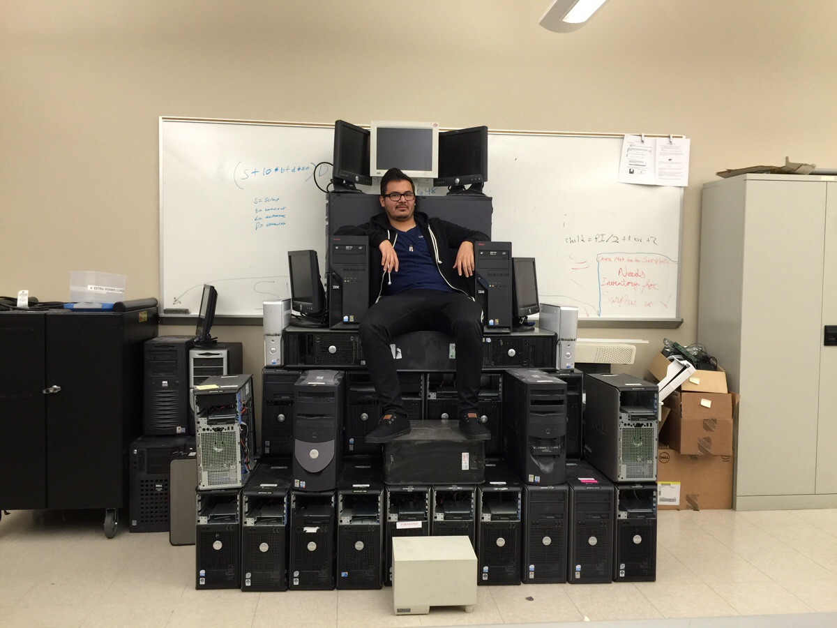
King of the Hill

Slide 20
Literature
Modern Operating Systems 4/E, by Andrew (Andy) Tanenbaum, Prentice-Hall, 2015
All information given on the course web pages. The links provided are mandatory readings to the extent they are relevant to the projects
We will also provide additional readings. Please, check the syllabus
All lectures, lecture notes, precept notes and topics notes
All projects
Other books that may help you are:
Protected Mode Software Architecture, by Tom Shanley, MindShare, Inc. 1996. This book rehashes several on-line manuals by Intel
Undocumented PC, 2nd Edition, by Frank Van Gilluwe, Addison-Wesley Developers Press, 1997
The C Programming Language, Brian W. Kerningham, Dennis M. Ritchie
Note! Lectures covers important topics that are not addressed by projects

Slide 21
Cooperation Policy: Working with your fellow students
Discuss all concepts, techniques, technologies, and peculiarities with your fellow students
But don’t in any way share your own code or copy code that is not developed by you.

Slide 22
Learning from Doing: Each student develops his/her own code
INF-2201 har en eksamensordning hvor oppgaver i kurset vurderes og gis veiledende karakterer som ved kursets slutt danner utgangspunkt for den endelige fastsettingen av karakter for kurset. På grunn av dette vil følgende bli betraktet som fusk iht. Forskrift for eksamener ved Universitetet i Tromsø:
Deling av kode (både i elektronisk og annen form) utviklet i forbindelse med oppgavene i kurset.
Kopiering av hele eller deler av løsning på oppgavene utviklet av andre.
Av hensyn til gjennomføring og karaktersetting for kurset i framtiden må kode og kursmateriale ikke på noe tidspunkt deles eller distribueres til andre enn faglig og administrativt personale ved UiT med ansvar for gjennomføring av kurset.
Med begrunnelse i det ovennevnte må alle studenter fylle ut og skrive under på følgende erklæring og levere denne til fakultetsadministrasjonen sammen med innleveringen av den første obligatoriske oppgaven.

Slide 23
Cheating
Jan Fuglesteg

Slide 24
Grading Policy
“Mappe evaluering”:
3 (6) individual grades: combined to give final grade
No written exam
Wiseflow
More details TBA
Note! It is your responsibility to make sure you submit the correct assignment on time

Slide 25
Grading Mechanism
100 point scale (A is 90-100)
Extra credits are additional to 100 ordinary point
You can get an A without doing extra credits
But hard in practice
Examiners follow grading guidelines:
Each part of assignment gives X points
Most points are for code correctness
Some are for code readability (comments, structure)
A few are for documentation
Examiners may give short explanation for grades < A
You should discuss your code/ solution with TAs

Slide 26
What is an Operating System?

Slide 27
What is an operating system?
Software between applications and hardware
System construction
Makes HW easier to use
Resource management
Allocate resources among application programs
Protection
Protecting OS and applications from malfunctioning or malicious applications

Slide 28
What Is an Operating System?
Extension of hardware
Virtual machine interface and physical machine interface
Coordinate between applications and hardware resources (concurrency, device drivers, memory, file system and networking)
Standard services (library, window system)
What if you don't have an OS?
source code -> compiler -> object code -> hardware
What if you run one application at a time? Early DOS, Libraries, device drivers, interrupt handler, No overlapping

Slide 29
HW is expensive, human cheap
User at console, OS as subroutine library
Batch monitor (no protection): load, run, print
Data channels, interrupts: overlap I/O and CPU, multiprogramming
DMA
Memory protection: Restrain bugs to individual programs
Multics: OS designed 1963 and ran in 1969
www.multicians.org
www.multicians.org/general.html#tag14
IBM 360 OS released with 1000 bugs

Slide 30
Is it challenging to write an OS?
Yes, but you’ll manage. Employing your own efforts, and the assistance of fellow students, TA’s, and professors.
Low-level, architecture dependent programming
We stick with only one architecture in only one configuration
Race-conditions
Let’s see (next slide) what a great computer scientist experienced some time ago …

Slide 31
60’s vs. 2010’s
Today is like in the late 60s. OS's are enormous
small OS: 100k lines
big OS: 10M lines
100-1000 people years
But ~90% is device drivers
Project 5 (“post files”): ~6500 lines ☺

Slide 32
HW cheap, human expensive
Use cheap terminals to let multiple users share a computer, interactive timesharing
Unix enters the mainstream
Problems: Thrashing as the number of users increases

Slide 33
HW cheaper, human more expensive
Alto OS: Ethernet, Bitmap display, laser printer and pop-menu window interface, e-mail, publishing software etc
Personal computers
Initially library and later with memory protection and multiprogramming
Workstations
Engelbart: Mother of all demos
3M machines: 1MIPS, 1MB, 1M pixels

