Slide 1
Introduction
inf-2202 Concurrent and Data-intensive Programming
Fall 2016
Lars Ailo Bongo (larsab@cs.uit.no)

Slide 2
Outline
Why?
What?
How?

Slide 3
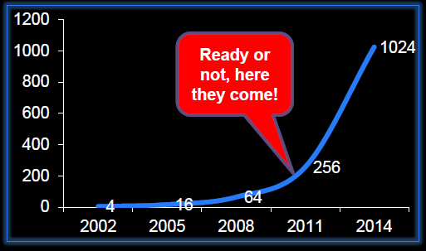
Motivation
“The core is the logic gate of the 21st century” Anant Agarwal, MIT
The number of cores will double every 18th month
Figure from a lecture by Bruce Shriver, Feb 2012, UiT
Notes:
Figure from a lecture by Bruce Shriver, Feb 2012, UiT

Slide 5
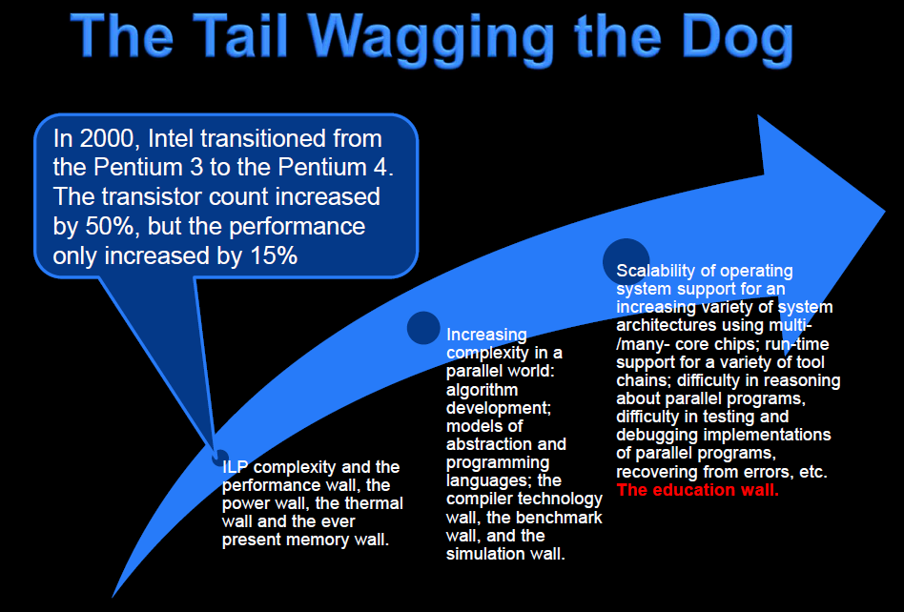
Slide from a lecture by Bruce Shriver, Feb 2012, UiT
Notes:
Slide from a lecture by Bruce Shriver, Feb 2012, UiT

Slide 6
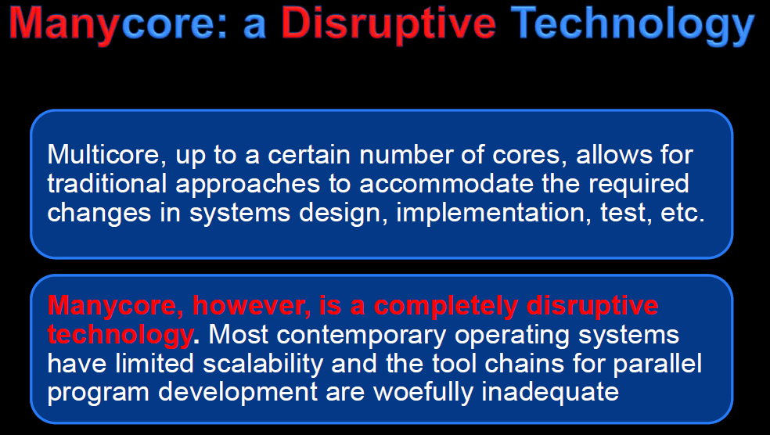
Slide from a lecture by Bruce Shriver, Feb 2012, UiT
Notes:
Slide from a lecture by Bruce Shriver, Feb 2012, UiT

Slide 7



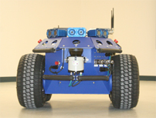
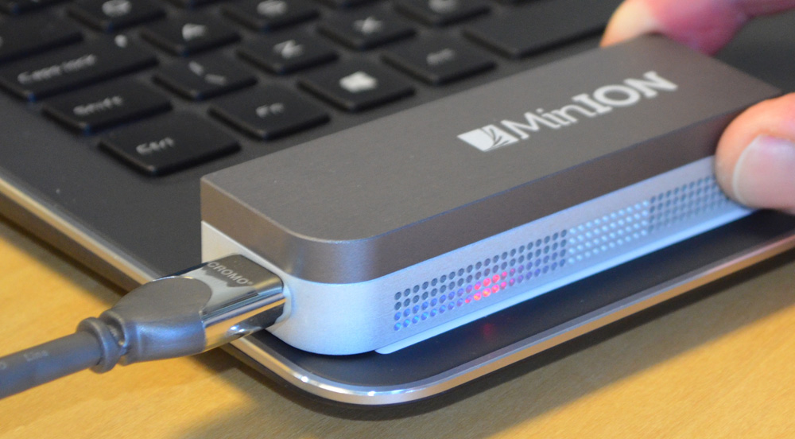

What can we do with all the cores?
Notes:
Sources:
http://engineering.stanford.edu/news/stanford-researchers-break-million-core-supercomputer-barrier
http://techcrunch.com/2012/08/22/how-big-is-facebooks-data-2-5-billion-pieces-of-content-and-500-terabytes-ingested-every-day/

Slide 8
Motivation - summary
Application pull
Supercomputing
Data-intensive computing
Games
Robotics
…
Technology push
How to utilize 1000’s of cores?

Slide 9
Teaching staff
Associate Prof. Lars Ailo Bongo
Teaching Assistant Tim Alexander Teige
PhD student Morten Grønnesby?

Slide 10
Information sources and contact info
Web page: http://www.cs.uit.no/kursinfo/inf2202
Or http://uit-inf-2202-f16.github.io
Mailing list: inf-2202-f16@list.uit.no
Github organization: https://github.com/uit-inf-2202-f16
We will not use Fronter/ It’s Learning

Slide 11
TODO list 1:
Make sure you are subscribed to the mailing list
https://list.uit.no/sympa/info/inf-2202-f16
Can use non-UiT email
Create github account
Request membership to github organization

Slide 12
Course content
3 main topics:
Concurrent programming
Data-intensive computing
Performance evaluation
Not included:
In-depth study of systems and approaches
GPU/ accelerator programming
Concurrency theory
No textbook

Slide 13
Lecture plan
https://uit-inf-2202-f16.github.io/
Most lectures on Fridays 10:15-11:00
Thursdays 14:15-16:00 will usually be for exercises
But some lectures require 2 hours
Colloquium on Tuesdays 14:15-16:00

Slide 14
Mandatory assignments
B-tree
Concurrent data structure
C or Python
Deduplication
Compression system
Go
100s of GB of data
PageRank
Amazon AWS/ EC2
Spark
Scala or Python
TBs of data

Slide 15
Exercises
Note! This is a programming course. You need to spend a significant amount of time designing, implementing, testing, and evaluating programs.
Note! Concurrent and data-intensive programming is easy if:
It is a simple problem
There is a library for it
You do not care about performance/ scalability
You do not care about correctness
Someone tells you how to do it
But, usually this is not the case

Slide 16
TODO list 2
Read:
Modern operating systems, 3ed, Andrew S. Tanenbaum. Prentice Hall. 2007. Chapters: 2.2, 2.3, 2.5, 10.3, 11.4
Alternative to MOS: another operating systems textbook: the chapters about threading, IPC mechanisms, and classical IPC problems.
Do:
Compare the overhead of forking a process vs. creating a Pthread
Compare the overhead of forking a process vs. creating a Python thread
Implement a solution the following classical IPC problems using pthreads/Python threads and semaphores/condition variables. Note that you also need to generate a use case, test data, and useful output:
Producer/ consumer
Reader/ writer
Sleeping barber
Dining philosophers
Modify the code in c) to use message passing.

