Slide 1
Summary
Inf-2202 Concurrent and Data-Intensive Programming
Fall 2016
Lars Ailo Bongo (larsab@cs.uit.no)

Slide 3
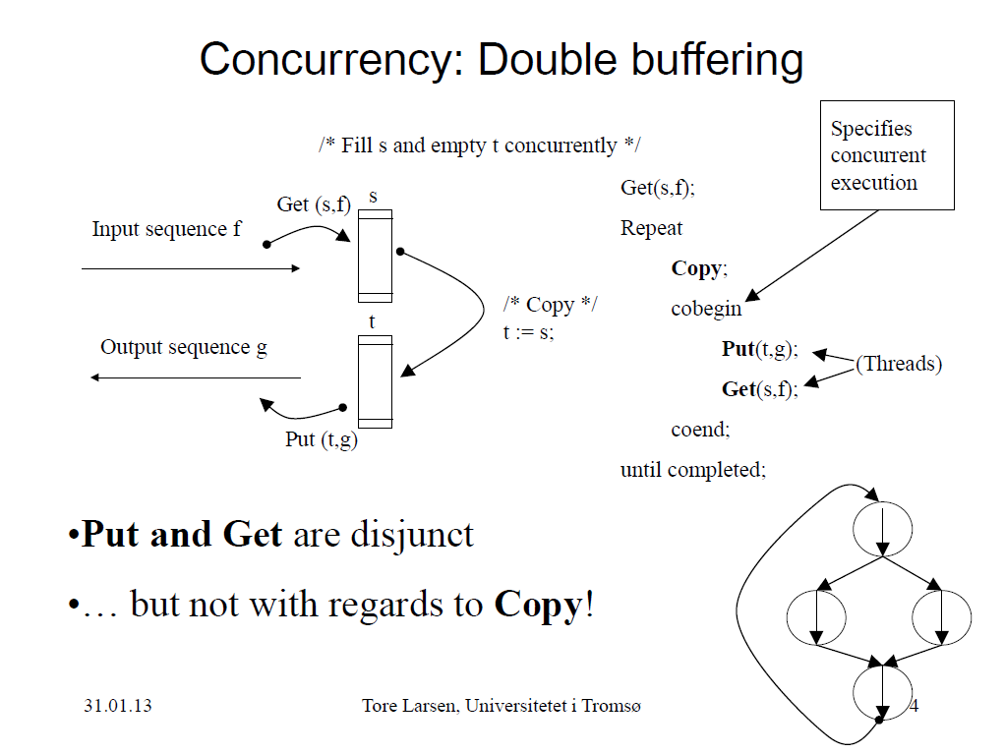

Slide 4
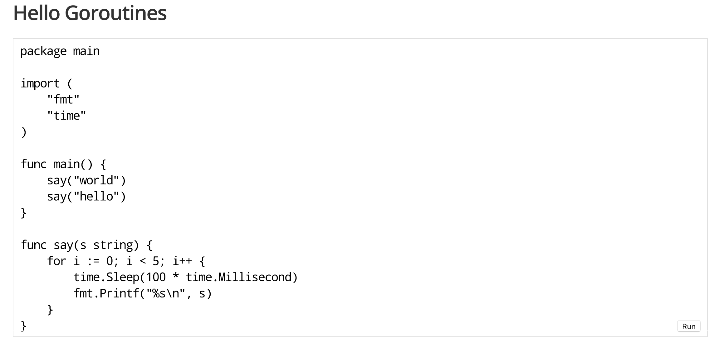

Slide 5
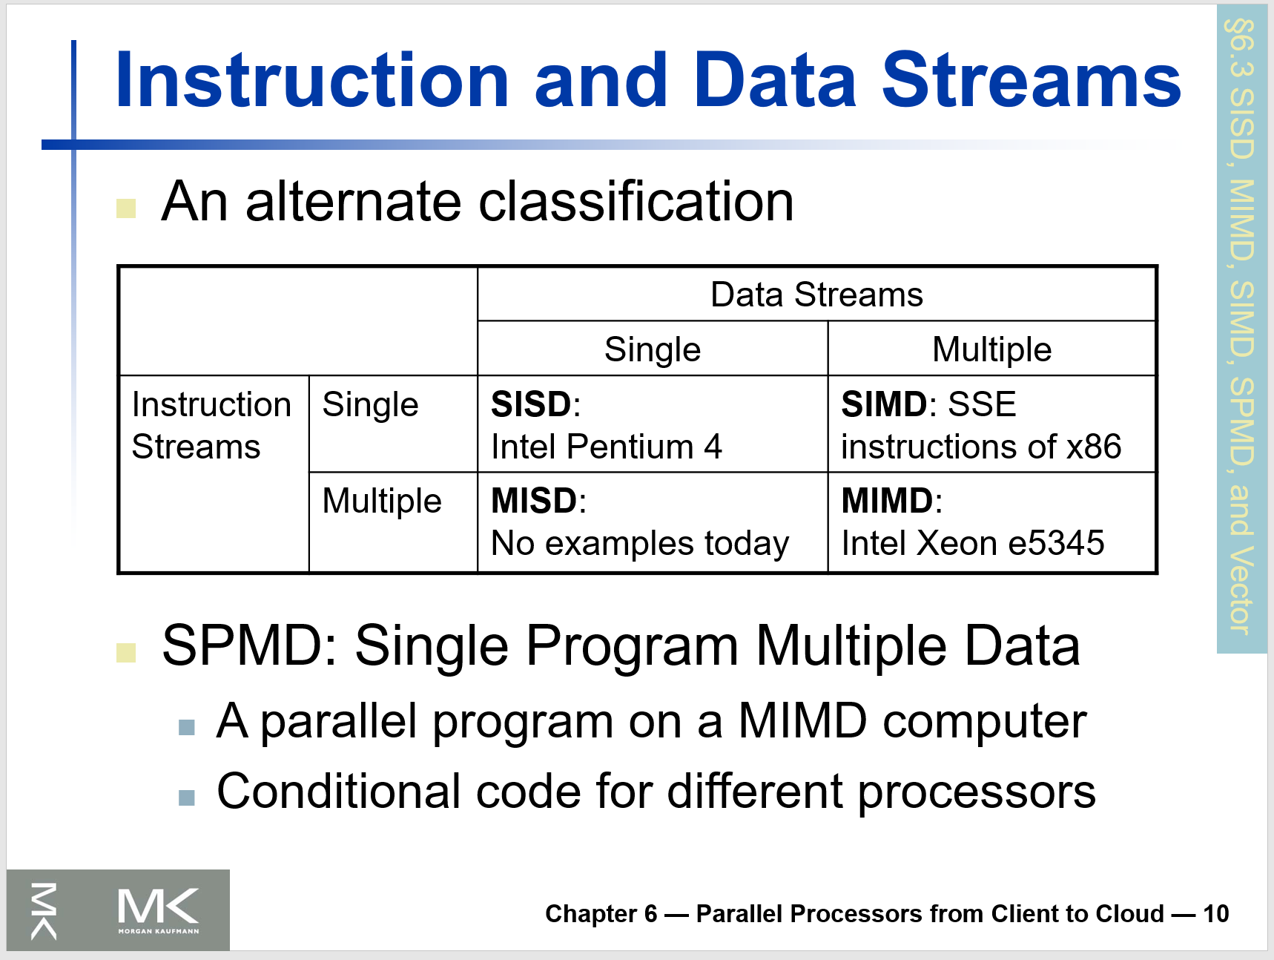

Slide 6
Goals of parallelization process
Step | Architecture dependent? | Major performance goals
Decomposition | Mostly no | Expose enough concurrency but not too much
Assignment | Mostly no | Balance workload Reduce communication volume
Orchestration | Yes | Reduce noninherent communication via data locality Reduce communication and synchronization cost as seen by the processor Reduce serialization to shared resources Schedule tasks to satisfy dependencies early
Mapping | Yes | Put related threads on the same core if necessary Exploit locality in chip and network topology

Slide 7
A performance model
$${Speedup}_{problem}\left(p\right)≤\frac{Busy\left(1\right)+{Data}_{local}\left(1\right)}{{Busy}_{useful}(p{)+{Data}_{local}\left(p\right)+Synch\left(p\right)+{Data}_{remote}(p)+{Busy}_{overhead}(p)}}$$

Slide 8
Step 4 – System and workload parameters
Workload:
Problem size
Communication-computation ratio
Execution time breakdown in different parts
Load balance
Temporal locality
Spatial locality

Slide 9
Selection of technique
Criterion | Modeling | Simulation | Measurement
Stage | Any | Any | Post-prototype
2. Time required | Small | Medium | Varies
3. Tools | Analyst | Computer languages/ simulator | Instrumentation
4. Accuracy | Low | Moderate | Varies
5. Trade-off evaluation | Easy | Moderate | Difficult
6. Cost | Small | Medium | High
7. Scalability | Low | Medium | High
Notes:
Slightly modified table 3.1 from The art of computer systems performance analysis. Raj Jain. Wiley. 1991.

Slide 10
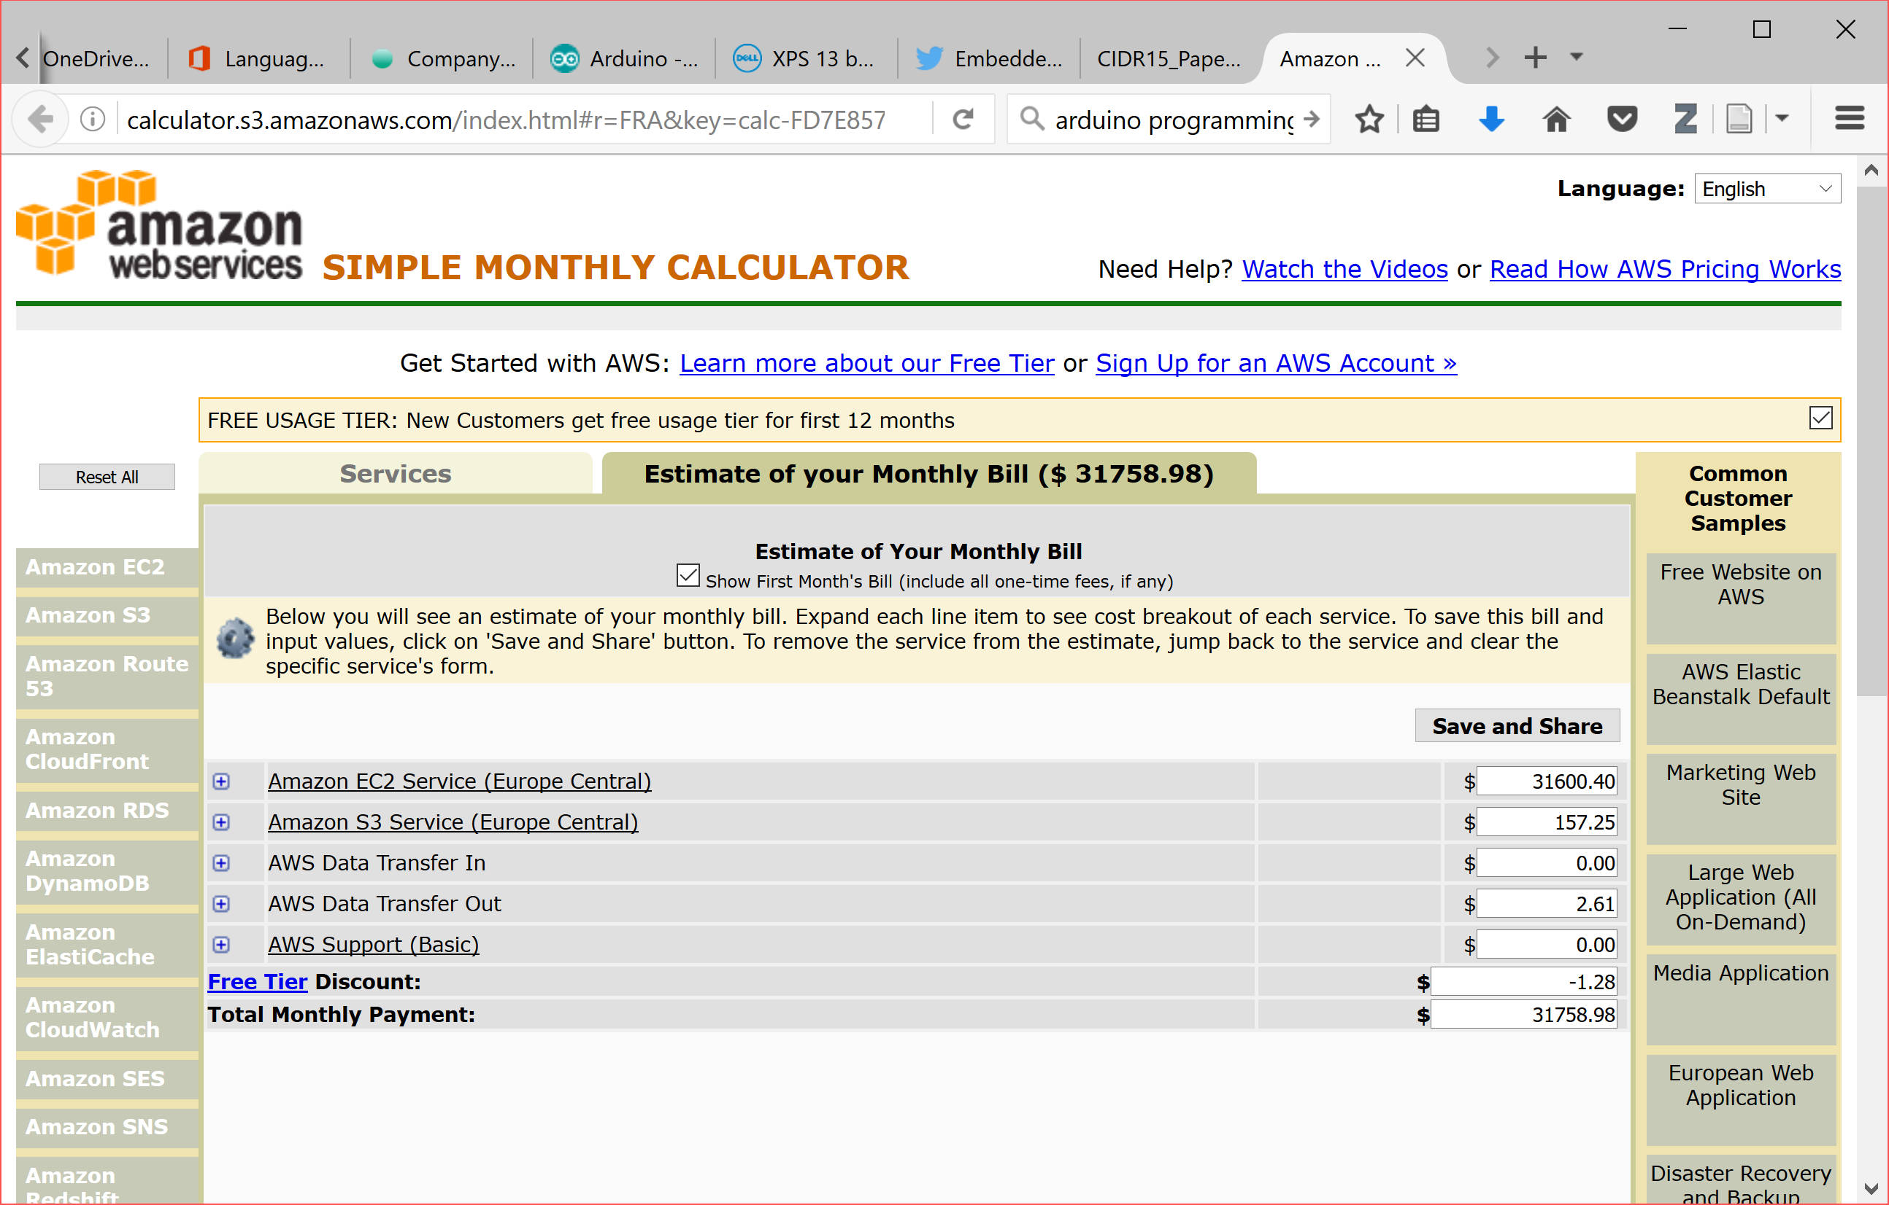

Slide 11
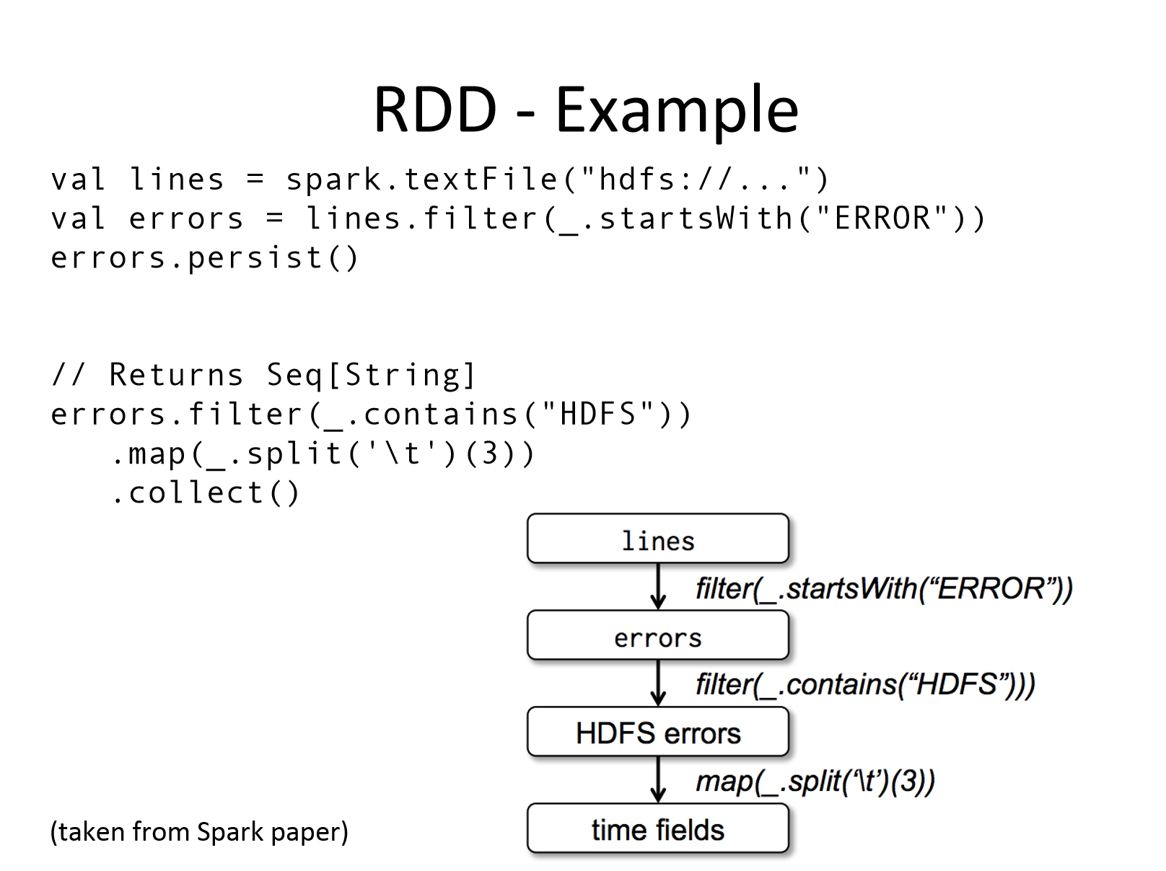

Slide 12
Commodity Component Distributed System
SATA 6Gbit/s
…
…
Notes:
1TB
on 100 nodes => 14s
On 1000 nodes => 1.4s
1PB
on 100 nodes => 4h
On 1000 nodes => 23min

Slide 13
Stallo

Slide 14
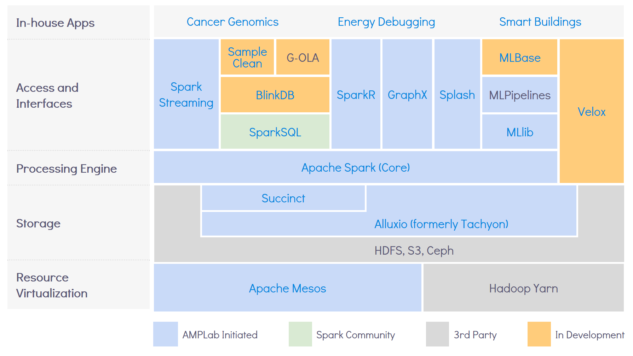
Berkeley AMPlab
Notes:
https://amplab.cs.berkeley.edu/software/

Slide 15
Mandatory assignments
B-tree
Deduplication engine
Spark PageRank on AWS

Slide 16
Exercises and readings

