Slide 1
Spark Software Stack
Inf-2202 Concurrent and Data-Intensive Programming
Fall 2016
Lars Ailo Bongo (larsab@cs.uit.no)

Slide 2
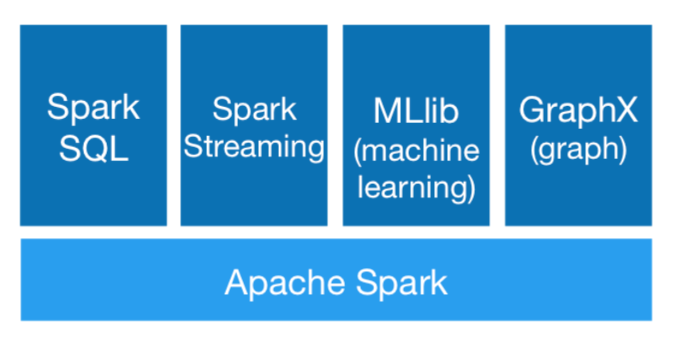
Apache Spark
Notes:
http://spark.apache.org/

Slide 3
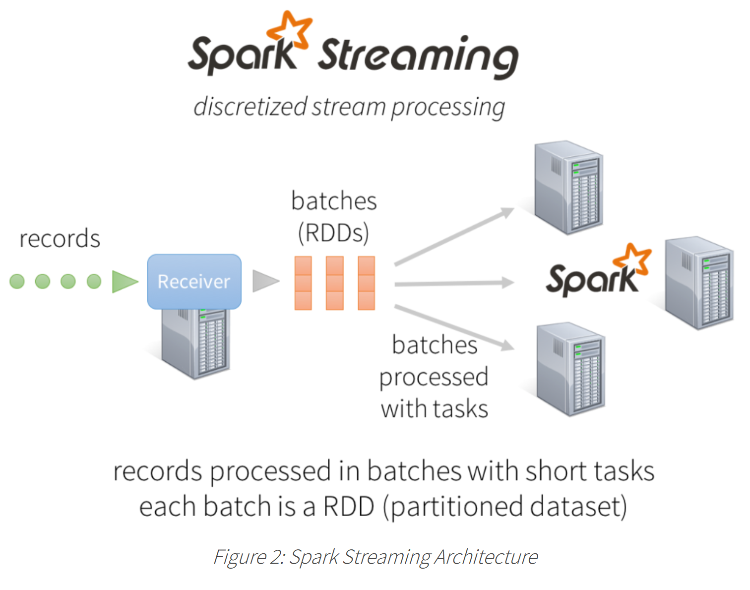
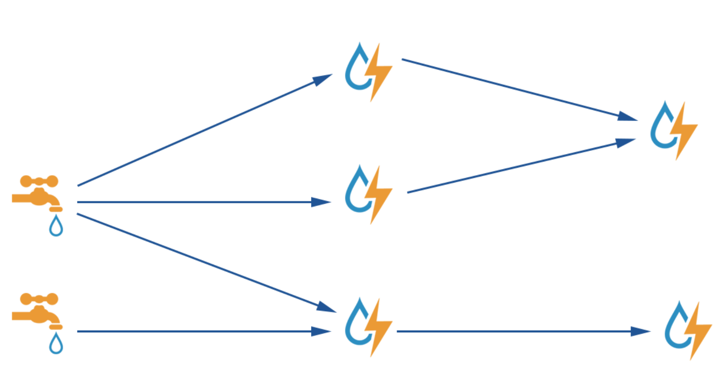
Spark Streaming
Batch vs. Stream processing
Applications
Realtime analytics
Online machine learning
Continuous computations
Extract, transform, load
Notes:
https://storm.apache.org/
https://databricks.com/blog/2015/07/30/diving-into-apache-spark-streamings-execution-model.html
Paper: http://dl.acm.org/citation.cfm?id=2522737
Workshop presentation: https://www.usenix.org/conference/hotcloud12/workshop-program/presentation/zaharia

Slide 4
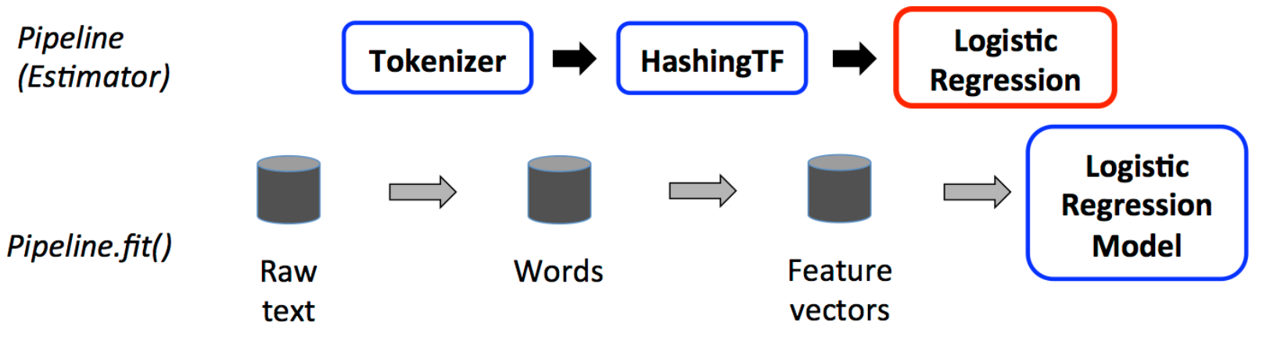
MLlib (machine learning)
Scalable ML Algorithms: classification, regression, clustering, and collaborative filtering
Featurization: feature extraction, transformation, dimensionality reduction, and selection
Persistence: saving and load algorithms, models, and Pipelines
Utilities: linear algebra, statistics, data handling, …
ML Pipelines: high-level APIs to create and tune machine learning pipelines.
Spark DataFrame: distributed collection of data organized into named columns.
Table in a relational database
Data frame in R or Python
Notes:
http://spark.apache.org/docs/latest/ml-guide.html
http://spark.apache.org/docs/latest/ml-pipeline.html
Paper: http://www.jmlr.org/papers/volume17/15-237/15-237.pdf
A presentation: https://www.youtube.com/watch?v=Riuee7qxdX4

Slide 5
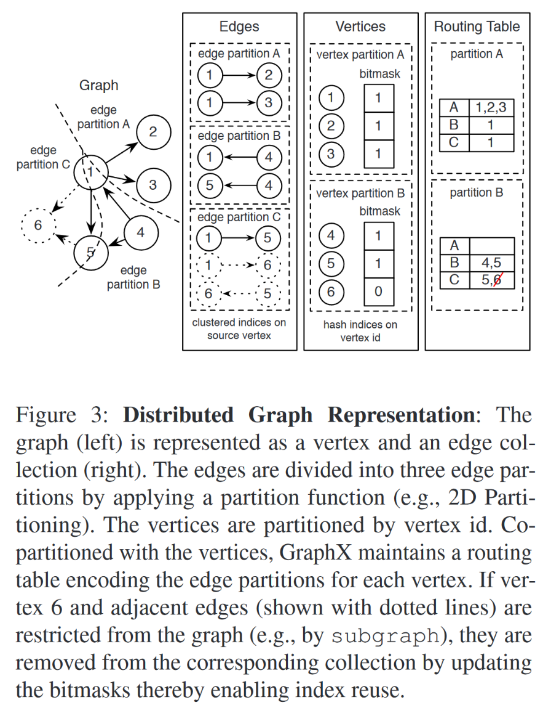
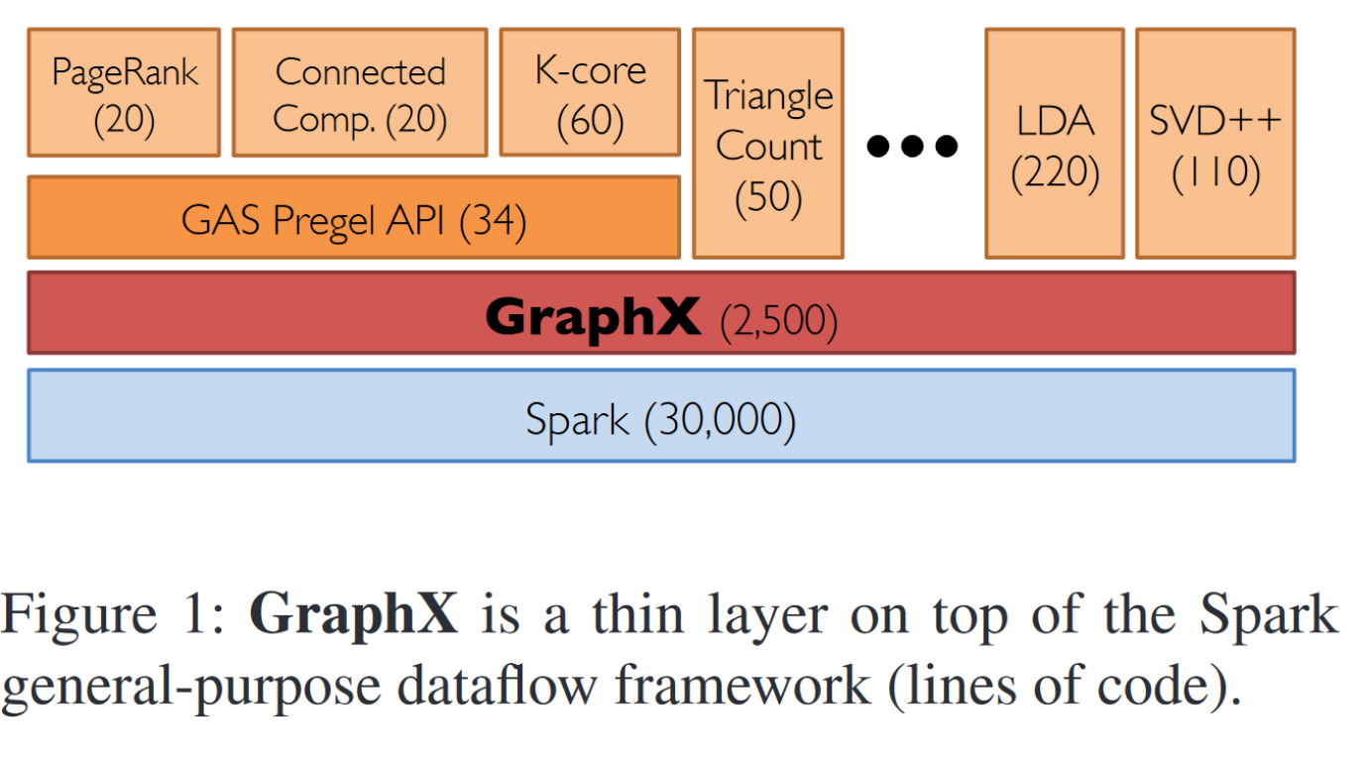
GraphX (graph)
Distributed graph processing
Application domains
Notes:
Paper: https://www.usenix.org/system/files/conference/osdi14/osdi14-paper-gonzalez.pdf
Video: https://www.usenix.org/conference/osdi14/technical-sessions/presentation/gonzalez

Slide 6
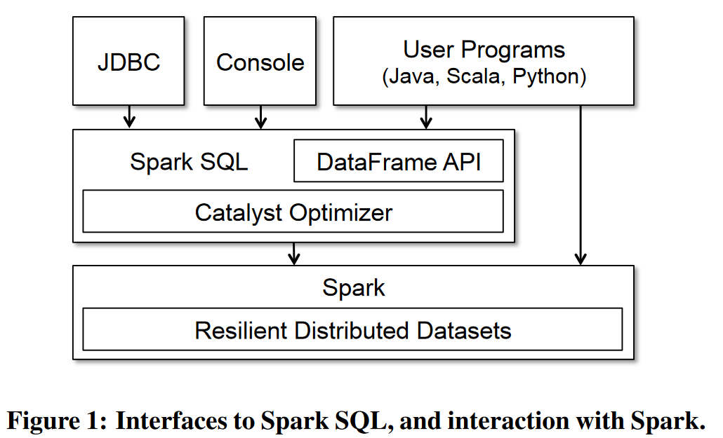
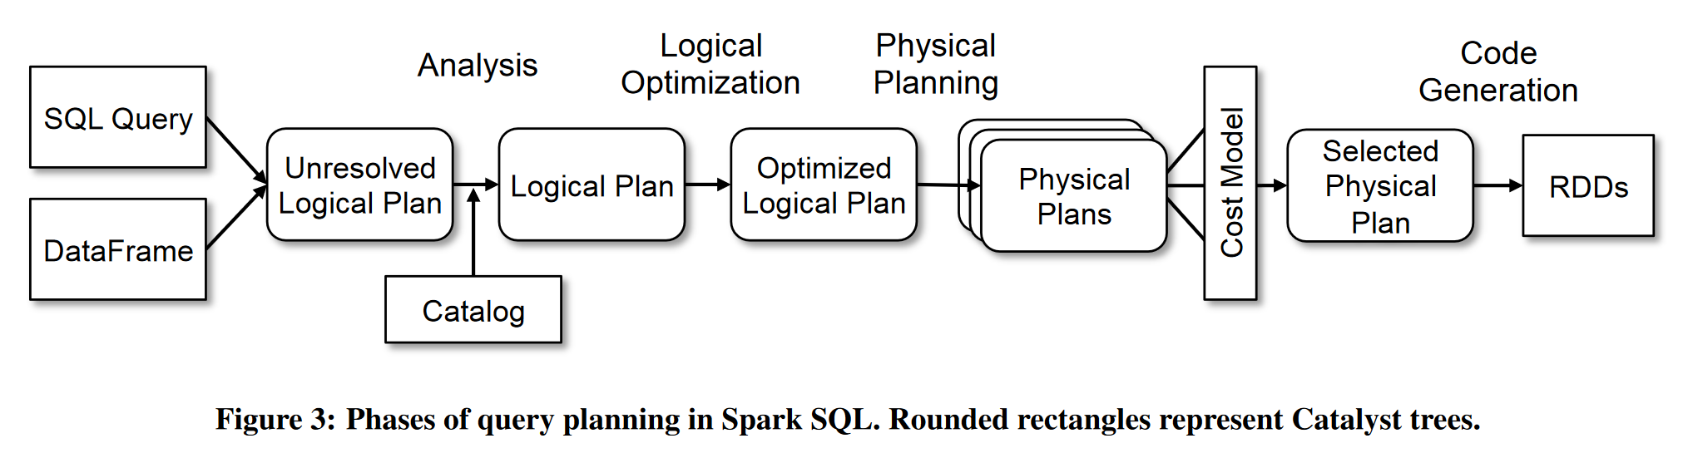
Spark SQL
Notes:
Paper: http://dl.acm.org/citation.cfm?id=2742797
Presentation: https://www.youtube.com/watch?v=KiAnxVo8aQY

Slide 7
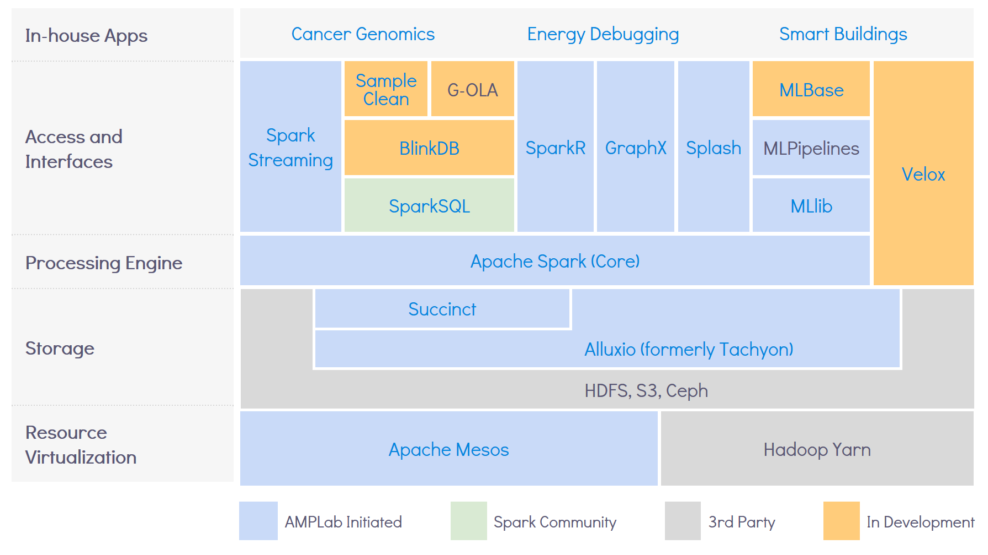
Berkeley AMPlab
Notes:
https://amplab.cs.berkeley.edu/software/

Slide 8
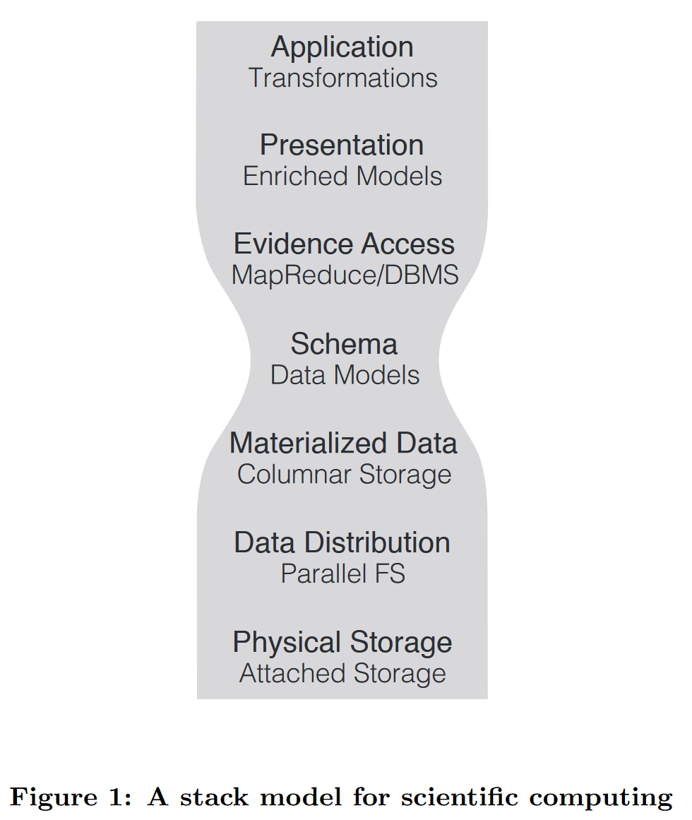
ADAM
Application: genomics data analysis pipeline
Presentation: genomics optimized data types
Evidence access: Spark
Schema: Avro
Materialized data: Parquet
Data distribution: HDFS + S3
Physical storage: distributed drives or block storage
Notes:
Paper: https://amplab.cs.berkeley.edu/wp-content/uploads/2015/03/adam.pdf

Slide 9
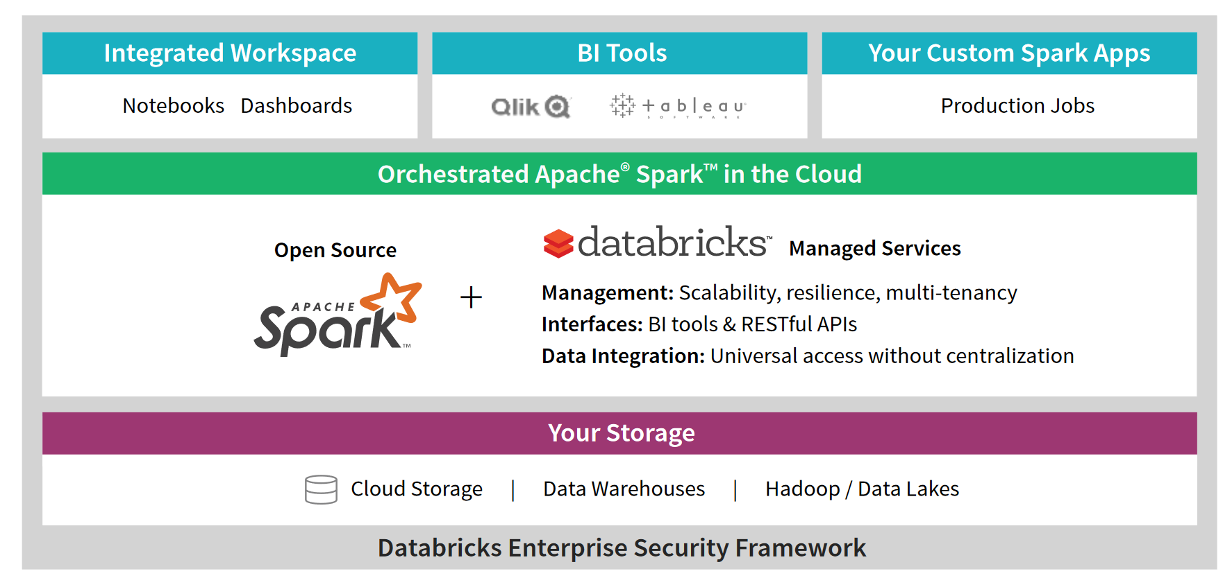
Databricks
Notes:
https://databricks.com/wp-content/uploads/2016/02/Databricks-Primer.pdf

Slide 10
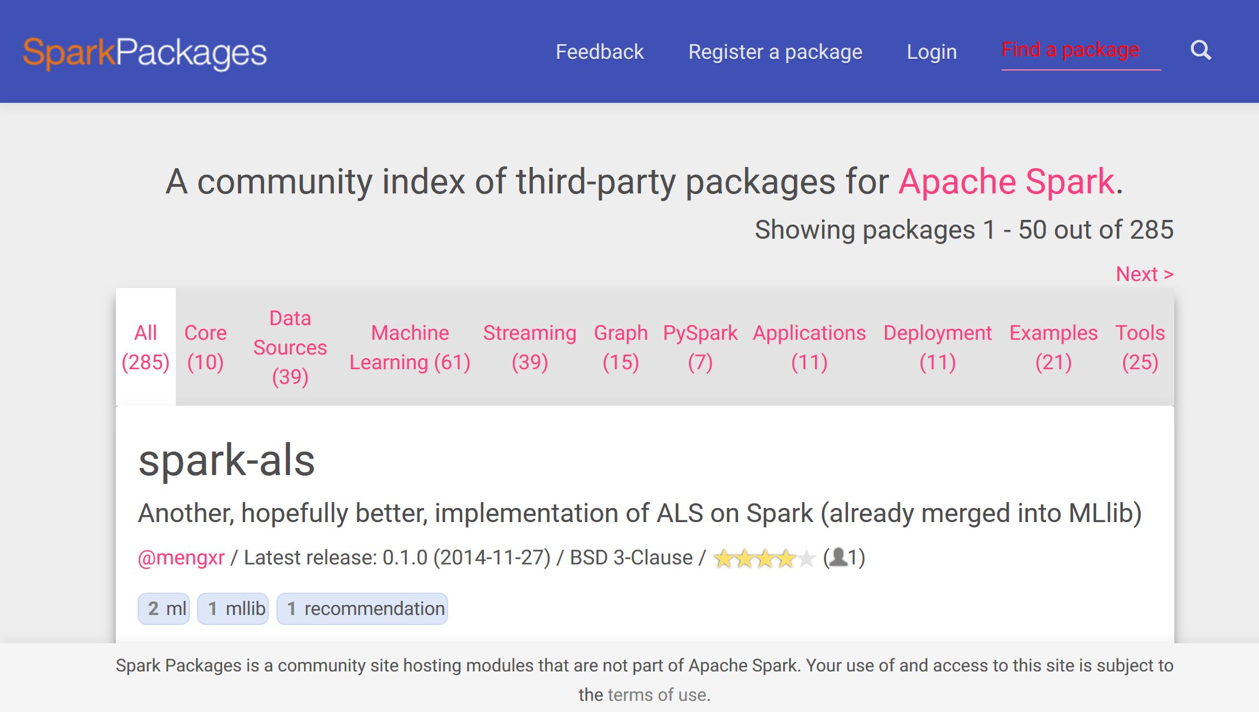
More packages

Slide 11
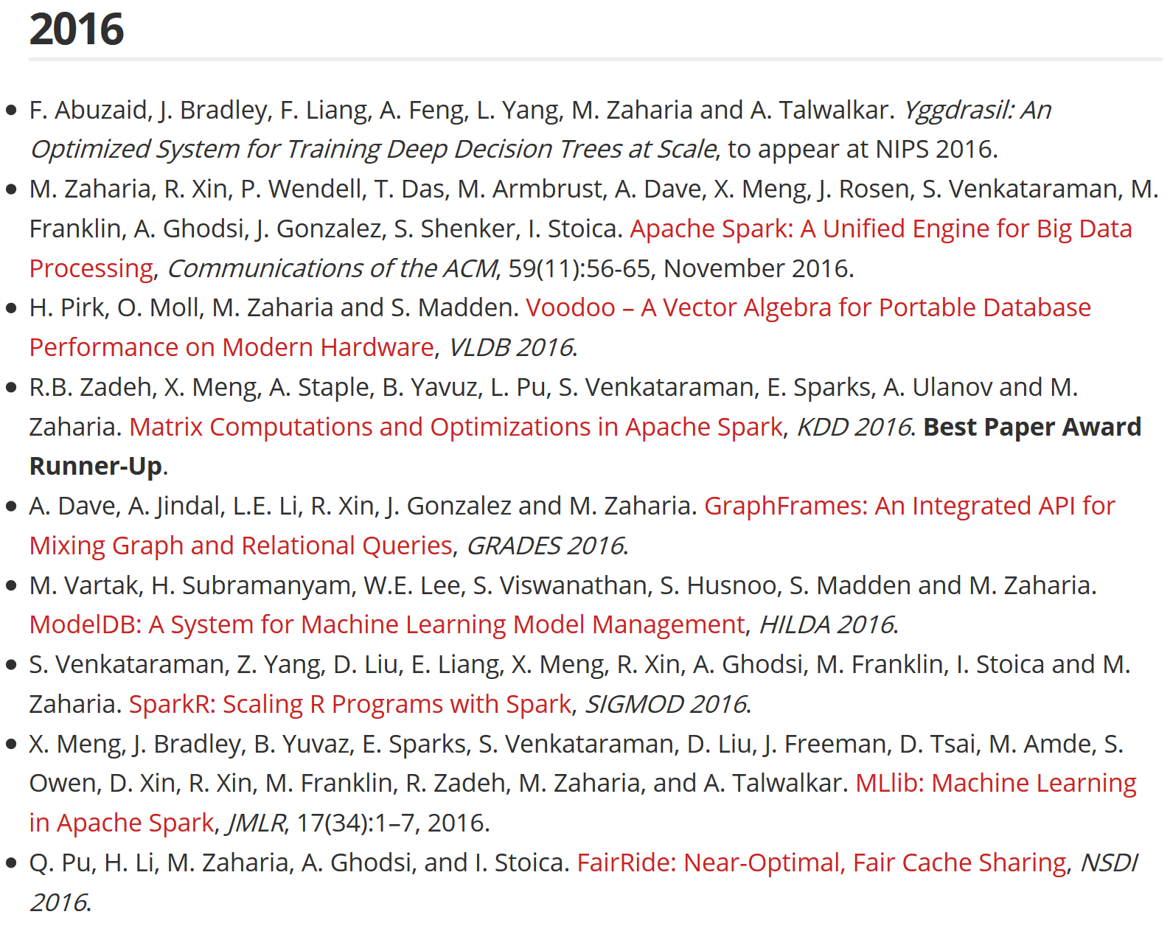
Zaharia publications

Slide 12
Videos
GraphX:
https://www.usenix.org/conference/osdi14/technical-sessions/presentation/gonzalez
MLlib
https://www.youtube.com/watch?v=Riuee7qxdX4
SparkSQL:
https://www.youtube.com/watch?v=KiAnxVo8aQY
Streams:
https://www.usenix.org/conference/hotcloud12/workshop-program/presentation/zaharia
Spark summit 2016:
https://spark-summit.org/2016/schedule/

