Slide 1
Parallel Program Performance Evaluation
Inf-2202 Concurrent and Data-intensive Programming
Fall 2016
Lars Ailo Bongo (larsab@cs.uit.no)

Slide 2
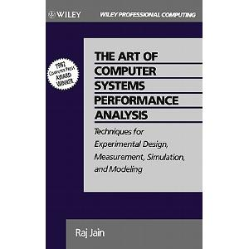
Source / recommended reading

Slide 3
Outline
Parallel program evaluation
Using deduplication as a case study

Slide 4
Steps for a performance evaluation study
State the goals of the study and define the system boundaries
List system services and possible outcomes
Select performance metrics
List system and workload parameters
Select factors and their values
Select evaluation techniques
Select the workload
Design the experiments
Analyze and interpret the data
Presents the results. Start over, if necessary
Notes:
Box 2.2 in The art of computer systems performance analysis. Raj Jain. Wiley. 1991.

Slide 5
Step 1 – System boundary and goals
Application
System software
Real machine
System or architecture ideas and trade-off
Goals?

Slide 6
Step 2 – System services and outcomes
System or application specific
Deduplication services?
Deduplication outcomes?

Slide 7
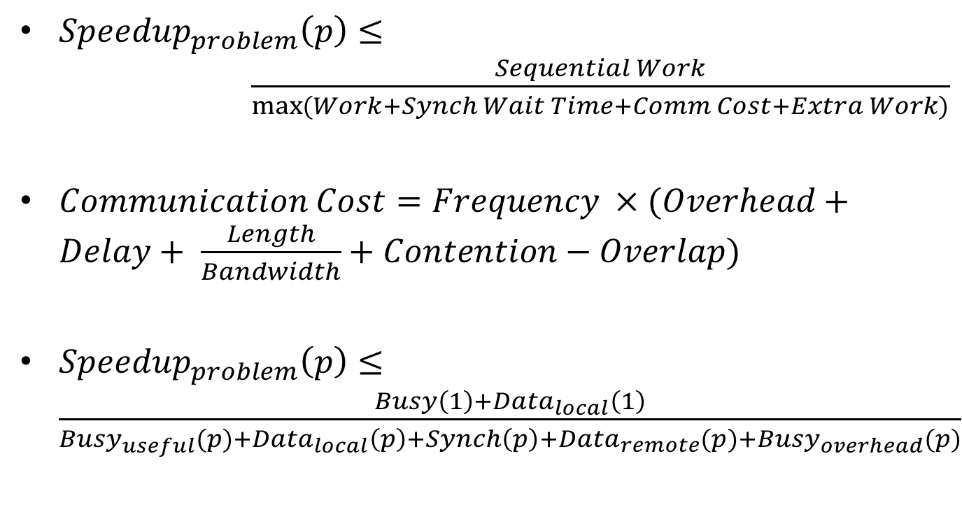
Recap – Programming for performance
${Speedup}_{problem}\left(p\right)≤ \frac{Sequential Work}{\max{(Work+Synch Wait Time+Comm Cost+Extra Work)}}$
$Communication Cost=Frequency ×(Overhead+Delay+ \frac{Length}{Bandwidth}+Contention−Overlap)$
${Speedup}_{problem}\left(p\right)≤\frac{Busy\left(1\right)+{Data}_{local}\left(1\right)}{{Busy}_{useful}(p{)+{Data}_{local}\left(p\right)+Synch\left(p\right)+{Data}_{remote}(p)+{Busy}_{overhead}(p)}}$

Slide 8
Step 3 - Metrics
Wall-clock time
Speedup = Time(1 core) / Time(N cores)
Amdahl´s law
Gustafson´s law
➔ scalability

Slide 9
Speedup
Speedup = time(1) / time(N)
How to measure time(1)?
Parallel program on one core on parallel machine
Sequential program on one core on parallel machine
Best sequential program on one core on parallel machine
Best sequential program on standard machine

Slide 10
Scalability
User-oriented properties:
Domain specific
Example: number of rows in table
Resource-oriented properties
Problem-constrained scaling
Problem size is fixed
Speedup = Time(1) / Time(N)
Time-constrained scaling
Wall-clock time is fixed
Speedup = Work(N) / Work(1)
How to measure work?
Memory-constrained scaling
Memory usage per thread is fixed
Speedup = (Work(N) / Time(N)) x (Time(1) / Work(1)) = Increase in work / increase in wall-clock time
“Others”

Slide 11
Step 3 - Metrics
Application:
Concurrency
Communication-to-computation ratio
Synchronization and I/O frequency
Temporal and spatial locality
(Message size)
System/ hardware:
Absolute performance (wall-clock time, time breakdown,…)
Speedup
Processing rate (FLOPS, queries/sec,…)
Utilization (CPU load, network load…)
Problem size (parallel efficiency, …)
Percentage improvement in performance (not recommended)

Slide 12
Step 4 – System and workload parameters
System:
#cores
#nodes (if distributed system)
Memory size, cache sizes, processor frequency, multi-threading, bus bandwidth,…
Cache coherency scheme
Synchronization primitive implementation, concurrent data structures
Programming languages
…

Slide 13
Step 4 – System and workload parameters
Workload:
Problem size
Communication-computation ratio
Execution time breakdown in different parts
Load balance
Temporal locality
Spatial locality

Slide 14
Step 5 – Factors and their values
System:
#cores: 1, 2, 4, 8, 16,…, N
#nodes: 1, 2, 4, 8, 16,…,N
Machine A vs. Machine B, vs. Machine C
Cache design A vs. proposed design B
De-facto standard systems vs. my system
Go vs. C
…

Slide 15
Step 5 – Factors and their values
Workload:
Problem size:
High-level goals (new meteorological model)
Simulator, small, medium, large (predefined)
Realistic sizes
Inherent behavioral:
Stress different parts of the system (many problem sizes)
Most realistic usage
Temporal and spatial locality:
Realistic working sets

Slide 16
Step 6 – Evaluation techniques
Real machine or system: performance measurements
Architectural or system idea or trade-off: simulation
Application design ideas: modeling or simulation

Slide 17
Step 7 – Select workload
Kernels, applications, or application suites
Input data size and algorithm parameters
Important properties:
Representativeness
Coverage of behavioral properties
Enough concurrency and load balanced

Slide 18
Optimization
How much should benchmarks be optimized?
Different levels stress different parts of system
Types of optimizations:
Algorithmic (decomposition and assignment)
Data structuring
Data layout, distribution, and alignment
Orchestrating of communication and synchronization

Slide 19
Step 8 – Design the experiments
Performance isolation (microbenchmarks)
Processing (non-memory accessing operations)
Local memory (latencies at different cache levels)
I/O (disk read/write)
Communication (remote reads/writes)
Synchronization

Slide 20
Steps 9 and 10 – analyze, interpret, and present results
Will skip this part

Slide 21
Summary
Most “standard” performance evaluation techniques and practices apply
Some specific issues:
Scalability very important
Important for assignment 2!

