Slide 1
Introduction
Inf-2202 Concurrent and Data-intensive Programming
Fall 2015
Lars Ailo Bongo (larsab@cs.uit.no)

Slide 2
Outline
Why?
What?
How?

Slide 3
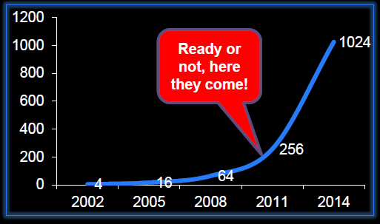
Motivation
“The core is the logic gate of the 21st century” Anant Agarwal, MIT
The number of cores will double every 18th month
Figure from a lecture by Bruce Shriver, Feb 2012, UiT
Notes:
Figure from a lecture by Bruce Shriver, Feb 2012, UiT

Slide 4
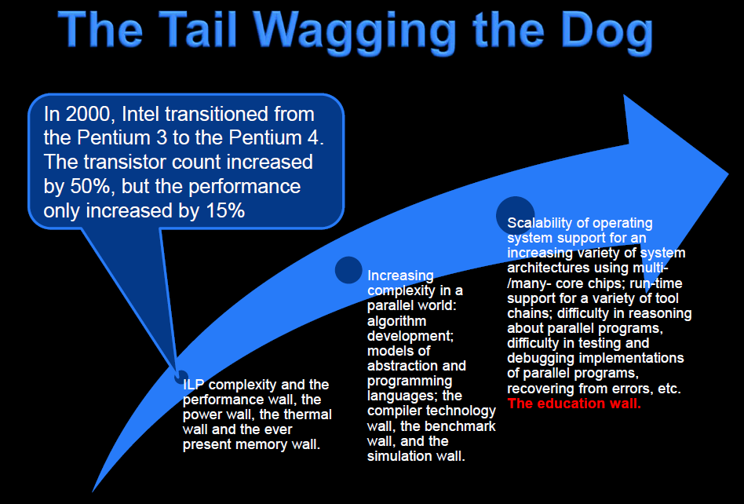
Slide from a lecture by Bruce Shriver, Feb 2012, UiT
Notes:
Slide from a lecture by Bruce Shriver, Feb 2012, UiT

Slide 5
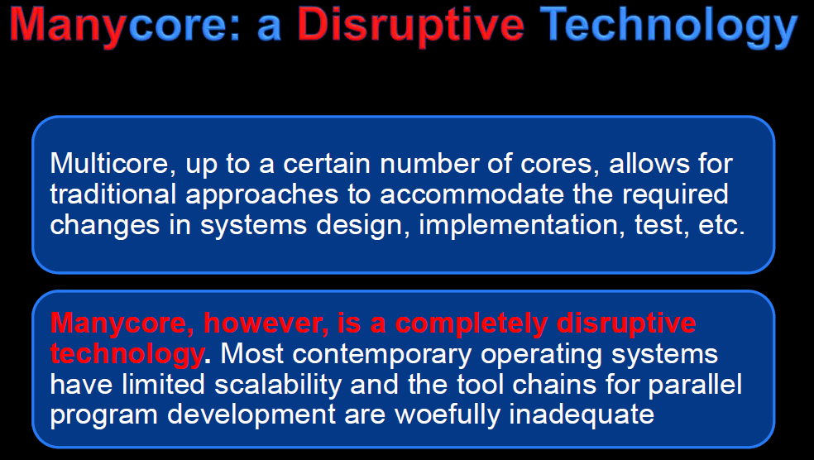
Slide from a lecture by Bruce Shriver, Feb 2012, UiT
Notes:
Slide from a lecture by Bruce Shriver, Feb 2012, UiT

Slide 6

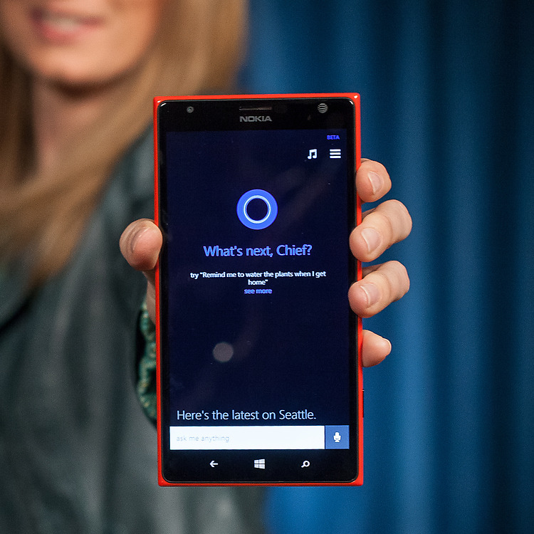

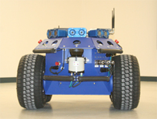


What can we do with all the cores?
Notes:
Sources:
http://engineering.stanford.edu/news/stanford-researchers-break-million-core-supercomputer-barrier
http://techcrunch.com/2012/08/22/how-big-is-facebooks-data-2-5-billion-pieces-of-content-and-500-terabytes-ingested-every-day/

Slide 7
Motivation - summary
Application pull
Supercomputing
Data-intensive computing
Games
Robotics
…
Technology push
How to utilize 1000’s of cores?

Slide 8
Teaching staff
Associate Prof. Lars Ailo Bongo
PhD student Ibrahim Umar

Slide 9
Information sources and contact info
Web page: http://www.cs.uit.no/kursinfo/inf2202
Mailing list: inf-2202-f15@list.uit.no
Github organization: https://github.com/uit-inf-2202
We will not use Fronter

Slide 10
TODO list 1:
Make sure you are subscribed to the mailing list
We plan to use the “Fronter email” addresses
Create github account

Slide 11
Course content
3 main topics:
Concurrent programming
Data-intensive computing
Performance evaluation
Not included:
In-depth study of systems and approaches
GPU/ accelerator programming
Concurrency theory
No textbook

Slide 12
Lecture plan
Lecture | Date | Subject | Lecturer
L1 | Fri 14.08 | Introduction | Lars Ailo
L2 | Thu 20.08 | Threads and synchronization primitives | Lars Ailo
L3 | Thu 27.08 | Guest lecture: Go | Giacomo Tartari
L4 | Thu 03.09 | Parallel architectures | Lars Ailo
L5 | Thu 10.09 | Parallel programs | Lars Ailo
L6 | Tue 15.09 | Programming for performance | Lars Ailo
L7 | Thu 24.09 | Performance evaluation | Lars Ailo
L8 | Thu 01.10 | Parallel program performance evaluation | Lars Ailo
L9 | Thu 08.10 | Guest lecture: Scala | Inge Alexander Raknes
L10 | Thu 15.10 | Data-intensive computing | Lars Ailo
L11 | Thu 22.10 | Spark | Lars Ailo
L12 | Thu 29.10 | Data analytics | Lars Ailo
L13 | Thu 05.11 | Event based programming or guest lecture | Lars Ailo
L14 | Thu 12.11 | Summary | Lars Ailo
 | Thu 19.11 | Backup slot
 | Thu 26.11 | Exam

Slide 13
Lectures and colloquium
Lectures: Thursdays 14:15-16:00
Colloquium/ lab: Tuesdays 14:15-16:00

Slide 14
Mandatory assignments
B-tree
Concurrent data structure
C or Python
Deduplication
Compression system
Go
100s of GB of data
Data intensive computing
Amazon AWS/ EC2
Spark
Scala or Python
TBs of data

Slide 15
Exercises
Note! This is a programming course. You need to spend a significant amount of time designing, implementing, testing, and evaluating programs.
Note! Concurrent and data-intensive programming is easy if:
It is a simple problem
There is a library for it
You do not care about performance/ scalability
You do not care about correctness
Someone tells you how to do it

Slide 16
TODO list 2
Read:
Modern operating systems, 3ed, Andrew S. Tanenbaum. Prentice Hall. 2007. Chapters: 2.2, 2.3, 2.5, 10.3, 11.4
Alternative to MOS: another operating systems textbook: the chapters about threading, IPC mechanisms, and classical IPC problems.
Do:
Compare the overhead of forking a process vs. creating a Pthread
Compare the overhead of forking a process vs. creating a Python thread
Implement a solution the following classical IPC problems using pthreads/Python threads and semaphores/condition variables. Note that you also need to generate a use case, test data, and useful output:
Producer/ consumer
Reader/ writer
Sleeping barber
Dining philosophers
Modify the code in c) to use message passing.

