Slide 1
SOK 1005 Lecture 1 Intro to R and Data Science
Dejene G.
UiT Norges Arktiske Universitet
dejen.g.kidane@uit.no
01/17/23

Slide 2
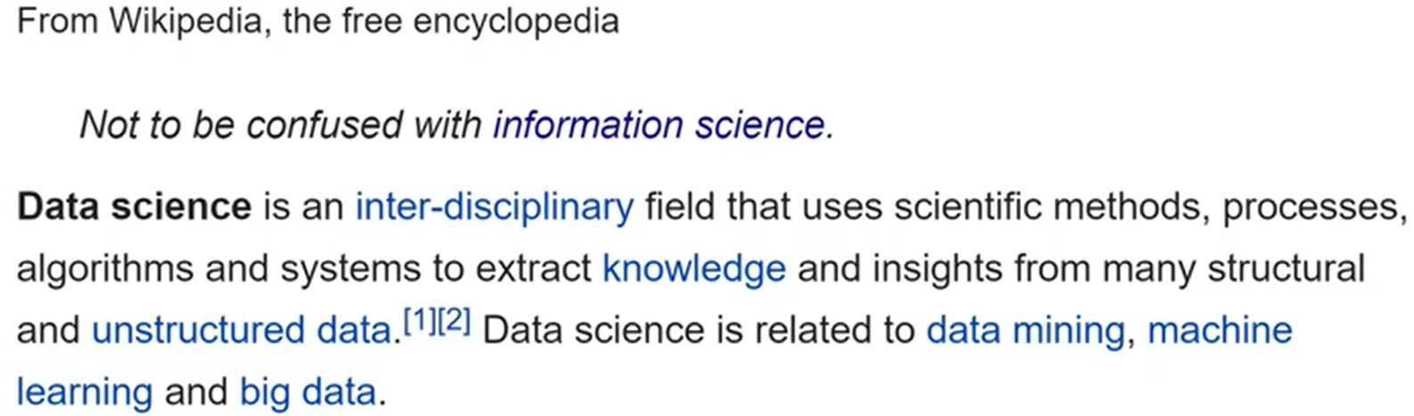
What is Data Science?
“Data Scientist: The Sexiest Job of the 21st Century,”
Harvard Business Review 90, no. 10 (2012): 70–76.

Slide 3
R
It is a statistical programming (scripting) language.
It can be used to preform all of the tasks of a data analysis.
It is built around the idea of packages: like apps
packages are sets of functions designed to work together to accomplish a specific set of tasks
There are thousands of packages, and you can install any one with a simple function install.packages().
Notes:
R is statistical programming (scripting) language.
You write code (a series of functions) to preform some task.

Slide 4
Two main flavors of R Users
Base R users & tidyverse users.
Base R is the default system
- it’s more general but not as intuitive or
consistent as the tidyverse.
Tidyverse packages
- are much more convenient for the vast majority of tasks.

Slide 5
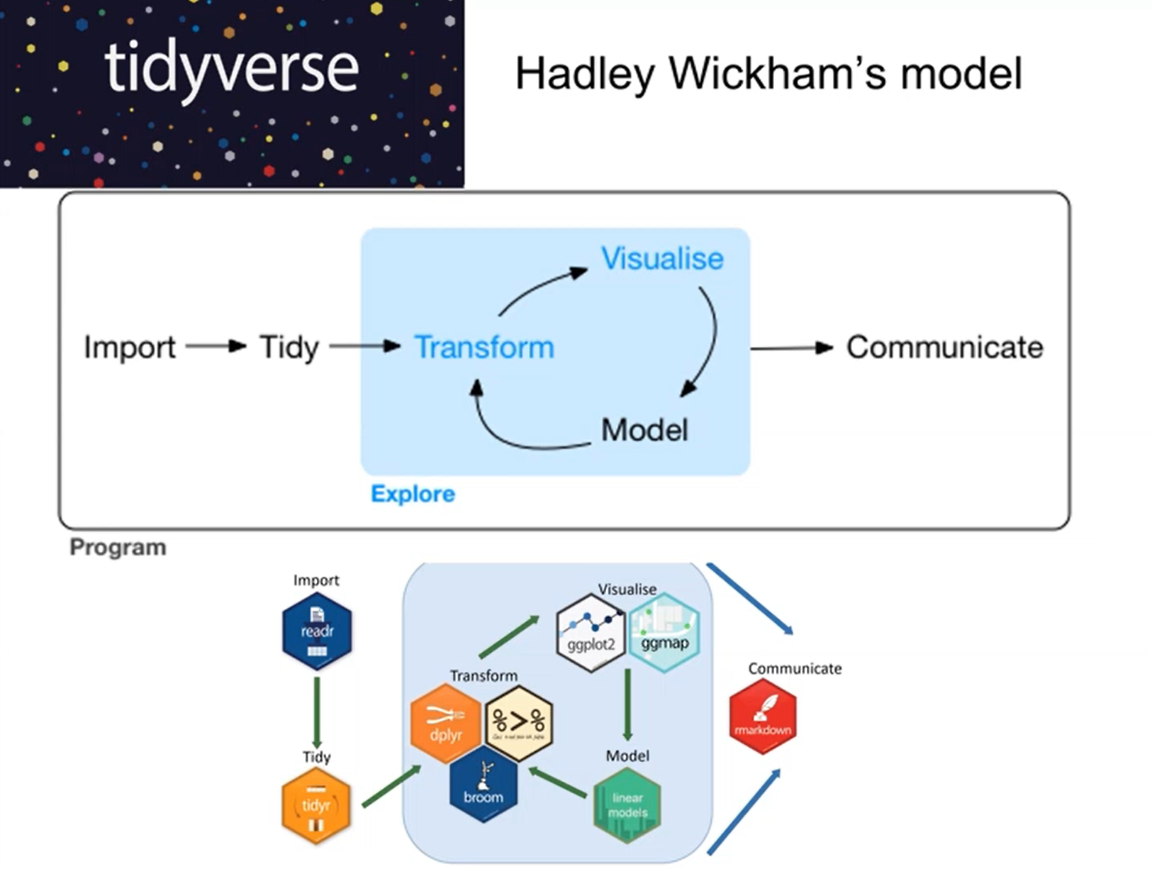
The Data Science Process & tidyverse
Notes:
The data science process. It starts by acquiring data, manipulating data, visualization, run some statistical analysis(if needed) and communicate and present the results.

Slide 6
Learning outcomes - See the syllabus
Import data from a variety of external sources
Use tidyverse capabilities to transform data to support analysis in R
Use tidyverse graphical tools to visualize and understand data
Generate research or analytical reports and presentations using R Markdown /Quarto

