Slide 1
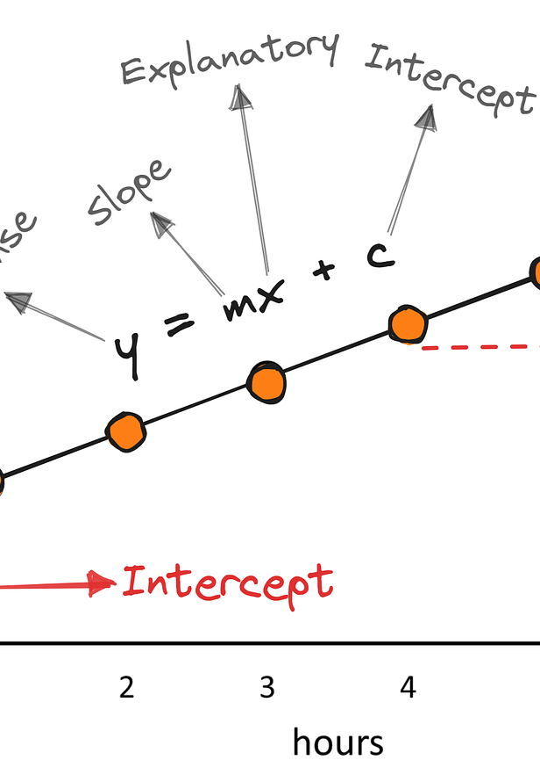
Chapter 2 The Simple Linear Regression Model
Sok-3081
Eirik Eriksen Heen
9. September 2026

Slide 2
Learning path
Economic question
Regression model
OLS line
Coefficients and residuals
Estimator and estimate
Repeated samples
Precision and standard errors

Slide 3
An Economic Model
Economic theory links many variables.
Keynes Model
Utility maximisation
Regression estimates how changes in one variable affect another.
Regression models rely on assumptions.
The continuous variable y has a probability density function (PDF).The PDF of y is conditional on x.
Think of typical food expenditure
Does increase or decrease with income?
How much do you think is fixed?
How much depend on income?
If income in the region increases by $100 dollars much more sales does local retailers get?
Notes:
Economic theory suggests many relationships between economic variables
A regression model is helpful in questions such as the following if one variable changes in a certain way, by how much will another variable change?
The regression model is based on assumptions
The continuous random variable y has a probability density function (pdf)
The pdf is a conditional probability density function since it is ‘‘conditional’’ upon an x

Slide 4
An economic model
How does weekly food expenditure vary with household income?
Economic theory suggests a positive relationship.
A hypothetical rule: food expenditure = 80 + 0.12 × income.
Here, both expenditure and income are measured in dollars.
Notes:
Source: Hill, Griffiths and Lim, Principles of Econometrics, 5th edition, Chapter 2, 2.1 An economic model. Course source: Book md/chapter-02-simple-linear-regression.md. Design reference: Old lectures/ch02.pptx.
R section 1. An extra $100 of income gives an extra $10 of spending under this hypothetical rule. This is a teaching example, not an estimated equation.

Slide 5
A household spending rule
food
A household spends per week:
80 dollars
plus 12 cents from every dollar of income
Income rises from 1,000 to 1,100 dollars
How much does food expenditure change?
income
Notes:
About 4 minutes. Do not reveal the answer immediately. After the vote, draw axes and the line by hand. Mark a horizontal change of 100 and a vertical change of 10. State that slope always carries units.

Slide 6
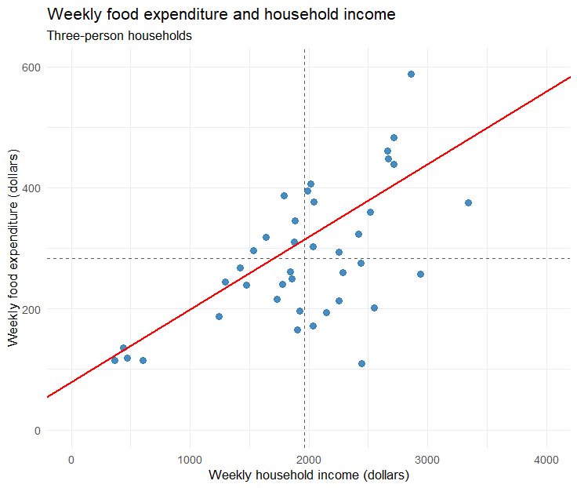
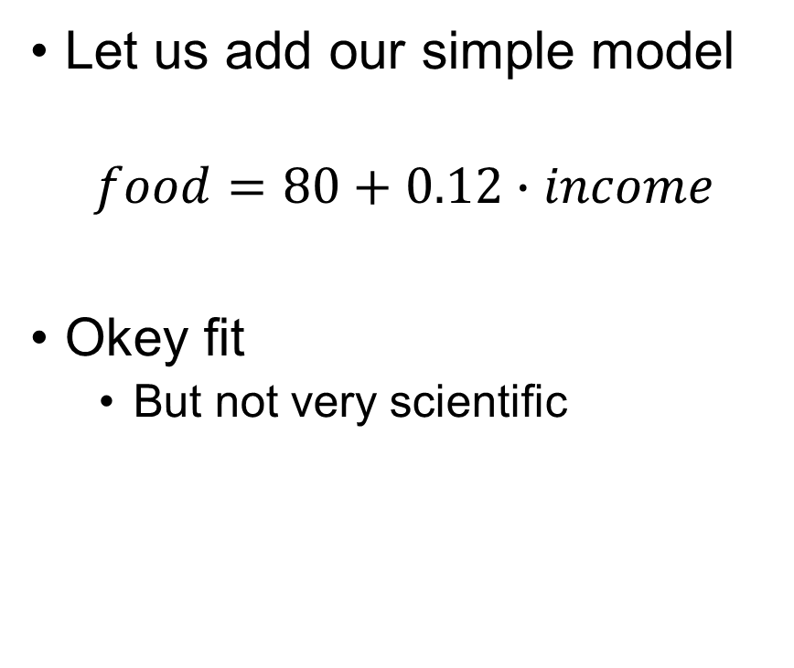
A simple model
Let us add our simple model
$$food=80+0.12∙income$$
Okey fit
But not very scientific
Notes:
About 4 minutes. Do not reveal the answer immediately. After the vote, draw axes and the line by hand. Mark a horizontal change of 100 and a vertical change of 10. State that slope always carries units.

Slide 7
The sample and its units
The sample contains 40 households.
3 persons household
y = weekly food expenditure, measured in dollars.
x = weekly household income, measured in dollars.
From the dataset food

Slide 8
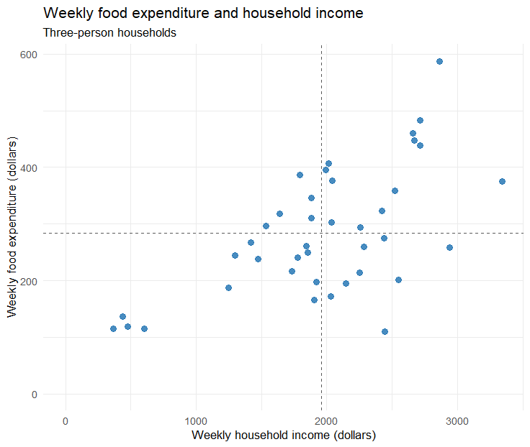

The simple regression model
$$y_{i}=β_{1}+β_{2}∙x_{i}+e_{i}$$
Economic model
Everything else
Notes:
About 4 minutes. Do not reveal the answer immediately. After the vote, draw axes and the line by hand. Mark a horizontal change of 100 and a vertical change of 10. State that slope always carries units.

Slide 9
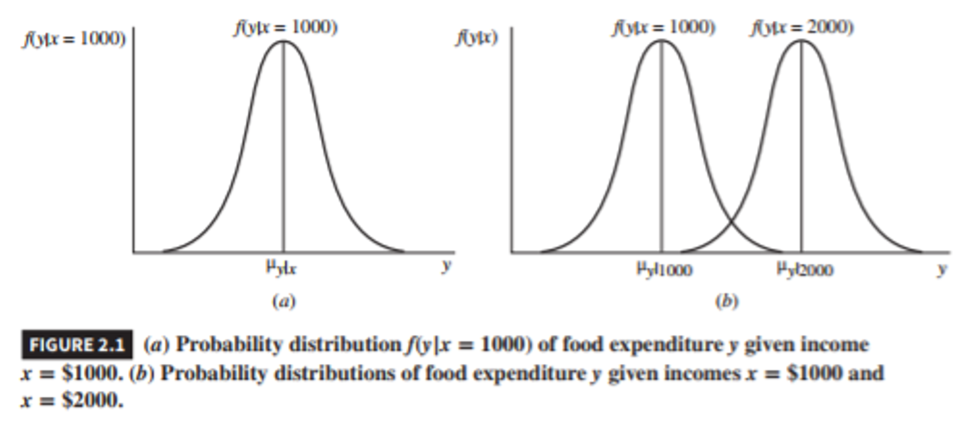
Figure 2.1
food
income

Slide 10
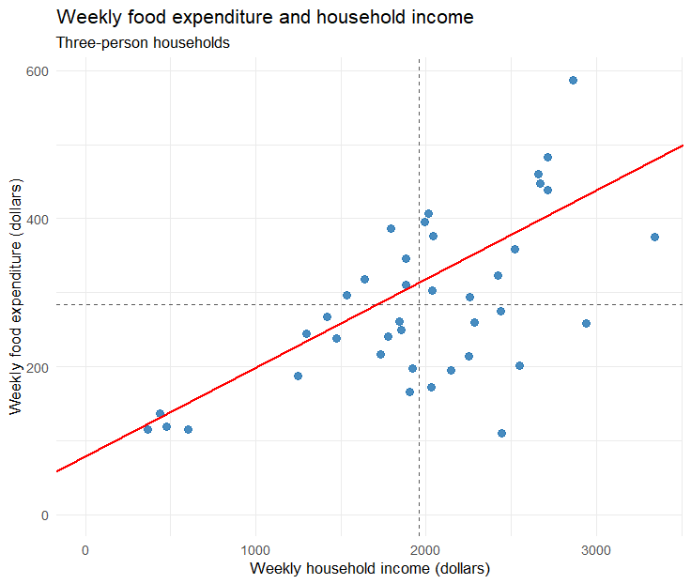
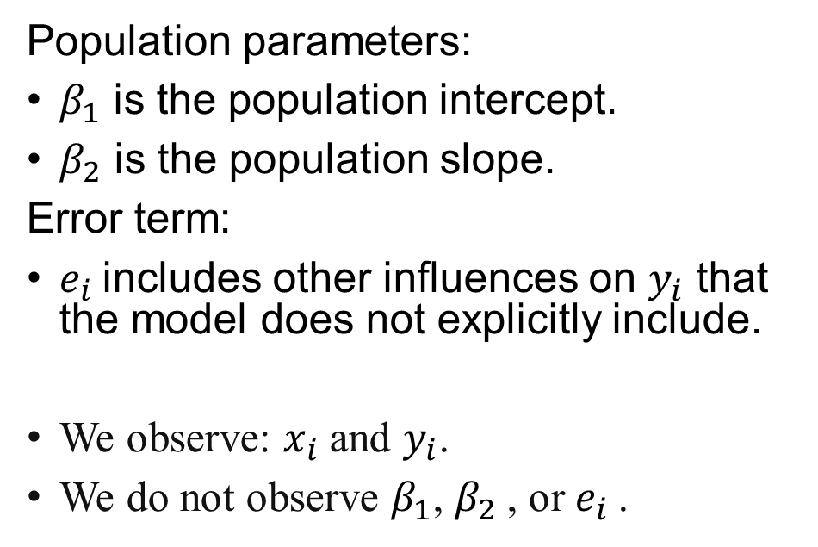

The econometric model
Lab 1
$$y_{i}=β_{1}+β_{2}∙x_{i}+e_{i}$$
Population parameters:
$β_{1}$ is the population intercept.
$β_{2}$ is the population slope.
Error term:
$e_{i}$includes other influences on $y_{i}$ that the model does not explicitly include.
We observe: $x_{i}$ and $y_{i}$.
We do not observe $β_{1}$, $β_{2}$, or $e_{i}$.

Slide 11

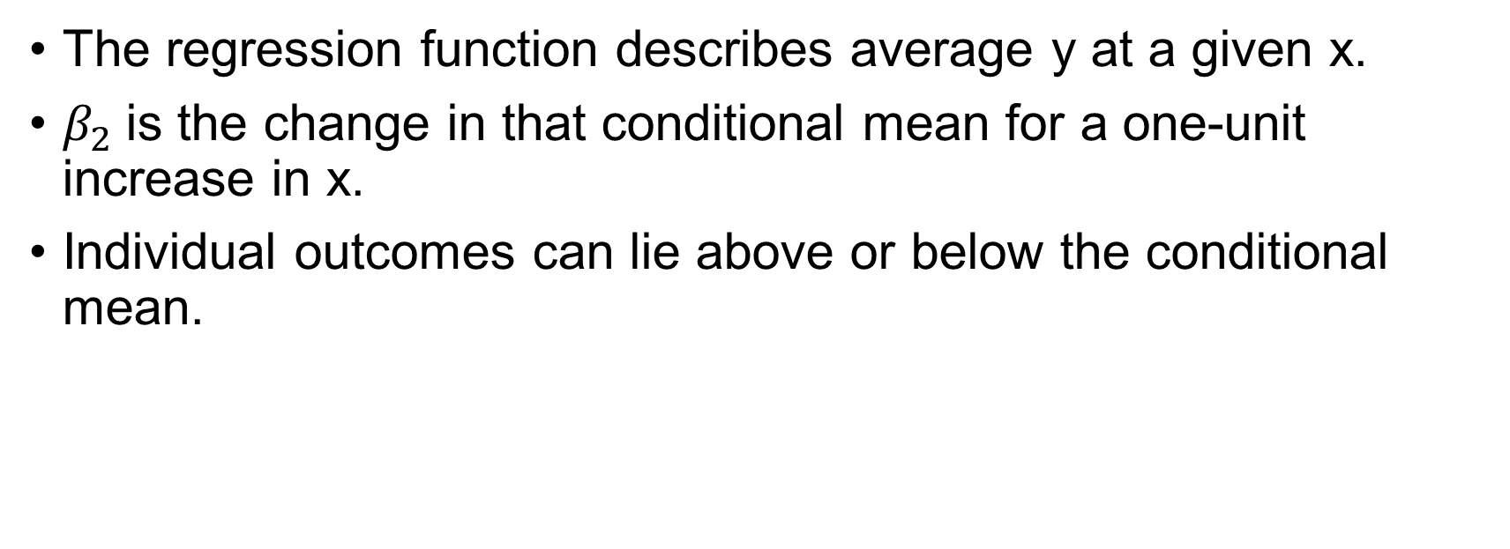

The population regression function
$$E(y_{i}|x_{i})=β_{1}+β_{2}∙x_{i}$$
when
$$E(e_{i}|x_{i})=0$$
The regression function describes average y at a given x.
$β_{2}$is the change in that conditional mean for a one-unit increase in x.
Individual outcomes can lie above or below the conditional mean.

Slide 12
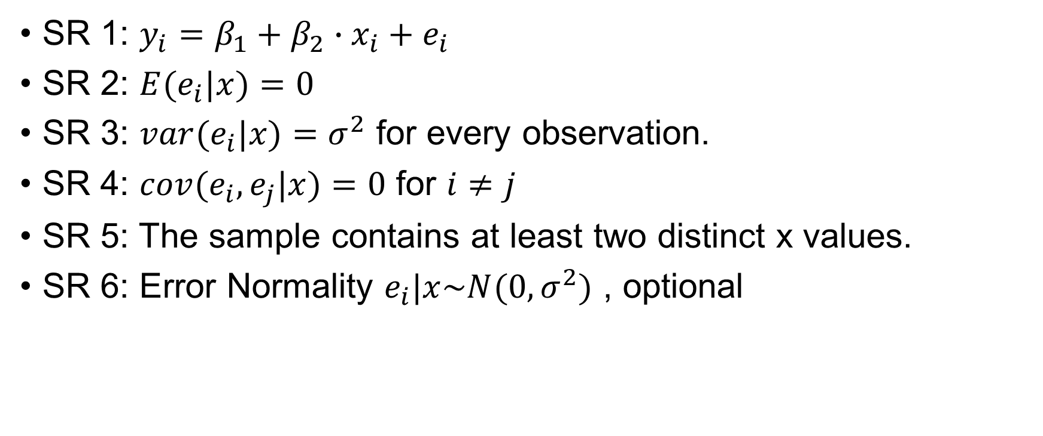
The simple regression assumptions
SR 1: $y_{i}=β_{1}+β_{2}∙x_{i}+e_{i}$
SR 2: $E(e_{i}|x)=0$
SR 3: $var(e_{i}|x)=σ^{2}$ for every observation.
SR 4: $cov(e_{i},e_{j}|x)=0$ for $i≠j$
SR 5: The sample contains at least two distinct x values.
SR 6: Error Normality $e_{i}|x\sim N(0,σ^{2})$ , optional

Slide 13
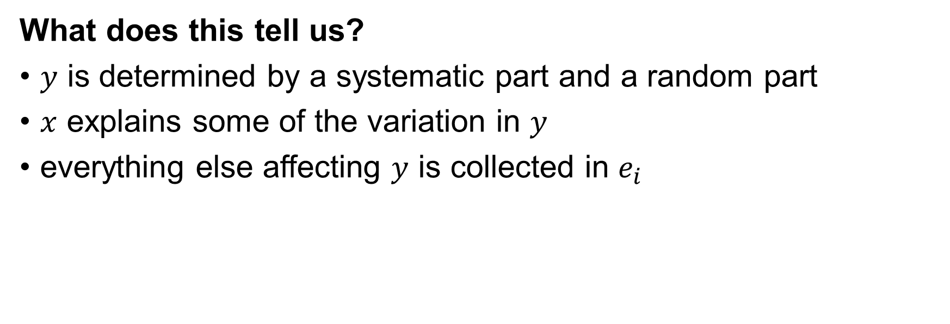

SR1: The econometric model
$$y_{i}=β_{1}+β_{2}∙x_{i}+e_{i}$$
What does this tell us?
$y$ is determined by a systematic part and a random part
$x$ explains some of the variation in $y$
everything else affecting $y$ is collected in $e_{i}$
Notes:
SR1 is just the starting point. It says that we model the outcome as a linear function of $x$plus an error term. The error term is important because real-world outcomes are never explained perfectly by a single variable.

Slide 14
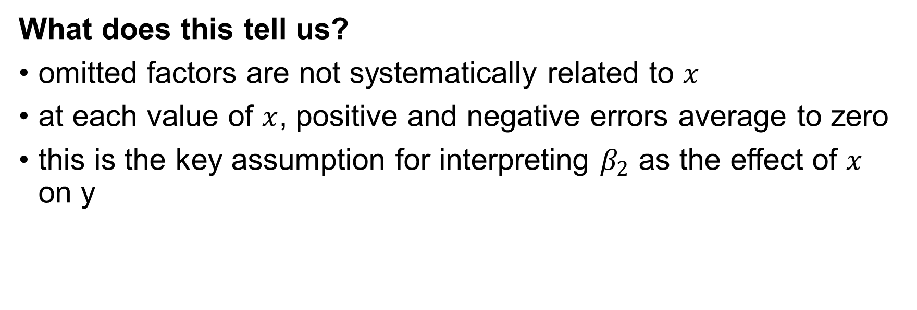

SR2: Strict exogeneity
$$E(e_{i}|x)=0$$
What does this tell us?
omitted factors are not systematically related to $x$
at each value of $x$, positive and negative errors average to zero
this is the key assumption for interpreting $β_{2}$ as the effect of $x$ on y
Notes:
Example:
In a wage–education regression, ability may affect both education and wages
Then education may be correlated with the error term
Short note / speaker note: This is the key causal assumption. It does not mean that every error is zero. It means that, on average, the omitted factors do not move systematically with $x$. If they do, then our estimated effect mixes together the effect of $x$and the effect of omitted variables.

Slide 15
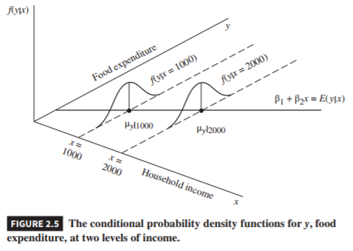
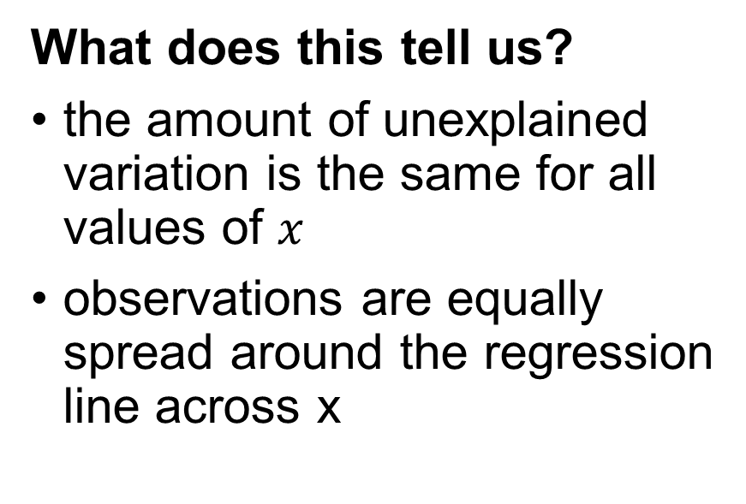

SR3: Homoskedasticity
$$var(e_{i}|x)=σ^{2}$$
What does this tell us?
the amount of unexplained variation is the same for all values of $x$
observations are equally spread around the regression line across x
Notes:
Sometimes a problem
Do you think the amount that people with my income and multimiionares expenditures flucuates?

Slide 16
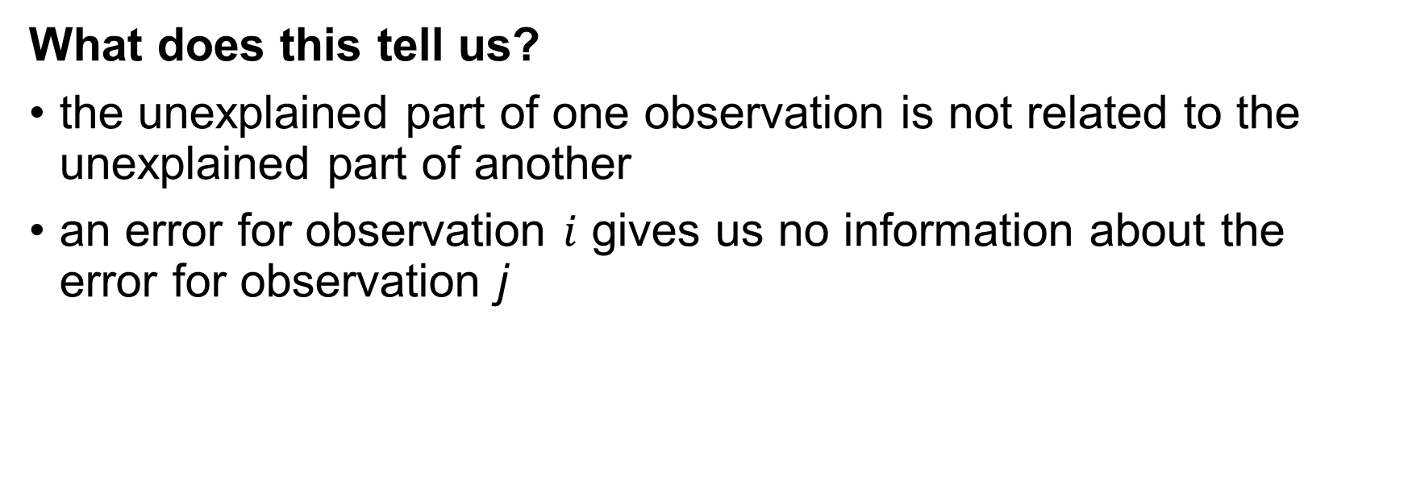

SR4: Uncorrelated errors
$$cov(e_{i},e_{j}|x)=0 \text{for} i≠j$$
What does this tell us?
the unexplained part of one observation is not related to the unexplained part of another
an error for observation $i$ gives us no information about the error for observation j
Notes:
Possible violations:
people in the same neighborhood
firms in the same industry
time series with serial correlation
Short note / speaker note: This assumption says the unobserved part of one observation should be independent of the unobserved part of another. In practice, this often fails with clustered data or time series data.

Slide 17
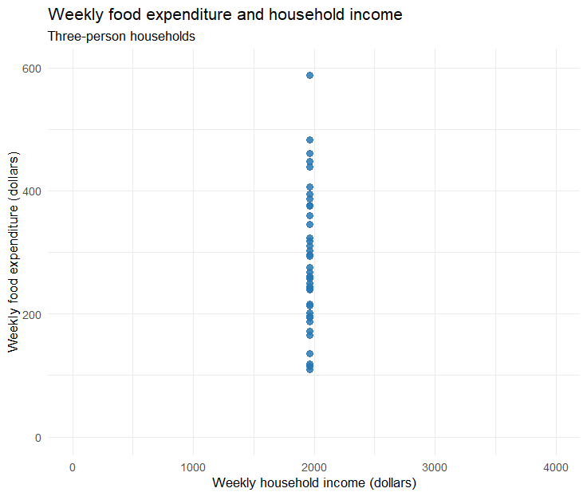
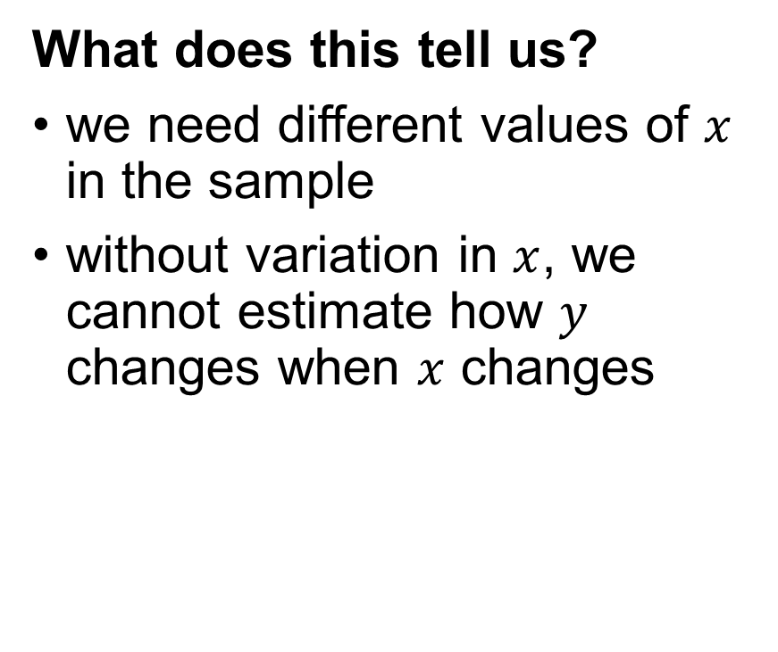
SR5: Variation in x
What does this tell us?
we need different values of $x$ in the sample
without variation in $x$, we cannot estimate how $y$ changes when $x$ changes

Slide 18

SR6: Normality
$$e_{i}|x\sim N(0,σ^{2})$$
What does this tell us?
the unexplained part of one observation is not related to the unexplained part of another
an error for observation $i$ gives us no information about the error for observation j
Notes:
Short note / speaker note: I would emphasize that SR6 is different from the others. It is mainly there to support exact inference in small samples. The earlier assumptions are more fundamental for interpretation and consistency.

Slide 19

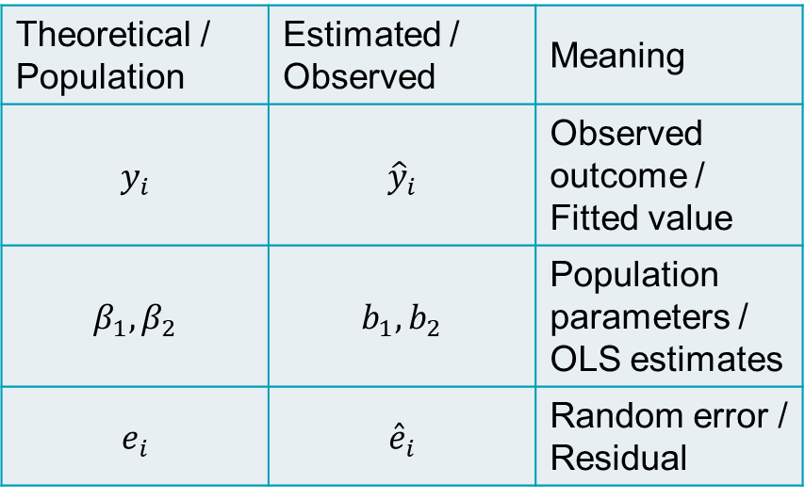


Theoretical → Estimated
When we start estimating parameters change
Theoretical / Population | Estimated / Observed | Meaning
$$y_{i}$$ | $${\hat{y}}_{i}$$ | Observed outcome / Fitted value
$$β_{1},β_{2}$$ | $$b_{1},b_{2}$$ | Population parameters / OLS estimates
$$e_{i}$$ | $${\hat{e}}_{i}$$ | Random error / Residual
$$y_{i}=β_{1}+β_{2}∙x_{i}+e_{i}$$
$$\hat{y_{i}}=b_{1}+b_{2}∙x_{i}$$
$$\hat{e_{i}}=y_{i}−\hat{y_{i}}$$

Slide 20

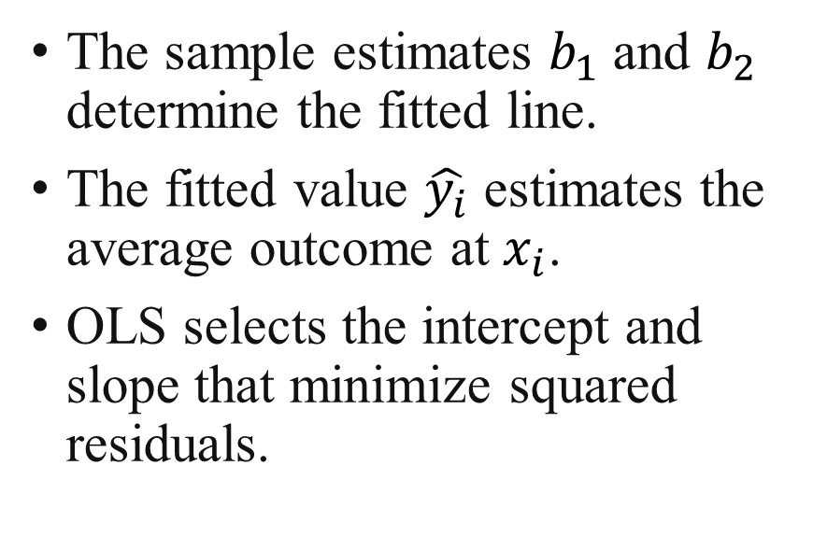
Ordinary least squares
$$\hat{y_{i}}=b_{1}+b_{2}∙x_{i}$$
The sample estimates $b_{1}$ and $b_{2}$ determine the fitted line.
The fitted value $\hat{y_{i}}$ estimates the average outcome at $x_{i}$.
OLS selects the intercept and slope that minimize squared residuals.

Slide 21

Fitted values and residuals
$$\hat{e_{i}}=y_{i}−\hat{y_{i}}$$
A residual is the observed outcome minus the fitted value.
A positive residual means the observation lies above the fitted line.
The residual êᵢ estimates an unobserved error eᵢ.

Slide 22
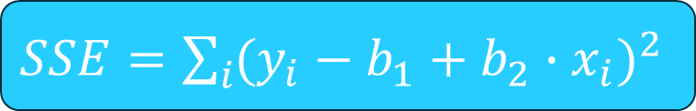
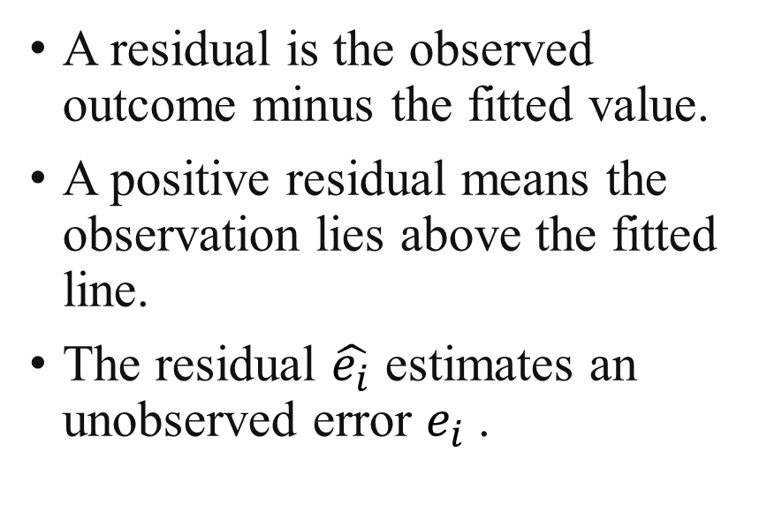
Fitted values and residuals
Lab 2
$SSE=\sum_{i}{{(y_{i}−b_{1}+b_{2}∙x_{i})}^{2}}$
A residual is the observed outcome minus the fitted value.
A positive residual means the observation lies above the fitted line.
The residual $\hat{e_{i}}$ estimates an unobserved error $e_{i}$.

Slide 23
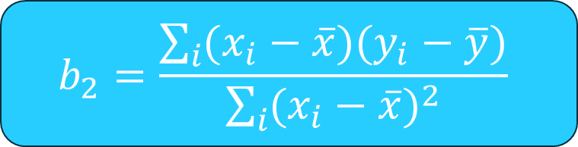

The OLS formulas
Lab 3
$$b_{1}=\overline{y}−b_{2}∙\overline{x}$$
$$b_{2}=\frac{\sum_{i}{(x_{i}−\overline{x})(y_{i}−\overline{y})}}{\sum_{i}{{(x_{i}−\overline{x})}^{2}}}$$
If all x values are equal, the slope denominator is zero.
The slope depends on how x and y vary together, relative to variation in x.

Slide 24

OLS vs our simple model
Lab 4
Estimate the OLS model using formlas
Run lm() function
Find $\sum_{i}{{\hat{e_{i}}}^{2}}$ and mean $\overline{\hat{e_{i}}}$ for:
Our simple model
OLS
Lm()
R
lm(food_exp ~ income, data = food)

Slide 25
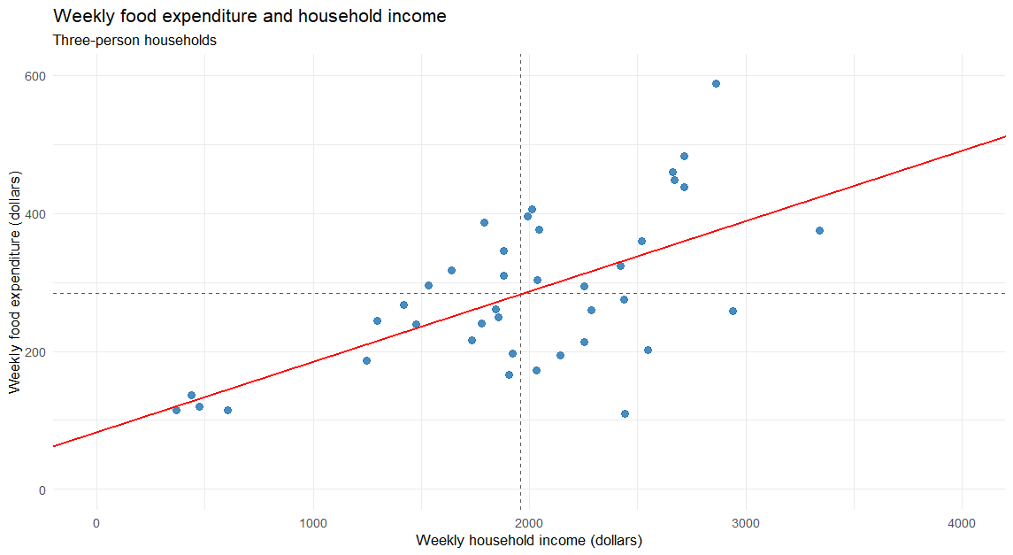

Plotting OLS
Lab 5
$$\hat{y_{i}}=83.416+10.209∙x_{i}$$

Slide 26

Properties of the fitted line
Lab 6
The fitted line passes through the sample means: $b_{1}=\overline{y}−b_{2}∙\overline{x}$
The residuals sum to zero: $\sum_{i}{\hat{e_{i}}=0}$
The regressor and residuals have zero sample covariance.
These algebraic properties do not establish population exogeneity.
Notes:
Source: Hill, Griffiths and Lim, Principles of Econometrics, 5th edition, Chapter 2, 2.3 OLS with an intercept. Course source: Book md/chapter-02-simple-linear-regression.md. Design reference: Old lectures/ch02.pptx.
R section 3 verifies these identities numerically. They follow from the normal equations whenever OLS includes an intercept.
This last point is important because it can look similar to the exogeneity assumption. But it is not the same thing. The zero sample covariance between \(x_i\) and the residuals is guaranteed by the way OLS is calculated. Population exogeneity, such as \(E(e_i\mid x)=0\), is an assumption about the data-generating process and cannot be established simply from these OLS algebraic properties.

Slide 27
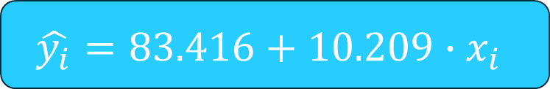

Prediction at a given income
Lab 7
$$\hat{y_{i}}=83.416+10.209∙x_{i}$$
x = 3000 corresponds to a weekly income of $3,000
An individual household can spend more or less than the fitted value.
$$\hat{y_{i}}=83.416+10.209∙3000=389.7$$

Slide 28
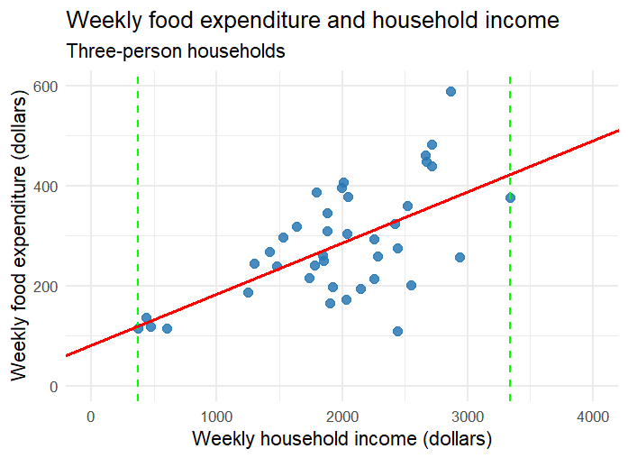
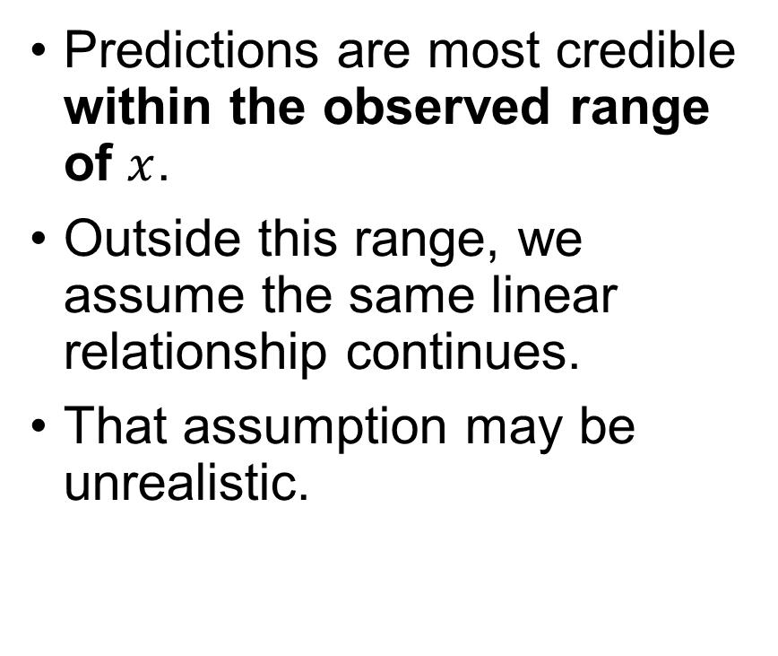
Avoid extrapolation!
Lab 8
Predictions are most credible within the observed range of $x$.
Outside this range, we assume the same linear relationship continues.
That assumption may be unrealistic.

Slide 29
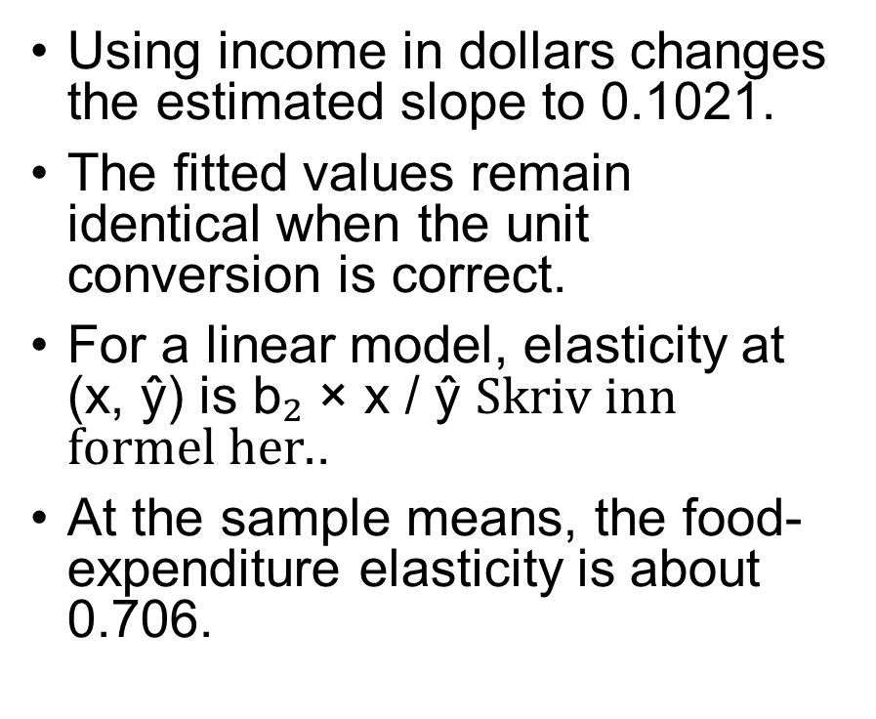
Elasticise
Lab 9
Using income in dollars changes the estimated slope to 0.1021.
The fitted values remain identical when the unit conversion is correct.
For a linear model, elasticity at (x, ŷ) is b₂ × x / ŷ .
At the sample means, the food-expenditure elasticity is about 0.706.

Slide 30
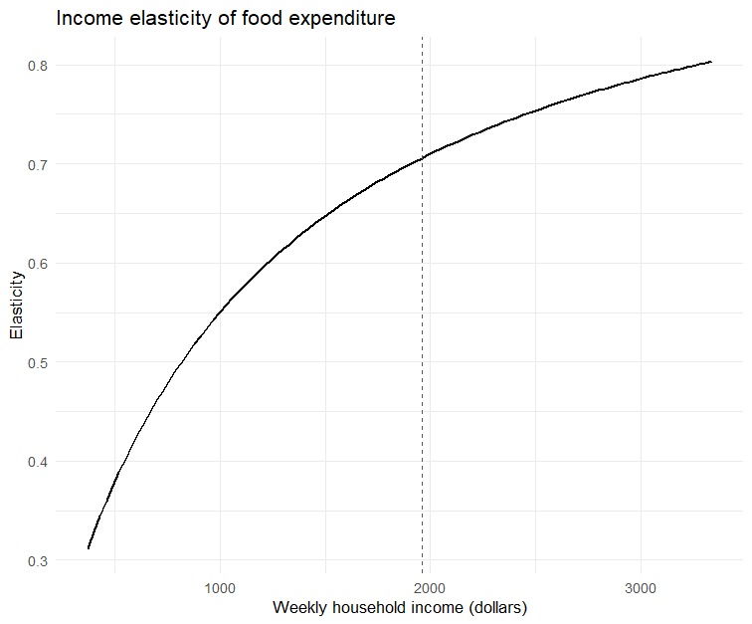

Elasticity and income
Lab 10
$$\hat{ε}(x)=b_{2}\frac{x}{\hat{y}}$$
Food expenditure increases with income, but less than proportionally.
Elasticity increases with income, but at a decreasing rate.
In our sample, elasticity remains below 1 → food is a necessity.
At the same time, food expenditure becomes a smaller share of income as income rises.

