Slide 1
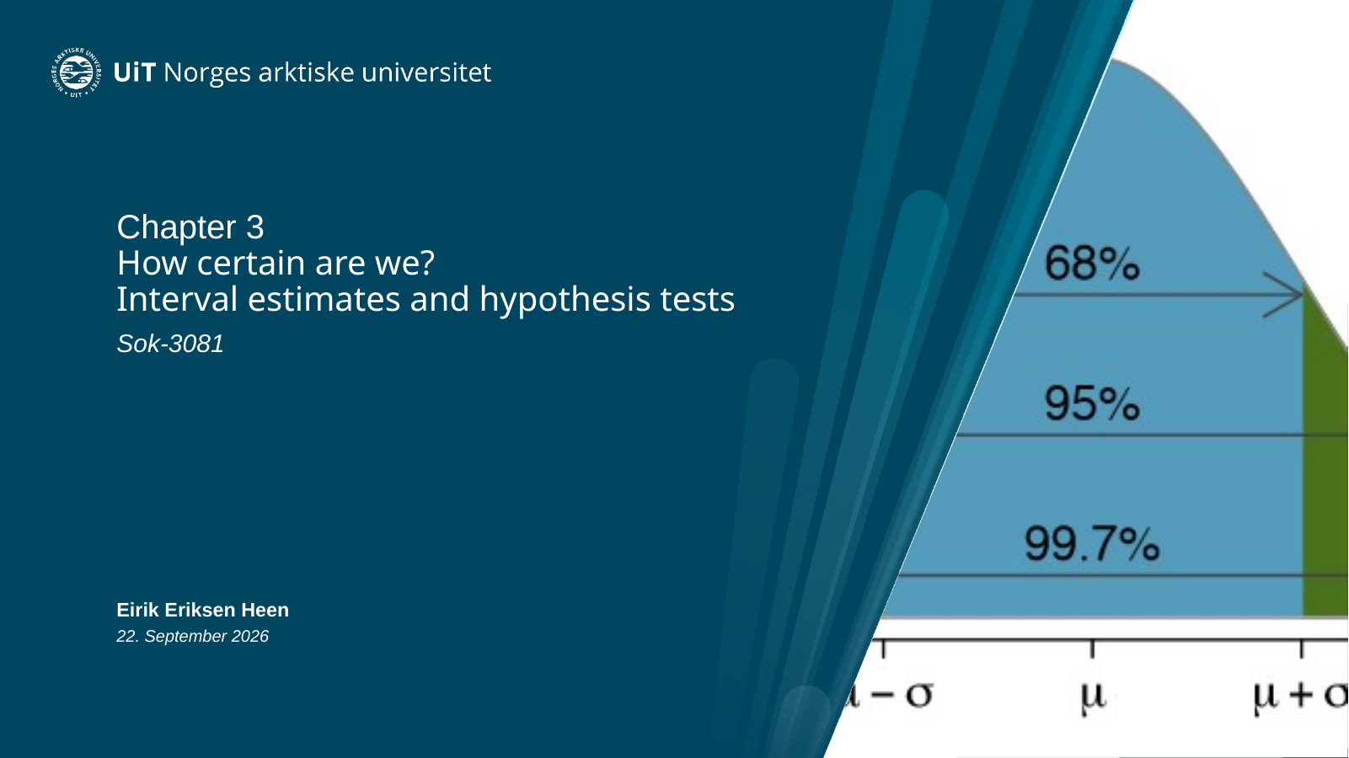
Notes:
Opening. Frame the chapter around one question: How certain are we about what we estimated?
The chapter has two main tools: interval estimates and hypothesis tests. Both start from the same object: an estimate and its sampling uncertainty.
Do not preview all technical details yet. The aim is to connect directly to Chapter 2.

Slide 2
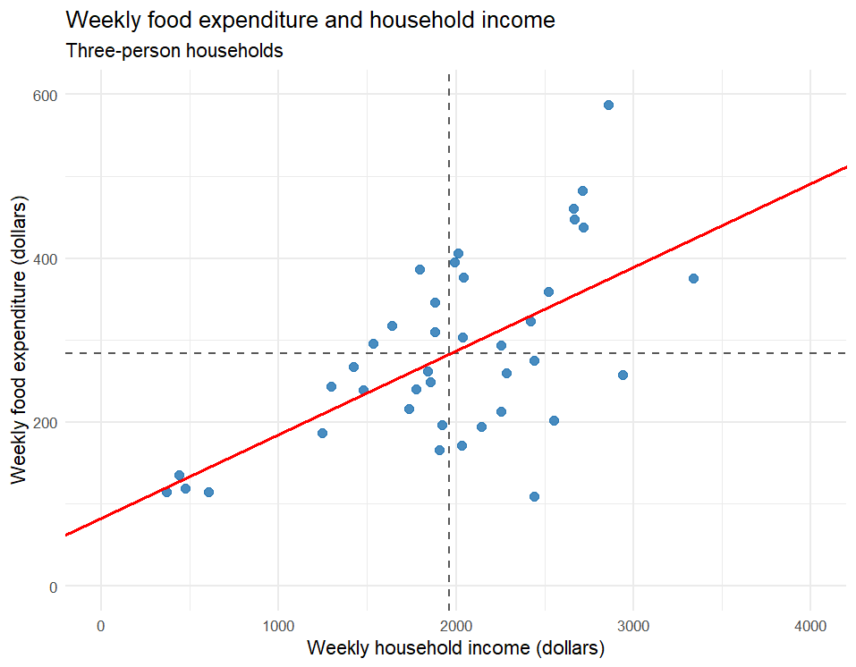
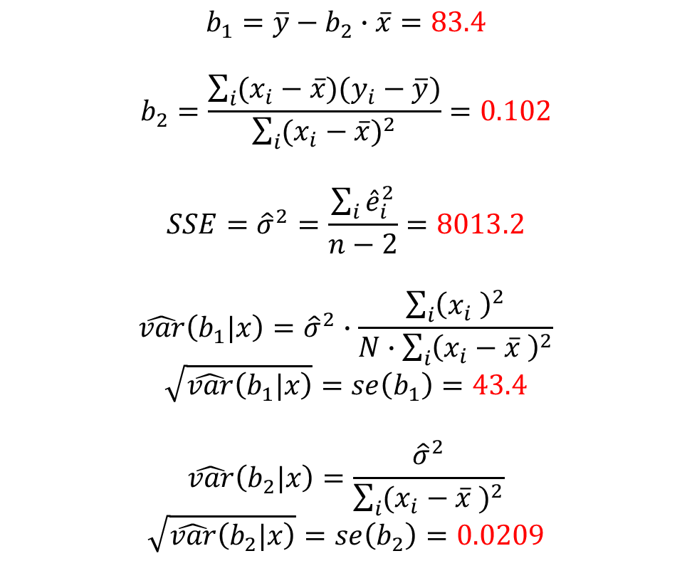

Results from food data
$$\hat{y_{i}}=83.4+0.102∙x_{i}$$
$$b_{1}=\overline{y}−b_{2}∙\overline{x}=83.4$$
$$b_{2}=\frac{\sum_{i}{(x_{i}−\overline{x})(y_{i}−\overline{y})}}{\sum_{i}{{(x_{i}−\overline{x})}^{2}}}=0.102$$
$$SSE={\hat{σ}}^{2}=\frac{\sum_{i}{{\hat{e}}_{i}^{2}}}{n−2}=8013.2$$
$$\hat{var}\left(b_{1}|x\right)={\hat{σ}}^{2}∙\frac{\sum_{i}{{\left(x_{i} \right)}^{2}}}{N∙\sum_{i}{{\left(x_{i}−\overline{x} \right)}^{2}}}$$
$$\sqrt{\hat{var}\left(b_{1}|x\right)}=se\left(b_{1}\right)=43.4$$
$$\hat{var}\left(b_{2}|x\right)=\frac{{\hat{σ}}^{2}}{\sum_{i}{{(x_{i}−\overline{x} )}^{2}}}$$
$$\sqrt{\hat{var}\left(b_{2}|x\right)}=se\left(b_{2}\right)=0.0209$$
Notes:
Use this as a quick reconnect to the food model. Do not re-derive all Chapter 2 formulas. Point to the slope estimate, the residual variance, and the standard error.
Key reminder: beta_2 is a population parameter. b_2 is what we obtained from one sample. se(b_2) tells us how much the estimator would vary across repeated samples.
Tell students that today we will add only one new ingredient at a time.

Slide 3
The food model and the decision
food_exp = 83.42 + 0.1021 income
USD 0.1021
USD 0.055
Estimated increase in food expenditure
per USD higher weekly income
Minimum increase required
for the investment to be profitable
Should the supermarket invest?
Notes:
Return to the economic decision. The estimated increase is about USD 10.21 per USD 100 higher weekly income. The investment threshold is USD 5.50.
Ask: Is b_2 > 0.055 enough to make the decision?
Expected answer: no. The estimate itself does not tell us how uncertain it is. This question motivates both interval estimation and hypothesis testing.

Slide 4
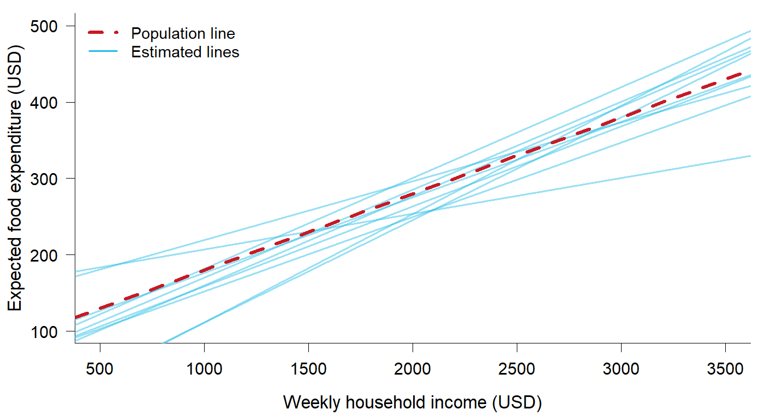


Population parameter and sample estimate
$$β_{2}$$
The fixed but unknown slope
in the population
One population value
Each random sample produces a different estimate $b_{2}$
Notes:
Stress the distinction. beta_2 is fixed but unknown. b_2 is random before we draw the sample because another random sample would produce another estimate.
The thin fitted lines are not different population relationships. They are estimates from different samples from the same population model.

Slide 5
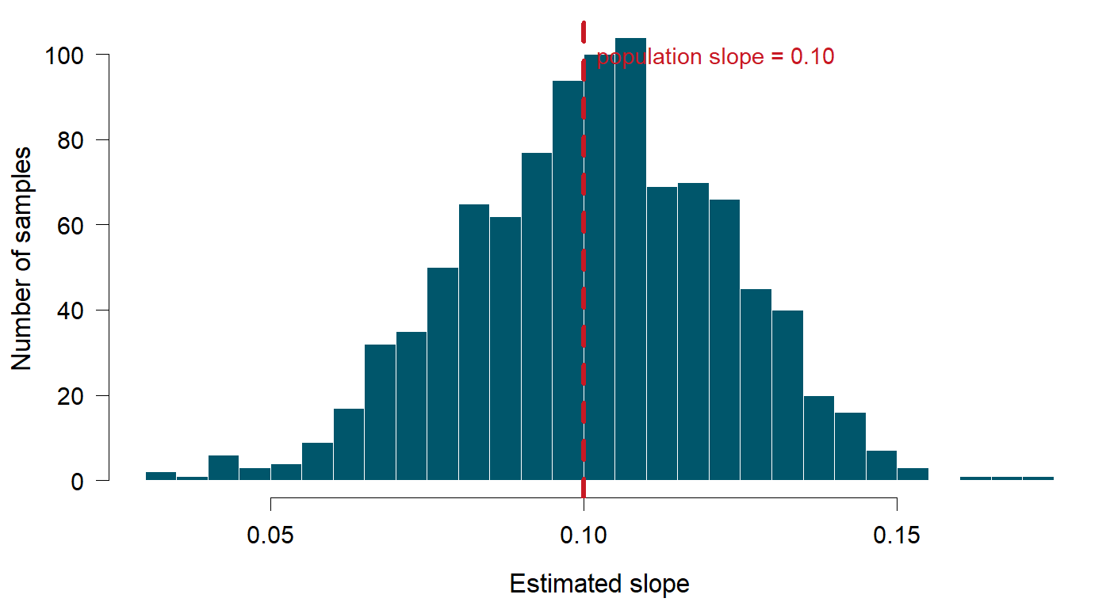
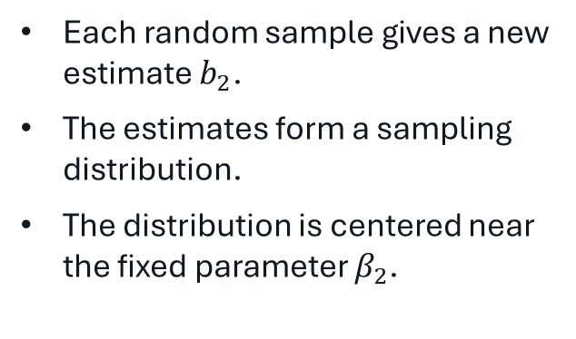
The sampling distribution of $b_{2}$
Each random sample gives a new estimate $b_{2}$.
The estimates form a sampling distribution.
The distribution is centered near the fixed parameter $β_{2}$.
What changes if N increases from 40 to 200?
Notes:
Ask the prediction question before discussing the answer: what changes when N goes from 40 to 200?
Expected: the center should remain near beta_2, but the sampling distribution should become narrower. This is the idea of precision.

Slide 6
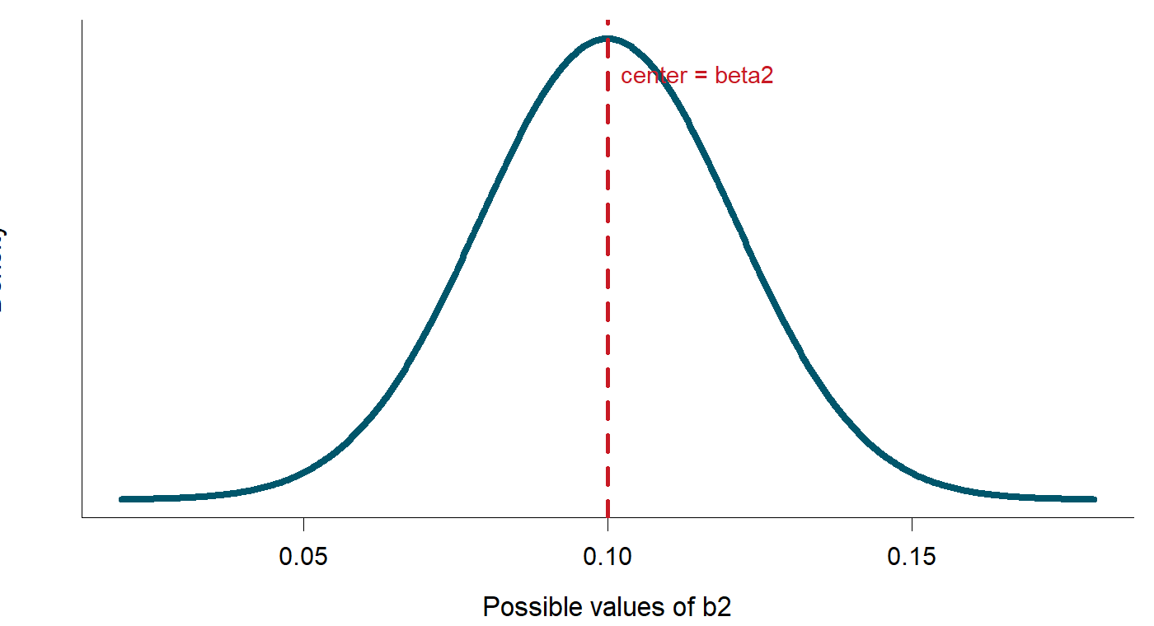
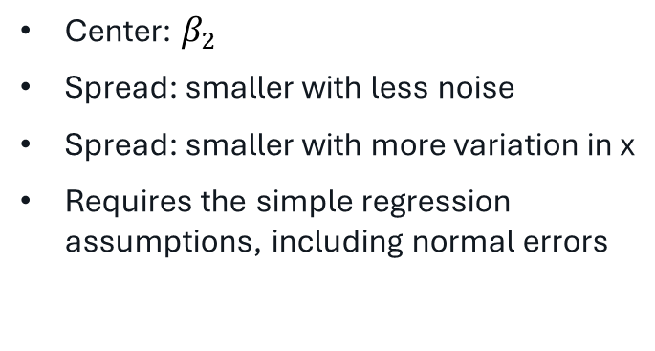
The distribution of the OLS slope estimator
$$b_{2}|x\sim N\left(β_{2},\frac{σ^{2}}{\sum_{i}{{(x_{i}−\overline{x} )}^{2}}}\right)$$
Center: $β_{2}$
Spread: smaller with less noise
Spread: smaller with more variation in x
Requires the simple regression assumptions, including normal errors
Notes:
This is the mathematical bridge from Chapter 2. Read the formula by components rather than deriving it.
Center: beta_2. Spread: sigma^2 divided by variation in x. Less noise and more variation in x both improve precision.
Mention SR6 / normal errors because this chapter uses the exact t distribution. With large samples, approximate inference can work without exact normality.

Slide 7


From a normal statistic to a t-statistic
If σ² were known
In practice, σ² is unknown
$$Z=\frac{b_{2}−β_{2}}{sd(b_{2})}$$
Estimate σ² from the residuals
Z follows N(0,1)
This adds uncertainty
$$t=\frac{b_{2}−β_{2}}{se(b_{2})}\sim t(n−2)$$
Notes:
Do this slowly. If sigma were known, standardizing gives a normal statistic. In practice sigma is unknown and is estimated from the residuals. That extra uncertainty changes the reference distribution from normal to t.
Important: we are not introducing a second regression model. We are changing the probability distribution used for inference.

Slide 8
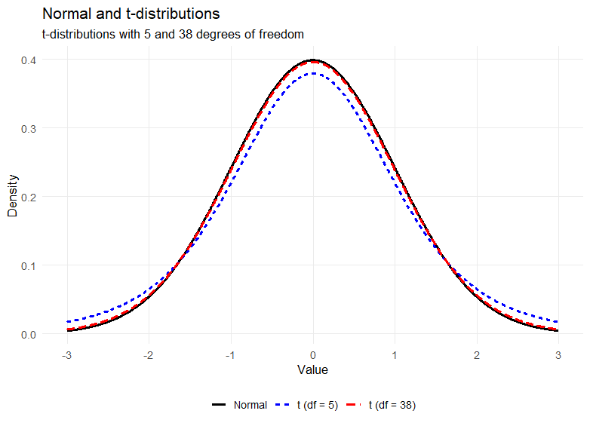
The t-distribution and degrees of freedom
The t-distribution is symmetric around zero.
Estimated σ gives thicker tails.
The tails become thinner as the degrees of freedom increase.
Simple regression estimates two parameters
N = 40 gives df = N - 2 = 38
Notes:
Compare normal, t(38), and a t distribution with few degrees of freedom. Focus on the thicker tails.
Simple regression estimates two parameters, so df = N - 2. For the food data N = 40, therefore df = 38.
Do not spend time on tables: qt() will give critical values in R.

Slide 9
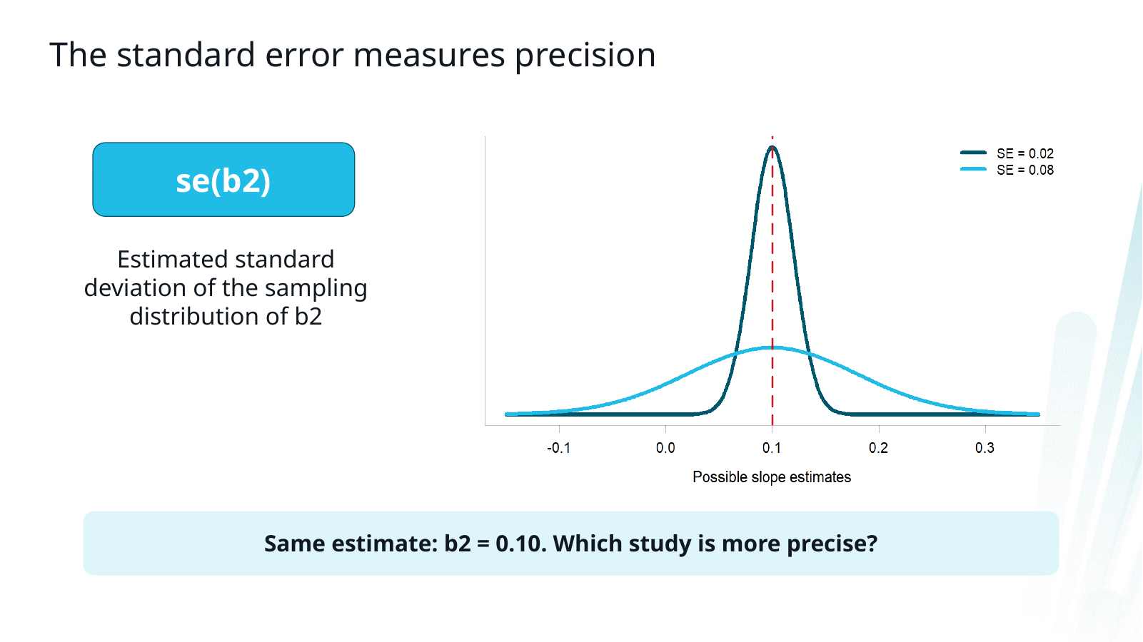
Notes:
Standard error is the estimated standard deviation of the sampling distribution of the estimator.
Ask which of the two studies is more precise even though both have b_2 = 0.10.
This prepares the students for why an estimate alone is not enough.

Slide 10
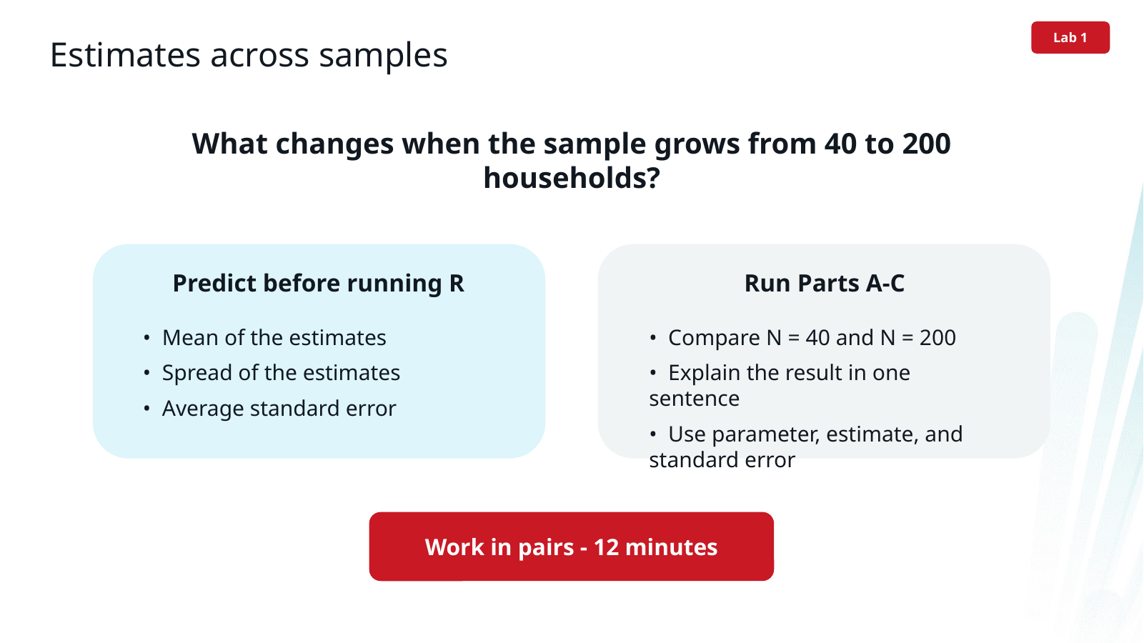
Notes:
LAB 1. Let students predict before running code. The prediction is more important than the exact simulation numbers.
Run Parts A-C of the R script. Ask them to compare the mean estimate, SD across simulated estimates, and average reported SE.
Allow about 12 minutes.

Slide 11
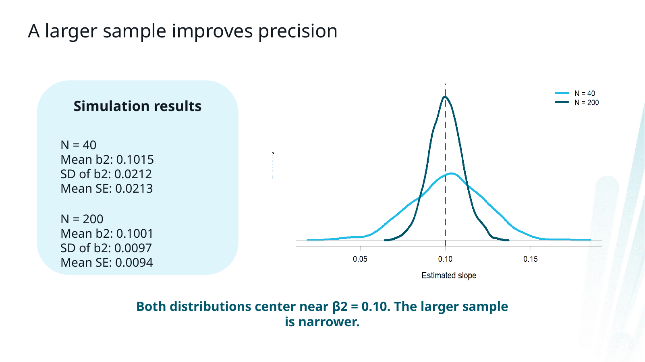
Notes:
Debrief the simulation. The mean estimate remains near the true beta_2. The larger sample has much smaller spread. The average standard error tracks the empirical spread of the estimates.
Do not say that a larger sample guarantees that every realized estimate is closer to beta_2; it improves the distribution of possible estimates.

Slide 12
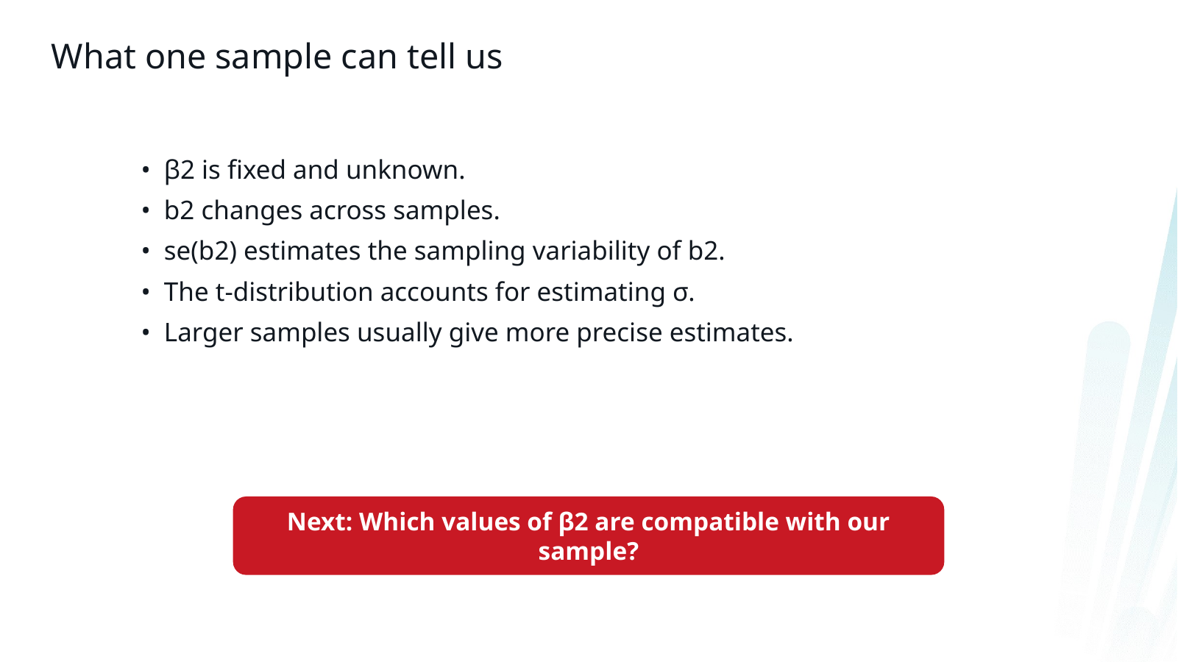
Notes:
Use this as the transition to interval estimation. Everything on this slide should now be familiar.
The next question is: instead of reporting only b_2, which values of beta_2 are reasonably compatible with the sample?
Natural place for a brief pause before the interval section.

Slide 13
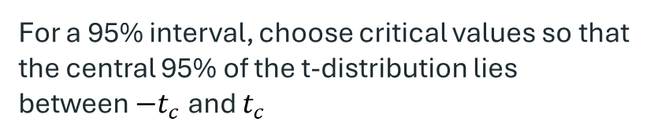
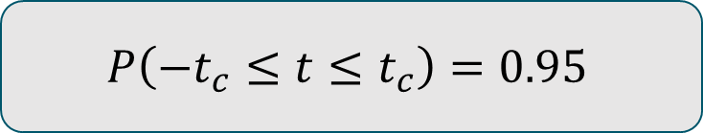

INTERVAL ESTIMATION
From a t-statistic to an interval
$$t=\frac{b_{2}−β_{2}}{se(b_{2})}$$
$$P\left(−t_{c}≤t≤t_{c}\right)=0.95$$
For a 95% interval, choose critical values so that the central 95% of the t-distribution lies between $−t_{c}$and $t_{c}$
The next step is just algebra.
Goal: isolate the unknown parameter β₂.
Notes:
This is the only derivation I would do for interval estimation. Start from the t-statistic they already saw.
Explain that t is random because b_2 and se(b_2) depend on the sample. beta_2 is fixed.
For a 95% interval we choose t_c so that 95% of the t distribution is in the middle. Then substitute the expression for t and solve the inequality for beta_2.
Do not perform the algebra on this slide. Move to the blank derivation slide and write it by hand.

Slide 14

WORK IT OUT TOGETHER
Derivation: construct the 95% interval
$$−t_{c}≤\frac{b_{2}−β_{2}}{se(b_{2})}≤t_{c}$$
Start here:
Notes:
Handwrite the derivation. One possible sequence:
1. Multiply all three parts by se(b_2).
2. Rearrange so beta_2 is in the middle.
3. Arrive at b_2 - t_c se(b_2) <= beta_2 <= b_2 + t_c se(b_2).
Emphasize that the endpoints are random before the sample is drawn because they depend on b_2 and se(b_2).

Slide 15




INTERVAL ESTIMATION
The interval estimator
$$b_{2}±t_{c}∙se(b_{2})$$
$$b_{2}$$
$$se(b_{2})$$
$$t_{c}$$
Center of the interval
Our point estimate
Sampling uncertainty
Larger SE → wider interval
How much probability we want in the procedure
Depends on confidence level and df
Estimate + uncertainty + chosen coverage procedure
Notes:
Use this slide to make the formula intuitive rather than algebraic.
The interval is centered at the point estimate. Its width is determined by the standard error and the critical t-value.
Do not call the width the “margin of error”; that phrase is deliberately avoided in this course.
Ask: what makes the interval narrower? Smaller SE, and for a fixed SE a lower confidence level / larger degrees of freedom.

Slide 16
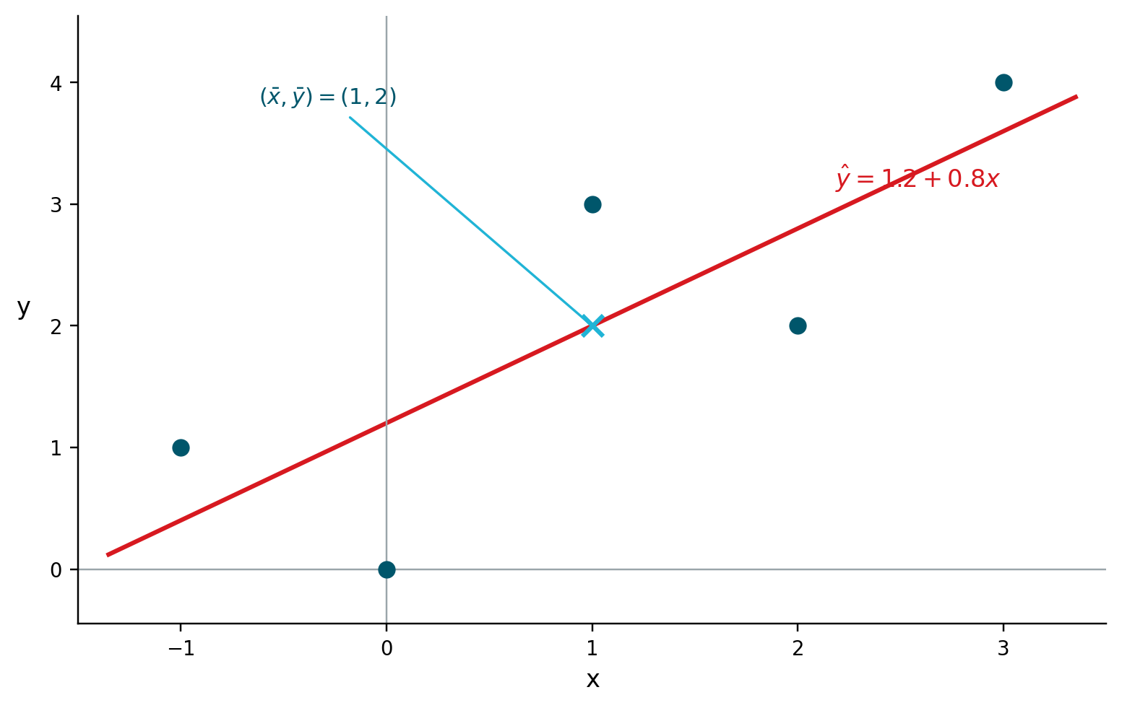
FROM SESSION 10
We built OLS from these five observations
Everything below was calculated by hand before using lm().
The data
What we carry forward
x
y
Point estimate
-1
1
b₂ = 0.80
0
0
1
3
Estimated sampling uncertainty
2
2
se(b₂) = 0.346
3
4
N = 5 → df = 3
Fitted regression line
ŷ = 1.2 + 0.8x
x = explanatory variable y = outcome variable
Today: use b₂ and se(b₂) to ask which values of the unknown population slope β₂ are compatible with this sample.
2
Notes:
Use this as a short re-entry into the small example from Session 10 rather than simply saying 'remember last time'.
We had five observations: x = (-1, 0, 1, 2, 3) and y = (1, 0, 3, 2, 4). We calculated the OLS line by hand. The sample means were x-bar = 1 and y-bar = 2; Sxx = 10 and Sxy = 8; therefore b2 = 0.8 and b1 = 1.2. We then calculated residuals, SSE = 3.6, sigma-hat-squared = 1.2, Var-hat(b2) = 0.12, and se(b2) = 0.346.
Do not redo those calculations here. The point is that Chapter 3 begins with quantities they already understand: a point estimate and its estimated sampling uncertainty. Ask: Is b2 = 0.8 a precise estimate? Which values of the unknown beta2 are still compatible with such a small sample? That question leads directly to the interval-estimation slide. Spend about 2–3 minutes here.

Slide 17

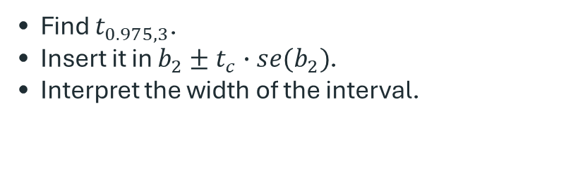

SMALL CALCULATION
Back to our five-observation example
From Session 10, we already found:
$$b_{2}=0.80$$
$$se\left(b_{2}\right)=0.346$$
N = 5 → df = 3
Construct a 95% interval for β₂.
Use R as a calculator if you do not have a t-table:
Find $t_{0.975,3}$.
Insert it in $b_{2}±t_{c}∙se(b_{2})$.
Interpret the width of the interval.
qt(0.975, df = 3)
Notes:
This example is useful because every component except the critical t-value was already calculated by hand in Session 10.
Let them calculate the critical value with R: qt(0.975, df=3) = approximately 3.182.
Then the interval is 0.80 +/- 3.182*0.346, approximately [-0.30, 1.90].
The striking feature is the width. N=5 leaves only 3 residual degrees of freedom, so the t critical value is large and the estimate is imprecise.

Slide 18
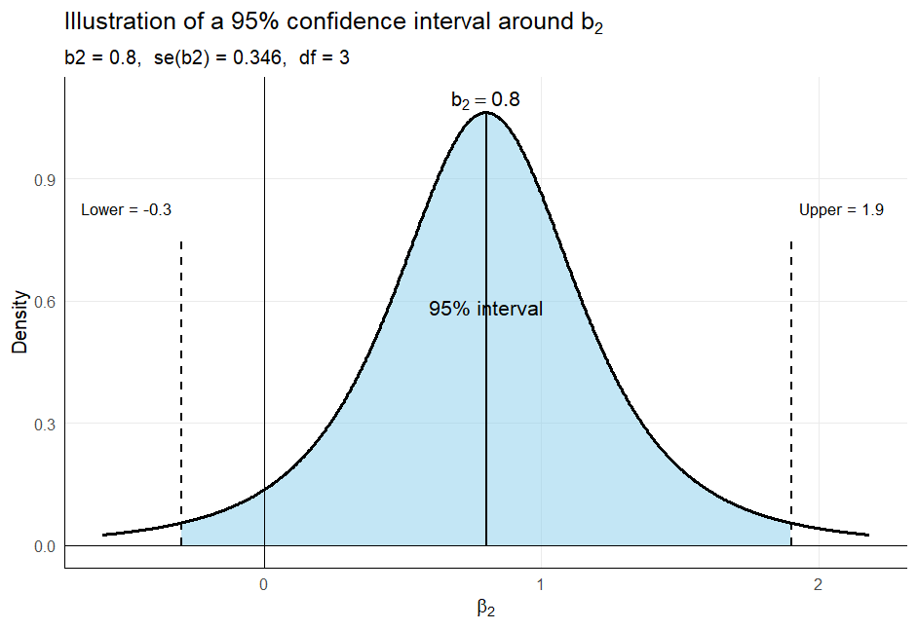
TWO MINUTES
Your calculation
$b_{2}=0.8$ $se\left(b_{2}\right)=0.346$ $df=3$ $t_{0.975,3}=3.1824$
95% interval: ____________________________________________
What does the width tell us?
Notes:
Give students about 2 minutes. Then solve on the slide or board.
Expected result: t_c ≈ 3.182 and the 95% interval is approximately [-0.30, 1.90].
Ask whether zero is inside. Do not introduce the formal hypothesis-test rule yet; simply note that zero is one value compatible with this imprecise sample.

Slide 19
R AS A CALCULATOR
Manual first — then let R check it
# Critical value
t_c <- qt(0.975, df = 3)
# Manual interval
lower <- 0.80 - t_c * 0.346
upper <- 0.80 + t_c * 0.346
c(lower, upper)
# Same idea after estimating a model
model <- lm(y ~ x, data = small_data)
confint(model, "x", level = 0.95)
The function is convenient because we already understand the calculation behind it.
Notes:
Run the code live. The teaching sequence is important: first calculate the interval from the formula, then use confint().
This prevents confint() from becoming a black box.
Point out that qt() is simply replacing the old statistical table.

Slide 20



THE IMPORTANT INTERPRETATION
95% confidence is a property of the procedure
$$β_{2}$$
Random sample
Interval
Fixed and unknown
There is one population value
A new sample gives new $b_{2}$
and $se\left(b_{2}\right)$
The endpoints change from sample to sample
If we repeatedly sample and construct intervals in the same way, about 95% of the intervals contain $β_{2}$.
The confidence is in the method — not in the particular interval after it has been calculated.
Notes:
Spend time here. This is the conceptual summary the user specifically wanted.
After the sample is observed, beta_2 is still fixed and the interval endpoints are fixed numbers. In the frequentist interpretation we do not assign a 95% probability to beta_2 being inside this particular interval.
The 95% refers to the long-run performance of the procedure across repeated samples.
A defensible classroom phrasing: “We used a procedure that captures the true parameter in 95% of repeated samples.”

Slide 21
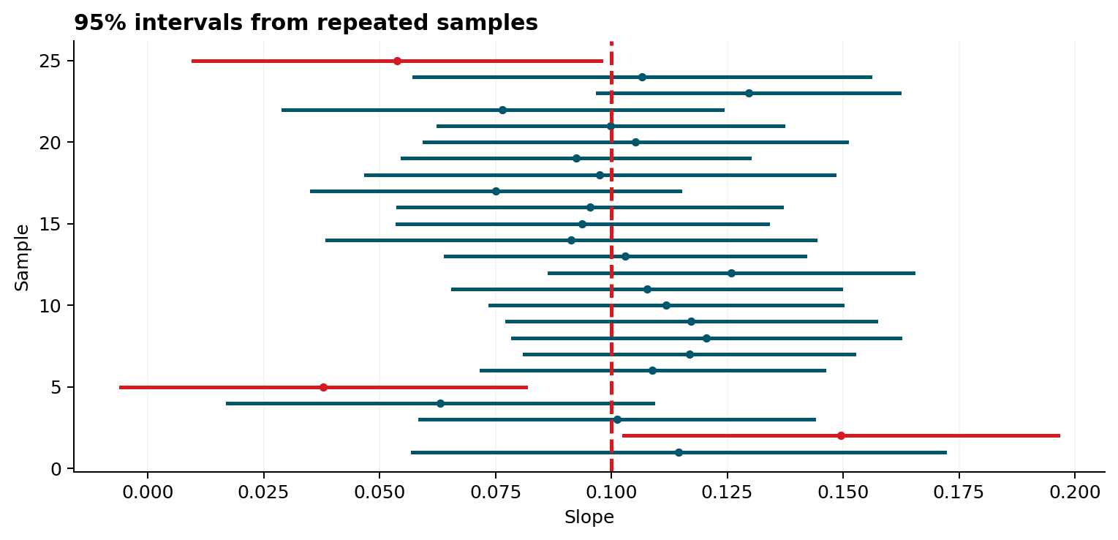
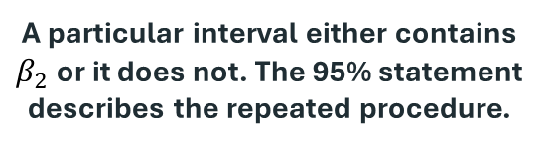
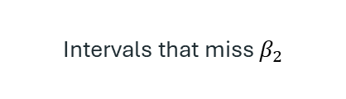

SIMULATION
Repeated sampling makes the meaning visible
Dashed line
The fixed true $β_{2}$
Red intervals
Intervals that miss $β_{2}$
A particular interval either contains $β_{2}$or it does not. The 95% statement describes the repeated procedure.
Notes:
Use the simulation rather than more algebra. The vertical dashed line is the known beta_2 in the simulation. Each horizontal line is generated from a different random sample using the same 95% procedure.
Some intervals miss. That is not a failure of the method; a 95% method is expected to miss in about 5% of repeated samples.
Run the corresponding simulation from the R file if time permits.

Slide 22
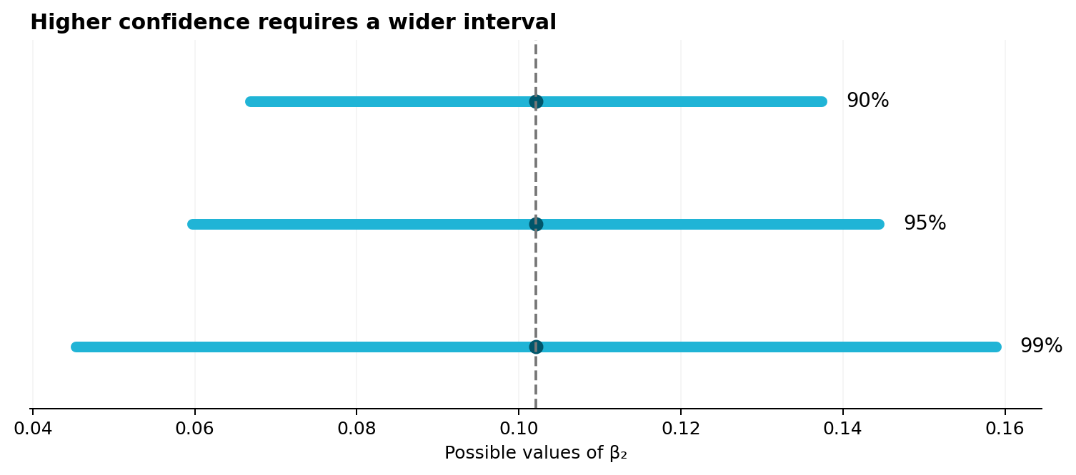
PRECISION VERSUS COVERAGE
Higher confidence requires a wider interval
Same estimate.
Same standard error.
Only the confidence level changes.
To capture the parameter more often, the procedure must allow a wider range of values.
Predict before running R: which interval is widest?
Notes:
This is a short conceptual check. Keep the estimate and SE fixed and compare 90%, 95%, and 99%.
Higher confidence implies a larger critical t-value, so the interval is wider.
Ask what happens if the SE is cut in half: all intervals become narrower.

Slide 23
The investment threshold and the interval
Additional food expenditure per USD 100 higher income
Investment threshold
USD 0.055
USD 0.102
USD 0.059
USD 0.144
Does the interval settle the investment decision?

Slide 24
LAB 2 — INTERVAL ESTIMATION
New data: motel occupancy
Textbook computer exercise 3.19
MOTEL_PCT = β₁ + β₂ · COMP_PCT + e
Interpretation question
What does a one-percentage-point increase in competitor occupancy correspond to in predicted motel occupancy?
Plot motel occupancy against competitor occupancy.
Estimate the regression with lm().
Extract b₂, se(b₂), and df.
Construct the 95% interval manually.
Check with confint().
Work in pairs • 12–15 minutes
Notes:
This is the first time in the chapter that students move away from the food dataset. The model comes from textbook computer exercise 3.19.
The aim is not to plug supplied numbers into the interval formula. They must first estimate the model, identify the slope and its SE, then construct the interval.
Let them use R as the calculator for qt().
Do not move into the textbook hypothesis-testing parts of the motel exercise yet. Hypothesis testing will continue with the supermarket question because that economic threshold is especially clear.
NATURAL STOP FOR SESSION 1: stopping after this lab and the debrief on the next slide is ideal. If time is shorter, stop anywhere after slide 19 and resume here next session.

Slide 25
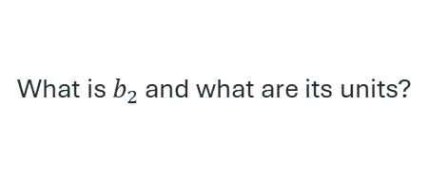

FROM OUTPUT TO INTERPRETATION
Motel debrief
1. Estimate
2. Uncertainty
3. Interpretation
What is $b_{2}$ and what are its units?
How large is ${se(b}_{2})$?
How wide is the interval?
Which population slope values are compatible with the sample?
Do not stop at “the interval is [lower, upper]”. State what the endpoints mean in the economic context.
Confidence is still about the procedure used to construct the interval.
Notes:
Debrief without turning the exercise into a list of R commands. Ask one group for the estimate, another for the interval, and a third for an interpretation.
Return explicitly to the method interpretation: the reported interval is one realization of a procedure with 95% repeated-sampling coverage.

Slide 26
Hypothesis testing
From a range of plausible values to one specific claim
Notes:
Use this as the start of Session 2 if you stopped after the motel lab.
The conceptual link: interval estimation asks which values are compatible with the sample. Hypothesis testing asks whether one specific claim about beta_2 is compatible with the sample.

Slide 27
A CLAIM WE CAN TEST
Return to the supermarket decision
food_exp = 83.42 + 0.1021 · income
Estimate
Decision threshold
USD 0.102 more food expenditure
per USD higher weekly income
Investment requires more than
USD 0.055 per USD
Question: Is the evidence strong enough to conclude that β₂ > 0.055?
Notes:
Use the same economic question from the beginning, but now phrase it as a claim about beta_2.
The estimate 0.1021 is above 0.055, but that alone is not enough. We need to compare the distance from the threshold with the sampling uncertainty.

Slide 28
HYPOTHESES
From the economic question to H₀ and H₁
H₀: β₂ ≤ 0.055
H₁: β₂ > 0.055
Not enough for investment
Large enough for investment
The alternative hypothesis determines the direction of the test.
For calculations, the boundary value 0.055 is used in the t-statistic.
Notes:
Start with the economic statement, then write hypotheses. This makes the direction of the test natural.
The alternative contains the statement we want evidence for: beta_2 > 0.055. Therefore evidence in favor of H1 corresponds to unusually large positive t-values.
Although H0 is written as <= 0.055, the t calculation uses the boundary value c = 0.055.

Slide 29

ONE FORMULA
The test statistic measures distance from the claim
$$t=\frac{b_{2}−c}{se(b_{2})}$$
Numerator
How far is the estimate from the hypothesized value?
Denominator
How much sampling variation is normal for b₂?
Interpretation: how many standard errors is the estimate from the value specified by H₀?
Notes:
This is the core of hypothesis testing. Avoid presenting it as a new formula to memorize: it is just distance divided by uncertainty.
If H0 is true and c is the correct population value, the statistic follows the t distribution under the assumptions. That gives us a reference for deciding whether the observed distance is unusual.

Slide 30

WORK IT OUT TOGETHER
Calculate the supermarket t-statistic
b₂ = 0.1021 c = 0.055 se(b₂) = 0.0209
$$t=\frac{b_{2}−c}{se(b_{2})}$$
Notes:
Calculate together: t = (0.1021 - 0.055) / 0.0209 ≈ 2.25.
Interpret 2.25 before discussing a rejection rule: the estimate is about 2.25 standard errors above the threshold under H0.
Then ask: is 2.25 unusually large for a t distribution with 38 df? That motivates the rejection region / p-value.

Slide 31
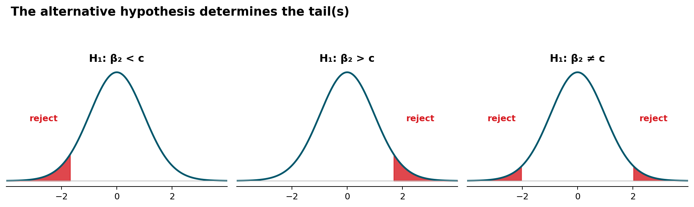
DO NOT LEARN THREE DIFFERENT TESTS
One idea, three alternatives
Same test statistic. What changes is where “unusual” values lie.
In this course we will mostly use two-sided tests, but the supermarket question is naturally right-sided.
Notes:
Cover the three alternatives together on one slide, as requested. Do not derive three separate rules.
H1: beta<c -> evidence is in the left tail.
H1: beta>c -> evidence is in the right tail.
H1: beta!=c -> evidence can be in either tail.
The formula for t does not change. The alternative determines the relevant tail probability and critical value.

Slide 32
HYPOTHESIS TESTING
A five-step routine
1
State H₀ and H₁
2
Calculate the test statistic
3
Choose $∝$ and the relevant tail(s)
4
Compare with a critical value or p-value
5
State the conclusion in context
The last step should use words from the economic question — not only H₀, H₁, and Greek letters.
Notes:
Keep this routine visible in later exercises. The most common student error is to stop after a mechanical reject/fail-to-reject decision.
The final sentence should translate back to the economic claim. Also reinforce “fail to reject” rather than “accept H0.”

Slide 33
Α = 0.05 VERSUS Α = 0.01
Food example: same evidence, two thresholds
t = 2.25 df = 38
α = 0.05
α = 0.01
Critical t ≈ 1.686
2.25 > 1.686
Reject H₀
Critical t ≈ 2.429
2.25 < 2.429
Fail to reject H₀
The data did not change. The standard for how unusual the evidence must be changed.
Notes:
This is an important conceptual example. At 5% the test rejects; at 1% it does not.
Do not describe 1% as “better” or “more correct.” It is a stricter Type I error tolerance.
At 5%, the sample provides evidence that the slope exceeds the investment threshold. At 1%, the evidence is not strong enough to reach that stricter standard.

Slide 34
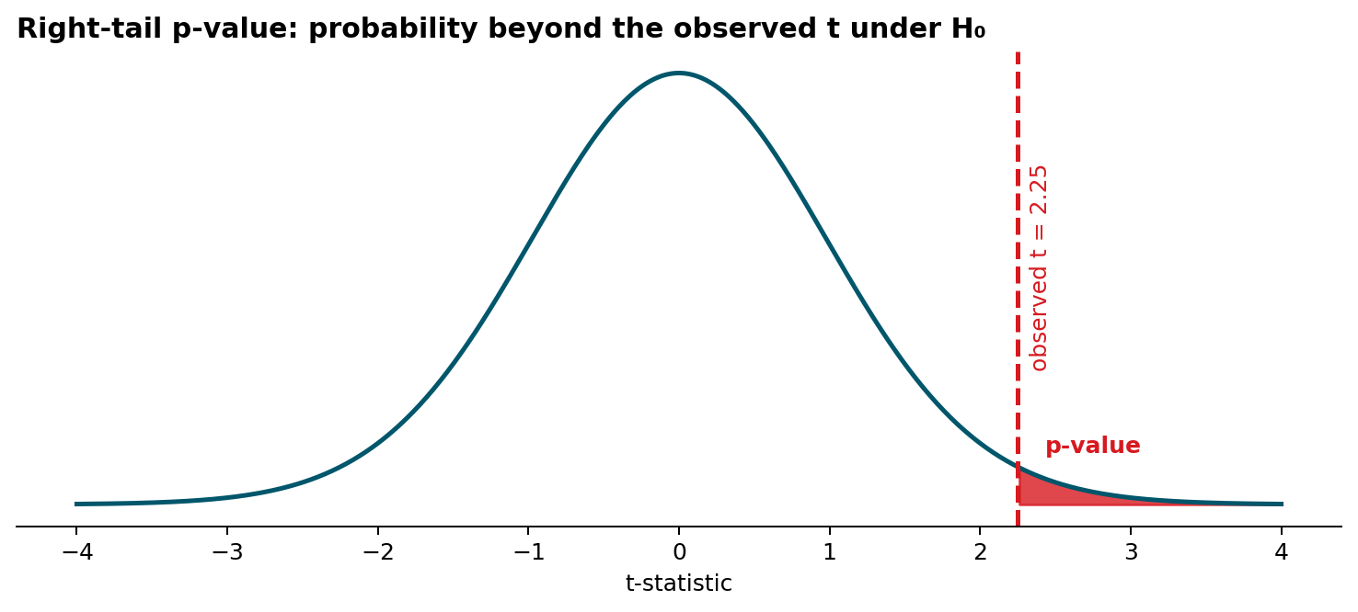

P-VALUE
The p-value asks how unusual our result is under H₀
$$p=P(t≥2.25|H_{0})$$
Small p-value → the observed t is difficult to reconcile with H₀.
Do not say: “the p-value is the probability that H₀ is true.”
The p-value is the probability of obtaining a t-value as extreme or more extreme than the observed t-value, assuming that the null hypothesis is true.
Notes:
Define the p-value using the observed t and the reference distribution under H0. For the right-tail supermarket test, it is the probability of a t-statistic at least as large as the one observed, assuming the boundary value in H0 is true.
Avoid the common misinterpretation that p is P(H0 is true). It is a probability about data/test statistics conditional on H0.

Slide 35

CRITICAL VALUE AND P-VALUE
R can calculate both routes
# Test statistic
t <- (b_2 - 0.055) / se_b2
# Critical value: right-tail 5% test
qt(0.95, df = 38)
# Right-tail p-value
1 - pt(t, df = 38)
Decision rules
$t≥t_{c}$ → reject H₀
p ≤ α → reject H₀
Two ways of expressing the same evidence.
Notes:
Run both calculations. The critical-value rule and p-value rule lead to the same decision for a given alpha.
Explain why software output is useful only after the student knows what null value and alternative the software is testing. summary(lm()) by default reports a two-sided test against zero; that is not the supermarket test.

Slide 36
P-VALUE
Calculate the p-value
Supermarket test
H₀: β₂ ≤ 0.055 H₁: β₂ > 0.055
What does 0.015 mean?
Observed test statistic: t = 2.25
If the null value β₂ = 0.055 were true, the probability of obtaining a t-value of 2.25 or larger is about 1.5%.
# Right-tail p-value
p_value <- 1 - pt(t_food, df = 38)
p_value
# 0.015
α = 0.05
α = 0.01
p < α → Reject H₀
p > α → Fail to reject H₀
Same data, different decision threshold.
Notes:
Use this immediately after introducing the p-value. Stress that the probability statement is conditional on the null value used to construct the test statistic. For this one-sided test the p-value is the area to the right of the observed t-statistic. The key comparison is p with alpha. At 5% we reject; at 1% we do not. Avoid saying that there is a 1.5% probability that H0 is true.

Slide 37
SMALL CALCULATION
Your turn: a new study
A study reports:
b₂ = 0.084
se(b₂) = 0.016
df = 48
Test at α = 0.05:
H₀: β₂ ≤ 0.055 vs. H₁: β₂ > 0.055
Calculate t.
Find the critical value or p-value.
State the conclusion in one sentence.
Use R as a calculator.
Notes:
Give 3–4 minutes. Expected calculations: t = (0.084-0.055)/0.016 = 1.8125. Critical t for right-tail 5% with 48 df is about 1.677. Therefore reject H0 at 5%. The p-value is about 0.038.
Ask for an economic sentence, not only “reject H0.”

Slide 38
A USEFUL CONNECTION
Two-sided tests and confidence intervals tell a consistent story
H₀: β₂ = c vs. H₁: β₂ ≠ c
If c is inside the 95% interval
If c is outside the 95% interval
Fail to reject H₀
at α = 0.05
Reject H₀
at α = 0.05
This equivalence is for a two-sided 5% test and a 95% interval for the same parameter.
Notes:
This is a conceptual payoff: interval estimation and hypothesis testing are two views of the same sampling uncertainty.
Be precise about scope: the equivalence is between a 100(1-alpha)% interval and a two-sided test at alpha for the same point null. The one-sided supermarket test does not use the same 95% two-sided interval rule.

Slide 39
TYPE I AND TYPE II
Errors are possible because we make decisions from samples
Type I error
Type II error
Reject H₀ even though H₀ is true.
For the supermarket: invest because we conclude β₂ > 0.055 when the true slope is not above the threshold.
Fail to reject H₀ even though the alternative is true.
For the supermarket: do not establish the threshold even though β₂ really is above 0.055.
α controls the probability of a Type I error under the null.
We will not develop power calculations here.
Notes:
Keep this light. The goal is interpretation, not power calculations.
Connect alpha to Type I error. Explain that a stricter alpha makes rejection harder, reducing Type I error probability but generally increasing the risk of failing to detect real departures from H0.
Do not spend time calculating Type II probabilities in this chapter session.

Slide 40
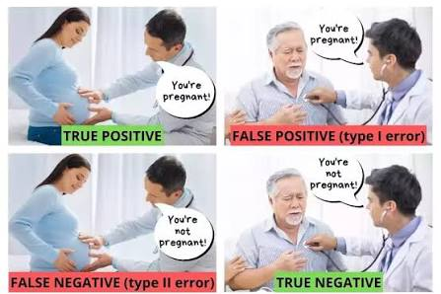

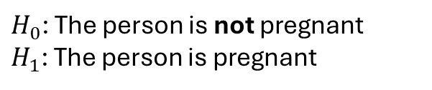



$H_{0}$: The person is not pregnant
$H_{1}$: The person is pregnant
Type I and Type II error illustrated
$H_{0}$: is true
$H_{0}$: is not true
Reject $H_{0}$
Keep $H_{0}$

Slide 41
INTERPRETATION
Statistical significance is not economic importance
Statistical question
Economic question
Is the estimated difference large relative to its sampling uncertainty?
This is what the t-statistic and p-value address.
Is the magnitude large enough to matter for the actual decision?
This requires context, units, costs, benefits, and thresholds.
A tiny effect can be statistically significant in a large sample. A large estimate can be too imprecise to be statistically significant.
Notes:
Use the supermarket threshold to make this concrete. A statistically nonzero slope is not automatically sufficient for investment. The relevant economic threshold is 0.055, not zero.
This is one reason testing meaningful values can be more informative than mechanically reporting the default test against zero.

Slide 42
SCOPE OF THE REGRESSION
Inference does not create causality
Which statement is defensible?
A
B
Raising a household’s income by USD 100 causes food expenditure to rise by USD 10.21.
In this sample, higher income is associated with higher food expenditure; the estimated slope is 0.1021.
Confidence intervals and hypothesis tests quantify sampling uncertainty conditional on the model assumptions. They do not solve identification.
Notes:
Ask for a vote between A and B. B is the defensible statement from this simple observational regression.
Inference answers how uncertain the estimated association is under the model. It does not by itself establish that changing income would cause the estimated change in food expenditure.

Slide 43
SUMMARY
Chapter 3: one chain of reasoning
β₂
Fixed but unknown population parameter
↓
b₂
Estimate from one random sample
↓
se(b₂)
Estimated sampling variability
↓
b₂ ± t_c se(b₂)
Range of parameter values compatible with the sample
↓
t = (b₂ − c) / se(b₂)
Distance from a specific claim
↓
p-value
How unusual the observed t would be under H₀
The same sampling uncertainty underlies both interval estimation and hypothesis testing.
Notes:
Close by returning to the chain rather than listing definitions.
Students should see that Chapter 3 is not a collection of unrelated procedures: estimate -> standard error -> t distribution -> interval or test.
Final reminder: confidence refers to the repeated-sampling method; a p-value is conditional on H0; and statistical inference does not by itself establish causality.

Slide 44
BOOK EXERCISE 3.19(C)
Worked example — motel occupancy
Model
MOTEL_PCT = β₁ + β₂ COMP_PCT + e
Question
Do the data provide strong evidence that the competitor’s occupancy rate is positively associated with the motel’s occupancy rate?
What we estimate from the data
H₀: β₂ ≤ 0
H₁: β₂ > 0
α = 0.01
MOTEL_PCT = 21.340 + 0.865 COMP_PCT
SE (12.907) (0.203)
Right-tail
N = 25 df = 23
I will work this one through first.
Source: Hill, Griffiths & Lim, Principles of Econometrics 5e, Exercise 3.19(c)
Notes:
Reintroduce the variables briefly: motel_pct is the motel occupancy percentage and comp_pct is the competitors' occupancy percentage. The regression results are rounded to the values reported in the book answer key. Ask the class to identify the tail before doing any arithmetic. Then move to the next slide and work through the calculation.

Slide 45
BOOK EXERCISE 3.19(C)
Worked example — calculation and decision
1. Test statistic
motel_t <- (motel_b2 - 0) / motel_se_b2
motel_t
# 4.27
Decision
t = 4.27 > 2.50
and p < 0.01
2. Critical value, right-tail α = 0.01
qt(0.99, df = 23)
# 2.50
Reject H₀
At the 1% level, the data provide evidence of a positive association between the two occupancy rates.
3. p-value
1 - pt(motel_t, df = 23)
# < 0.001
Always return to the economic question after the calculation.
Notes:
Work through this slowly. First calculate the standardized distance from the null value. Then choose the critical value based on the alternative, not by habit. Finally calculate the right-tail p-value. The exact p-value from R may differ slightly in the last digits from a calculation based on the rounded textbook coefficient and standard error. The conclusion is unchanged.

Slide 46
BOOK EXERCISE 3.19(D)
Your turn — same data, a different claim
Tasks
Test
Write down the test statistic.
1
H₀: β₂ = 1
H₁: β₂ ≠ 1
α = 0.01
2
Calculate t in R.
3
Find the two-sided critical value.
What would β₂ = 1 mean economically?
Use the regression you already estimated.
4
Calculate the two-sided p-value.
motel_b2
motel_se_b2
motel_df
5
State the statistical and economic conclusion.
Do not use the p-value reported by summary(lm()) — that tests β₂ = 0.
Notes:
Answer for instructor: t ≈ -0.67. For a two-sided 1% test with df=23, the critical values are approximately ±2.807. The two-sided p-value is about 0.51. Fail to reject H0. beta2=1 means that a one percentage-point increase in competitor occupancy is associated with a one percentage-point increase in expected motel occupancy. The data are compatible with that one-for-one relationship.

Slide 47
BOOK EXERCISE 3.20(D)
Your turn — a left-tail test with the motel data
A different regression
Tasks
1
Interpret the estimated REPAIR coefficient.
MOTEL_PCT = δ₁ + δ₂ REPAIR + e
2
Calculate the t-statistic for the boundary value δ₂ = 0.
model_repair <- lm(motel_pct ~ repair, data = motel)
summary(model_repair)
Find the left-tail critical value.
3
4
Calculate the left-tail p-value.
Question: did the repairs reduce occupancy?
5
State the conclusion in the context of the motel’s claim.
H₀: δ₂ ≥ 0 H₁: δ₂ < 0 α = 0.05
Now the direction of H₁ points to the left.
Notes:
Answer for instructor: the repair coefficient is approximately -13.24 with SE approximately 5.96. t ≈ -2.22. The left-tail 5% critical value with df=23 is approximately -1.714. The p-value is about 0.018. Reject H0 at 5%. The data support the claim that occupancy was lower during the repair period. This is an association in this simple regression; be careful about stronger causal language unless the research design supports it.

