Slide 1
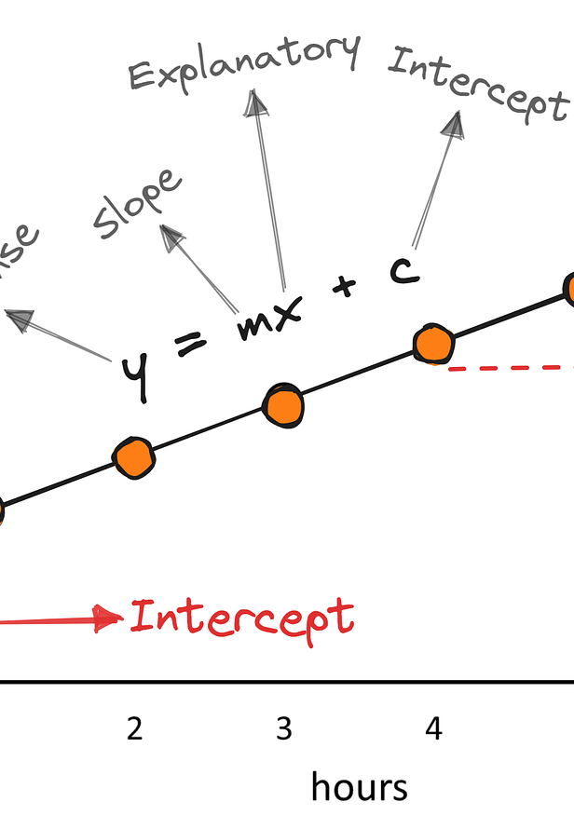
Chapter 2 part 2 The Simple Linear Regression Model
Sok-3081
Eirik Eriksen Heen
9. September 2026

Slide 2
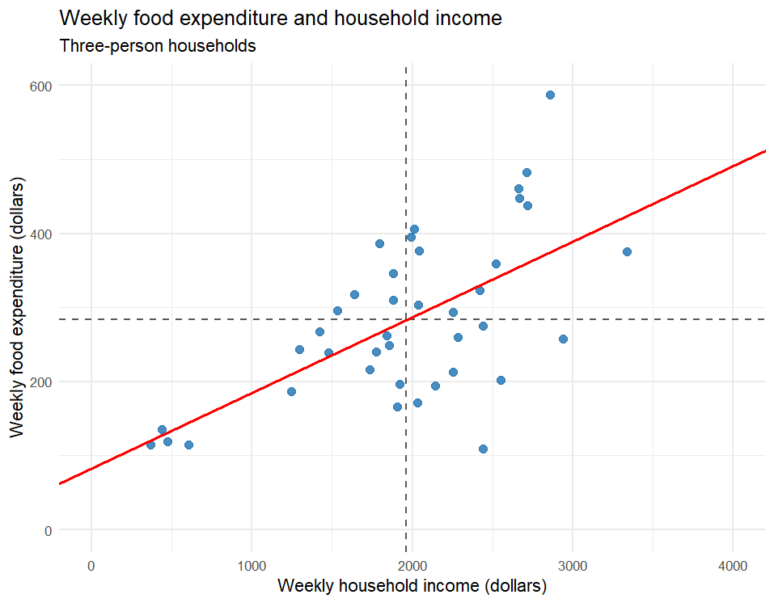

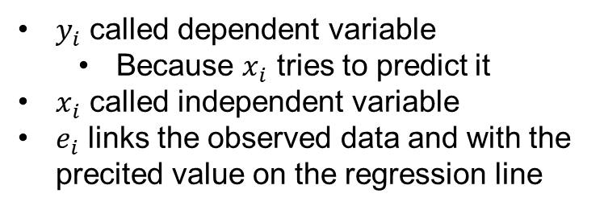
The simple regression model
$$y_{i}=β_{1}+β_{2}∙x_{i}+e_{i}$$
outcome
systematic part
everything else
$y_{i}$ called dependent variable
Because $x_{i}$ tries to predict it
$x_{i}$ called independent variable
$e_{i}$ links the observed data and with the precited value on the regression line
Notes:
About 4 minutes. Do not reveal the answer immediately. After the vote, draw axes and the line by hand. Mark a horizontal change of 100 and a vertical change of 10. State that slope always carries units.

Slide 3
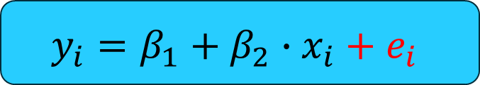
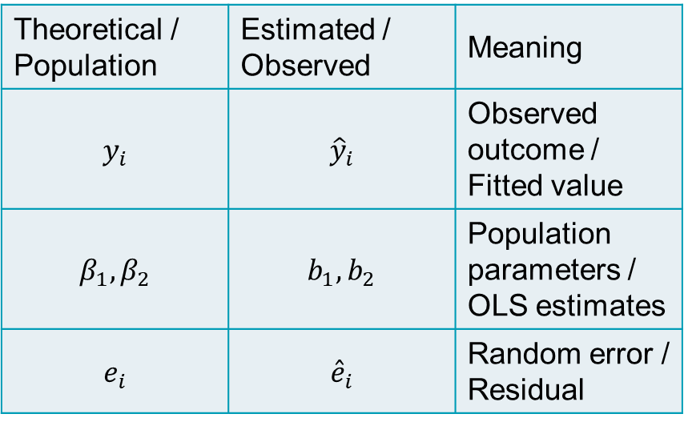
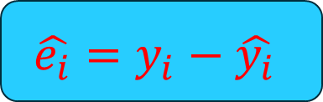
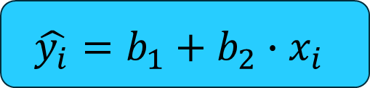
Theoretical → Estimated
Theoretical / Population | Estimated / Observed | Meaning
$$y_{i}$$ | $${\hat{y}}_{i}$$ | Observed outcome / Fitted value
$$β_{1},β_{2}$$ | $$b_{1},b_{2}$$ | Population parameters / OLS estimates
$$e_{i}$$ | $${\hat{e}}_{i}$$ | Random error / Residual
When we start estimating parameters change
$$y_{i}=β_{1}+β_{2}∙x_{i}+e_{i}$$
$$\hat{y_{i}}=b_{1}+b_{2}∙x_{i}$$
$$\hat{e_{i}}=y_{i}−\hat{y_{i}}$$

Slide 4
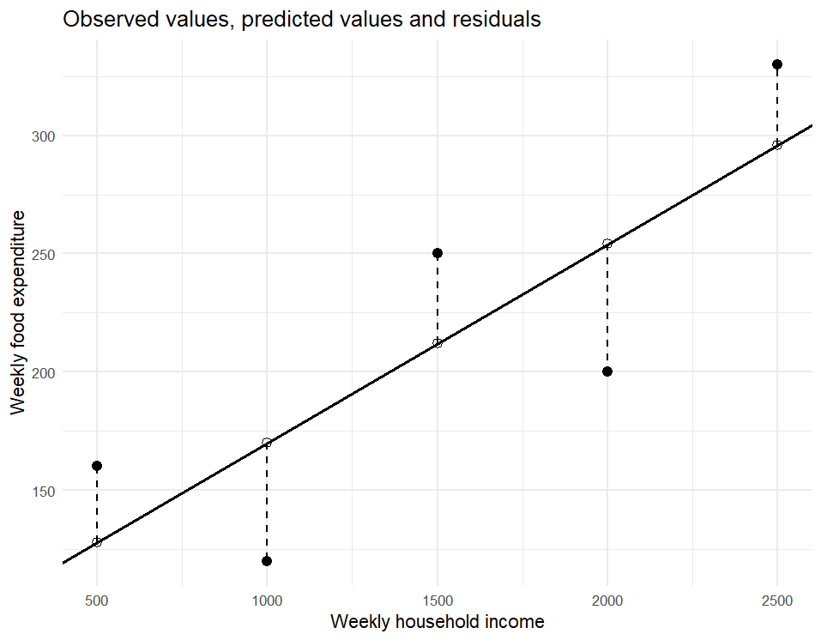
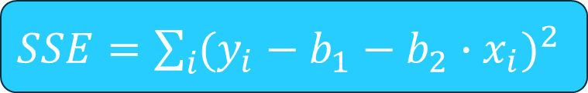
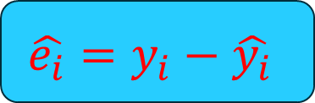
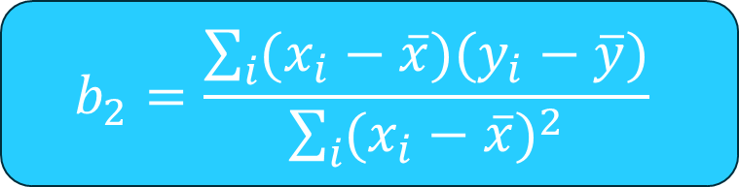

Minimizing squared errors
Lab 1
$$\hat{e_{i}}=y_{i}−\hat{y_{i}}$$
$SSE=\sum_{i}{{(y_{i}−b_{1}−b_{2}∙x_{i})}^{2}}$
$$b_{1}=\overline{y}−b_{2}∙\overline{x}$$
$$b_{2}=\frac{\sum_{i}{(x_{i}−\overline{x})(y_{i}−\overline{y})}}{\sum_{i}{{(x_{i}−\overline{x})}^{2}}}$$

Slide 5
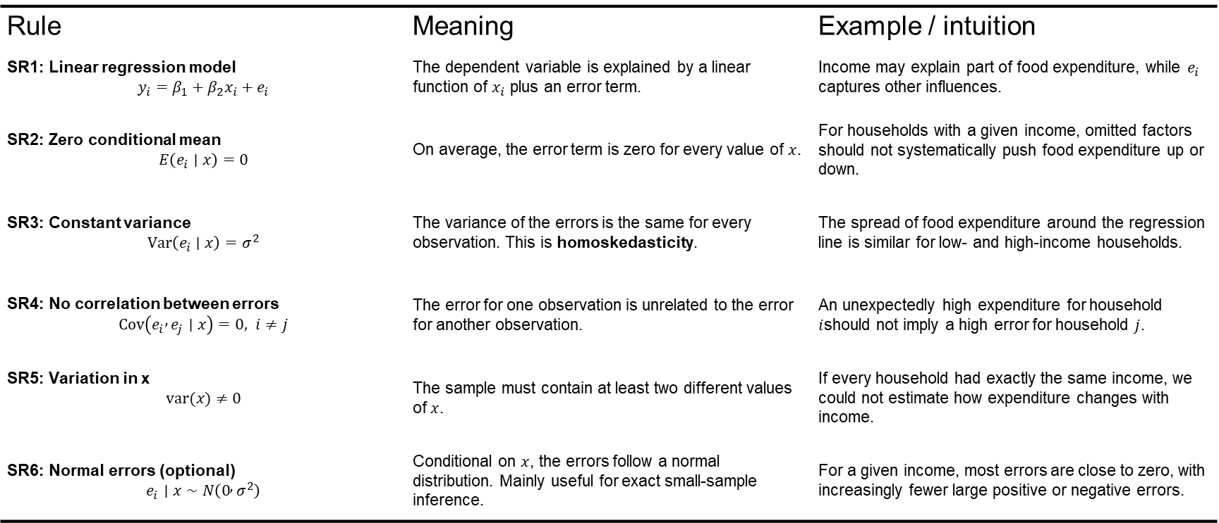
The simple regression assumptions
Rule | Meaning | Example / intuition
SR1: Linear regression model $$y_{i}=β_{1}+β_{2}x_{i}+e_{i}$$ | The dependent variable is explained by a linear function of $x_{i}$ plus an error term. | Income may explain part of food expenditure, while $e_{i}$ captures other influences.
SR2: Zero conditional mean $$E\left(e_{i}∣x\right)=0$$ | On average, the error term is zero for every value of $x$. | For households with a given income, omitted factors should not systematically push food expenditure up or down.
SR3: Constant variance $$Var⁡\left(e_{i}∣x\right)=σ^{2}$$ | The variance of the errors is the same for every observation. This is homoskedasticity. | The spread of food expenditure around the regression line is similar for low- and high-income households.
SR4: No correlation between errors $$Cov⁡\left(e_{i} , e_{j}∣x\right)=0, i≠j$$ | The error for one observation is unrelated to the error for another observation. | An unexpectedly high expenditure for household $i$should not imply a high error for household $j$.
SR5: Variation in x $$var(x)≠0$$ | The sample must contain at least two different values of $x$. | If every household had exactly the same income, we could not estimate how expenditure changes with income.
SR6: Normal errors (optional) $$e_{i}∣x∼N\left(0 , σ^{2}\right)$$ | Conditional on $x$, the errors follow a normal distribution. Mainly useful for exact small-sample inference. | For a given income, most errors are close to zero, with increasingly fewer large positive or negative errors.

Slide 6
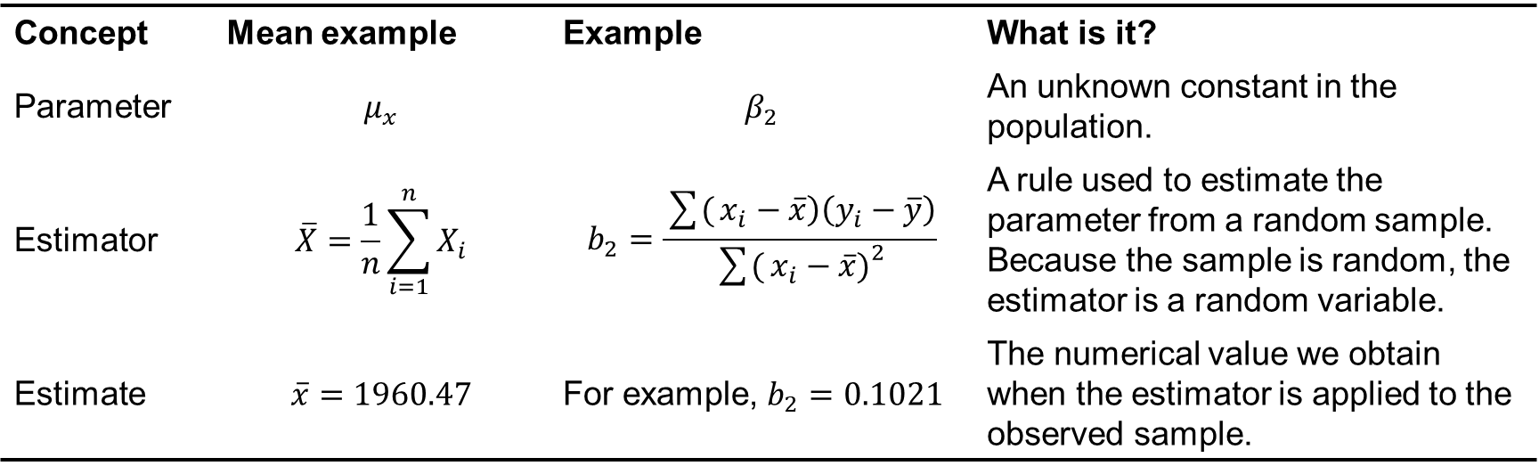
Terminology
Concept | Mean example | Example | What is it?
Parameter | $$μ_{x}$$ | $$β_{2}$$ | An unknown constant in the population.
Estimator | $$\overline{X}=\frac{1}{n}\sum_{i=1}^{n}{X_{i}}$$ | $$b_{2}=\frac{\sum{(}\left.x_{i}−\overline{x}\right)\left(y_{i}−\overline{y}\right)}{\sum{(}\left.x_{i}−\overline{x}{\left.)\right.}^{2}\right.}$$ | A rule used to estimate the parameter from a random sample. Because the sample is random, the estimator is a random variable.
Estimate | $$\overline{x}=1960.47$$ | For example, $b_{2}=0.1021$ | The numerical value we obtain when the estimator is applied to the observed sample.

Slide 7
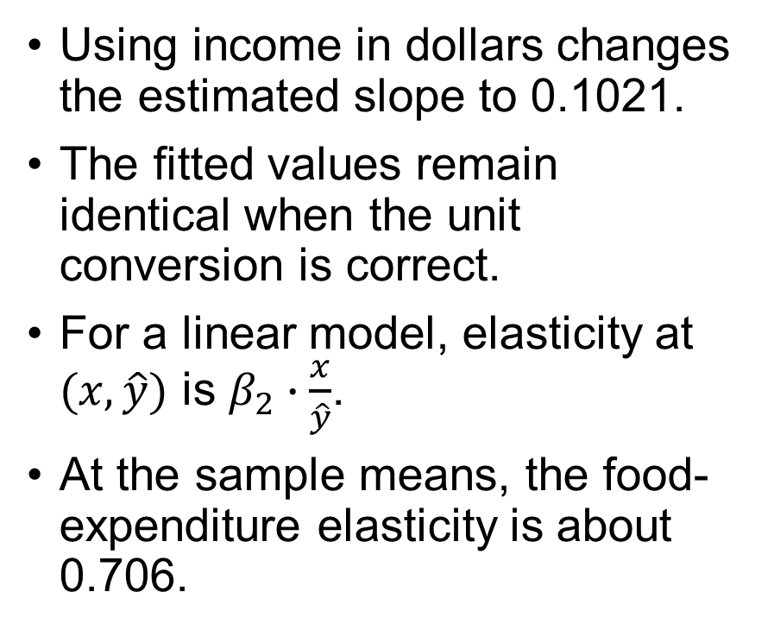
Elasticise
Lab 1
Using income in dollars changes the estimated slope to 0.1021.
The fitted values remain identical when the unit conversion is correct.
For a linear model, elasticity at $(x,\hat{y})$ is $β_{2}∙\frac{x}{\hat{y}}$.
At the sample means, the food-expenditure elasticity is about 0.706.

Slide 8
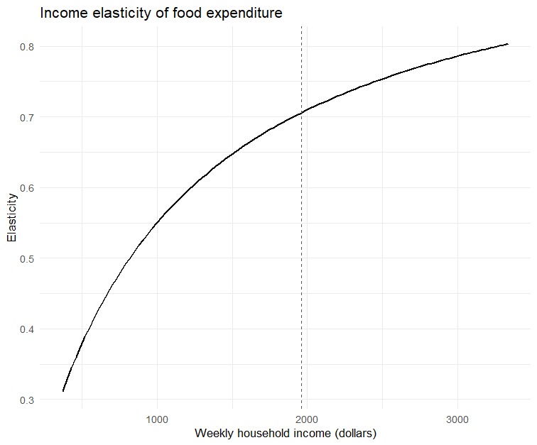
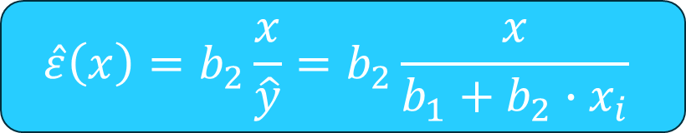
Elasticity and income
Lab 2
$$\hat{ε}\left(x\right)=b_{2}\frac{x}{\hat{y}}=b_{2}\frac{x}{b_{1}+b_{2}∙x_{i}}$$
Food expenditure increases with income, but less than proportionally.
Elasticity increases with income, but at a decreasing rate.
In our sample, elasticity remains below 1 → food is a necessity.
At the same time, food expenditure becomes a smaller share of income as income rises.

Slide 9


One sample is only one possible sample
$$\hat{y_{i}}=83.416+10.209∙x_{i}$$
$$\text{If} \text{we} \text{collected} \text{data} \text{from} \text{another}\text{ 40 }\text{households}\text{, }\text{would} \text{we} \text{get} \text{exactly} \text{the} \text{same} \text{slope} \text{and} \text{exactly} \text{the} \text{same} \text{intercept}\text{?}$$

Slide 10
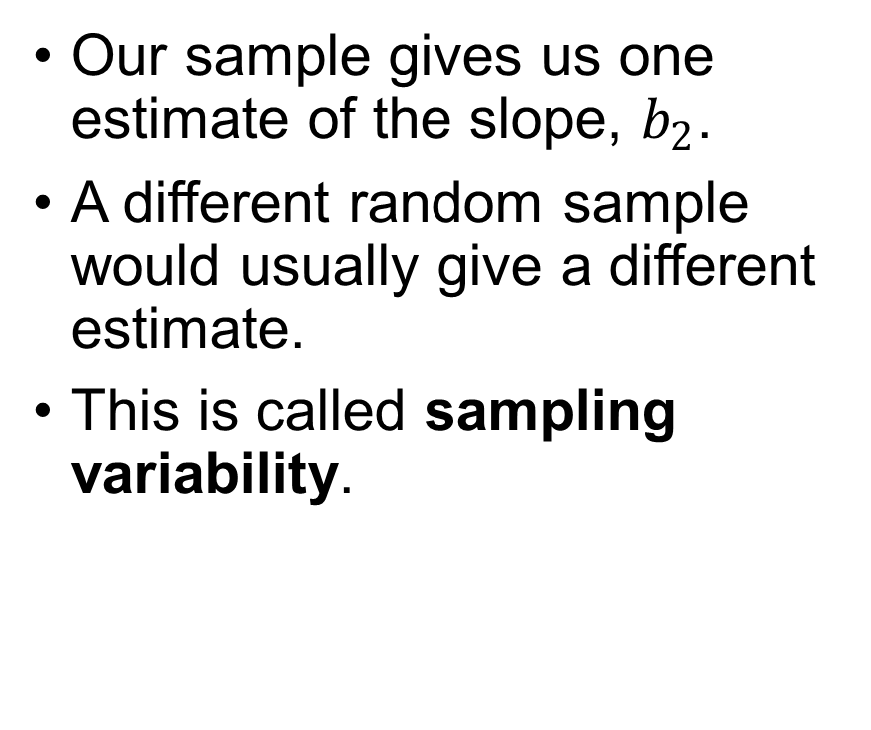

One sample, one estimate
Our sample gives us one estimate of the slope, $b_{2}$.
A different random sample would usually give a different estimate.
This is called sampling variability.
$$\hat{y_{i}}=b_{1}+b_{2}∙x_{i}$$
Same estimator, but different sample leads to different estimate
What would happen if we could repeat the study many times?
Notes:
We estimated a slope of about 0.102. But that number comes from these particular 40 households. Had we observed another sample of households, we would probably not have obtained exactly 0.102.

Slide 11
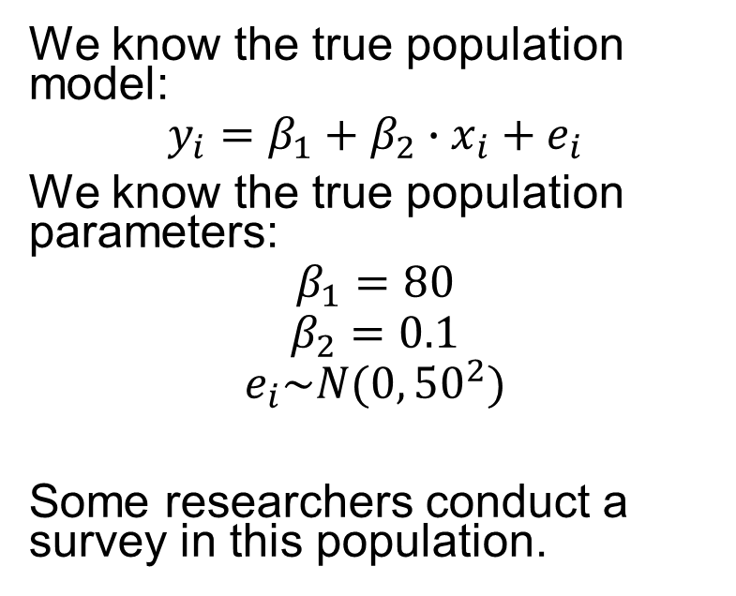
Suppose we knew the truth
Imagine that we are psychic
They collect a random sample of 40 households and estimate a regression from the sample.
What estimates will they get?
Will they estimate exactly
And what happens if another researcher collects another sample of 40 households?
We can recreate this experiment on a computer and repeat it many times.
We know the true population model:
$$y_{i}=β_{1}+β_{2}∙x_{i}+e_{i}$$
We know the true population parameters:
$$β_{1}=80$$
$$β_{2}=0.1$$
$$e_{i}\sim N(0,{50}^{2})$$
Some researchers conduct a survey in this population.
This is called a Monte Carlo simulation.

Slide 12
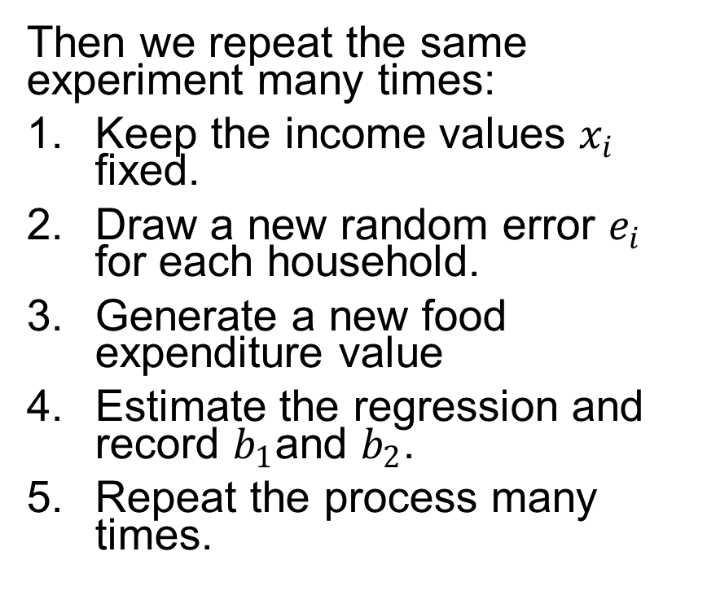
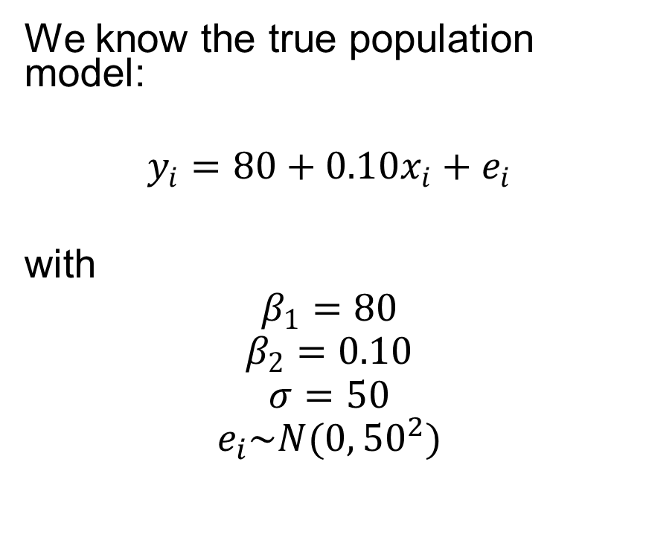
Monte Carlo simulation: the idea
Lab 3
We know the true population model:
$$y_{i}=80+0.10x_{i}+e_{i}$$
with
$$β_{1}=80$$
$$β_{2}=0.10$$
$$σ=50$$
$$e_{i}\sim N(0,{50}^{2})$$
Then we repeat the same experiment many times:
Keep the income values $x_{i}$ fixed.
Draw a new random error $e_{i}$ for each household.
Generate a new food expenditure value
Estimate the regression and record $b_{1}$and $b_{2}$.
Repeat the process many times.

Slide 13
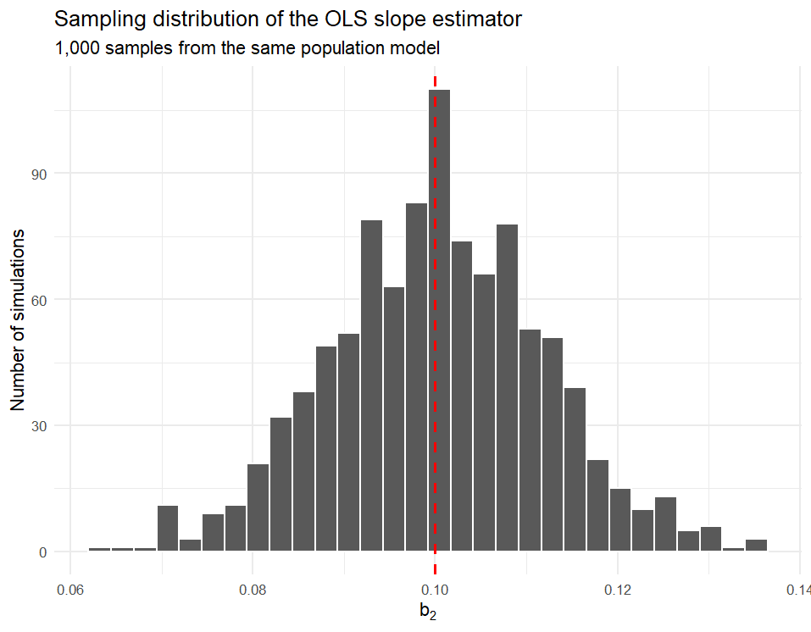
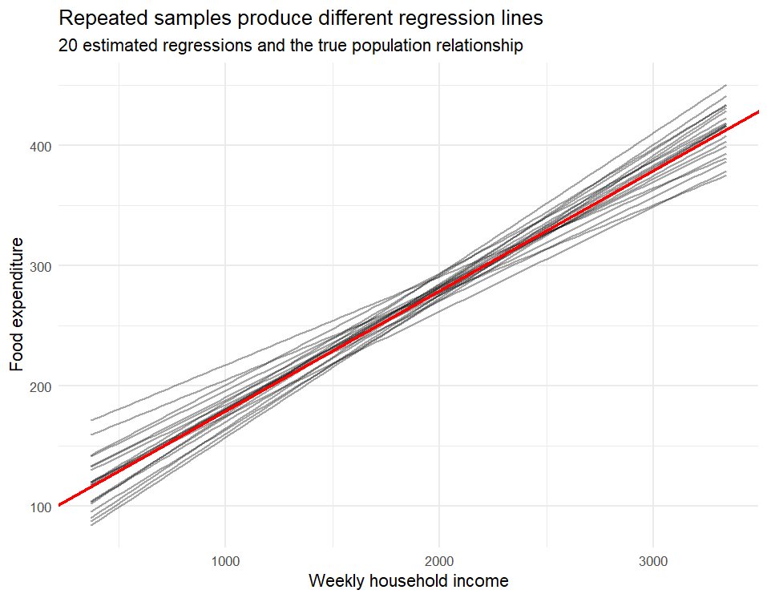

What did the simulation show?
True slope: $β_{2}=0.10$
Notes:
A single estimate can be “unlucky”, even when the estimator works well.

Slide 14
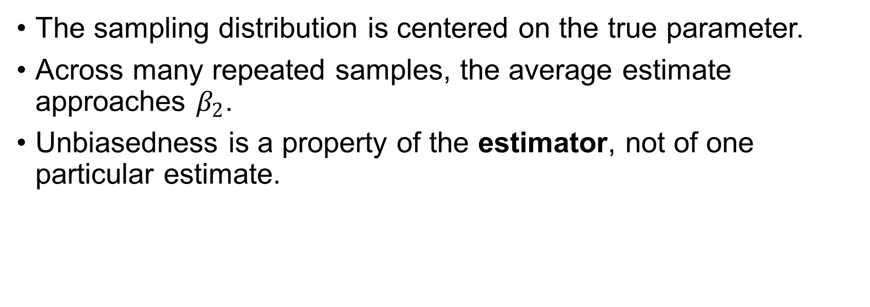

The OLS estimator is unbiased
$$E\left(b_{2}|x\right)=β_{2}$$
The sampling distribution is centered on the true parameter.
Across many repeated samples, the average estimate approaches $β_{2}$.
Unbiasedness is a property of the estimator, not of one particular estimate.
Notes:
Her ser vi resultatet av at vi gjentar det samme eksperimentet mange ganger.
Vi vet at den sanne helningen i populasjonen er 0,10. Likevel får vi ikke nøyaktig 0,10 hver gang vi trekker et nytt utvalg og estimerer modellen. Noen ganger får vi litt høyere verdier, andre ganger litt lavere.
Det viktige er hvor disse estimatene er sentrert.
Hvis OLS-estimatoren er forventningsrett, betyr det at gjennomsnittet av alle de mulige estimatene er lik den sanne parameterverdien.
Matematisk skriver vi dette som:
E(b₂ | X) = β₂
Dette betyr ikke at hvert enkelt estimat er riktig. Et enkelt utvalg kan være ganske uheldig og gi en verdi som ligger et stykke unna den sanne helningen.
Forventningsretthet er derfor en egenskap ved estimatoren over mange gjentatte utvalg, ikke en egenskap ved ett bestemt estimat.
Det vi ser i histogrammet er nettopp denne ideen: estimatene varierer fra utvalg til utvalg, men de er samlet rundt den sanne verdien 0,10.

Slide 15


Unbiased does not mean precise
Unbiasedness
$$E\left(b_{2}|x\right)=β_{2}$$
Precision
$$var\left(b_{2}|x\right)$$
Where is the sampling distribution centered?
Centered on the true parameter
No systematic over- or underestimation
How much does the estimator vary across samples?
Small variance → estimates stay close together
Large variance → estimates can vary substantially
An estimator can be unbiased and still be imprecise.
Notes:
Begge disse estimatorene kan være forventningsrette.
De er begge sentrert på den sanne parameteren.
Men den ene har mye mindre variasjon fra utvalg til utvalg.
Det er dette vi mener med presisjon.
Så nå går vi fra spørsmålet «treffer estimatoren riktig i gjennomsnitt?» til «hvor mye varierer den rundt den sanne verdien?»

Slide 16
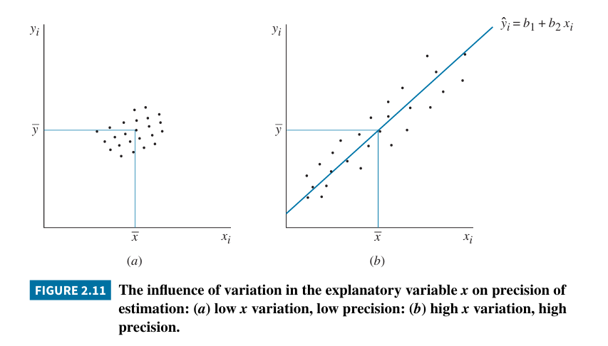
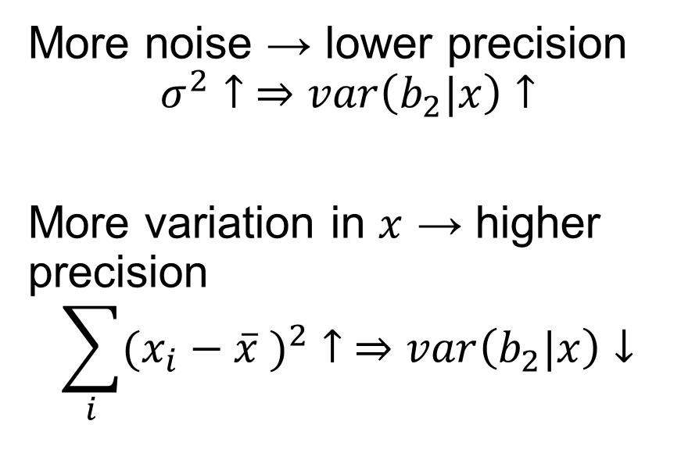
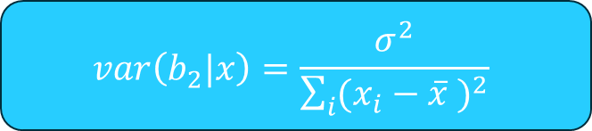
The variance of the slope estimator
Lab 4
$$var\left(b_{2}|x\right)=\frac{σ^{2}}{\sum_{i}{{(x_{i}−\overline{x} )}^{2}}}$$
More noise → lower precision
$$σ^{2}↑ ⇒var\left(b_{2}|x\right)↑$$
More variation in $x$ → higher precision
$$\sum_{i}{{(x_{i}−\overline{x} )}^{2}}↑ ⇒var\left(b_{2}|x\right)↓$$
Precision improves when the signal is easier to distinguish from the noise.

Slide 17
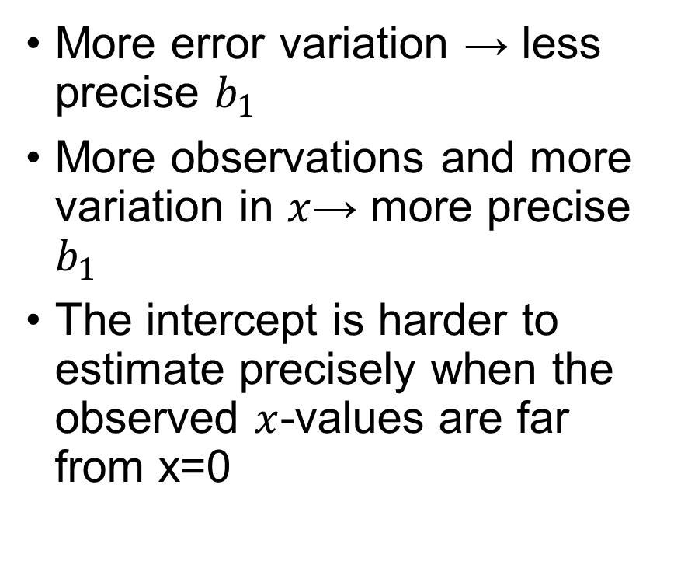
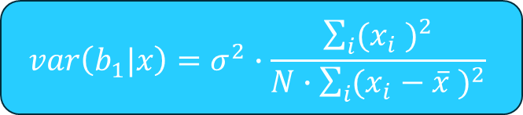
What about the intercept?
Lab 5
More error variation → less precise $b_{1}$
More observations and more variation in $x$→ more precise $b_{1}$
The intercept is harder to estimate precisely when the observed $x$-values are far from x=0
$$var\left(b_{1}|x\right)=σ^{2}∙\frac{\sum_{i}{{(x_{i} )}^{2}}}{N∙\sum_{i}{{(x_{i}−\overline{x} )}^{2}}}$$
Notes:
We have focused on $b_{2}$because the slope is usually the economically interesting parameter. But the intercept is also an estimator and therefore also varies from sample to sample.
Its variance looks slightly more complicated, but the intuition is similar. More noise makes it less precise, and more information in the data makes it more precise.
There is one additional issue: estimating the intercept means estimating the value of $y$at $x=0$. If our observations are far away from zero, we have relatively little information about where the regression line crosses the y-axis.

Slide 18
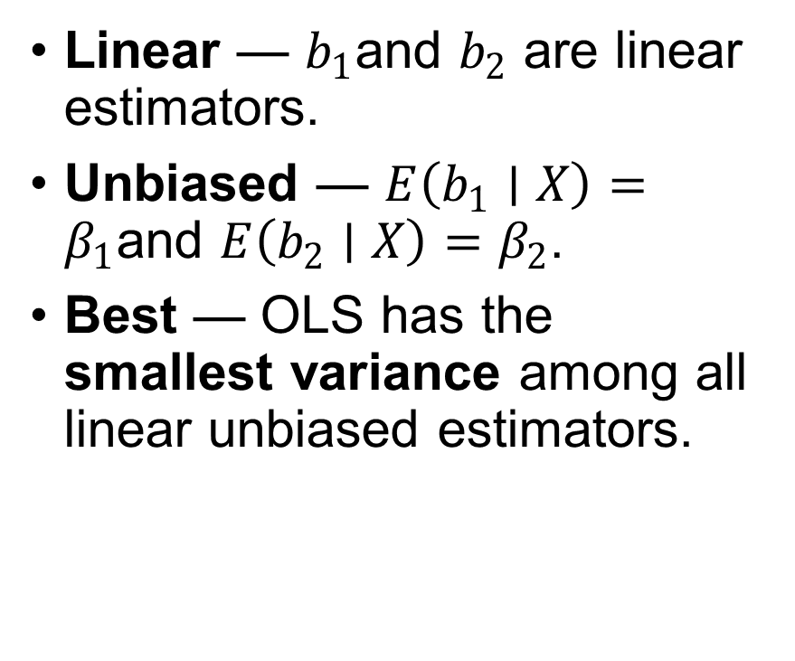
The Gauss–Markov Theorem
Under assumptions SR1–SR5:
Best
Linear
Unbiased
Estimator
Linear — $b_{1}$and $b_{2}$ are linear estimators.
Unbiased — $E\left(b_{1}∣X\right)=β_{1}$and $E\left(b_{2}∣X\right)=β_{2}$.
Best — OLS has the smallest variance among all linear unbiased estimators.
OLS is BLUE
Notes:
“Best” means most precise within the class of linear unbiased estimators.

Slide 19
Relationships do not have to be straight lines
Economic relationships are often nonlinear. We can still use the simple regression framework by transforming x and/or y.
Linear
Nonlinear
y
y
x
x
Linear regression means linear in the parameters — not necessarily a straight line in the original variables.

Slide 20

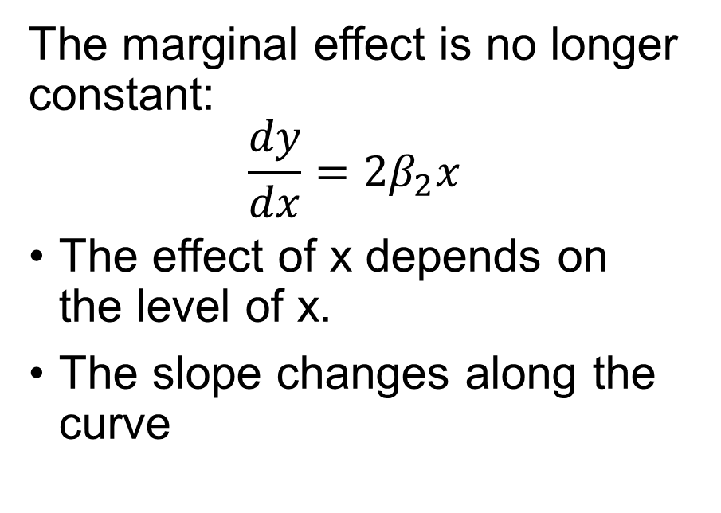
A quadratic relationship
Lab 6
y
$$y=β_{1}+β_{2}∙x^{2}$$
The marginal effect is no longer constant:
$$\frac{dy}{dx}=2β_{2}x$$
The effect of x depends on the level of x.
The slope changes along the curve
x

Slide 21
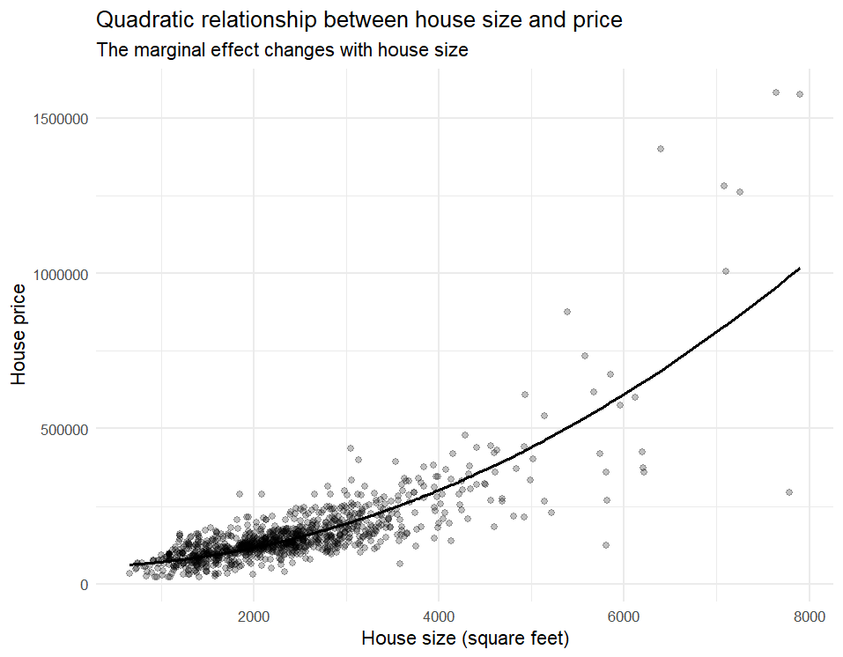
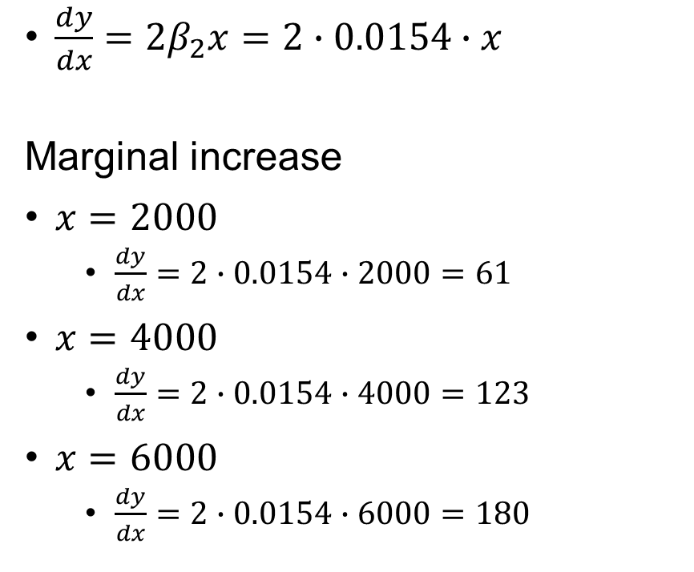
Perdictions
$\frac{dy}{dx}=2β_{2}x=2∙0.0154∙x$
Marginal increase
$x=2000$
$\frac{dy}{dx}=2∙0.0154∙2000=61$
$x=4000$
$\frac{dy}{dx}=2∙0.0154∙4000=123$
$x=6000$
$\frac{dy}{dx}=2∙0.0154∙6000=180$

Slide 22
Lab 7
A log-linear relationship
ln(y) = β₁ + β₂x
Example: β₂ = 0.004
≈ 0.4% increase in y for a one-unit increase in x

