Slide 1
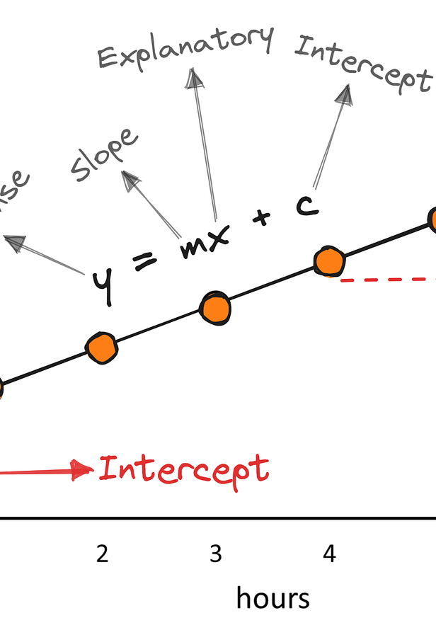
Chapter 3
Hypothesis testing
Sok-3081
Eirik Eriksen Heen
25. September 2026

Slide 2



HYPOTHESIS TESTING
A simple example: is Daniel cheating?
$$P\left(Daniell\right)=\frac{1}{4}=0.25$$
$$P\left(\overline{Daniell}\right)=\frac{3}{4}=0.75$$
Adam
Bernt
Camilla
Question
How surprising would it be if Daniel avoided the dishes again and again?
Four siblings, four slips of paper.
Each day one name is drawn. That person does the dishes.
Daniel draws the slips.
SOK-3081 • Chapter 3
Notes:
Use the story only to introduce the logic of hypothesis testing. If the drawing is fair, Daniel should be selected with probability 1/4 each day. Do not introduce H0 and H1 yet. First ask how many unusual outcomes we are willing to tolerate before becoming suspicious.

Slide 3


A FIRST INTUITION
Lab 1
How suspicious should we be?
4 days
12 days
$${\left(\frac{3}{4}\right)}^{4}≈0.316$$
$${\left(\frac{3}{4}\right)}^{12}≈0.032$$
Not especially surprising
Much more surprising
At what point does an unlikely outcome become evidence against the “fair drawing” story?
SOK-3081 • Chapter 3
Notes:
The point is not the exact arithmetic. The question is when an outcome becomes sufficiently unlikely under a fair drawing that we start questioning the assumption of fairness. This is the logic that later becomes a significance level and rejection rule.

Slide 4
EXPERIMENT
Run the drawing for 100 days
100
22
25
days
times Daniel does the dishes
expected under a fair draw
If the draw is fair, what is the probability that Daniel is selected 22 times or fewer?
P(X ≤ 22 | p = 0.25) ≈ 0.27
Why “22 or fewer”? Outcomes even further in the suspicious direction also count as evidence.
SOK-3081 • Chapter 3
Notes:
Under a fair draw, X follows a Binomial(100, 0.25) distribution. The probability of 22 or fewer is about 27%. Emphasize 'or fewer': hypothesis testing is not interested only in the exact observed outcome, but in the observed outcome and outcomes more extreme in the direction of the alternative.

Slide 5
THE HYPOTHESIS TEST
The logic of a test
Null hypothesis
Alternative hypothesis
H₀: p ≥ 0.25
H₁: p < 0.25
Daniel is not favored by the draw.
Daniel is selected less often than
chance would suggest.
Observed result: 22 out of 100
About 27% of fair experiments would produce 22 or fewer → not especially unusual.
SOK-3081 • Chapter 3
Notes:
Now name the two competing explanations. For the one-sided formulation, H0 includes p >= 0.25 and H1 is p < 0.25; calculations use the boundary p = 0.25. Since a result at least this suspicious occurs about 27% of the time under the boundary null, we do not have strong evidence against H0.

Slide 6
WHAT IF…
Daniel is selected only 14 times?
New experiment: 100 days
Daniel does the dishes only 14 times
P(X ≤ 14 | p = 0.25) ≈ 0.0054
About 0.5%
Now the observed outcome would be very unusual if the drawing were fair.
SOK-3081 • Chapter 3
Notes:
This is the same setup, but now the data are much harder to reconcile with the null. The probability of 14 or fewer under p = 0.25 is about 0.0054, or roughly half a percent. Do not yet call this a p-value if you prefer to introduce that term later; simply call it the probability of this result or something more extreme under the null.

Slide 7
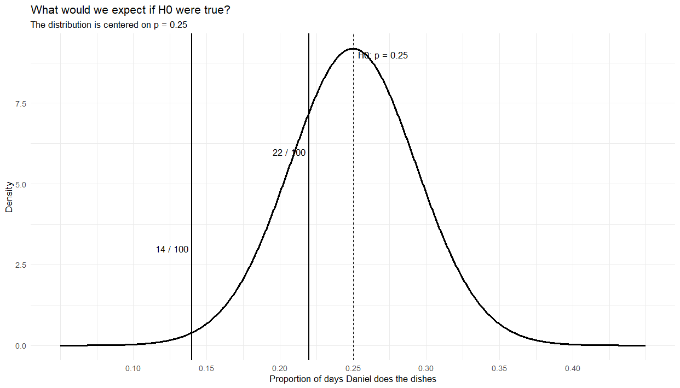

Slide 8
WHY HYPOTHESIS TESTING?
Two explanations — and we need a decision rule
The null is true
The null is false
1
2
The drawing is fair, and we happened
to observe a very unusual sample.
The fair-drawing explanation is wrong;
Daniel is being selected too rarely.
Hypothesis testing gives us a formal rule for deciding when the data are too unusual to maintain H₀.
Assume the null hypothesis is true until proven otherwise
SOK-3081 • Chapter 3
Notes:
This is the bridge into the formal material. A rare result under H0 does not logically prove H0 is false; rare events can happen. But statistical testing gives us a rule for how much evidence we require before rejecting H0. From here move to your supermarket example and formal notation. The story has already introduced the central logic: specify a null, identify outcomes that are difficult to reconcile with it, and decide how unusual is unusual enough.

Slide 9
HYPOTHESIS TESTING
Before we start: the tools we will use
Significance level α
A threshold chosen before the test.
Common values: α = 0.05 and α = 0.01.
qt(): probability → t-value
qt(0.95, df = 38) # right-tail 5% test
qt(0.975, df = 38) # two-sided 5% test
Critical t-value
The boundary for what counts as unusually large or small.
It depends on α, the degrees of freedom, and whether the
test is one- or two-sided.
pt(): t-value → probability
pt(t, df = 38) # area to the left of t
1 - pt(t, df = 38) # area to the right of t
p-value
How unusual our observed result would be if H₀ were true.
Decision rule
Degrees of freedom
p ≤ α → reject H₀
Needed for the t-distribution. In simple regression: df = N − 2.
Takeaway: qt() goes from probability to a critical t-value. pt() goes from a t-value to probability.
SOK-3081 • Chapter 3
Notes:
Use this as a very short toolbox slide before returning to the supermarket decision. The aim is only to make alpha, the critical t-value, the p-value, and the two R functions familiar.
Alpha is chosen before the test and determines how strict the rejection rule is. The critical t-value comes from qt() and depends on alpha, the degrees of freedom, and whether the test is one-sided or two-sided.
The p-value goes the other direction: from an observed t-statistic to a probability under H0. For right-tail tests, use 1 - pt(t, df). For left-tail tests, pt(t, df). For two-sided tests, use 2*(1 - pt(abs(t), df)).
Do not spend long here. The actual test statistic itself will be introduced on the next slides with the supermarket example.

Slide 10
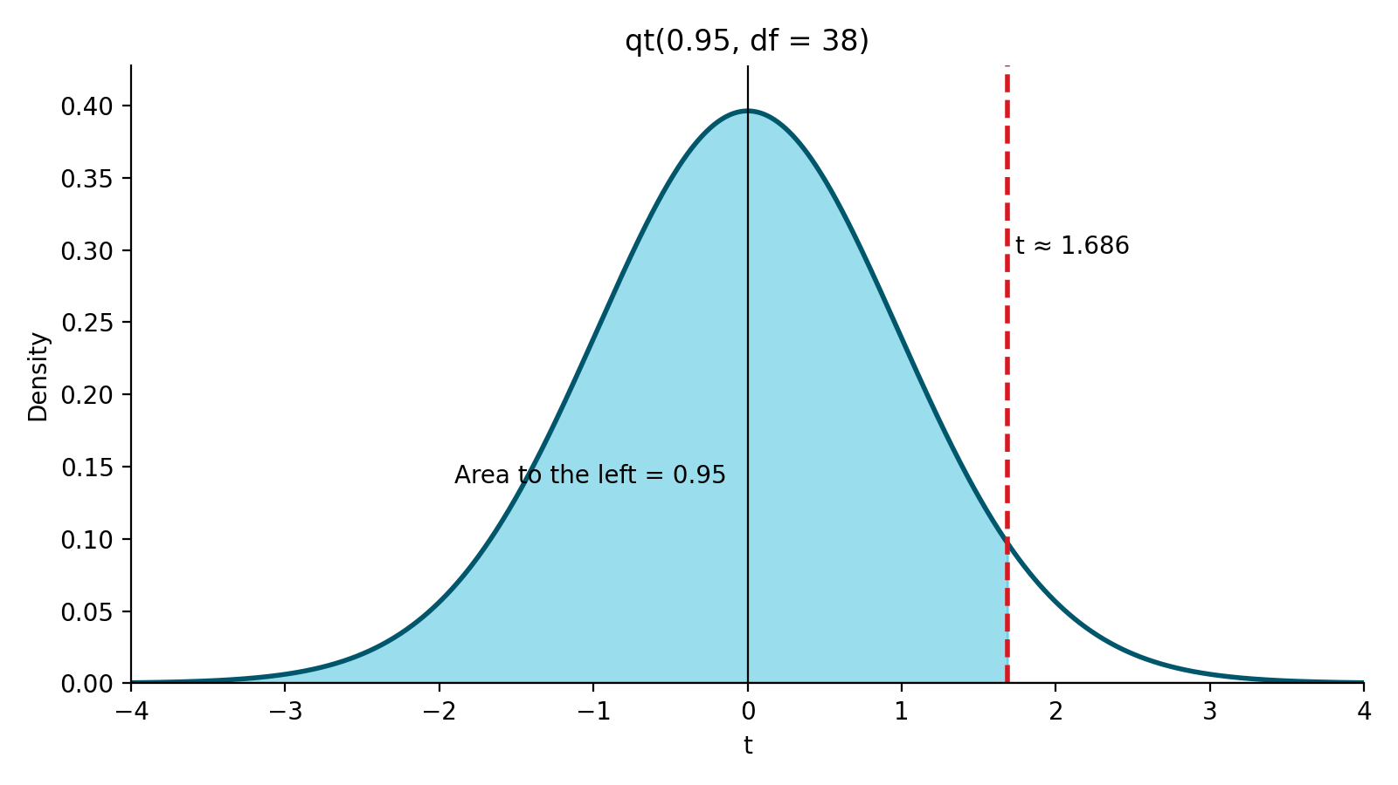
t-DISTRIBUTION IN R
qt(): from probability to a critical t-value
Example: qt(0.95, df = 38)
qt() returns the t-value with
the requested cumulative
probability to the left. Here, about
95% of the t(38) distribution l
ies to the left of the dashed line.
qt(0.95, df = 38) # ≈ 1.686
Remember: qt() goes from probability to t. pt() goes from t to probability.
SOK-3081 • Chapter 3
Notes:
qt() returns the t-value with the requested cumulative probability to the left. Here, about 95% of the t(38) distribution lies to the left of the dashed line.

Slide 11
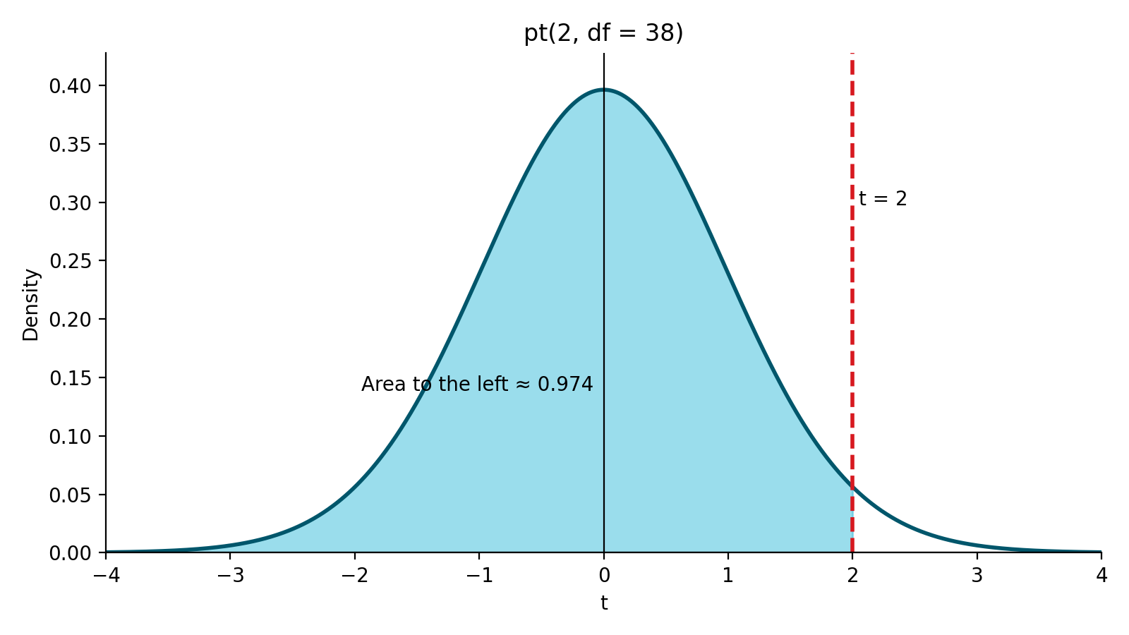
t-DISTRIBUTION IN R
pt(): from a t-value to probability
Example: pt(2, df = 38)
pt() returns the cumulative
probability to the left of the chosen
t-value. Here, it gives the area
under the t(38) curve to the
left of t = 2.
pt(2, df = 38) # ≈ 0.974
Remember: qt() goes from probability to t. pt() goes from t to probability.
SOK-3081 • Chapter 3
Notes:
pt() returns the cumulative probability to the left of the chosen t-value. Here, it gives the area under the t(38) curve to the left of t = 2.

Slide 12
A CLAIM WE CAN TEST
Lab 2
Return to the supermarket decision
food_exp = 83.42 + 0.1021 · income
Estimate
Decision threshold
USD 0.102 more food expenditure
per USD higher weekly income
Investment requires more than
USD 0.055 per USD
Question: Is the evidence strong enough to conclude that β₂ > 0.055?
Notes:
Use the same economic question from the beginning, but now phrase it as a claim about beta_2.
The estimate 0.1021 is above 0.055, but that alone is not enough. We need to compare the distance from the threshold with the sampling uncertainty.

Slide 13
HYPOTHESES
From the economic question to H₀ and H₁
H₀: β₂ ≤ 0.055
H₁: β₂ > 0.055
Not enough for investment
Large enough for investment
The alternative hypothesis determines the direction of the test.
For calculations, the boundary value 0.055 is used in the t-statistic.
Notes:
Start with the economic statement, then write hypotheses. This makes the direction of the test natural.
The alternative contains the statement we want evidence for: beta_2 > 0.055. Therefore evidence in favor of H1 corresponds to unusually large positive t-values.
Although H0 is written as <= 0.055, the t calculation uses the boundary value c = 0.055.

Slide 14
HYPOTHESIS TESTING
Hypothesis testing starts by assuming H₀ is true
Step 1
Step 2
Step 3
Assume the null
hypothesis is true.
Compare our estimate
with the value implied
by H₀.
Measure that distance
relative to normal
sampling variation.
For the supermarket
example:
H₀: β₂ = 0.055
Observed estimate:
b₂ = 0.1021
Use the standard error
se(b₂) = 0.0209
Key idea: We ask what we would expect to see if H₀ were true,
and then compare that with what we actually observed.
SOK-3081 • Chapter 3
Notes:
This slide makes explicit the step that is often left implicit. Hypothesis testing begins by assuming the null hypothesis is true. In the supermarket example, we temporarily act as if the true slope were 0.055. Then we compare our observed estimate, 0.1021, with that benchmark. But we do not stop at the raw difference. We scale the difference by the standard error because some deviation from the null value is normal in random samples.

Slide 15

ONE FORMULA
The test statistic measures distance from the claim
$$t=\frac{b_{2}−c}{se(b_{2})}$$
Numerator
How far is the estimate from the hypothesized value?
Denominator
How much sampling variation is normal for b₂?
Interpretation: how many standard errors is the estimate from the value specified by H₀?
Notes:
This is the core of hypothesis testing. Avoid presenting it as a new formula to memorize: it is just distance divided by uncertainty.
If H0 is true and c is the correct population value, the statistic follows the t distribution under the assumptions. That gives us a reference for deciding whether the observed distance is unusual.

Slide 16
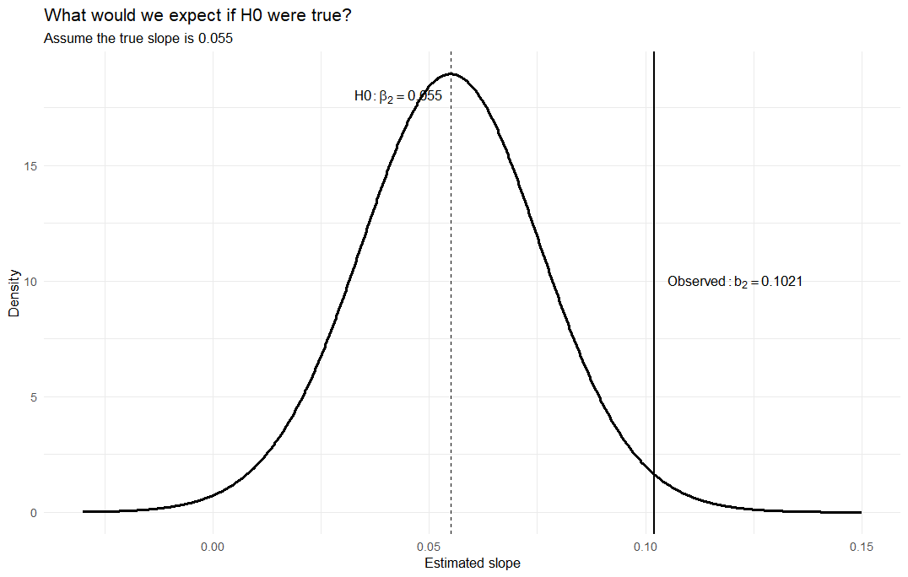

$$t=\frac{b_{2}−c}{se(b_{2})}$$

Slide 17

WORK IT OUT TOGETHER
Calculate the supermarket t-statistic
b₂ = 0.1021 c = 0.055 se(b₂) = 0.0209
$$t=\frac{b_{2}−c}{se(b_{2})}$$
Notes:
Calculate together: t = (0.1021 - 0.055) / 0.0209 ≈ 2.25.
Interpret 2.25 before discussing a rejection rule: the estimate is about 2.25 standard errors above the threshold under H0.
Then ask: is 2.25 unusually large for a t distribution with 38 df? That motivates the rejection region / p-value.

Slide 18
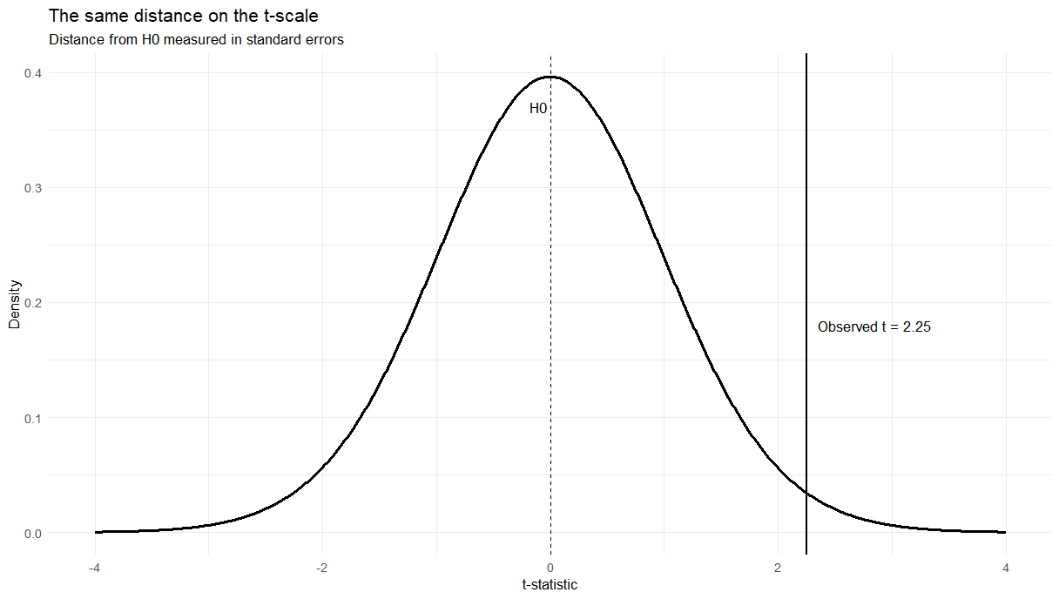
Lab 3

Slide 19



HYPOTHESIS TESTING
From the null assumption to the test statistic
Distance from the null claim
Standardize by the usual sampling variation
If H₀ is true, how far is our estimate
from the value specified by H₀?
$$t=\frac{b_{2}−c}{se(b_{2})}$$
$$b_{2}−c$$
$$t=\frac{\text{0.0471}}{\text{0.0209}}≈2.25$$
Raw difference:
0.1021 − 0.055 = 0.0471
Interpretation: the estimate is about 2.25
standard errors above the null value.
Next question: If H₀ were true, how unusual would a t-value this large be?
SOK-3081 • Chapter 3
2
Notes:
This slide turns the logic into the test statistic. Start from the null assumption, H0: beta2 = 0.055. The observed estimate is 0.1021, so the raw distance is 0.0471. But that number is meaningful only relative to the normal sampling variation in the estimator. Dividing by the standard error gives the t statistic, about 2.25. Now the students can interpret the statistic before you introduce critical values or the p-value: the estimate is 2.25 standard errors above the null value. This naturally leads into the next question: how unusual would such a value be if the null were true?

Slide 20
Α = 0.05 VERSUS Α = 0.01
Lab 4
Food example: same evidence, two thresholds
t = 2.25 df = 38
α = 0.05
α = 0.01
Critical t ≈ 1.686
2.25 > 1.686
Reject H₀
Critical t ≈ 2.429
2.25 < 2.429
Fail to reject H₀
The data did not change. The standard for how unusual the evidence must be changed.
Notes:
This is an important conceptual example. At 5% the test rejects; at 1% it does not.
Do not describe 1% as “better” or “more correct.” It is a stricter Type I error tolerance.
At 5%, the sample provides evidence that the slope exceeds the investment threshold. At 1%, the evidence is not strong enough to reach that stricter standard.

Slide 21
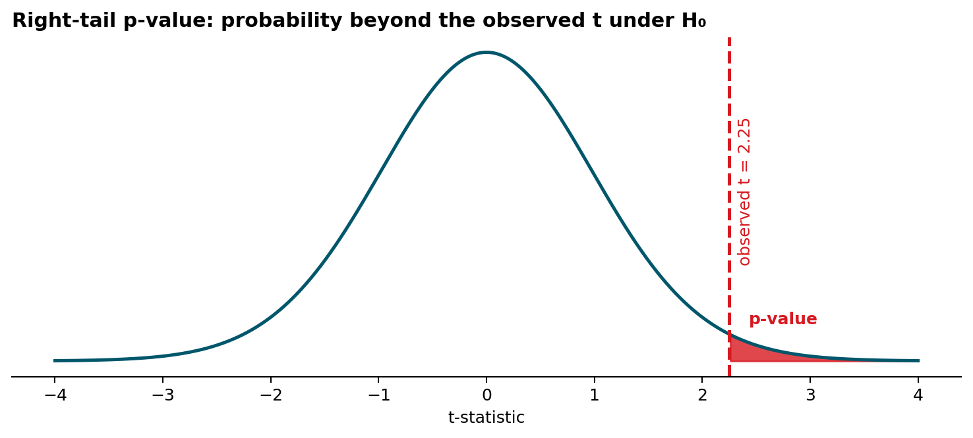

P-VALUE
Lab 5
The p-value asks how unusual our result is under H₀
$$p=P(t≥2.25|H_{0})$$
Small p-value → the observed t is difficult to reconcile with H₀.
p=0.015
Do not say: “the p-value is the probability that H₀ is true.”
The p-value is the probability of obtaining a t-value as extreme or more extreme than the observed t-value, assuming that the null hypothesis is true.
Notes:
Define the p-value using the observed t and the reference distribution under H0. For the right-tail supermarket test, it is the probability of a t-statistic at least as large as the one observed, assuming the boundary value in H0 is true.
Avoid the common misinterpretation that p is P(H0 is true). It is a probability about data/test statistics conditional on H0.

Slide 22

CRITICAL VALUE AND P-VALUE
R can calculate both routes
# Test statistic
t <- (b_2 - 0.055) / se_b2
# Critical value: right-tail 5% test
qt(0.95, df = 38)
# Right-tail p-value
1 - pt(t, df = 38)
Decision rules
$t≥t_{c}$ → reject H₀
p ≤ α → reject H₀
Two ways of expressing the same evidence.
Notes:
Run both calculations. The critical-value rule and p-value rule lead to the same decision for a given alpha.
Explain why software output is useful only after the student knows what null value and alternative the software is testing. summary(lm()) by default reports a two-sided test against zero; that is not the supermarket test.

Slide 23
P-VALUE
Calculate the p-value
Supermarket test
H₀: β₂ ≤ 0.055 H₁: β₂ > 0.055
What does 0.015 mean?
Observed test statistic: t = 2.25
If the null value β₂ = 0.055 were true, the probability of obtaining a t-value of 2.25 or larger is about 1.5%.
# Right-tail p-value
p_value <- 1 - pt(t_food, df = 38)
p_value
# 0.015
α = 0.05
α = 0.01
p < α → Reject H₀
p > α → Fail to reject H₀
Same data, different decision threshold.
Notes:
Use this immediately after introducing the p-value. Stress that the probability statement is conditional on the null value used to construct the test statistic. For this one-sided test the p-value is the area to the right of the observed t-statistic. The key comparison is p with alpha. At 5% we reject; at 1% we do not. Avoid saying that there is a 1.5% probability that H0 is true.

Slide 24
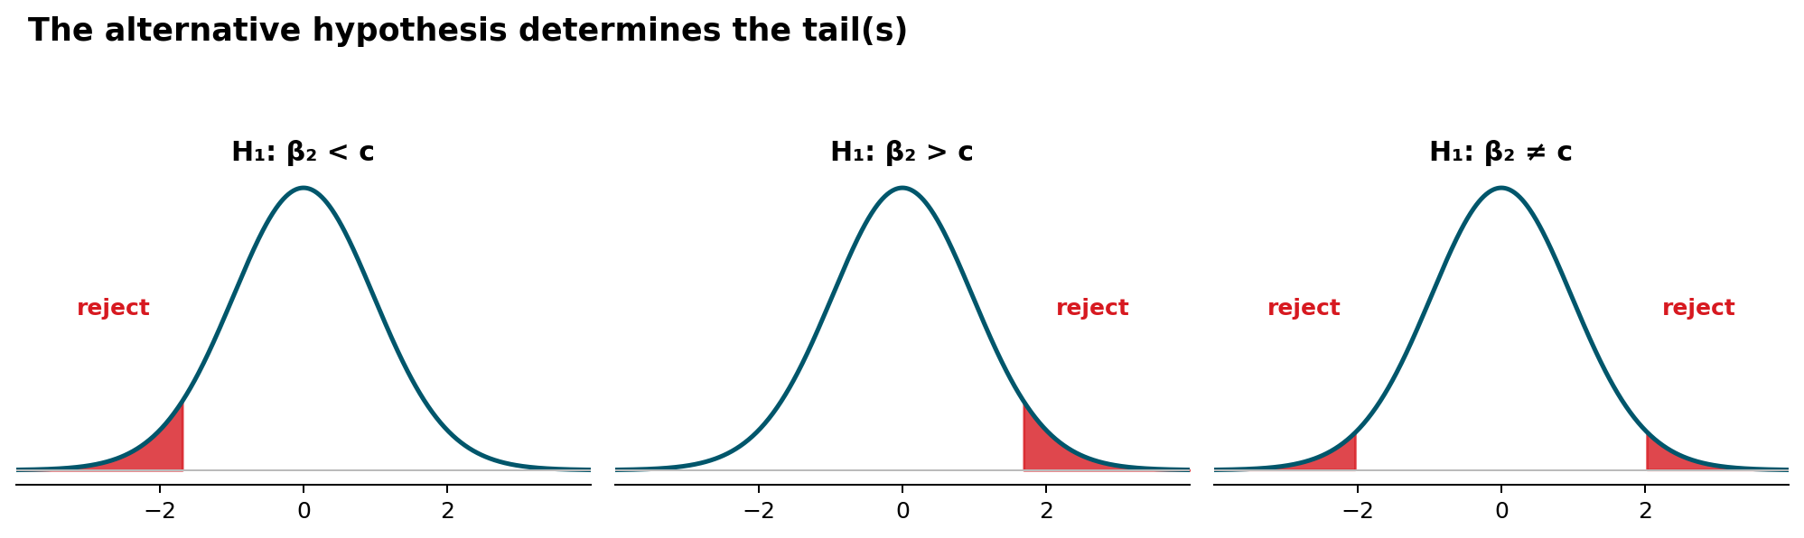
DO NOT LEARN THREE DIFFERENT TESTS
One idea, three alternatives
Same test statistic. What changes is where “unusual” values lie.
In this course we will mostly use two-sided tests, but the supermarket question is naturally right-sided.
Notes:
Cover the three alternatives together on one slide, as requested. Do not derive three separate rules.
H1: beta<c -> evidence is in the left tail.
H1: beta>c -> evidence is in the right tail.
H1: beta!=c -> evidence can be in either tail.
The formula for t does not change. The alternative determines the relevant tail probability and critical value.

Slide 25
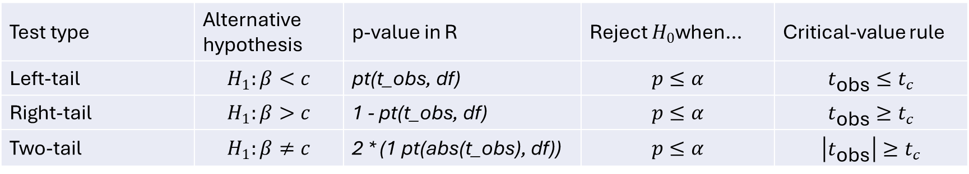
Test type | Alternative hypothesis | p-value in R | Reject $H_{0}$when… | Critical-value rule
Left-tail | $$H_{1}:β<c$$ | pt(t_obs, df) | $$p≤α$$ | $$t_{\text{obs}}≤t_{c}$$
Right-tail | $$H_{1}:β>c$$ | 1 - pt(t_obs, df) | $$p≤α$$ | $$t_{\text{obs}}≥t_{c}$$
Two-tail | $$H_{1}:β≠c$$ | 2 * (1 pt(abs(t_obs), df)) | $$p≤α$$ | $$\left|t_{\text{obs}}\right|≥t_{c}$$

Slide 26
A USEFUL CONNECTION
Two-sided tests and confidence intervals tell a consistent story
H₀: β₂ = c vs. H₁: β₂ ≠ c
If c is inside the 95% interval
If c is outside the 95% interval
Fail to reject H₀
at α = 0.05
Reject H₀
at α = 0.05
This equivalence is for a two-sided 5% test and a 95% interval for the same parameter.
Notes:
This is a conceptual payoff: interval estimation and hypothesis testing are two views of the same sampling uncertainty.
Be precise about scope: the equivalence is between a 100(1-alpha)% interval and a two-sided test at alpha for the same point null. The one-sided supermarket test does not use the same 95% two-sided interval rule.

Slide 27
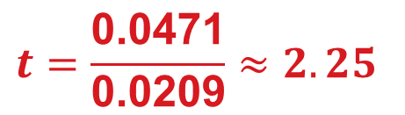
HYPOTHESIS TESTING
Same null value — different question
Two-sided test
Observed estimate and test statistic
H₀: β₂ = 0.055
Observed estimate: b₂ = 0.1021
H₁: β₂ ≠ 0.055
Standard error: se(b₂) = 0.0209
$$t=\frac{\text{0.0471}}{\text{0.0209}}≈2.25$$
We are now asking whether
the slope is different from 0.055
in either direction.
Same t-statistic as before.
What changes is the alternative hypothesis
and therefore where we look for unusual values.
SOK-3081 • Chapter 3
1
Notes:
This slide is only for comparison. The null value is the same as in the one-sided supermarket test, beta2 = 0.055. The estimate and the standard error are also the same, so the t-statistic stays 2.25. The only change is the question. We are no longer asking whether beta2 is greater than 0.055; we ask whether it is different from 0.055. That means evidence against the null can now appear in either tail.

Slide 28
HYPOTHESIS TESTING
Lab 6
One-sided vs two-sided: what changes?
Right-tail test
Two-sided test
H₁: β₂ > 0.055
H₁: β₂ ≠ 0.055
Evidence against H₀ is only in the right tail.
Evidence against H₀ can be in either tail.
At α = 0.05: t_c ≈ 1.686
At α = 0.05: critical values ±2.024
Since 2.25 > 1.686, reject H₀.
Since |2.25| > 2.024, reject H₀.
Takeaway: the test statistic does not change. The alternative hypothesis determines which tail — or tails — matter.
SOK-3081 • Chapter 3
2
Notes:
This is the comparison slide. The t-statistic is still 2.25. In the one-sided test, all 5 percent go into the right tail, so the critical value is lower. In the two-sided test, the 5 percent significance level is split across two tails, 2.5 percent in each tail, so the critical values move further out to plus/minus 2.024. The main teaching point is that the alternative hypothesis determines the rejection region. The data are the same; the question is different.

Slide 29
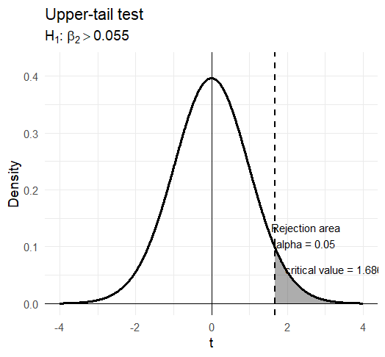
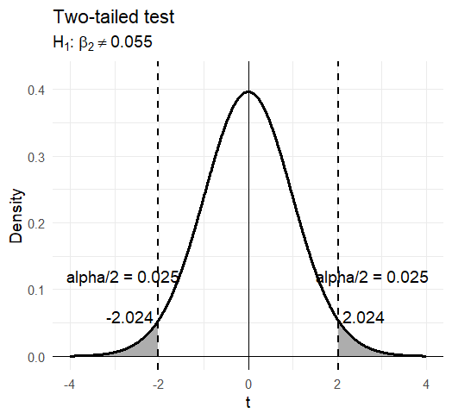

Slide 30
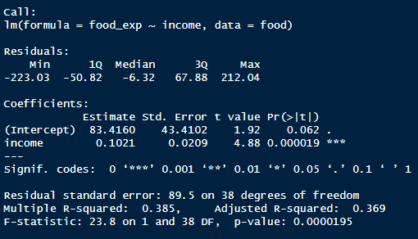
HYPOTHESIS TESTING
A five-step routine
1
State H₀ and H₁
2
Calculate the test statistic
3
Choose $∝$ and the relevant tail(s)
4
Compare with a critical value or p-value
5
State the conclusion in context
The last step should use words from the economic question — not only H₀, H₁, and Greek letters.
Notes:
Keep this routine visible in later exercises. The most common student error is to stop after a mechanical reject/fail-to-reject decision.
The final sentence should translate back to the economic claim. Also reinforce “fail to reject” rather than “accept H0.”

Slide 31
TYPE I AND TYPE II
Errors are possible because we make decisions from samples
Type I error
Type II error
Reject H₀ even though H₀ is true.
For the supermarket: invest because we conclude β₂ > 0.055 when the true slope is not above the threshold.
Fail to reject H₀ even though the alternative is true.
For the supermarket: do not establish the threshold even though β₂ really is above 0.055.
α controls the probability of a Type I error under the null.
Notes:
Keep this light. The goal is interpretation, not power calculations.
Connect alpha to Type I error. Explain that a stricter alpha makes rejection harder, reducing Type I error probability but generally increasing the risk of failing to detect real departures from H0.
Do not spend time calculating Type II probabilities in this chapter session.

Slide 32
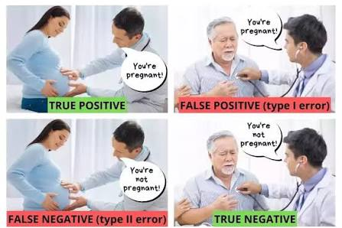
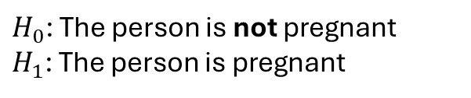




$H_{0}$: The person is not pregnant
$H_{1}$: The person is pregnant
Type I and Type II error illustrated
$H_{0}$: is not true
$H_{0}$: is true
Reject $H_{0}$
Keep $H_{0}$

Slide 33

SMALL CALCULATION
Lab 7
Your turn: a new study
A study reports:
b₂ = 0.084
se(b₂) = 0.016
df = 48
Test at α = 0.05:
H₀: β₂ ≤ 0.055 vs. H₁: β₂ > 0.055
Calculate t.
Find the critical value or p-value.
State the conclusion in one sentence.
R: $pt(t, df)$
Use R as a calculator.
Notes:
Give 3–4 minutes. Expected calculations: t = (0.084-0.055)/0.016 = 1.8125. Critical t for right-tail 5% with 48 df is about 1.677. Therefore reject H0 at 5%. The p-value is about 0.038.
Ask for an economic sentence, not only “reject H0.”

Slide 34
INTERPRETATION
Statistical significance is not economic importance
Statistical question
Economic question
Is the estimated difference large relative to its sampling uncertainty?
This is what the t-statistic and p-value address.
Is the magnitude large enough to matter for the actual decision?
This requires context, units, costs, benefits, and thresholds.
A tiny effect can be statistically significant in a large sample. A large estimate can be too imprecise to be statistically significant.
Notes:
Use the supermarket threshold to make this concrete. A statistically nonzero slope is not automatically sufficient for investment. The relevant economic threshold is 0.055, not zero.
This is one reason testing meaningful values can be more informative than mechanically reporting the default test against zero.

Slide 35
SCOPE OF THE REGRESSION
Inference does not create causality
Which statement is defensible?
A
B
Raising a household’s income by USD 100 causes food expenditure to rise by USD 10.21.
In this sample, higher income is associated with higher food expenditure; the estimated slope is 0.1021.
Confidence intervals and hypothesis tests quantify sampling uncertainty conditional on the model assumptions. They do not solve identification.
Notes:
Ask for a vote between A and B. B is the defensible statement from this simple observational regression.
Inference answers how uncertain the estimated association is under the model. It does not by itself establish that changing income would cause the estimated change in food expenditure.

Slide 36
SUMMARY
Chapter 3: one chain of reasoning
β₂
Fixed but unknown population parameter
↓
b₂
Estimate from one random sample
↓
se(b₂)
Estimated sampling variability
↓
b₂ ± t_c * se(b₂)
Range of parameter values compatible with the sample
↓
t = (b₂ − c) / se(b₂)
Distance from a specific claim
↓
p-value
How unusual the observed t would be under H₀
The same sampling uncertainty underlies both interval estimation and hypothesis testing.
Notes:
Close by returning to the chain rather than listing definitions.
Students should see that Chapter 3 is not a collection of unrelated procedures: estimate -> standard error -> t distribution -> interval or test.
Final reminder: confidence refers to the repeated-sampling method; a p-value is conditional on H0; and statistical inference does not by itself establish causality.

Slide 37
Lab 9
BOOK EXERCISE 3.19(C)
Worked example — motel occupancy
Model
MOTEL_PCT = β₁ + β₂ COMP_PCT + e
Question
Do the data provide strong evidence that the competitor’s occupancy rate is positively associated with the motel’s occupancy rate?
What we estimate from the data
H₀: β₂ ≤ 0
H₁: β₂ > 0
α = 0.01
MOTEL_PCT = 21.340 + 0.865 COMP_PCT
SE (12.907) (0.203)
Right-tail
N = 25 df = 23
MOTEL_PCT: Occupancy rate of the motel, in percent
COMP_PCT: Occupancy rate of the competitor motel, in percent
I will work this one through first.
Source: Hill, Griffiths & Lim, Principles of Econometrics 5e, Exercise 3.19(c)
Notes:
Reintroduce the variables briefly: motel_pct is the motel occupancy percentage and comp_pct is the competitors' occupancy percentage. The regression results are rounded to the values reported in the book answer key. Ask the class to identify the tail before doing any arithmetic. Then move to the next slide and work through the calculation.

Slide 38
BOOK EXERCISE 3.19(C)
Worked example — calculation and decision
1. Test statistic
motel_t <- (motel_b2 - 0) / motel_se_b2
motel_t
# 4.27
Decision
t = 4.27 > 2.50
and p < 0.01
2. Critical value, right-tail α = 0.01
qt(0.99, df = 23)
# 2.50
Reject H₀
At the 1% level, the data provide evidence of a positive association between the two occupancy rates.
3. p-value
1 - pt(motel_t, df = 23)
# < 0.001
Always return to the economic question after the calculation.
Notes:
Work through this slowly. First calculate the standardized distance from the null value. Then choose the critical value based on the alternative, not by habit. Finally calculate the right-tail p-value. The exact p-value from R may differ slightly in the last digits from a calculation based on the rounded textbook coefficient and standard error. The conclusion is unchanged.

Slide 39
BOOK EXERCISE 3.19(D)
Your turn — same data, a different claim
Tasks
Test
Write down the test statistic.
1
H₀: β₂ = 1
H₁: β₂ ≠ 1
α = 0.01
2
Calculate t in R.
3
Find the two-sided critical value.
What would β₂ = 1 mean economically?
Use the regression you already estimated.
4
Calculate the two-sided p-value.
motel_b2
motel_se_b2
motel_df
5
State the statistical and economic conclusion.
Do not use the p-value reported by summary(lm()) — that tests β₂ = 0.
Notes:
Answer for instructor: t ≈ -0.67. For a two-sided 1% test with df=23, the critical values are approximately ±2.807. The two-sided p-value is about 0.51. Fail to reject H0. beta2=1 means that a one percentage-point increase in competitor occupancy is associated with a one percentage-point increase in expected motel occupancy. The data are compatible with that one-for-one relationship.

Slide 40
BOOK EXERCISE 3.20(D)
Your turn — a left-tail test with the motel data
A different regression
Tasks
1
Interpret the estimated REPAIR coefficient.
MOTEL_PCT = δ₁ + δ₂ REPAIR + e
2
Calculate the t-statistic for the boundary value δ₂ = 0.
model_repair <- lm(motel_pct ~ repair, data = motel)
summary(model_repair)
Find the left-tail critical value.
3
4
Calculate the left-tail p-value.
Question: did the repairs reduce occupancy?
5
State the conclusion in the context of the motel’s claim.
H₀: δ₂ ≥ 0 H₁: δ₂ < 0 α = 0.05
Now the direction of H₁ points to the left.
Notes:
Answer for instructor: the repair coefficient is approximately -13.24 with SE approximately 5.96. t ≈ -2.22. The left-tail 5% critical value with df=23 is approximately -1.714. The p-value is about 0.018. Reject H0 at 5%. The data support the claim that occupancy was lower during the repair period. This is an association in this simple regression; be careful about stronger causal language unless the research design supports it.

