Slide 1
RESEARCH ON LIGHTWEIGHT MLLM
FOR VIETNAMESE OCR
Fine-tuning GLM-OCR for Diacritical Mark Recognition
Team Members
250201052 — Nguyen Tuan Dung
250201068 — Nguyen Trong Kien
250201072 — Pham Nhat Linh
Advisor: ............................
University of Information Technology • Faculty of Computer Science • May 2026
1/15

Slide 2
OUTLINE
01
Introduction & Motivation
02
GLM-OCR Architecture
03
Fine-tuning Method
04
Training Data Pipeline
05
Training & Optimization
06
Evaluation & Results
07
Conclusion & Future Work
2/15

Slide 3
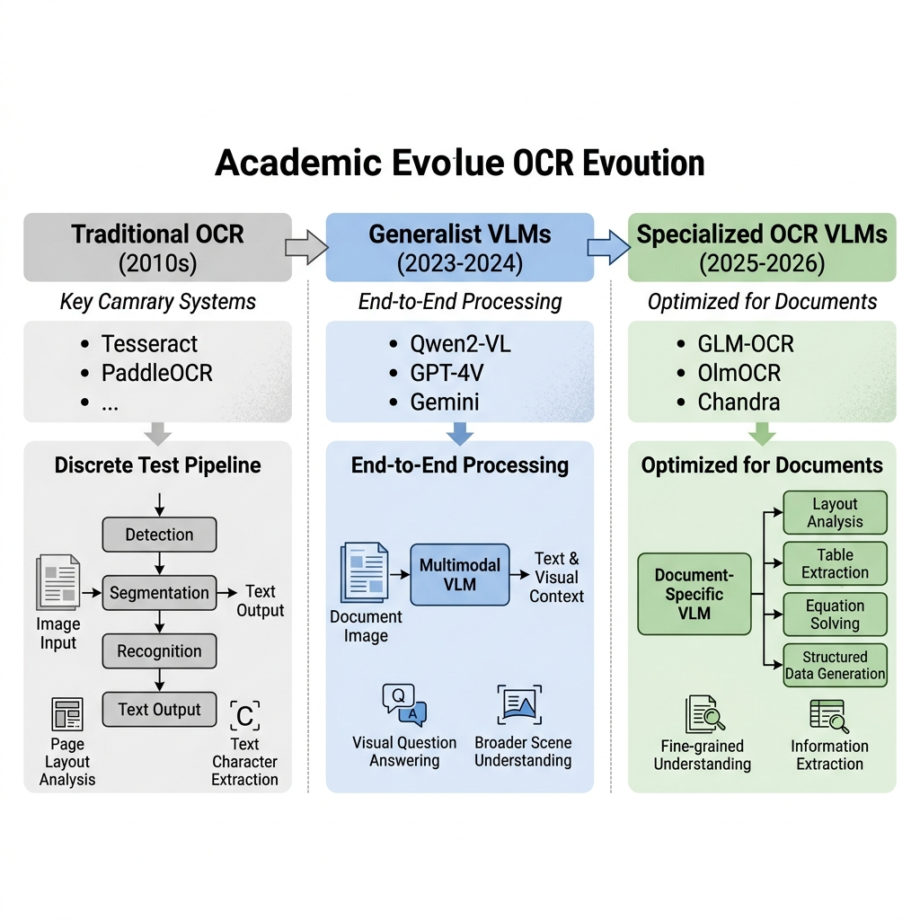
INTRODUCTION & MOTIVATION
🔥 Vietnamese OCR Challenges
💡 Proposed Solution
▸ Complex diacritical system: 6 tones + double diacritics (ă, â, ê, ô, ơ, ư, đ)
▸ One wrong mark = different meaning: ma, má, mà, mả, mã, mạ
▸ Current VLMs (GLM-OCR, Qwen-VL) poorly recognize Vietnamese diacritics
▸ Lack of high-quality Vietnamese pre-training data
▸ Fine-tune GLM-OCR (0.9B params) with LoRA
▸ Two-stage curriculum learning
▸ Anti-bias: prevent diacritical hallucination
▸ Complete pipeline: data → train → eval → deploy
3/15

Slide 4
VLM LANDSCAPE FOR OCR
Model Type | Examples | Params | Key Characteristics
Traditional OCR | Tesseract, PaddleOCR | — | Pipeline: detect → segment → recognize
Generalist VLM | Qwen2.5-VL, GPT-4o, Gemini 2.5 | 7B–70B | Strong reasoning, long context, resource-heavy
Specialized OCR VLM | GLM-OCR, OlmOCR-2, dots.ocr | 0.9B–8B | Optimized text extraction, structured output
Compact/Efficient | GLM-OCR, PaddleOCR-VL | <1B | Edge deployment, compute-efficient
📌 Choice: GLM-OCR (0.9B) — best balance of performance & efficiency, suitable for fine-tuning on Colab T4. Features MTP (Multi-Token Prediction) for 50% faster inference, clear 3-component architecture enables flexible freeze/unfreeze.
4/15

Slide 5
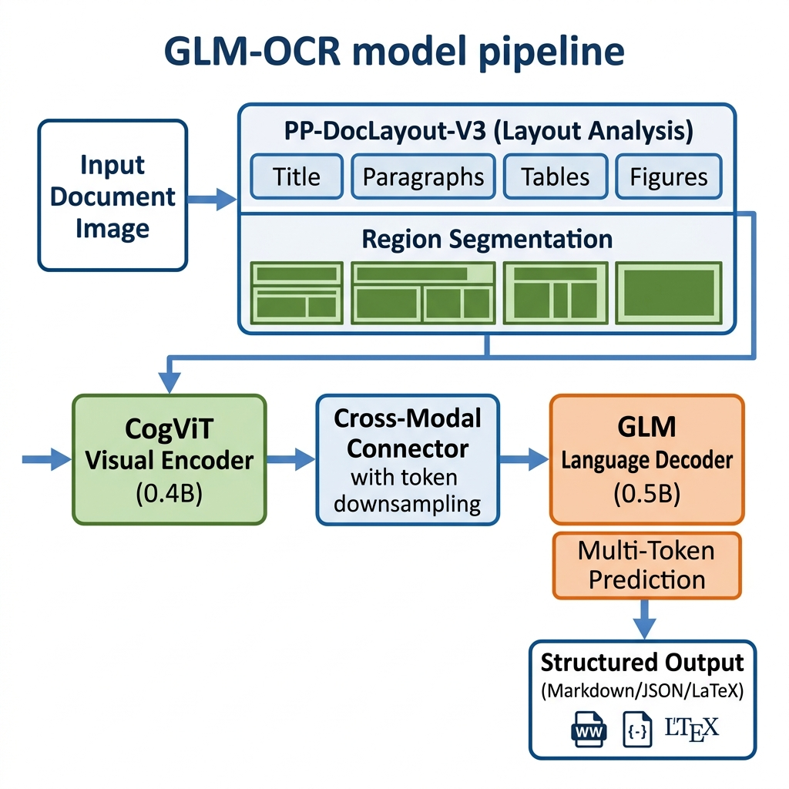
GLM-OCR ARCHITECTURE
CogViT Encoder
Cross-Modal Projector
GLM Decoder
0.4B params
Bridge
0.5B params
24 layers, hidden=1024 Patch 14×14, merge=2 336×336 input
Visual → Language Token downsampling Unfrozen during fine-tune
16 layers, hidden=1536 GQA 8 KV heads MTP: 5.2 tokens/step
5/15

Slide 6
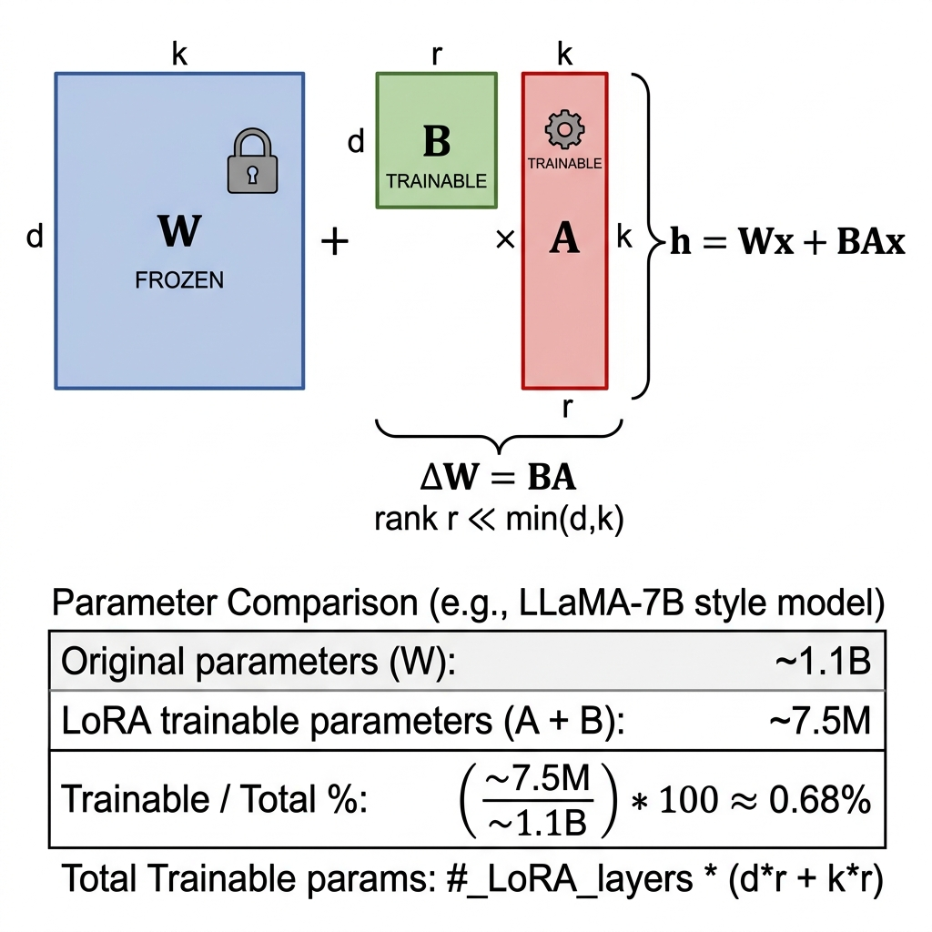
LoRA FINE-TUNING METHOD
LoRA Configuration
h = Wx + ΔWx = Wx + BAx
Rank (r) = 16 | Alpha = 32 | Dropout = 0.1
Target: all linear layers
(q/k/v/o_proj, gate/up/down_proj, lm_head)
Trainable: ~7.5M / 1.1B = 0.68% ✅
VRAM: only ~7 GB (T4 16 GB)
🔑 Freeze ViT + Unfreeze Projector → Build new "visual dictionary" for Vietnamese diacritics without losing pre-trained visual knowledge. Projector maps visual features → multiple tokens ("Nguyen" = 3 tokens).
Stage 1: Line-level SFT 50K synthetic · LR 1e-4 · Cutoff 2048
Stage 2: Document-level SFT 10K news · LR 5e-5 · Cutoff 4096
6/15

Slide 7
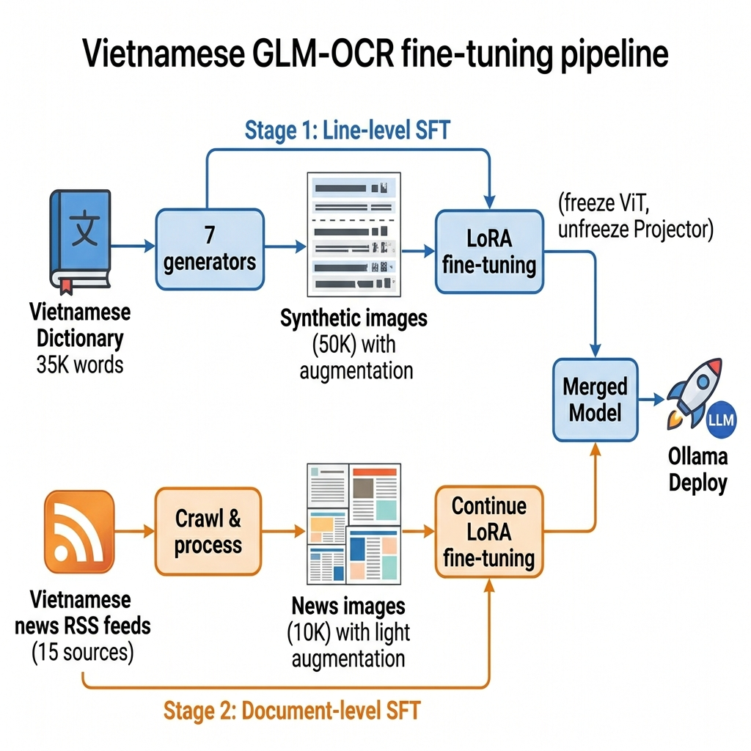
TRAINING DATA PIPELINE
Stage 1: Synthetic Data
Stage 2: News Data
▸ 35,501 dictionary words + 3,544 hard words
▸ 58 verified Windows fonts
▸ 7 diverse sample generators
▸ 14 augmentation types (40% no-aug)
▸ Output: 50K train + 100 val + 100 test
▸ 15 RSS feeds: VNExpress, Tuoi Tre, Thanh Nien
▸ Pipeline: RSS → fetch → filter → chunk
▸ 30% strip diacritics (anti-hallucination)
▸ Light augmentation: blur, noise, jpeg, rotate
▸ Output: 10K train + 50 val + 100 test
7/15

Slide 8
7 SAMPLE GENERATORS
# | Generator | Ratio | Description | Purpose
1 | gen_word_list | 10% | 8-16 random words | Vocabulary diversity
2 | gen_phrase_list | 25% | 2-4 phrases + commas | Phrase learning
3 | gen_confusion_pair | 15% | Near-identical pairs (dist=1) | Fine-grained discrimination
4 | gen_grouped_words | 10% | Same diacritic group | Focus on ă, â, ê, ô, ơ, ư
5 | gen_mixed_line | 15% | Phrases + words, 2 lines | Multi-line layout
6 | gen_dense_sentence | 25% | Phrases + periods | Complex sentences
7 | gen_plain_words | 10% | Mixed with/without diacritics | ⚠️ Anti-bias
⚠️ Anti-bias Strategy: gen_plain_words (10%) + 30% strip diacritics (Stage 2) → Teach the model NOT to add diacritics to plain text (prevent hallucination). Measured via False Positive Rate.
Confusion Pairs — examples:
chuồng ↔ chuồng | lặng ↔ lẫm | hổ ↔ hỗ | ngã ↔ ngả | mật ↔ mịt → Up to 5,000 pairs (edit distance = 1) for fine-grained discrimination
8/15

Slide 9
DATA AUGMENTATION — 14 TYPES
Type | Params | Simulates | Type | Params | Simulates
Gaussian Blur | R=0.3-0.8 | Camera blur | Shadow | 5 directions | Drop shadow
Gaussian Noise | I=15-35 | Image noise | Glare | Bright overlay | Overexposure
Contrast ↑ | 1.1-1.5× | Bright scene | Perspective | 2-7% | Angle warp
Contrast ↓ | 0.65-0.9× | Dark scene | Downscale | 0.75-0.92× | Low resolution
JPEG Compress | Q=55-80 | Compression | Wave | 2-10px | Curved page
Rotation | ±3° | Tilted scan | Elastic | σ=3-6 | Deformation
Motion Blur | 5-12px | Motion blur | Defocus | Blur+noise | Focus blur
📊 Distribution: 40% no augmentation (clean diacritical learning) + 60% random augmentation (robustness). Stage 2 uses only 4 lighter types: blur, noise, jpeg, rotate.
9/15

Slide 10
TRAINING CONFIGURATION
Stage 1 — Line-level SFT
Stage 2 — Document-level SFT
LoRA: r=16, α=32, dropout=0.1
Target: all linear layers
freeze_vision = true | freeze_projector = false 🔓
LR = 1e-4 | Scheduler = constant_with_warmup
Batch = 8 × 8 accum = 64 effective
FP16 | Cutoff 2048 | 50K samples
VRAM: ~6.9 GB | Speed: ~1.6s/step | ~2h/epoch
Load S1 adapter → optimizer reset
LR = 5e-5 (lower than S1)
Cutoff = 4096 (2× S1)
Batch = 2 × 8 accum = 16 effective
10K news images | FP16
Early stopping: patience = 3
Eval every 200 steps on 50 val samples
🔑 Key Design Decisions
Unfreeze Projector: Build new visual dictionary for VN diacritics, preserve ViT knowledge
constant_with_warmup: Enables training resume without LR decaying to zero (vs. cosine)
Auto-resume on Colab: Detect latest checkpoint on Drive → compute next epoch automatically
meta.json protocol: Generator writes split counts → Notebook reads accurately, no hardcoding
10/15

Slide 11
EVALUATION FRAMEWORK
Metric | Description | Method
CER | Character Error Rate | Edit distance / total characters
WER | Word Error Rate | Word-level edit distance
Diacritic Accuracy | Per-group accuracy | 7 groups: ă, â, ê, ô, ơ, ư, đ (Wagner-Fischer DP)
False Positive Rate | Spurious diacritics rate | a→ă, e→ê, o→ô, u→ư, d→đ
Word Accuracy | Exact word match | Position-aligned comparison
Exact Match | 100% match rate | String comparison
⚠️ False Positive Rate — Critical metric for production: measures rate of spurious diacritical insertions (e.g., "ma" → "má"). Two anti-bias mechanisms reduce FP: gen_plain_words (10%) + 30% strip diacritics.
🔬 Wagner-Fischer DP alignment → produces (gt_char, pred_char) pairs → precise per-group diacritic evaluation. Automatic comparison with base model (downloaded from HuggingFace).
11/15

Slide 12
RESULTS
📊 Generated Datasets
Dataset | Train | Val | Test | Total Images | Size | Source
Stage 1 (synthetic) | 50,000 | 100 | 100 | 100,390 | 1.76 GB | Dictionary + augmentation
Stage 2 (news) | 10,000 | 50 | 100 | 10,100 | 1.07 GB | RSS VNExpress, Tuoi Tre, Thanh Nien
🤖 Fine-tuned Models
Model | Stage | Dataset | Params | Size | Format
glm-ocr-vn | Stage 1 | 50K synthetic | ~7.5M trainable | ~2.1 GB | safetensors (bf16)
glm-ocr-vn-s2 | Stage 2 | 10K news | ~7.5M trainable | ~2.1 GB | safetensors (bf16)
💻 Training Resources
▸ GPU: Google Colab T4 (16 GB VRAM, using ~6.9 GB)
▸ Time: ~2 hours/epoch (Stage 1) | Framework: LLaMA-Factory
▸ Merge: CPU + bfloat16 → safetensors | Deploy: Ollama (context 4096)
12/15

Slide 13
DEPLOYMENT
🔀 Merge LoRA
🖥️ Local Inference
🦂 Ollama Deploy
▸ Load base model (CPU, bf16)
▸ Load PEFT LoRA adapter
▸ merge_and_unload() → fuse
▸ Save safetensors + tokenizer
▸ Single / batch / folder input
▸ Text / Table / Formula Recognition
▸ Auto GPU/CPU (~4 GB VRAM)
▸ max_new_tokens=512, greedy
▸ Auto-generate Modelfile
▸ Context length: 4096 tokens
▸ Template: GLM-OCR chat format
▸ One-command deploy ready
📁 Project Structure
tools/dataset/
finetune_glm_ocr_vn_1epoch.ipynb # Training notebook (8 steps)
generate_vietnamese_dataset_v3.py # Synthetic data generator
crawl_vi_news.py # News crawler (Stage 2)
compare_models.py # Evaluation script
test_local.py # Local inference
merge_lora.py # LoRA merger
dictionary/ # 35K+ Vietnamese words
font_test/ # 58 fonts validated
vietnamese_ocr/ # Stage 1: 100K images
vietnamese_ocr_s2/ # Stage 2: 10K images
13/15

Slide 14
CONCLUSION
✅ Key Contributions
Synthetic data pipeline: 14 augmentation types, 58 fonts, 7 generators, confusion pairs
Anti-bias dual-layer: gen_plain_words (S1) + 30% strip diacritics (S2) → reduce FP
Two-stage curriculum: Line-level synthetic → Document-level news
Comprehensive evaluation: CER, WER, diacritic accuracy × 7 groups, False Positive rate
Tooling: Font tester, local inference, model comparison, Ollama deploy
🚀 Future Work
▸ Extend to Table Recognition & Formula Recognition for Vietnamese
▸ Collect more domains: invoices, ID cards, contracts
▸ Benchmark on standard datasets (ICDAR, IIIT) for Vietnamese
▸ Compare with Qwen2.5-VL, PaddleOCR-VL, OlmOCR
▸ Optimize inference speed for production deployment
14/15

Slide 15
THANK YOU
for your attention
Team Members
250201052 — Nguyen Tuan Dung
250201068 — Nguyen Trong Kien
250201072 — Pham Nhat Linh
15/15

