Slide 1
RNN
Double Lan

Slide 2
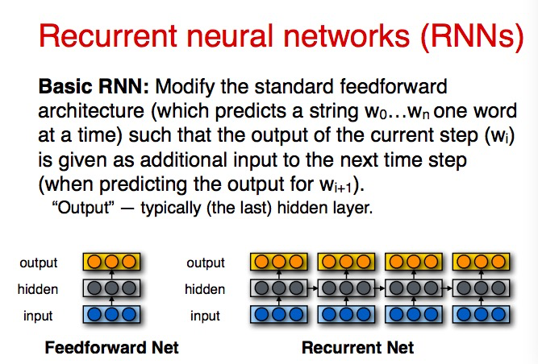
Why RNN
[reference: uiuc cs 447 ]

Slide 3
FeedForward NN & Recurrent NN
Recurrent NN: Use previous time vector to update the current time vector
why not back up at each step instead of sum them at the end
-- possible: the first one gets more feedback than the last one, the last one only gets fourth loss function

Slide 4
BI-RNN
this can be used for tagging
but not for language model
you can not see the words both from right and left, this would be seen as cheating...

Slide 5
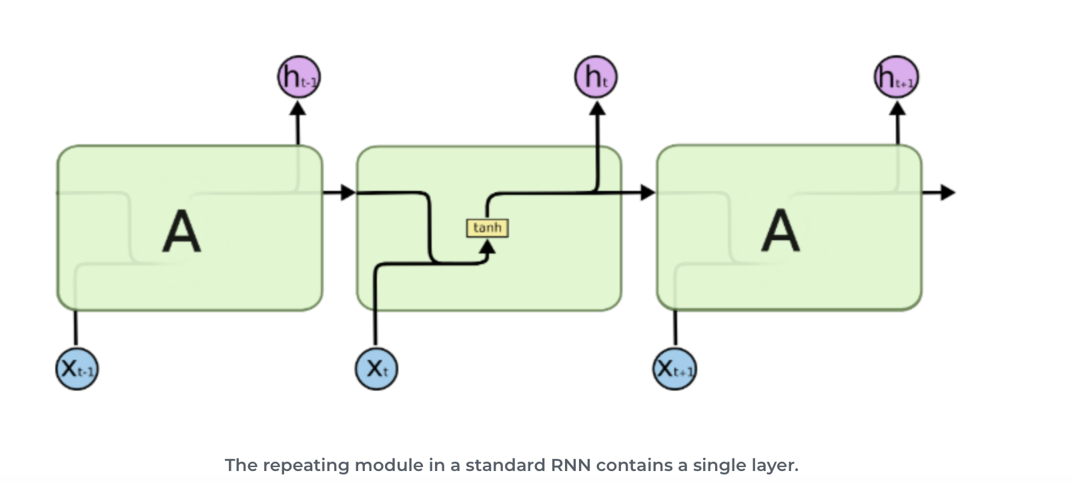
RNN TO LSTM
Issue: Long-term dependency
Figure 1: architecture of RNN. Retrieved from: https://www.infolks.info/blog/recurrent-neural-network/

Slide 6
gradient explosion (without tanh)

Slide 7
gradient vanish (with tanh)

Slide 8
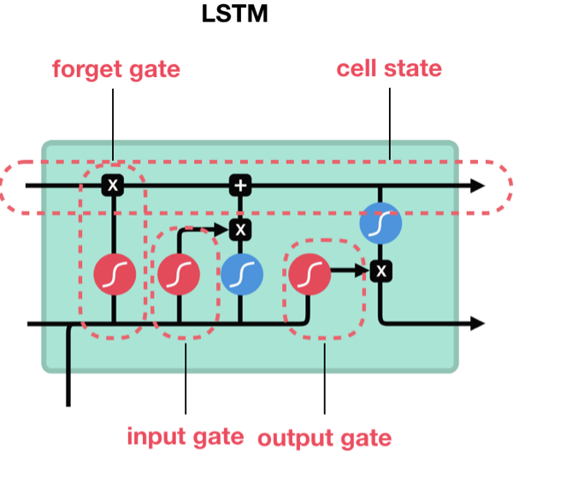
LSTM
Strategy:
Forget gate ( how much information to preserve)
Input gate ( how much new information to add)
Cell state ( information include current and previous)
Output gate (current hidden state)
Solution:
sigmoid (0 forget, 1 keep/ 0 not important, 1 important)
tanh (squish to [-1,1])
Figure 2: architecture of LSTM. Retrieved from: https://towardsdatascience.com/illustrated-guide-to-lstms-and-gru-s-a-step-by-step-explanation-44e9eb85bf21

Slide 9
Forget gate

Slide 10
Input gate

Slide 11
Cell state

Slide 12
Output gate

Slide 13
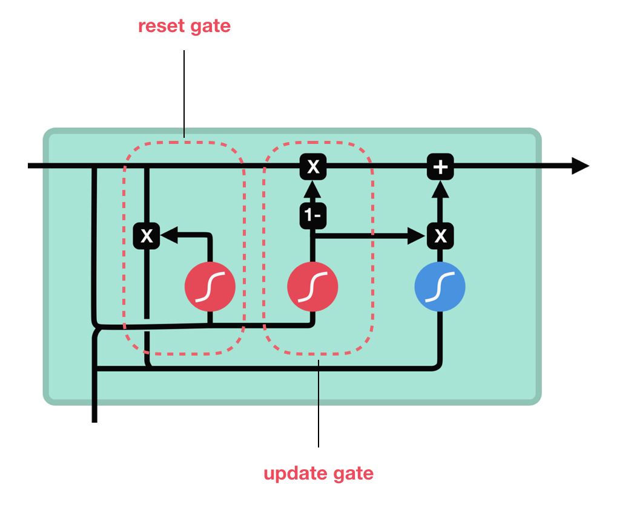
GRU
Reset gate (how much past information to forget)
Update gate (information to add and forget)

