Slide 1
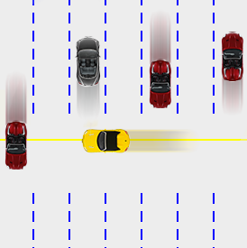

Optimal Acceleration-Bounded Trajectory Planning in Dynamic Environments Along a Specified Path
Jeff Johnson and Kris Hauser
School of Informatics and Computing

Slide 2
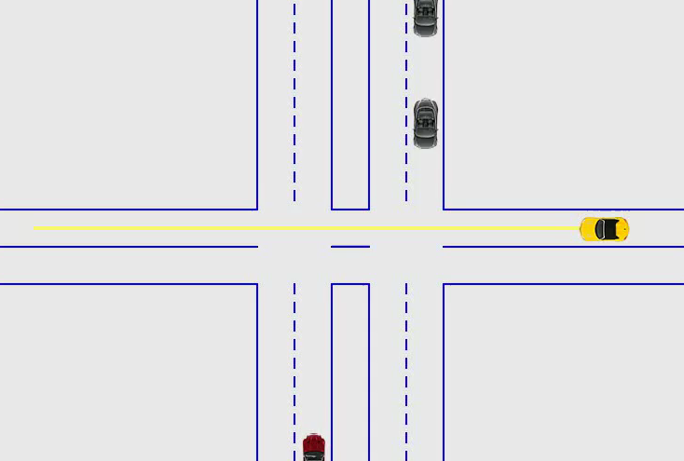
Motivation: Intersection Crossing
Plan a collision-free trajectory along the yellow path
Notes:
Let’s look at a motivating example. If you are driving this yellow car and you are approaching an intersection marked with a yield sign, then the oncoming vehicles have right-of-way, and it is your job to adjust your velocity to avoid collision. [PLAY VIDEO] In this case, as you traverse the path across the intersection, you’ll have to brake before crossing the intersection in order to avoid colliding with either of these other vehicles.

Slide 3

Other Scenarios
Trains or streetcars
Warehouse robots
Conveyer belt type systems
Kiva Systems
Notes:
There are other examples of such scenarios…
Now how do we implement this capability in an autonomous or semi-autonomous system?

Slide 4
Main Points
Problem: choose braking and acceleration controls along a fixed path to avoid moving obstacles
Exact, optimal, polynomial-time algorithm uses visibility graph construction and velocity interval propagation
Suitable for “real-time” (10Hz) replanning with up to 100 dynamic obstacles on a standard PC
Applications to emergency collision avoidance

Slide 5
Related Work
Planning with dynamic constraints:
Fiorini and Shiller (1998): Used velocity obstacles with discretized time to search a tree of trajectories – planning limited to the time discretization
Anderson, Peters, Iagnemma, and Pilutti (2009): Used Model Predictive Control for producing safe vehicle trajectories – planning limited to a receding horizon
Delsart, Fraichard, and Martinez (2009): Introduced Tiji for randomized trajectory planning incorporating final time constraints – planning limited to a parameterized space of trajectories
Planning with fixed paths:
Peng and Akella (2005): Introduced a Mixed-Integer Linear Programming method for coordinated multiple robots along specified paths – computes sub-optimal trajectories in general
Kant and Zucker (1986): Introduced a Path-Time decomposition and a visibility graph for trajectory construction – computes optimal trajectories in the absence of acceleration bounds
Notes:
We can take advantage of the fact that we’re assuming a path is given to us. Now given that path, how do we incorporate acceleration constraints?

Slide 6
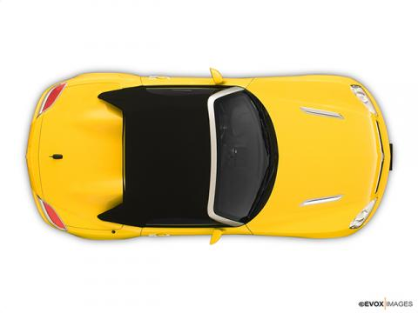
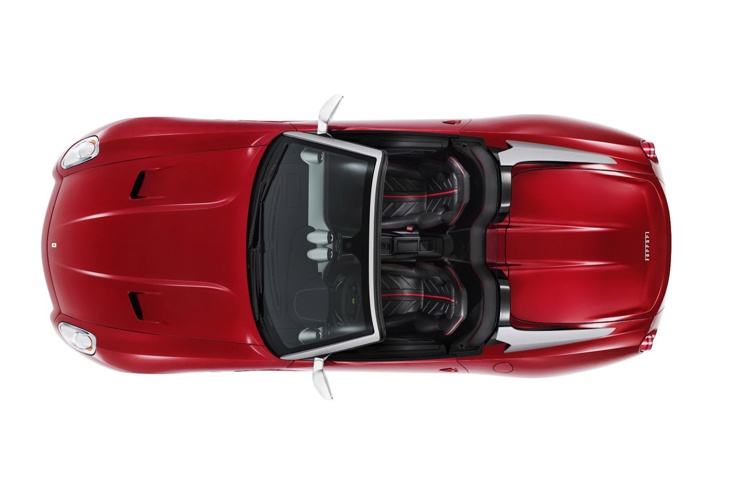
Path-Time Space: Construction
Agent
vehicle
Overlap path parameter
t₂
Deceleration
Overlap duration
p₂
t₁
Acceleration
p₁
p₂
p₁
Obstacle
vehicle
Notes:
Suppose you are driving this yellow car, and you are following this red path. There is an oncoming red vehicle that crosses the path at some point in time, so you need to time your controls to avoid it. In order to think about this problem, consider a space composed of a path position dimension and a time dimension, where each point in this space puts your car at a certain position in the path at a certain time. This is the path-time space. As this oncoming red vehicle crosses the path, it will make some segment of the path unreachable, or “forbidden.” Further, that segment will be forbidden for only a finite time—until after it passes. The plot on the left shows this forbidden region, and you can see that the path-time space captures it rather nicely. Your task as the driver is then to plan a trajectory that either passes in before the car, or one that waits and passes after it. To do this, you can accelerate ahead of it, or decelerate to pass after it, and you can see both of these trajectories in the graph.

Slide 7
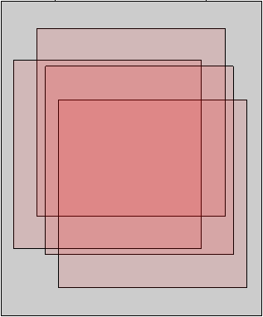
Path-Time Space: Construction
Agent
vehicle
Overlap path parameter
t₂
Deceleration
Overlap duration
p₂
t₁
Acceleration
p₁
p₂
p₁
Obstacle
vehicle
Notes:
Suppose you are driving this yellow car, and you are following this red path. There is an oncoming red vehicle that crosses the path at some point in time, so you need to time your controls to avoid it. In order to think about this problem, consider a space composed of a path position dimension and a time dimension, where each point in this space puts your car at a certain position in the path at a certain time. This is the path-time space. As this oncoming red vehicle crosses the path, it will make some segment of the path unreachable, or “forbidden.” Further, that segment will be forbidden for only a finite time—until after it passes. The plot on the left shows this forbidden region, and you can see that the path-time space captures it rather nicely. Your task as the driver is then to plan a trajectory that either passes in before the car, or one that waits and passes after it. To do this, you can accelerate ahead of it, or decelerate to pass after it, and you can see both of these trajectories in the graph.

Slide 8
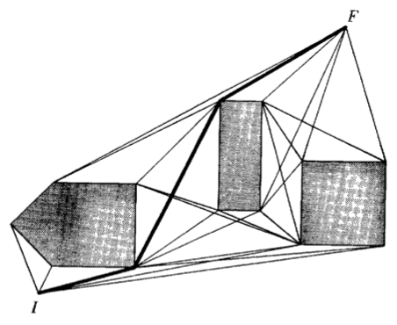
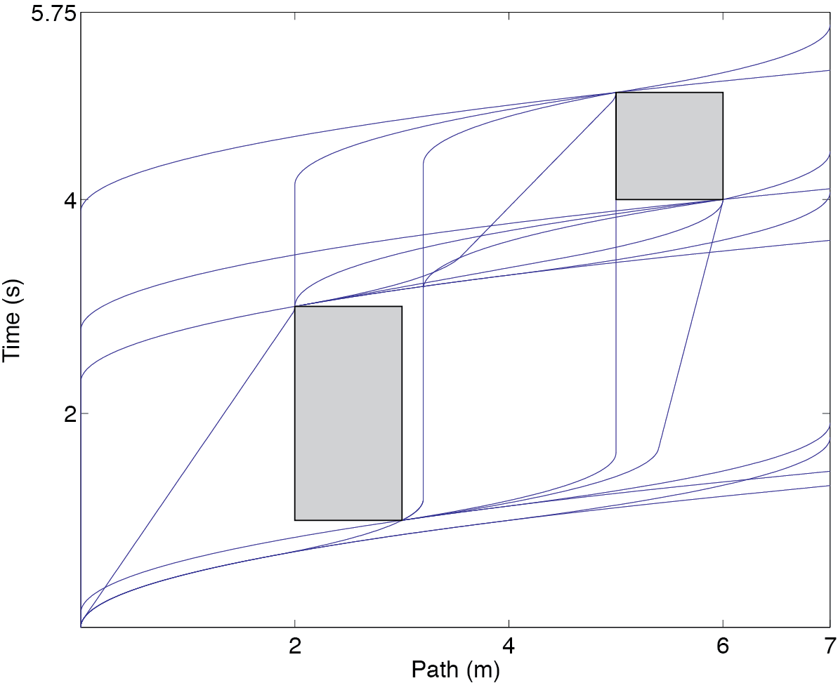
Our Contribution
We extend the work of Kant and Zucker to incorporate acceleration constraints into velocity planning
Visibility graph with unbounded accelerations
Visibility graph with bounded accelerations
Notes:
Kant and Zucker approached the problem by constructing a visibility graph of feasible trajectories that disregarded acceleration bounds. If you limit the problem to only consider velocity constraints, the trajectories you get are defined in a piece-wise linear fashion, and you’ll note here that the slope at a given point of the trajectory defines the velocity at that point. You can see that if acceleration constraints are disregarded the trajectories have discontinuities in their first derivative, which means the agent experiences infinite acceleration at those points. The image on the left displays such trajectories for some arbitrary obstacles. We extended this construction to incorporate acceleration bounds, and so can plan curved trajectories that respect those bounds. We extend the path-time space to include a velocity dimension, and we augment the visibility graph to contain information about reachable sets of velocities.

Slide 9
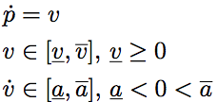
Problem Definition
Problem:
Plan an optimal, collision-free trajectory along a given path in the presence of dynamic obstacles that satisfies velocity and acceleration constraints:
Main Assumptions:
Constraints are path-independent
Obstacle behavior is known
Agent behavior does not affect obstacle behavior
Agent does not move in reverse
Agent can accelerate, coast, decelerate

Slide 10
Summary of Planner Operation
Incrementally compute reachable velocity intervals at obstacle vertices
Construct visibility graph iteratively, merging reachable intervals at each iteration
Recover a time-optimal trajectory from resulting visibility graph

Slide 11
The Planner
Incrementally compute reachable velocity intervals at obstacle vertices
Construct visibility graph iteratively, merging intervals at each iteration
Recover a time-optimal trajectory from resulting visibility graph

Slide 12
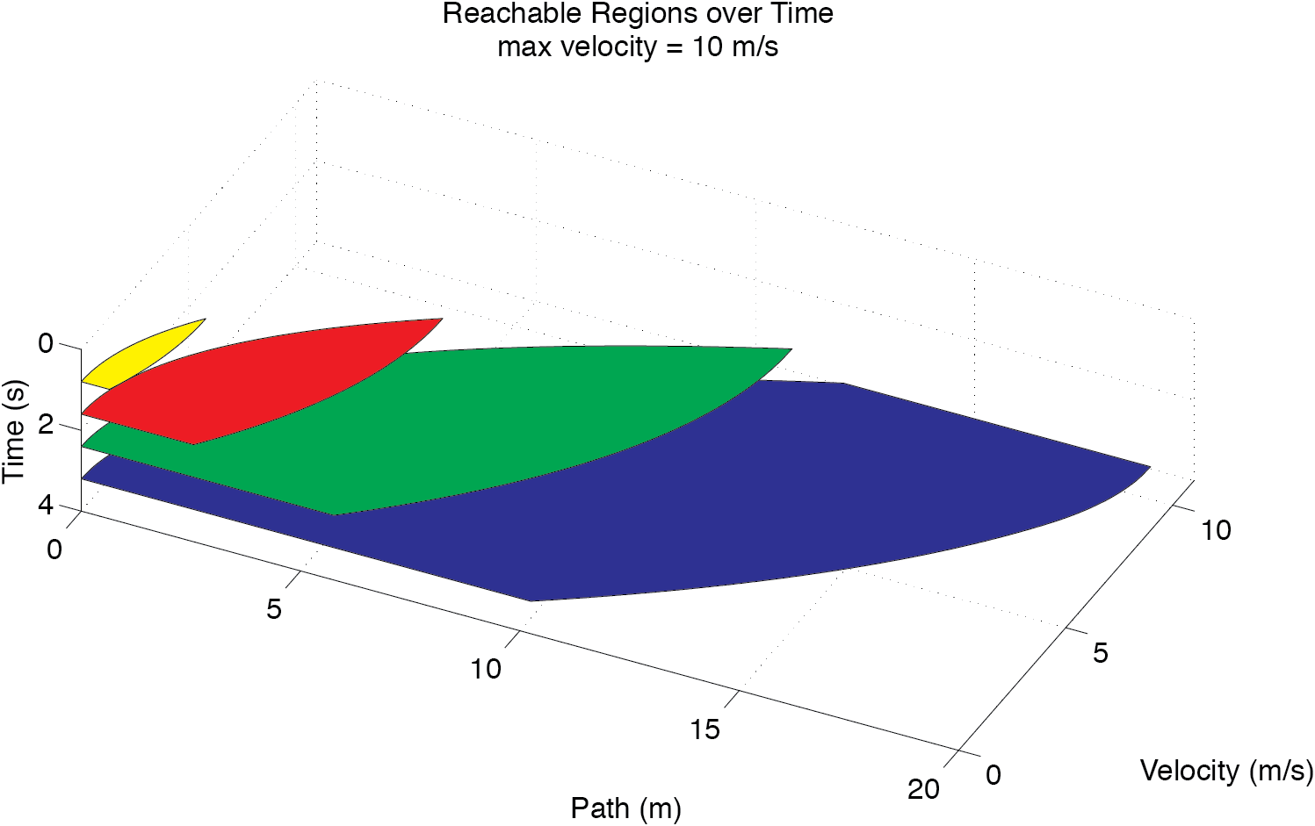
Reachable Regions in Path-Velocity-Time Space with bounded Acceleration
Parabolic boundaries due to acceleration constraints
Linear boundary due to velocity constraint
Notes:
Let’s look at the path-time space augmented with a velocity dimension. If you start at the origin, given constraints on your velocity and acceleration, the region of this path-velocity-time space that is reachable grows over time. This plot shows four slices of that region at different four different times. This reachable region in the space has two types of boundaries: parabolic boundaries, due to the acceleration constraints, and linear boundaries due to the velocity constraints. Here you can see the linear boundaries at 0 and 10, and the parabolic boundaries on either side.

Slide 13
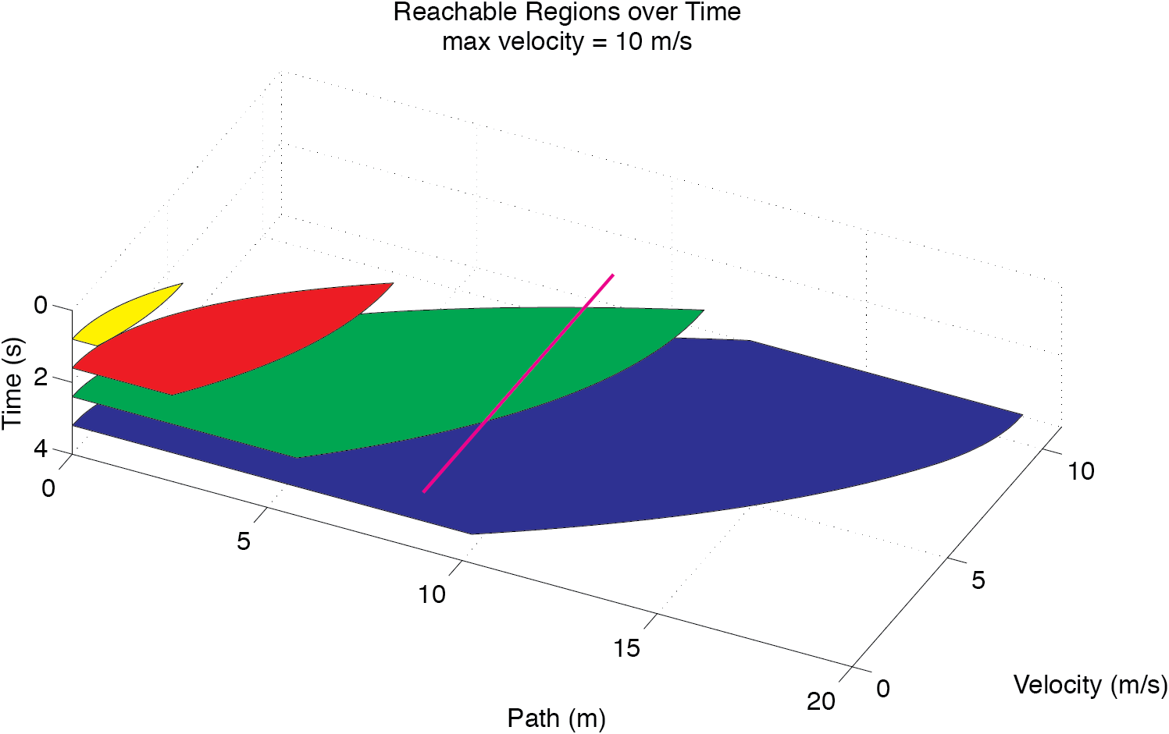
Reachable Regions in Path-Velocity-Time Space with bounded Acceleration
Reachable velocity interval at path-time point
The reachable velocity interval is convex
Notes:
Now consider some point on the path-time plane shown here in white, and the line that can be formed by fixing the path and time coordinates and allowing the velocity to vary shown here in red. What you can see is that this line intersects the reachable region in path-velocity-time space. So at that point, the reachable set of velocities are exactly those contained on the intersecting line segment. This means that we can compute the reachable set of velocities under acceleration constraints at any point by computing this intersection. You’ll notice also that the reachable interval is convex; and, in fact, we show in the paper that it is always convex. This means that we can compute the entire interval by simply computing its extrema.

Slide 14
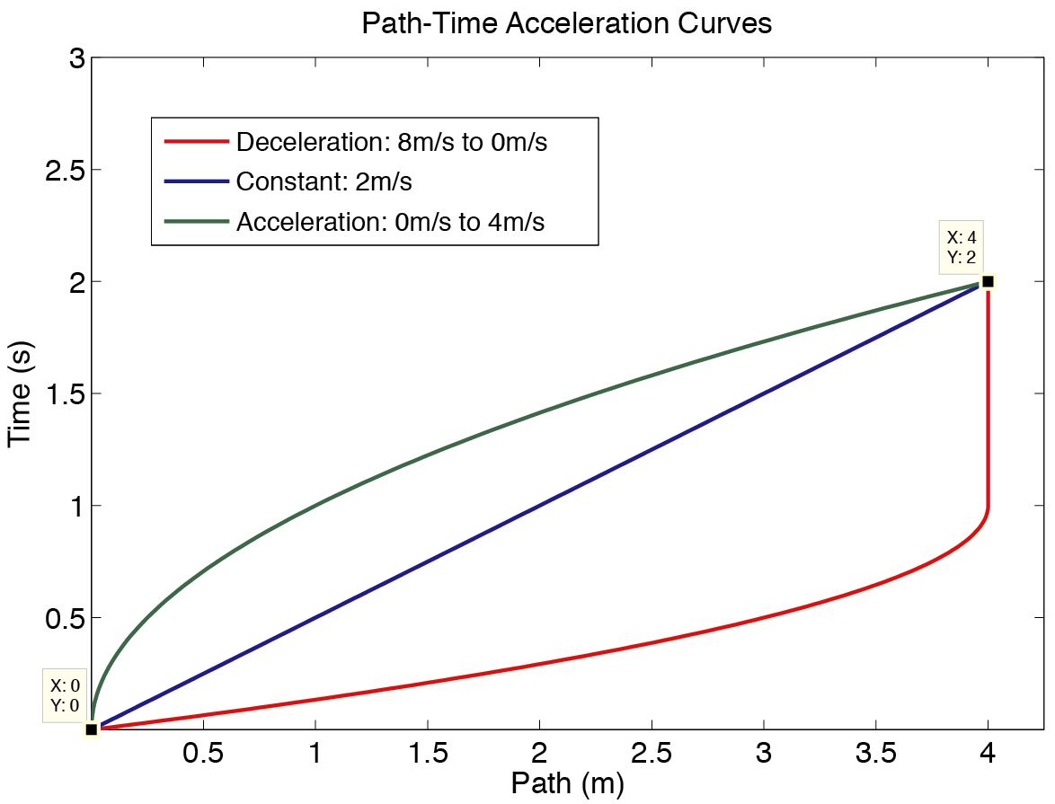
Velocity Interval Propagation Subroutine
Given
Start PT point
Goal PT point
Start velocity range [a,b]
Outputs
Reachable end velocities [c,d] in absence of obstacles
Upper and lower trajectories for collision checking
Notes:
We do that with a Velocity Interval Propagation sub-routine, which forms the backbone of the planner. Just looking at the path-time projection, let’s say you start at the origin with some initial range of velocities. To compute the set of velocities reachable another point in the space, (4,2), in this case, we need only compute the bounds of the reachable velocity set.

Slide 15
Feasible Curves in Path-Time Channels
O’Dunliang (1983)
Given an upper and lower bounding curve, the set of all feasible acceleration-bounded trajectories connecting p₁ to p₂ is a convex set
Moreover, the velocity extrema at the endpoint summarize all the trajectories passing through that point
Notes:
So what happens when obstacles come into the mix?

Slide 16
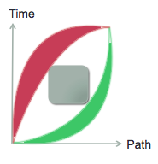
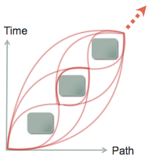
Reachable Regions with Obstacles
In the presence of obstacles each channel of free space contributes a convex interval to the reachable velocity set at the goal point
Thus, to compute all reachable sets of velocities, one could simply enumerate over all channels…
2 channels…
but…
However: Potentially 2^{n} unique channels!

Slide 17
The Planner
Incrementally compute reachable velocity intervals at obstacle vertices
Construct visibility graph iteratively, merging intervals at each iteration
Recover a time-optimal trajectory from resulting visibility graph

Slide 18
Velocity Interval Merging
Goal
Time
Reachable sets of velocities may be disjoint due to channels
Start
Path
Notes:
Illustrate where intervals come from, also illustrate disjoint intervals

Slide 19
Velocity Interval Merging
Goal
Interval reachable from lower channel
Time
Interval reachable from upper channel
Start
If the intervals overlap, they can be merged
Path
Notes:
Illustrate where intervals come from, also illustrate disjoint intervals

Slide 20
Velocity Interval Merging
Goal
Only the merged interval must be propagated, not the original two
Time
Theorem: The maximum number of disjoint merged intervals at a given point is effectively constant. Therefore, merging reduces complexity from EXP to P
Start
Path

Slide 21
Graph construction
Non-trivial time-optimal trajectories must pass tangentially along upper-left or lower-right obstacle vertices -Y.-H. Liu & S. Arimoto (1992)
It suffices to search for trajectories at obstacle corners
A set of corner vertices with a set of reachable velocities provides enough information to recover the trajectories that pass through those points
Computing reachable velocities at all corners allows recovery of a time-optimal trajectory
Notes:
Now we can do velocity interval propagation both in free space and obstructed space, and it remains only determine how to direct propagation. It turns out that time-optimal trajectories must must either connect directly to the goal, in which case they are trivial, or they must pass tangentially along upper-left or lower-right obstacle vertices.

Slide 22
The Planner
Incrementally compute reachable velocity intervals at obstacle vertices
Construct visibility graph iteratively, merging intervals at each iteration
Recover a time-optimal trajectory from resulting visibility graph

Slide 23
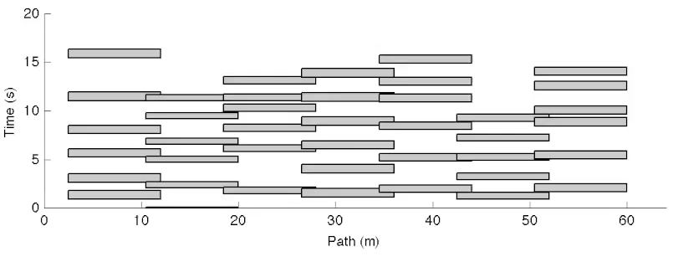
Stepping through the Planner -- Video
Notes:
This video belies the speed of the planner; the actual amount of computation time spent on this problem was about 45 milliseconds.

Slide 24
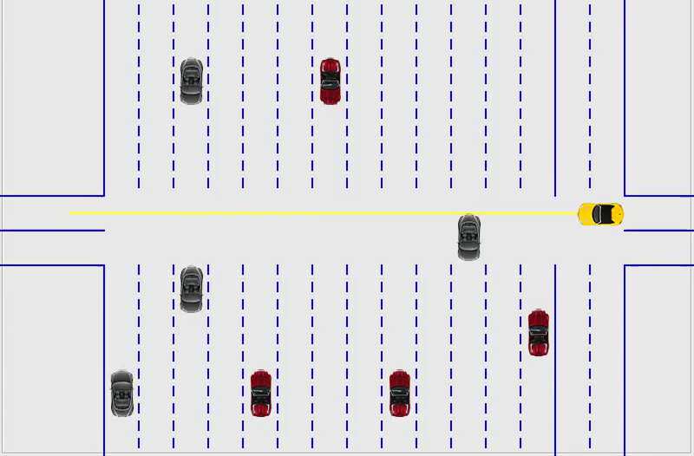
Demonstration -- Planner
Notes:
Now let’s look at the same scene in simulation. Here our driver is trying to cross thirteen lanes of traffic unaided by traffic lights. Hopefully a real driver will never have to do this, but the complexity of the scenario demonstrates the power of the planner. The yellow car here will execute the trajectory discovered by the planner on the previous slide in order to traverse the lanes safely.

Slide 25
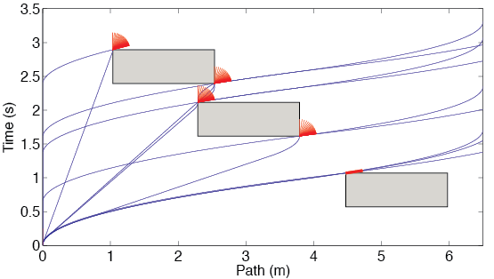
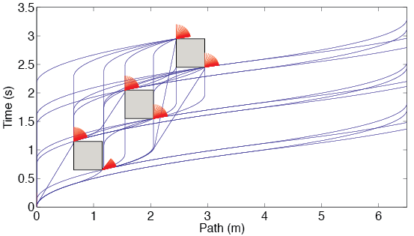
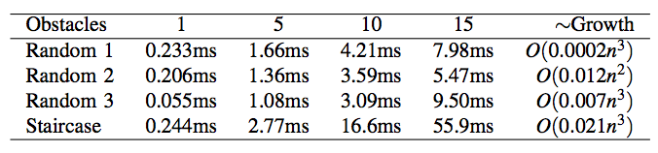
Properties
Random
Config.
Exact and time-optimal
Time complexity O(n⁴)
Space complexity O(n²)
n: number of obstacle corners
Empirical results:
Scaling ~ O(n³)
Fast computation times standard PC
Staircase
Config.

Slide 26
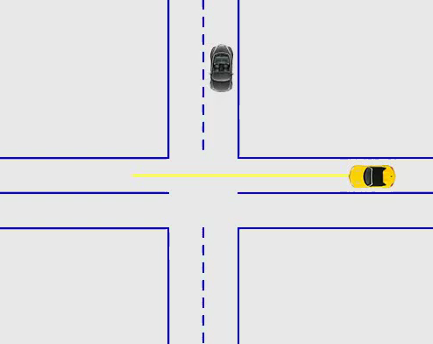
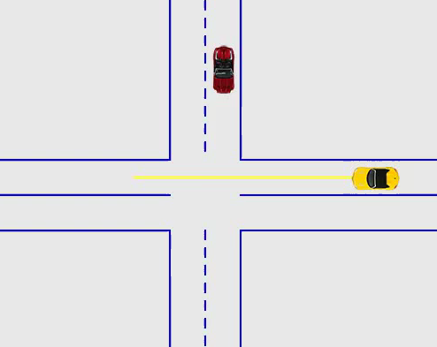
Demonstration – Collision Avoidance
Driver input only
With collision avoidance

Slide 27
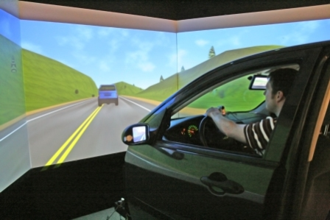
Conclusion
Summary
Presented a poly-time algorithm for trajectory planning
Demonstrated complexity analysis and scalability
Paper/code available: http://www.indiana.edu/~motion/pvtp/
Future Work
Obstacle generation for uncertain obstacle behavior
Further work in collision avoidance
Study human reactions to collision avoidance systems
This work is partially supported by the Indiana University Collaborative Research Grant fund of the Office of the Vice President for Research.
The DriveSafety DS-600c Driving Simulator at TASI

Slide 28
Questions?

