Slide 1










$$x(q)$$
$$L_{2}$$
$$q_{2}^{B}$$
$$q_{2}$$
$$L_{1}$$
$$q_{1}^{A}$$
$$q_{1}$$
$$x_{D}$$
$$q_{1}^{B}$$
$$q_{2}^{A}$$
(a)
(b)
(c)

Slide 2







$$\left\|x(q)\right\|=\left\|x_{D}\right\|$$
$$q_{2}^{A}$$
$$x_{D}$$
$$q_{1}=0$$
$$q_{1}^{B}$$
$$q_{1}^{A}$$
$$q_{2}^{B}$$
(a)
(b)
(c)

Slide 3
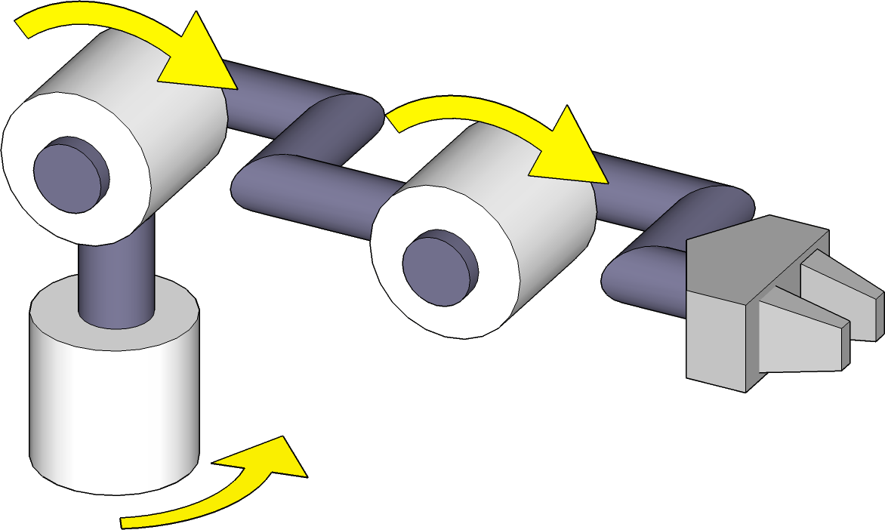












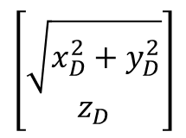





$$q_{2}$$
$$q_{3}$$
$$d$$
$$q_{3}$$
$$y$$
$$z$$
$$\left[\begin{matrix}\sqrt{x_{D}^{2}+y_{D}^{2}} \\ z_{D}\end{matrix}\right]$$
$$\left[\begin{matrix}x_{D} \\ y_{D}\end{matrix}\right]$$
$$q_{2}$$
$$L_{1}$$
$$L_{2}$$
$$q_{1}′$$
$$q_{1}$$
$$L_{1}$$
$$L_{3}$$
$$x$$
$$d$$
$$q_{1}$$
(a)
(b)
(c)

Slide 4
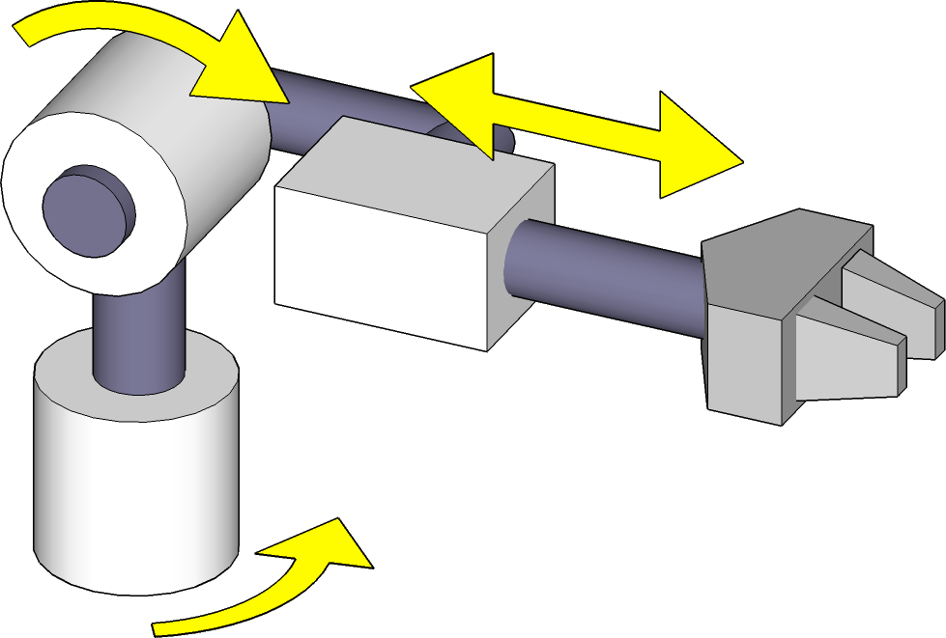


$$q_{2}$$
$$L_{1}$$
$$q_{3}$$
$$q_{1}$$

Slide 5
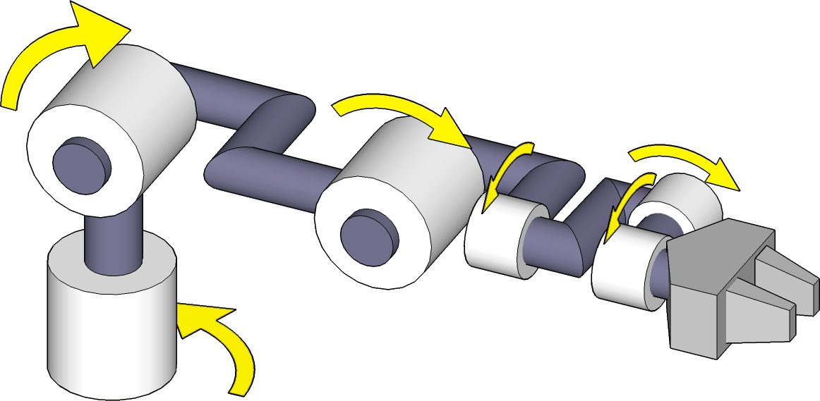























$$q_{2}$$
$$q_{3}$$
$$q_{4}$$
$$q_{5}$$
$$q_{6}$$
$$L_{1}$$
$$L_{2}$$
$$q_{1}$$
$$L_{3}$$
$$L_{6}$$
(a)
$$T_{tcp}$$
$$R_{3}$$
$$R_{4}$$
$$R_{5}$$
$$R_{6}$$
$$L_{2}$$
$$x$$
$$L_{3}$$
$$T_{6}$$
$$L_{6}$$
$$y$$
$$L_{1}$$
$$x$$
(b)
(c)

Slide 6












$$\frac{∂x}{∂q_{1}}(q)$$
$$\dot{q_{1}}\frac{∂x}{∂q_{1}}(q)$$
$$x(q)$$
$$J\left(q\right) \dot{q}$$
$$\frac{∂x}{∂q_{2}}(q)$$
$$q_{2}$$
$$\dot{q_{1}}$$
$$\dot{q_{1}}$$
$$\dot{q_{2}}$$
$$\dot{q_{2}}$$
$$q_{1}$$
$$\dot{q_{2}}\frac{∂x}{∂q_{2}}(q)$$

Slide 7

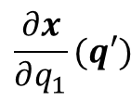


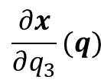


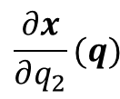

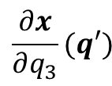
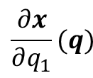


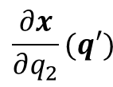
$$\frac{∂x}{∂q_{1}}(q)$$
$$\frac{∂x}{∂q_{2}}(q)$$
$$q_{3}$$
$$\frac{∂x}{∂q_{3}}(q)$$
$$q_{2}$$
$$q_{1}$$
$$x(q)$$
(a)
$$q_{3}^{′}$$
$$q_{2}^{′}$$
$$\frac{∂x}{∂q_{2}}(q′)$$
$$\frac{∂x}{∂q_{1}}(q′)$$
$$q_{1}^{′}$$
$$\frac{∂x}{∂q_{3}}(q′)$$
$$x(q′)$$
(b)

