Slide 1
Named Entity Recognition
IS407 Intro to Data Science

Slide 2
What we will discuss today
Section-1: Introduction
Section-2: Approaches
Section-3: Implementation in Python
Section-4: What lies ahead?
Section-5: Further References

Slide 3
Introduction
What is NER?
Named entity recognition (NER) is an NLP based technique to identify and assign labels named entities in text
Labels like a person, location, organisation, product etc.
What is a Named entity?
A real world object (such as a person, location, organization, product, etc.,) that can be denoted with a proper name.

Slide 4
Named Entities
Examples:
Facebook - <organization>
Spanish - <language>
Bill Gates - <person>
Grainger Engineering Library - <location>

Slide 5
Use Cases
Document Categorisation
Tracking mentions of particular entities in documents
For question answering, answers are usually named entities
Extracting wanted information using named entities
Support Chatbots
NER for Medical Purposes

Slide 6
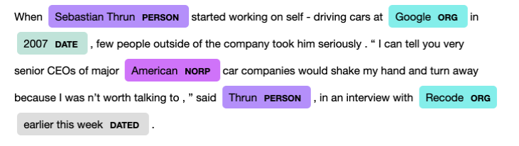
Results
Below is an screenshot of how a NER algorithm can extract particular entities from a given text:

Slide 7
Intuition: Example Sentence
'European authorities fined Google a record $5.1 billion on Wednesday for abusing its powers'

Slide 8
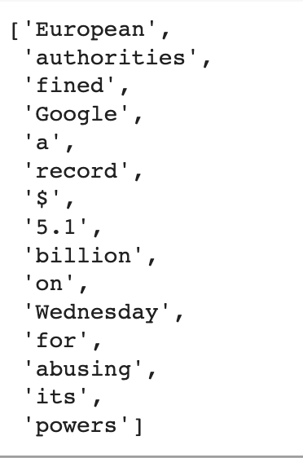
Step-1: Tokenize

Slide 9
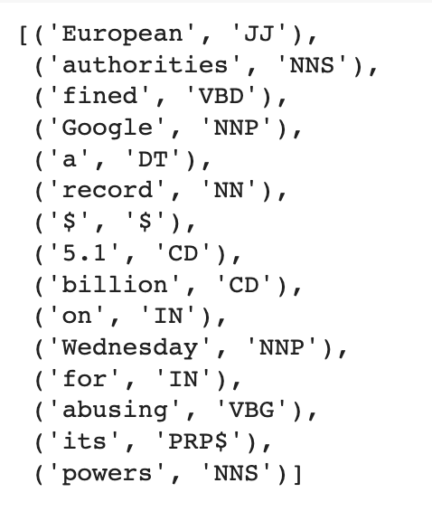
Step-2: Part-of-Speech(POS) Tagging
POS tags list

Slide 10

Step-3: Chunking Noun Phrases
Identify named entities using a regular expression(regex)
Regex rules indicate how sentences should be chunked
Our chunk pattern consists of one rule, that a noun phrase, NP, should be formed whenever the chunker finds an optional determiner, DT, followed by any number of adjectives, JJ, and then a noun, NN.

Slide 11
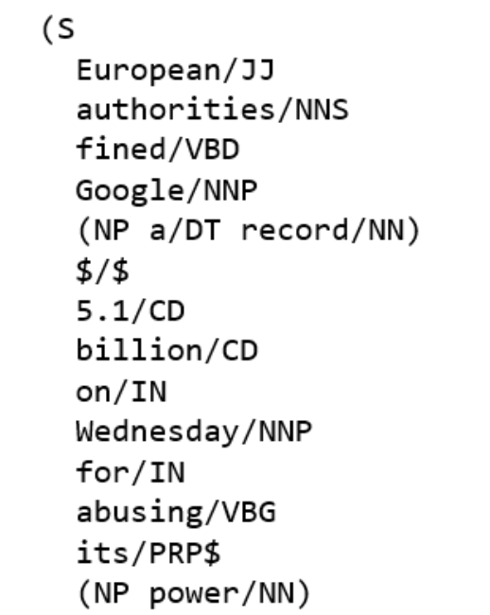
Step-4: Add category labels to named entities

Slide 12
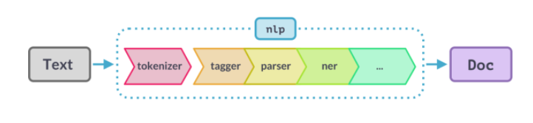
SpaCy’s Pipeline

Slide 13
Section-2 Approaches
A. Traditional approaches :
Rule-based solutions: have an obvious flaw, i.e. they require a well-defined and exhaustive lexicon set
Feature-based supervised machine learning approaches: requires carefully hand-crafted features like lookup list, case/morphology/POS tag etc to make it work.
B. Deep Learning-based models
Training Neural Network models for NER
Rather than training models from scratch, the new paradigm in NLP is to select an off-the-shelf model that has been trained on the task of “language modelling” (predicting which words belong in a sentence), then “fine-tuning” the model with data from your specific task.

Slide 14
Section-3: Implementation
Let’s jump to experiment notebook

Slide 15
Section-4: What’s next for you?
Advanced courses at UIUC
IS 567 - Text Mining
CS 447 - Natural Language Processing
CS 410 - Text Information Systems
CS 510 - Advanced Information Retrieval
CS 542 - Advanced topics in NLP

Slide 16
Section-5: References for further study
R book with chapters and examples with NER （need university library to access）
https://learning.oreilly.com/library/view/mastering-text-mining/9781783551811/ch07.html#ch07lvl1sec41
https://learning.oreilly.com/library/view/mastering-text-mining/9781783551811/ch07s03.html#ch07lvl3sec59

Slide 17
Implementation in R
https://www.analyticsvidhya.com/blog/2021/06/nlp-application-named-entity-recognition-ner-in-python-with-spacy/#:~:text=Spacy%20is%20an%20open%2Dsource,very%20easily%20for%20NER%20tasks.
https://towardsdatascience.com/named-entity-recognition-ner-using-spacy-nlp-part-4-28da2ece57c6
https://towardsdatascience.com/custom-named-entity-recognition-using-spacy-7140ebbb3718
https://medium.com/in-pursuit-of-artificial-intelligence/named-entity-recognition-using-spacy-ner-da6eebd3d08
https://nanonets.com/blog/named-entity-recognition-with-nltk-and-spacy/
https://towardsdatascience.com/named-entity-recognition-with-nltk-and-spacy-8c4a7d88e7da
Notes:
This example follows this blog article: https://towardsdatascience.com/quick-guide-to-entity-recognition-and-geocoding-with-r-c0a915932895

Slide 18
Questions/comments?

