Slide 1

CS 512: Computer Vision - Spring 2025
EfficientViT: Memory Efficient Vision Transformer with Cascaded Group Attention
Urjita Saxena (A20578349)
Arpitha Ramakrishnaiah (A20523821)

Slide 2


Introduction
What are Vision Transformers (ViTs)?
  Neural networks that process images as sequences of patches.
  Excel at capturing long-range dependencies.
Advantages of ViTs
  State-of-the-art performance on image classification tasks.
  Flexible architecture for various vision tasks.
Challenges
  High computational complexity (quadratic with input size).
  Large memory requirements, limiting use on resource-constrained devices.

Slide 3
Problem Statement
The Need
  Efficient ViTs are critical for deployment on edge devices (e.g., mobile phones, IoT).
  Traditional ViTs are resource-intensive, impractical for real-world applications.
Our Goal
  Implement EfficientViT to reduce memory and computational costs while preserving accuracy.

Slide 4
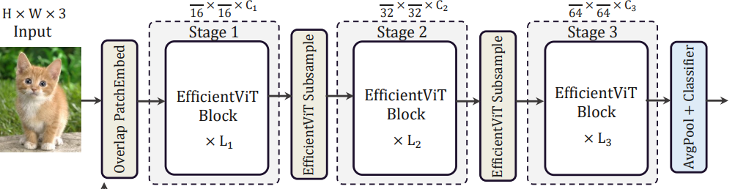
Proposed Solution – EfficientViT architecture
EfficientViT Overview A lightweight Vision Transformer designed for efficiency.
Key Innovations:
  Cascaded Group Attention (CGA).
  Sandwich layout of transformer blocks.

Slide 5
Cascaded Group Attention
What is CGA?
  Splits input features into groups for separate attention computation.
  Cascades attention across heads to enhance feature diversity.
Benefits
  Reduces memory usage and computational complexity compared to traditional self-attention.
Pseudocode
Input: Feature :map X
Split X into G groups: X_1, X_2, ..., X_G
For each group g:
Compute Q_g, K_g, V_g
Apply attention: A_g = softmax(Q_g * K_g^T) * V_g
Concatenate outputs: Y = [A_1, A_2, ..., A_G]
Output: Y

Slide 6
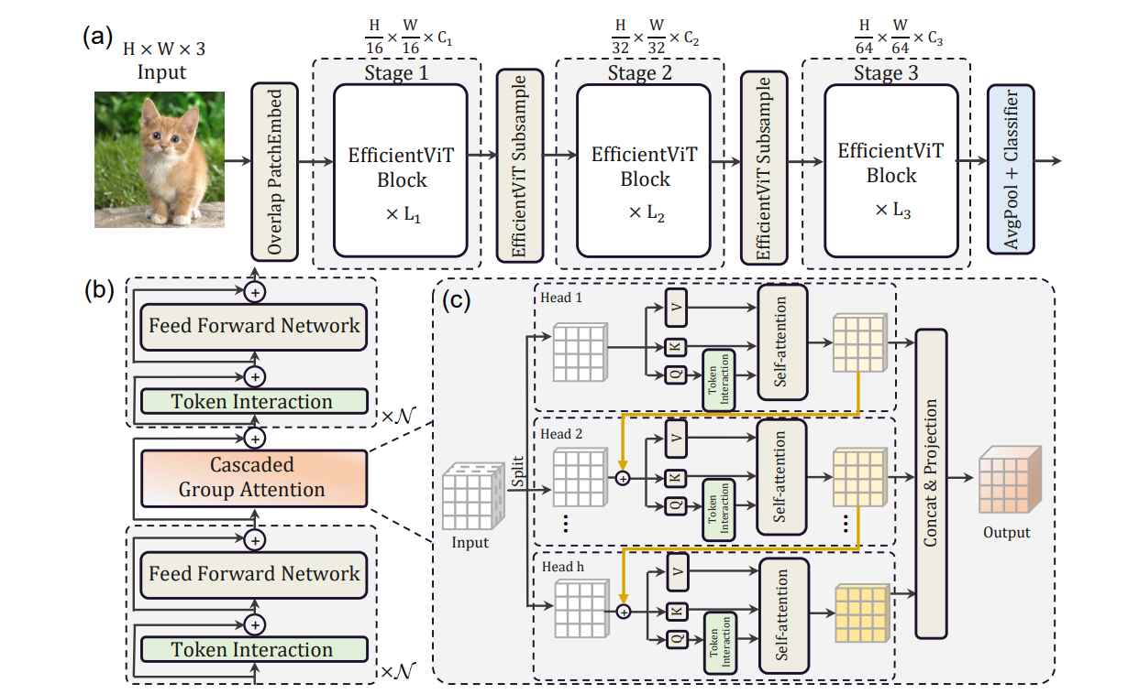
Sandwich Layout
Structure
  Transformer block layout: FeedForward (FFN) → CGA → FFN.
  Combines channel mixing (FFN) with efficient attention (CGA).
Advantages
  Reduces memory-bound operations.
  Improves efficiency without sacrificing performance.

Slide 7
Implementation Details
Key Components
  PatchEmbedding: Converts images into patch tokens.
  FeedForward: Two-layer MLP with GELU activation.
  CascadedGroupAttention: Implements CGA mechanism.
  EfficientViTBlock: Integrates FFN and CGA in sandwich layout.
Training
  Dataset: CIFAR-100 (100 classes, 32x32 images)
  Hyperparameters: 50 epochs, Adam optimizer, learning rate 0.001.
  Techniques: Data augmentation (random crop, flip)

Slide 8
Evaluation metrics
Performance Metrics
  Accuracy: Top-1 and Top-5.
  Precision, Recall, F1-score: Per-class analysis.
  AUC: Macro-average and per-class.
Visualization
  Confusion Matrix: Heatmap of predictions.
  Attention Maps: Visual insight into model focus.
Efficiency Metrics
  FPS (frames per second), FLOPs (floating-point operations), Parameter count.

Slide 9
Results
Top-1 Accuracy: 49% on CIFAR-100.
Efficiency: Lower FLOPs and parameters compared to MobileNetV3.
Comparison with Paper
  Paper: 70.8% Top-1 on ImageNet (EfficientViT-M2).
  Ours: Lower accuracy due to CIFAR-100 complexity and smaller model scale.
Discrepancies
  Used LayerNorm (vs. BatchNorm) for simplicity.
  Used GELU (vs. ReLU) for transformer compatibility.
  Equal Q/K/V dimensions, FFN ratio of 4 (vs. paper’s optimized settings).

Slide 10
Classification and efficiency metrics
Class | Precision | Recall | F1-score | AUC
Apple | 0.73 | 0.77 | 0.75 | 0.9943
Aquarium Fish | 0.46 | 0.69 | 0.55 | 0.9863
Baby | 0.51 | 0.47 | 0.49 | 0.9752
Bear | 0.25 | 0.42 | 0.31 | 0.9613
Macro Avg | 0.50 | 0.49 | 0.49 | -
Metric | EfficientViT-M2 | MobileNetV3-Large
FLOPs (M) | 201 | 217
Parameters (M) | 4.2 | 5.4
FPS (GPU) | 18,218 | 7,560
FPS (CPU) | 121.2 | 39.1

Slide 11
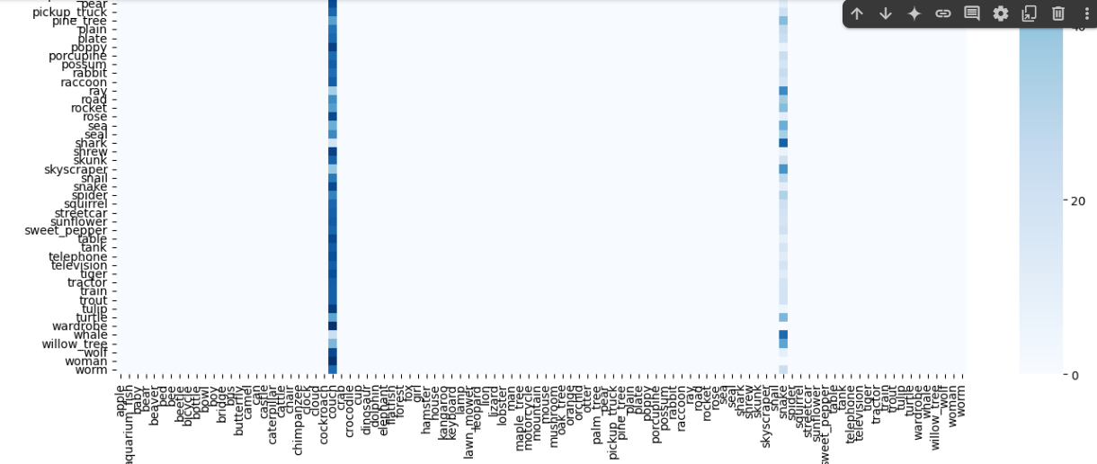
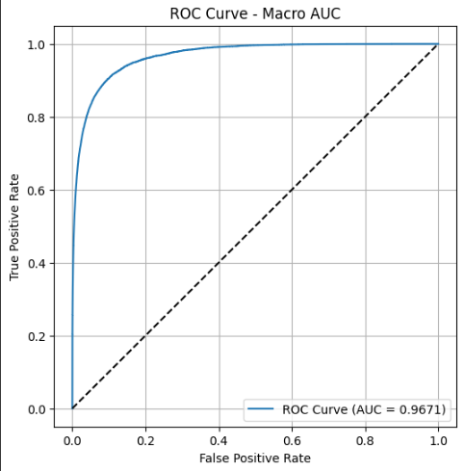
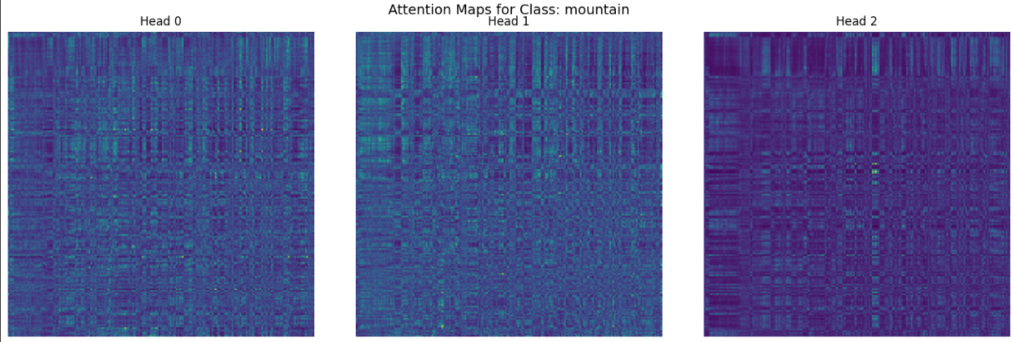
Results
  Confusion matrix
  Attention map
  AUC curve

Slide 12
Challenges
Technical Challenges
  - CGA implementation
  - Efficiency optimization
  - Dataset handling
Limitations
  - Lower CIFAR-100 accuracy
  - Suboptimal normalization/activation
  - Non-optimized parameters

Slide 13
Conclusion
Successfully implemented EfficientViT with CGA and sandwich layout.
Achieved reasonable performance on CIFAR-100 with reduced resource usage.
EfficientViT balances accuracy and efficiency for practical deployment.
Future Scope
  Experiment with BatchNorm and ReLU.
  Optimize Q/K/V dimensions and FFN ratio per the paper.
  Test on larger datasets like ImageNet.

Slide 14
References
Liu, X., et al. (2023). "EfficientViT: Memory Efficient Vision Transformer with Cascaded Group Attention." CVPR.
Dosovitskiy, A., et al. (2021). "An Image is Worth 16x16 Words." arXiv.
Krizhevsky, A., et al. (2009). "Learning Multiple Layers of Features from Tiny Images."

Slide 15
THANK YOU

