Slide 1

OOAD PROJECT
CONFIDENTIAL QR CODE COMMUNICATOR
Submitted to : Dr. Namita Mittal
Team efforts of Gunjan, Chaman and Ujesh

Slide 2
Functionality
Converting text to QR code (image)
Sending QR code to remote receiver
Receiver on receiving QR code displays text with live feedback
Final QR code gets automatically saved on receiver side
Convert any QR code to text
Encryption prevents any kind of security breach

Slide 3
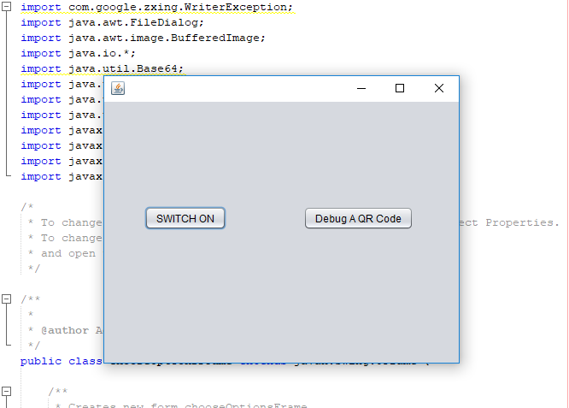
Client side features
Client can switch ON its device to connect to server
It can also Decrypt a QR code to text

Slide 4
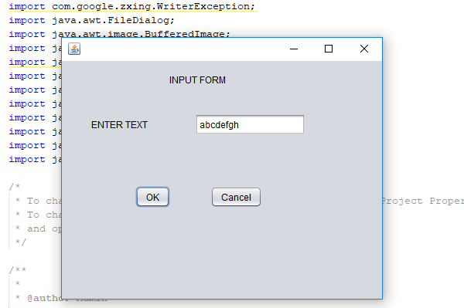
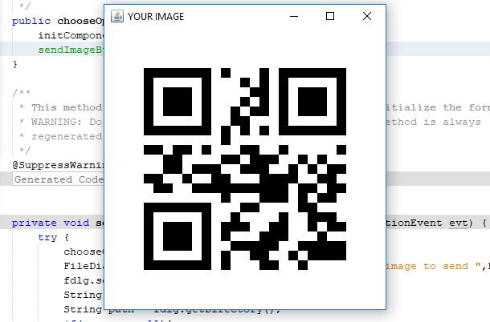
Converting text to QR code
Enter any text on server side input form
The same text can be received on client side
Encrypted QR code is also generated and saved on client side

Slide 5
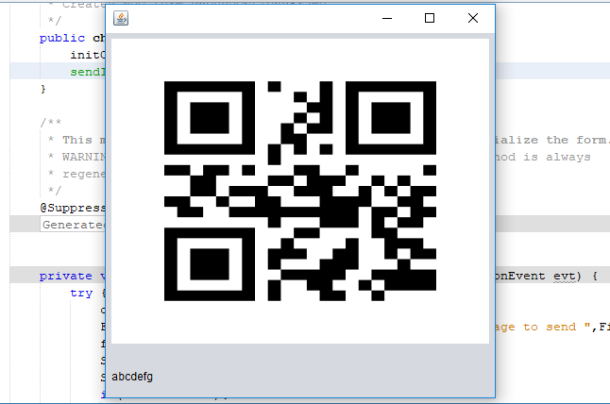
Live feedback on receiver side

Slide 6
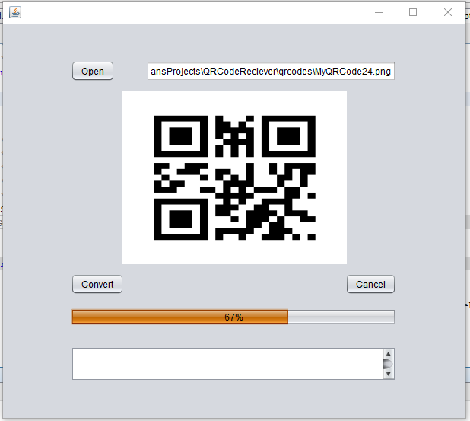
Convert any QR code to text

Slide 7
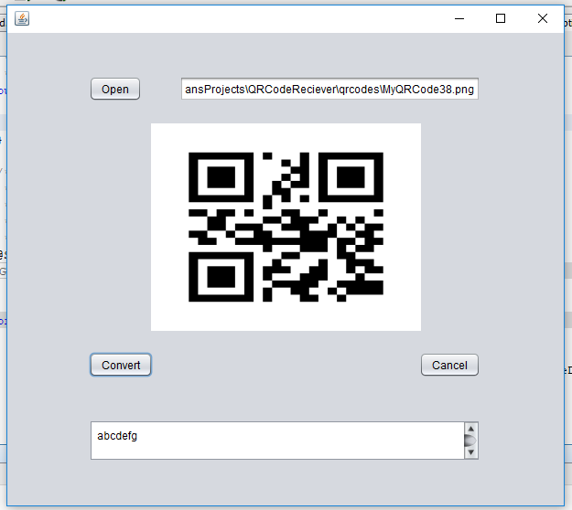
QR code gets saved on client side

Slide 8
Classes used in Server side
Encrypt
encryptText()
decryptText()
QRCodeGenerator
generateQRCodeImage()
Sender
Communicate()
ItemSend (implements Serializable)
getImageByte()

Slide 9
Classes used in Client Side
Encrypt
encrytText(), decryptText()
QRCodeSimplifier
getQRText()
Receiver
setQRImageFrame(), getQRImageFrame()
communicate()
ItemSend
getImageByte()

Slide 10
Frames Functionality
ChooseOptionFrame (extends Jframe)
sendTxtBtnActionPerformed()
QRImageFrame (extends Jframe)
QRImageFrame(Constructor)

Slide 11


