Slide 1
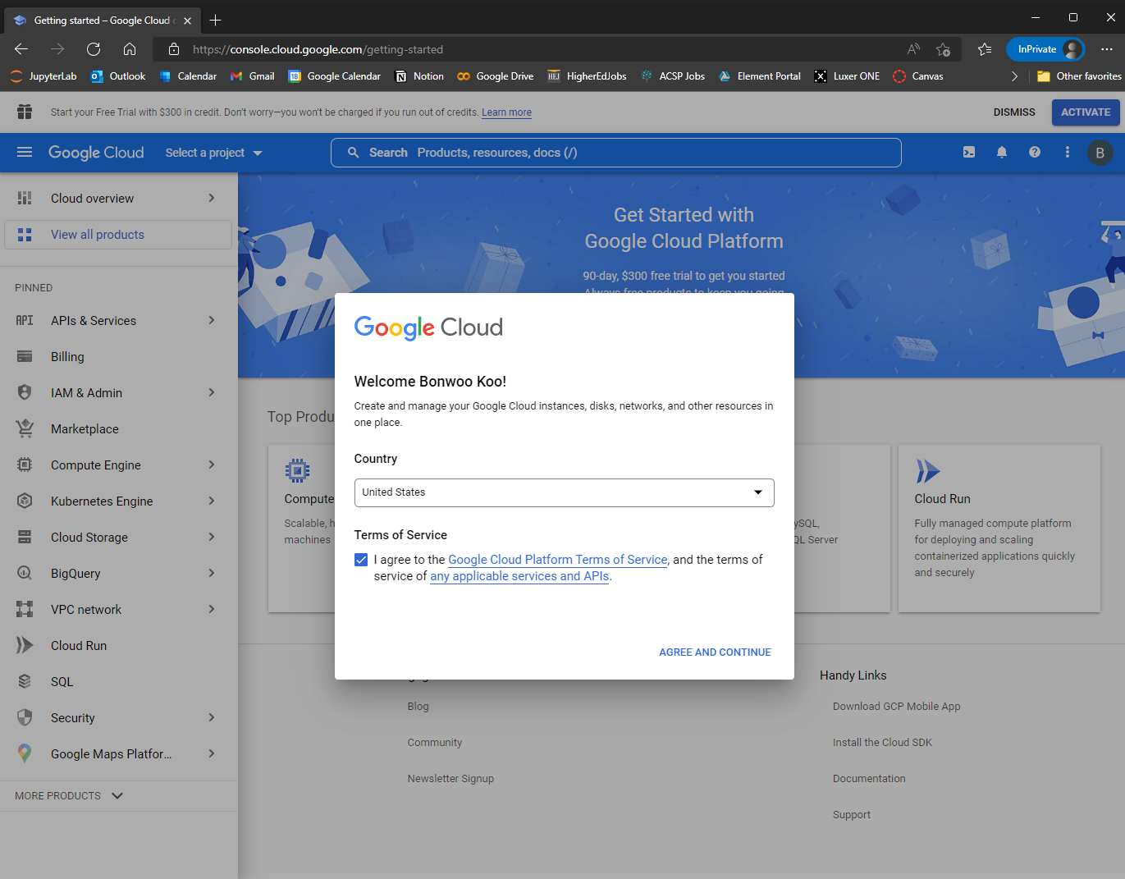
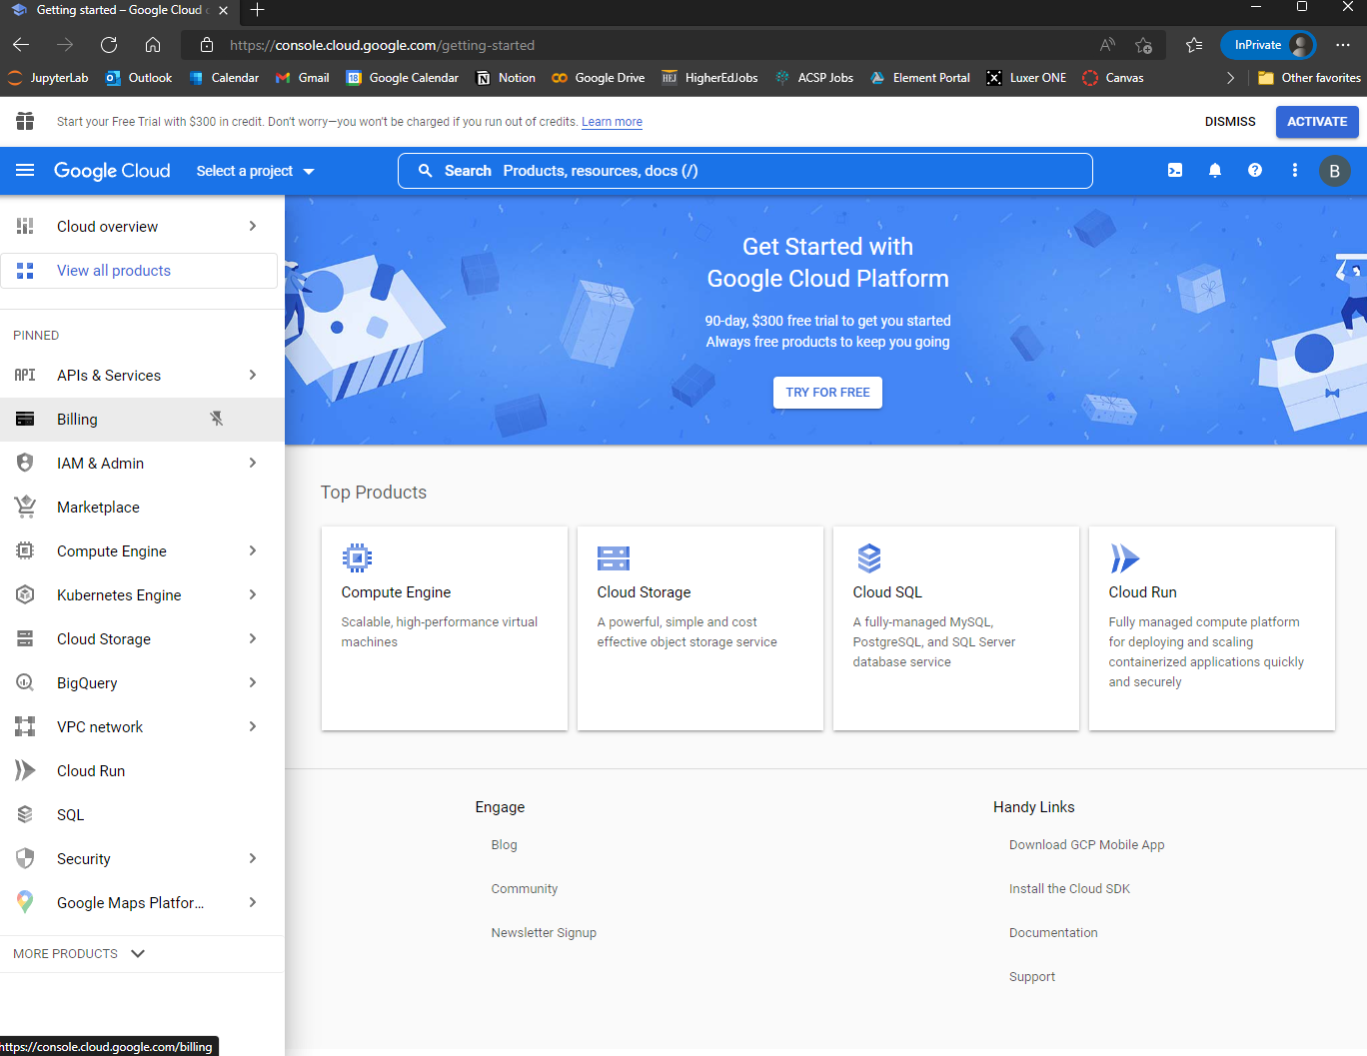
Search ‘google cloud console.’
If asked, log in using your google credential.
You will land on a page that looks like ->>
Select County & Agree and continue.
Select the 3-strip button.
click
click

Slide 2
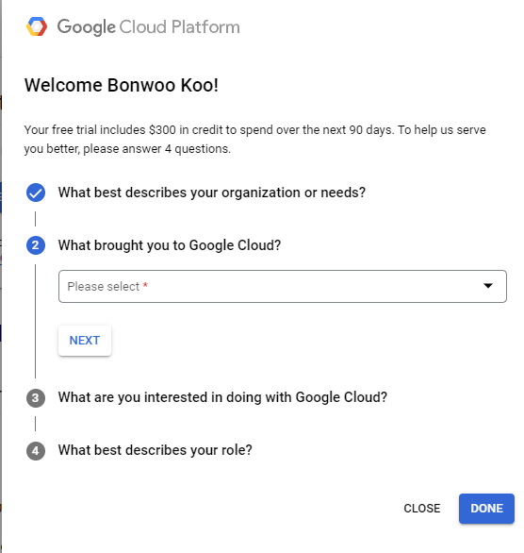
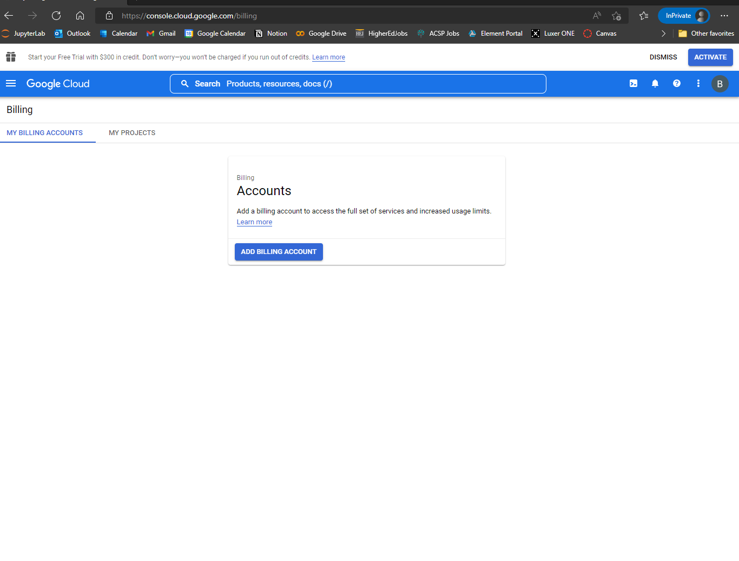
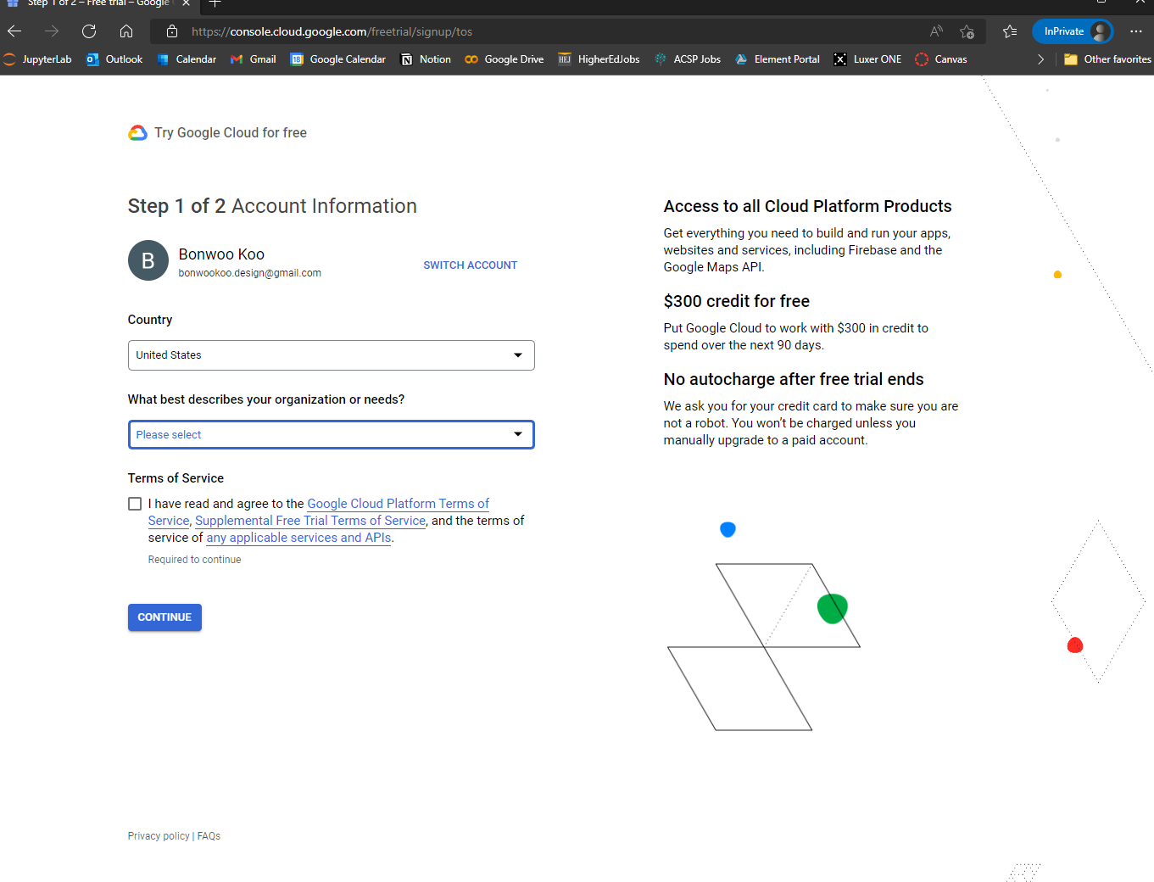
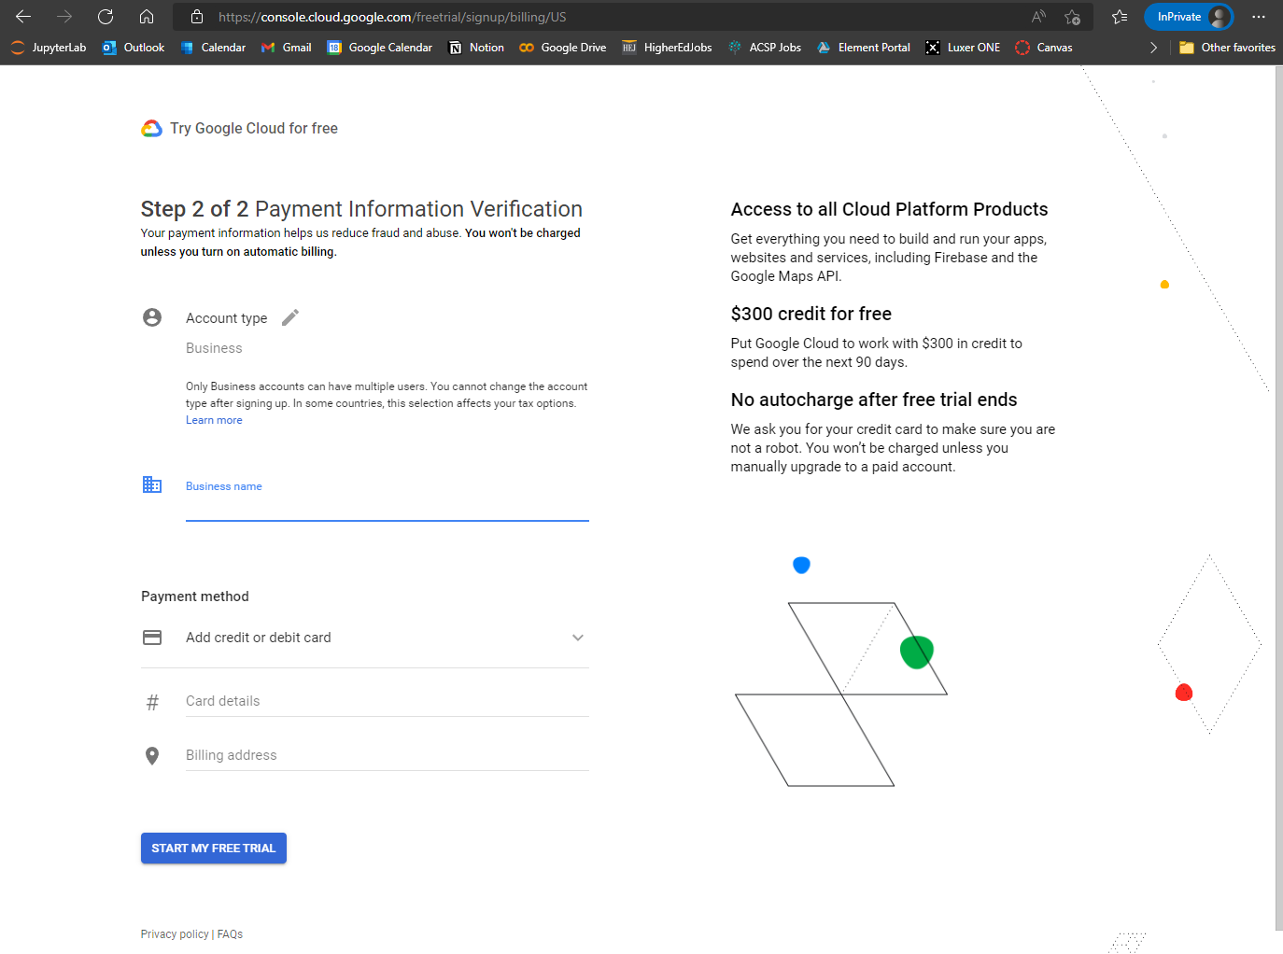
In Billing tab, click ADD BILLING ACCOUNT.
On the page that says “Step 1 of 2 …”, fill out the forms as shown on the right and CONTINUE.
On the page that says “Step 2 of 2 …”, complete the form and click START MY FREE TRIAL.
You will see a survey. You can close it.
Click
Select
Fill out
Click

Slide 3
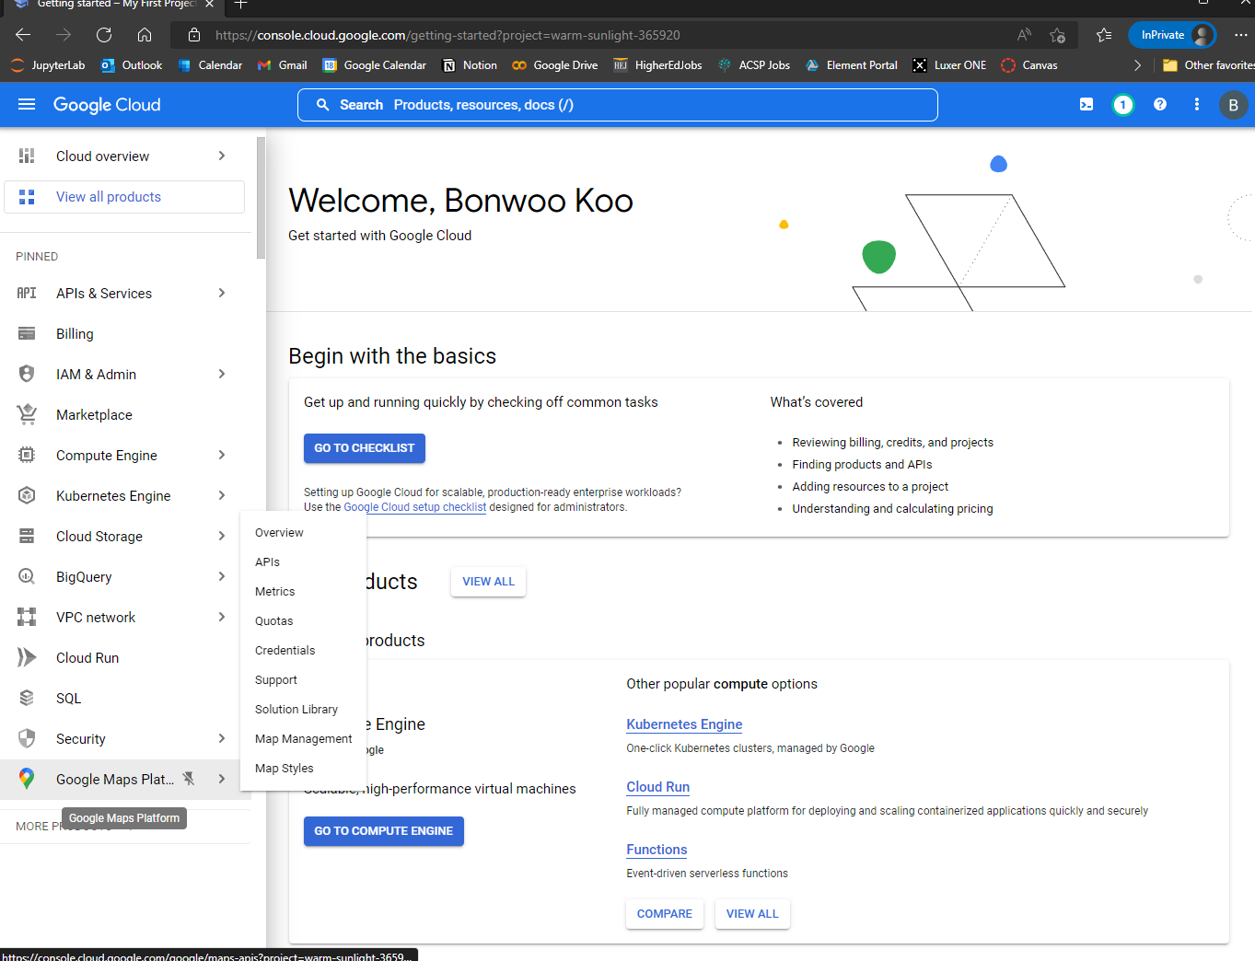
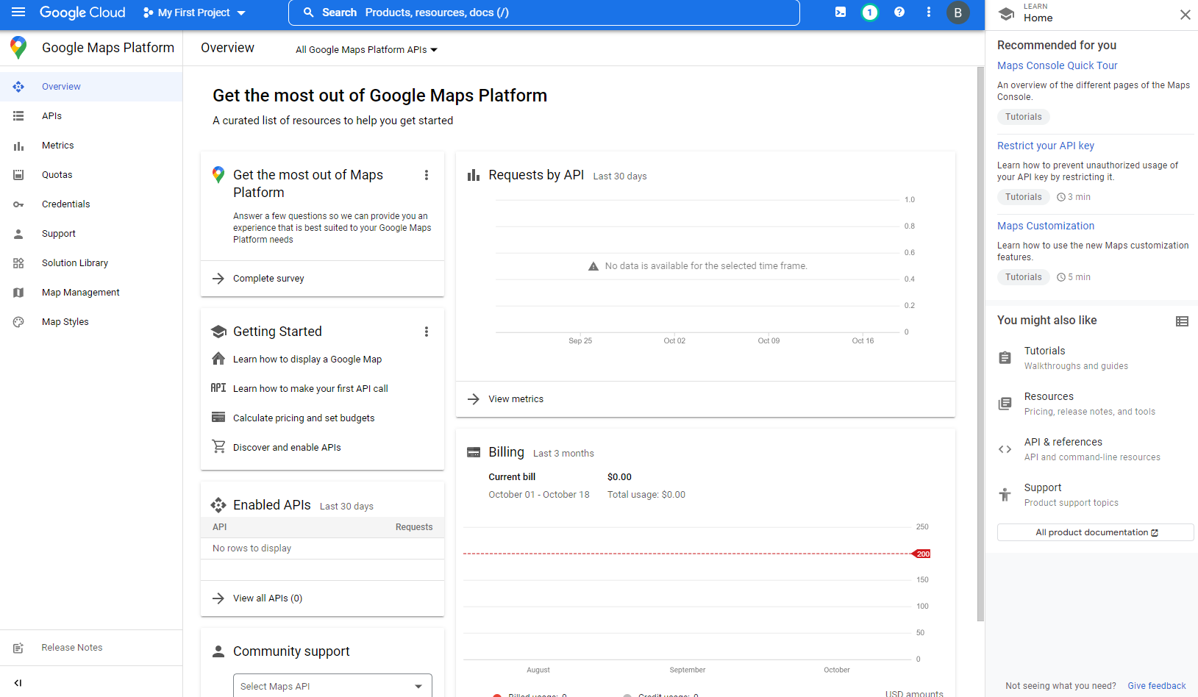
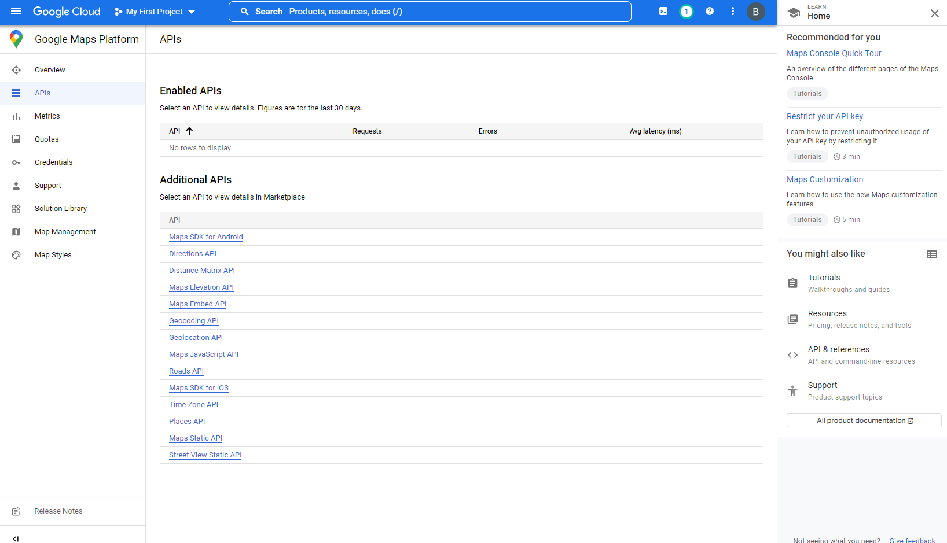
Now, from the 3-strip menu, look for Google Maps Platform and click it.
If you are on a page that looks like the second image, click APIs. You will see a page like the third image.
Under Additional APIs, click Street View Static API.
Click
Click
Click

Slide 4
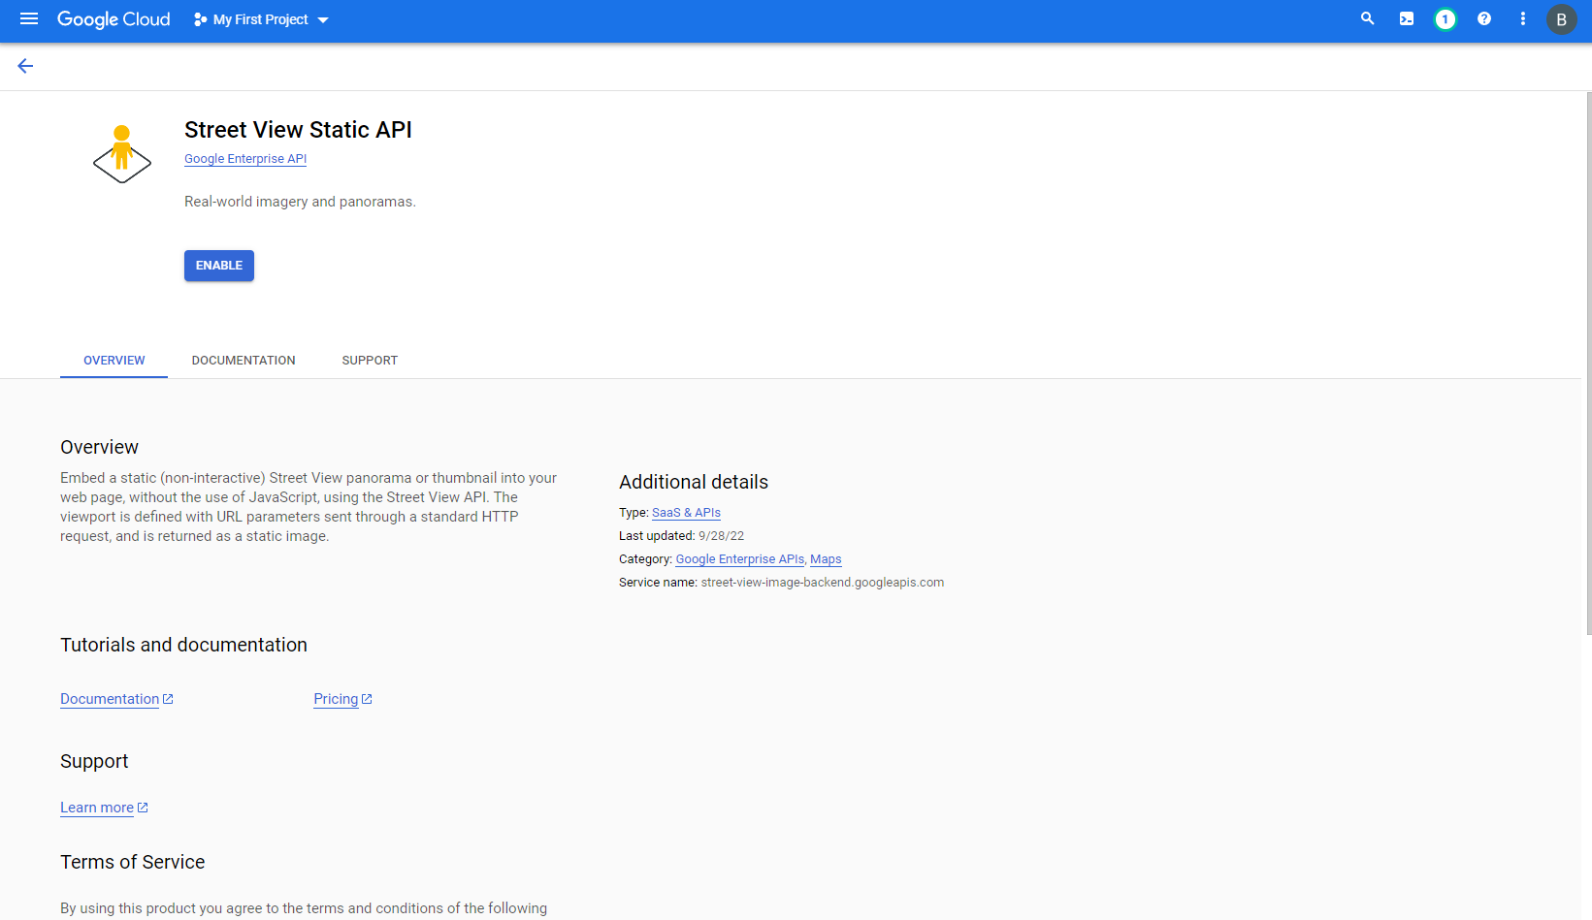
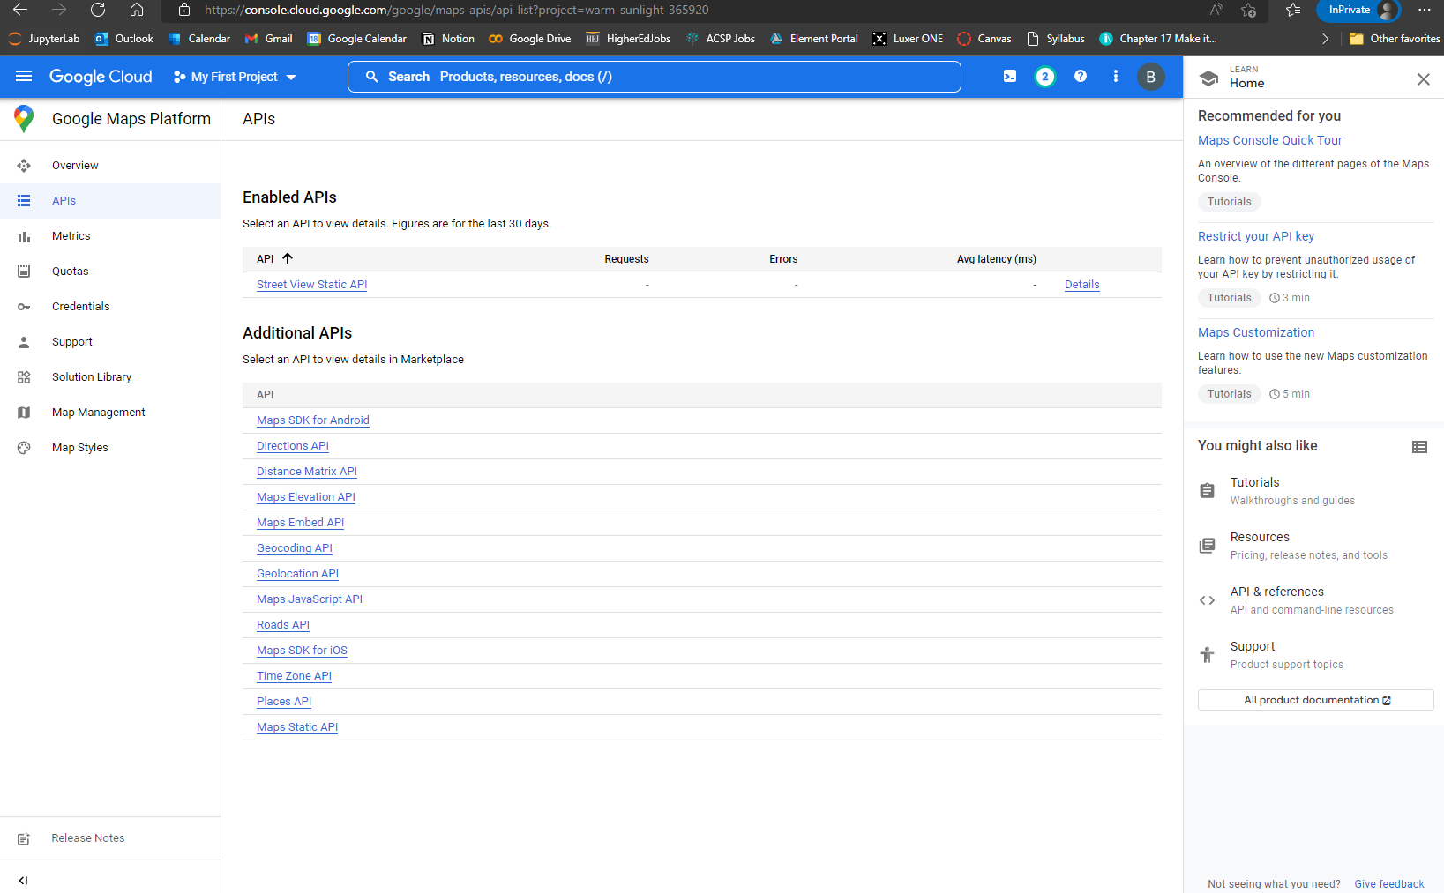
You will see a page like the first image. Click ENABLE.
You will be redirected back to the previous page. Make sure that Steet View Static API is now under Enabled APIs.
Click
Make sure

Slide 5
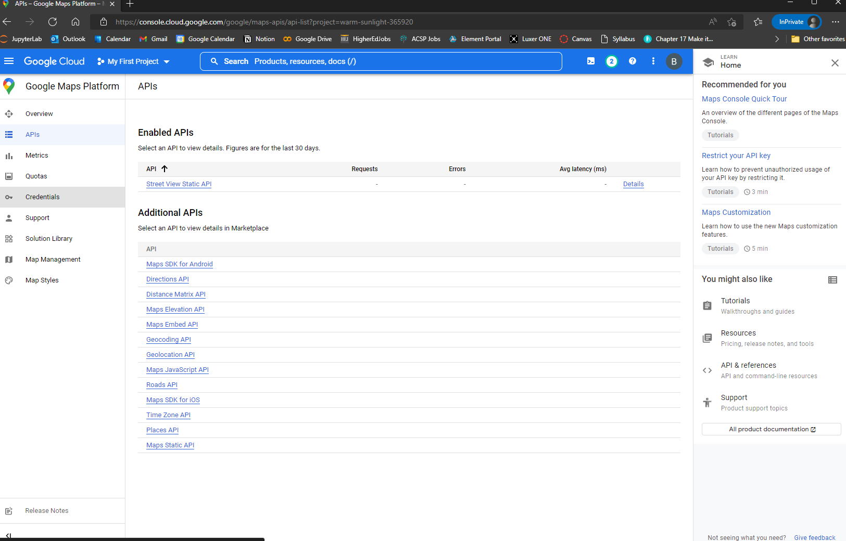
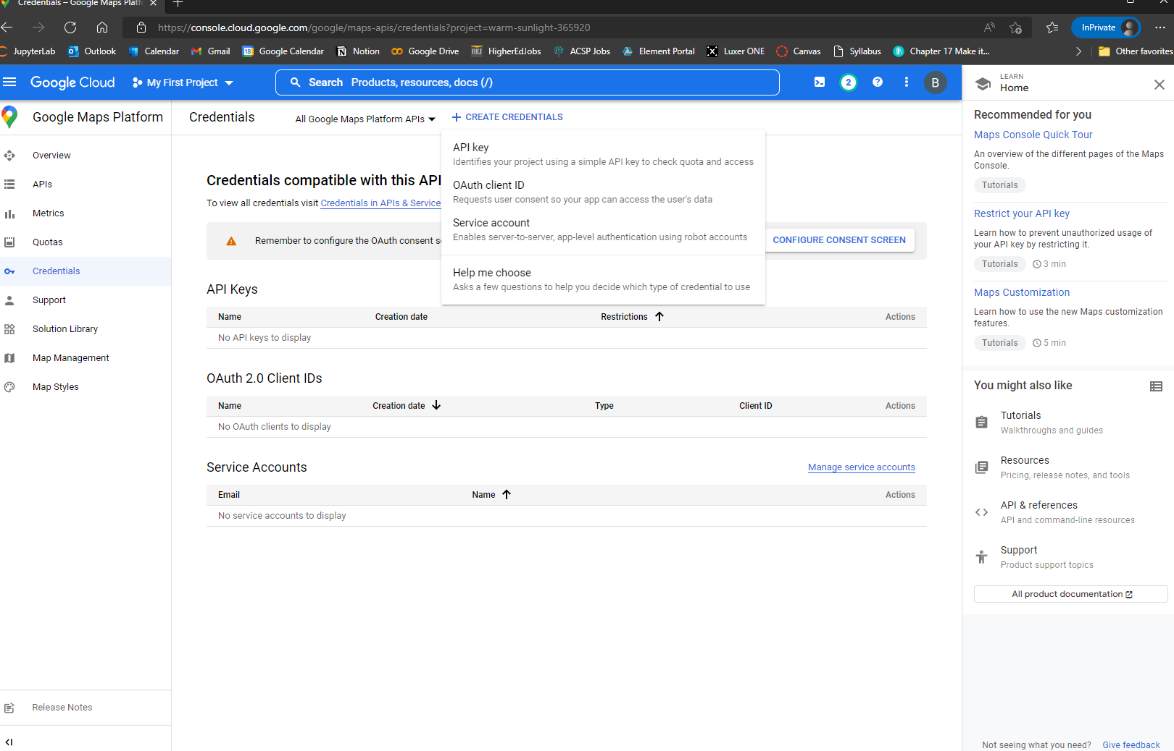
From the 3-strip menu, click Credential.
On the Credentials page (2nd image), click CREATE CREDENTIALS. It will open a dropdown menu. Click API key.
After a few second from the click, the page will display for API key. Copy it and save it as your environment variable.
NEVER EVER EXPOSE THIS KEY. YOUR CREDIT CARD IS LIKED TO THIS KEY. IF EXPOSED AND USED BY OTHERS, YOU CAN GET CHARGED.
Click
Click
Click

