Slide 1
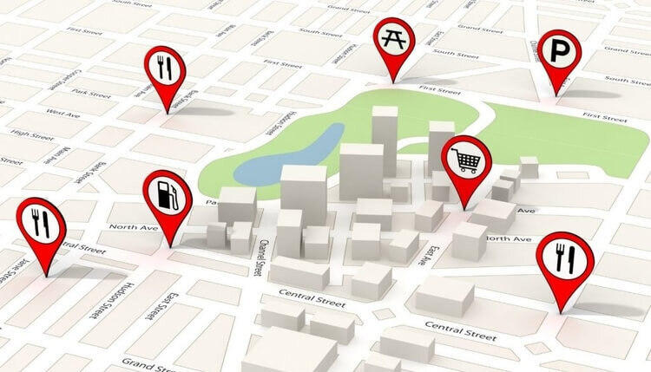
Module 1: Point of Interest
CP8883 Intro to Urban Analytics
Group 1
Bill Huang, Faiza Hasan, Chaeyeon Han, Lisa Stanovski, Ansley McKenzie

Slide 2
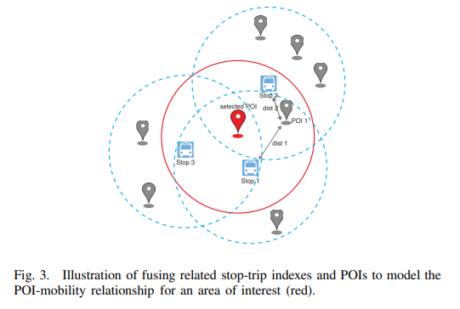
POIs in Transportation Modeling
POIs help determine destinations in transportation modeling when trip purpose is understood
“if a person goes [shopping the subset of available destination estimations should be shopping locations]. If a person deviates from their route, it would be most beneficial to first search other shopping locations instead of choosing the next most probable location.”
(Kraus & Zhang, 2019)
(Wei et al., 2017)
Krause, & Zhang, L. (2019). Short-term travel behavior prediction with GPS, land use, and point of interest data. Transportation Research. Part B: Methodological, 123, 349–361. https://doi.org/10.1016/j.trb.2018.06.012
Wei Zeng, Chi-Wing Fu, Arisona, S. M., Schubiger, S., Burkhard, R., & Kwan-Liu Ma. (2017). Visualizing the Relationship Between Human Mobility and Points of Interest. IEEE Transactions on Intelligent Transportation Systems, 18(8), 2271–2284. https://doi.org/10.1109/TITS.2016.2639320
Notes:
POI is useful in transportation modeling because POIS attach a meaning to a location that people visit. The meaning of a poi, for example shopping for a mall, can be used if we know a mom goes shopping every Saturday morning. This eliminates all other possible destinations to consider when that mom goes out in her car other than locations that support shopping activities. This is a model that Kraus and Zhang develop and implement along with more traditional transportation route history models.
Figure 3 just shows how these points of interest dataset are often merged with more traditional trip start and stop models. (feel free to ask me last minute questions on this one if the picture is confusing)

Slide 3
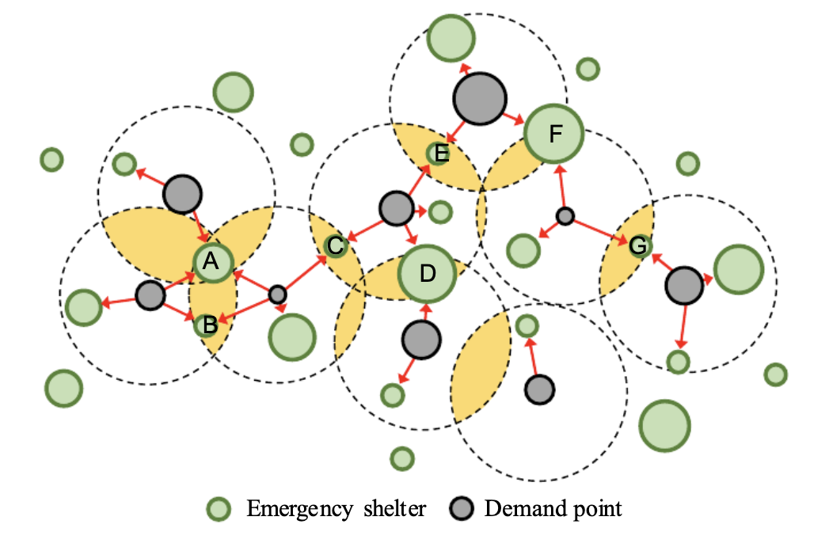
POIs in Disaster Relief & Hazard Infrastructure Development
POI data can be used in the creation of disaster simulations to understand if current hazard infrastructure is suitable in the case of a natural disaster
In the simulation, current disaster shelters are plotted in a grid and their capacities, as well as the number of people that are zoned for the shelter are run through a model
The results are used to create new disaster plans, as well as build new shelters that can accommodate the number of people necessary
Chen, Guanhua & Fang, Hao & Zhai, Qing & Wang, & Zhang, Yiyi. (2020). Assessing Emergency Shelter Demand Using POI Data and Evacuation Simulation. ISPRS International Journal of Geo-Information. 9. 41. 10.3390/ijgi9010041.

Slide 4
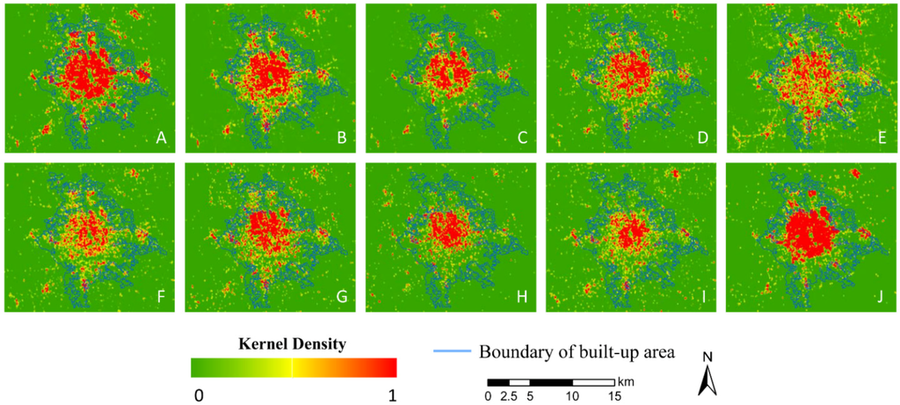
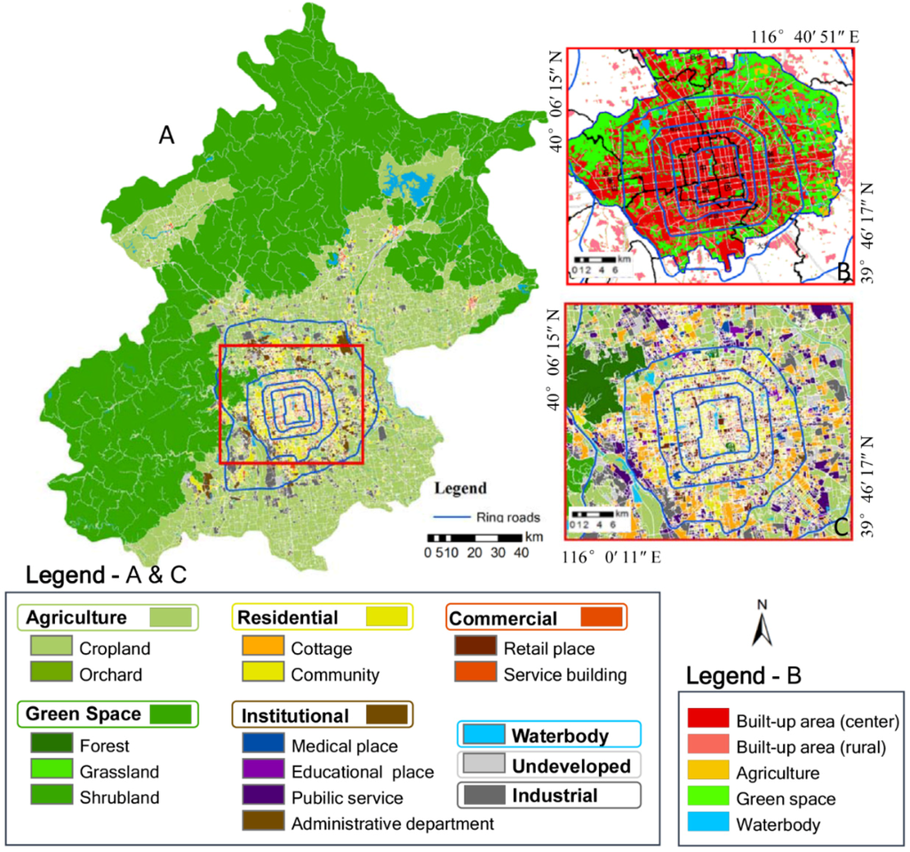
POI in Land Use
Accurate land use maps are important for planning and development. However, these maps often lack information or are completely unavailable for certain locations.
The use of POI data can aid in efficiently creating updated land use maps.
In this study, POI data from Chinese social media was used to help create a detailed land use map of the Bejing Area.
Normalized Kernel density maps of Points of Interest (POI) data: (A) residential; (B) marketing and recreation; (C) service building; (D) hotel and restaurant; (E) industrial; (F) medical; (G) educational; (H) institutional infrastructure; (I) government and social organization; and (J) transportation land.
Hu T, Yang J, Li X, Gong P. Mapping Urban Land Use by Using Landsat Images and Open Social Data. Remote Sensing. 2016; 8(2):151. https://doi.org/10.3390/rs8020151
Notes:
- The first figure shows density map from poi data so you can visually interpret the prevlence of these areas in Bejing
- The second image shows the overall map, the residential, institutional, commercial, and industrial locations all come from poi data

Slide 5
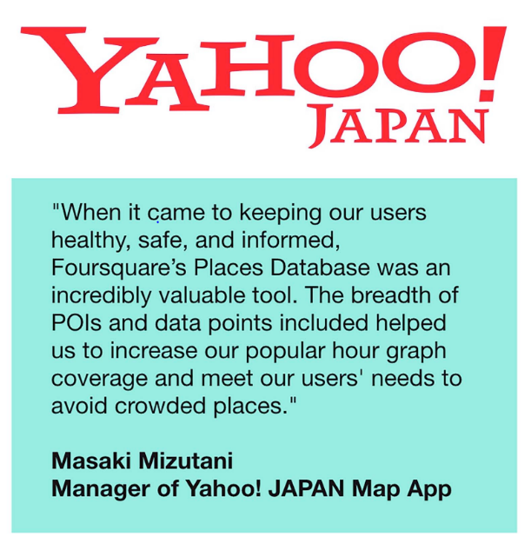
POI in Covid-19 Safety Information Alert
Yahoo! Japan partnered with Foursquare to develop a "Time Model" dataset that could inform the least congested time for a location during Covid-19.
Using POI traffic data, Yahoo! Japan was able to better understand consumer visitation pattern and identify the safest times to visit in any given location across the country.
Foursquare. (2022, June 27). https://foursquare.com/article/foursquare-places-helps-yahoo-japan-keep-consumers-informed-during-covid-19/

