Slide 1


CS598 – Deep Learning for Healthcare
Final Project Submission
May 11, 2021

Slide 2
Survey on Convolutional Neural Network Models that Detect COVID-19 using Chest X-Ray Images
Ujjal Saha | Ashish Pradhan | Dilip Ravindran
May 11, 2021
CS598 – Deep Learning for Healthcare | Final Project
GRAINGER ENGINEERING

Slide 3

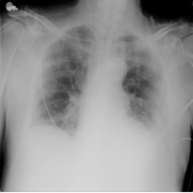
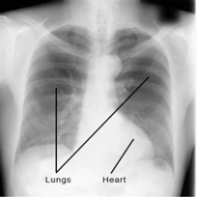
Objective
COVID-19 Chest X-ray Image
The main objective of this project
Select 4 CNN models that claims high precision and accuracy (98% and above)
in detecting COVID-19 using Chest X-Ray Images
Reimplement using common dataset and computational environment
Focus areas:
a. Veracity of the claims in the form of metrics comparison chart
(Precision, Accuracy, AUC and F1 score)
b. Overall performance of these models
c. Unbiased observations and challenges encountered
Normal Chest X-ray Image
Image Courtesy: Kaggle CXR Data Source
CS 598 Deep Learning for Healthcare | Final Project
GRAINGER ENGINEERING

Slide 4
CNN Models that detects COVID-19 from Chest X-Ray Images
8 Models were initially Studied
COVINet [1]
Sarki et al [2]
Ioannis et al [3]
EMCNet [4]
Haque et al [5]
ConvNet [6]
CoroNet [7]
DarkCovidNet [8]
[1] M. Umer, I. Ashraf, S. Ullah, A. Mehmood & G. S. Choi. COVINet: a convolutional neural network approach for predicting COVID-19 from chest X-ray images. Jan 2021, J Ambient Intell Human Comput (2021). doi: https://doi.org/10.1007/s12652-021-02917-3
[2] R. Sarki, K. Ahmed, H. Wang, Y. Zhang and K. Wang. Automated Detection of COVID-19 through Convolutional Neural Network using Chest x-ray images. Feb 2021, [Preprint – Not Reviewed Not Published]. doi: https://doi.org/10.1101/2021.02.06.21251271
[3] I. D. Apostolopoulos and T. Bessiana. COVID-19: Automatic detection from X-Ray images utilizing Transfer Learning with Convolutional Neural Networks. Physical and Engineering Sciences in Medicine 43:635-40, Mar 2020 doi: https://doi.org/10.1007/s13246-020-00865-4
[4] P. Saha, M. S. Sadi and M. M. Islam. EMCNet: Automated COVID-19 diagnosis from X-ray images using convolutional neural network and ensemble of machine learning classifiers. Informatics in Medicine Unlocked, Vol 22, 2021, https://doi.org/10.1016/j.imu.2020.100505
[5] K. F. Haque and A. Abdelgawad. A Deep Learning Approach to Detect COVID-19 Patients from Chest X-ray Images. AI. 1. 418-435. Sep 2020, doi: http://dx.doi.org/10.3390/ai1030027
[6] B. Sekeroglu and I. OzsahinFirst. Detection of COVID-19 from Chest X-Ray Images Using Convolutional Neural Networks. Sep 18, 2020, PubMed https://doi.org/10.1177/2472630320958376
[7] A. I. Khan, J. L. Shah and M. M. Bhat . CoroNet: A deep neural network for detection and diagnosis of COVID-19 from chest x-ray images. Comput Methods Programs Biomed. Nov 2020 196: 105581. https://doi.org/10.1016/j.cmpb.2020.105581
[8] T. Ozturk, M. Talo, E. A. Yildirim, U. B. Baloglu, O. Yildirim and U. R. Acharya. Automated detection of COVID-19 cases using deep neural networks with X-ray image. Computers in Biology and Medicine Vol 121, June 2020, 103792. https://doi.org/10.1016/j.compbiomed.2020.103792
CS 598 Deep Learning for Healthcare | Final Project
GRAINGER ENGINEERING

Slide 5
4 CNN Models for Reimplementation
Qualifying Criteria for Reimplementation
Paper must be published
Detailed architecture information about the CNN layers
Credible dataset sources
Thorough result and analysis discussion
Higher value metrics (accuracy and precision above 90%)
4 Models were selected for reimplementation
EMCNet [4]
Haque et al [5]
CoroNet [7]
DarkCovidNet [8]
[4] P. Saha, M. S. Sadi and M. M. Islam. EMCNet: Automated COVID-19 diagnosis from X-ray images using convolutional neural network and ensemble of machine learning classifiers. Informatics in Medicine Unlocked, Vol 22, 2021, https://doi.org/10.1016/j.imu.2020.100505
[5] K. F. Haque and A. Abdelgawad. A Deep Learning Approach to Detect COVID-19 Patients from Chest X-ray Images. AI. 1. 418-435. Sep 2020, doi: http://dx.doi.org/10.3390/ai1030027
[7] A. I. Khan, J. L. Shah and M. M. Bhat . CoroNet: A deep neural network for detection and diagnosis of COVID-19 from chest x-ray images. Comput Methods Programs Biomed. Nov 2020 196: 105581. https://doi.org/10.1016/j.cmpb.2020.105581
[8] T. Ozturk, M. Talo, E. A. Yildirim, U. B. Baloglu, O. Yildirim and U. R. Acharya. Automated detection of COVID-19 cases using deep neural networks with X-ray image. Computers in Biology and Medicine Vol 121, June 2020, 103792. https://doi.org/10.1016/j.compbiomed.2020.103792
CS 598 Deep Learning for Healthcare | Final Project
GRAINGER ENGINEERING

Slide 6
Dataset and Environment
Data Source
Common set of datasets for all four models
3600 positive COVID-19 CXR images were collected from Kaggle COVID-19 Radiography Database
3600 Non COVID-19 chest X-Ray images were collected from NIH Chest X-Ray dataset
Balanced dataset
Training Validation Test Ratio: 60%:20%20%
Environment
Common platform for all four models
Google Colab (GPU Instances) Notebooks
Dataset saved in Google Drive
Web Browser based platform as a service.
System Independent, Can be run from anywhere.
Can also be shared easily for review and peer programming
Using PyTorch 1.8.1 package for reimplementation
Dataset | COVID-19 CXR Images | Non COVID-19 CXR Images | Total CXR Images
Training Set 60% | 2160 | 2160 | 4320
Validation Set 20% | 720 | 720 | 1440
Testing Set 20% | 720 | 720 | 1440
Combined 100% | 3600 | 3600 | 7200
CS 598 Deep Learning for Healthcare | Final Project
GRAINGER ENGINEERING

Slide 7
Implementation Details
Convolutional Layer Summary of the selected four models
Implementation steps
Define the model as per the paper
Train and validate the model for 100 epochs. Calculate validation accuracy for each epoch.
At the end of training, select the model with the highest validation accuracy
Test the trained model with the testing dataset
Record performance metrics
Common Implementation parameters
-- Learning rate : 0.0001
-- Batch size : 32
-- No. of epochs : 100
-- Loss function : Cross Entropy
-- Optimizer : Adam
Selected Models | Conv. Layers | Max Pooling | Activation Function | FC Layers | Other Information
EMCNet | 6 | After every Convolution Layer | ReLU Sigmoid | 2 | Padding = ‘Valid’, Dropout after every conv. layer
CoroNet | 36 | After first three layer, And last layer | ReLU | 1 | Adds a dropout layer and two FC layer at the end of Xception Layer
DarkCovidNet | 16 | After convolution layers 1,2,5,8, 11 | Leaky ReLU | 1 | Three convolutional layer blocks: one conv layer, one batch normalization and Leaky ReLU
Haque et al | 4 | After every Convolution Layer | ReLU Sigmoid | 1 | Dropout of 0.5 before connecting to FC Layer
CS 598 Deep Learning for Healthcare | Final Project
GRAINGER ENGINEERING

Slide 8
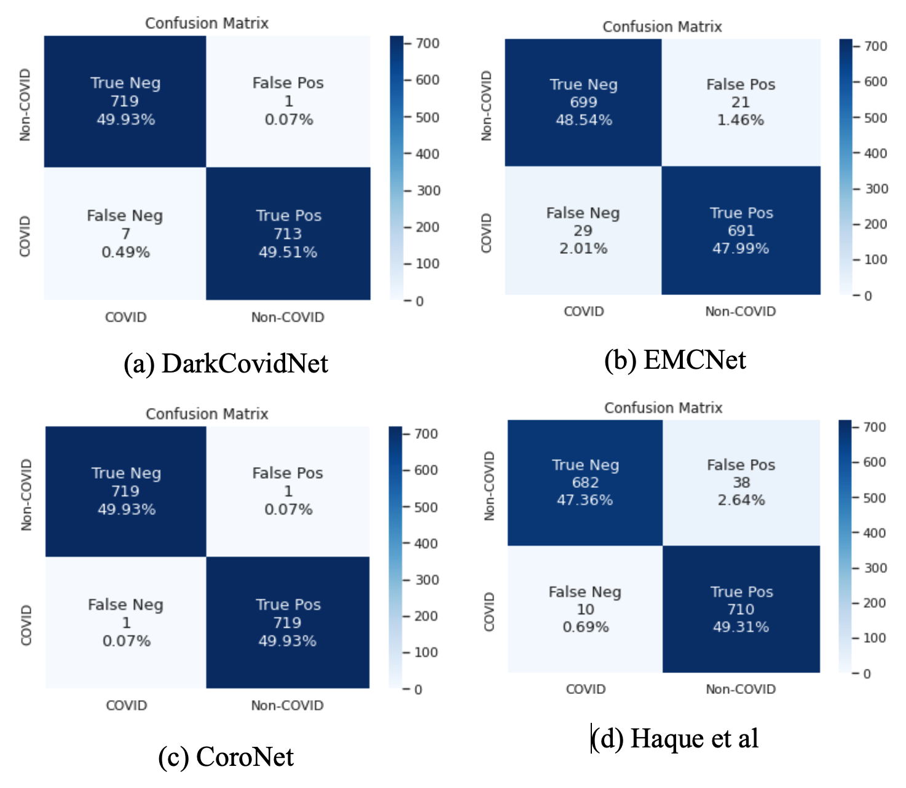
Confusion Matrix Comparison
Training -- Common balanced dataset of 4320 Images
Validation -- Common balanced dataset of 1440 Images
Testing -- Common balanced dataset of 1440 Images
CoroNet had the highest accuracy of 99.86%
EMCNet had the lowest accuracy at 96.53%
CS 598 Deep Learning for Healthcare | Final Project
GRAINGER ENGINEERING

Slide 9
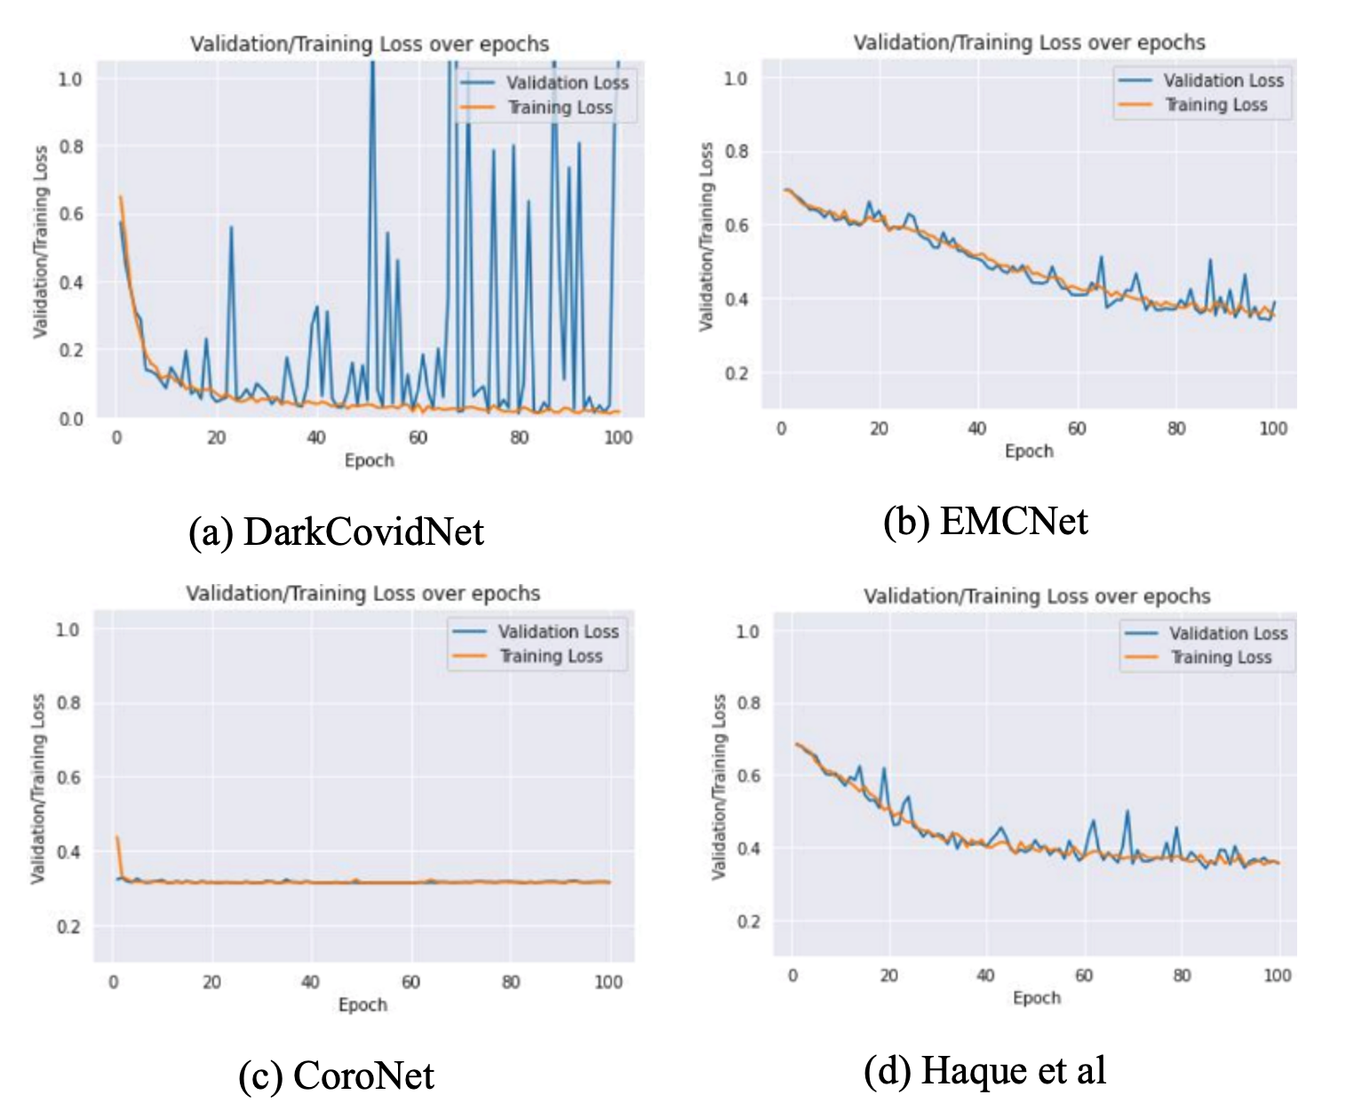
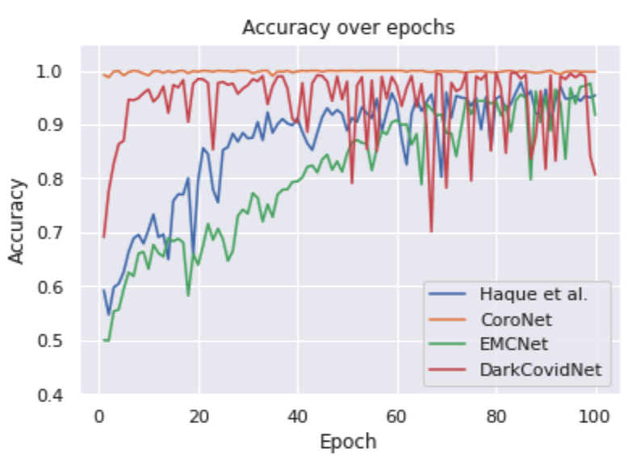
Accuracy and Loss Graphs
Accuracy over epoch chart for all the four models
Validation/Training Loss over epoch for all four models
CS 598 Deep Learning for Healthcare | Final Project
GRAINGER ENGINEERING

Slide 10
Discussion
Easily Implemented: DarkCovidNet and CoroNet due to well detailed architecture
a. EMCNet -- No info. on learning rate, optimizer or loss function.
b. CoroNet -- Paper and Repo combined had all information
c. DarkCovidNet -- Paper and Repo combined had all information
d. Haque et al -- No info. on learning rate, optimizer, loss function, padding, strides etc.
It was not clear if there were two FC layers or one
Challenges and Limitations:
a. Rewriting code in Pytorch from TF and Fastai
b. Dataset lacks metadata
Further scope:
a. Improved robust dataset more credible model
b. Expand to a multi-class model
CS 598 Deep Learning for Healthcare | Final Project
GRAINGER ENGINEERING

Slide 11
Conclusion
Best Performing Model
CoroNet → 99.86% accuracy, 99.86% precision
Least Performing Model
EMCNet → 96.53% accuracy, 96.53 % precision
Least Training Time
DarkCovidNet → 1 hour 46 mins
Most Training Time
CoroNet → 2 hours 58 mins
Reimplementation Feedback
DarkCovidNet and EMCNet could be easily reimplemented due to the authors including all the essential parts of the model, including the parameters and the architecture.
Selected Models | Accuracy |  | Precision |  | Recall |  | F-Score
 | Claimed | Observed | Claimed | Observed | Claimed | Observed | Claimed | Observed
EMCNet | 96.52 | 96.53 | 100 | 96.53 | 96.52 | 96.53 | 98.23 | 96.53
CoroNet | 99.00 | 99.86 | 98.30 | 99.86 | 99.30 | 99.86 | 98.50 | 99.86
DarkCovidNet | 98.08 | 99.44 | 98.03 | 99.45 | 95.13 | 99.44 | 96.51 | 99.44
Haque et al | 98.30 | 96.67 | 96.72 | 96.74 | 100 | 96.67 | 98.30 | 96.67
Four Models with claimed and observed values of accuracy, precision, F-score and Recall.
All numbers are in percentages (%)
Model | Training Runtime (sorted: lowest first)
DarkCovidNet | 1 hour 46 mins
Haque et al | 1 hour 57 mins
EMCNet | 2 hours 15 mins
CoroNet | 2 hours 58 mins
Execution time of the four models when reimplemented with 100 Epochs,
0.0001 learning rate, 32 batch size, Adam optimizer, Loss Entropy function
CS 598 Deep Learning for Healthcare | Final Project
GRAINGER ENGINEERING

Slide 12
Thank You
Ujjal Saha
ujjals2@Illinois.edu
Ashish Pradhan
apradh6@Illinois.edu
Dilip Ravindran
dilipr2@Illinois.edu
CS 598 Deep Learning for Healthcare | Final Project
GRAINGER ENGINEERING

Slide 13


