Slide 1


Summer Training Presentation
HOMEWORTH AI
AI-Powered House Price Prediction & Real Estate Valuation System
Carried out at: IIHMF, Motilal Nehru National Institute of Technology (MNNIT), Prayagraj
SUBMITTED BY:
• Ujjaval Kumar Kesarwani
AKTU Roll No: 2400101530154
• Shlok Tiwari
AKTU Roll No: 2400101530134
UNDER THE SUPERVISION OF:
Dr. Divya Kumar
Associate Professor
Department of Computer Science & Engineering
Motilal Nehru National Institute of Technology (MNNIT), Prayagraj

Slide 2
Presentation Outline
01 Introduction & Problem Statement
The valuation gap, broker subjectivity, and real estate market opacity.
02 Project Objectives
Predictive modeling, composite quality scoring, automated AI buying advisor.
03 Methodology & Architecture
506 benchmark properties, 34 attributes, 10 Indian metropolitan cities.
04 Machine Learning Pipeline
Preprocessing, One-Hot Encoding, ColumnTransformer, and regression training.
05 Model Evaluation & Results
Gradient Boosting (93.92% R²) vs. Random Forest vs. Linear Regression.
06 Explainable AI (XAI)
Feature importance weights driving fair market value estimation.
07 Implementation & Web Dashboard
Production Streamlit application, financial EMI planner, property comparison.
08 Conclusion & Future Work
Summary of internship outcomes, practical impact, and future extensions.

Slide 3
Introduction: The Real Estate Valuation Gap
⚠️ The Traditional Valuation Dilemma
• Subjective & Biased Estimates: Traditional home pricing heavily depends on middleman / broker opinions and anecdotal neighborhood pricing.
• Market Opacity: Buyers frequently overpay due to artificial inflation, while sellers face stagnant listings when overpriced.
• Static Calculators Lack Context: Generic price calculators solely evaluate area, ignoring air quality (AQI), crime rates, and transit.
• High Financial Risk: Real estate represents the largest single lifetime investment for Indian families; inaccurate valuation causes severe financial distress.
💡 The HomeWorth AI Solution
• Data-Driven Machine Learning: Replaces guesswork with empirical regression models trained on multi-metro Indian transaction records.
• Holistic Multi-Factor Pricing: Incorporates 34 structural, environmental, transit, security, and society amenities parameters.
• Composite Property Quality Score: An objective 0–100 index evaluating Location, Architecture, Amenities, and Safety.
• Actionable Advisory Engine: Contextual recommendations on negotiation leverage, asset strengths, and due diligence checks.
• Production-Grade Web Application: Interactive Streamlit interface with integrated mortgage/EMI planner.

Slide 4
Project Objectives & Scope
🎯 High-Precision Valuation
Develop and tune robust supervised regression models to predict residential prices with >90% R² accuracy, minimizing MAE on unseen test data.
📐 Multi-Dimensional Feature Modeling
Engineer comprehensive feature transformers that account for physical carpet area, age, facing, society amenities, and transit corridors.
🏆 4-Pillar Livability Index
Construct a standardized 100-point Property Health Score assessing Location, Physical Construction, Lifestyle Amenities, and Environmental Safety.
🤖 Explainable AI & Buyer Advisory
Deliver transparent feature importance rankings and automated real estate advice detailing growth drivers, risk flags, and negotiation tactics.
🏦 Integrated Financial Planning
Equip users with built-in mortgage / EMI calculations, loan-to-value ratios, and downloadable official property valuation reports.
🌐 Production Web Deployment
Deploy a responsive, enterprise-grade dark-glassmorphism Streamlit platform accessible to home buyers, sellers, and evaluators.

Slide 5
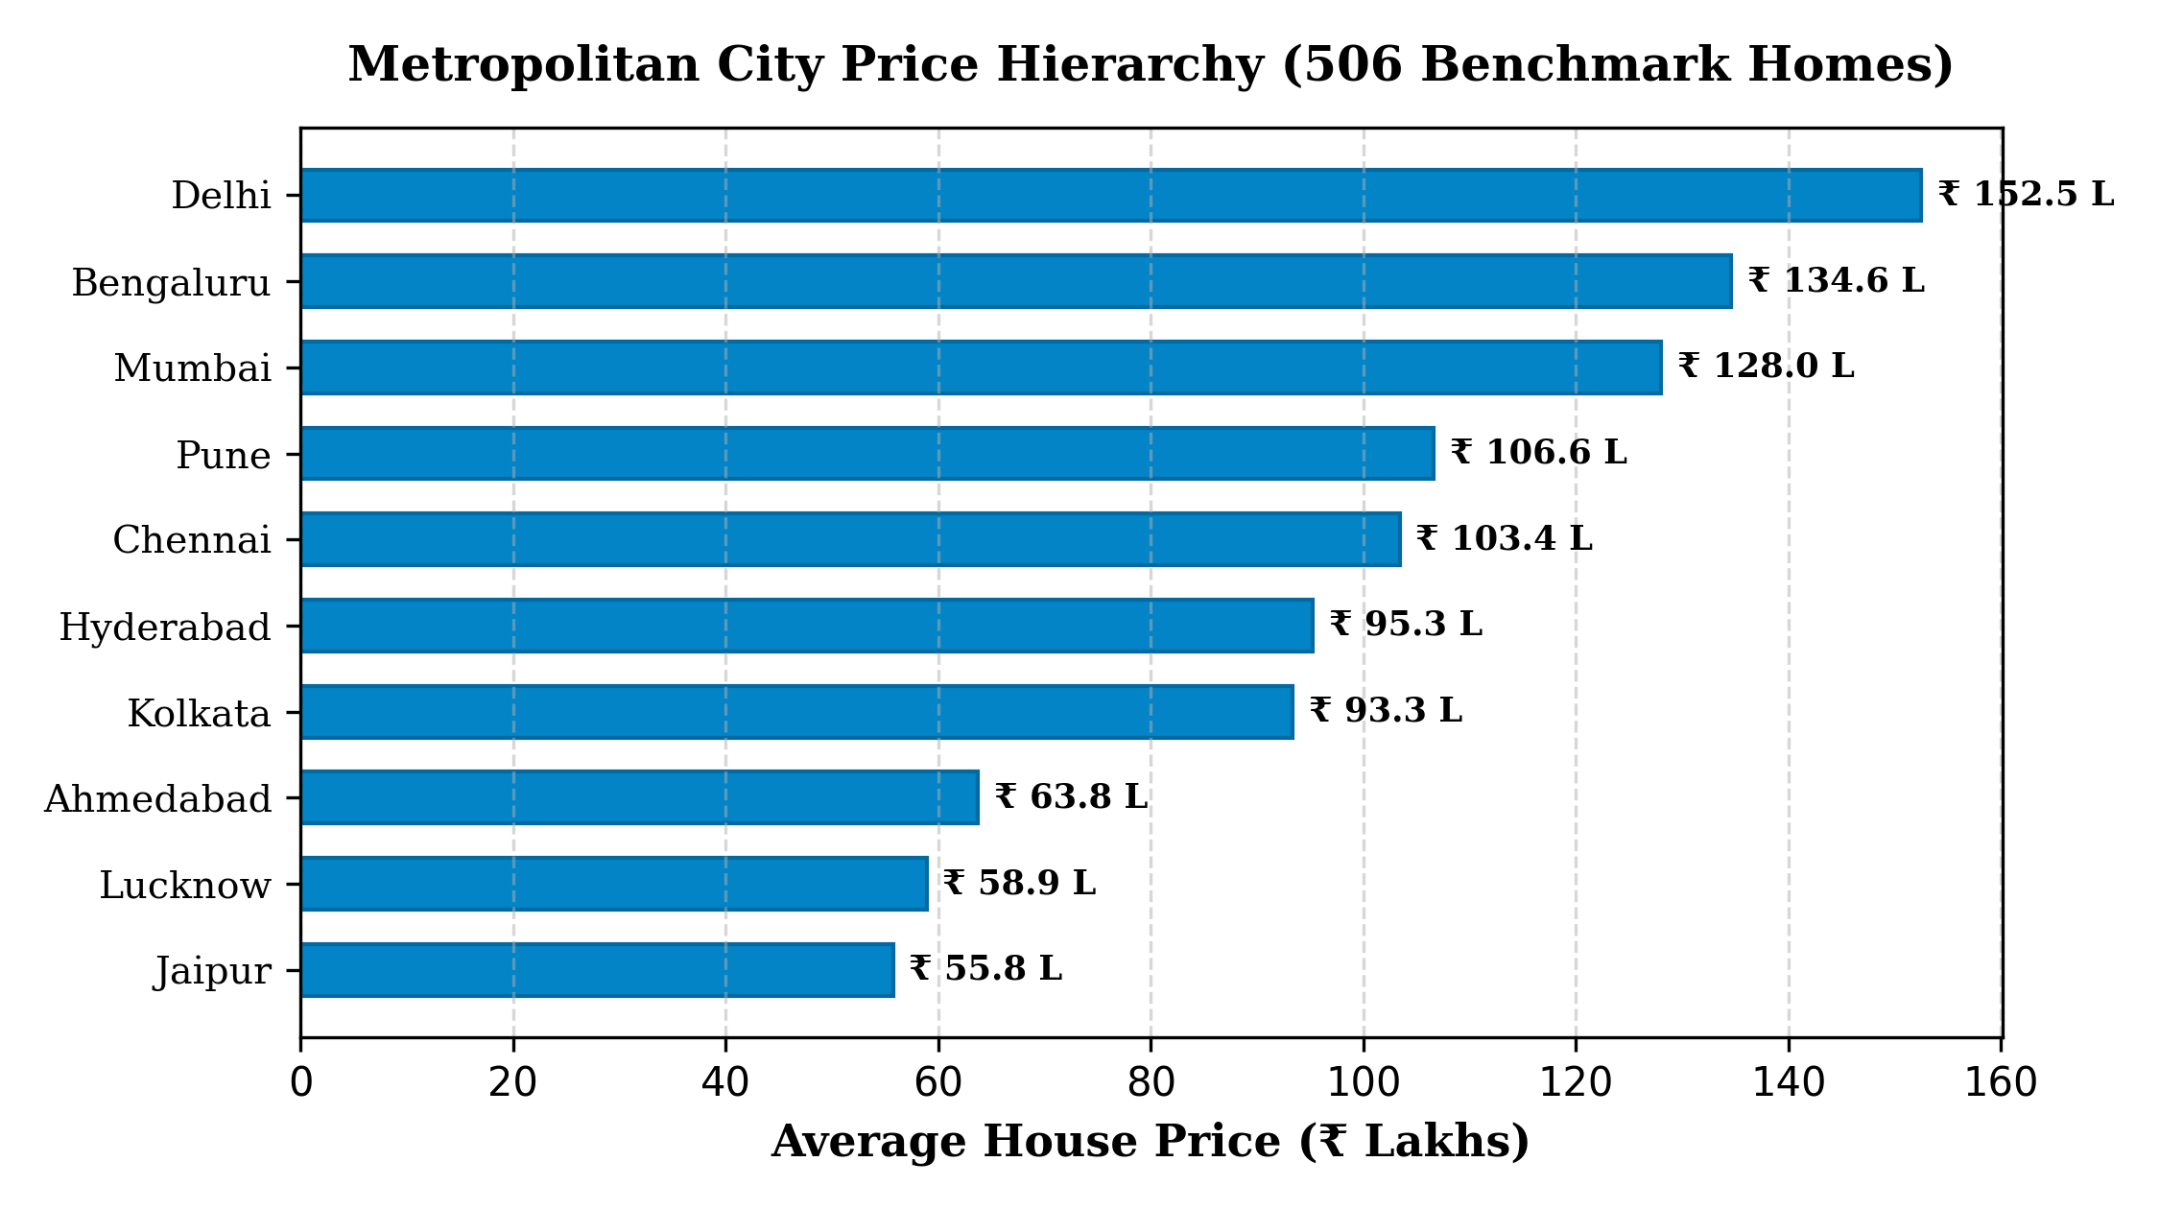
Dataset Architecture & Geographic Scope
📊 Dataset Overview (506 Benchmark Homes)
• Scope & Dimensions: 506 validated property transactions across 10 top Indian metropolitan centers, containing 34 detailed attributes.
• Geographic Coverage: Mumbai, Delhi, Bengaluru, Pune, Chennai, Hyderabad, Kolkata, Ahmedabad, Lucknow, and Jaipur.
• Property Types: High-rise Apartments (54.7%), Luxury Villas (16.0%), Independent Houses (17.2%), and Builder Floors (10.1%).
• Target Variable: Price_Lakhs (INR) ranging from ₹ 10.0 Lakhs to ₹ 473.21 Lakhs (Mean: ₹ 99.61 L, Median: ₹ 92.90 L).
• Data Hygiene: Missing values in numerical attributes imputed via median; categorical features imputed with mode; zero target nulls.

Slide 6
Machine Learning Methodology & Pipeline
Step 1: Data Ingestion & Cleaning
Load 506 raw records from Excel. Drop House_ID unique identifier. Impute missing values with statistical medians and modes.
Step 2: ColumnTransformer Architecture
10 Categorical Features (City, Locality, Property Type, Facing, Furnishing, etc.) processed via OneHotEncoder(handle_unknown='ignore') -> 46 dummy variables.
22 Numerical Features passed through without data leakage.
Step 3: 80/20 Train-Test Partitioning
Split data into Training Set (396 samples, 32 raw features) and Testing Set (100 samples, 32 raw features) with fixed random state 42 for reproducible benchmarking.
Step 4: Regression Algorithm Training
Train candidate models (Linear Regression, Random Forest, Gradient Boosting Regressor) inside scikit-learn Pipeline objects combining preprocessing and estimators.
Step 5: Model Serialization & Deployment
Serialize the best-performing pipeline using Joblib into house_price_pipeline.pkl for real-time inference in Streamlit.

Slide 7
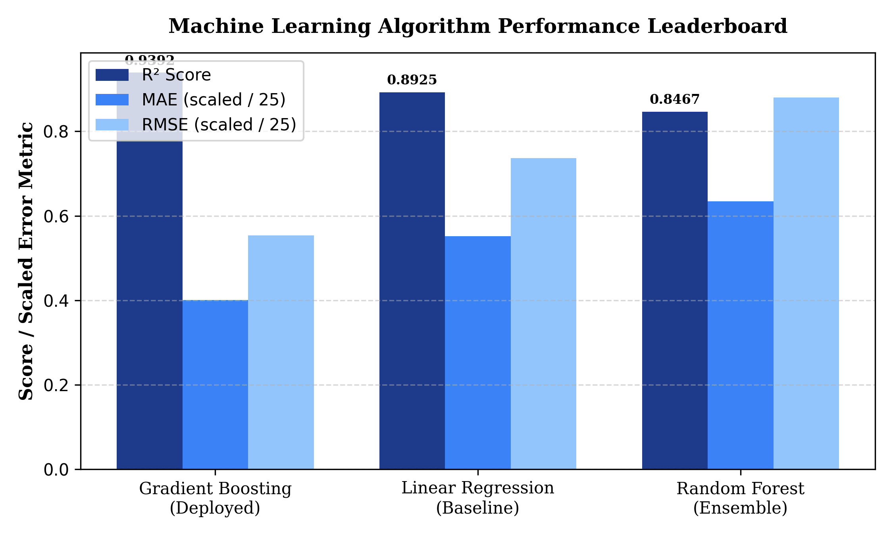
Model Evaluation & Performance Leaderboard
🏆 Model Benchmark Results
• Gradient Boosting Regressor (Winner):
• R² Score: 0.9392 (93.92% variance explained)
• MAE: ₹ 10.01 Lakhs (Lowest test error)
• RMSE: ₹ 13.85 Lakhs
• Linear Regression (Baseline):
• R² Score: 0.8925 | MAE: ₹ 13.79 Lakhs | RMSE: ₹ 18.42 Lakhs
• Solid baseline but struggles with non-linear amenity interactions.
• Random Forest Regressor (Ensemble):
• R² Score: 0.8467 | MAE: ₹ 15.86 Lakhs | RMSE: ₹ 22.00 Lakhs
• Suffered slight variance penalties on smaller sample subsets.
• Deployment Decision: Gradient Boosting selected for superior convergence and lowest residual errors.

Slide 8
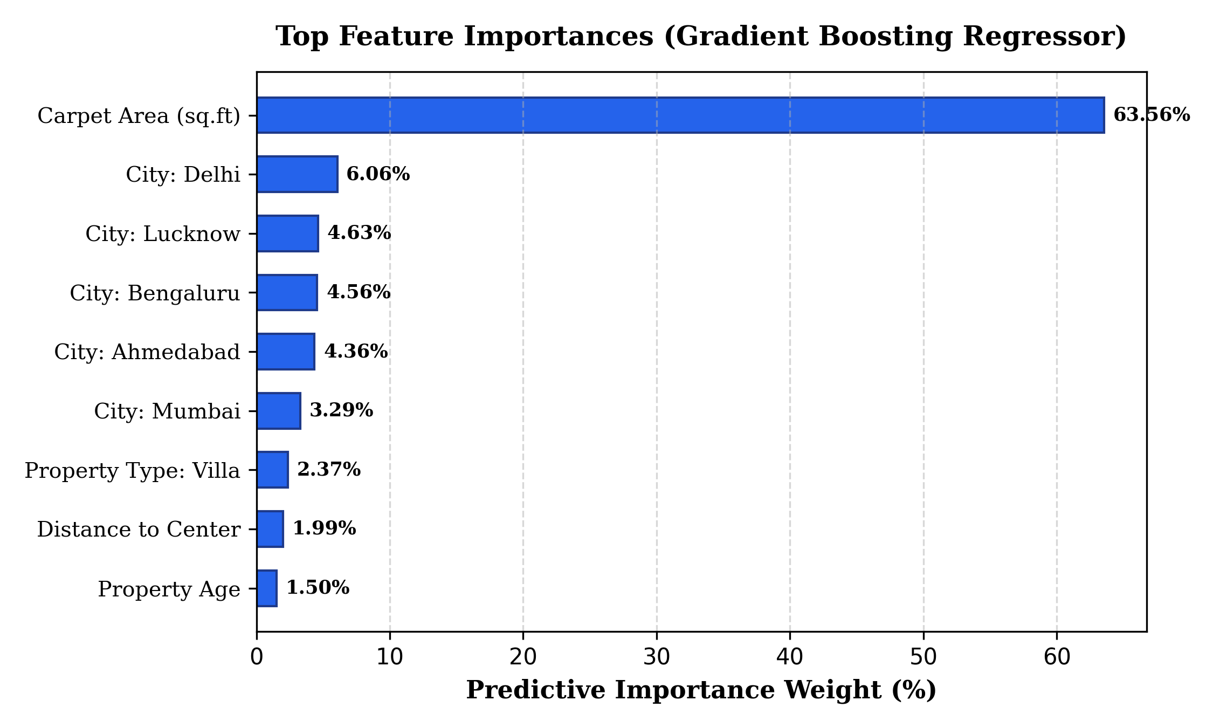
Explainable AI (XAI): Key Feature Weights
🔍 Feature Contribution Insights
• Carpet Area (63.56%): The dominant physical valuation driver; unit price scales strongly with square footage.
• Metropolitan City Tier (~23% Combined):
• Delhi (6.06%), Lucknow (4.63%), Bengaluru (4.56%), Ahmedabad (4.36%), Mumbai (3.29%).
• Metro economic status creates massive baseline price differentials.
• Property Classification (Villa: 2.37%):
• Standalone land ownership and luxury villas command premium pricing over standard high-rise apartments.
• Distance to City Center (1.99%):
• Peripheral properties trade at a noticeable discount due to commute overhead.
• Age of Property (1.50%):
• Newer builds trade at premiums; properties >18 years face maintenance discounts.

Slide 9
System Implementation & Technology Stack
Python 3.10+
CORE LANGUAGE
High-performance scripting, data handling, and native scientific libraries.
Scikit-Learn
MACHINE LEARNING
Pipelines, ColumnTransformer, OneHotEncoder, and GradientBoostingRegressor.
Streamlit 2.0
WEB FRAMEWORK
Interactive reactive dashboard, session-state management, and instant execution.
Plotly Express
INTERACTIVE GRAPHICS
Hardware-accelerated gauges, polar radar charts, box plots, and histograms.
Pandas & NumPy
DATA MANIPULATION
Dataset filtering, aggregation, and mathematical vector calculations.
Custom CSS3
DESIGN SYSTEM
Dark-mode glassmorphic theme, responsive cards, and refined typography.

Slide 10

Valuation Studio: Interactive Production Features
🏠 Valuation Studio Capabilities
• 1-Click Sample Presets: Load realistic configurations for Mumbai Luxury 3BHK, Bengaluru Tech 2BHK, Jaipur Villa, and Lucknow Budget in one click.
• Dual Currency Valuation: Automatically displays market estimates in Lakhs and Crores (e.g., ₹ 1.89 Cr / 188.56 L).
• High-Confidence Spread: Computes empirical price bands (±8.5%) based on regression mean absolute error.
• Rate per Square Foot: Dynamically benchmarks per-sqft pricing against municipal locality comps.
• Input Validation: Enforces physical constraints (e.g., floor number cannot exceed total building floors).

Slide 11
Market Intelligence: Real-Time Data Exploration
📊 Empirical Market Analytics
• Integrated 506-Home Dataset: Exposes full internship dataset directly within the Streamlit web application.
• Live Market KPIs: Real-time calculation of Average Market Price (₹ 99.6L), Median (₹ 92.9L), and Max Asset Value (₹ 473.2L).
• Amenities Value Premium: Visual bar charts quantifying the price premium added by Swimming Pools, Gyms, Clubhouses, and Power Backups.
• Interactive Comp Explorer: Filterable tabular viewer allowing buyers to cross-filter by City, Property Type, and Budget.
⭐ Amenities Valuation Premium
• Swimming Pool: Adds an average of +₹ 36.4 Lakhs (+39.8% value premium) in high-density metro communities.
• Fitness Gym: Adds +₹ 28.2 Lakhs (+32.1% premium) due to younger demographic tenant demand.
• Power Backup: Crucial livability requirement adding +₹ 22.5 Lakhs (+26.4% premium).
• Gated 24x7 Security: Standard expectation in Tier-1 cities; non-gated properties face severe illiquidity.

Slide 12
Key Innovations: AI Advisory & Comparison Tool
🤖 Intelligent AI Buying Advisor
• Four Actionable Advice Pillars:
1. Core Strengths: Highlights prime location, security, and daylighting.
2. Growth Drivers: Identifies metro transit and school corridors.
3. Due Diligence Cautions: Flags high crime, elevated AQI, or aging builds.
4. Buyer's Negotiation Playbook: Recommends 5–10% discount bids if property has spent >6 months on market.
• Target Persona Matching: Automatically assigns recommended investor profile (First-time Buyer, Family End-User, HNW Luxury Seeker).
⚖️ Side-by-Side Property Comparator
• Direct Comps Matching: Evaluate Property Option A vs. Property Option B side-by-side on one screen.
• Delta Comparison Metrics: Instant computation of price delta, rate/sqft gap, and property score differential.
• Automated Verdict: Data-backed synthesis declaring the higher-value option for long-term capital preservation.
• Financial EMI Planner: Interactive mortgage calculator computing down payment, monthly EMI, and total interest outlay.

Slide 13
Limitations & Future Roadmap
⚠️ Current Project Limitations
• Geographic Boundary: Sampled across 10 major Indian metros; expansion needed for Tier-2 and Tier-3 emerging hubs.
• Static Transaction Dataset: Relies on periodic batch updates rather than real-time live MLS streaming.
• Macroeconomic Rates: Does not currently ingest live RBI repo rate shifts or changing home loan interest cycles automatically.
• Physical Inspection Variance: Models cannot evaluate internal interior quality, marble finishes, or woodwork condition.
🚀 Future Enhancement Roadmap
• Live Real Estate Portal APIs: Integrate real-time scrapers and listing feeds from MagicBricks, 99acres, and Housing.com.
• GIS & Satellite Mapping: Incorporate Google Maps Platform APIs for micro-distance routing and topological mapping.
• Deep Learning Models: Experiment with Deep Neural Networks and TabNet for complex non-linear feature interactions.
• Mobile Application (Flutter): Package into cross-platform iOS & Android mobile apps with camera-based property scanning.

Slide 14
Conclusion & Project Achievements
Summary of Internship Outcomes:
✅ High-Precision ML Predictive Engine: Built and validated a Gradient Boosting Regressor achieving 93.92% R² accuracy, significantly outperforming Linear Regression and Random Forest baselines.
✅ Comprehensive 34-Feature Domain Modeling: Bridged physical dimensions with societal, environmental, and connectivity indicators to eliminate subjective broker bias.
✅ Objective Property Health Scoring: Invented a 4-pillar 100-point livability index providing actionable clarity to home buyers.
✅ Commercial-Grade User Experience: Transformed raw research into an interactive, multi-tab, glassmorphic Streamlit application with live mortgage planning and report export.
✅ Academic Fulfillment: Successfully met all curriculum and research deliverables for the AIML Summer Internship 2026 at IIHMF, MNNIT Prayagraj and UCER AKTU.

Slide 15
References & Acknowledgments
📚 Academic & Technical References
• Scikit-Learn: Machine Learning in Python, Pedregosa et al., JMLR 12, pp. 2825-2830, 2011.
• Gradient Boosting Machines, Jerome H. Friedman, The Annals of Statistics, Vol. 29, No. 5, 2001.
• Streamlit Open-Source Framework: Deploying Machine Learning Applications, 2026.
• Plotly Technologies Inc.: Collaborative Data Visualization, Montreal, QC, 2026.
• Housing Price Indices in Indian Metros: National Housing Bank (NHB RESIDEX) Reports.
🙏 Institutional Acknowledgments
• IIHMF, MNNIT Prayagraj: For hosting the AIML Summer Internship 2026 and providing technical guidance under Project Coordinator Arpit Dubey.
• Dr. Divya Kumar (Project Supervisor, MNNIT Prayagraj): For invaluable mentorship, architectural feedback, and rigorous academic oversight.
• United College of Engineering & Research (UCER), Prayagraj: Department of Computer Science & Engineering (AI & ML).
• Dr. A.P.J. Abdul Kalam Technical University (AKTU), Lucknow: For the comprehensive B.Tech engineering curriculum.

